Slide 1
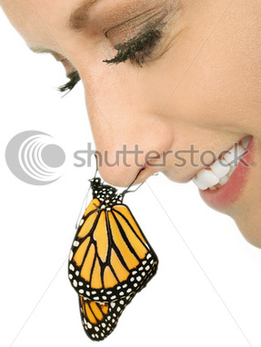
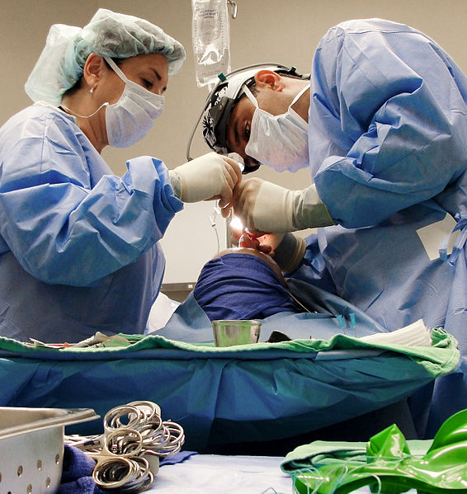
Cosmetic
RHINOPLASTY
Dr. Yogesh Bhatt
Professor and HOD
Dept. of Plastic Surgery, SBKSMI & RC

Slide 2
The nose is the central & most prominent feature of the face; & on its shape, size, & appearance, to a greater degree, depends the relative facial beauty of the person
Notes:
Impossible is often the untried

Slide 3
HISTORY
The importance of the nose to facial harmony has been well recognized throughout history.
Rhinoplasty is plastic surgery that can be used to improve the look of the nose or improve its function.
Cosmetic Rhinoplasty makes the nose more beautiful, while medical rhinoplasty improves the function of the nose and is referred to as Reconstructive Rhinoplasty
The word rhinoplasty originates from two Greek words: rhinos and plastikos.
Rhinos means nose and Plastikos means ‘to shape'.

Slide 4
HISTORY
Jacques Joseph (1865–1934) described refined surgical techniques for performing nose reduction Rhinoplasty via Internal Incisions.
In the United States, in 1887, the otolaryngologist John Orlando Roe (1848–1915) performed the first, modern Endonasal Rhinoplasty (Closed Rhinoplasty) about which he reported in the article The Deformity Termed “Pug Nose” and its Correction, by a Simple Operation (1887), and about his management of saddle nose deformities
In the early twentieth century, Freer, in 1902, and Killian, in 1904, respectively pioneered the Submucous Resection Septoplasty procedure for correcting a deviated septum
Rethi introduced the Open Rhinoplasty approach featuring an incision to the columella to facilitate modifying the tip of the nose

Slide 5
HISTORY
Nonetheless, at mid–twentieth century, despite such refinement of the open rhinoplasty approach, the endonasal rhinoplasty was the usual approach to nose surgery — until the 1970s, when Padovan presented his technical refinements, advocating the open rhinoplasty approach
In 1987, in the article External Approach for Secondary Rhinoplasty (1987), Jack P. Gunter reported the technical effectiveness of the open rhinoplasty approach for performing a Secondary Rhinoplasty

Slide 6
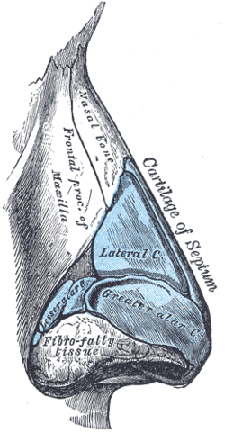
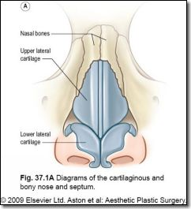
ANATOMY
(Osseocartilagenous framework)

Slide 7
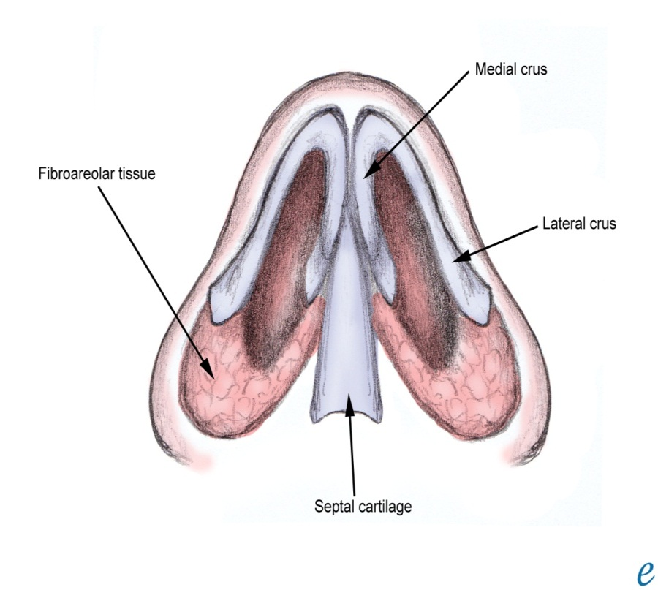
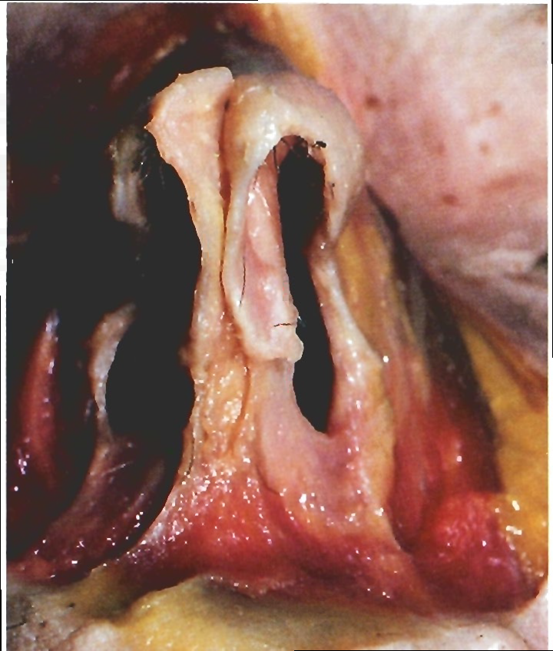
Alar Cartilages
ANATOMY

Slide 8
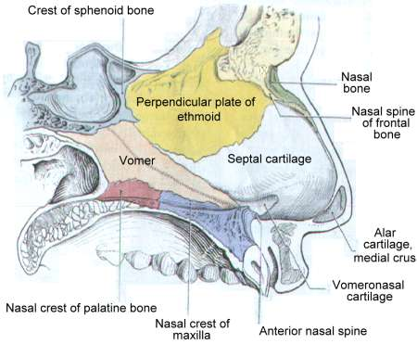
(Nasal septum)
ANATOMY

Slide 9
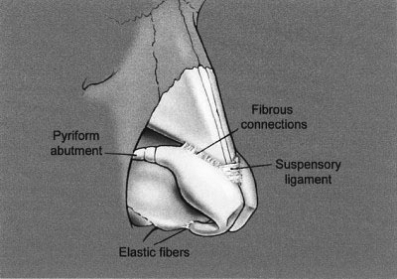
ANATOMY
Ligamentous support of the cartilaginous framework

Slide 10
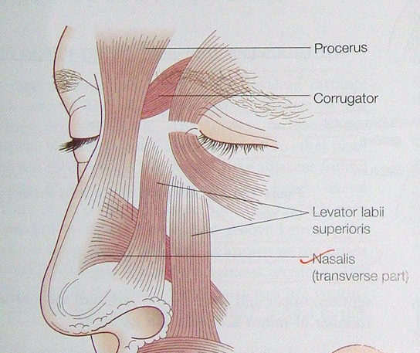
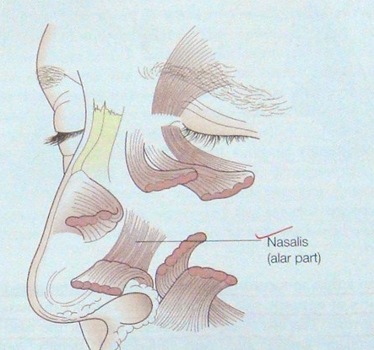
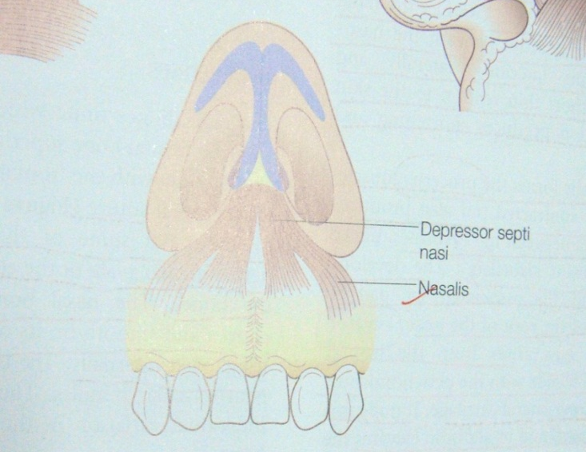
(Muscles of Nose)
ANATOMY

Slide 11
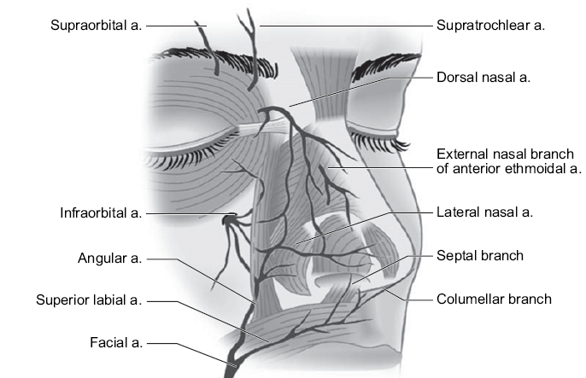
(Blood supply)
ANATOMY

Slide 12
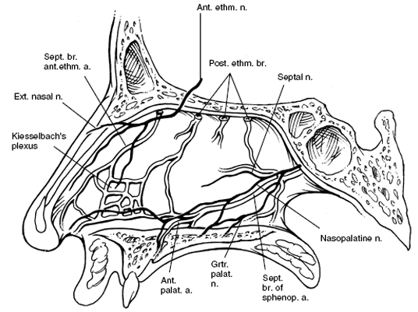
ANATOMY
(Blood supply)

Slide 13
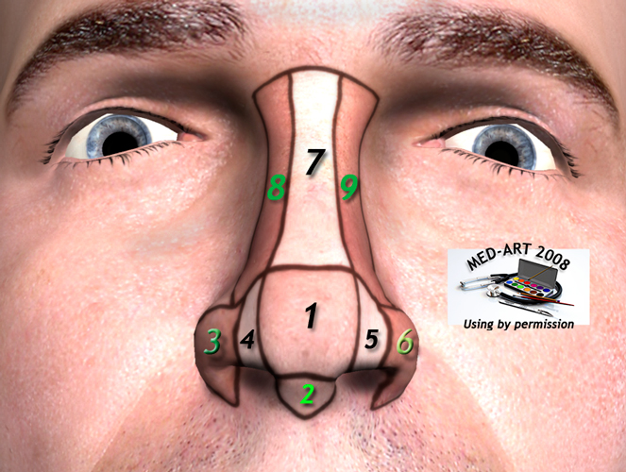
SUBUNITS OF NOSE
ANATOMY(Aesthetic)
Five convex subunits:
Dorsum: Hemicylinder
Tip: Hemisphere
Columella: Truncated cone
Alar x 2: Curved spindle
Four concave subunits:
Nasal side walls x 2
Soft triangles x 2
The subunit principle is useful in reconstruction of convex subunits only
If >50% of subunit is missing, the entire subunit is to be replaced

Slide 14
SUBUNITS OF NOSE

Slide 15
Zones of Skin of Nose
Zone 1: upper dorsum & side walls of nose. Smooth, thin, non sebaceous & free gliding skin
Zone 2: nasal tip & alar lobule region. Stiff, thick skin filled with sebaceous glands
Zone 3: A 4 mm strip along the alar margin, soft triangles, lower half of infratip lobule & the columella. Differs from zone 1 skin in that it is fixed to the deep cartilage & fibro-fatty structures

Slide 16
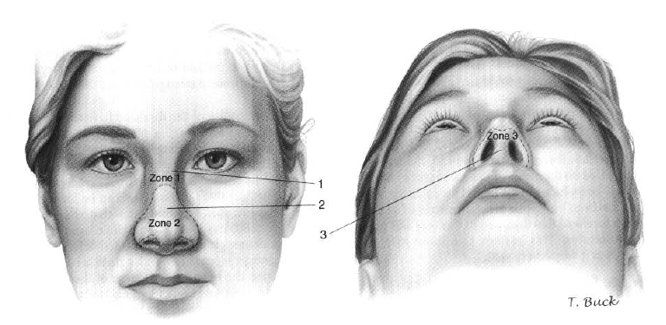
Zones of Skin of Nose

Slide 17
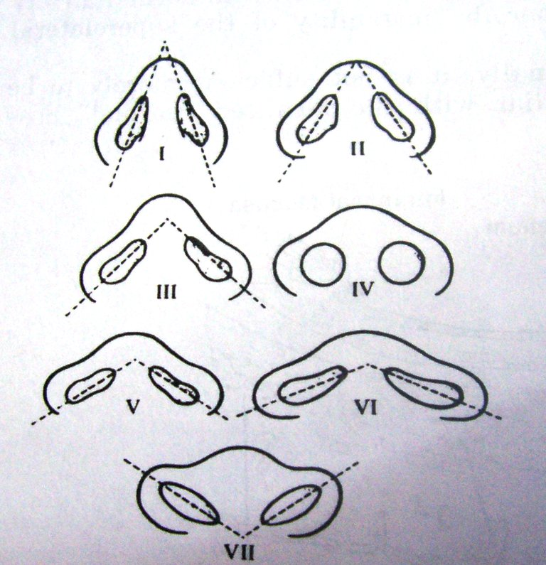
Nostril Types
Classified on the basis of average inclination of the medial longitudinal axis, average width of the alar base & height of the Columella
I & II- Caucasians
III & V- Asians
VI, VII & IV- Blacks

Slide 18
Nasofacial Analysis
Accurate, systematic, and thorough nasofacial analysis is Critical in determining the subsequent operative plan.
The nose must not only be looked at in isolation, but also with Respect to the rest of the face, in order to create or preserve overall facial balance and harmony.
It is also necessary to evaluate the patient preoperatively for any natural Facial asymmetries so that the patient gains a better understanding of exactly what was present before any operative intervention.
These are generally for the White Female, but can be modified depending on the ethnicity and gender of the patient .

Slide 19
It is important to remember that these proportions are General Guidelines.
To achieve optimal nasofacial balance and harmony, each nose should be Individualized to the patient.
The Skin type, thickness, and texture are evaluated.
This is important because thicker, more sebaceous skin requires more aggressive modification of the underlying osseocartilaginous framework as changes tend to be camouflaged
Whereas thinner skin tends to show even minor changes.

Slide 20
Nasal Landmarks

Slide 21
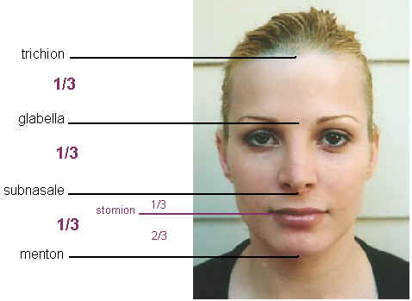
Ideal Facial Relationships

Slide 22
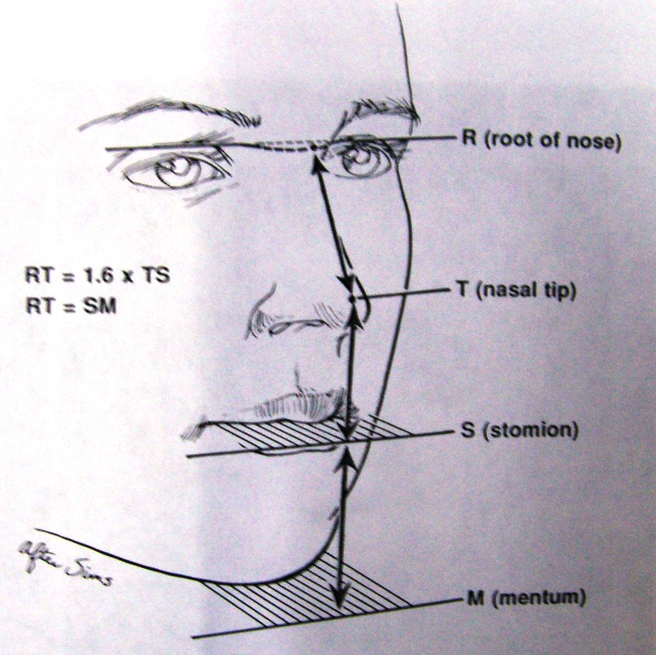
Ideal Facial Relationships

Slide 23
The ideal Lower Lip Position is 2 mm behind a vertical line dropped from a point half the ideal nasal length along the natural horizontal facial plane.

Slide 24
Symmetry is determined by drawing a vertical line from the midglabellar area to the menton

Slide 25
The curvilinear Dorsal Aesthetic Lines extend from the supraorbital ridges to the tip-defining points. The ideal width of the dorsal aesthetic lines should be approximately equivalent to the width of either the Tip-Defining Points or the Interphiltral distance.

Slide 26
A The normal Alar Base Width equals the Intercanthal distance, or the width of one Eye. B The Bony Base should be approximately 80% of the alar base width.

Slide 27
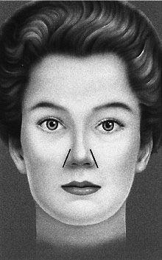
The Alar Rims should flare outward inferolaterally

Slide 28
Tip Assessment is performed by analysing two equilateral triangles with opposing bases The supratip break, tip-defining points, and columellar lobular angle serve as landmarks to draw these triangles.

Slide 29
Outline of the Nostril on lateral view simulates an oval

Slide 30
The outline of the Alar Rims and Columella should resemble a seagull in gentle flight

Slide 31
Ideal Alar Columellar Relaionship(Frontal view)

Slide 32
Ideal Alar Columellar Relaionship (Latral view)

Slide 33
The Alar Columellar Relationship is assessed by drawing two perpendicular lines one through the long axis of the nostril and the other from the alar rim to the columellar rim

Slide 34
The outline of the Nasal Base should describe an equilateral triangle with a lobule-to-nostril ratio of 1:2 The Nostril itself should have a teardroplike geometry, with the long axis oriented in a slight medial direction (from base to apex)

Slide 35
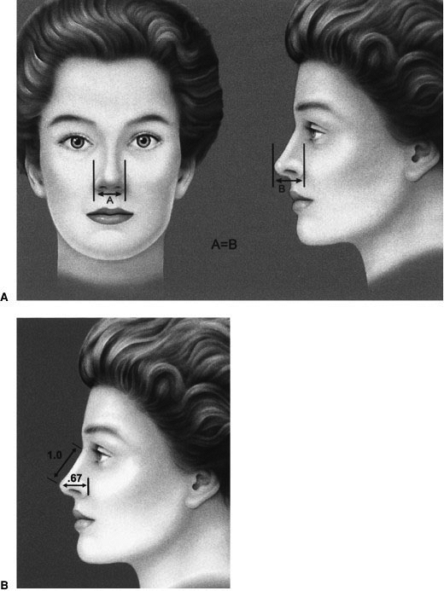
A Tip Projection should equal alar base width B Tip Projection should also equal 0.67 x R-T (radix to tip)

Slide 36
Fifty to 60% of the Tip should lie anterior to a vertical line tangent to the most projecting part of the upper lip vermilion

Slide 37
The Dorsum is analyzed by drawing a line from the radix to the tip-defining points In Women, the ideal aesthetic nasal dorsum should lie approximately 2 mm behind and parallel to this line In Men, it should approach this line

Slide 38
Nasolabial Angle formed between a line coursing through the most anterior and posterior edges of the nostril and a plumb line dropped perpendicular to the natural horizontal facial plane. The nasolabial angle is usually 95 to 100 degrees in Females and 90 to 95 degrees in Males

Slide 39
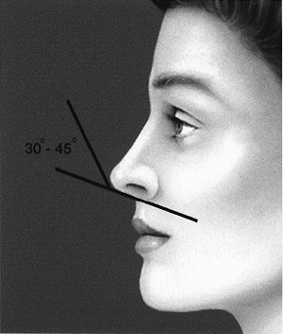
Columellar Labial Angle is formed at the junction of the columella with the infratip lobule The columellar labial angle is normally 30 to 45 degrees

Slide 40
With the eye in forward gaze the Nasofrontal Angle lies at a level b/w the upper eye lashes and the supratarsal crease
This angle can vary between 128 and 140 degrees, but is ideally approximately 134 degrees in Females and 130 degrees in Males

Slide 41
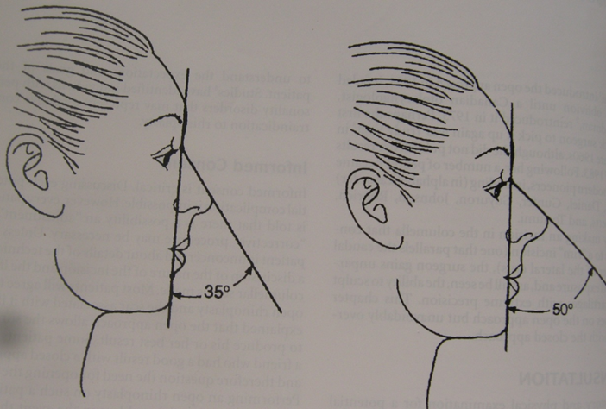
The NasoFacial Angle, the slope of the nose relative to the plane of the face.
Ideally, the nasofacial angle should measure between 32 to 37 degrees.

Slide 42
Male V/S Female Nose
Male have longer nose and a more prominent, straighter bridge and greater width to the middle of the nose.
More tip projection and less rotation
Male nose is a lot more angular than the female nose.
A more acute nasofrontal angle and nasolabial angle
Men tend to have stronger, heavier cartilages and bone along with thicker skin. This will influence what needs to be done to create the desired changes and also the expected timeline of healing.
The female nose generally will not push out from the face as much as the male nose.

Slide 43
Approach to Cosmetic Rhinoplasty
The system is a five step approach and consists of
(l) Identify the patient's goals
(2) Photographs
(3) Defining the deformity
(4) Order laying the ideal
(5) Establishing the operative plan.

Slide 44
The Initial Consultation
The Patient's Expectation level must be assessed prior to any operative intervention.
Patients Considered Appropriate surgical candidates are ones whose degree of concern is proportionate to their degree of deformity.
Some patients frequently have an expectation level that exceeds the reasonable ability of the operation to gain aesthetic improvement and should be Avoided

Slide 45
PHOTOGRAPHIAC ANALYSIS
Photographic analysis is Extremely Valuable for identifying problems that might have been missed on clinical examination and for evaluating various operative plans
Computer imaging is useful for providing the patient with a visual level of understanding of the anticipated outcome
Although the images are not meant to guarantee surgical results.
These images, combined with standardized anterior, oblique, lateral, and basal both static and dynamic, external and internal, visual and tactile photographs
The Goal of this exercise is to identify the aesthetic problems and their anatomical correlates, which allows evolution of the operative plan

Slide 46
“Ideal" Candidate for Cosmetic Rhinoplasty?
A person who is obviously intelligent, preferably educated, and who listens (rather than merely hears) and clearly understands the procedure is a good candidate.
There are two major reasons for rejecting a patient seeking rhinoplasty.
-- One is anatomical unsuitability
-- Emotional inadequacy
Emotional inadequacy is by far the more important reason.

Slide 47
The easiest patients are those requesting elimination of obvious deformities (bump on profile, round tip)
While the most difficult are those who are unable to say exactly what they desire or those who demand a specific “look.”
Essentially, one must get patients to commit to what they want.
The patient has an idea of what he or she wants
The surgeon knows, more or less, what can be done.
The problem is for the two to communicate as accurately as possible beforehand.

Slide 48
Women, however, more frequently wish to change themselves to feel more attractive.
Men seem more interested in changing others' attitudes toward them
The characteristics of the individual least likely to be satisfied with his postoperative result can be formed into a useful acronym- SIMON
Single
Immature
Male
Over expectant
Narcissistic

Slide 49
PRINCIPLES
One must correct the deformities that bother the patient or they will not be happy.
The more detail the pre-op planning is, the smoother the operation.
The simpler the operative plan is, the smaller the risk.
Always design an operative plan with maximum gain and minimum risk.
Write out your operative sequence step by step and put it up in the operating room know what you are going to do.

Slide 50
History:-
To determine the patient’s suitability for undergoing a rhinoplasty procedure, the surgeon clinically evaluates him or her with a complete Medical History to determine his or her physical and Psychological Health.
The surgeon asks about the ailments’ symptoms and their duration, past surgical interventions, allergies, drugs use and drugs abuse

Slide 51
Examination:-
Specific facial and nasal evaluations record the patient’s skin type, existing surgical scars, and the symmetry and asymmetry of the aesthetic nasal subunits.
The external and internal nasal examination concentrates upon the anatomic thirds of the nose
--Upper section
-- Middle section
-- Lower section
Specifically noting their structures; the measures of the nasal angles and the physical characteristics of the naso-facial bony and soft tissues.

Slide 52
TIP
Volume
Definition
Width
Position
Rotation
Projection
RADIX
Level
Depth
Angles
DORSUM
Bony vault
Height
Base width
Bone length

Slide 53
BASE
Columella
Col-Lab angle
Septum
Nasal spine
Alar base
Alar width
Nostril/lobule
Nostril shape
CARTILAGE VAULT
Height
Dorsal width
Length
OTHER
Septum area
Turbinate
Chin
Forehead

Slide 54
The Internal Examination evaluates the condition of the:-
Nasal septum
Internal and external nasal valves
Turbinate's
Nasal lining
Especial attention to the structure and the form of the nasal Dorsum and the Tip of the nose.

Slide 55
Anesthesia
L.A
  -- I.V. Sedation
  -- Topical & Infiltrative Anesthesia
G.A. with endotracheal intubation

Slide 56
PRINCIPLES
Use general anesthesia with appropriate monitors and a throat pack.
Do a thorough intranasal prep with Betadine prior to injection.
Do a five-area injection of local anesthesia based on the vascular anatomy.
Pack the nose with 0.5 in. gauze soaked in a topical vasoconstrictive agent.
Once injected, wait 15 min. Do the definitive prep and drape.

Slide 57
The local anesthesia with its vasoconstrictive agent (1% xylocaine with epinephrine 1:100,000) is injected
The injections are done in Two components: a picture frame block to reduce the regional blood supply and then the specific areas of surgery.
Specifically, the Five areas for injection consist of
(1) tip and columella
(2) lateral wall
(3) dorsum/extramucosal tunnels
(4) incision lines
(5) septum if appropriate.

Slide 58
After injection, cottonoid pledgets soaked with a local vasoconstrictor solution are placed, three per naris
-- to shrink the nasal mucosa
-- facilitate exposure
-- minimize blood loss.
Oxymetazolin or 4% cocaine can be used.
A throat pack is carefully placed in the posterior oropharynx to prevent inadvertent digestion of blood during surgery, which helps prevent postoperative nausea and vomiting

Slide 60
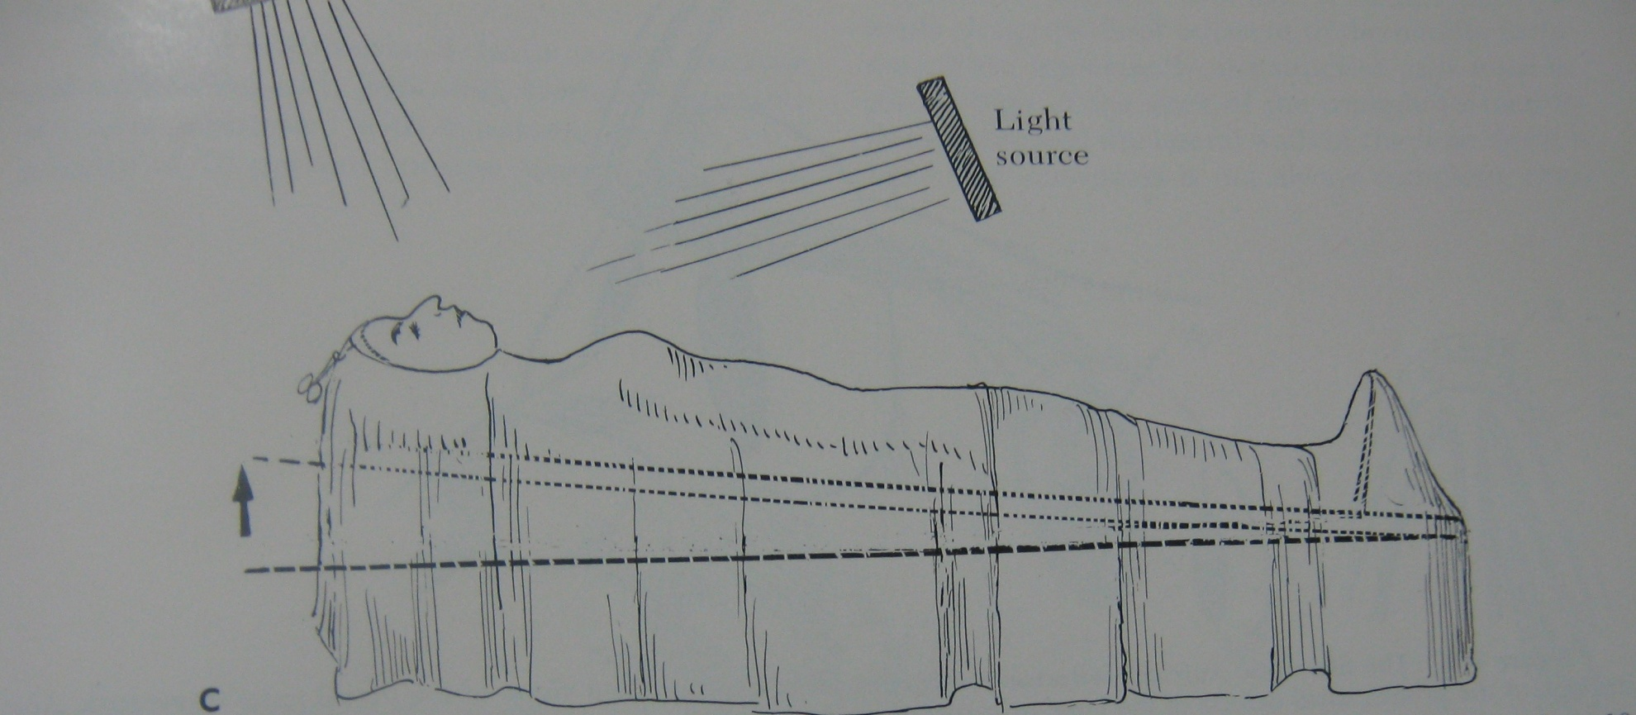
Positioning of the Patient

Slide 61
Open Rhinoplasty Versus Closed Rhinoplasty
Technically, the incisional approach classifies the nasal surgery either as an open rhinoplasty or as a closed rhinoplasty procedure.
In open rhinoplasty, the surgeon makes a small, incision to the columella.
In closed rhinoplasty, the surgeon performs every procedural incision endonasally (exclusively within the nose), and does not cut the columella.
Except for the columellar incision, the technical and procedural approaches of open rhinoplasty and of closed rhinoplasty are similar

Slide 62
Primary and Secondary Rhinoplasty
Primary rhinoplasty denotes an initial (first-time) reconstructive, functional, or aesthetic corrective procedure.
The term Secondary rhinoplasty denotes the revision of a failed rhinoplasty, an occurrence in 5–20 per cent of rhinoplasty operations, hence a revision rhinoplasty.
The corrections usual to secondary rhinoplasty include:-
The cosmetic reshaping of the nose
A defective tip of the nose, i.e. pinched (too narrow), hooked (parrot beak), or flattened (pug nose)
The restoration of clear airways
Although most revision rhinoplasty procedures are “open approach”, such a correction is more technically complicated

Slide 63
Open Rhinoplasty Approach
Distinct Advantages
Binocular visualization
Evaluation of complete deformity without distortion
Precise diagnosis and correction of deformities
Allows use of both hands
More options with original tissues and cartilage grafts
Direct control of bleeding with electrocautery
Suture stabilization of grafts (invisible and visible)

Slide 64
Potential disadvantages
External nasal incision (transcolumellar scar)
Prolonged operative time
Protracted nasal tip edema
Columellar incision separation
Delayed wound healing

Slide 65
Closed Rhinoplasty Approach
Advantages
Leaves no external scar
Limits dissection to areas needing modification
Permits creation of precise pocket so graft material fits exactly without need for fixation
Allows percutaneous fixation when large pockets are made
Promotes healing by maintaining vascular bridges
Encourages accurate preoperative diagnosis and planning
Produces minimal postsurgical edema
Reduces operating time
Results in fast patient recovery
Creates intact tip graft pocket
Allows composite grafting to alar rims

Slide 66
Disadvantages
Requires experience and great reliance on accurate preoperative diagnosis
Prohibits simultaneous visualization of surgical field by teaching surgeon and students
Does not allow direct visualization of nasal anatomy
Makes dissection of alar cartilages difficult, particularly in cases of malposition

Slide 67
Cosmetic Rhinoplasty Procedure
In Rhinoplasty one or more of the following procedures are done:
1. Elevation of depressed nose by adding cartilage, bone or implant.
2. Removal of hump.
3. Reduction of bulk of the tip.
4. Reshaping of nasal bones.
5. Elevation of tip of nose.
6. Reduction of size of nostrils.

Slide 68
Nasal Augmentation
Defined as the Addition of autogenous and/or alloplastic materials to the nose to alter contour and achieve a more natural form.
When analysing a nose for aesthetic correction, one may note a Deficiency of tissue in some areas in which augmentation would bring the nose into more balanced proportions.
This is especially true in secondary rhinoplasty, in which the need for augmentation may be the Rule rather than the exception.
About one-fourth of all rhinoplasties , will involve some augmentation

Slide 69
Nasal augmentation has many specific uses in aesthetic rhinoplasty.
These include correction of
A disproportionately low radix
Insufficient dorsal nasal profile
Inadequate projection of the nasal tip
Alar collapse
Columellar recession

Slide 70
Anatomical Location and Preferred Source of Augmentation
Dorsum
Bone
1. Cranial
2. lliac crest
Cartilage
1. Septal
2. Conchal
3. Rib
Fascia
Temporalis
Dermis
Alloplast
Alar collapse
Cartilage
Bone
Radix
Temporalis fascia
Cartilage
Septal
Conchal
Tip
Cartilage
Septal
Conchal
Columella
Cartilage
Bone

Slide 71
Autogenous Material
Bone
The survival of grafted bone depends on both the origin of the bone graft and the site into which the graft is placed.
Cartilage
Cartilage is Excellent for providing contour augmentation in nasal reconstruction.
Cartilage grafts have certain Advantages over bone grafts.
Cartilage has a much lower absorption rate than bone because cartilage survives without a vascular supply.
Cartilage is also quite easy to shape.

Slide 72
Fascia
In nasal surgery, fascia is often used to correct minor contour defects and to augment contour irregularities.
Although fascial grafts have little resorption, they do compact and condense.
Therefore defects should be overcorrected at least 20 percent fascial grafts do not encapsulate and are useful when a cartilage graft might show beneath thin skin.
Deep Temporal Fascia is used exclusively due to its thickness and long term survival.
Dermis
They are not as frequently used because they are less predictable than other grafts in terms of resorption.
Dermal grafts are harvested by taking skin as a full-thickness graft from a non-hairbearing area
The fat and epidermis are both removed and the dermis grafted

Slide 73
Alloplast
Alloplastic materials are used in nasal surgery, although they are not preferred because of the abundance of autogenous material that can be harvested with minimal morbidity.
Alloplastic implants have a significant rate of extrusion and infection, possibly due to the constant trauma and rubbing to which the nose and midface are constantly subjected.
More successful use in nasal surgery in non- Caucasians than Caucasians, possibly because the thicker skin in the former provides better protection against trauma

Slide 74
Septal Harvest
Septal cartilage is the graft material of choice because of its survival, strength, shaping, and availability.
Technique
In general, the amount of cartilage to be resected is determined by the types of grafts required while preserving at least a 10 mm L-shape strut dorsally and caudally.
Prior to the actual harvest, the following 3 things must be done:
1) the definitive dorsum and caudal septum established,
2) the mucosa elevated bilaterally back to the bony septum
3) the side with the septal spur identified which indicates the side with the septal extension

Slide 75
At this point, the following 5 step septal harvest is done:
1) Dorsal incision 10mm below and parallel to the dorsal septum,
2) Caudal incision 10mm back and parallel to the caudal septum,
3) Posterior dissection of the septum out of the vomerine groove,
4) A downward “push” disarticulation of the cartilaginous septum from the bony perpendicular plate of the ethmoid,
5) Careful mobilization of the cartilaginous tail of the septum which can be 10–15mm long.

Slide 76
Septal harvest

Slide 77
Conchal Harvest
Technique
With the ear retracted forward, a longitudinal incision is made above the planned incision site of the cartilage.
The posterior concha is exposed.
The cartilage is incised below the antihelical fold and the anterior skin is elevated.
Once the skin is completely elevated, the entire conchal bowl can be removed.
Any sharp cartilage edges are rounded off.
The incision is closed with a running locking 4–0 plain catgut suture.
The tie-over bolster dressing is applied

Slide 79
a),

Slide 80
Composite Conchal Grafts
Three applications of composite grafts are seen which often represent a progression in size and difficulty:
(1) alar rim lowering
(2) correction of vestibular stenosis
(3) internal valve stenosis.
Technique
The most common donor site is the anterior surface of the ipsilateral cymba concha.
Traction on the helical root and the antihelix will expose the hidden medial extent of the cymba concha.
The desired graft is then drawn most often with an elliptical shape.

Slide 81
Standard composite graft

Slide 82
Rib Harvest
Traditionally, rib cartilage grafts were harvested from the chondrosynschium of ribs 5-7 both for ear and nasal reconstruction.
In contrast, rhinoplasty straight segments of rib cartilage, use either the Subcostal (9th & 8th ribs) or Inframmary (5th & 6th ribs)
Two different Types of rib grafts – cartilage or osseocartilaginous.
Osseocartilaginous grafts are reserved for the cocaine nose or paranasal trauma cases.

Slide 83
Harvesting Costal Cartilage
Subcostal Approach
Patient is supine position with a small sand bag under the hip.
The 9th rib tip is palpated and a incision is marked between the 8th and 9th rib
The initial incision is carried down to the fascia dissection continues through the muscle and fascia till the distal 9th rib is fully exposed.
Once the rib tip is revealed, it is grasped with forceps and then a retrograde supraperiosteal dissection is done back to the bony junction
Once the graft is removed, then the wound is filled with saline and the anesthesiologist maximally expands the chest to test for any Pneumothorax.
If additional cartilage is required, then a segment of the 8th rib is harvested

Slide 84
Costal cartilage harvest

Slide 85
Inframmary Approach
It is important to mark the inframmary fold preoperatively with the patient sitting.
The incision is placed 1cm above the inframmmary fold which usually coincides with the 5th costal interspace.
The incision is made and then dissect down the 5th and 6th ribs are easily exposed.
The perichondrium elevated then the cartilage is divided at either end.
Once the cartilage graft is removed, the wound is checked for a pneumothorax.

Slide 86
Inframammary rib harvest of full thickness segment and partial thickness piece

Slide 87
Harvesting Osseocartilaginous
When structural dorsal grafts are required (cocaine nose), harvest an osseocartilaginous graft from the 9th rib
Survival occurs because bone is placed over bone and cartilage over cartilage.
The incision is centered at the tip of the 10th rib and drawn in the intercostal space between the 9th and 10th ribs.
A incision is made and the osseocartilaginous junction is exposed
The periosteum is divided over the bony portion of the 9th rib and elevated
A minimum 4 cm of bone is taken
A standard test for pneumothorax is done.

Slide 88
Osseocartilaginous rib harvest

Slide 89
Fillers: Fantastic or Fantasy?
Advantages
The ability to correct localized Depressions and blend in Prominences is the most attractive aspect of fillers.
If valid, it would mollify patients and possibly Reduce Revisions.
The idea of major augmentation with fillers would help secondary patients with Limited Economic resources.
Disadvantages
It is Transitory
Complications of skin slough and Infection following injections in secondary cases
Improvement fades?

Slide 90
Clinical Application of Nasal Crafts
Radix
Radix grafts are generally inserted through an Intranasal incision.
It is also possible to insert the grafts (particularly if fascia is used) through very small (2 mm) vertical external incisions, which heal well.
When fascia is used, it is important to create the pocket to the exact size and configuration of the area that requires augmentation.
Fascia will simply fill the area dissected.

Slide 91
Nasal Dorsum
Dorsal nasal augmentation is more commonly needed in secondary rhinoplasty
The crucial step is to recognize that preoperatively there is a deficiency of tissue, thus requiring nasal augmentation.
A Pocket can be made through an intercartilaginous incision that is large enough to accommodate the bone
The Periosteum of the underlying nasal bones should be stripped to allow bone to bone contact with the graft.
The graft is placed with the Cancellous surface down to allow faster revascularization.
Alloplastic materials should be used with caution in dorsal augmentation because of their comparatively high incidence of extrusion and mobility.

Slide 93
Tip Projection
Augmentation of the nasal tip often helps achieve harmony for a nose in rhinoplastic surgery.
Cartilage grafts are most often used for the nasal tip, with three different designs.
Sheen describes the use of the shield shaped graft of septal (or conchal) cartilage, which is placed in the tip, essentially subcutaneously, just anterior to the alar cartilages
The second design, by Peck who employs an onlay graft of 1 to 2 layers of cartilage placed at the apex of the alar domes
In more severe cases of inadequate tip support, one can use a cartilaginous or bony strut within the columella
Small amounts of Temporalis fascia can provide some augmentation.

Slide 94
A graduated algorithm to alter tip projection is used that is based on nondestructive techniques.
The algorithm begins with Suture Techniques, which can reliably deliver an increase of 1 to 2 mm of tip projection.
The choice of suture material is surgeon dependent
The Four general types of techniques used to alter projection are
Medial crural
Medial crural septal
Interdomal
Transdomal.

Slide 95
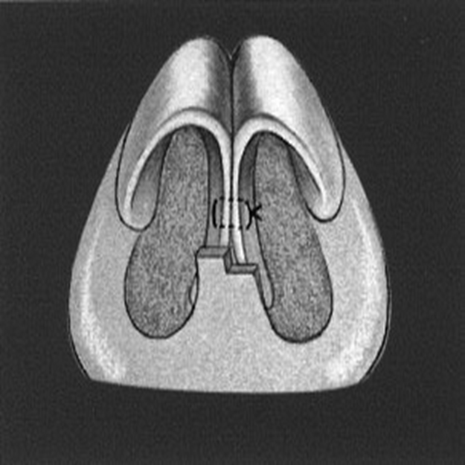
Medial crural sutures
Unify the medial crura
Rectify flaring of the medial crura
Help in stabilize a columellar strut

Slide 96
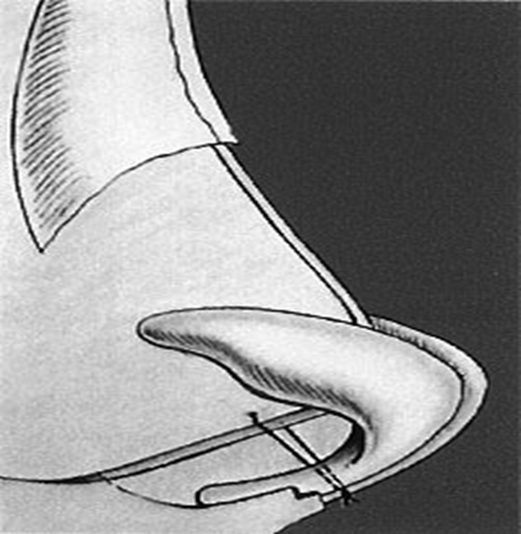
Medial crural septal sutures
Anchor the medial crura to
the caudal septum
Can alter both projection
and rotation
Often used in conjunction
with columellar struts

Slide 97
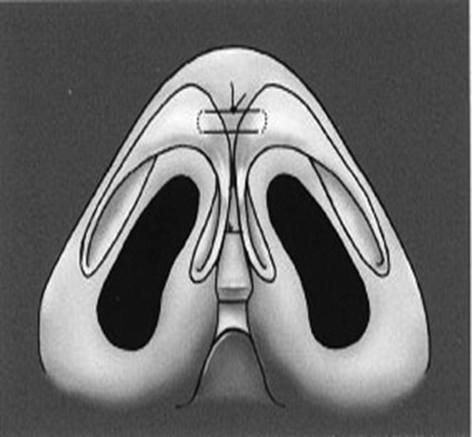
Interdomal sutures
Can increase both tip refinement and tip projection.
Approximating the medial crura.
Sutures are placed in vertical mattress fashion
Tightened to achieve the desired result.

Slide 98
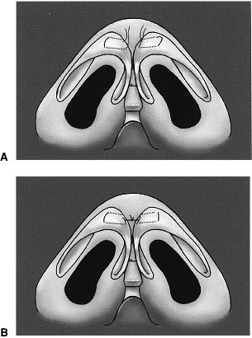
Transdomal sutures Mattress-type sutures placed across the dome of the middle crura Can also affect tip refinement and projection. Transdomal sutures with the ends left long can be tied together in interdomal fashion, as well.

Slide 99
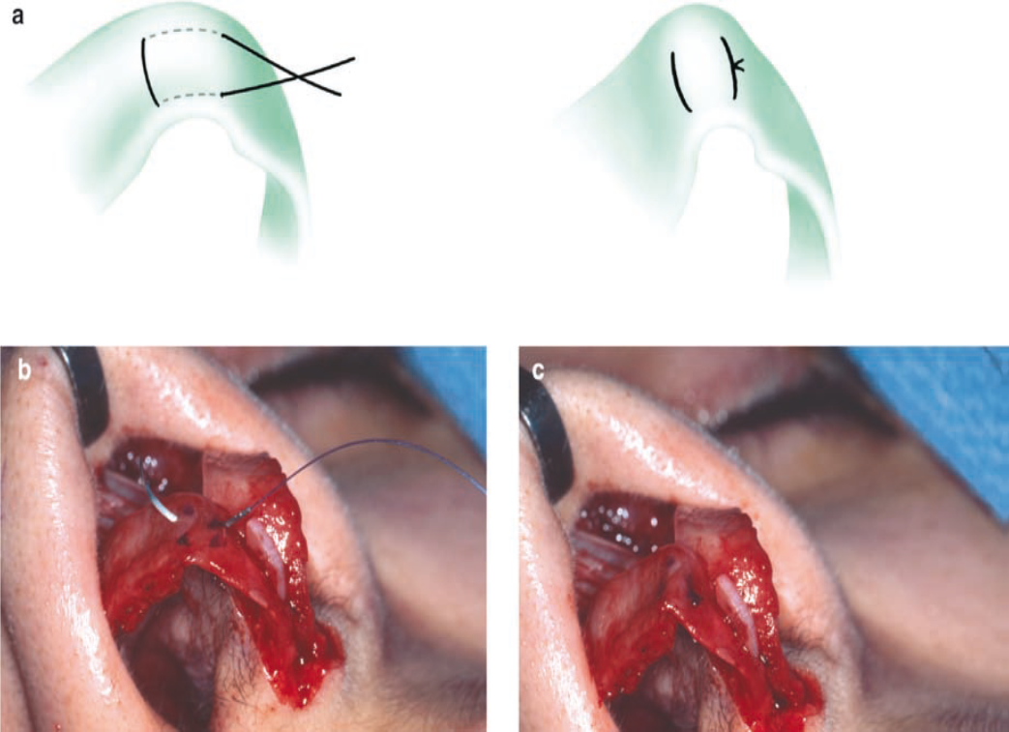
Domal Creation Suture
Inserts a horizontal mattress suture across the domal segment at the domal notch
Cinches it down to create a convex domal segment next to a concave lateral crura.

Slide 100
The placement of a Columellar Strut is the second step in the algorithm of tip projection alteration.
This strut, usually fashioned from septal cartilage, can be placed in a fixed or a floating fashion, depending on whether or not it is secured to the anterior maxilla or not.
This strut controls the columellar profile as well as supports tip projection.
A pocket is dissected between the medial crura and the strut is inserted.
The columellar strut is usually cut 20 mm long, 2.5 mm wide, and 1.5 mm thick.
Then the alars are elevated upward and rotated 90° medially.
A vertical suture of 5–0 PDS is placed across the columellar which sandwiches the strut between the middle crura

Slide 101
Columellar strut and suture

Slide 102
Tip Grafts are the final step in the algorithm for graduated tip modification if more tip projection or definition is desired after the preceding manoeuvres.
These grafts may take several forms, but have a tendency to be visible regardless of the specific type used, so their use is reserved only for the patient in which the prior, more predictable, methods do not result in satisfactory tip projection.
The three general types of tip grafts are
-- Onlay tip grafts
-- Infratip lobular graft
-- Columellar tip graft

Slide 103
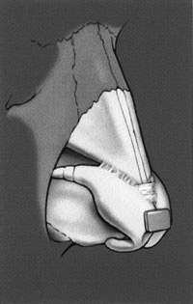
The onlay tip graft is usually placed over the dome of the middle crura

Slide 104
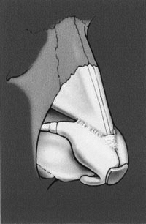
The infratip lobular graft overlies the dome and extends inferiorly a variable distance

Slide 105
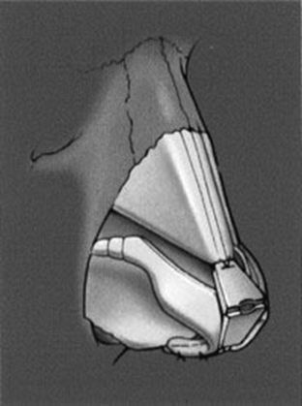
The columellar tip graft
Indication
difficult primary rhinoplasties
thick-skinned patients
secondary rhinoplasties with
inadequate tip projection
Combination graft of the onlay tip graft and infratip lobular graft

Slide 106
Decreasing Tip Projection
The primary means of decreasing tip projection lies in alteration of the length and strength of the lower lateral cartilages.
Several techniques, such as transection, setback, and resuturing of the medial or lateral crura, may be used to obtain the desired result.
It is important to recognize that if the tip projection is significantly decreased, alar flaring or columellar bowing may result.
This, then, would require concomitant correction.

Slide 107
Altering Tip Rotation
To alter tip rotation, the existing extrinsic forces stabilizing the tip at its current position must be released.
The first step is usually to perform a cephalic trim, which separates the connection between the upper and lower lateral cartilages.
Another technique is to resect a variable amount of the caudal septum.
This releases tension on the nasal tip and allows for more cephalad rotation
This maneuver can also affect tip projection, as well.
After the desired amount of tip rotation has been achieved, its position is maintained with suture techniques (medial crural septal sutures) and/or a columellar strut or septal extension graft.

Slide 108
Columella
When the soft tissue is adequate but support is lacking, columellar retracrion can be corrected by Grafting
A cartilaginous strut between the two medial crura of the lower lateral cartilages
Alae
Alar collapse most commonly occurs following excessive removal of the lower lateral cartilages during rhinoplasty.
The collapse manifests during inspiration with a Pinched look of the nasal lobule.
In most cases, alar support can be adequately corrected by inserting cartilaginous Grafts that override the normal lower lateral cartilages.

Slide 109
Noncaucasian Nose
The characteristics of the black nose typically include some degree of a flattened dorsum, as well as a flat nasal tip and wide alae.
Tip projection is often lacking and the columella is frequently retracted.
Augmentation is commonly needed in addition to alar base excision and lower lateral cartilage refinement.
The thick dorsal skin of the black nose allows the choice of using bone, cartilage, or even alloplast.
Tip projection as well as columellar retraction are best corrected with cartilage grafts.

Slide 110
Reshaping of Nasal Bones
Osteotomies
Several techniques exist for performing osteotomies, including medial, lateral, transverse, or a combination of the above.
These can be performed via an external or internal approach, depending on surgeon preference.
Osteotomies are generally performed for the following reasons:
To narrow the lateral walls of the nose
To close an open-roof deformity (after dorsal hump reduction)
To create symmetry by allowing for straightening of the nasal bony framework.

Slide 111
Contraindications include patients with short nasal bones, elderly patients with thin fragile nasal bones, and patients with heavy eye glasses.
Lateral osteotomies may be performed as low-to-high, low-to-low, or as a double level
Furthermore, they may be combined with medial, transverse, or greenstick fractures of the upper bony segment.
Regardless of the technique used, however, it is paramount to preserve Webster triangle.
This bony triangular area of the caudal aspect of the maxillary frontal process near the internal valve is necessary for internal nasal valve support.
Preservation of this triangle prevents functional nasal airway obstruction from internal valve collapse.

Slide 112
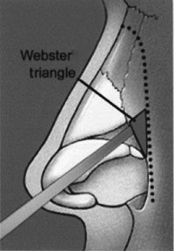

Slide 113
A Low-to-High Osteotomy
Begins low at the pyriform aperture and ends high medially on the dorsum
The nasal bones are then medialized by a gentle greenstick fracture along predictable fracture patterns obtained based on nasal bone thickness.
Thicker nasal bones may require a separate superior oblique osteotomy in order to mobilize them enough to be greensticked.

Slide 114
Low to high osteotomy

Slide 115
A Low-to-Low Osteotomy
Starts low along the pyriform aperture and continues low along the base of the bony vault to end up in a lateral position along the dorsum near the intercanthal line.
More powerful technique in that it results in more significant medialization of the nasal bones
Used when there is a large open-roof deformity or if a wide bony base requires correction.
Frequently accompanied by a medial osteotomy in order to better mobilize the nasal bones to achieve the desired result.

Slide 116
Low to low osteotomy

Slide 117
A double-level lateral osteotomy
Indicated in cases where there is an excessive lateral wall convexity that is too great to be corrected with a standard single-level lateral osteotomy
When significant lateral nasal wall asymmetries exist.
The more medial of the two lateral osteotomies is first created along the nasomaxillary suture line.
The more lateral of the two is then created in standard low-to-low fashion.

Slide 118
Double level osteotomy

Slide 119
Medial osteotomies
Used to facilitate medial positioning of the nasal bones in patients with thick nasal bones or wide bony bases
Frequently used in combination with lateral osteotomies, it is not necessary to use both in all cases.
If both techniques are performed, however, the medial osteotomy is usually performed first, as this makes it technically easier to perform the subsequent lateral osteotomy.
The cant of the medial osteotomy can be oriented in a medial oblique, paramedian, or transverse direction.
It is also important to avoid placing the medial osteotomy too far medially as it connects with the lateral osteotomy as this can cause a Rocker deformity where widened upper dorsum results from the fractured nasal bone kicking out

Slide 120
Medial oblique osteotomy

Slide 121
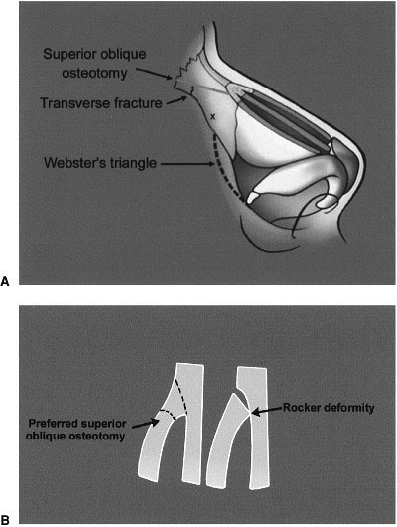
A The course of a superior oblique medial osteotomy B Rocker deformity caused by placing the medial osteotomy too far medially.

Slide 122
Complications of Nasal Osteotomies
Infection
Operative trauma
Local Hemorrhage (hematoma, ecchymosis)
Edema
Nasal cyst formation
Anosmia
Epiphora
Cosmetic problems
Excessive narrowing or convexity
Insufficient mobilization of lateral bony walls
Unstable bony pyramid
Rocker deformity
Redundant soft tissue
Stair-step deformity
Nasal bone asymmetry

Slide 123
Spreader Grafts
Following the osteotomies, the dorsum is reassessed as regards smoothness and final profile.
Any additional rasping is done as well as minor cartilage excisionsat the keystone area.
Once satisfied with the dorsum, then the spreader grafts are inserted.
Spreader grafts are matchstick-sized pieces of cartilage or vomerine bone that restore the normal dorsal width of the septum which has been lost during dorsal reduction.
They can correct asymmetries, prevent an inverted-V deformity, and avoid a pinched nose.
They are easily cut to the desired length (20–25 mm) and height (2.5–3.5 mm), while the width (0.5–3.5 mm) varies with the desired aesthetics of the middle vault.

Slide 124
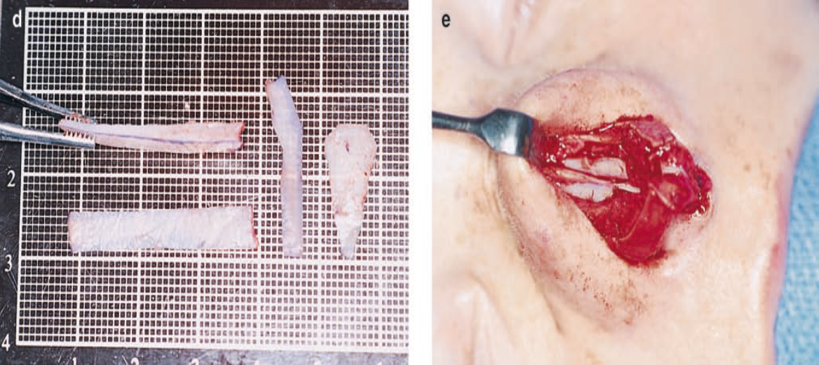
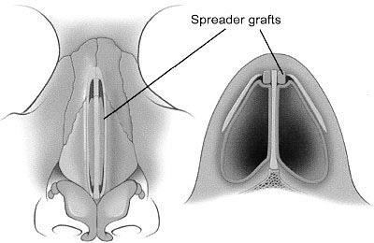

Slide 125
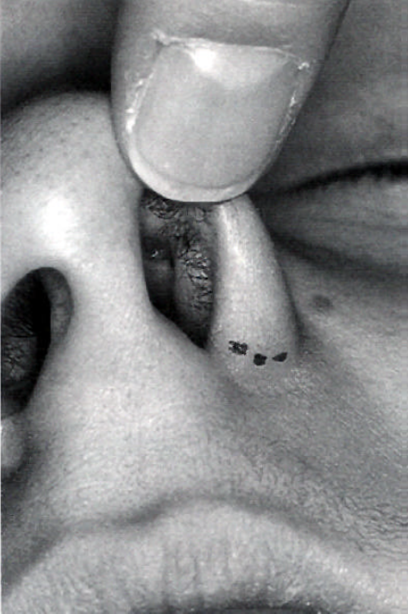
Alar Base Modification
Indications
Alar flaring
Bulbosity
Excess width
Wide nostril floor
Imbalance after tip narrowing
General guidelines
Graduated fashion
1-2 mm above alar-facial crease
Precise repair, buried interrupted suture

Slide 126
Alar base modification should be carefully planned preoperatively, and executed very conservatively aggressive excisions can be disastrous and virtually irreparable.
The decision as to the type and amount of the excision is based upon nostril shape and sill width.
Alar rim grafts are often necessary as alar base excisions accentuates alar rim notching
The critical factor is the relationship between alar flare and alar width as regards intercanthal width.

Slide 127
The normal alar base width is equivalent to the intercanthal distance, or the width of one eye.
If the alar base width is greater than the intercanthal distance, the underlying etiology should be examined.
If the discrepancy is the result of a narrow intercanthal distance, it is better to maintain a slightly wider alar base.
If there is true increased interalar width, a nostril sill resection may be indicated.

Slide 128
If the increase in width is secondary to alar flaring (>2 to 3 mm outside the alar base), an alar base resection should be considered.
The bony base should equal approximately 80% of the alar base width.
If the bony base is greater than 80% of the alar base width, osteotomies may be required.
There are basically three surgical techniques:
(1) a simple nostril sill excision to reduce nostril show,
(2) an alar wedge excision to reduce nostril flare
(3) a combined sill/wedge excision with components that can reduce flare as well as alar width.

Slide 129
Nostril Sill Excision
For nostril sill excisions, a 2.5–3.5 mm wide inverted trapezoid is drawn
The sides are vertical and then triangular with equal extension into the vestibule and onto the skin surface.
After injection with local anesthesia, the wedge is excised.
The sill/vestibule component is closed with a horizontal mattress suture

Slide 130
Nostril sill excision

Slide 131
Alar Wedge Excision
For alar wedge excisions, it is important that the line of incision be placed in the alar crease
The line of excision is drawn using a caliper (2.5–4 mm average) with quantitative variance on the two sides to accommodate asymmetries.
With the area stabilized on a skin hook, a V-wedge excision is made without penetrating the underlying vestibular skin.
The edges are closed with 6–0 nylon and the knots placed on the more dependent side.

Slide 132
Alar wedge excision

Slide 133
Combined Sill/Wedge Excision
In more severe cases, a combined excision of nostril sill and alar wedge is necessary.
These are complex advanced excisions which are most common in ethnic rhinoplasty cases

Slide 134
Combined sill/wedge excision

Slide 135
Alar Rim Graft and Alar Rim Support Graft
For patients with a retracted alar rim or a high potential for developing it, alar rim grafts of septal cartilage are effective
What is the difference between alar rim grafts (ARG) and alar rim structure grafts (ARS)?
Basically, it is the same graft, but placed along the alar rim in two different ways.
The ARG is inserted into a subcutaneous pocket while the ARS is sutured into a marginal rim incision along the full-length of the nostril.
In general, ARG grafts are used for minor weaknesses and slight retractions of the alar rim.
In contrast, ARS grafts are used for major retractions and to fundamentally change the shape of the nostrils

Slide 136
Alar rim graft (ARG)

Slide 137
Alar rim support graft (ARS)

Slide 138
Lateral Crural Strut Grafts
These grafts were develop to reshape, reposition, or reconstruct the lateral crura while providing support for the external valve.
Essentially these are straight strong pieces of cartilage measuring 3–4 mm in width by 14–20 mm in length.
Although used in different ways, the medial portion of the graft is sutured to the undersurface of the alar cartilage while the distal end is placed in a lateral pocket.
Insert the lateral portion into one of three locations: pyriform, alar base, or nostril rim depending upon indication

Slide 139
Lateral crural strut grafts (LCSG)

Slide 140
Reduction Rhinoplasty
Incremental Dorsal Reduction
The most common selection is dorsal reduction which is done incrementally using rasps for the bony hump and scissors for the cartilaginous hump
The bone is done first using puller rasps to reduce the midline and then each nasal bone individually on an angle.
Once the bony dorsum matches the ideal profile line drawn on the skin preoperatively, then the cartilaginous hump is reduced.
The skin is redraped and the dorsal line checked by pulling the nasal skin laterally.
Next, the upper lateral cartilages are excised conservatively.
In general, upper lateral excision is 33–50% of the dorsal cartilage reduction (3 mm of septum, 1–1.5 mm of upper lateral).

Slide 141
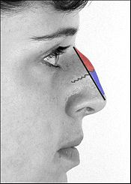
The black line delineates the dorsal plane of the new nose.
The nasal hump is bone (red) above the scalloped grey line
Cartilage (blue) below the scalloped grey line

Slide 142
Bony reduction

Slide 143
Cartilage reduction

Slide 144
Radix Reduction
The new approach to radix reduction by dividing the radix components into soft tissue and bone based on preoperative palpation.
It is important to assign a relative importance to each component in selecting the best operative technique.
Soft Tissue Reduction
Preoperatively, one must assess both the soft tissue fullness that blunts the nasofrontal angle and the width of the medial orbital lines that continue into the dorsal lines.

Slide 145
In younger patients, one can excise the soft tissue fullness using the following technique:
(1) Elevate the skin over the radix and glabellar region
(2) Then dissect upward on top of the dorsal bones
(3) Excise the intervening soft tissue
(4) Place a drain and compressive dressing.
In older patients, one may need to do a concurrent endoscopic central forehead lift.

Slide 146
Radix reduction

Slide 147
Soft tissue excision

Slide 148
Bony Reduction
The first step is to visually separate radix from dorsum using a transverse line through the lateral canthus.
Then the ideal nasion is determined and the nasofacial angle set, which reveals the new dorsal line.
Since both areas are usually excessive, dorsal reduction is necessary and it is done first.
Two-step technique is preferred.
First, the dorsum is lowered using rasps for the bony vault and a scissor for the cartilage vault.
Once satisfied with the dorsal line, the radix area is undermined extensively using a Joseph elevator.

Slide 149
Bony excision

Slide 150
Wide Dorsum
A wide dorsum is corrected in most rhinoplasties by reducing the wide hump and infracturing the lateral nasal walls.
For minor width excesses, achieve narrowing with hump reduction plus transverse and low-to-low osteotomies.
For moderate width problems, do the hump reduction and then a medial oblique osteotomy coming from the open roof and angling out about 45° followed by a low-to-low lateral osteotomy.
The reason for the medial oblique osteotomy is that it insures that narrowing will occur at the dorsum.

Slide 151
Narrowing wide dorsum

Slide 152
Crooked Nose
Difficult problem
Contributions septum, bony and cartilaginous dorsum, tip
Manipulations must not compromise support
Lower 1/3rd support mechanisms
Structural integrity of lower lateral cartilages
Fibrous attachment cepahlic lateral crura and caudal upper lateral
Soft tissue attachment cephalic margin medial crura and caudal nasal septum
Interdomal ligament attachment to anterior septal angle

Slide 153
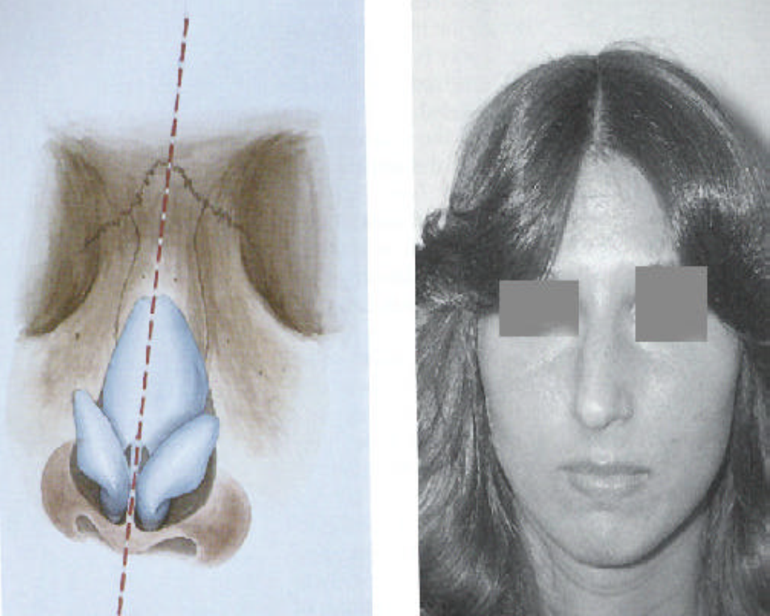
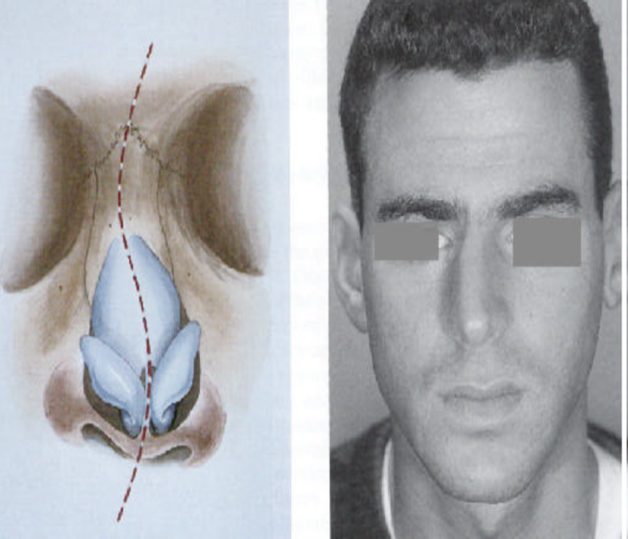

Slide 154
Crooked Nose Diagnosis
Facial symmetry
Lower 2/3 deviation
Palpation
Tip recoil

Slide 155
Crooked Nose Correction
Pitfalls
Deviations of the caudal, dorsal septum
Irregularities upper lateral cartilages
Correction
Dorsum Hump removal
Less from vertically oriented
Intermediate osteotomies
Don’t elevate periosteum

Slide 157
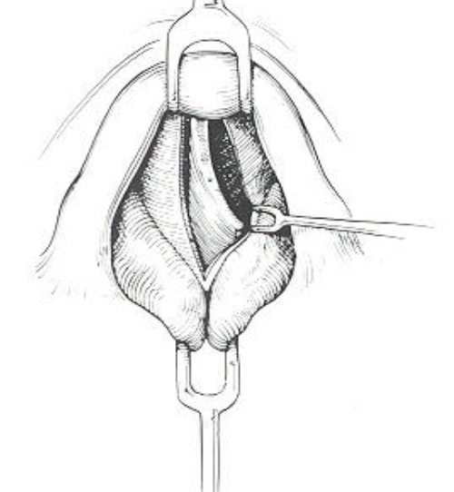
Free upper lateral cartilages
Prevent collapse
Mucosa intact
Suture into position
Open approach
Visualize deviated portions dorsal septum
Dorsal septal deviation

Slide 158
Shave convex, unilateral spreader graft
Further correction, on-lay grafts
Airway Obstruction

Slide 159
Ethmoid bone stenting
Cartilage crosshatching

Slide 160
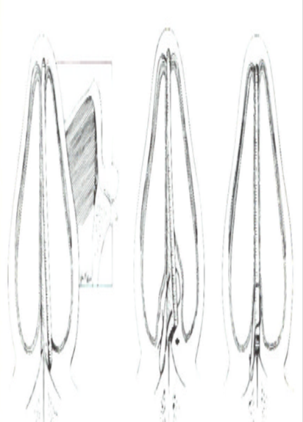
Caudal septal deviation
Cartilage manipulation and suture
Triangular wedge
Replacement
Columellar strut

Slide 161
Saddle Nose
Loss of profile, bony and
cartilaginous dorsum
Ethnic, trauma, infection,
hematoma, overzealous profile
reduction

Slide 162
Saddle Nose Classifiction
Minimal
Moderate tip-supratip differential
Mildly accentuated bony hump
Little columellar retraction
Overwide nose
Minimal supratip augmentation
Contouring hump

Slide 163
Moderate
Significant quadrangular cartilage dorsal height loss
Significant collumellar retraction acute nasolabial angle
Blunt trauma, bony pyramid broad and flattened
Major
All stigmata of moderate to greater degree
Childhood or massive trauma, major nasal twist, septal deformity

Slide 164
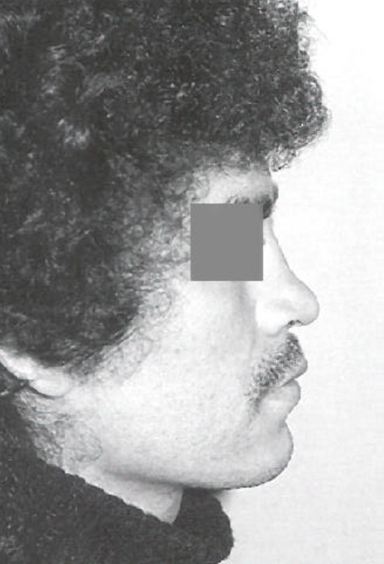
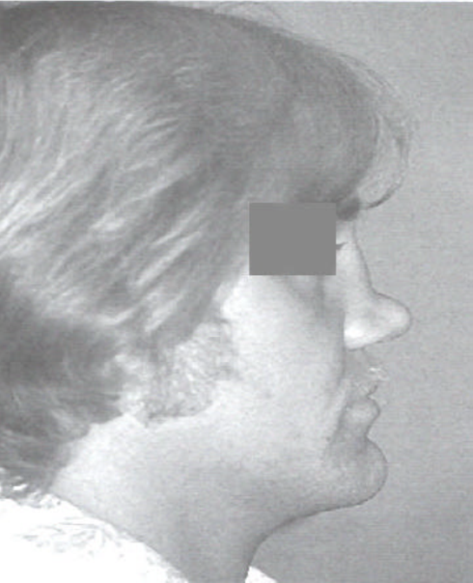

Slide 165
Saddle Nose Repair
Dorsal augmentation
Variety of techniques
Variety of materials
Septal conchal cartilage
Autogenous cartilage, bone
Synthetic, alloplastic
Heterografts, homografts

Slide 166
Saddle Nose Correction
Mark supratip depression
Anesthetic infiltration
Exacting pocket
Midline axial intercartilaginous stab
Blunt pocket dissection 1-2 mm larger than graft

Slide 167
Saddle Nose Correction Example

Slide 168
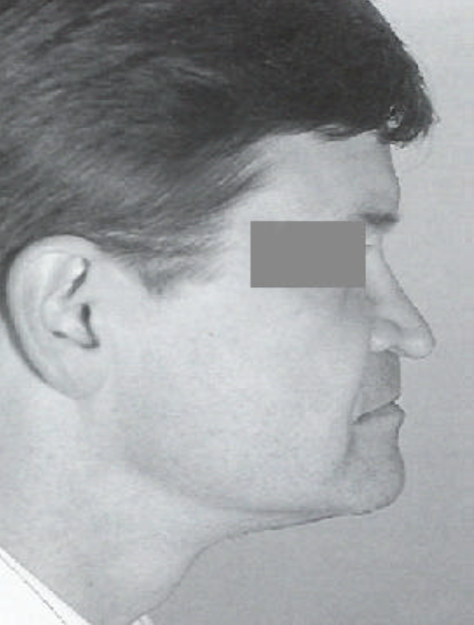
Aging and Rhinoplasty
Special consideration
Longstanding dissatisfaction
Undesired life change
Medical problems
Changes of aging
Tip support weakens
Descent of nasal tip
Nasal elongation
Nasolabial angle changes
Alar cartilage flattened, fragmented
Loss of upper lower attachments
Thin nasal bones
Skin thinner less elastic
Skin heals less aggressive, finer scars
Changes in surrounding face

Slide 169
Correction
Maintain tip support mechanisms
Columellar strut useful
Care of septal mucosa
Wide undermining of skin possibly
Use of external incisions(dorsal)
Fine 2-3 mm osteotomes
Extended taping

Slide 171
Postoperative Management
The following are prescribed routinely:
Antibiotic — 3 days
Steroid — 7 days (to minimize postoperative edema)
Pain killer – 3 to 5 days
Normal nasal saline for postoperative nasal congestion
During the first 48 to 72 hours, the patient is instructed to keep the head of bed elevated at 45 degrees
Use a chilled gel eye mask to help minimize postoperative swelling.

Slide 172
Postoperative taping

Slide 173
Any manipulation of the nose, including rubbing, blotting, or blowing, is discouraged for the first 3 weeks postoperatively.
Sneezing should be done through the mouth during this time.
It is imperative to keep the nasal splint dry to prevent premature discontinuation of the splint.
Prefer to keep the patients on a liquid diet on the day of surgery and then advance them to a soft regular diet the following day.
Any foods that require excessive lip movements, such as eating apples should be avoided for 2 weeks after surgery.

Slide 174
During the first 2 weeks postoperatively nasal congestion should be treated with the use of normal saline nasal spray and over-the-counter oxymetazoline nasal sprays.
The patient is encouraged to breathe through the mouth if there is difficulty with air passage through the intranasal splints.
The sutures and nasal splints are removed at the initial visit on postoperative day 5 to 7.
The nose (especially the tip) may appear swollen and turned up and the tip may feel numb, but the patient is reassured that both are expected and that both will resolve with time.
Normal sensation usually returns within 3 to 6 months.

Slide 175
The patient is instructed to avoid letting anything, including eyeglasses, rest on the nose for at least 4 weeks.
Restrict the patient's activity for 3 weeks postoperatively, after which the patient can gradually resume normal activity.
Any contact sports or activities that may cause direct trauma to the nose are prohibited for at least 4 to 6 weeks after surgery.
Follow the patient at postoperative months 3, 6, and 12, and then annually thereafter.

Slide 176
Complication
Skin Necrosis
Alar Collapse and Alar Retraction:- Due to loss of architectural shape or integrity of the lateral crus
Supratip Deformity
Early:- Odema
Late:- Supratip fullness and thickness k/a Polly beak deformity
-- Manifestesd as pronounced dorsal convexity in supratip area
-- It is due to over resection of cartilage

Slide 177
A HAPPY AND
SATISFIED PT.
A REWARD TO
CHERISH
THANK YOU
FOR
ATTENTION

