Slide 1
Overview of assessment procedures for child language disorders; adult language disorders; and neurogenic language disorders

Slide 2
OVERVIEW OF ASSESSMENT
History of the Client
Procedures
Written Case History
Information-Getting Interview
Specific Questions to Ask About Language Development/Disorder
Information from Other Professionals

Slide 3
Contributing Factors
Hearing Impairment
Medical or Neurological Factors
Maturation and Motor Development
Intelligence, Sex, Birth Order, Motivation, and Levels of Concern

Slide 4
Assessment of Language
Procedures
Screening
Informal Tests
Standardized Tests
Speech-Language Sampling

Slide 5
Areas to Assess
Pragmatics
Semantics
Syntax
Morphology

Slide 6
Analysis
Error Types
Form of Errors
Consistency of Errors
Contextual Differences
Oral-Facial Examination
Hearing Assessment
Determining the Diagnosis
Providing Information (written report, interview, etc.)

Slide 7
Assessment Approaches
The development of language is influenced by other aspects of development such as cognition, motor development, and social development. Clinical conditions such as mental retardation, hearing impairment, various genetic syndromes, and autism also affect language
The components of language (i.e., pragmatic, semantic, syntactic, morphologic, and phonologic) do not occur in isolation; they are integrated with one another. In addition, assessment of these individual components does not provide information about a client’s use of language holistically.

Slide 8
Expectations of language performance change across time. What is normal at age 1 is deviant at age 3.
Speakers of any given language are not a homogeneous group. Individual experiences and abilities result in a broad definition of normal language.
Because of individual variability, there is no “best” approach for the assessment of language with all clients.

Slide 9
Case history questionnaire and caregiver interviews
Observation of the client in a variety of naturalistic settings
Direct testing, including formal assessments
Conversational language sampling

Slide 10
Components of Language
Semantic: refers to the meaning of language
Syntactic: refers to the rules governing grammatical constellation of language units
Morphologic: refers to units of meaning a. Free morphemes: units that can stand alone (most words) b. Bound morphemes: units that cannot stand alone; they must be attached to a free morpheme (e.g., pre-, -ing)
Pragmatic: refers to the social aspects of language (e.g., eye contact, turn-taking)
Phonologic: refers to speech sounds, sound patterns, and rules of sound organization

Slide 11
Language Disorder Categories
Specific language impairment (SLI)
Language learning disability (LLD)
Autism spectrum disorder (ASD) or Pervasive developmental disorder (PDD)
Brain injury
Mental retardation (MR)
Deafness

Slide 12
SCREENING
Adolescent Language Screening Test (Morgan & Guilford, 1984)
Bankson Language Test (BLT-2) (Bankson, 1990)
Boehm Test of Basic Concepts (Boehm, 2001)
Clinical Evaluation of Language Fundamentals (CELF-4) Screening Test (Semel, Wiig, & Secord, 2004)
Denver Developmental Screening Test II (Frankenburg & Dodds, 1992)
Fluharty Preschool Speech and Language Screening Test (Fluharty, 2000)
Joliet 3-Minute Preschool Speech and Language Screen (Kinzler, 1993)
Joliet 3-Minute Speech and Language Screen-Revised (Kinzler & Johnson, 1992)
Kindergarten Language Screening Test (Gauthier & Madison, 1998)
Speech-Ease Screening Inventory (Speech-Ease, 1985)

Slide 13
ASSESSMENT OF EARLY LANGUAGE DEVELOPMENT
Babies are born with limited no ability to communicate. By the time they grow to the age of 5 years, normally developing children have nearly adult-like symbolic communication skills.

Slide 14
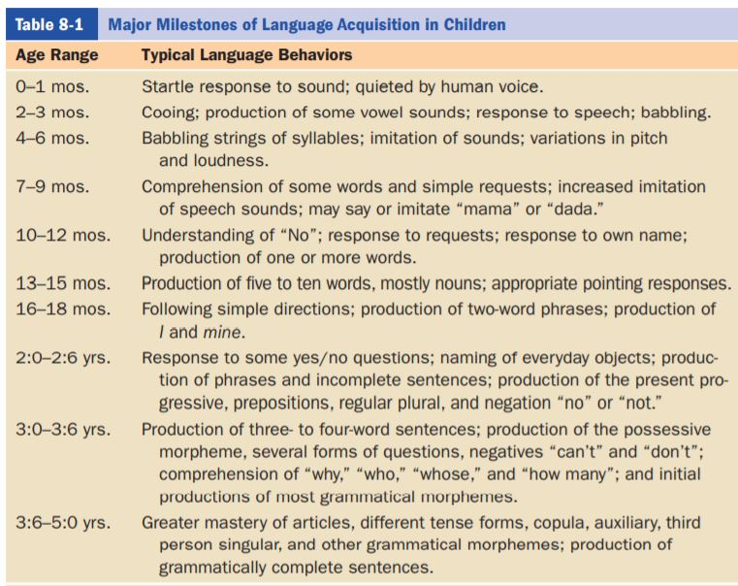

Slide 15
Early Indicator in Children
Natal conditions that cause brain injury
Maternal drug abuse, including alcoholism
Significant prematurity with low birth weight
Presence of genetic syndrome(s)
Sensory deficits, especially hearing loss
Frequent and/or prolonged hospitalizations
Neglect or abuse
Lack of eye contact (mutual gaze)
Lack of smiling
Lack of joint attention
Reduced use of gestures
Lack of play activities Delayed babbling Early phonological difficulties (Hegde, 1996)

