Slide 1
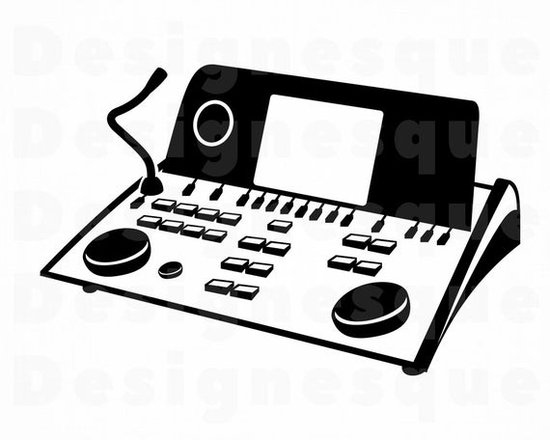
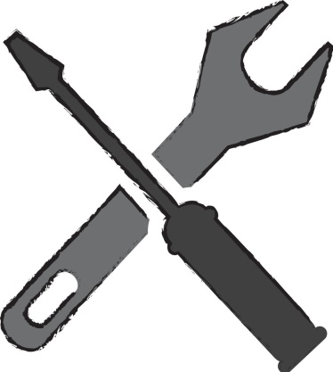
CALIBRATION

Slide 2
INTRODUCTION
There are certain standards that audiometric instruments need to meet. These standards are set by AMERICAN NATIONAL STANDARD INSTITUTE (ANSI).
CALIBRATION is the process of making sure that an instrument is really doing what it is supposed to be doing.
To better understand the procedures for checking calibration, one must ﬁrst understand the parameters that need to be checked, as well as the equipment used to perform these calibration checks.

Slide 3
DAILY LISTENING AND SUBJECTIVE CALIBRATION
For pure tone and speech audiometers, the three parameters are (1) frequency, (2) level (sound pressure level [SPL] or force level or [FL]), and (3) time. These parameters apply whether one is using a portable audiometer, a standard diagnostic audiometer, or a computer-based audiometric system.
Some organizations, such as ASHA and OSHA (Occupational Safety and Health Administration), specify time intervals at which calibration checks should be made.
With current solid-state electronic circuitry, frequency, and time, parameters should be checked when the audiometer is ﬁrst acquired and at yearly intervals thereafter.

Slide 4
CONT..
In the early days of audiometers, checks on the reliability of the hearing level were conducted by testing a group of subjects with known normal hearing—the “psychoacoustic method.”
This is done by taking the median of the threshold findings and posting a correction chart on the audiometer to remind the audiologist to correct any readings obtained on a patient by the number of decibels the audiometer had drifted out of calibration.
If daily listening checks are strictly enforced, transducers should be veriﬁed at least annually, unless there is reason to suspect that the output has changed.

Slide 5
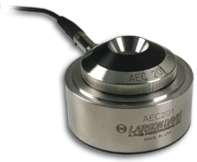
AIR CONDUCTION CALIBRATION
Air-conduction calibration involves measuring the sounds produced by the earphones, and is done separately for each earphone.
The earphone is placed on an NBS-9A coupler, which is a metal cavity having a volume of 6 cc. This coupler is used because it roughly approximates the acoustical characteristics of the ear, and is often called a 6-cc coupler or an artificial ear.
A high-quality microphone is located at the bottom of the coupler. The microphone is connected to the audiometer calibrator or sound level meter, which measures the actual sound pressure level being produced by the earphone.

Slide 6
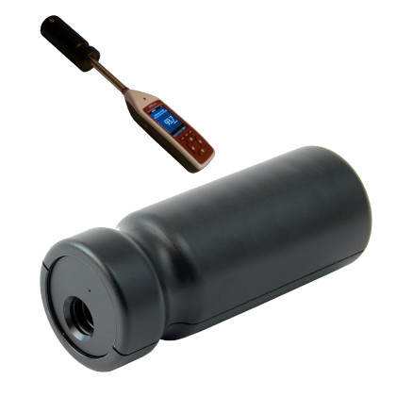
CONT…
The accuracy of the sound level meter itself is often conﬁrmed using a sound level calibrator, which is a device that produces a precisely controlled signal.
The reference values for insert earphones are obtained using special types of 2-cc couplers or occluded ear simulators instead of the 6-cc NBS-9A coupler described for use with standard audiometric earphones.
Special measurement couplers are used because insert receivers are placed into the ear canal instead of being worn over the ear, and are used for many hearing aid measurements.

Slide 7
CONT…
It is very simple to perform a sound level calibration check once we know the reference SPLs. The following procedure is used at each test frequency and for both earphones:
1. Select the frequency.
2. Set the attenuator to a convenient level, such as 70 dB HL. (We use a high level so that the intensity of the tone will be well above any noise levels in the room.
3. Turn on the tone.
4. Read the meter on the audiometer calibrator (or sound level meter) to measure the actual sound pressure level that is produced by the earphone.
5. Compare the actual sound pressure level to what it is supposed to be and Record any difference.

Slide 8
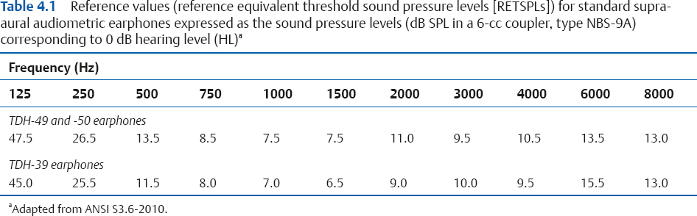
CONT…

Slide 9
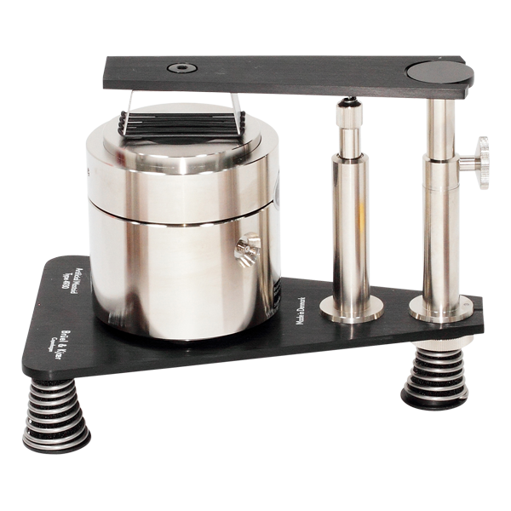
BONE CONDUCTION CALIBRATION
The bone-conduction system can be calibrated using an artificial mastoid or mechanical coupler This type of measurement is usually done by a service technician because most clinical facilities do not own their own artiﬁcial mastoids.
The basic concept is analogous to what is done with the earphone and artiﬁcial ear, but involves reference values in terms of the force needed to achieve 0 dB HL for bone-conduction.
These values are called reference equivalent threshold force levels (RETFLs) because they show the force needed to achieve 0 dB HL with bone-conduction stimulation.

Slide 10
CONT…
The biological calibration procedure is done at each frequency where bone-conduction testing is done (usually up to 4000 Hz), as follows:
(1) Obtain and record the air-conduction threshold.
(2) Obtain the bone-conduction threshold and record the number of decibels indicated on the attenuator dial.
(3) Find the difference between the air-conduction hearing level and the bone-conduction dial reading. This is the amount by which the bone-conduction dial reading must be corrected to indicate the correct bone-conduction threshold.
A point to note that these calibration are done with the patients having a reliable sensorineural hearing loss.

Slide 11
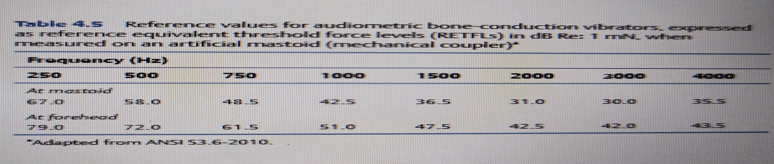
CONT..
(4) Correction values are obtained for several patients with sensorineural losses (using steps 1 to 3) to arrive at average corrections for each frequency, which are then posted on a correction chart.
The more subjects used to establish the averages, the more conﬁdence you can have in the correction factors.

Slide 12
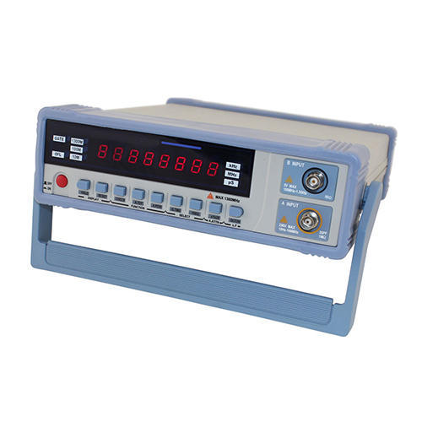
CHECKING THE CALIBRATION OF PURETONE AUDIOMETERS
FREQUENCY CHECK
The frequency output from the audiometer should be checked by using an electronic frequency counter. This instrument will tell the exact frequency of the output signal.
The electrical output from the audiometer may be routed directly to the instrument (i.e., unplug the earphone, then plug in the frequency counter input to the audiometer output) because the frequency is determined by an oscillator in the audiometer rather than the transducer.
By using an electronic frequency counter, one can easily determine if the output from the audiometer corresponds to the nominal frequency.

Slide 13
CONT…
The standard for audiometers allows a tolerance of ±1% of the indicated frequency value for Type 1 and 2 audiometers; ±2% for Type 3 and 4 audiometers.
For example, if the audiometer dial reads 1,000 Hz, then the actual output must be between 990 and 1,010 Hz for a standard diagnostic Type 1 audiometer.
Frequency should be checked on initial receipt of the audiometer and at yearly intervals thereafter. Nevertheless, it is appropriate to listen to the audiometer each day to judge whether the frequencies are maintaining reasonably good accuracy.

Slide 14
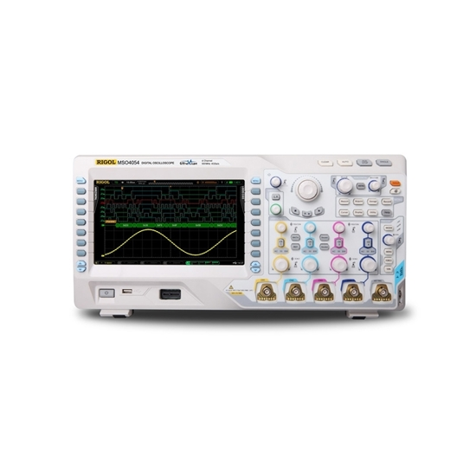
RISE-FALL TIME
The rise–fall time of the tone is a basic parameter of the audiometer, which may be checked by taking the output directly from the audiometer and routing it into a digital or storage oscilloscope.
When gating the signal on, rise time is the length of time it takes for the signal to increase from 20 to 1 dB (10% to 90%) of its ﬁnal steady-state value.
The fall time is the length of time between 1 and 20 dB (90% to 10%) relative to its steady-state value. This is usually checked at a hearing level of 60 dB HL or less. ANSI S3.6-2010 speciﬁes a rise time as well as a fall time of not less than 20 m/s and not more than 200 m/s.

Slide 15
LINEARITY CHECK
Attenuator linearity (the hearing level dial) may be checked electrically, directly from the audiometer, or acoustically through its transducer (earphone or bone vibrator).
If measurements are to be made electrically, the earphone should remain in the circuit and the voltage should be measured in parallel to the earphone, or a dummy load that approximates the earphone impedance should replace the transducer.
To check linearity, the audiometer should be turned to its maximum output and then attenuated in 5-dB steps until the output can no longer be read. Each attenuator on the audiometer should be checked separately.

Slide 16
CONT…
To meet the ANSI standard, the attenuator should be linear within 0.3 of the interval step or by 1 dB, whichever is smaller.
That is, if you change the level in 5-dB steps, the audiometer must attenuate between 4 and 6 dB per step. If the attenuation step is 2 dB, then the reading should be between 1.4 and 2.6 dB per step (0.3 × 2 dB = 0.6 dB, which is less than 1 dB).
If the audiometer attenuates in 1 or 2 dB steps, then these smaller attenuation steps should be checked if they are used clinically

Slide 17
THANK YOU

