Slide 1

CONFIGURATION OF AUDIOGRAM

Slide 2
INTRODUCTION
Audiometric Threshold are displayed in tabular or graphical formats.
The tabular format is useful for recording the results of serial monitoring of thresholds, as in a hearing conservation program, but in many applications, thresholds are plotted on an audiogram.
Although other formats for plotting audiograms are acceptable, it is helpful to use a standardized format for ease of interpretation across clinics. The audiogram must be consistent with that recommended in the ASHA guidelines.

Slide 3
IMPORTANCE OF CONFIGURATION
One important factor, Audiograms can also be described by the hearing-loss configuration. The configuration takes into account the shape of the hearing loss.
A description of the configuration of the loss helps in summarizing the loss to patients and to other professionals and often provides insight into the etiology or cause of the loss.
An audiogram is summarized verbally by the degree, type, and configuration of the hearing loss for both ears.

Slide 4
TYPES OF CONFIGURATIONS CRITERIA
1. Flat
2. Gradually falling
3. Sharply falling
4. Precipitously falling
5. Rising
6. Peaked or saucer
7. Trough
8. Notched

Slide 5
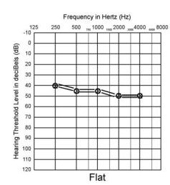
1. Flat Configuration
We can configure an Audiogram as in Flat Configuration when <5 dB rise or fall per octave is seen.

Slide 6
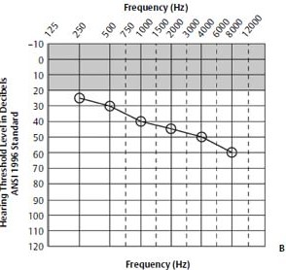
2. Gradually Falling Configuration
This configuration can be seen if 5–12 dB increase per octave is observed in the Audiogram.

Slide 7
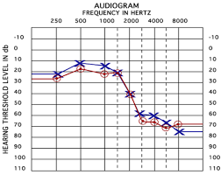
3. Sharply Falling Configuration
If a 15–20 dB increase per octave is seen in an Audiogram, this configuration can be estimated.

Slide 8
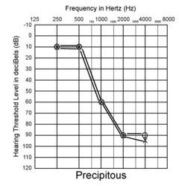
4. Precipitously Falling Configuration
A Precipitously falling curve can be determined when an Audiogram has Flat or gradually sloping, then threshold increasing at 25 dB or more per octave.

Slide 9
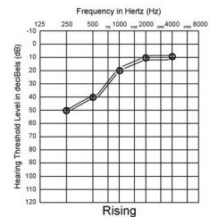
5. Rising Configuration
In this criteria of configuration, if >5 dB decrease in threshold per octave is observed in an audiogram, we state it as Rising Configuration.

Slide 10
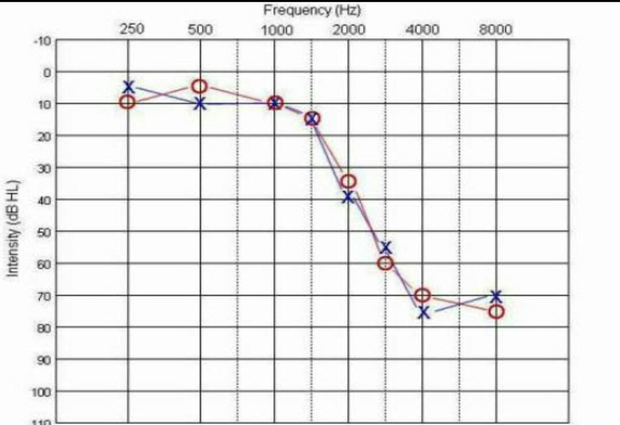
6. Peaked Configuration
If 20 dB or greater loss at the extreme frequencies, but not at the mid frequencies is seen, it is known as Peaked Configuration.

Slide 11
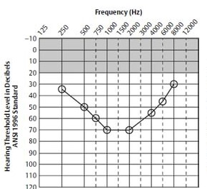
7. Trough Configuration
A Trough Configuration is observed when 20 dB or greater loss in the mid frequencies (1,000–2,000 Hz), but not at the extreme frequencies (500 or 4,000 Hz) is present in Audiogram.

Slide 12
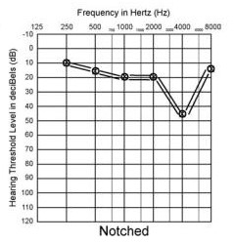
8. Notch Configuration
When 20 dB or greater loss at one frequency with complete or near-complete recovery at adjacent octave frequencies is observed, this criteria of configuration is called Notch Configuration.

Slide 13
THANK YOU

