Slide 1
Tuning fork tests

Slide 2
TUNING FORK
Tuning fork is a small metal instrument consisting of a stem, two prongs and one foot piece that produces a constant pitch when held against a firm surface.
The preferred tuning fork, by Audiologists, is a 512Hz tuning fork. At this frequency the tone does not fade too quickly, producing limited overtones and is not vibrotactile in comparison to the 256Hz and 1024 Hz tuning forks.

Slide 3
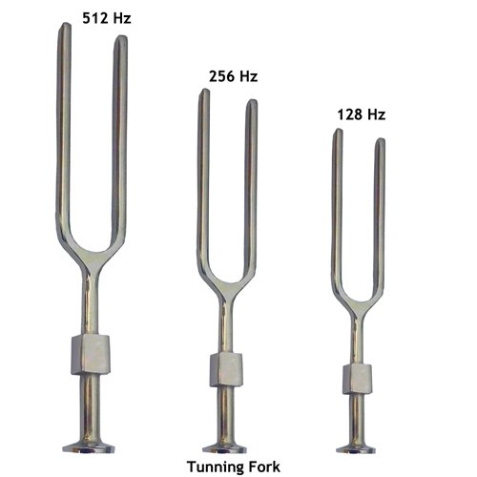
TUNING FORK

Slide 4
TYPES OF TUNING FORK TESTS
Schwabach Test
Weber Test
Bing Test
Rinne Test

Slide 5
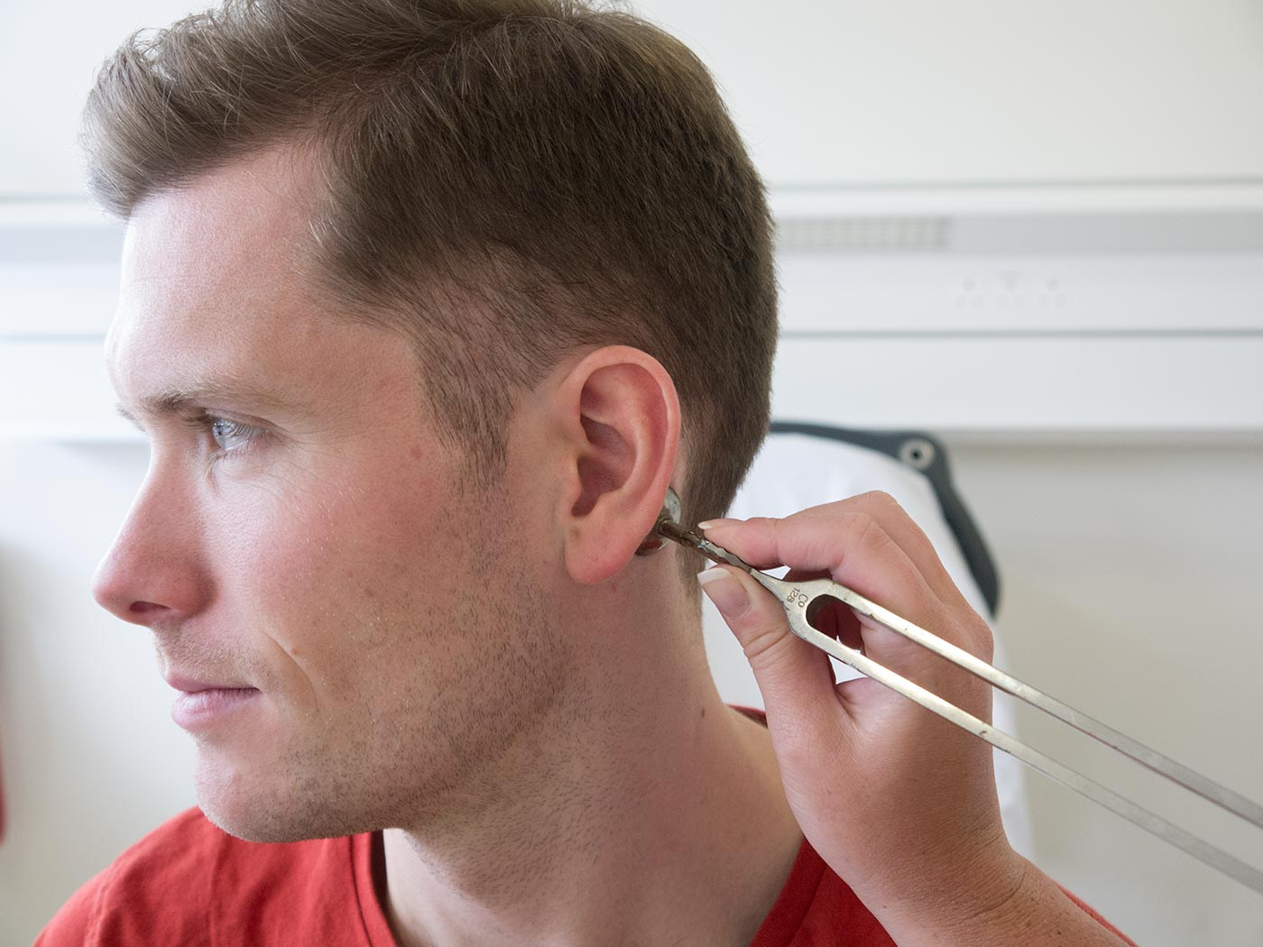
SCHWABACH TEST
In Schwabach's Test for hearing, the patient's bone conduction is compared with that of the examiner (presuming that the examiner's hearing is normal)

Slide 6
PROCEDURE AND INTERPRETATION
Procedure
A vibrating tuning fork is placed on the mastoid process of the patient. Once the patient signals that he/she can no longer hear the sound (i.e., the sound fades completely), the examiner places the tuning fork on his/her mastoid process and repeats the same.

Slide 7
CONT..
Interpretation
a) Normal Schwabach - If the examiner and patient hears the sound equally well, then the patient's hearing is normal.
b) Prolonged Schwabach - If the bone conduction of the patient is better than the examiner (i.e., patient can hear the sound for a longer period due to the absence of masking effect of environmental noise), patient is suffering from conductive deafness.
c) Diminished Schwabach - If the bone conduction of the patient is worse compared to the examiner (ie, patient stops hearing the sound sooner than the examiner), patient is suffering from sensorineural deafness.

Slide 8
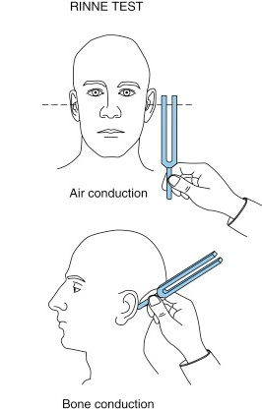
RINNE TEST
This test is a comparison of loudness of perceived air conduction to bone conduction in one ear at a time.

Slide 9
PROCEDURE AND INTERPRETATIONS
Procedure
The practitioner should start with the ear where the Weber has lateralized to (if appropriate). Strike the tuning fork and hold the tines of the tuning fork approximately 25mm from the ear canal entrance. The vibrating fork should be held parallel to the acoustic axis .
The orientation of the tuning fork is critical so ensure the acoustic axis is pointing towards the ear canal. Hold the tuning fork there for about 2 seconds. Without any interruption and without touching the tines press the footplate firmly against the mastoid (without any hair getting between the footplate and the mastoid).
Place your other hand gently, but firmly on the opposite side of the patients head to ensure enough counter-pressure is applied. Hold the tuning fork in place for another 2 seconds.

Slide 10
CONT..
Response
After giving the patient listening time, ask them whether the tone is louder next to the ear or behind the ear. The patient should respond verbally.
Children may choose to point to the ear rather than giving a verbal response.

Slide 11
CONT…
Interpretation
1. If air conduction (next to the ear canal) is louder, this is a Rinne positive result, indicating either normal hearing or a sensorineural hearing loss
2. If bone conduction (held on mastoid) is louder, this is a Rinne negative result, indicating a significant conductive element to the hearing loss,
The Rinne test is able to distinguish a conductive hearing loss with an air-bone gap of 17.5 dB - 30 dB. It therefore has limited utility in detecting mild conductive hearing losses or mixed hearing losses where there is an air-bone gap of less than 17.5dB.

Slide 12
CONT…
The tester should be aware that the Rinne test can result in a False Rinne Negative. This occurs when the bone conduction transmits through the skull to the opposite ear and is detected through cross hearing by the better cochlea (in the non-test ear).
This mostly happens with severe sensorineural loss predominantly on the test side. It can be distinguished through considering if the Weber test result is contradictory and through asking the patient which ear the bone conduction part of the test was heard in.

Slide 13
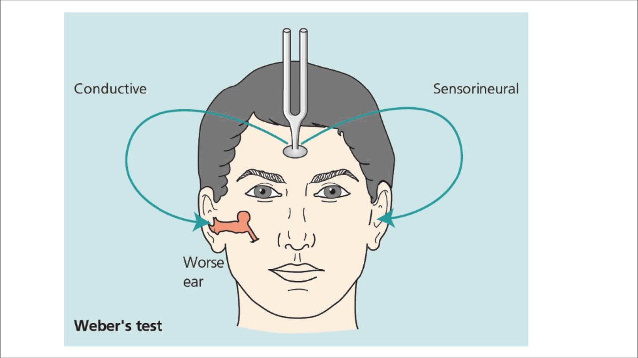
WEBER TEST
The Weber test is a test of lateralization and establishes where a tone is perceived.

Slide 14
PROCEDURE AND INTERPRETATIONS
Procedure
Strike the tuning fork and place it on the midline, typically on the patient’s forehead, (but it can also go on the vertex, bridge of the nose or chin).
Place your other hand gently, but firmly on the back of the patients head to ensure enough counter-pressure is applied. Hold the tuning fork in place for up to 4 seconds.

Slide 15
CONT…
Response
After giving the patient listening time ask them where the tone is heard: is it in both ears / centrally / in the head or towards the left or right.
Children may choose to point to the ear rather than giving a verbal response.

Slide 16
CONT…
Interpretation
1. With symmetrical hearing or a symmetrical hearing loss the sound should be central.
2. With an asymmetrical sensorineural loss the sound should be heard in the better ear.
3. With an asymmetrical conductive hearing loss the sound should be heard in the poorer ear.

Slide 17
CONT…
The Weber test can determine a difference of 5 decibels between each ear in terms of bone conduction thresholds at the frequency being tested.
This test can be complicated by the presence of a unilateral or asymmetrical conductive hearing loss, where the tone can be heard on the conductive side or the side with the greater conductive loss. Interpretation of the Weber test in isolation can be prone to error.

Slide 18

BING TEST
For some time it has been known that when persons with normal hearing close off the opening into the ear canal, the loudness of a tone presented by bone conduction increases.
This phenomenon has been called the occlusion effect. This is the premise of the Bing test.

Slide 19
PROCEDURE AND INTERPRETATION
Procedure
The tuning fork handle is held to the mastoid process behind the ear while the examiner alternately closes and opens the ear canal with a finger.
Response
The patient is suppose to answer verbally, if the sound given is increased and softer, or there is no change in the loudness of the sound.

Slide 20
CONT…
Interpretation
Normal hearing or a patient with sensorineural hearing loss, would hear the sound getting louder and softer (Positive Bing).
A patient with conductive hearing loss, would not notice any changes in the given sound, and would hear the same loudness (Negative Bing).

Slide 21


