Slide 1
ROLE OF CLINICIAN AND PATIENT IN SPEECH AUDIOMETRY

Slide 2
CONTEXT…….
WHAT IS SPEECH AUDIOMETRY ?
NEED OF SPEECH AUDIOMETRY ?
WHAT IS ROLE OF CLINICIAN IN SPEECH AUDIOMETRY ?
WHAT IS ROLE OF PATIENT IN SPEECH AUDIOMETRY ?

Slide 3
SPEECH AUDIOMETRY
Pure tone Audiometry provides only a partial picture of the patients auditory sensitivity. Because it doesn't give any information about its ability to hear and understand speech. To find out the persons ability to hear and understand speech. We do this testing with speech stimulus and this process is called SPEECH AUDIOMETRY.
The instrument use for speech Audiometry is called SPEECH AUDIOMETER.

Slide 4
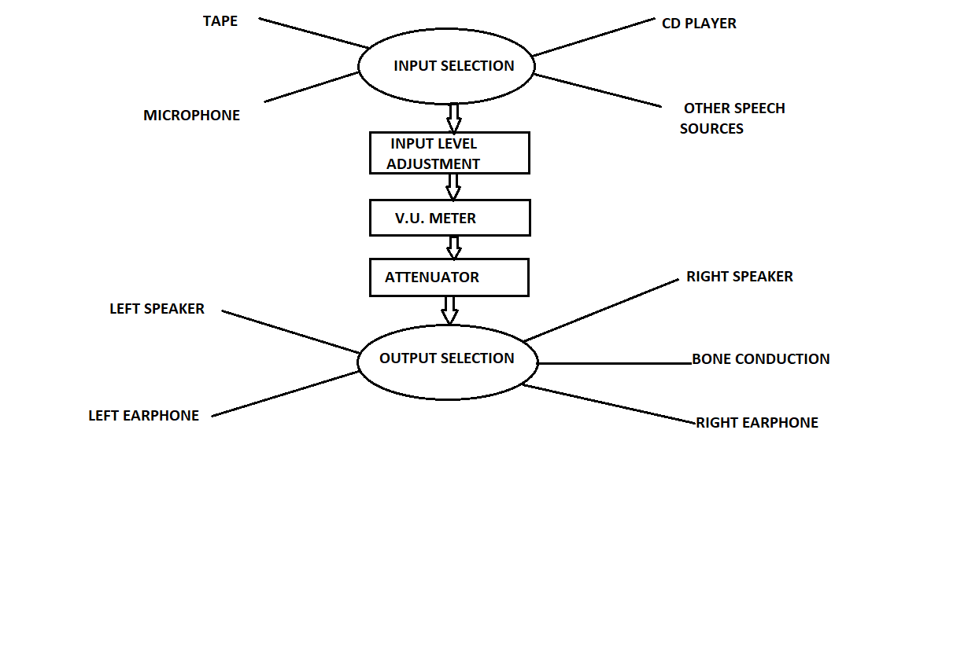
COMPONENTS WHICH ARE REQUIRED FOR THE SPEECH AUDIOMETRY

Slide 5
Input Selection : To select the desired source of speech material Tape, deck, CD player = For recorded speech.
Microphone = For live voice.
Input level control : Which is used with the V-U (Volume Unit) meter to ensure that the speech signal are of at the level necessary for them to being properly calibrated.
Attenuation : To control the level of speech being presented to the patient.
Output selector : Through which mode you want to present the speech signal to the patient.

Slide 6
NEED FOR SPEECH AUDIOMETRY
The PTA doesn't talk about the communication ability of the person. Communication ability of two persons are not same. Thus speech Audiometry helps in different aspects such as :
To cross-check the pure tone threshold.
To find out the type of hearing loss
To find out the degree of hearing loss
Help in hearing aid selection
Help in identifying functional hearing loss
Helps in identifying the site of lesion.

Slide 7
. Advantages of speech Audiometry :
It require less time than PTA.
More validity ( Sp.Stimulus > Non ñ Sp.Stimulus )
It tells about the communication ability of the individual.

Slide 8
ROLE OF CLINICIAN’S IN SPEECH AUDIOMETRY
First and foremost in speech Audiometry, through whatever means necessary, the audiologist must convey to patients what is expected of them during the session. A combination of written and verbal instructions is usually successful with adults and older children, whereas gestures and pantomime may be required for small children and certain adults. At times, the instructions are given to patients through their hearing aids or, if this is not feasible, through a portable amplifier or the microphone circuit of the audiometer.

Slide 9
It is just as important that the patient not observe the examiner’s face during speech Audiometry as it is during pure-tone Audiometry, and even more so if monitored live-voice testing is used.

Slide 10
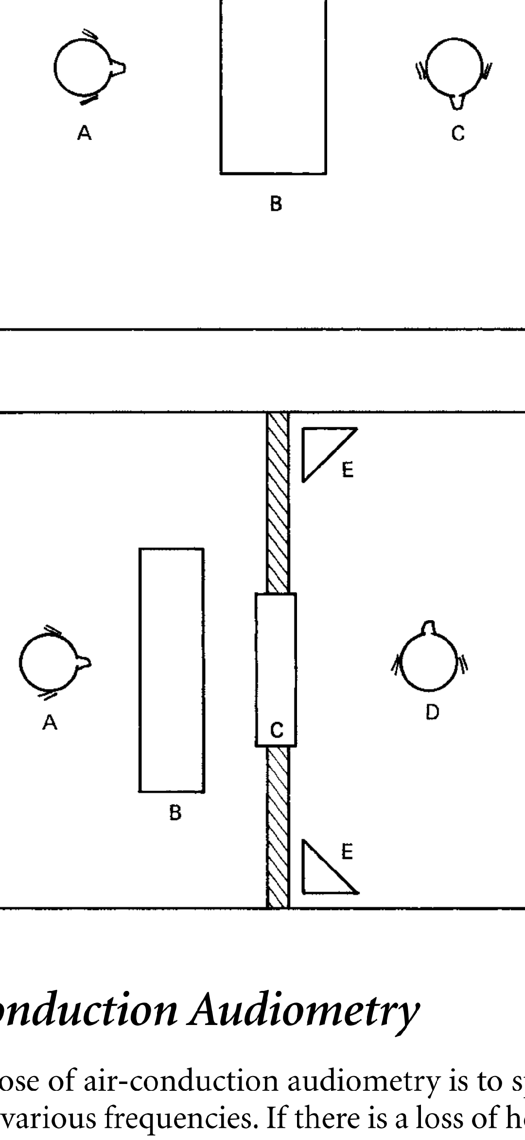
TWO ROOM SUITE FOR SPEECH AUDIOMETRY
A= Examiner
B= Audiometer
C= Window separating rooms.
D= Patient
E= Loudspeakers

Slide 11
The Patient’s Role in Speech Audiometry
To use speech Audiometry, patients must know and understand reasonably well the words with which they are to be tested. Depending on the type of test, a response must be obtainable in the form of an oral reply, a written reply, or the identification of a picture or object.
Although spoken responses are more necessary in some speech tests than in others, they have certain advantages and disadvantages. One advantage is in the speed with which answers can be scored. Also, a certain amount of rapport is maintained through the verbal interplay between the patient and the audiologist.

Slide 12
The use of pictures or objects is generally reserved for small children, who otherwise cannot or will not participate in a test. Adults with special problems are sometimes tested by this method, in which the patient is instructed to point to a picture or object that matches a stimulus word.

Slide 13
FALSE NEGATIVE /POSITIVE RESPONSE
False responses may occur in speech Audiometry, as well as in pure-tone Audiometry.
False positive responses are theoretically impossible, because patients cannot correctly repeat words or sentences that have been presented to them below their thresholds, unless, through the carelessness of the examiner, they have been allowed some visual cues and have actually lip-read the stimulus words.
False negative responses, however, do occur. The audiologist must try to make certain that the patient completely understands the task and will respond in the appropriate manner whenever possible.

Slide 14
THANK Q
THANK Q

