Slide 1

CHRONIC PERIODONTITIS
Dr. Prasad Nadig

Slide 2
CONTENTS
Introduction
Definition
Clinical features
- General characteristics
- Symptoms
- Disease distribution
- Disease severity
- Disease progression
- Prevalence

Slide 3
Risk factors
# Prior history
- Local factors
- Systemic factors
- Environmental and Behavioral factors
- Genetic factors

Slide 4
INTRODUCTION
Formerly known as “ ADULT PERIODONTITIS ” or “ CHRONIC ADULT PERIODONTITIS”
generally considered -Slowly progressing disease
As it also occur in children and adolescents in response to plaque and calculus, this is the reason it is no more termed as adult periodontitis

Slide 5
DEFINITION
“ An infectious disease resulting in inflammation within the supporting tissues of the teeth, progressive attachment loss and bone loss”
-Batista, 1999

Slide 6
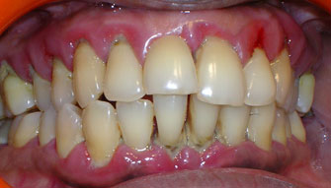
CLINICAL FEATURES
GENERAL CHARACTERSTICS
Supra-gingival and sub-gingival
plaque accumulation
Gingival inflammation
Pocket formation
Loss of periodontal attachment
Loss of alveolar bone
Gingiva – slightly to moderately swollen
- color change ranges from pale red to magenta
-Loss of gingival stippling
-Blunted or rolled gingival margins and flattened or
cratered papillae.

Slide 7
In those cases where regular home care measures are performed,
-All the signs of inflammation may not always be present.
- Only sign may be bleeding on probing the pocket- either spontaneous or in response to probing.

Slide 8
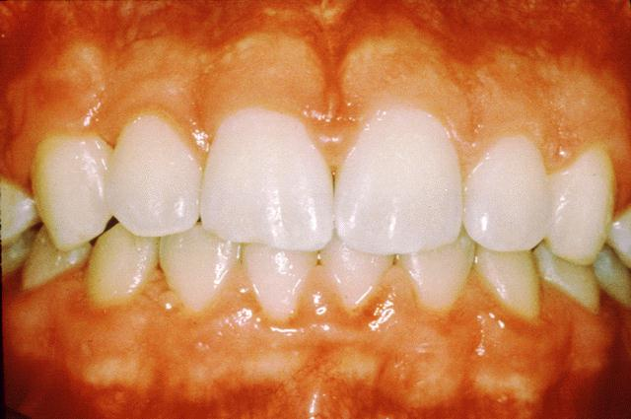
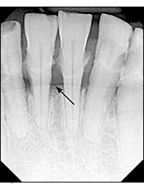
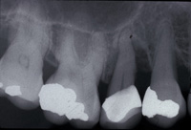
In long standing cases,
-Signs of inflammation may be masked because of the fibrotic changes.
-Horizontal and vertical bone loss.
-Progressive increase in the mobility of the teeth involved.

Slide 9
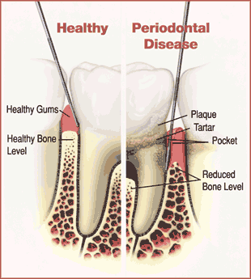
Can be clinically diagnosed by:
Detection of chronic inflammatory changes in the marginal gingiva
Presence of periodontal pockets
Loss of clinical attachment.
Radiographically by:
evidence of bone loss

Slide 10
Differntial diagnosis: AGGRESSIVE PERIODONTITITS
Differential diagnosis is based on:
Age of the patient
Rate of disease progression over time
Familial nature of the disease
Relative absence of local factors in aggressive disease compared with the presence of abundant plaque and calculus in chronic form.

Slide 11
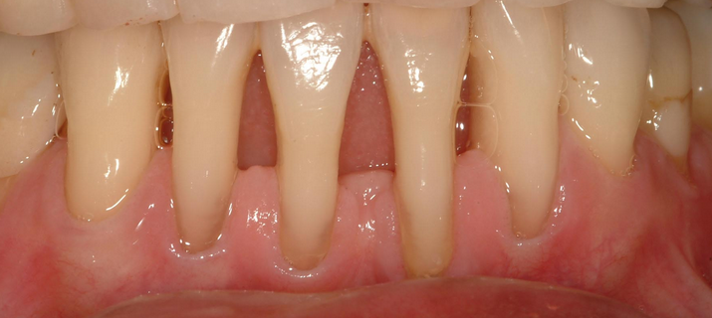
SYMPTOMS
Bleeding of gums when brushing or eating
Spaces between the teeth as a result of tooth movement or teeth become loose
It occurs because usually painless –patient are unaware that they have the disease and less likely to seek treatment
Sometimes localized dull pain, radiating deep into the jaw . Sensitivity to hot and cold or both due to root exposure
Areas of food impaction cause discomfort
Itchiness in gingiva

Slide 12
DISEASE DISTRIBUTION
Chronic periodontitis : Site specific
i.e. Present only at the sites where there is plaque and calculus.
Can be localized or generalized

Slide 13
LOCALIZED PERIODONTITIS
when less than 30% of sites assessed in mouth demonstrate attachment loss and bone loss.
GENERALIZED PERIODONTITIS
when 30%or more of the sites assessed in the mouth demonstrate attachment loss and bone loss.

Slide 14
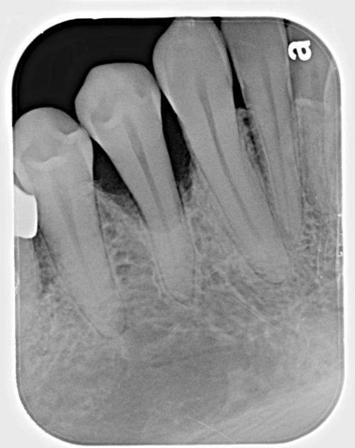
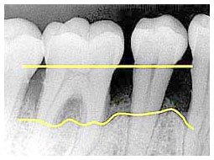
Patterns of bone loss observed:
1. VERTICAL: when attachment and bone loss on one tooth surface is greater than that on an adjacent surface.
-associated with angular bony defects and intrabony pocket formation.
2. HORIZONTAL: when attachment and bone loss precedes at a uniform rate on the majority of the tooth surfaces.
- associated with suprabony pockets.

Slide 15
DISEASE SEVERITY
The terms describing the disease severity of disease : The entire mouth or a part of the mouth, such quadrant or sextant are as follows:
1.Slight (mild ) periodontitis : Periodontal destruction not more than 1 - 2 mm of clinical attachment loss .
2. Moderate periodontitis : 3 – 4 mm of clinical attachment loss .
3. Severe periodontitis : 5 mm or more clinical attachment loss.

Slide 16
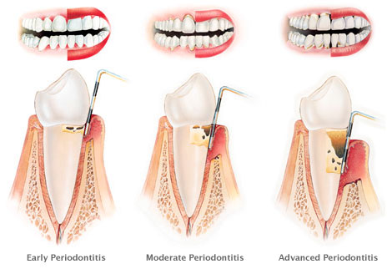

Slide 17
DISEASE PROGRESSION
Slow rate but may be modified by systemic and / or environmental and behavioral factors
Onset can occur any time in the presence of plaque and calculus . Usually becomes more evident in the mid - 30s therefore has accumulative effect
Does not progress at an equal rate in all affected sites . Some areas may remain static . More rapid progress in inter-dental areas

Slide 18
PREVALENCE
Increases with age - age associated disease.
Affects both genders equally .

Slide 19
RISK FACTORS
PRIOR HISTORY
Not a true risk factor but rather a disease predictor
Prior history of periodontitis puts the patient at greater risk for developing further loss
Patient has to take more care for maintenance of oral hygiene and regular scaling and root planing
Proper monitoring required
The following risk factors contribute to patient’s susceptibility to disease:

Slide 20
1.LOCAL FACTORS
Plaque accumulation on tooth and gingival surfaces is considered primary etiologic agent
Increase in the proportion of gram negative organisms in the sub-gingival plaque biofilm like Bacteroides gingivalis, Bacteroides forsythus, and Treponema denticola – forming the RED COMPLEX
These microorganisms are associated with attachment and bone loss in chronic periodontitis as they impart a local effect on : 1.The cells of inflammatory response. 2. Cells and tissues of the host - resulting in a local site specific disease process .

Slide 21
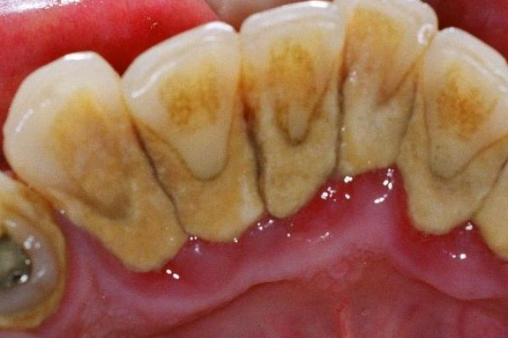
PLAQUE RETENTIVE FACTORS :
- Important in the development and progression of periodontitis .
They retain plaque microorganisms in close proximity to the periodontal tissues providing an ecologic niche for plaque growth and maturation .
Calculus is the most important
plaque retentive factor because of
its ability to retain and harbor
plaque of chronic bacteria on its
rough surface .

Slide 22
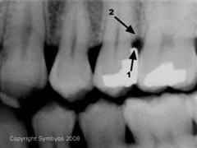
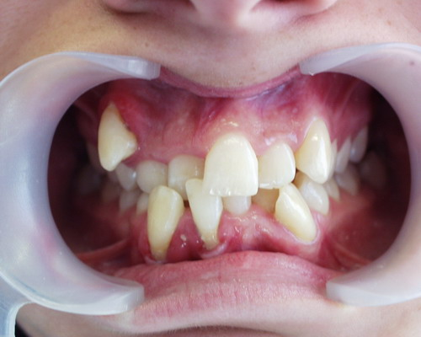
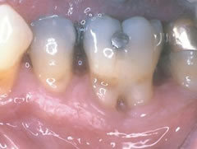
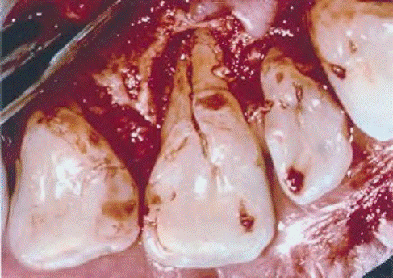
Other factors that retain plaque or prevent its removal are :
Subgingival and / or overhanging
margins of restorations
Furcations exposed by loss of attachment and bone
Crowded or malaligned teeth
Root grooves and concavities

Slide 23
2. SYSTEMIC FACTORS
The rate of periodontal destruction is increased in patient suffering from systemic disease
Diabetes is a systemic condition that increase the severity and extent of periodontal disease in an affected patient
Type 1 or Insulin dependent diabetes mellitus ( IDDM ) is observed in children, teenagers, and young adults may lead to increased periodontal destruction when it is uncontrolled

Slide 24
Other systemic diseases affecting chronic periodontitis:
Blood diseases- Leukemia, Anemia, Thrombocytopenia, Leukocyte disorders.
Female sex hormones- at puberty, menstrual cycle, pregnancy and menopause.
Nutritional deficiencies-Vitamin B complex, Vit. D, Vit. C, etc.
Stress and many others.

Slide 25
3. ENVIRONMENTAL & BEHAVIOURAL FACTORS
Smoking increase the severity and extent of periodontal disease
Smokers with chronic periodontitis have : More attachment and bone loss, more furcation involvements, Deeper pockets
Smokers form more supra-gingival and less sub-gingival calculus
They demonstrate less bleeding on probing than nonsmokers

Slide 26
4. GENTIC FACTORS
Periodontal destruction seen among family members and across different generations within family. E.g. a familial aggregation of localized and generalized aggressive periodontitis.
Studies of monozygotic twins suggest a genetic component to chronic periodontitis .
More aggressive periodontal breakdown in response to plaque and calculus accumulation may exist .
Genetic variation or polymorphism in the genes encoding interleukin 1α and interleukin 1β are associated with an increased susceptibility to a more aggressive form of chronic periodontitis.
Heavy smokers and IL- 1 genotype increase risk of tooth loss by 2.9 times . The combined effect of IL- 1genotype and smoking increased the risk of tooth loss by 7.7 times .

Slide 27

THANK YOU

