Slide 1

MINOR PERIODONTAL SURGERIES
Dr. Ekta Shah
Dept. of Periodontology

Slide 2
FRENECTOMY
FRENOTOMY
CROWN LENTHENING

Slide 3
FRENECTOMY
Frena / Frenum / Frenulum is a fold of mucous membrane, which attaches the lips and cheek to the alveolar mucosa and / or gingiva and periosteum.
Anatomy:
Mostly sickle shaped and normally found in the maxillary and mandibular alveolar mucosa, in between the central incisors and the canine-premolar area.
It can be:
Single / multiple
Labial / buccal / lingual

Slide 4
Placek et al (1974) gave a morphologic-functional classification of labial frenal attachments:
Mucosal attachment: refers to an attachment of the frenum to the mucogingival junction. About 1.4% in maxillary frena and 14% in mandibular frenae
Gingival attachment: refers to an attachment of the frenum within the attached gingiva. Most common and the incidence is about 80%.
Papillary attachment: refers to the attachment of the frenum within the papilla. The incidence is about 16%.
Papilla-penetrating attachment: refers to the attachment of the frenum passing through the papilla while inserting into attached gingiva (of the palate). This is rare and the incidence in the maxillary and mandibular frenae is about 2%.

Slide 5
An aberrant frenum can:
Create spacing between teeth. eg. midline diastema in central incisors.
Lead to poor oral hygiene due to difficulty in toothbrushing and maintenance in the area.
Create distension of the orifice of the sulcus leading to an area of debris and/or food impaction.
Recession of marginal gingiva.
Resultant inflammation and periodontal destruction. (Hirshfield 1939)
Increase the severity of the pocket, impairing healing.

Slide 6
Frenectomy and Frenotomy
Frenectomy is the excision of the frenum, including its attachments to the underlying bone.
Frenotomy is the incision of the frenum.
Both procedures are used, but Frenotomy generally suffices for periodontal purposes- that is, relocating the frenal attachment so as to create a zone of attached gingiva between the gingival margin and the frenum.

Slide 7
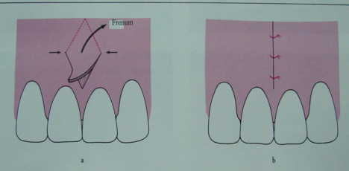
V-Rhomboid plasty

Slide 8
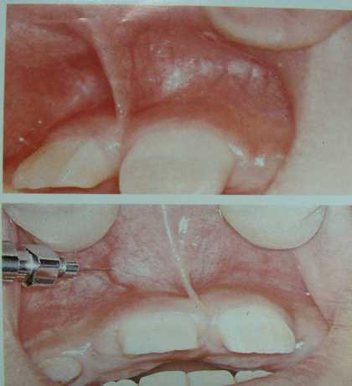
V-Rhomboid plasty

Slide 9
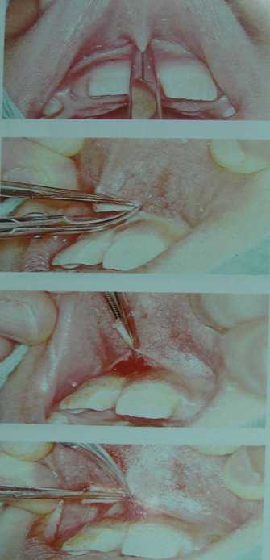

Slide 11
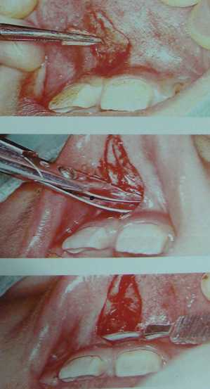
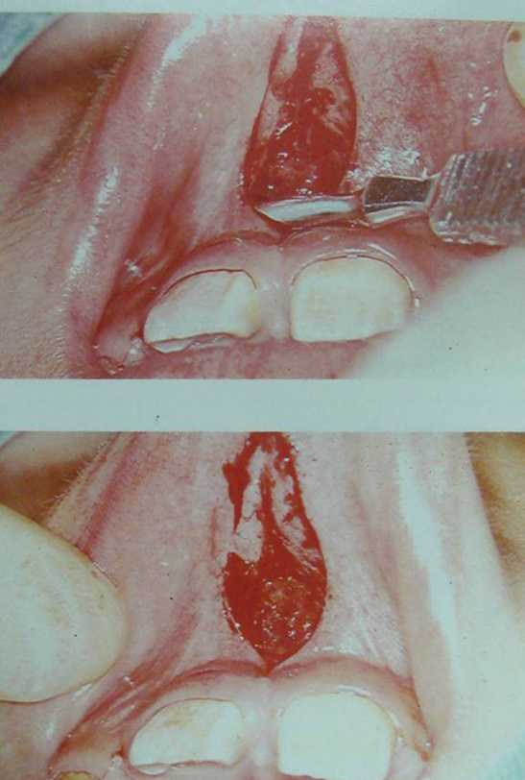

Slide 12
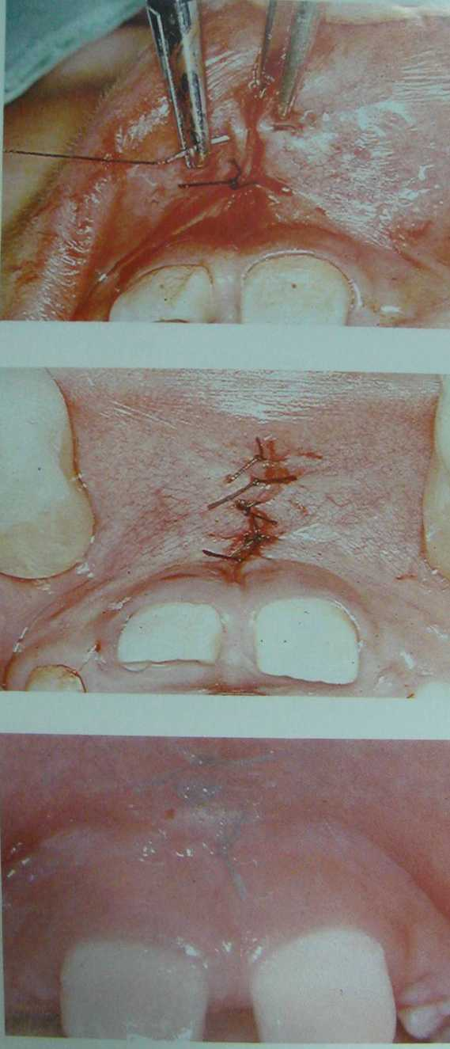

Slide 13
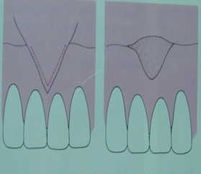
Frenotomy

Slide 14
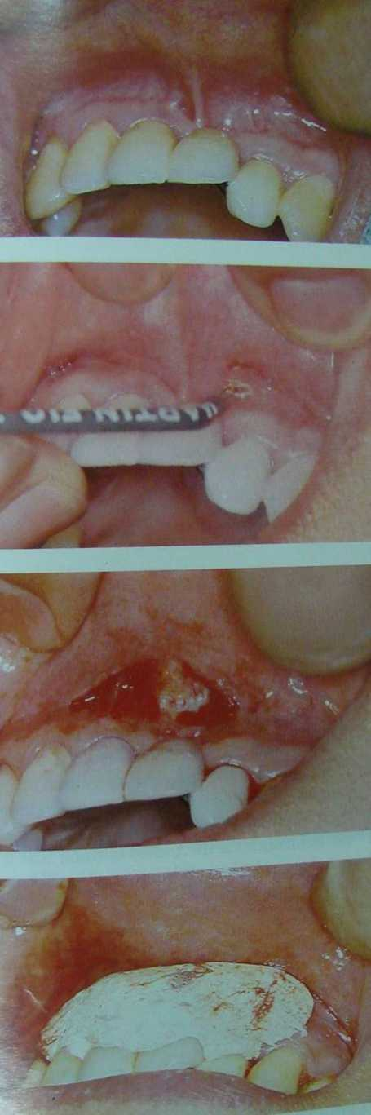
Frenotomy

Slide 15
Crown Lengthening
The Surgical Procedure to expose adequate clinical crown to prevent placement of the crown margin into the area of biologic width.
Atleast 3 mm. between the most apical extension of the restorative margin and alveolar bone.
Source :- Carranza 9th Edi.

Slide 16
Indications
1.) Reduced clinical crowns which can be caused due to :-
Subgingival or subcrestal root fracture
Perforations of the root at the coronal third
Caries with subgingival extension
Excessive wear of the dentition
Presence of previous subgingival margins of restorations
Source :- Hughes – Compendium 1996

Slide 17
Indications
To correct violation of biologic width
( Kois – J. Esthet. Dent. 1994)
Esthetic Reasons
Short teeth
Excessive wear
Uneven gingival contours
Gummy smile ( Minsk – Compendium 2001)
To Gain additional tooth structures to meet the mechanical needs of the restorative procedures

Slide 18
Contraindications
Deep carious lesions or fractures that are non restorable
Unfavorable crown to root ratio due to short roots or reduced bone support
When there is risk of furcation exposure
High Smile line
Anterior teeth with long clinical crowns

Slide 19
Biologic Width
Term Coined by Cohen in 1962
Based on work of Gargiulo et al in 1961

Slide 20
DEFINITION
Carranza, 9th edition :-
“ The dimensions of space that the healthy gingival tissues occupy above the alveolar bone.”

Slide 21
DEFINITION
Gargiulo et al in 1961,
“ Biologic width is the combined width of connective tissue and epithelial attachment superior to the crestal bone.”

Slide 22
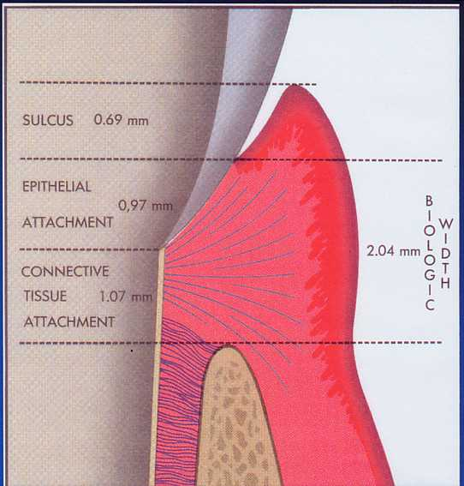

Slide 23
Cohen in 1962
Gave the term Biologic Width
Junctional Epithelium – 0.97 mm.
Connective tissue attachment - 1.07 mm.
Hence Average Biologic Width -
0.97 + 1.07 = 2.04 mm.

Slide 24
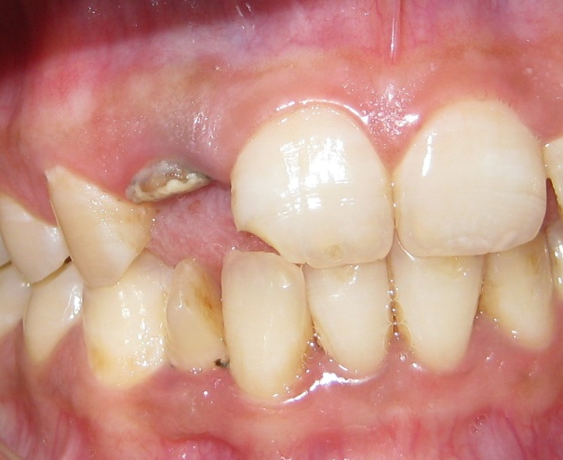
SURGICAL APPROCH

Slide 25
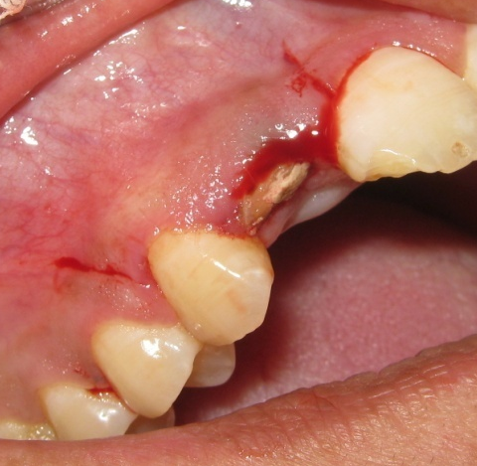
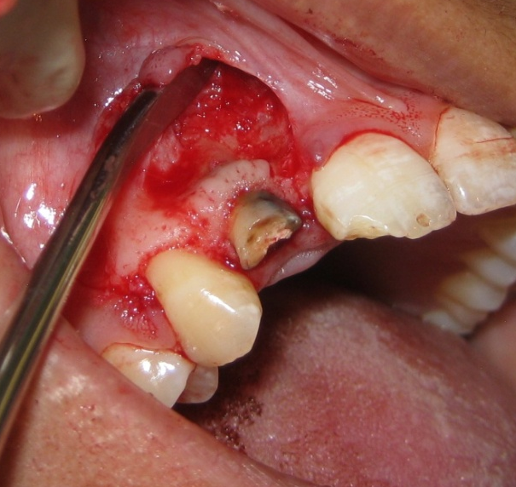
SURGICAL APPROCH
A
B

Slide 26
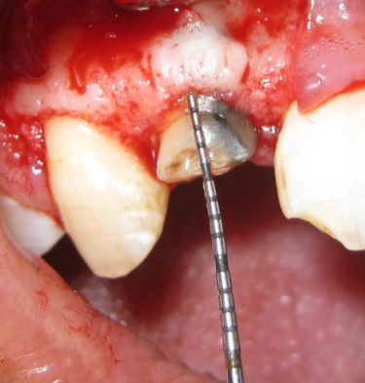
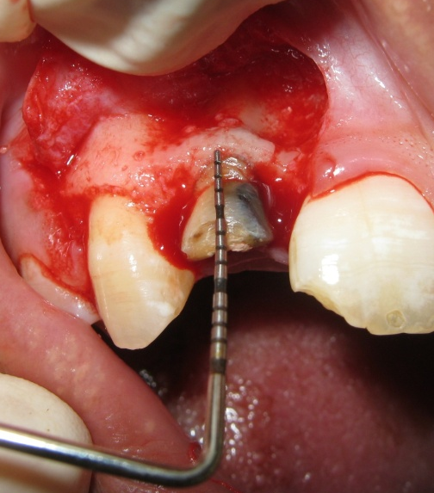
SURGICAL APPROCH
C
D

Slide 27
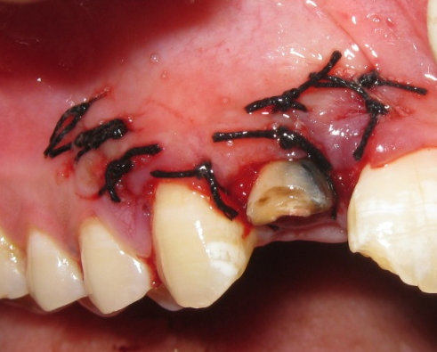
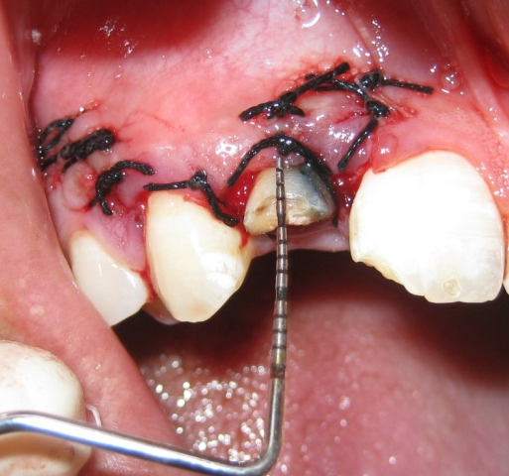
SURGICAL APPROCH
E
F

Slide 28
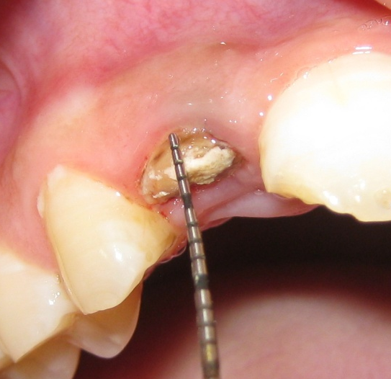
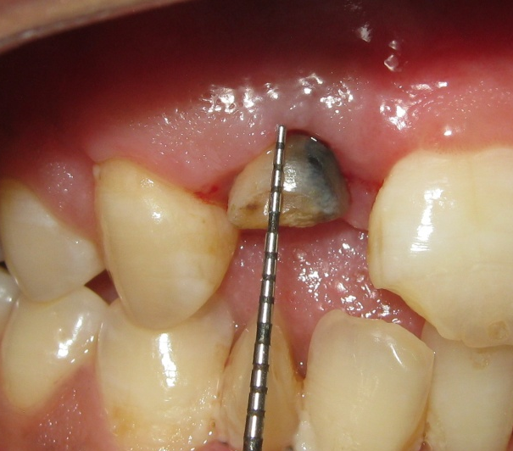
PRE-OPERATIVE
POST-OPERATIVE

Slide 29
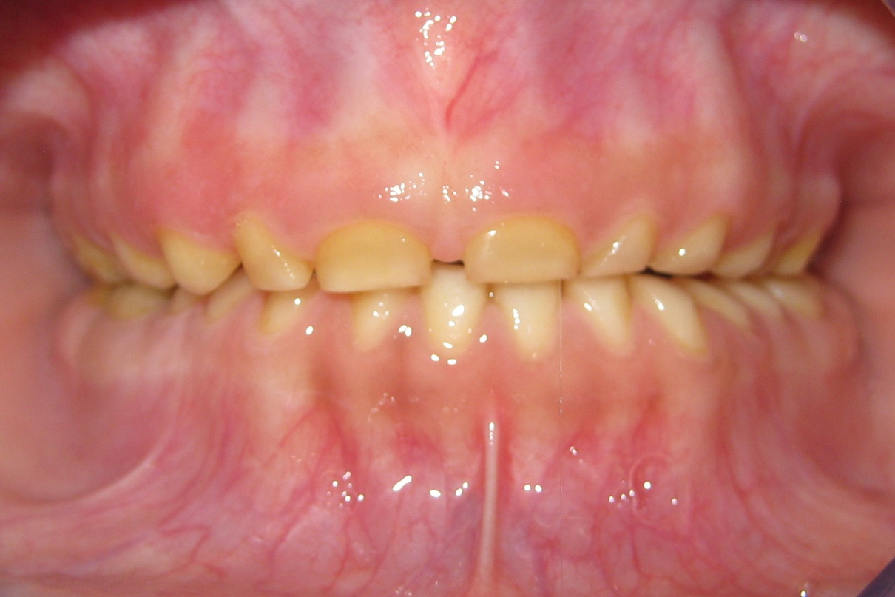
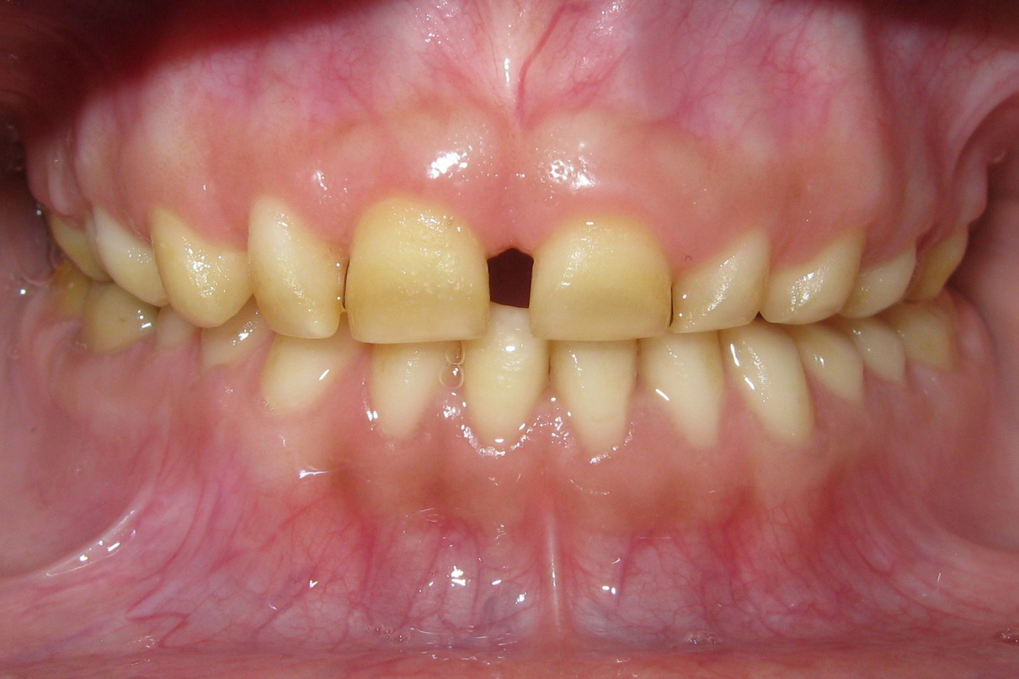

Slide 30
THANK YOU…

