Slide 1
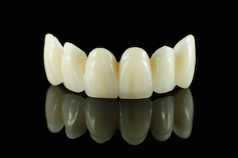

Principles of tooth Preparation -Esthetic

Slide 2
PRINCIPLES OF TOOTH PREPARATION
(According to Rosenstiel)
BIOLOGIC
Conservation of tooth structure
Avoidance of over contouring
Supra gingival margins
Harmonious occlusion
Protection against tooth fracture
MECHANICAL
Retention form
Resistance form
Deformation
ESTHETIC
Minimum display of metal
Maximum thickness of porcelain
Porcelain occlusal surfaces
Subgingival margins
Optimal restoration

Slide 3
Learning objectives
Factors affecting aesthetics in full ceramic restorations
Factors affecting aesthetics in Metal ceramic restorations
Factors affecting aesthetics in Partial coverage restorations

Slide 4
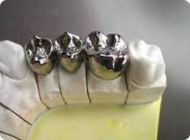
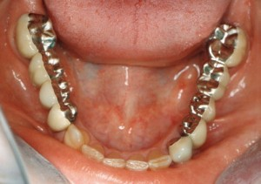
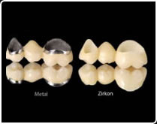
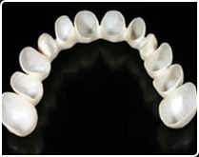

Slide 5
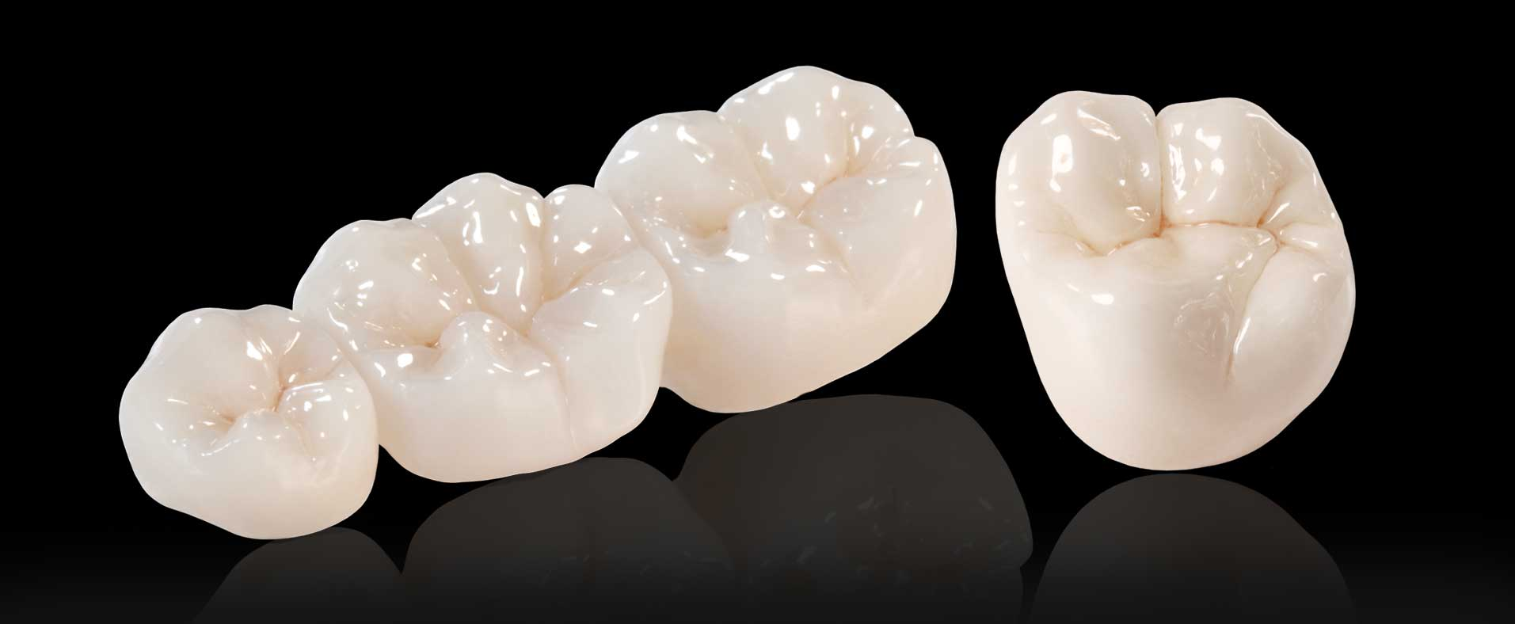
Esthetic Consideration
Affects appearance of the patient

Slide 6

Esthetic Consideration- patients

Slide 7
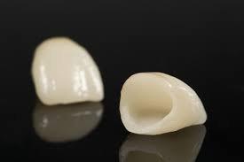
Esthetic Consideration
All ceramic restoration
One of the most pleasing esthetic restoration is all ceramic restoration.

Slide 8
Scope of All-Ceramic

Slide 9
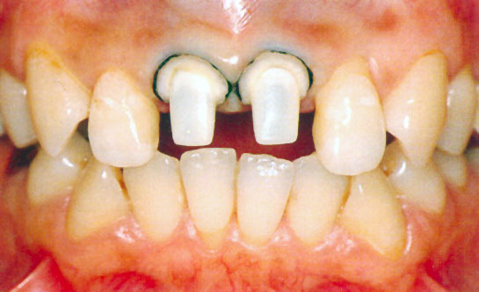
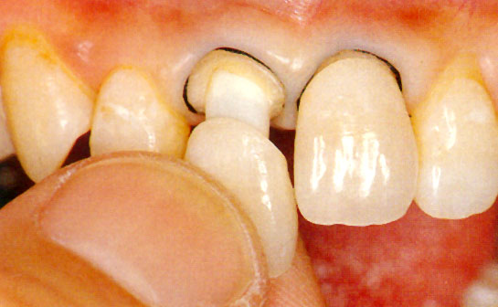
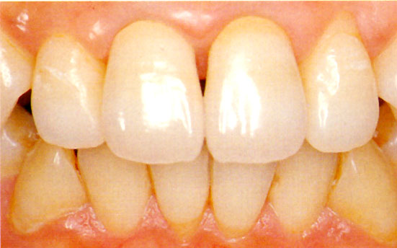
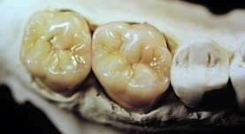
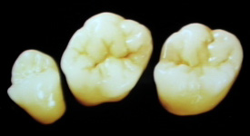
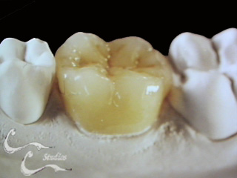
1.Anterior Crowns
2.Posterior Crowns

Slide 10
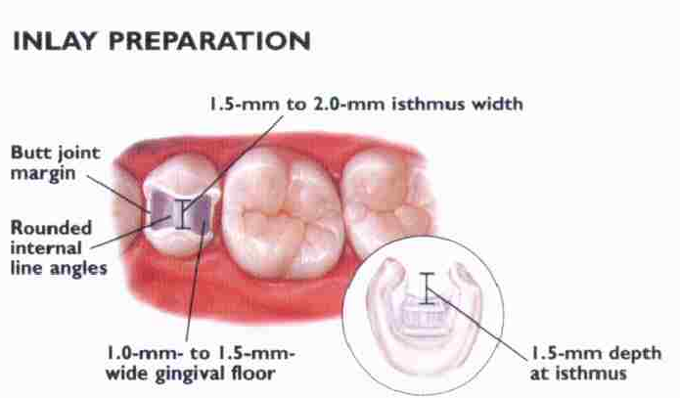
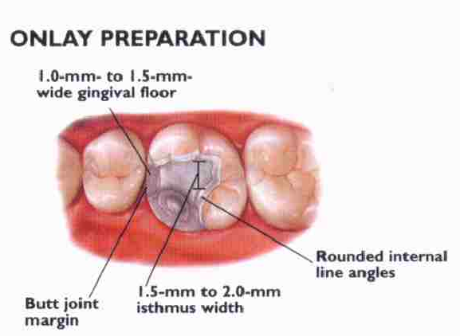
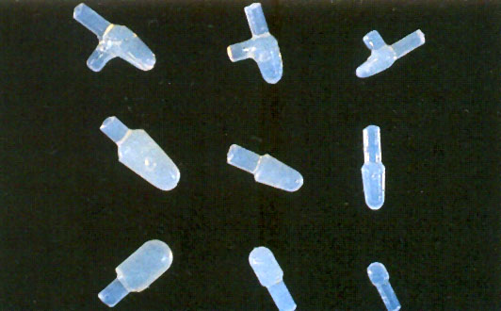
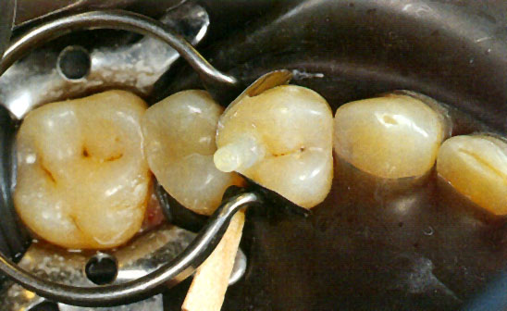
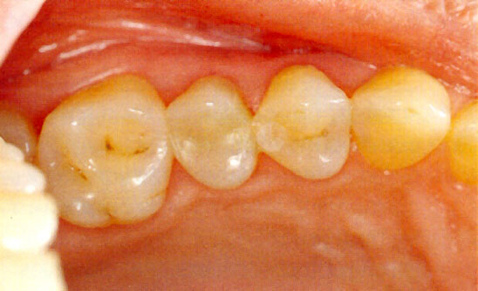
3.Inlays & Onlays
4.Ceramic inserts

Slide 11
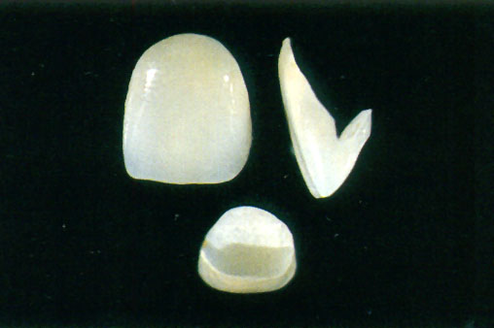
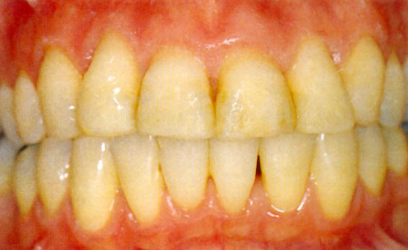
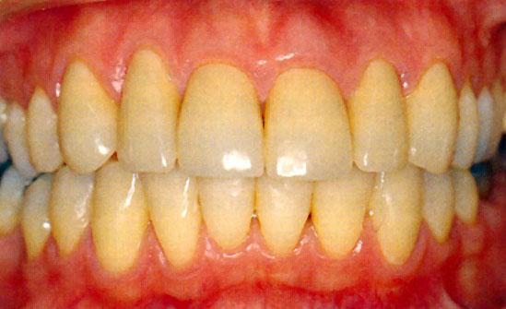
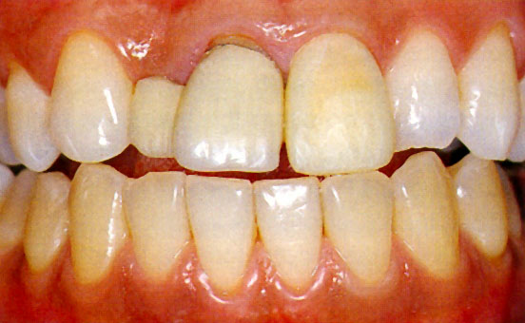
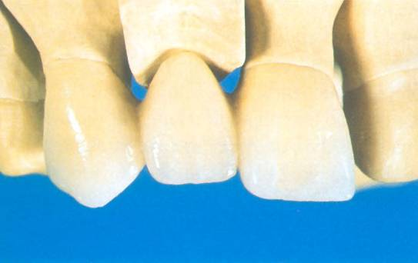
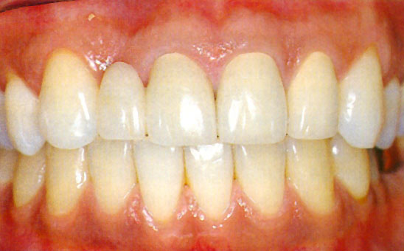
5.Porcelain laminate veneers
Pre treatment
Post treatment
6.All ceramic anterior F P D
Pre (PFM)
3 unit FPD
Post (All Ceramic)

Slide 12
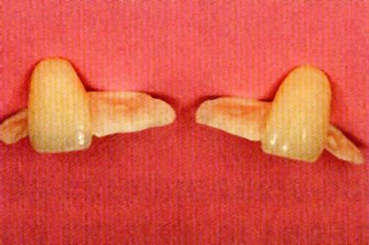
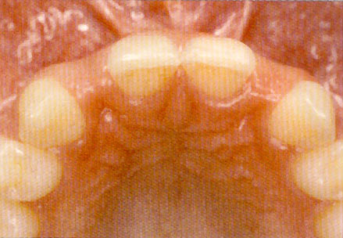
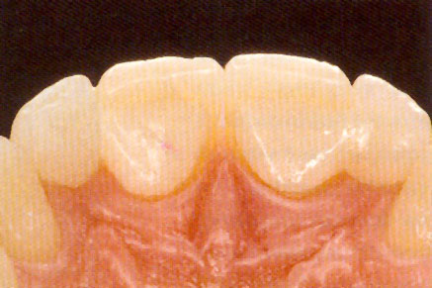
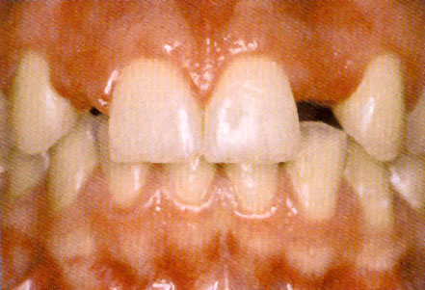
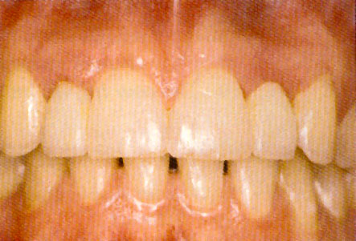
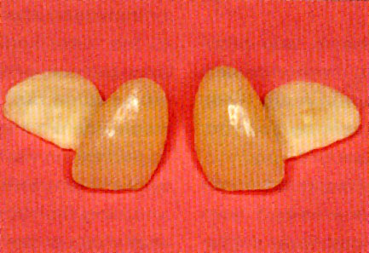
8.All ceramic Resin bonded fixed partial dentures
Introduced 1986-1988 Ibsen et al and Garber et al
Matthias kern 2005 :Cantilever resin bonded FPD

Slide 13
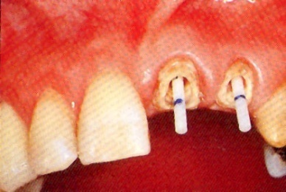
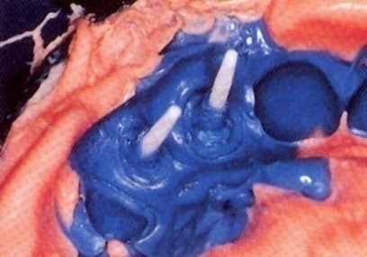
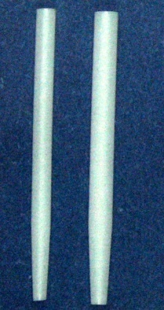
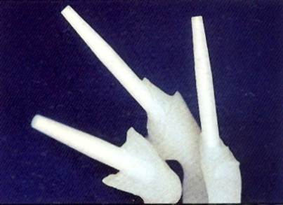
10.All ceramic Posts

Slide 14
Considerations during crown preparation

Slide 15
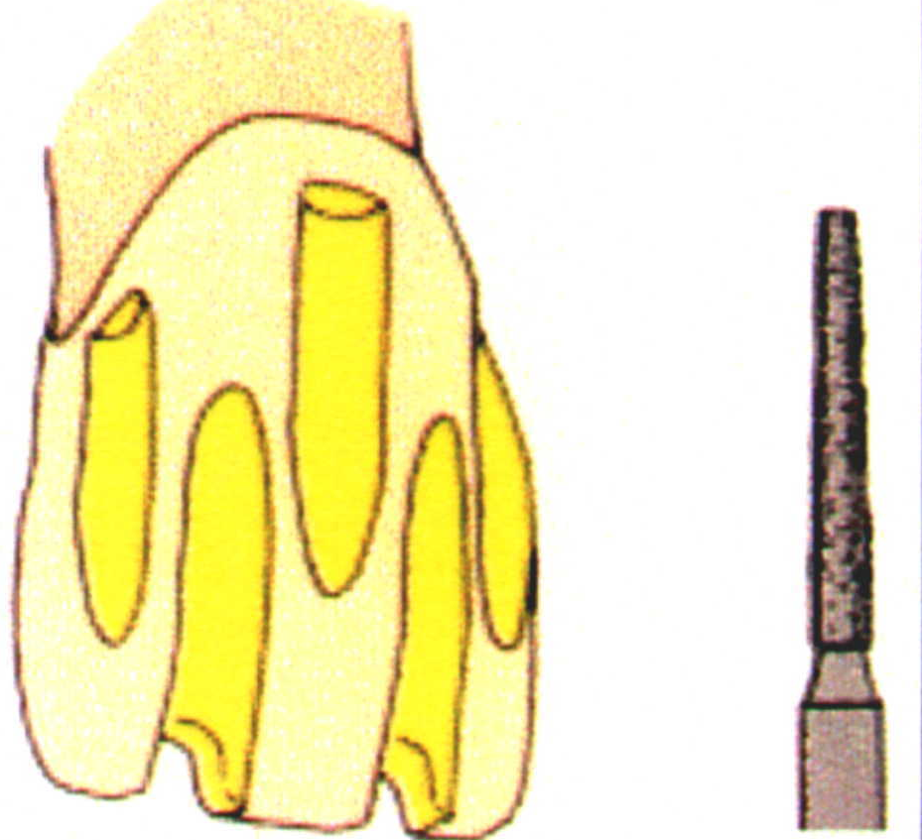
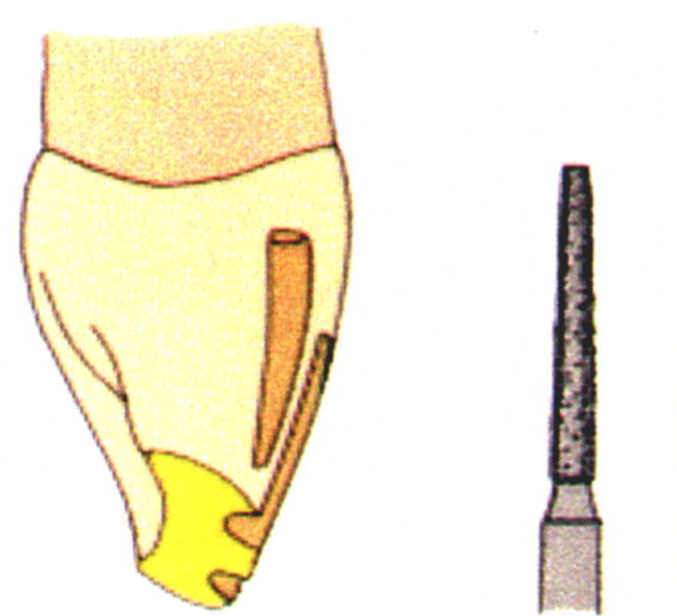
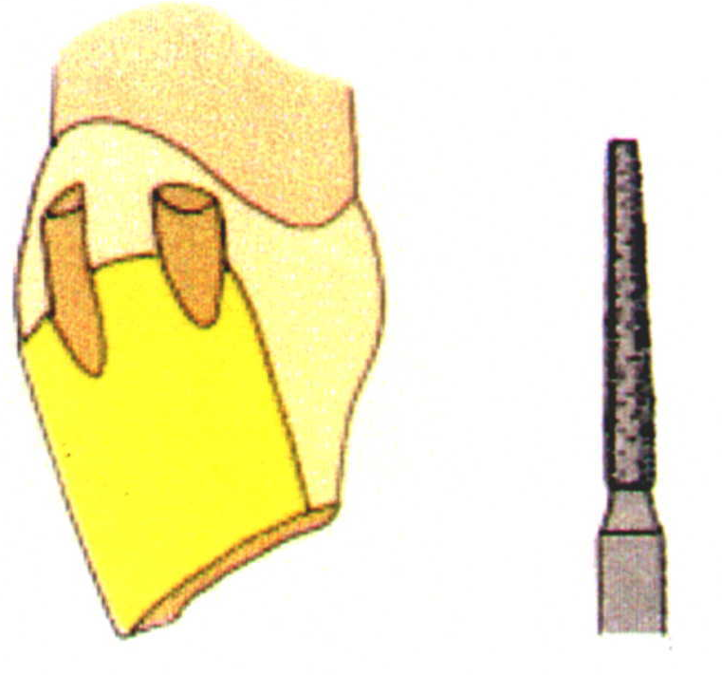
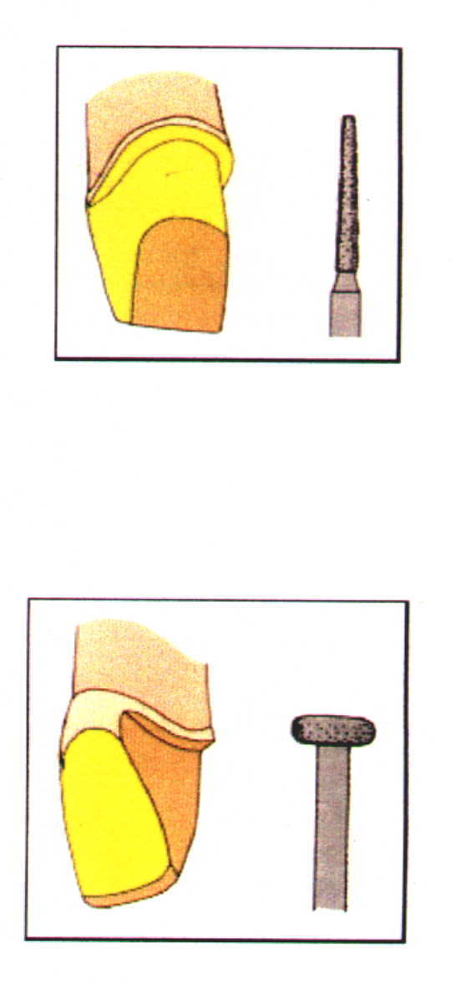
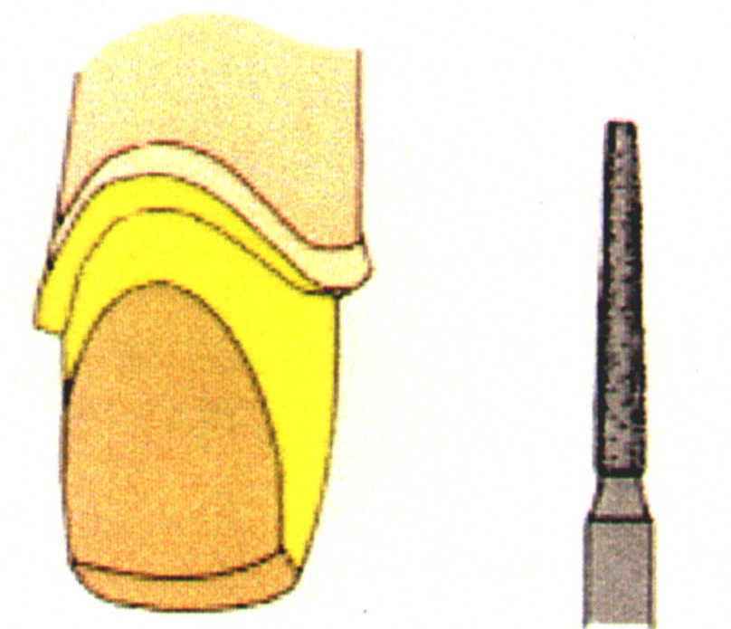
Depth orientation
grooves-0.8 mm Deep
Incisal reduction
1.5mm
Facial reduction, incisal half
1mm
Facial reduction,
gingival half 1mm
Lingual reduction
A small round diamond
Lingual axial reduction
and finishing 1mm
PORCELAIN JACKET CROWN PREPARATION

Slide 16
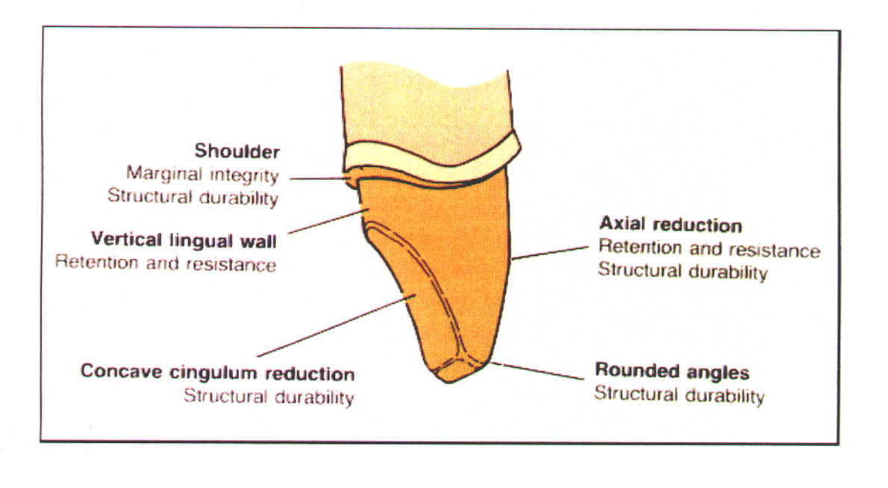
The features of all ceramic crowns preparation for a porcelain jacket crown on an anterior tooth.
1mm
1mm
1.5 mm

Slide 17
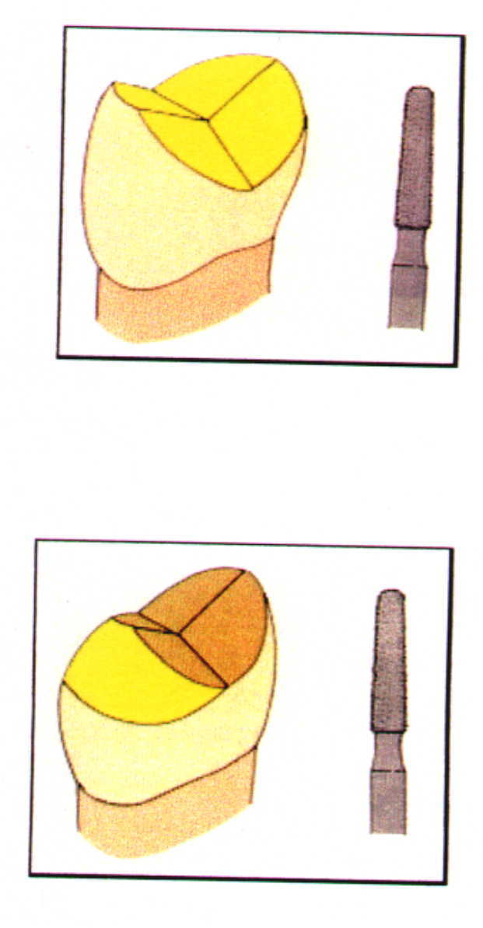
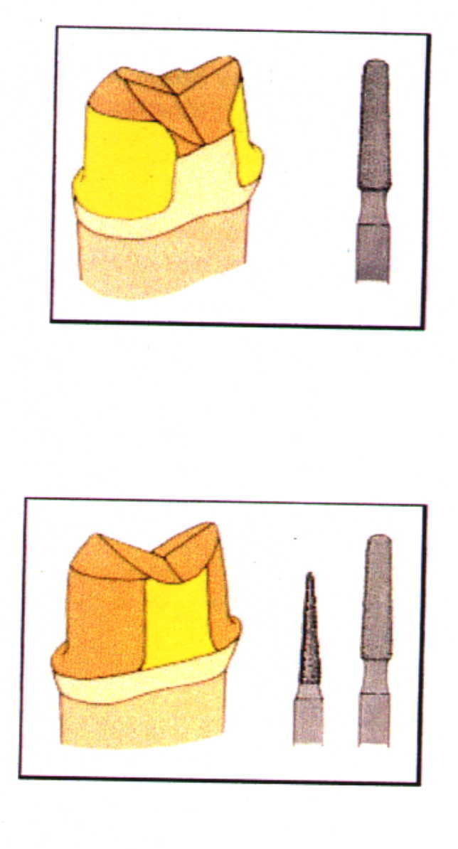
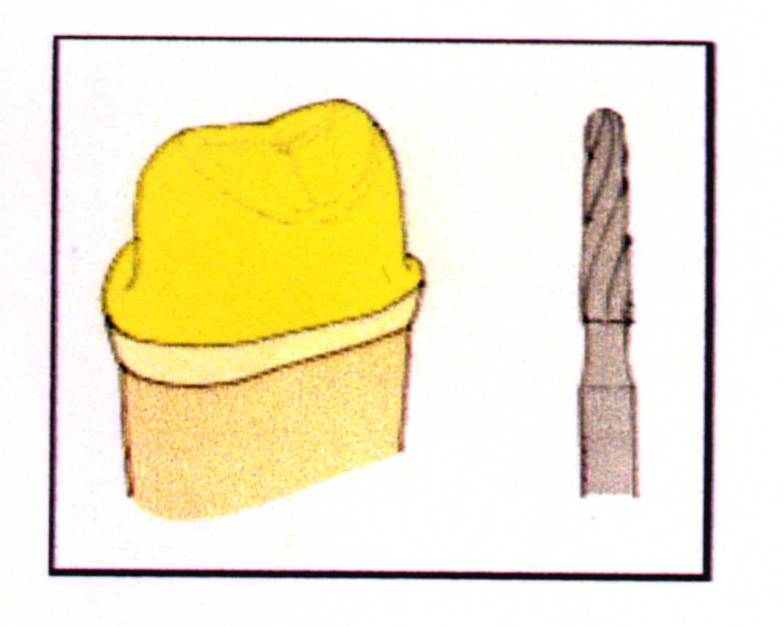
Occlusal reduction
1.5 mm -2.0 mm deep
Functional cusp bevel
Facial and lingual
axial reduction
1.0 to 1.5 mm
Complete axial reduction
Preparation finishing
CAST CERAMIC CROWN PREPARATION

Slide 18
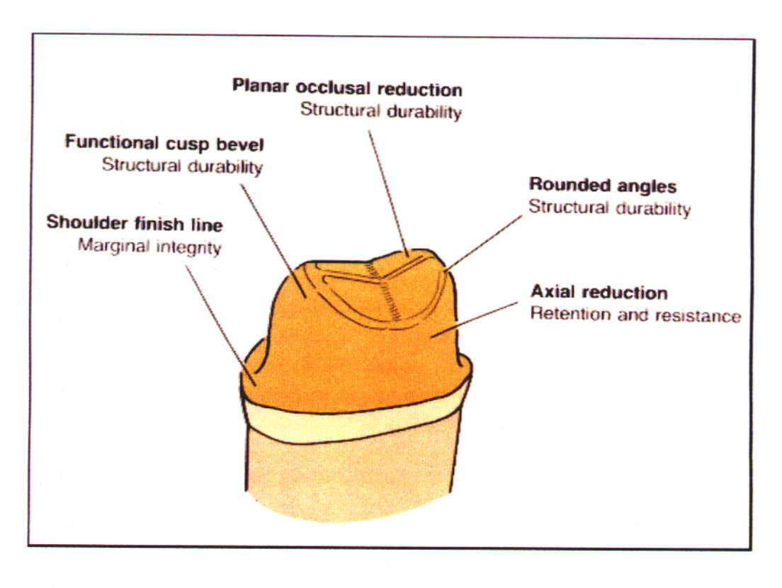
The features of a cast ceramic crown preparation for an all ceramic crown on a posterior tooth.

Slide 19
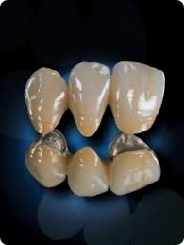
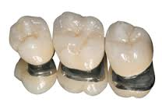
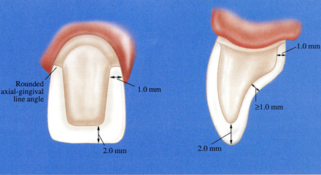
Esthetic Consideration
Metal Ceramic restoration

Slide 20
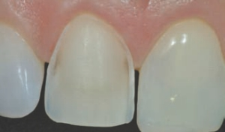
Facial tooth reduction
If there is to be sufficient bulk of porcelain for appearance and metal for strength, adequate reduction of the facial surface is essential.
The exact amount of reduction depends to some extent on the physical properties of the alloy used for the substructure, as well as on the manufacturer and the shade of the porcelain.

Slide 21
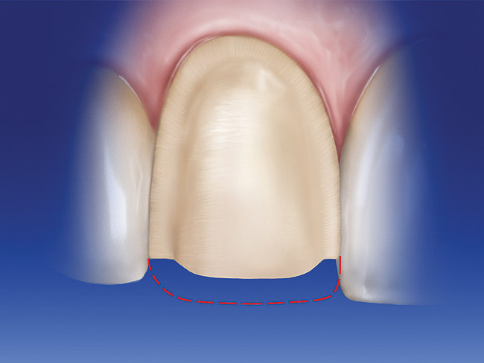
Incisal tooth reduction
The incisal edge of a metal ceramic restoration has no metal backing and can be made with a translucency similar to that of natural tooth structure.
An ideal incisal reduction of 2mm is recommended for good esthetics.
Excessive incisal reduction must be avoided because it reduces the resistance and retention form of the preparation.

Slide 22
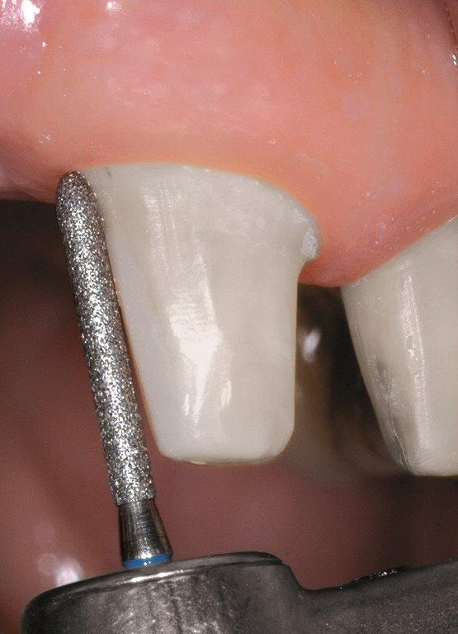
Proximal reduction
The exact of proximal reduction is contingent on exact predetermination of the location of the metal ceramic junction in the completed restoration.
The proximal surfaces of anterior teeth look most natural if they are restored at the incisal edges, without metal backing.
It allows some light to pass from the restoration in a manner similar to what occurs on a natural tooth.

Slide 23



Labial margin placement

Slide 24
Partial coverage restorations
Whenever possible, accomplishment of an esthetically acceptable result without the use of complete crowns is preferred.
Because tooth structure is conserved and because no restorative material can approach the appearance of intact tooth enamel.
Esthetic partial coverage restoration depends on the placement of facial and proximal margins.

Slide 25

PARTIAL COVERAGE RESTORATION
No restorative material can achieve the appearance of intact tooth enamel
Esthetic depends on accurate placement of potentially visible facial and proximal margins
PROXIMAL MARGIN
Mesial margin → buccal to contact area
Distal margin → can be extended beyond the contact
point
Tooth preparation angulation →long axis of posterior
teeth and incisal 2/3rd of
facial surface of anterior

Slide 26

FACIAL MARGIN
Maxillary → margin should be extended just beyond the occlusofacial line angle
If buccal margin is correctly shaped following the original cuspal contour, it will not reflect light to an observer and tooth will appear merely a little shorter than normal
Mandibular → metal display is unavoidable because ….
If unacceptable to the patient → metal ceramic
restoration with porcelain coverage on occlusal surface

Slide 27
Title | source | Materials and Method | conclusion | Level of Evidence
The safety and efficacy of anterior ceramic fixed partial dentures: A review of the literature | J Prosthet Dent 2001;86:520-5. http://dx.doi.org/10.1067/mpr.2001.120111 | This article reviews data on ceramic FPDs published between 1966 and 2001 in the English language. Peer-reviewed articles were identified through a MEDLINE search and a hand search of relevant textbooks and annual publications; abstracts were not considered for inclusion. | The available data suggest that more clinical studies (preferably randomized clinical trials) that assess the long-term outcome of anterior ceramic FPDs are required to determine whether they can serve as a viable replacement for a maxillary anterior missing tooth and, at the same time, provide patients with a safe and effective restoration, oral health, and social comfort. | 1B

Slide 28


