Slide 1

IMPRESSIONS
IN
FIXED PARTIAL DENTURES

Slide 2
Lesson Plan
Target: Final BDS students
Duration: 50 Minutes
Topic: Impressions in Fixed Prosthodontics
Content | Duration in Minutes
Introduction | 05
Terminologies | 05
Techniques of making Impressions in FDP | 20
Evaluating Impressions | 05
Summary | 02
Discussion | 08
CCES | 05

Slide 3
Impression are MADE;
Not TAKEN.

Slide 4
INTRODUCTION
To obtain an impression is the first step necessary for the indirect fabrication of a prosthesis.
An impression is an imprint or negative likeness of teeth and tissues.
Fixed prosthodontics is practiced as indirect restorations.

Slide 5
High quality impressions.
accurate casts of the oral tissues
Well-fitting indirect restorations

Slide 6
TERMINOLOGIES

Slide 7
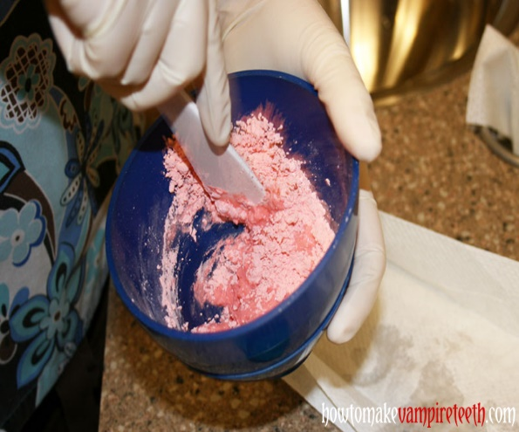
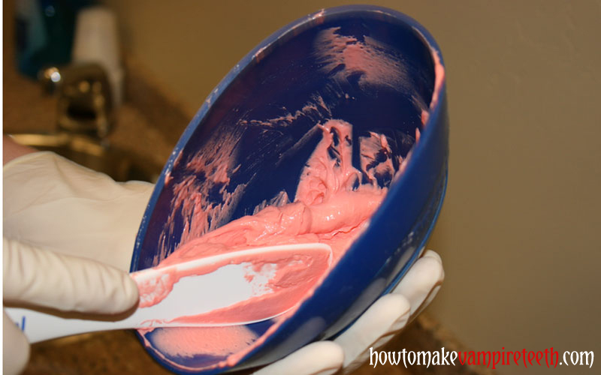
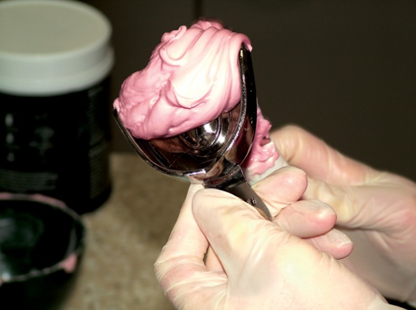
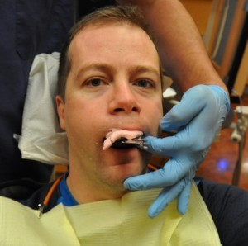
Initial Impressions

Slide 8
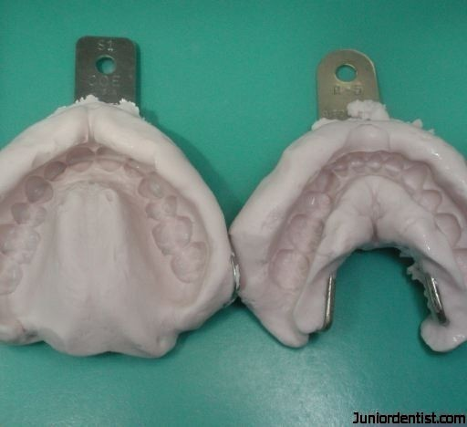
Initial Impressions

Slide 9
Techniques for final impression procedure:
Copper band impression technique
  Copper band technique with low fusing compound
  Copper band technique with putty and light body consistency elastomeric impression material
Final impression with reversible hydrocolloid impression material.
  Traditional reversible hydrocolloid impression
  Wet-field technique
  Laminated/ Combination reversible and irreversible hydrocolloid impression technique
Elastomeric impressions
  Single step, single mix technique
  Single step, double mix technique
  Double step, double mix technique
Dual arch impression/ triple tray impression technique
  Single step dual arch impression technique
  Hydraulic and Hydrophobic Impressions
  Laminar technique
Matrix impression technique
Digital impression techniques

Slide 10
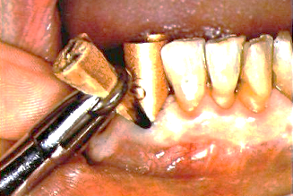
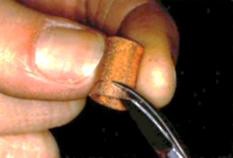
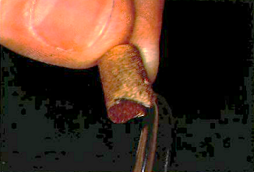
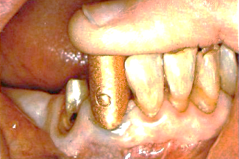
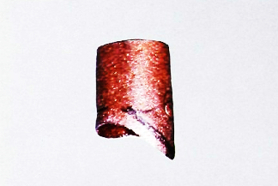
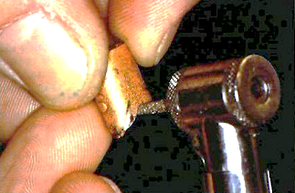
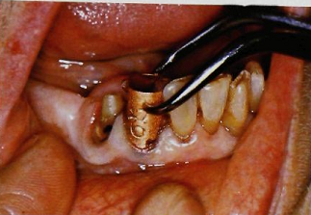
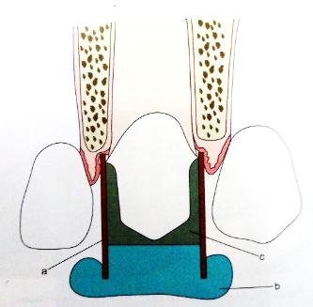
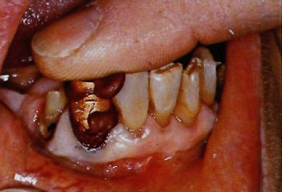
Copper band Impressions

Slide 11
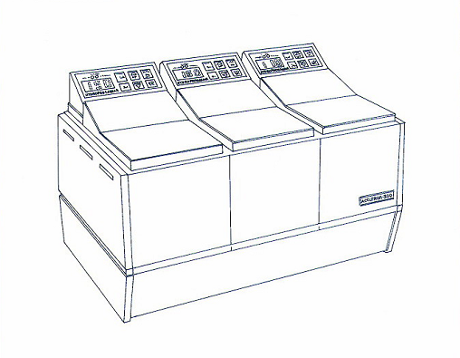
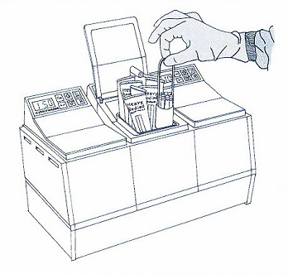
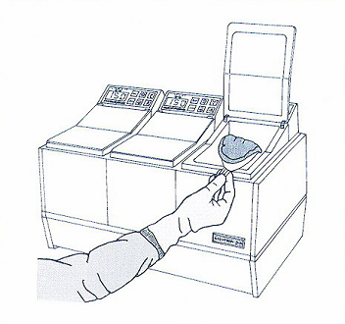
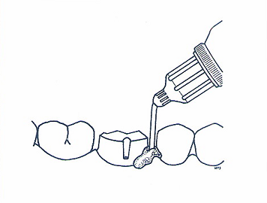
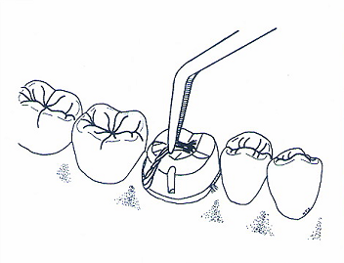
Reversible Hydrocolloid Impression

Slide 12
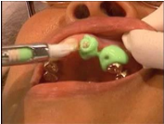
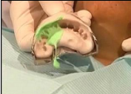
Laminate Technique

Slide 13
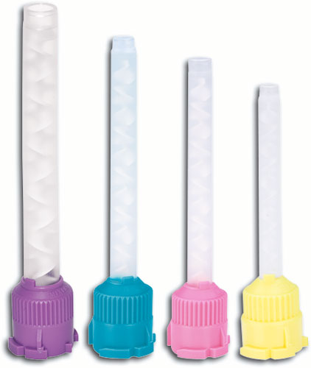
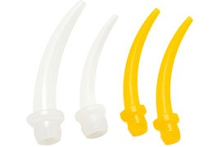
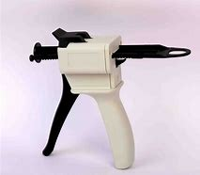
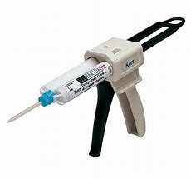
Static auto mixing technique

Slide 14
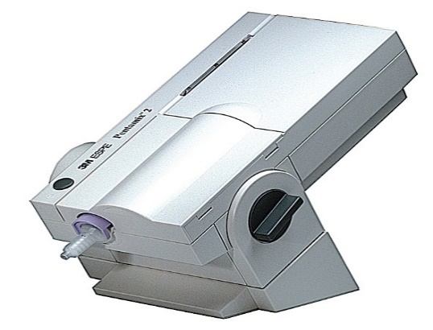
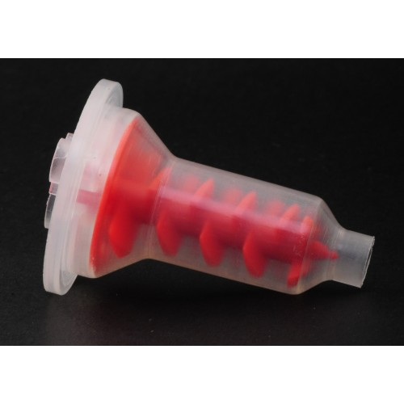
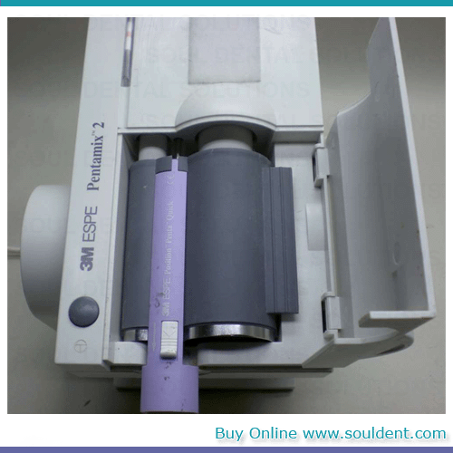
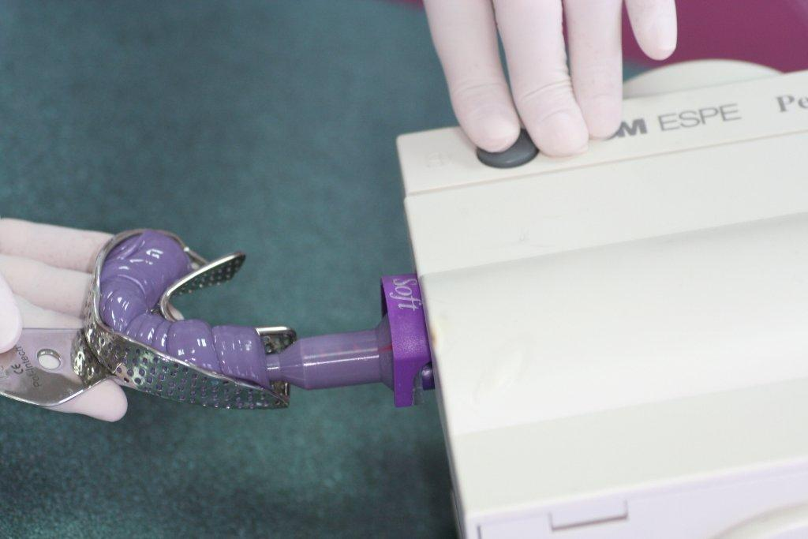
Machine mixing

Slide 15
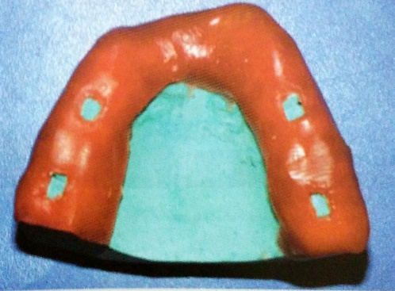
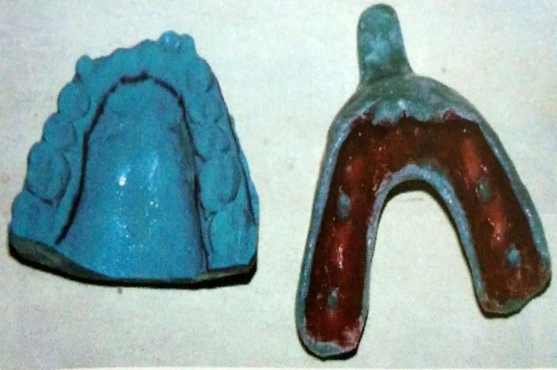
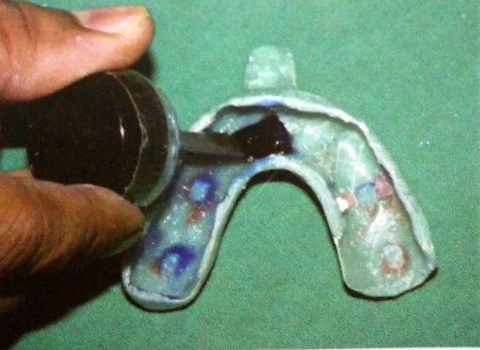
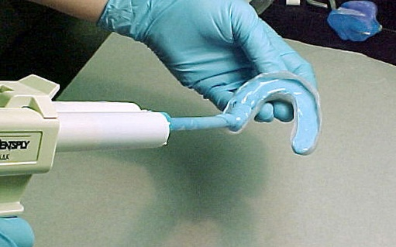
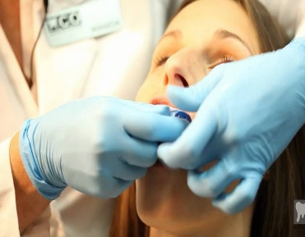
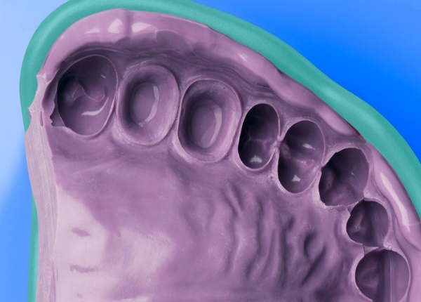
Single-step, single mix impression technique

Slide 16
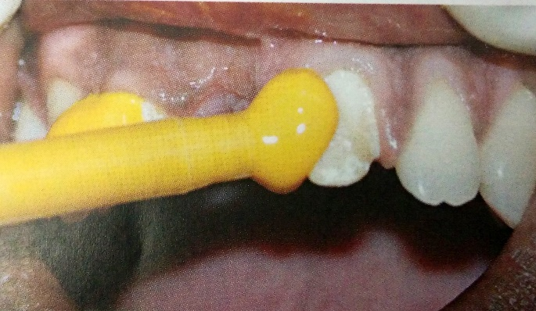
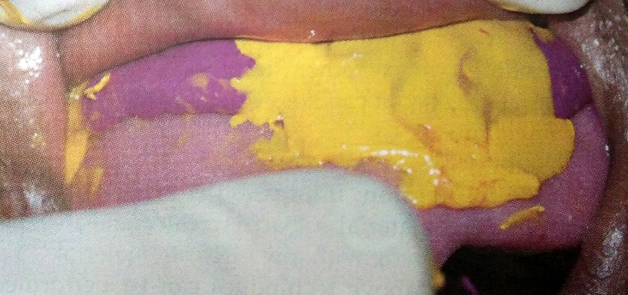
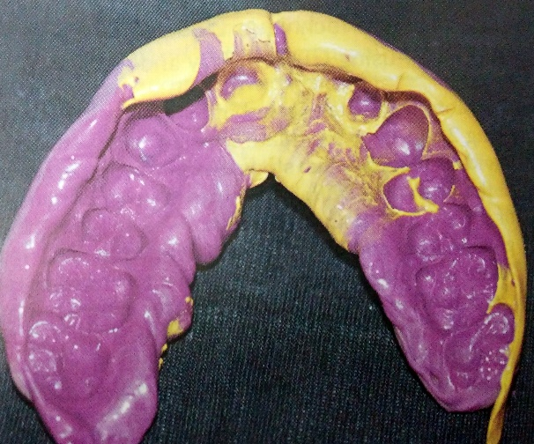
Single-step, double mix impression technique

Slide 17
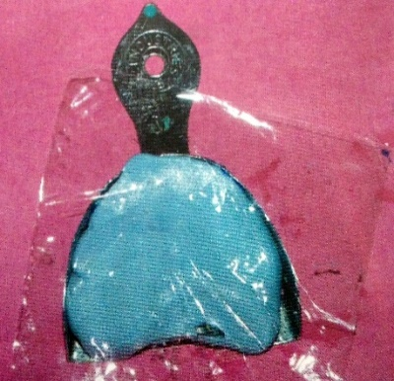
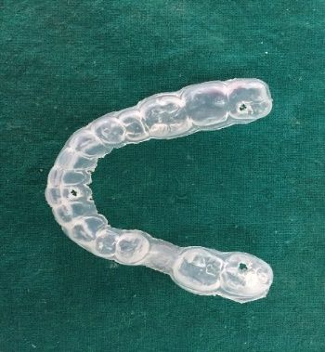
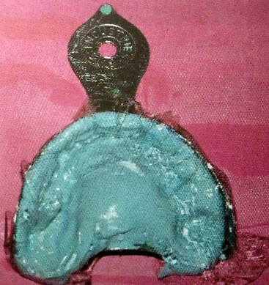
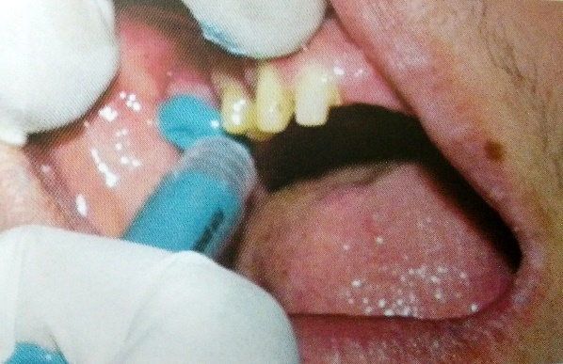
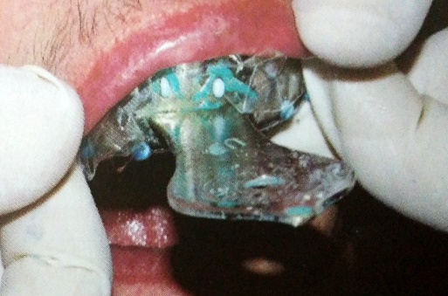
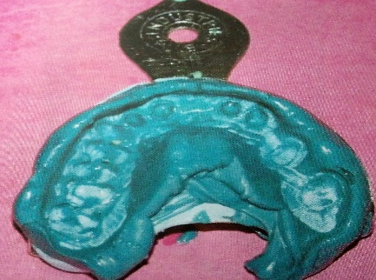
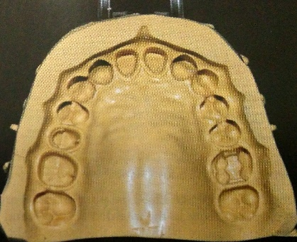
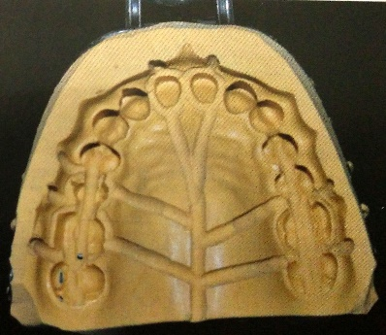
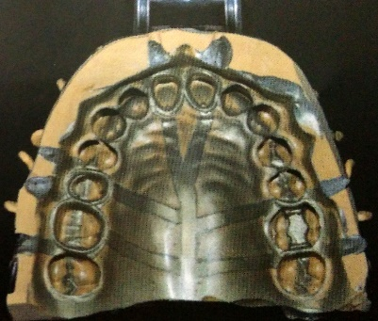
Double-step, double mix impression technique

Slide 18
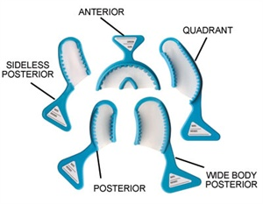
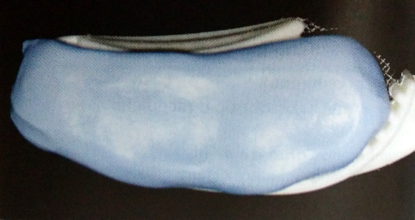
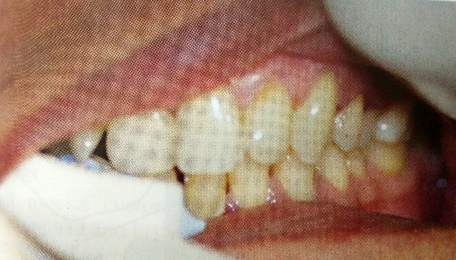




Dual arch impression trays

Slide 19
Title | Journal | Methodlogy | Inferences | Level of eveidence
Dimensional accuracy of resultant casts made by a monophase, one-step and two-step, and a novel two-step putty/light-body impression technique: an in vitro study | J Prosthet Dent. 2008 Apr;99(4):274-81 | A stainless steel model with 2 abutment preparations was fabricated, and impressions were made 15 times with each technique. All impressions were made with an addition-reaction silicone impression material (Aquasil) and a stock perforated metal tray. The monophase impressions were made with regular body material. The 1-step putty/light-body impressions were made with simultaneous use of putty and light-body materials. The 2-step putty/light-body impressions were made with 2-mm-thick resin-prefabricated copings. The 2-step injection impressions were made with simultaneous use of putty and light-body materials. In this injection technique, after removing the preliminary impression, a hole was made through the polymerized material at each abutment edge, to coincide with holes present in the stock trays. Extra-light-body material was then added to the preliminary impression and further injected through the hole after reinsertion of the preliminary impression on the stainless steel model. | The 2-step putty/light-body and 2-step injection techniques were the most dimensionally accurate impression methods in terms of resultant casts. | Level V

Slide 20

Evaluating final impression
Elastomeric material should be present 0.5 mm beyond visible finish line.
Note presence of bur marks, the junction of smooth root surface, and continuous finish line.
There should be no shiny smooth areas; if present, they suggest moisture contamination.
There should be no tray show-though in any areas of the impression except at tissue stops.

Slide 21
There must be no voids present, they suggest mixing problems or contamination.
There should be no thin areas leaving the finish line unsupported. These areas distort under the weight of the stone.

Slide 22
The matrix impression system
The MIS uses three impression materials:
A suitable elastomeric semi rigid material required to form the matrix;
A high viscosity elastomeric impression material, which will preferably bond to the matrix-forming material, required to make an impression of the preparations in the matrix; and
A stock tray with a medium viscosity elastomeric impression material to pick up the matrix impression and the remaining arch not covered by the matrix.

Slide 23


Slide 24


Slide 25


Slide 26

Digital Impressions
CAD/CAM systems are composed of three major parts:
  1. Data acquisition unit,
  2. Software for designing virtual models
  3. Computerized milling device

Slide 27
Title | Journal | Methodlogy | Inferences | Level of eveidence
Clinical evaluation of all-ceramic crowns fabricated from intraoral digital impressions based on the principle of active wavefront sampling. | J Dent. 2010; 38(7):553-559 | One crown was fabricated from intraoral scans using the Lava™ Chairside Oral Scanner (Lava C.O.S.), and the other crown from a two-step silicone impression. Prior to cementation the fit of both crowns was clinically evaluated by two calibrated and blinded examiners; the marginal fit was also scored from replicas | Although the marginal discrepancies obtained from both the techniques were within clinical acceptable limits, the crowns obtained from the digital impressions had significantly better marginal fit. | Level 3

Slide 28
Title | Journal | Methodlogy | Inferences | Level of eveidence
Diagnostic accuracy of impression-free digital models | Am J Orthod Dentofacial Orthop. 2013 Dec;144(6):916-22 | The study sample comprised 60 dry skulls. Each skull had the maxillary and mandibular arches scanned with a Cadent iTero scanner (Align Technology, San Jose, Calif) and had a cone-beam computed tomography scan taken with a CS 9300 unit (Carestream Health, Atlanta, Ga). Linear measurements in all 3 dimensions of the space in each dental arch together with tooth-size arch-length analysis for both the maxillary and mandibular arches were carried out manually on the dry skulls with calipers and digitally on the scanned 3-dimensional models and cone-beam computed tomography images. | Direct digital acquisition of the dental arches with a chairside scanner provided almost 1-to-1 diagnostic information of the investigated anatomy and was superior to the cone-beam computed tomography measurements. | Level V

Slide 29
Summary
Impression technique and material should be selected on the basis of biologic factor dictated by the anatomy and the physiology of the mouth dictated by the orofacial tissues.
Even though there are innumerable techniques and procedure for impression making ,it is the responsibility of the dentist to select the best possible procedure based on sound knowledge , for achieving the best possible result for the patient.

Slide 30
An Excellent Restoration Begins with Mastering the Art of Creating Accurate Impressions

Slide 31


