Slide 1
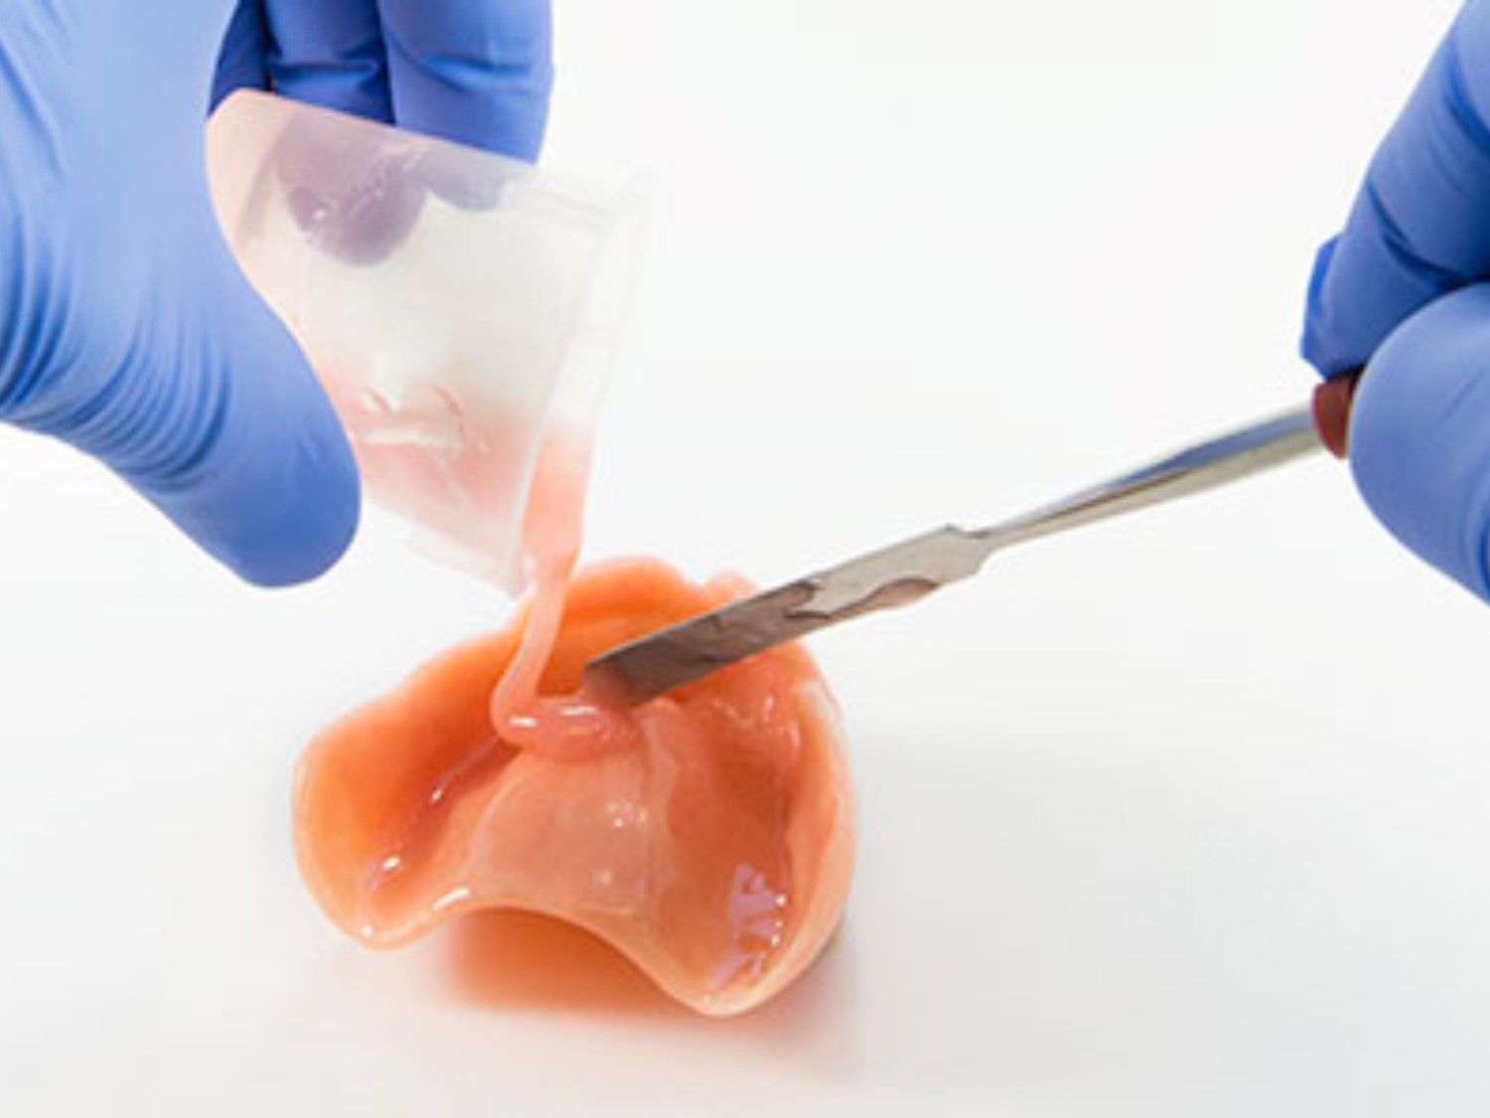

Relining, Rebasing
of Complete Dentures
DR. NAMRATA SHAH NAIDU

Slide 2

OBJECTIVES
INTRODUCTION
DIAGNOSIS AND TREATMENT PLANNNING
RELINING
INDICATIONS AND CONTRAINDICATIONS
PROCEDURES FOR RELINING
REBASING
PROCEDURES FOR REBASING
INDICATIONS AND CONTRAINDICATIONS

Slide 3
INTRODUCTION
Residual ridge contour changes so rapidly
repeated reconstruction of dentures
Critical part: is to maintain adaptation of denture to these ever resorbing tissues

Slide 4
PURPOSE
Re-establish adequate adaptation of the denture
Re-establish the original jaw relation

Slide 5
DEFINITION OF RELINING
the procedures used to resurface the intaglio of a removable dental prosthesis with new base material, thus producing an accurate adaptation to the denture foundation area – GPT - 9
Winkler – the process of adding some material to the tissue side of a denture to fill the space between the tissue and the denture base to improve the fit of the denture.

Slide 6
INDICATIONS:
Immediate dentures after 3-6 months of use
When the adaptation of the denture to the ridge is poor due to RRR
Geriatric or chronically ill patients who cannot withstand physical and mental stress of construction of new dentures
Economical reason

Slide 7
CONTRAINDICATION:
When the residual ridge has resorbed excessively
Abused soft tissues due to an ill-fitting denture
TMJ problems
Patient dissatisfied with the appearance of the existing dentures
Unsatisfactory jaw relationships in the denture
Denture causing major speech problems
Severe osseous undercuts

Slide 8
ADVANTAGES:
Eliminates frequency of patient visits
Economical for the patient
Improves fit of the denture
A soft liner can be incorporated in this denture, if necessary

Slide 9
DISADVANTAGES:
Likelihood of altering the jaw relationship during this process
Cannot correct aesthetics, or jaw relation
Cannot correct occlusal arrangement
Cannot be used when excessive resorption has occurred
Its not a substitute for a new denture

Slide 10
DIAGNOSIS:
Is important to determine the choice of treatment
The nature of tissue changes, their extent and location should be studied
Tissue changes may be due to:
Incorrect occlusion
Changes in supporting structures – If vertical dimension has changed – rebasing is required or relining
Amount of resorption

Slide 11
GENERAL CONSIDERATIONS PRIOR TO RELINING:
A thorough examination – patient & denture
Vertical Dimension of occlusion – should be correct
Centric occlusion should coincide with centric relation
Aesthetics should be acceptable
Oral tissues should be in good health
Hyperplastic tissues or severe osseous undercuts – elimate
Posterior limit of denture – correct
Denture base extensions should be adequate
Interocclusal distance – should be adequate
Speech - Satisfactory

Slide 12
PRETREATMENT PROCEDURES:
Hyperplastic tissues – surgically excised
Oral mucosa should be free of irritations
Dentures should not be worn during sleep
Dentures should not be worn for atleast 2-3 days prior to final impression appointment

Slide 13
PREPARATION OF DENTURES FOR IMPRESSION
Pressure areas on the tissue surface of the denture should be relieved
Minor occlusal disharmony should be corrected by selective grinding
Border inadequacies should be corrected
Borders should be shortened by 1mm to allow space for new impression material
PPS should be established using green stick compound or autopolymerising resin
All large undercuts should be removed

Slide 14
Relining can be accomplished by
      Clinical procedures and
      Laboratory procedures

Slide 15
Relining procedure
Clinical procedure
Laboratory procedure
1. Static methods
2. Functional method
3. Chair-side technique
1. Articulator method
2. Jig method
3. Flask method
Closed–mouth
technique
Open- mouth
Technique(Bouchers)

Slide 16
CLINICAL PROCEDURES:
For both relining and rebasing are similar only laboratory procedure varies

Slide 17
STATIC METHODS:
OPEN-MOUTH TECHNIQUE (BOUCHER)
  The dentures are used as special tray
    Border molding and impressions
    After impressions, a new centric relation record is acquired.

Slide 18
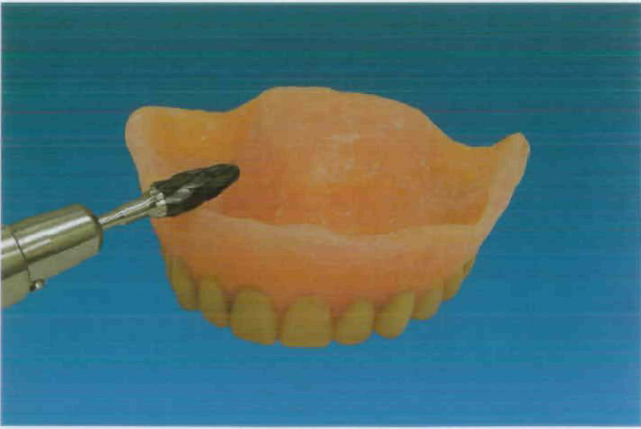

Slide 19
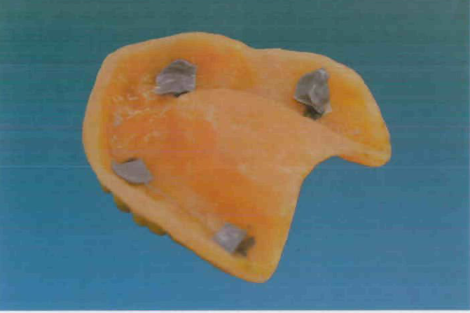

Slide 20
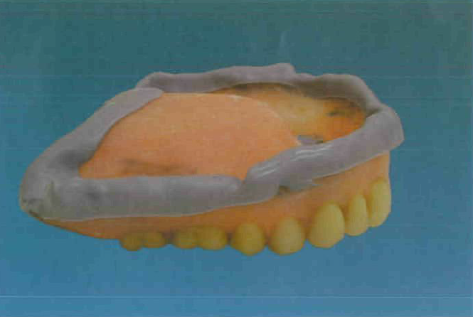

Slide 21
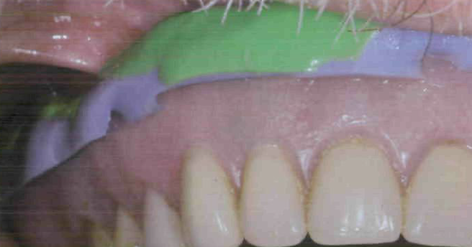

Slide 22
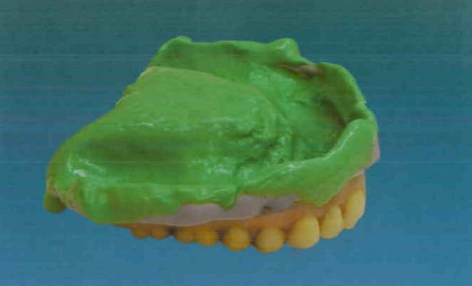

Slide 23
ADVANTAGES:
Selective trimming helps to make a selective impression
Making a separate inter-occlusal record
Possible to verify centric relation
DISADVANTAGES:
Difficult
It requires more clinical and laboratory steps

Slide 24
CLOSED-MOUTH TECHNIQUE
  In this technique impressions are made utilizing the existing centric occlusion
  Some clinicians also prefer to make a new centric relation record

Slide 25
TECHNIQUE A
CR is recorded using an interocclusal record- wax or compound before the impression- which is used to guide the dentures into position while making reline impressions
Center portion of palate can be removed for visibility
Border moulding – low fusing modeling compound
Impression – ZnOE
During impression making the patient is asked to close lightly into the new interocclusal record
Impression of exposed part of palate – Quick setting plaster

Slide 26
ADVANTAGES
Palatal opening- allow better seating of denture and visibility
Pre-made inter-occlusal record helps to position the denture during impression making
Also helps in orientating the dentures to the articulator
More reliable – as it is a 2 step procedure as it reduces the movement of the denture

Slide 27
DISADVANTAGES:
Cannot be used to reline/rebase maxillary and mandibular arches simultaneously
Use of wax interocclusal record is not very accurate

Slide 28
TECHNIQUE B
Existing centric relation record is used
Border moulding – low fusing compound
Impression – impression wax
Impressions made in 2 stages
A wax that flows at mouth temperature, such as Kerr’s impression wax (Iowa wax)* is the material of choice in this technique.
The impression is made in two steps.
The impression of the labial flange and the crest of the alveolar ridge between the canines is made as a second step.

Slide 29
ADVANTAGES:
Reduces possibility of forward movement
DISADVANTAGES:
Impression waxes are difficult to work with – distort easily

Slide 30
TECHNIQUE C
No new CR record
Prepare dentures
PERFORATE labial and palatal flanges to decrease the pressure inside dentures during impression making
ADVANTAGES AND DISADVANTAGES SAME AS TECHNIQUE A AND B

Slide 31
TECHNIQUE D
Existing CR is used
Dentures are prepared
Borders are shortened and made flat
A large opening is made in mid palatal region
Adhesive tape is attached over buccal and labial borders of both dentures 2mm above the denture borders (no border molding)
Make impression of most of the areas using – ZnOE
Use plaster to record the palatal portion

Slide 32
After impression cut a deep groove into labial and buccal surfaces of dentures at the junction of the impression material and fill it with molten wax.
The wax at the edge of the denture is used to record the sulcus.
Advantages same as technique A
DISADVANTAGES
Existing centric occlusion may cause some pressure points

Slide 33
FUNCTIONAL METHOD:
Suggested by Winkler
Patient need not be without dentures like previous techniques
Tissue conditioners are used as impression materials
Adavantages-
  Easy to use
  Excellent refitting of dentures
  Capable of retaining for many weeks
  Good in dimensional stability
  Good in bonding to resin denture bases

Slide 34
Remove occlusal errors
Correct all flange overextensions and underextensions as well as PPS area
Reduce the tissue surface of the denture
Dry the tissue surface
Flow even layer of tissue conditioning material on the entire impression surface and borders
Insert the dentures in patient’s mouth and guide to CR
Examine for unsupported material – correct those areas – insert dentures in patient’s mouth
Recall after 3-5days
After tissues are normal make impression with ZnOE and pour cast

Slide 35
CHAIR SIDE PROCEDURE
This method makes use of acrylic that could be added to the denture and allowed to set
in the mouth to produce instant reline/rebase.
DISADVANTAGES:
Material produces chemical burn in oral mucosa.
Material is porous and develops a bad odour
Poor color stability
Recent advances:
Visible light cure(VLC) resin has been developed which is similar to tissue conditioner.

Slide 36
LABORATORY PROCEDURES

Slide 37
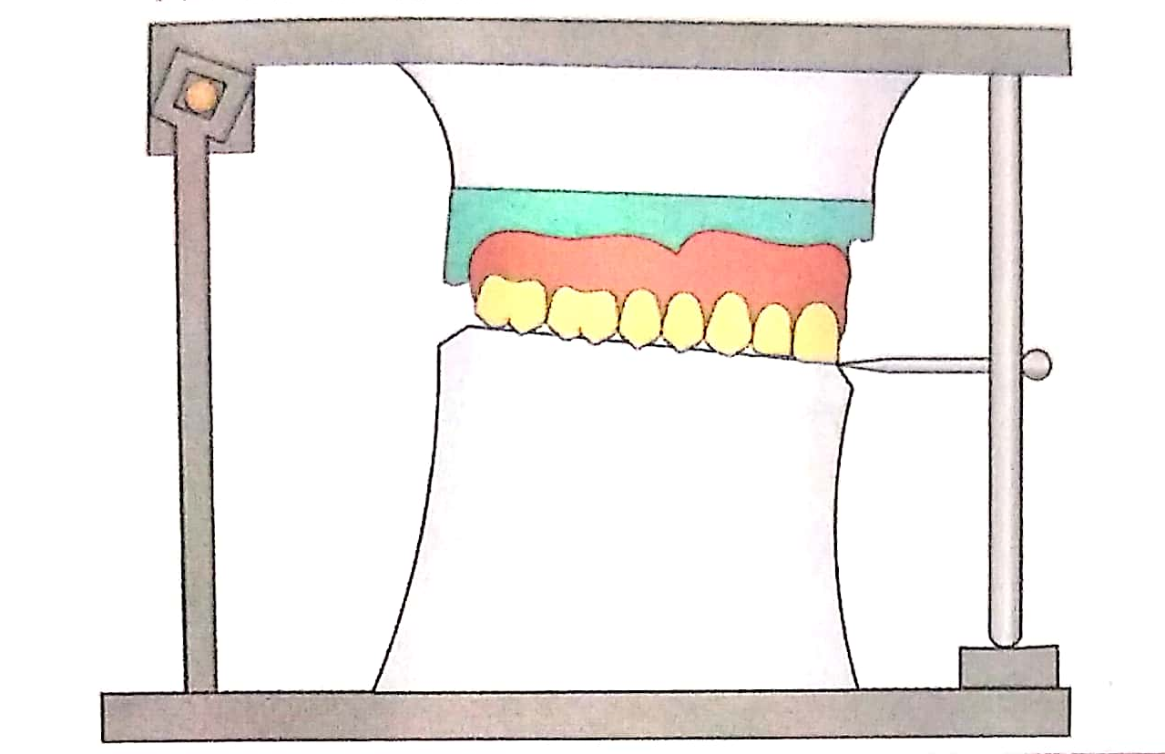
ARTICULATOR METHOD

Slide 38
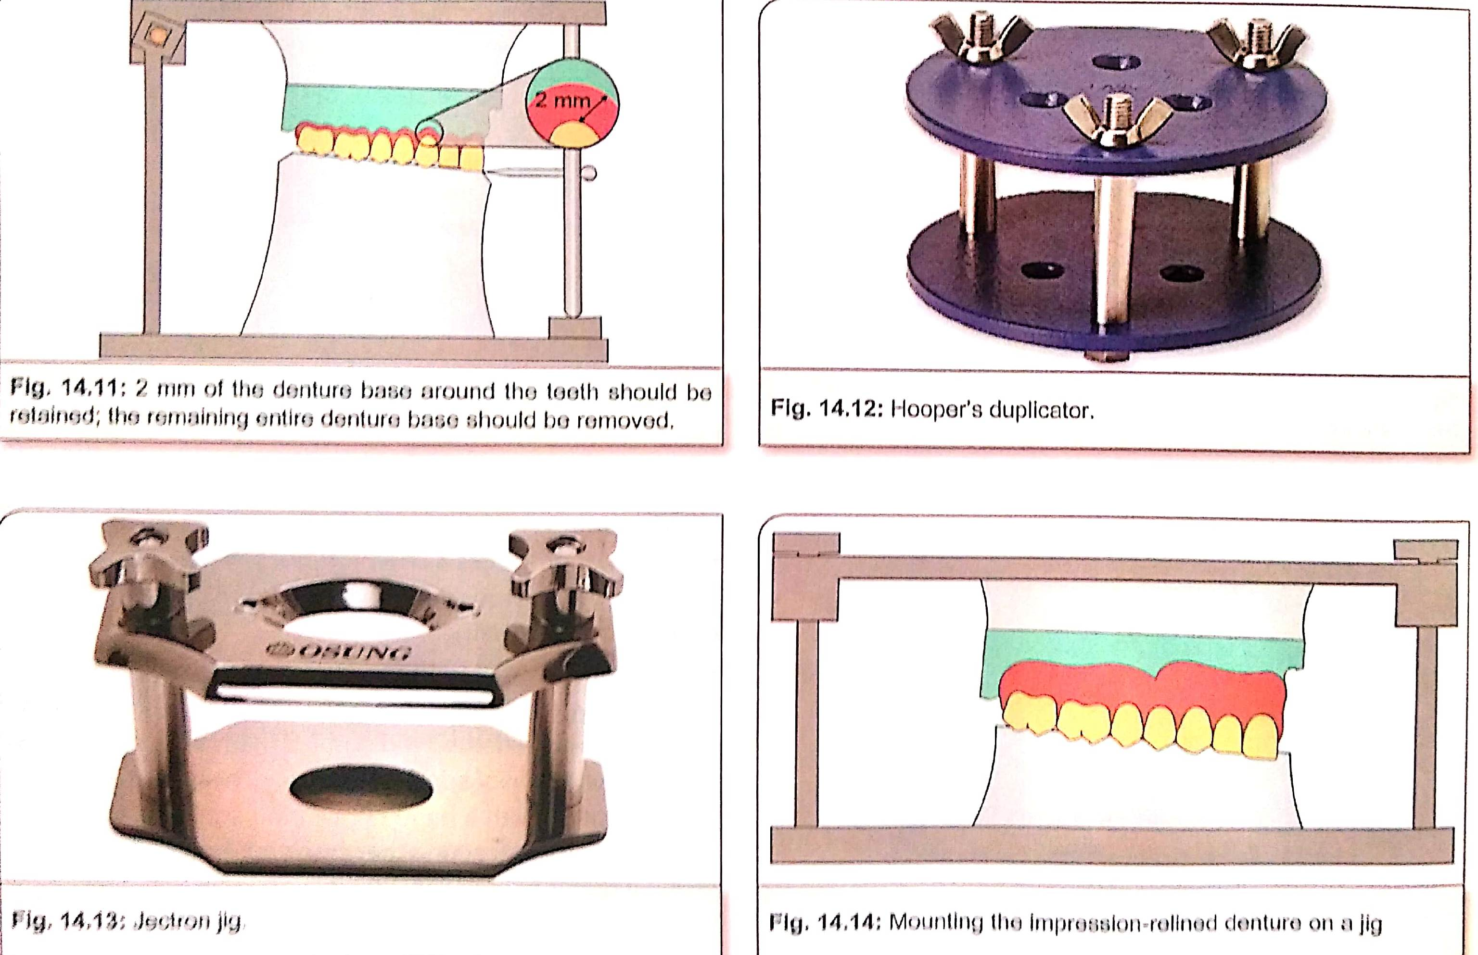

Slide 39
JIG METHOD
Jectron jig

Slide 41
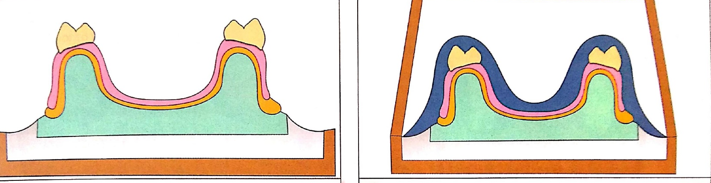
Flask Method

Slide 42
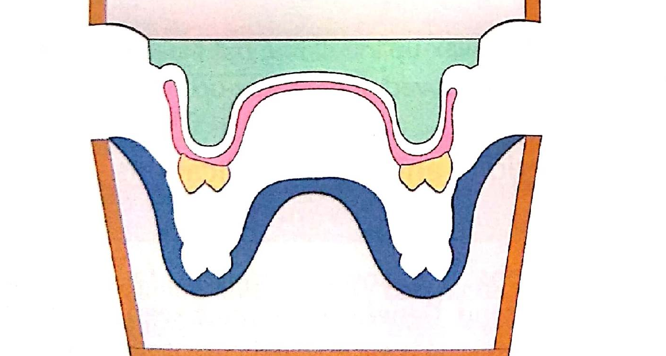

Slide 43
REBASING
Is defined as a process of refitting a denture by the replacement of the denture base material – GPT -9
Rebasing is similar to relining except that there is extensive replacement of the denture base material.
Steps:
  Preparing the denture
  Border moulding and impression
  Difference:
    Relining – only a layer of acrylic is removed before wax-up
    Rebasing – the entire denture base is removed prior to wax-up

Slide 44
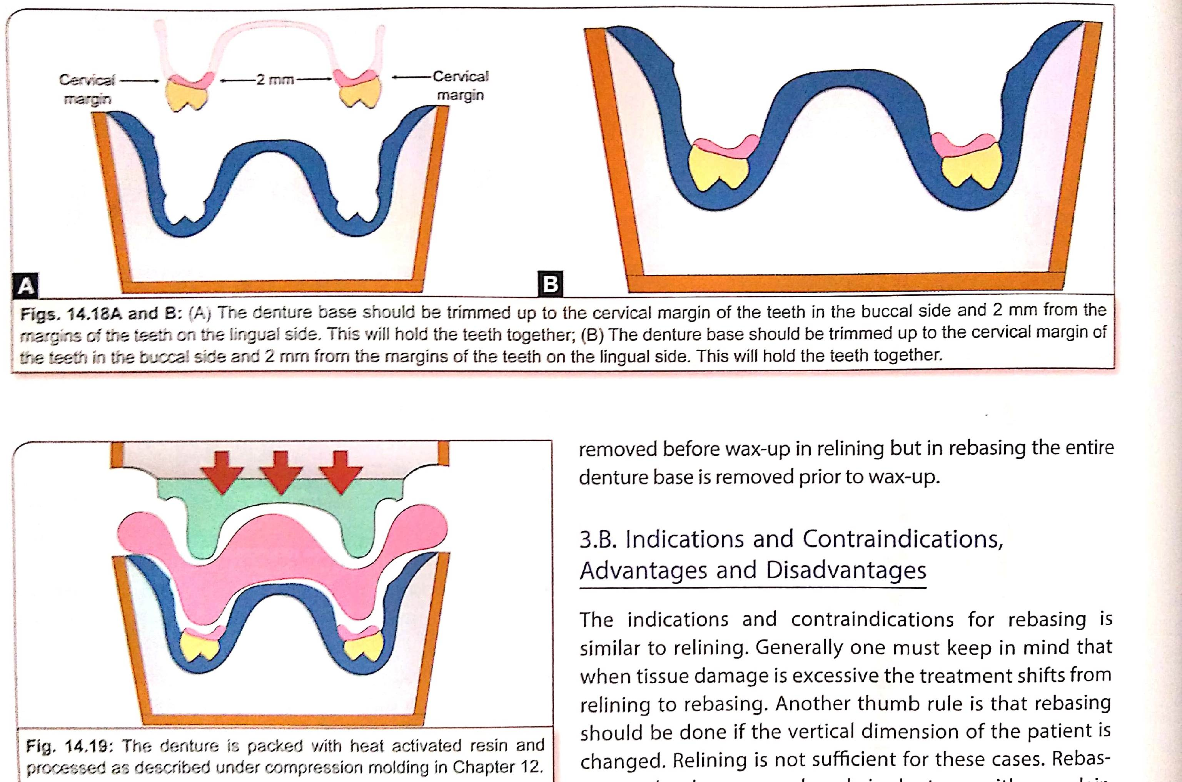

Slide 46
INDICATIONS
When tissue damage is excessive
When there is a change in vertical dimension

Slide 47
THANK YOU

