Slide 1




Slide 2
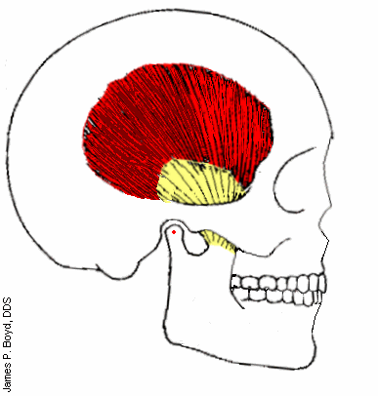
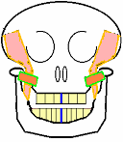
Horizontal jaw relations in complete dentures

Slide 3
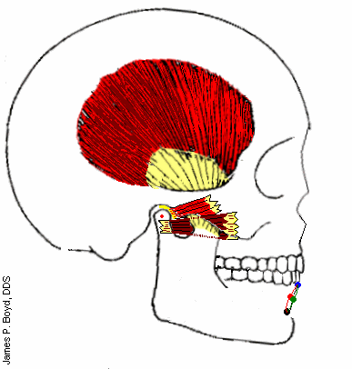
Introduction

Slide 4
Jaw relation/maxillomandibular relation
Any relation of the Mandible to maxilla- GPT
Types:
  Orientation relation
  Vertical relation
  Horizontal relation
  centric relation
  eccentric relation—protrusive records
  ---lateral records.

Slide 5

HOME

Slide 6
FUNCTIONAL METHODS

Slide 7
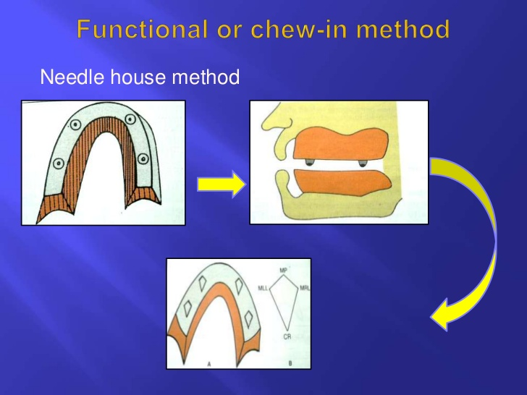

Slide 8
Occlusal rims are made from inpression compound.
Four styli are embedded into premolar and molar areas of maxillary occlusal rims.
Protrusive, retrusive, right and left movements.
Diamond shape markings.

Slide 9
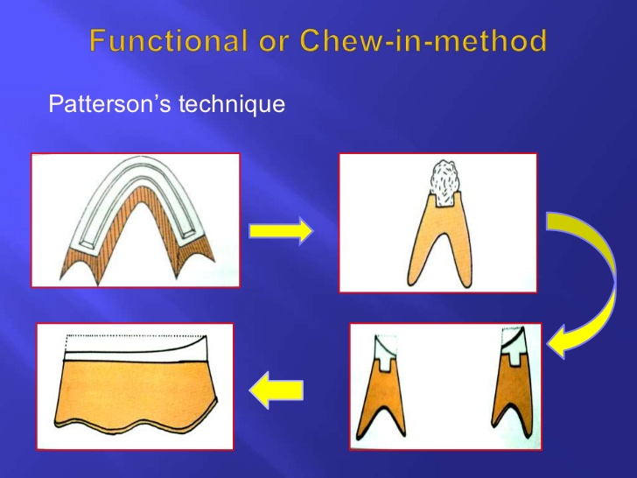

Slide 10
Occlusal rims are made of wax.
Trench or trough is made on the mandibular occlusal rim.
1:1 ratio mixture of carborundum and dental plaster is loaded in the trench.
Movements.
Retrude and close.
Staple.

Slide 11
GRAPHIC METHOD
These methods are so called because they use graphs to record the centric relation
Two types:
1.Arrow point tracing
2.Pantograph

Slide 12
GOTHIC ARCH TRACING
ARROW POINT TRACING

Slide 13
Why is it called arrow point????

Slide 14
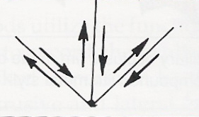

Slide 15
Why is it called Gothic arch tracing???

Slide 16


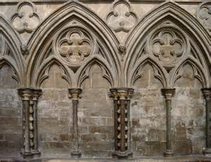
Romanesque architecture
during Gothic era

Slide 17
ARROW POINT TRACING
Measured across a single plane
Central bearing device is used.

Slide 18
Defined as" a device that provides a central point of bearing or support between the maxillary and mandibular dental arches. It consists of a contacting point attached to one dental arch and a plate attached to the opposing dental arch. The plate provides the surface on which the bearing point rests or moves and on which the tracing of the mandibular movement recorded. It may be used to distribute the occlusal forces evenly during jaw relation and/or the correction of disharmonious occlusal contacts.-GPT

Slide 19
CENTRAL BEARING DEVICE CONSISTS OF :
Central bearing point
Central bearing plate

Slide 20
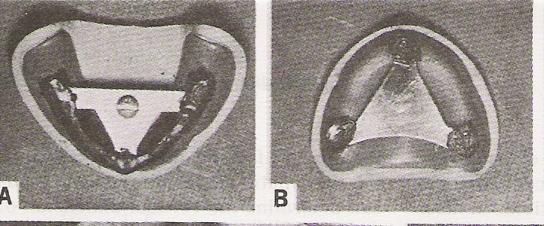
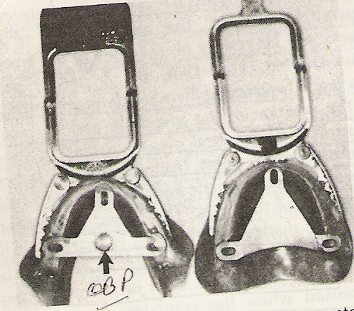
Central bearing point
Central bearing plate

Slide 21
TYPES OF ARROW POINT TRACERS
Depending upon the placement of recording device:
Intra oral
Extra oral

Slide 22
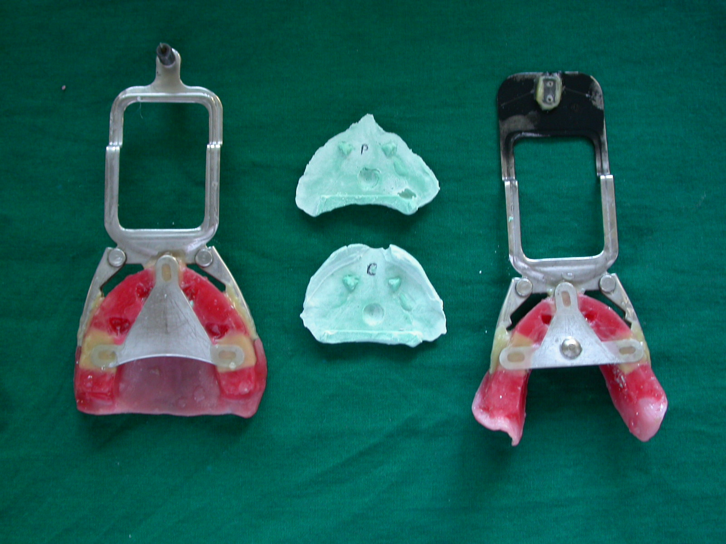

Slide 23
EXTRAORAL ARROW POINT TRACING
Larger than intraoral because they are made farther from centers of rotation
Apex is more discernible.
It is visible while tracing is being done
Patient can be guided properly.

Slide 24
Types of Extra Oral Tracers
Hight tracers(with or without central bearing point)
Stransbery tracers
Sears trivet (is a central bearing point tracer with two registration pins)
Phillips tracer (it registers CR and condyle paths simultaneously)

Slide 25
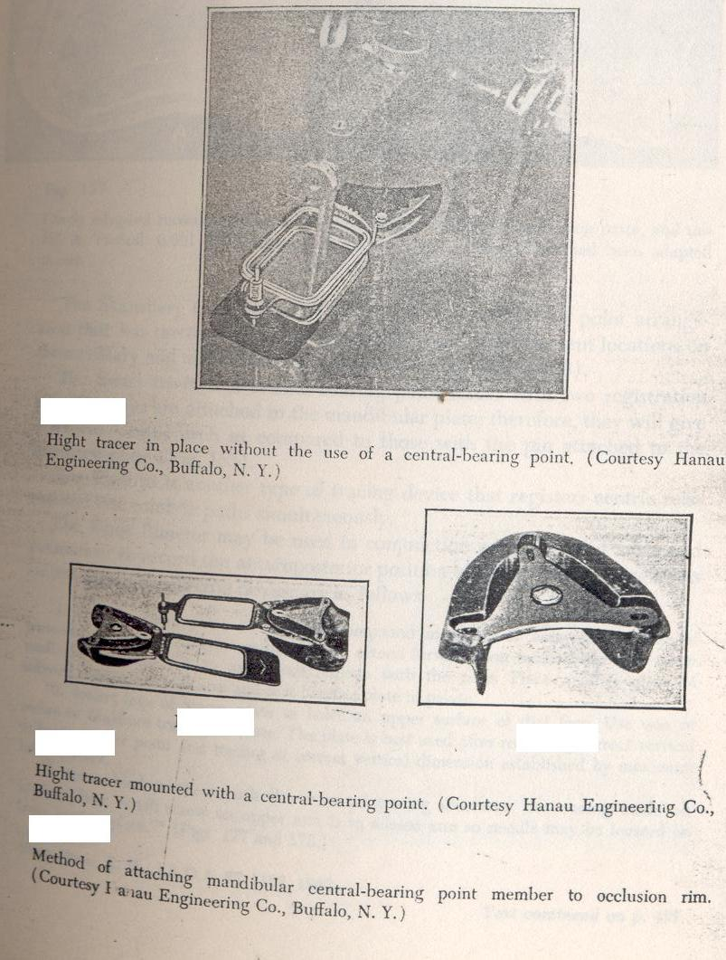
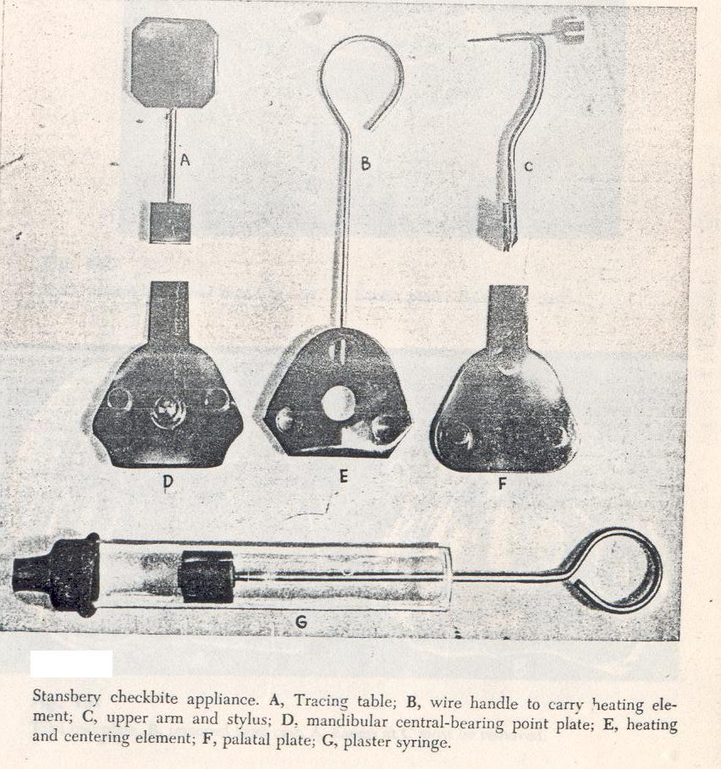
Hight’s Tracers
Stransbery Tracers

Slide 26
The extraoral tracer is always combined with an intra oral bearing device to ensure equalization of pressure on the bases.
Orientation Jaw relation
Vertical Jaw relation
Tentative centric Jaw relation
Mandibular occlusal rim reduced to accommodate the tracers.
Central bearing plate and central bearing point are attached on Rims.
Recording plate is coated with precipitated chalk and denatured alcohol.
Intra-orally central bearing point is positioned to touch central bearing plate at the pre determined VD.

Slide 27
Patient is asked to perform protrusive, lateral and antero-posterior movement.
Ney excursion guide can be used to guide the patient.
A needlepoint tracing made on a tracing table coated with carbon or wax is used to indicate the relative position of the upper and lower jaws in the horizontal plane.
Tracing is examined for a sharp apex.
Once the records are satisfactory quick setting plaster is injected between occlusal rims.
The assembly is removed and articulated.

Slide 28
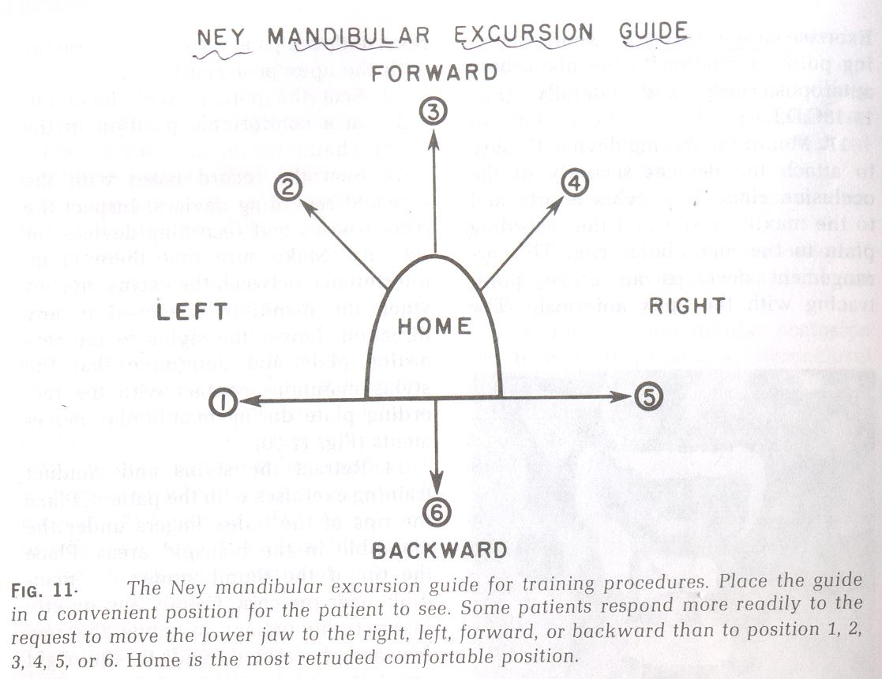

Slide 30
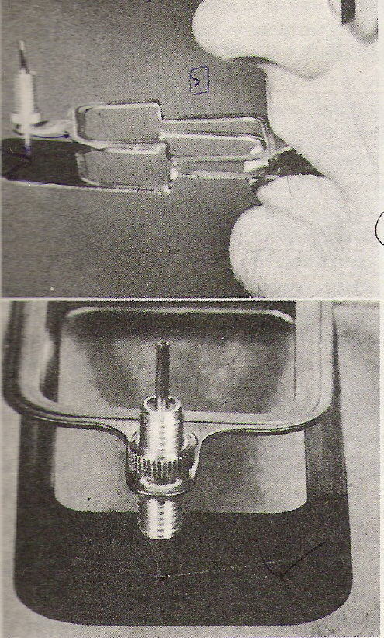

Slide 31
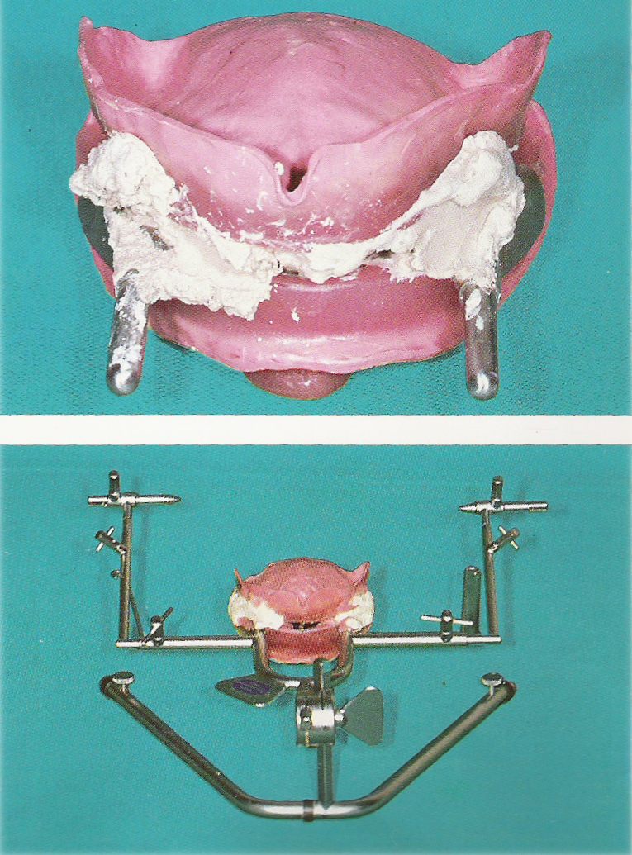

Slide 32
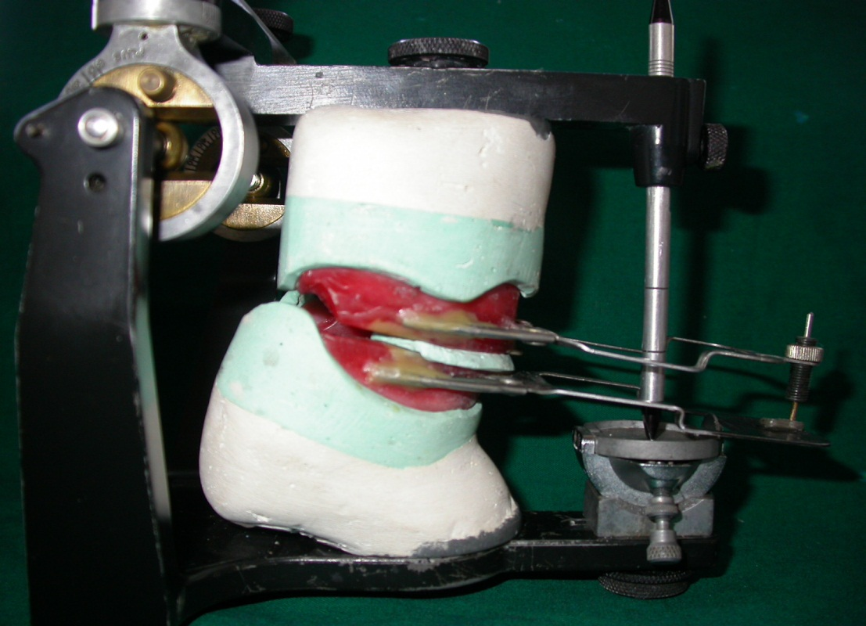

Slide 33
INTRAORAL ARROW POINT TRACING
Located intraorally
Simple compared to extraoral
Disadvantage:
1. it cannot be observed during the tracing
2.small, it is difficult to find the true apex.
Procedure……..

Slide 34
The Intraoral arrow point tracer combines a central bearing and tracing device.
It has pointed screw in bearing and a tracing device mounted on the maxillary rim and a plate mounted on the mandibular rim.
The plate is covered with a marking substance.
The central bearing pin is connected to the proper vertical relation and when the rims are in place, the patient is instructed to perform lateral and protrusive movements.
As these movements are performed, the Gothic arch form is traced on the plate.

Slide 35
Types of INTRAORAL ARROW Tracers
Seidel
Ballard
Masserman

Slide 36
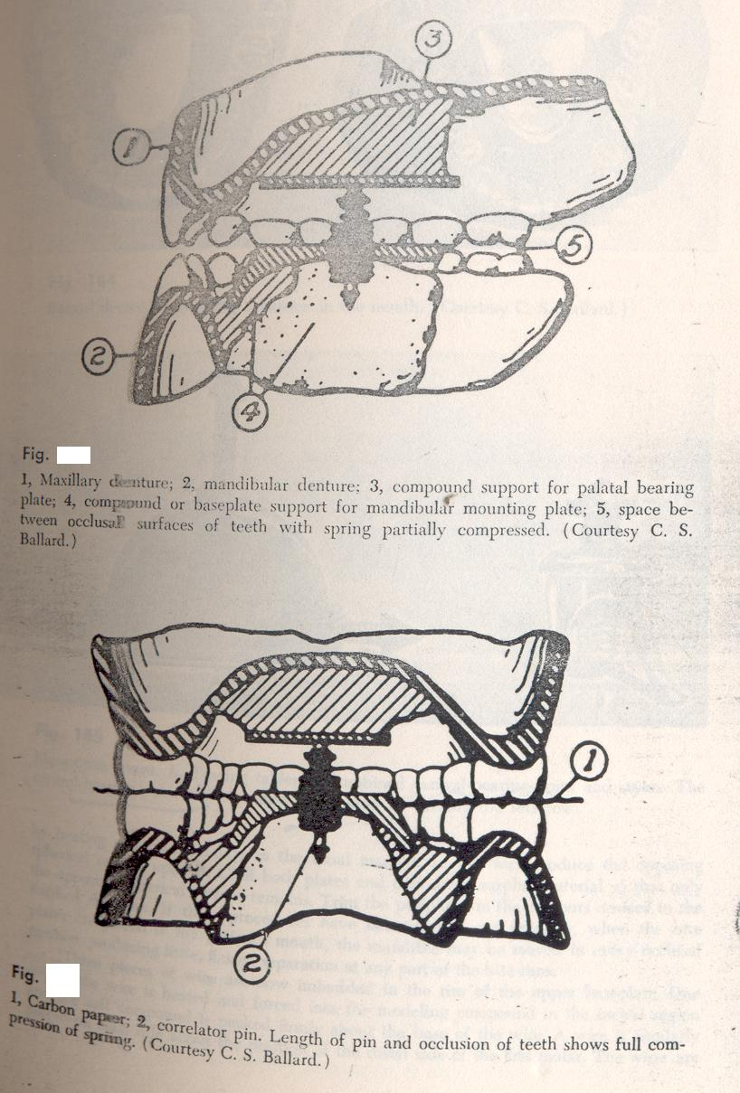

Slide 37
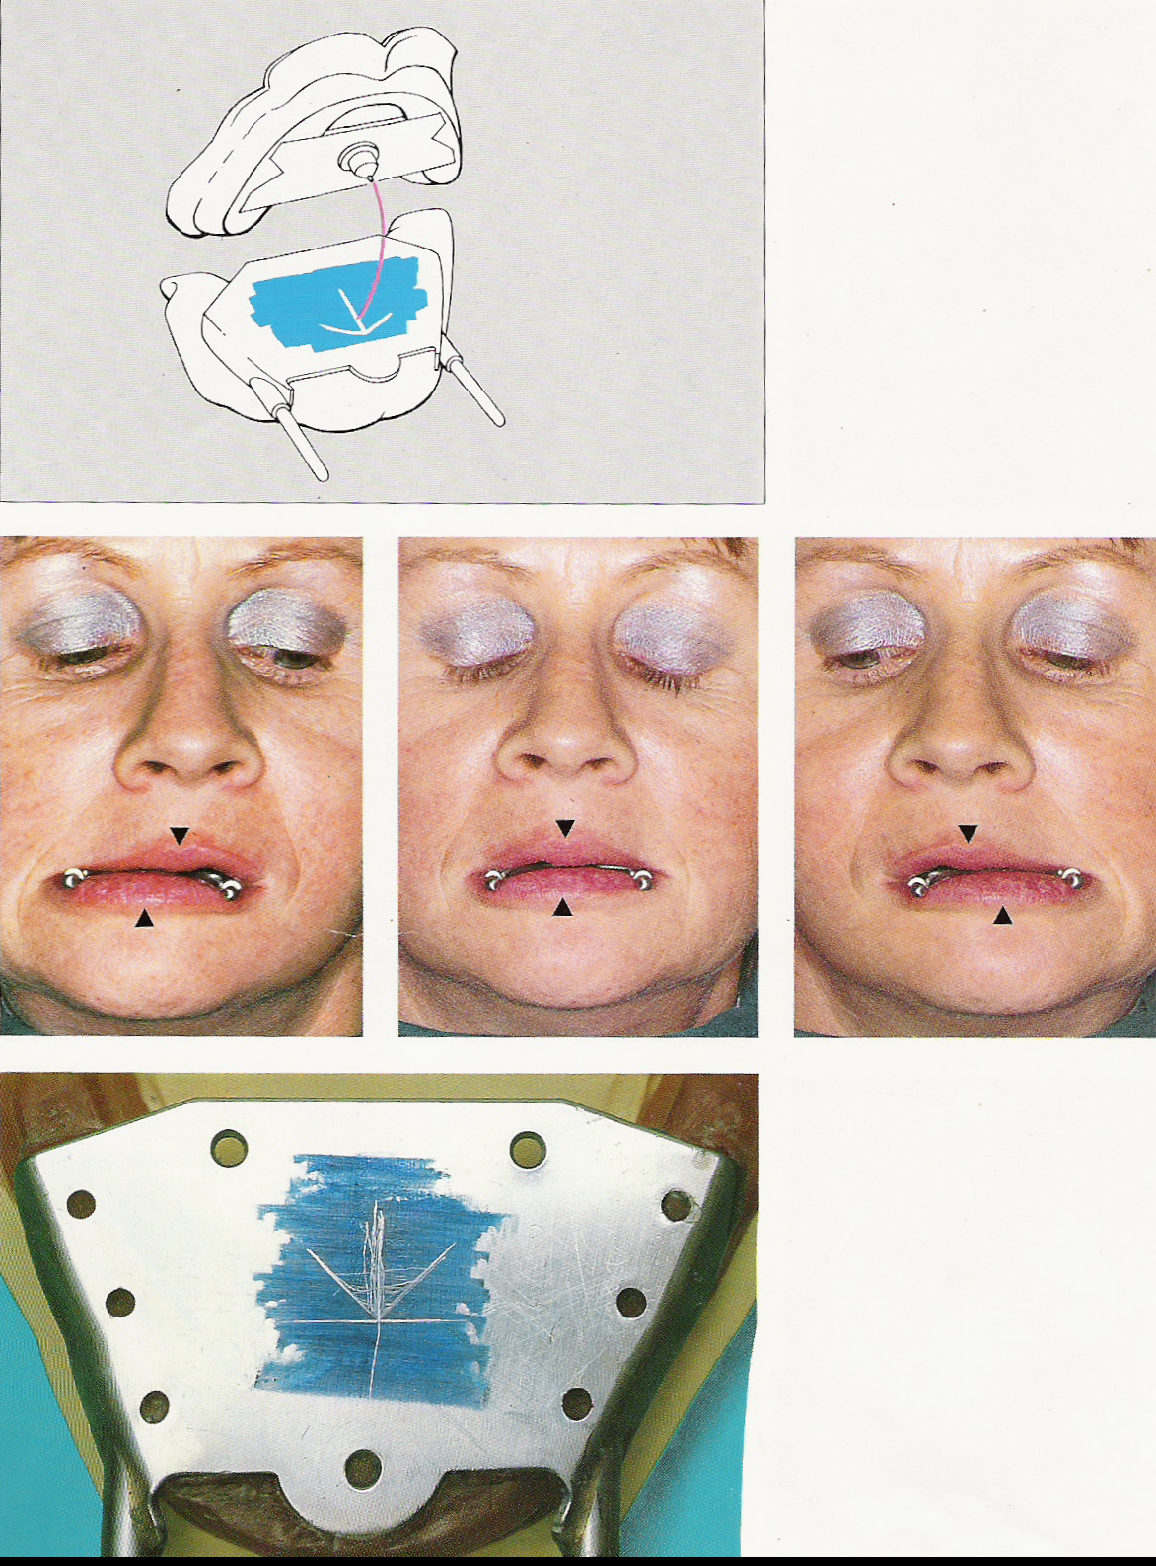

Slide 38
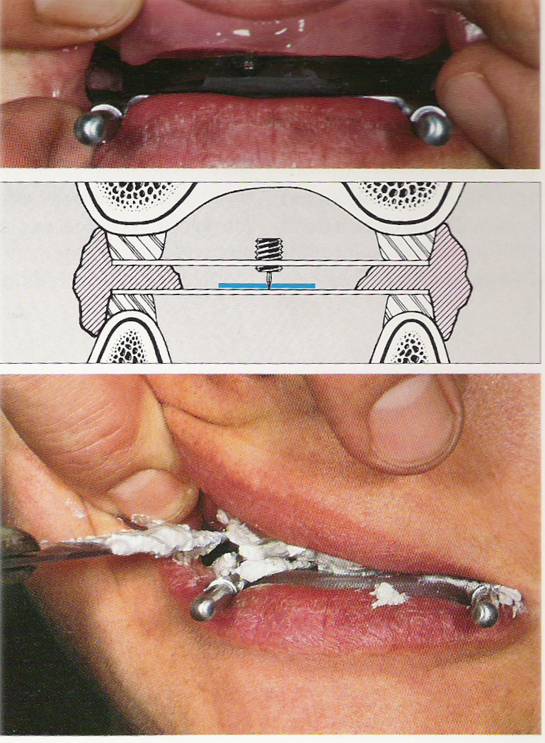

Slide 39
MATERIALS USED FOR INTER OCCLUSAL RECORDS
1.Waxes.
2.Impression plaster
3.Zinc oxide eugenol
4.Acrylic resin
5.Polyether
6.silicone

Slide 40
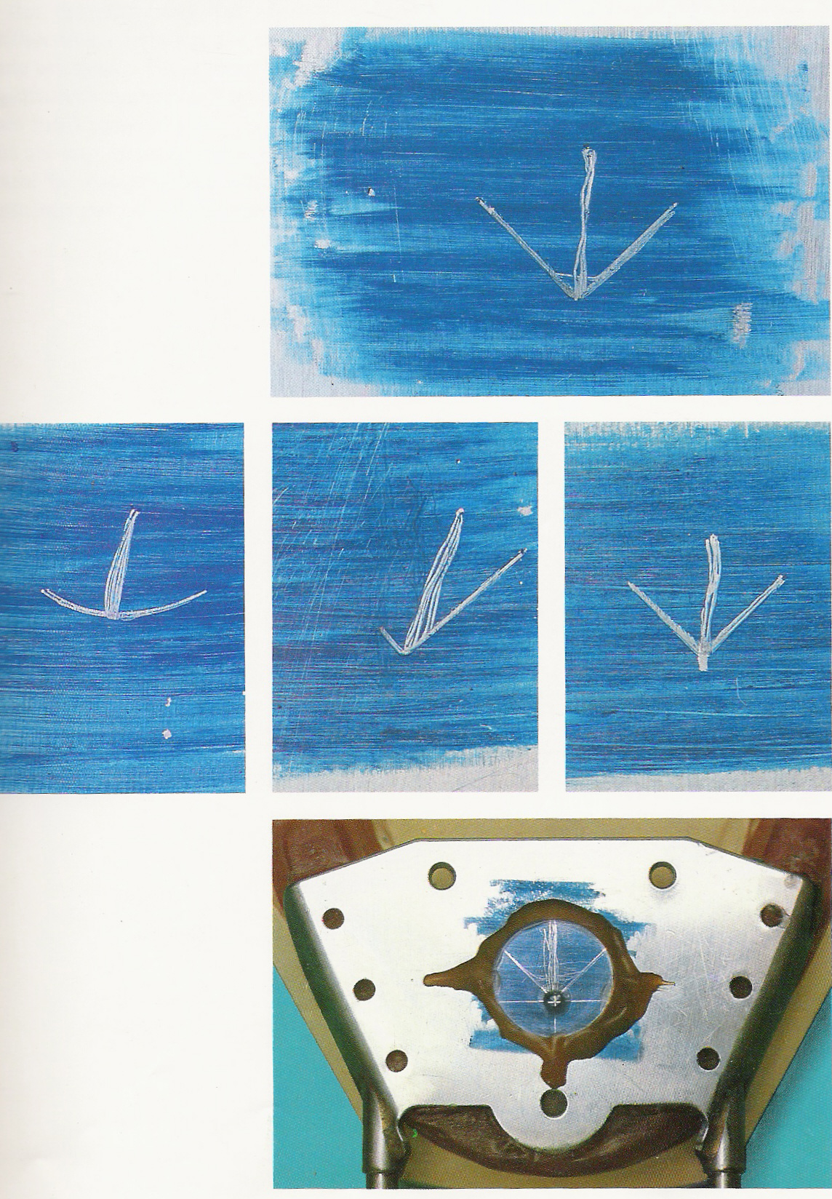

Slide 41
      PANTOGRAPH
      Is an instrument used to graphically record one or more planes/paths of mandibular movement and to provide information for the programming of the articulator-GPT
PANTOGRAPHIC TRACING;
A graphic record of mandibular movement in three directional planes as registered by the styli on the recording tables of a pantograph; Tracings of mandibular movement recorded on plates in horizontal and sagittal planes-GPT.

Slide 42
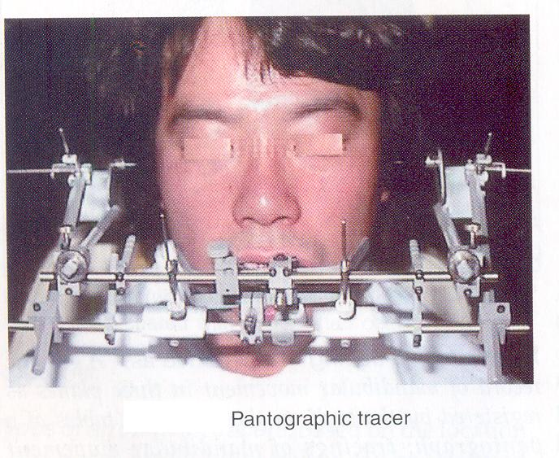

Slide 43
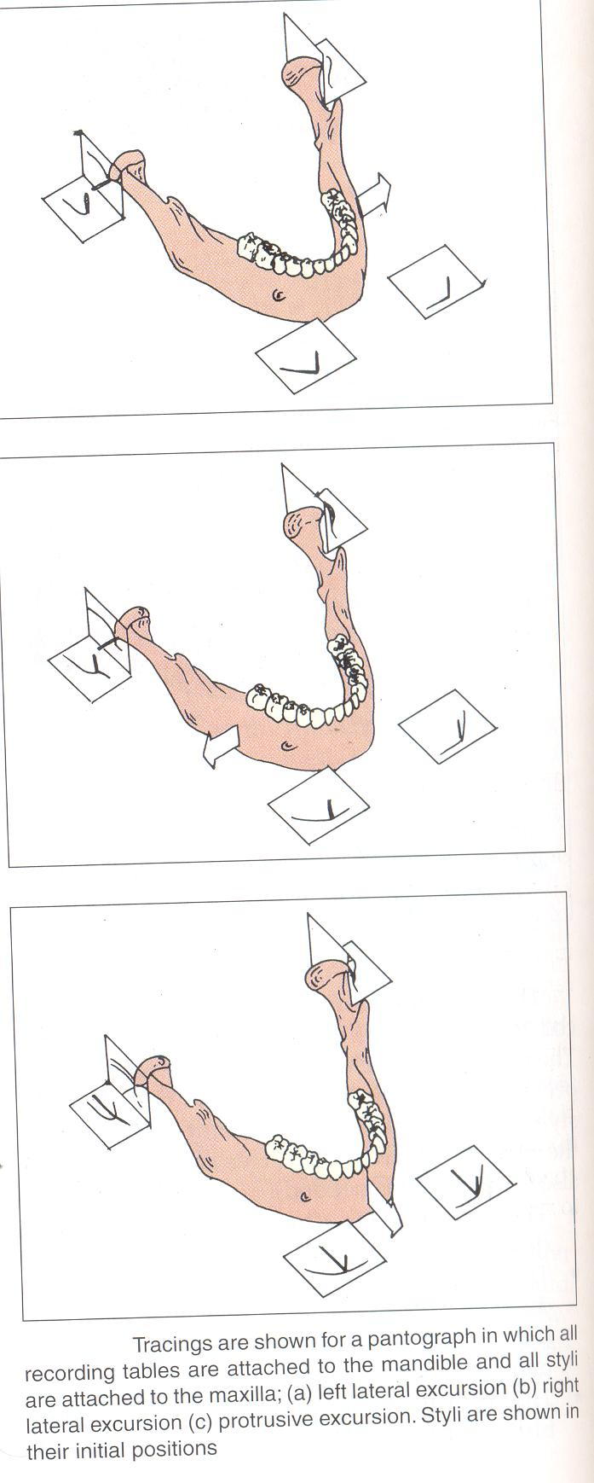

Slide 44
RADIOGRAPHIC METHOD
The use of cephalometrics to record centric relation was described by Pyott and Schaeffer.
The proper centric relation and vertical dimension of occlusion were determined by cephalometric radiographs.

Slide 45
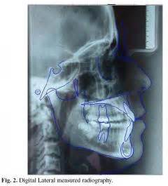

Slide 46
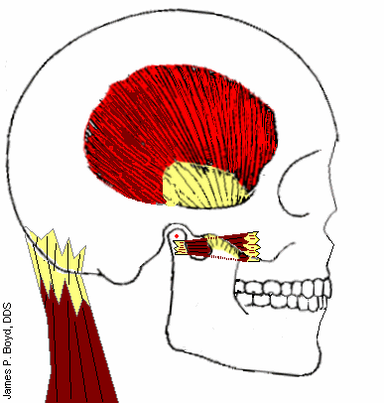
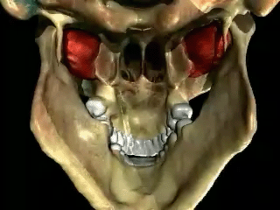
Consequences of incorrect centric relation recording
Natural dentition– damage to periodontal structure, hypersensitivity, excessive attrition, hypermobility of teeth.
Pain & dysfunction of masticatory muscle, headache, neck& shoulder pain.
Dentures- not in centric relation— premature contact.
TMJ dysfunction— condyle press upon peripheral vascular & innervated part of articular disc.
Mucosal irritation & soreness.
Spasm of muscle of mastication
Resorption of residual alveolar ridges.

Slide 47

conclusion

Slide 48


THANK U

