Slide 1
Constrictive Pericarditis
By – Dr. Ankur Gupta/Dr Jayesh Rawal
Department of Cardiology
Dhiraj Hospital.
Sumandeeep Vidyapeeth

Slide 2
Clinical Presentation
A 22-year-old male presented with chief complaints of:
  Easy fatigability x 8 months
  Abdominal discomfort x 8 months
  B/L lower extremity edema x 6 months
  Breathlessness on exertion (NYHA Class II) x 6 months

Slide 3
H/o Decreased appetite and weight loss for past 6-8 months.
No history of:
  Fever
  Vomiting/diarrhea
  Cough with expectoration
  Orthopneoa
  PND
  Decreased urine output
  Yellowish discoloration of sclera
No past h/o: HTN/DM/IHD/TB/B.A.
  (Diagnosed as a case of DCM 3 months back).
Family history: Nothing significant.
Personal history: No h/o smoking, alcoholism or tobacco chewing.

Slide 4
Case Summary
A young male with complaints of:
  Rt. hypochondrium discomfort
  Easy fatigability
  Pedal edema
  Exertional dyspnoea
  Diagnosed as ?DCM

Slide 5
Differentials at this stage
RHF
Pericardial effusion
Nephrotic Syndrome/CKD
Chronic liver disease
CCF

Slide 6
On physical examination
  Cachexia +
  Afebrile
  Pulse – 110/min, regular low volume pulse.
  RR – 22/min.
  BP - 102/70 mmHg.
  Pallor +
  B/L lower limb pitting edema.
  JVP – Elevated, 10 cm. above the sternal angle. Normal x and rapid y descent.
  Kussmaul's sign present.
  No icterus, lymphadenopathy, cyanosis, clubbing.

Slide 7
On systemic examination
  CVS - On inspection – Apex impulse not visible. No other visible pulsations, dilated veins over precordium.
  On Palpation – Apex beat is in 5th ICS, 1 cm medial to MCL. No palpable heart sounds or thrill.
  On percussion – Lt. heart border coincides with apex. 2nd Lt. ICS is resonant. Rt. heart border is retrosternal.
  On auscultation - S1 S2 normal. No other sounds audible. No murmur.
  RS – Breath sounds B/L equal. No adventitious sounds heard.
  P/A – Hepatomegaly + 4 cms. below the rt. costal margin. Liver span of 18 cm.
  CNS – Conscious, oriented.

Slide 8
Clinical Diagnosis
Right heart failure

Slide 9
Causes of RHF
Massive Pericardial effusion
Pulmonary Hypertension
Constrictive pericarditis
Restrictive cardiomyopathy/Endomyocardial fibrosis
Pulmonary stenosis
Tricuspid Regurgitation
RA myxoma.

Slide 10
Most likely clinical diagnosis:
Constrictive pericarditis
Restrictive cardiomyopathy/Endomyocardial fibrosis
??? DCM

Slide 11
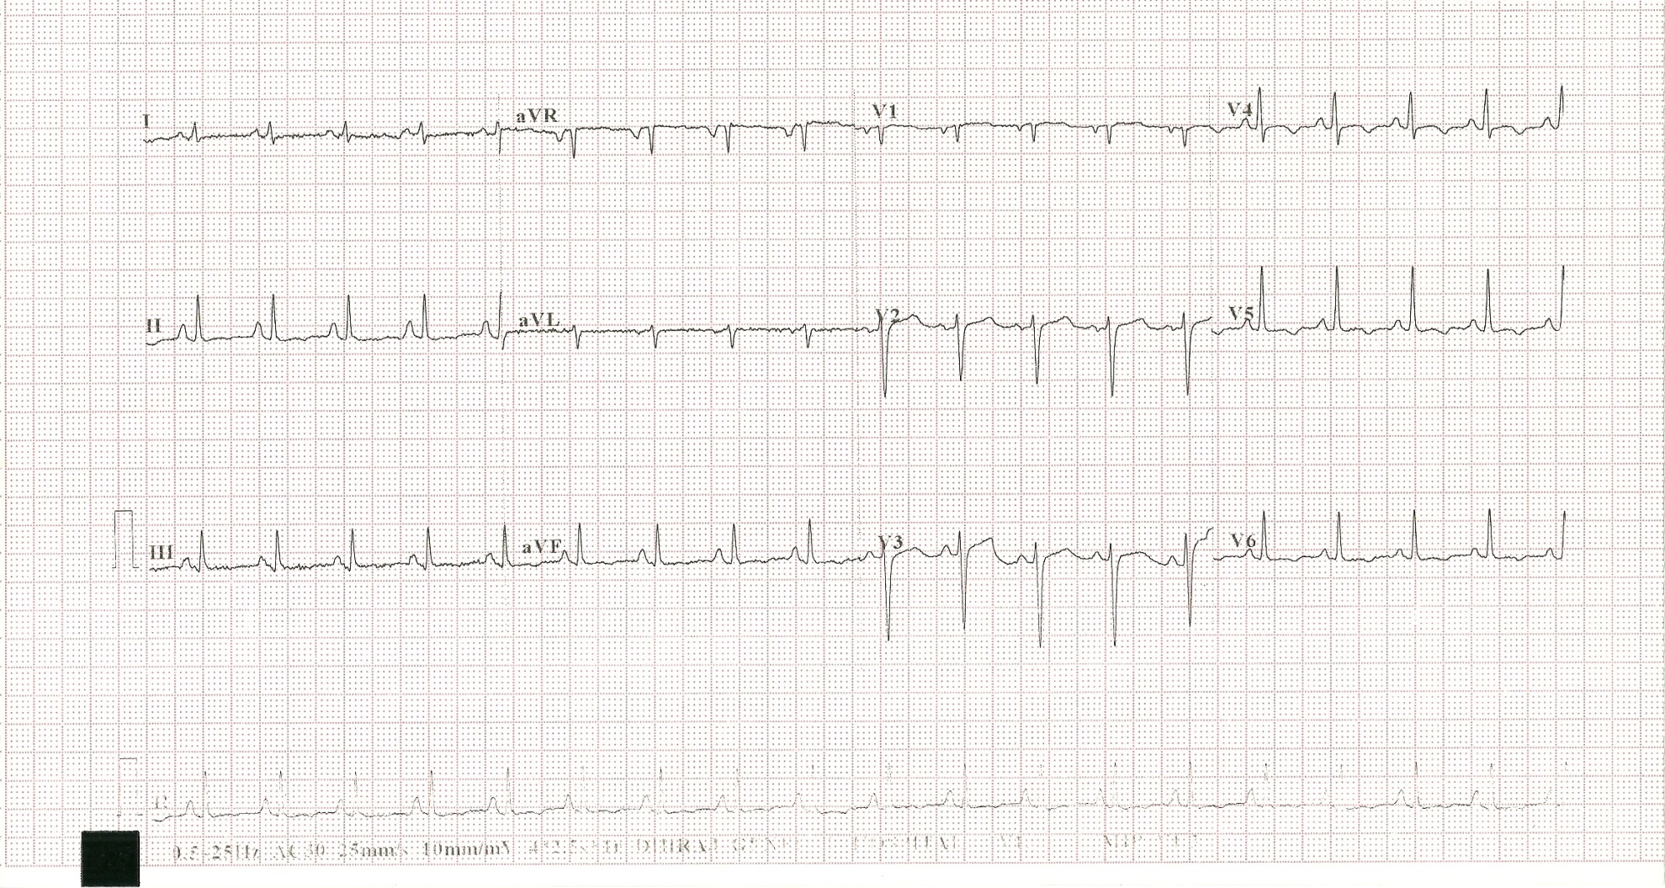
ECG

Slide 12
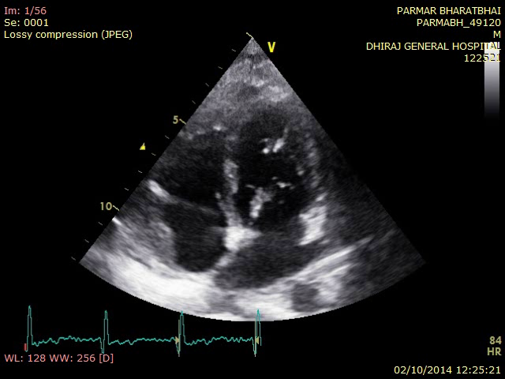
ECHOCARDIOGRAPHY

Slide 13
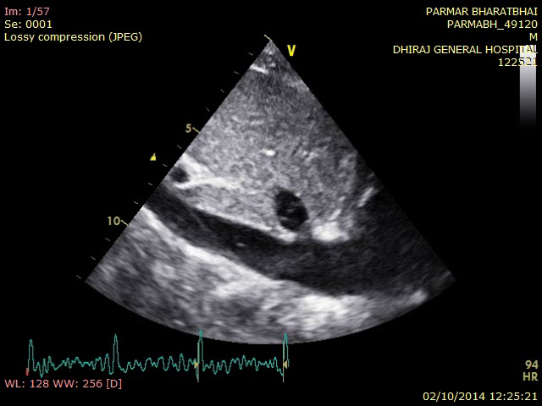

Slide 14
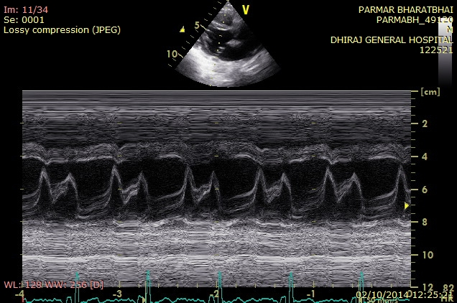

Slide 15
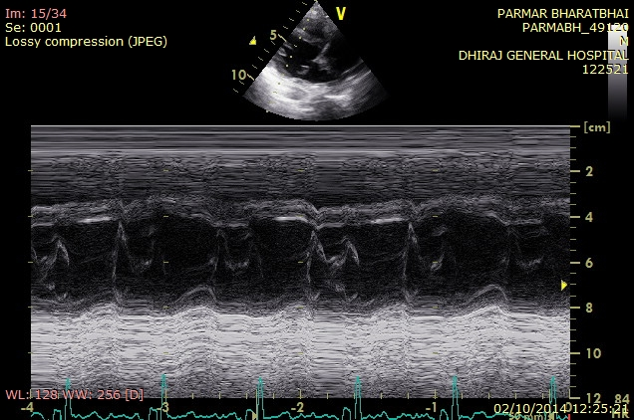

Slide 16
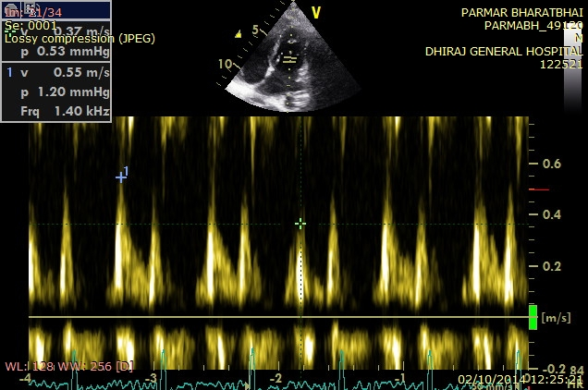

Slide 17
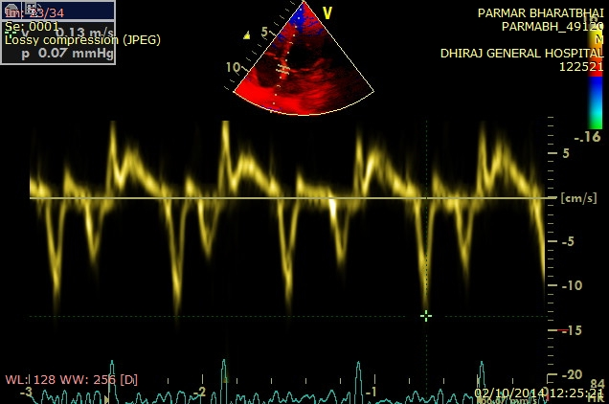

Slide 18
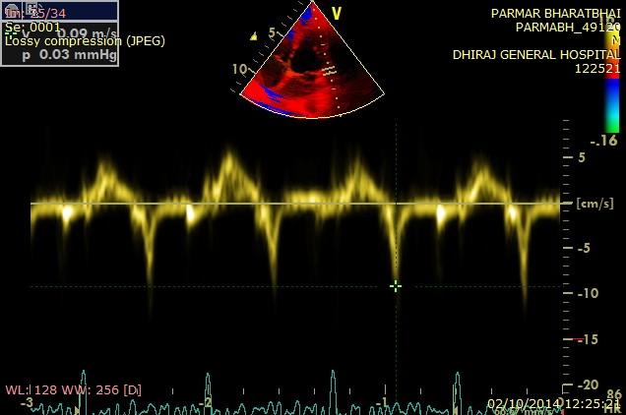

Slide 19
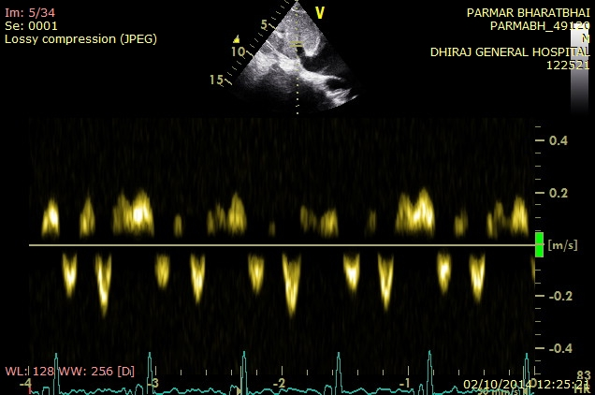

Slide 20
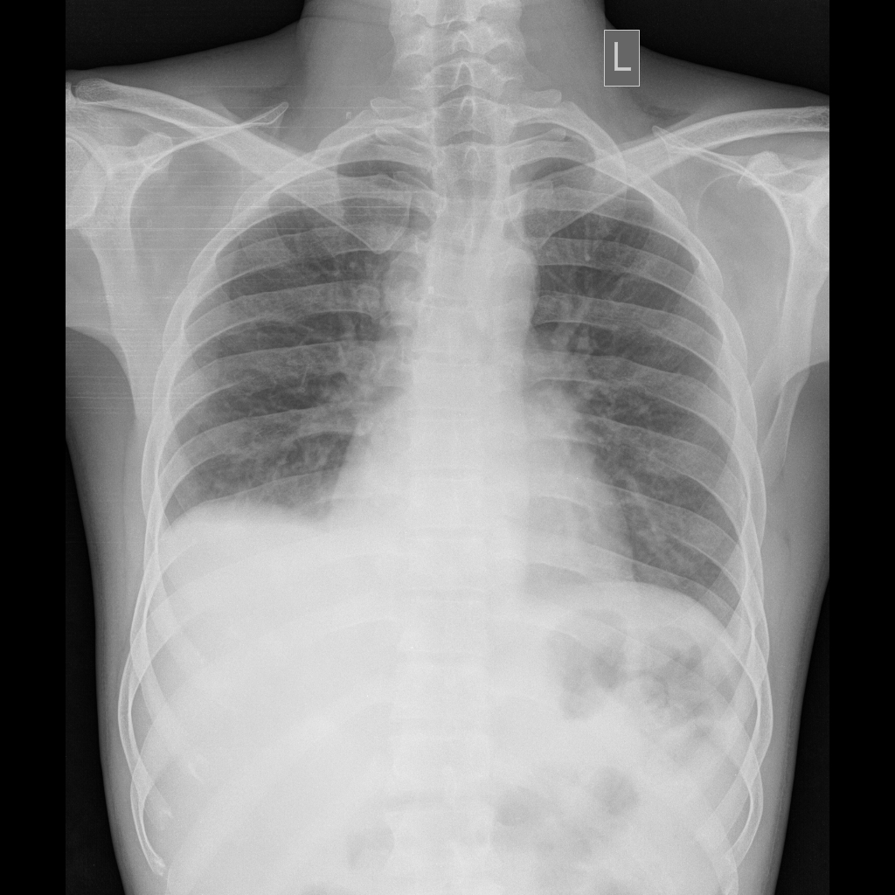
CXR

Slide 21
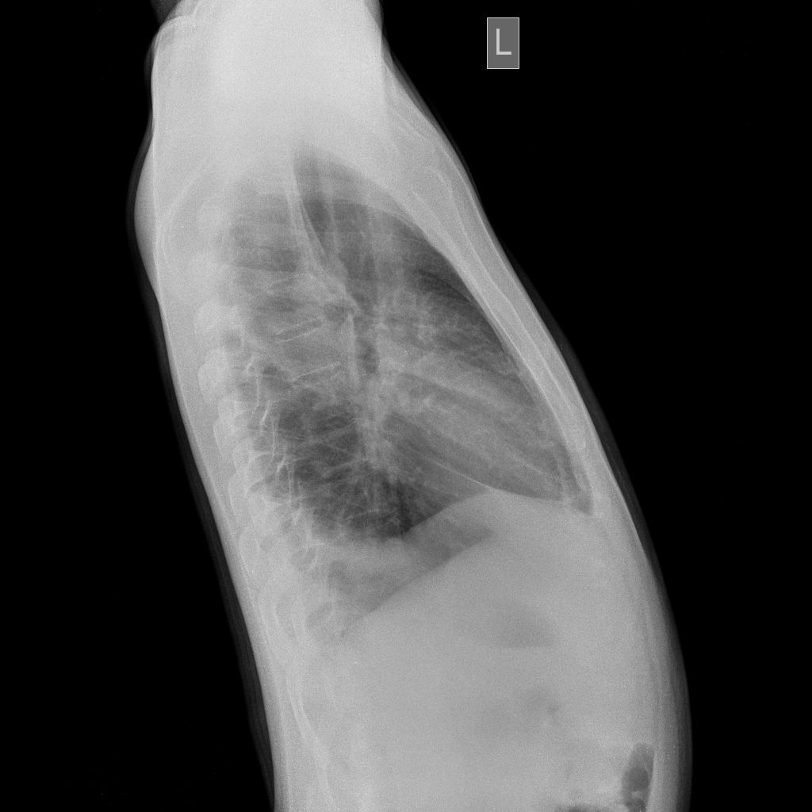

Slide 22
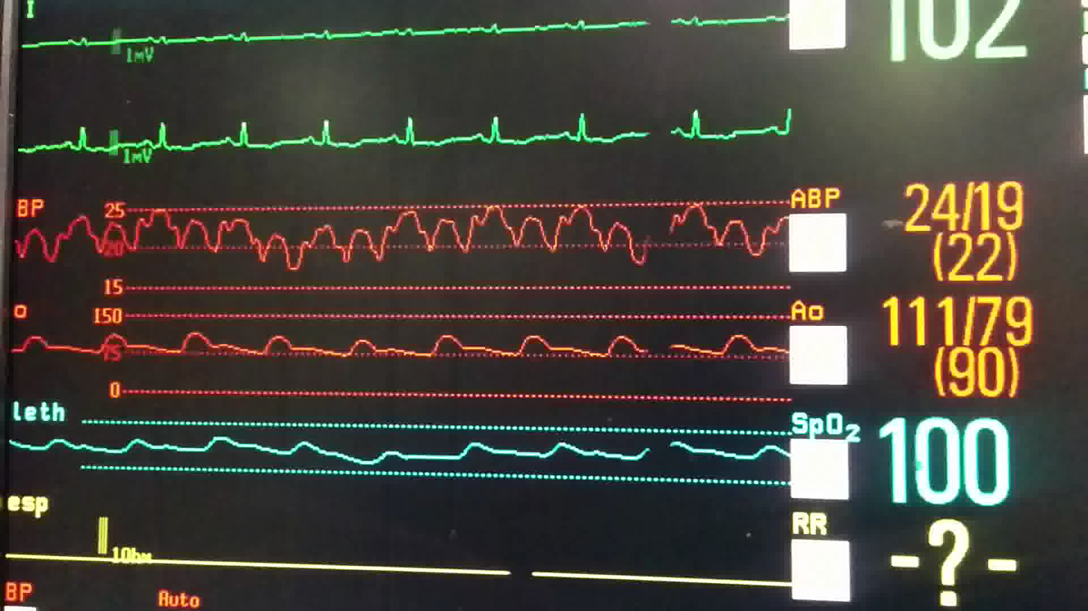
Hemodynamics

Slide 23
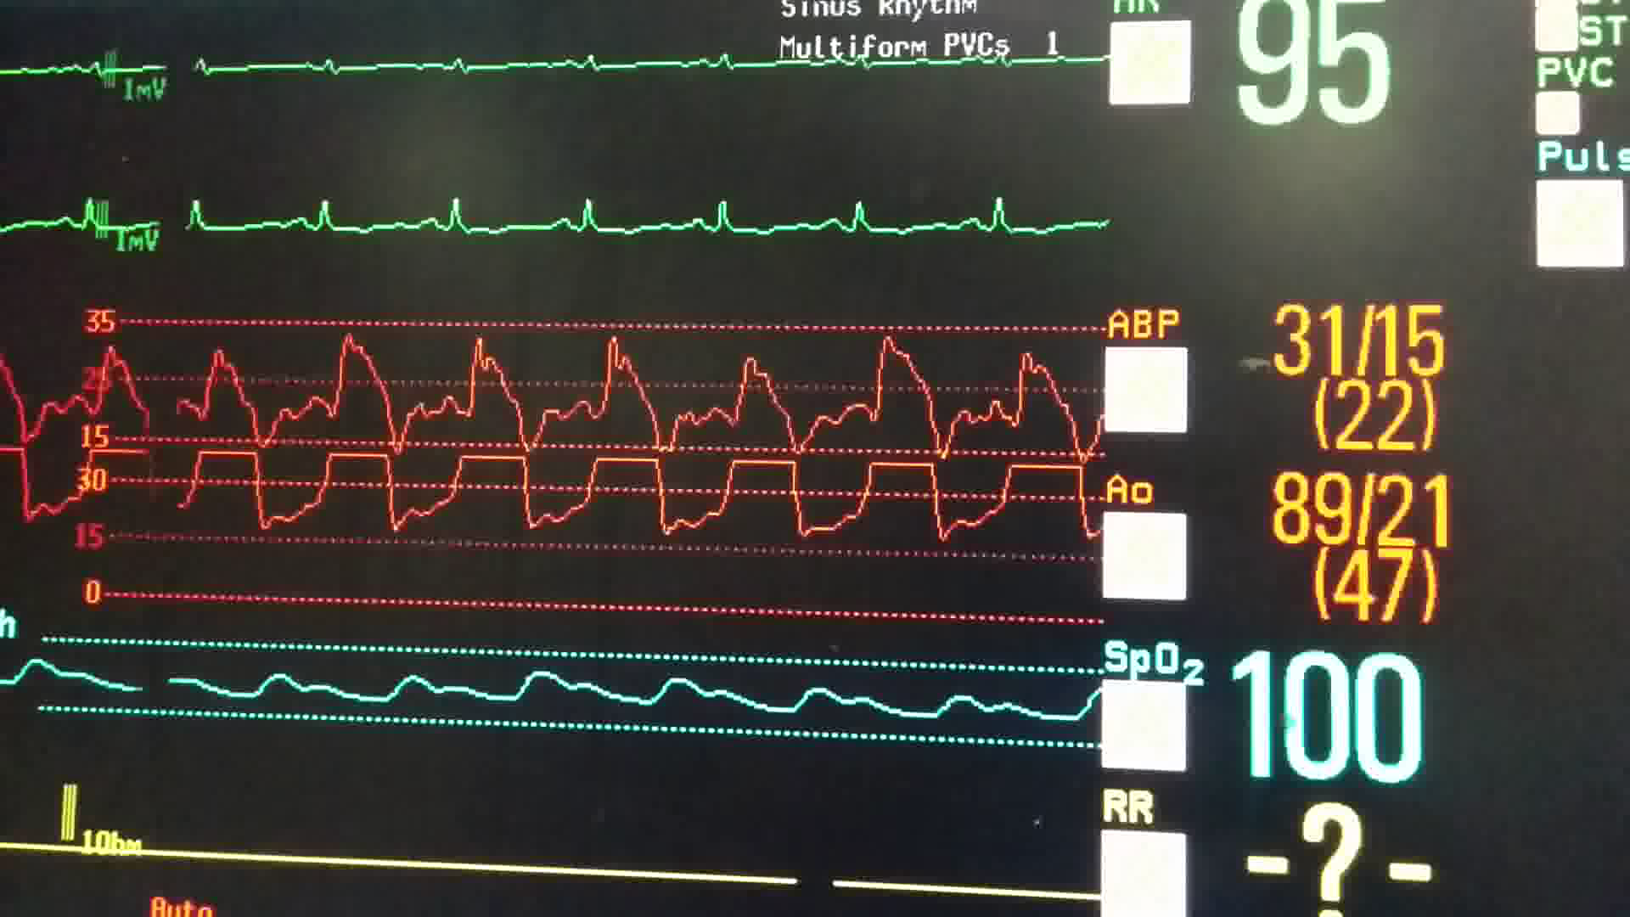

Slide 24
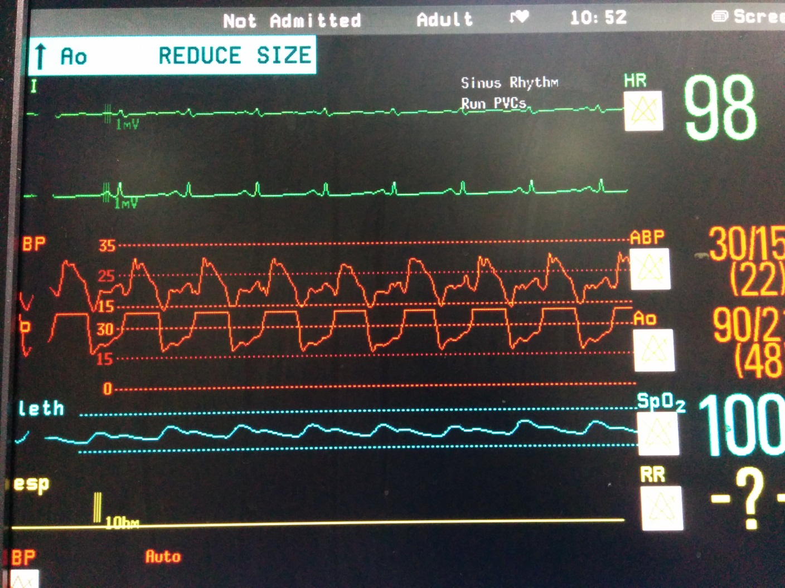

Slide 25
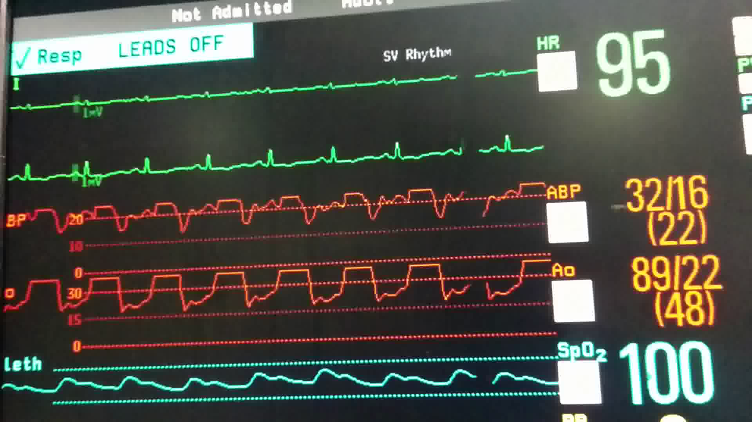

Slide 26
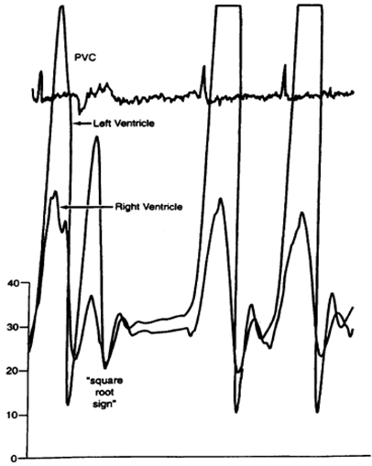
Simultaneous RV and LV tracings. Near equalization of diastolic pressures, the rapid filling wave (√).

Slide 27
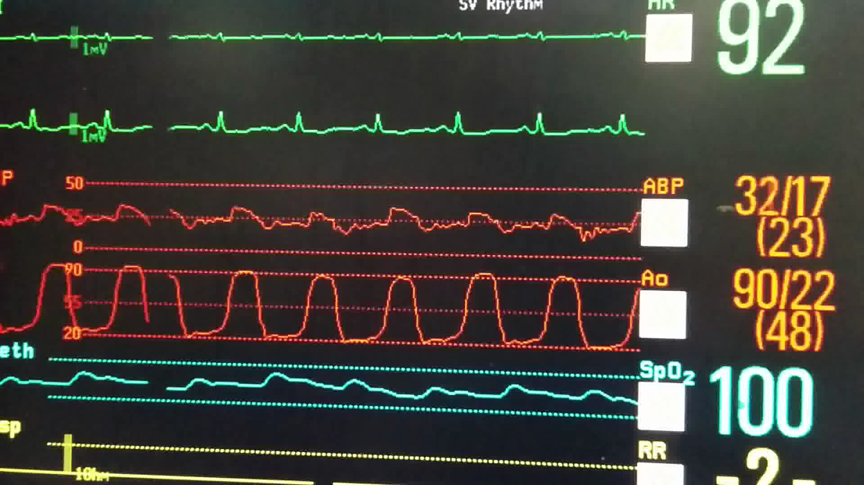

Slide 28
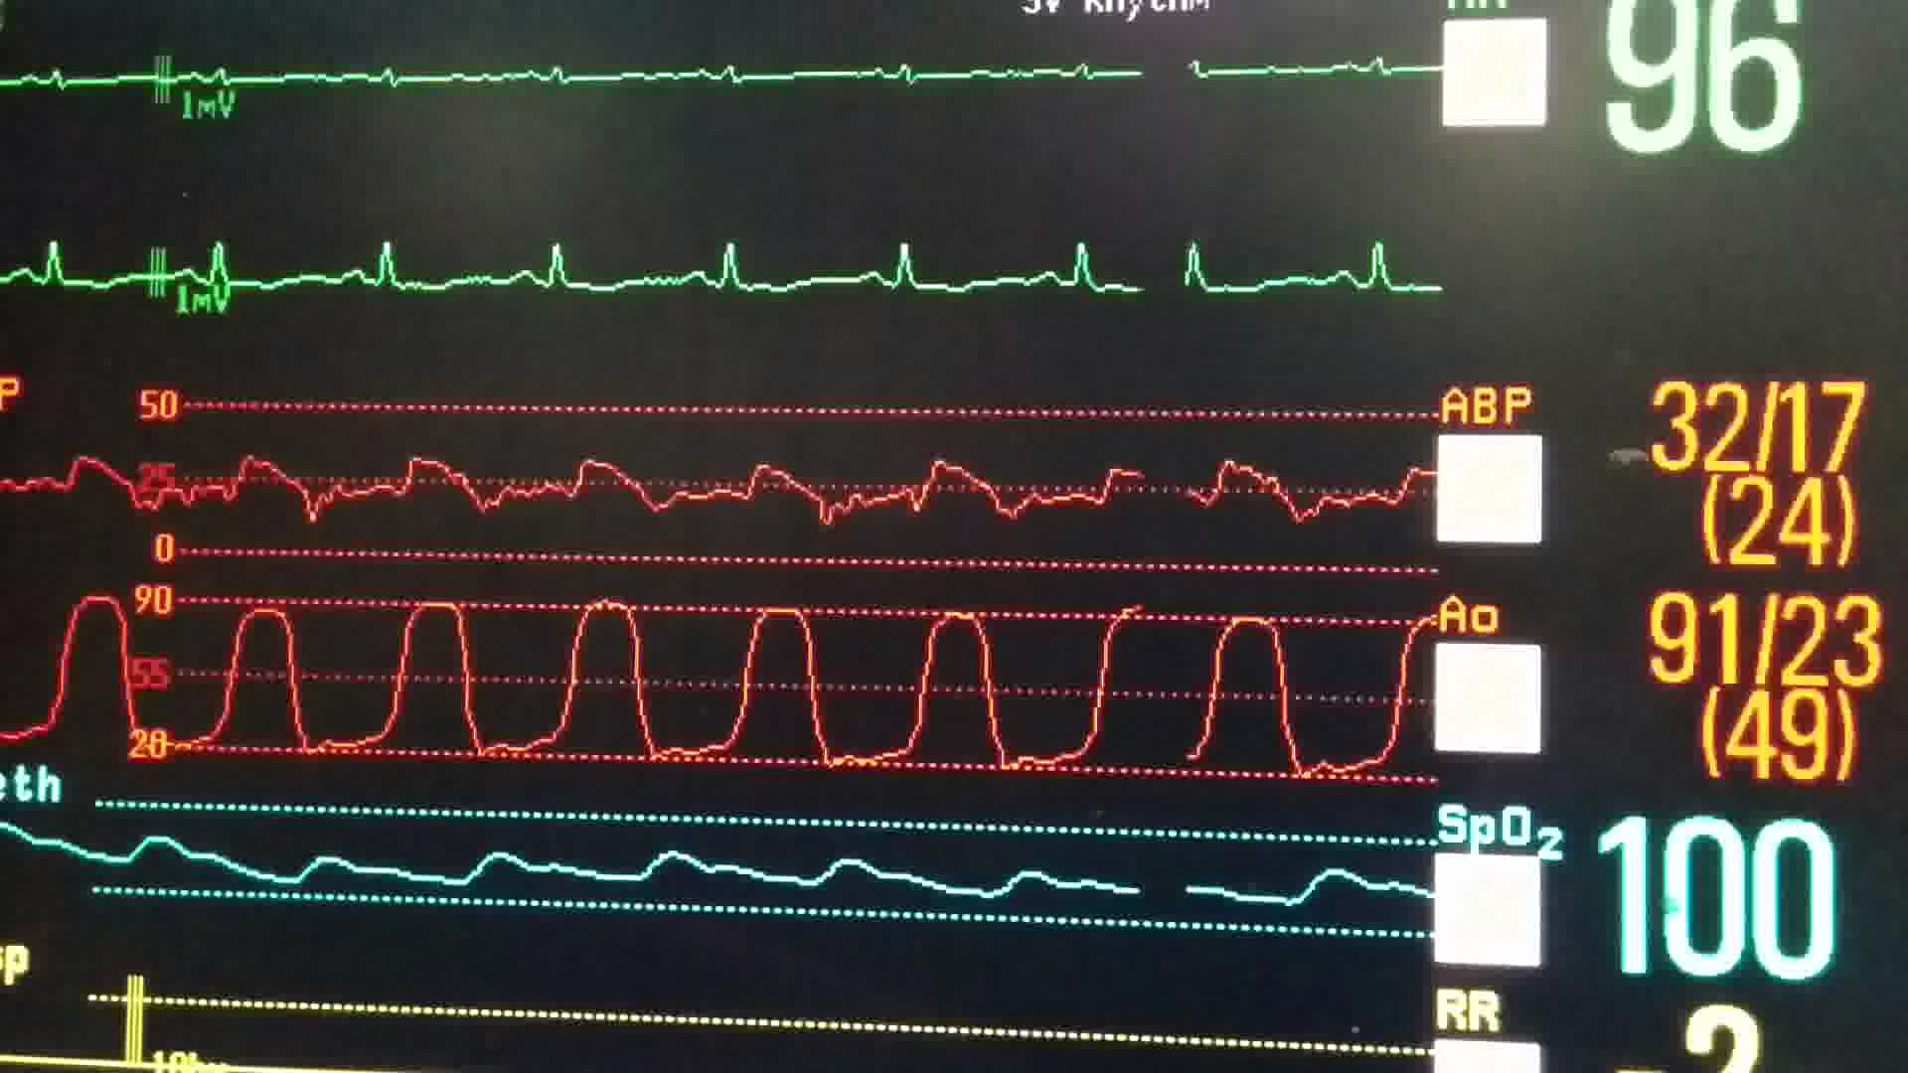

Slide 29
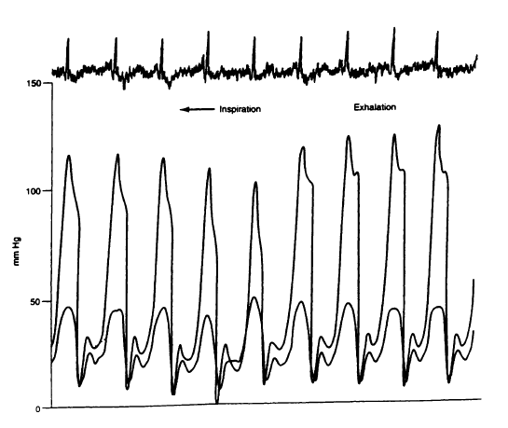
Simultaneous right ventricular and left ventricular tracings. Close approximation of diastolic pressures.

Slide 30
Site | Basal Pressure (mm Hg) | Remarks
Femoral artery | S114 D79 M93
RA | S25 D19 M22 | Prominent x and y descents (M or W sign)
RV | Peak systolic 30 RVedp 22 | Dip and plateau contour seen
LV | Peak systolic 94 LVedp 26 | Dip and plateau contour seen
Interventricular interdependence seen due to LV and RV systolic pressure discordance with respiration
PASP | S31 D21 M23
RVEDP/RVSP | 22/30
LVEDP - RVEDP | 26 - 22 = 4 | (<5 mm Hg)

Slide 31
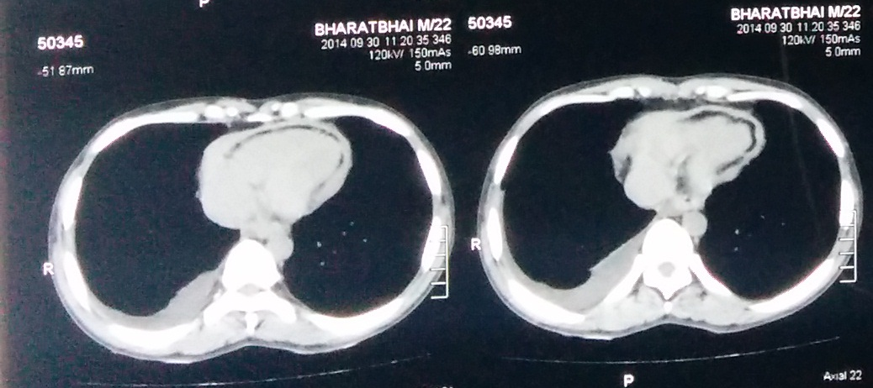
IMAGING

Slide 32
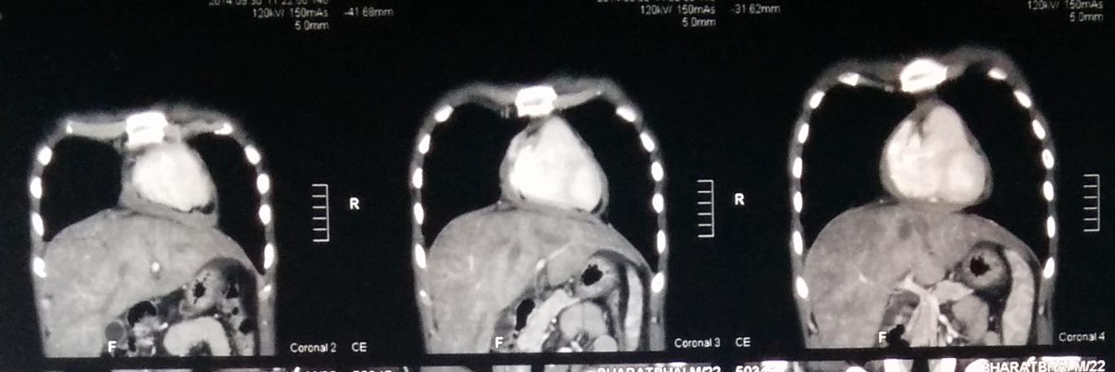

Slide 33
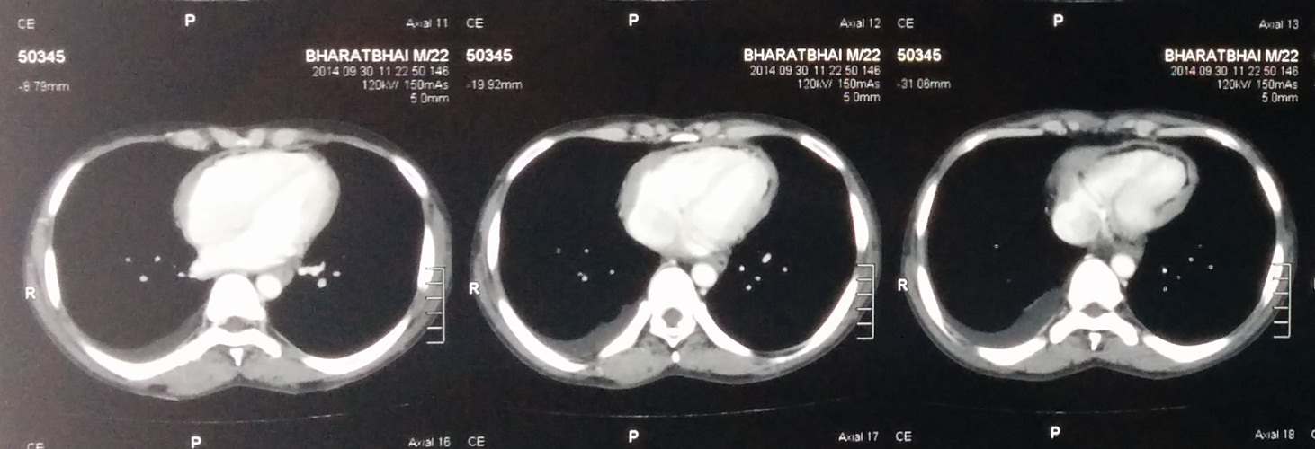

Slide 34
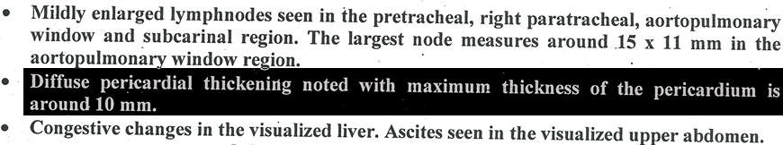
CT Chest Report

Slide 35
CT/MRI : Thickened pericardium (>4mm) in a patient with a hemodynamic profile consistent with CP physiology is considered diagnostic.

Slide 36
Final Diagnosis
CONSTRICTIVE PERICARDITIS

Slide 37
Discussion

Slide 38
Introduction
End stage inflammatory process involving pericardium.
Restricted diastolic filling of the heart by fibrotic pericardium.
Thickened and adherent pericardium.
The visceral and parietal pericardium usually become adherent.
Obliteration of the pericardial space
  In some cases the constricting process is formed by the visceral pericardium (epicardium) alone.
Calcium deposition may occur with further thickening and stiffening of the pericardium.

Slide 39
Pathophysiology
Acute and subacute forms of pericarditis
(may or may not be symptomatic)
Deposit Fibrin (can cause Pericardial effusion).
Pericardial organization, chronic fibrotic scarring, and calcification.
Parietal/Visceral Pericardium (inflamed, thickened, and fused).
Obliteration of Pericardial space.
Ventricle loose distensibility.

Slide 40
Limitation of venous return to the heart.
Reduced ventricular filling.
Inability to maintain adequate preload.
Filling pressures of the heart tend to become equal in both the ventricles and the atria.

Slide 41
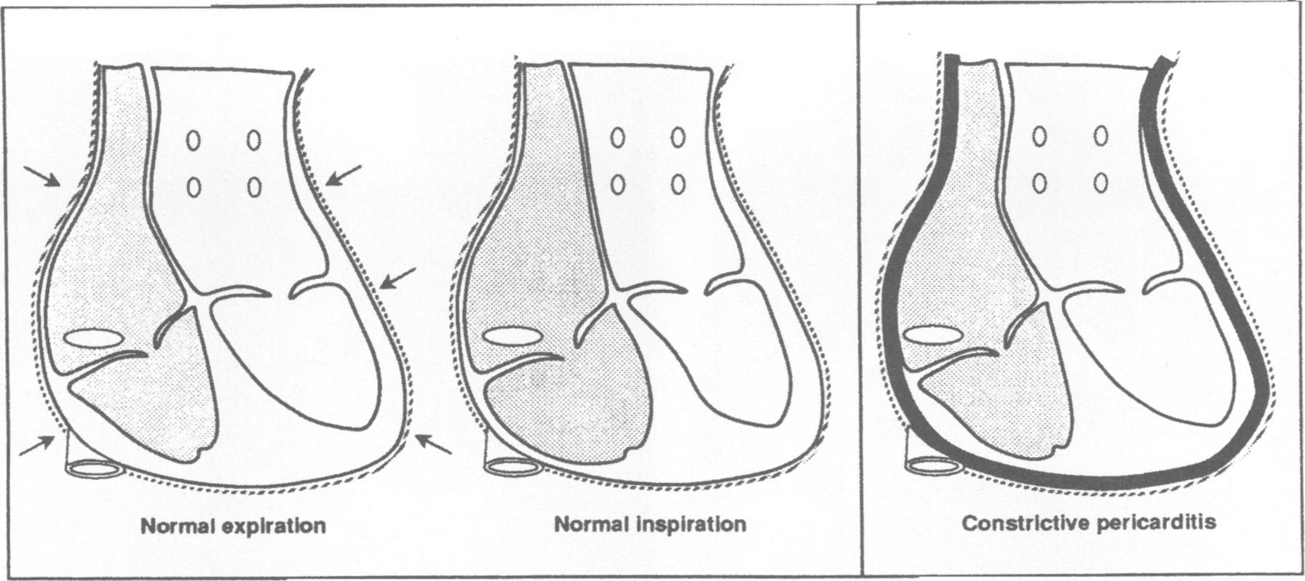
Effects of inspiration on the RA and RV in the normal heart causing bowing of the IVS and a resultant decrease in LV preload and therefore a decreased pulse.
In CP, however, a thickened and rigid pericardium prevents transmission of intrathoracic pressure variations to the RA and RV resulting in little effect of respiration on the intracardiac pressures and hence little pulse pressure variation with respiration.

Slide 42
Myocardium is unaffected → early ventricular filling during the first third of diastole is unimpeded.
After early diastole → stiff pericardium affects flow and hemodynamics.
Ventricular pressure
  Initially decreases rapidly (steep y descent on RA pressure waveform tracings) and
  then increases abruptly to a level that is sustained until systole (the “dip-and-plateau waveform” or “square root sign” seen on RV or LV pressure waveform tracings).

Slide 43
Preservation of myocardial function in early diastole aids in distinguishing CP from restrictive cardiomyopathy.
Systolic function is rarely affected until late in the course of the disease
  Secondary to infiltrative processes from the overlying adjacent pericardial disease.
Symptoms consistent with CCF, especially right-sided heart failure.
  Inability of the heart to increase stroke volume.
“Pure CP” – Normal contractile function. EF may be reduced due to reduced preload.

Slide 44
Markedly elevated atrial pressures +
Small end systolic volumes → accentuated early diastolic ventricular suction
Abnormal rapid filling of ventricles in early diastole.
Intracardiac volumes reach limit set by stiff pericardium.
Early to mid diastole – Ventricular filling abruptly caeses.
As a result, almost all ventricular filling occurs early in diastole.

Slide 45
The clinical symptoms and classic hemodynamic findings of CP
Early rapid diastolic filling and pressure elevation.
Eventual equalization of the diastolic pressures in all of the cardiac chambers
Restricted late diastolic filling
Venous engorgement and decreased cardiac output, all secondary to a confining pericardium.

Slide 46
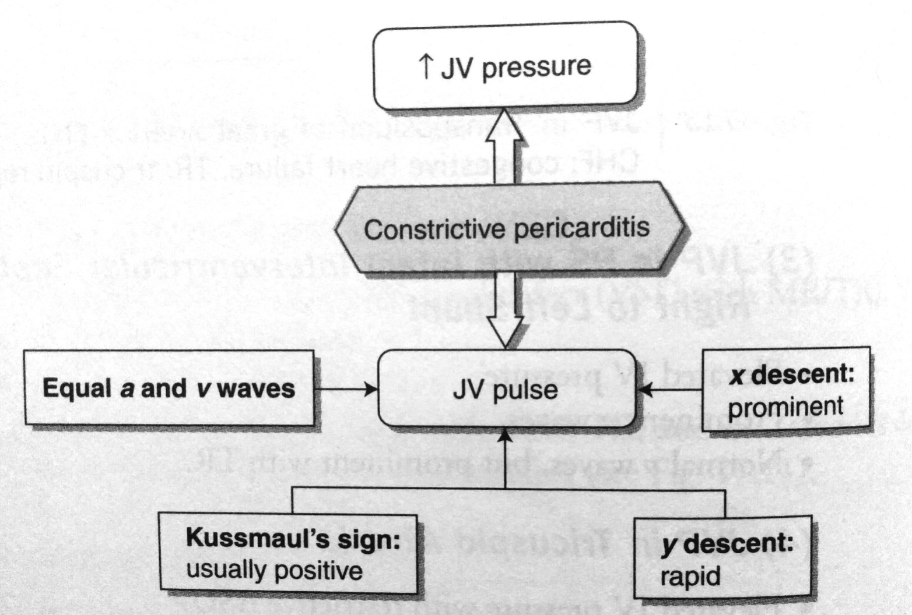

Slide 47
ETIOLOGY
Idiopathic
Infectious:
  Tuberculosis
  Viral esp. Coxackie B
  Bacterial
  Fungal
  Parasitic
Post radiotherapy
Post cardiac surgery
Post traumatic
Neoplastic
Connective tissue diseases esp. rheumatoid arthritis and SLE
Toxic/Metabolic
  Uremia, chylous pericardium, methysergide
Post myocardial infarction
Familial

Slide 48
Diagnostic evaluation
ECG
  Rarely normal, nonspecific and highly variable.
  Atrial arrhythmias are frequent, with AF occurring late in course.
  Low voltage (<50% cases).
  LA enlargement (19-37%).
Chest X ray
  Pulmonary venous congestion and pleural effusions (late in the disease).
  Calcified pericardium is highly suggestive of CP when present in a patient with constrictive/restrictive physiology.

Slide 49
2D echo:
Pericardial thickening (TEE more sensitive)
Normal RV and LV chamber size
LA and RA enlargement
Abnormal septal and posterior wall motion
Paradoxical septal motion
Premature opening of the pulmonic valve
Dilated IVC without respiratory variation

Slide 50
Doppler findings:
Superior Vena Cava: Diastolic Flow Velocity > Systolic Flow Velocity
Hepatic vein: Exaggerated diastolic flow reversal after onset of expiration.
Pulmonary Venous Flow: Increase in diastolic flow velocity on expiration. Systolic/Diastolic flow velocity ratio < .65
Peak Diastolic flow velocity falls 40% on inspiration.
Mitral inflow pattern: During onset of exhalation – 25% increase in early diastolic flow velocity

Slide 51
HEMODYNAMICS
A LV diastolic and RV diastolic pressure difference of less than 5 mmHg at rest.
Diastolic dip and plateau (square root sign) of ventricular tracing. Prominent rapid filling wave.
Lack of respiratory variation or an increase in RA pressure on inspiration (Kussmaul’s sign).
RVedp/RVSP ratio greater then 1/3.
RVSP or PA pressure >55 mmHg.

Slide 52
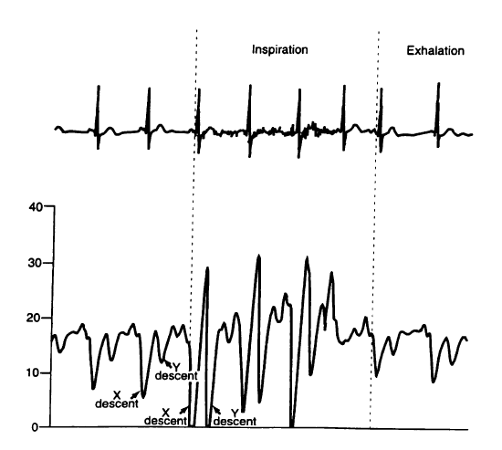
Kussmaul's sign on hemodynamic tracing. Exaggerated x and y descent particularly during inspiration.

Slide 53
Simultaneous right ventricular and left ventricular tracings. Close approximation of diastolic pressures.

Slide 54
Simultaneous RV and LV tracings. Near equalization of diastolic pressures, the rapid filling wave (√).

Slide 55
IMAGING
Chest Radiography
  Findings are commonly unremarkable.
  Severe pericardial calcification (20-30%).
  If no significant pericardial effusion - cardiac silhouette may appear normal.
  The superior vena cava may be dilated.
  Pleural effusions are common (late), usually bilateral.

Slide 56
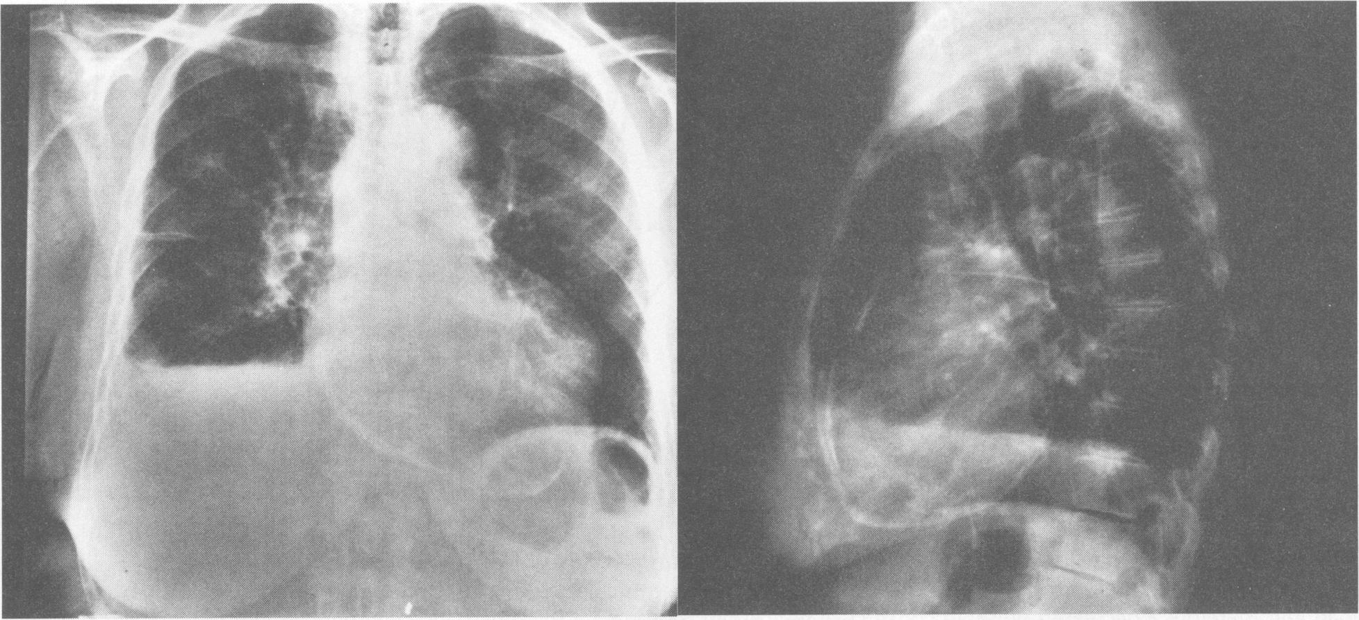
Posterior-anterior and lateral chest radiograph demonstrating a thickened calcified pericardium in another patient with CP

Slide 57
Computed Tomography (HRCT)
  Pericardial thickness
  Degree of calcification
  Distribution of these findings
  Pericardial thickening >4 mm assists in differentiating constrictive disease from restrictive cardiomyopathy, and thickening >6 mm adds even more specificity for constriction.
  Normal pericardial thickness does not exclude pericardial constriction, and the clinical situation must always be taken in account.

Slide 58
 | Restrictive cardiomyopathy | Constrictive Pericarditis
Physical Exam. | Kussmaul’s sign may be present. Apical impulse may be prominent. S3 may be present, rarely S4. Regurgitant murmurs more common. | Usually present Usually not palpable. Pericardial knock may be present. Regurgitant murmurs uncommon.
ECG | Low voltage, pseudoinfarction, LAD, AF, conduction abnormalities. Low voltage (<50%). | Non specific changes.
Echo. | Increased wall thickness. Thickened cardiac valves. Dilated atria. MR/TR common. | Normal wall thickness. Prominent early diastolic filling with abrupt displacement of IVS (septal bounce). Dilated atria. MR/TR uncommon.

Slide 59
 | Restrictive cardiomyopathy | Constrictive Pericarditis
Echo. | Inspiratory augmentation of hepatic vein diastolic flow. TD E’ velocity – Reduced. | Expiratory augmentation of hepatic vein diastolic flow (diastolic flow reversal). Increased.
Cardiac Cath. | LVedp often <5 mmHg greater than RVedp RVedp >1/3rd of RVSP Concordant pressure change between LV and RV. | RVedp and LVedp usually equal. Discordant pressure change between LV and RV during inspiration and expiration.
Endomyoca-rdial biopsy | May reveal specific cause of RCM | Normal or show non- specific myocyte hypertrophy or myocardial fibrosis.
CT/MRI | Pericardium usually normal. May reveal significant myocardial fibrosis. | Thickened pericardium.

Slide 60
BNP levels:
  RCM - >650 ng/L
  CP – <150 ng/L

Slide 61
JVP | DCM | RCM | EMF | Cardiac Tamponade | CP
JV pressure | May be elevated | May be elevated | Usually elevated | Elevated | Elevated
a waves | Normal | Prominent | Prominent | Never prominent | Normal or may be prominent
v waves | May be prominent | Normal | Prominent due to TR | Normal | Usually equal to a waves
x descent | Normal | Normal | Obliterated with TR | Normal | Prominent
y descent | May be rapid descent | Normal | Rapid descent due to TR | or absent | Rapid
Kussmaul’s sign | Negative | May be positive | Negative | Negative. May be positive | Usually positive

Slide 62
Management….

Slide 63
Pharmacologic Therapy
  Steroids - Subacute CP (before pericardial fibrosis occurs).
  Diuretics - Relieve congestion and optimize clinical volume status (may decrease preload to the point of reducing cardiac output).
  Any therapy directed toward the causative disease (eg, antituberculosis medication).
  Beta-blockers and CCBs – Avoided.

Slide 64
Pericardiectomy
  Complete pericardiectomy - Definitive therapy and a potential cure.
  Results are generally better if the procedure is performed earlier in the course, when less calcification is present and when the chance of abnormal myocardium or advanced heart failure is reduced.
  Between 80% and 90% of patients who undergo pericardiectomy achieve NYHA class I or II postoperatively.
  One study found that only 60% of patients showed complete normalization of cardiac hemodynamics.

Slide 65

Take message
Diagnosis of CP requires high index of suspicion, with careful clinical examination and echocardiography.
Cardiac catheterization establishes the physiology and Cardiac CT is confirmatory.
Patients with CP have a good outcome when their disease process is discovered early in its course.
(else it can be a case of missed diagnosis)

Slide 66

The thousand mysteries around us would not trouble but interest us, if only we had cheerful, healthy hearts.
—Nietzsche
If we all had healthy
hearts, the mysteries
of the heart would
not trouble us;
however,
constrictive pericarditis
certainly has been a mystery
and remains a diagnostic challenge to this day.

