Slide 1
Evidence for Pre hospital thrombolysis and the logistics challenges
Dr. Nirav Panchani
Associate Professor,
SBKS MI & RC

Slide 2
Total Ischemia Time
Pre-Hospital Lysis – What the studies tell us
TN STEMI Project
TN STEMI Project – Phase II
Challenges for a successful Program

Slide 3
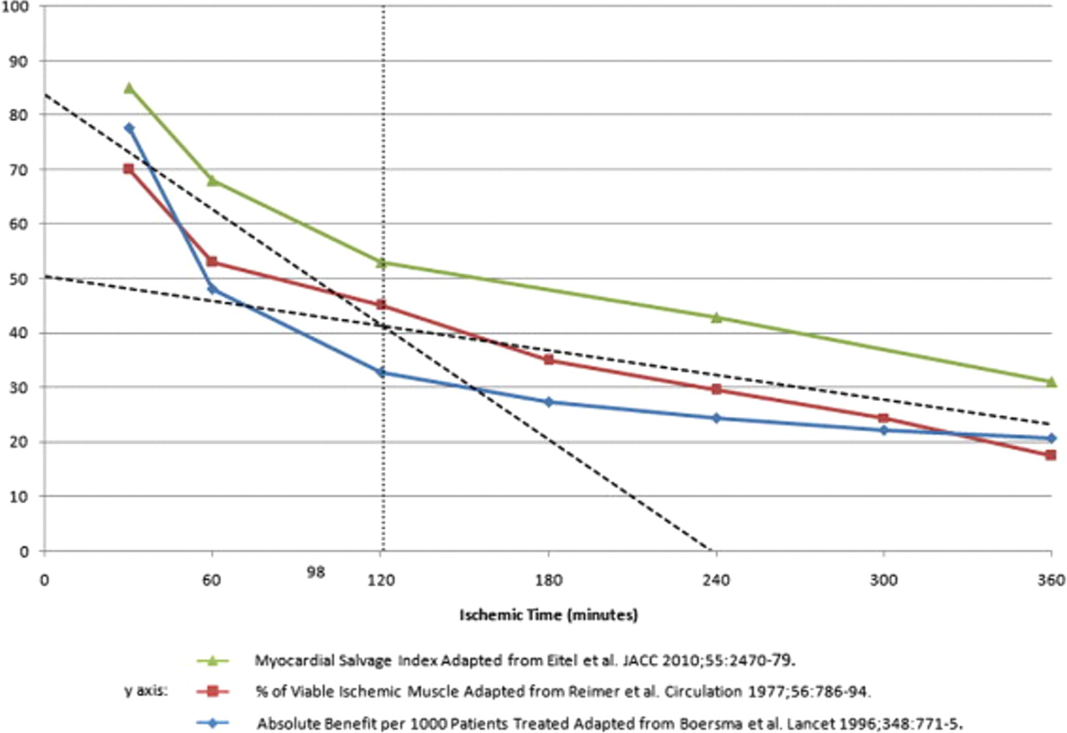
Effects of Total Ischemic Time on Infarct Size and Clinical Outcomes
The dotted lines are linear fits to the group of data points in the first 2 h and a separate fit to the data points beyond 2 h. The intersection at about 120 min of ischemic time defines a cut off point for optimal outcomes.
Denktas, A. E. et al. J Am Coll Cardiol Intv 2011;4:599-604

Slide 4
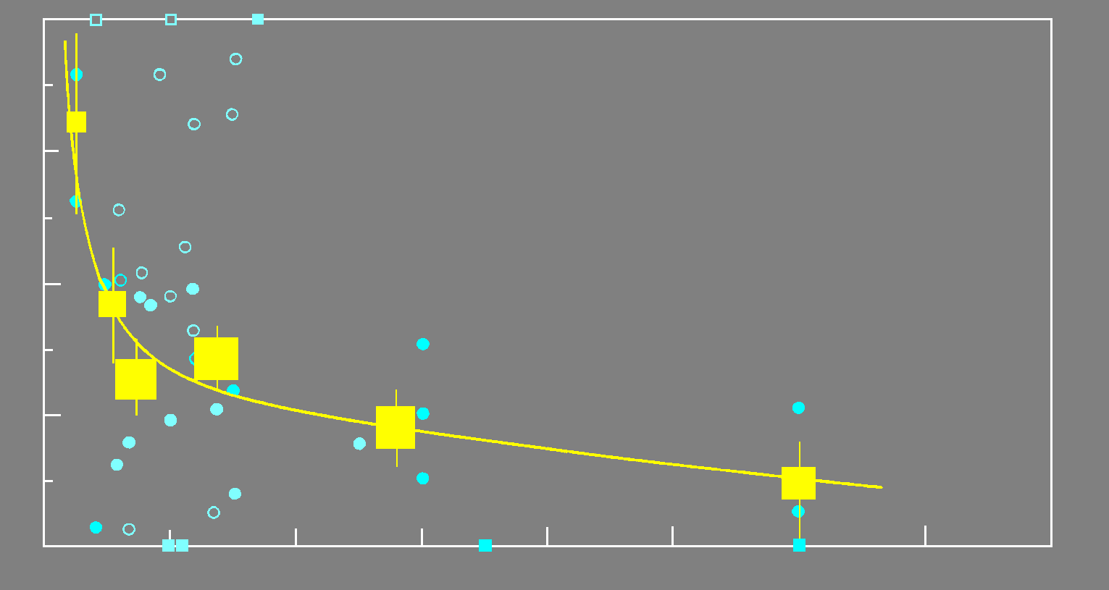
Thrombolysis: the ‘golden hour’
Absolute reduction in 35 mortality per 1000 patients treated
80
60
40
Lives saved per 1000 treated patients
20
0
0
3
6
9
12
15
18
21
24
Treatment delay (h)
FTT data - closed circles
Smaller trials - open circles
Boersma, Lancet 1996;348:771

Slide 5
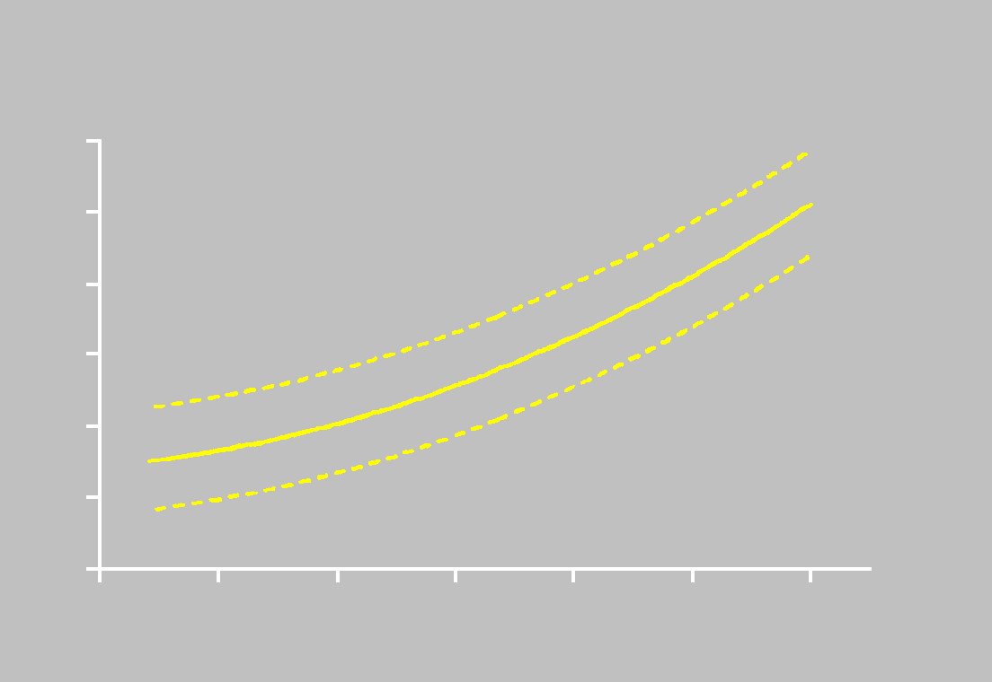
Time delay from symptom onset
to primary PCI: every minute counts
6 RCTs of primary PCI by the Zwolle group 1994-2001
(1791 STEMI patients)
12
10
8
One year mortality (%)
6
4
RR 1.08 for every 30 min delay
95% CI 1.01-1.16, p<0.0001
2
0
0
60
120
180
240
300
360
Ischaemic time (mins)
De Luca, Circulation 2004;109:1223
Notes:
Risk of one year mortality increases by 7.5% for each 30 min delay

Slide 6
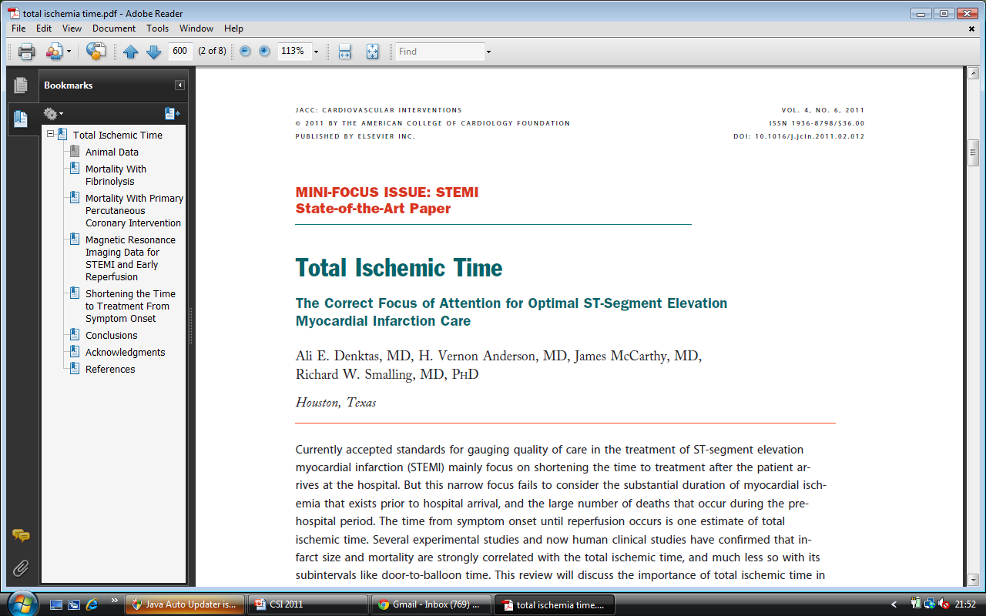
Total Ischemia time – symptom onset to reperfusion
“First Medical contact” or ‘Door’ is defined as the “time of EMS arrival on scene” after the patient calls EMS/9-1-1 or
Door in India is usually the “time of arrival at the emergency department door” when the patient self-transports
I
I
I
IIa
Door to Balloon time -Primary PCI within 90 min of first medical contact as a systems goal.
Door to Needle time - fibrinolytic therapy within 30 min of hospital presentation as a systems goal
IIa
IIa
IIb
IIb
IIb
III
III
I
III
I
I
IIa
IIa
IIa
IIa
IIb
IIb
IIb
IIb
III
III
I
III
I
I
IIa
IIa
IIa
IIa
IIb
IIb
IIb
IIb
III
III
III
III
A
I
I
I
IIa
IIa
IIa
IIa
IIb
IIb
IIb
IIb
III
III
III
I
III
I
I
IIa
IIa
IIa
IIa
IIb
IIb
IIb
IIb
III
III
III
I
III
I
I
IIa
IIa
IIa
IIa
IIb
IIb
IIb
IIb
III
III
III
III
B

Slide 7
Delays to treatment in AMI
Patient education
TIME
Pre-hospital intervention
(lytics, IIbIIIa etc)
Logistics
Interhospital transfer

Slide 8
Kovai Erode Pilot STEMI Study
Time (Mins) | Range | Mean | Median
Time taken for Transport | 5-29 | 44 | 35
Time from Ambulance to Stenting | 14-103 | 69 | 58
Time from Arrival to Hosp to stenting | 14-125 | 31 | 27

Slide 9
Patient Delay
CREATE Registry - The median time from symptoms to hospital was 360 (interquartile range 123-1317) minutes
KOVAI-ERODE Pilot study – median time was 165 minutes (range 60-330 minutes)
Severity of symptoms
Time of day or day of the week
Past medical history
Educational status
Awareness of the disease

Slide 10
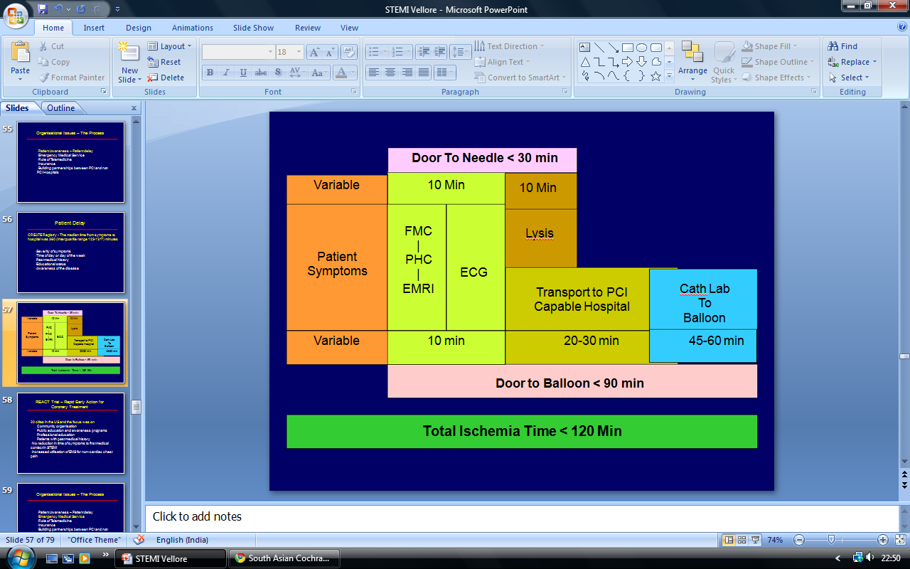
STEMI INDIA
Proposed National STEMI Guideline
Pharmaco-invasive - 3-24 hours
FMC – First Medical Contact
PHC – Primary Health Centre
EMRI – Ambulance Service

Slide 11
Total Ischemia Time
Pre-Hospital Lysis – What the studies tell us
TN STEMI Project
TN STEMI Project – Phase II
Challenges for a successful Program

Slide 12
Quantitative review of 23 trials of primary angioplasty versus thrombolysis (n=7739)
Short-term clinical outcomes
Keeley, Lancet 2003;361:13

Slide 13
Keeley meta-analysis:
Patient group | N | Absolute mortality difference | OR 95%CI | P value
All 23 trials | 7739 | 2.3% | 0.70 (0.59-0.83) | <0.0001
PCI vs fibrin-specific lytic | 5902 | 1.7% | 0.77 (0.63-0.94) | 0.009
PCI vs acc tPA | 5314 | 1.6% | 0.78 (0.64-0.96) | 0.019
PCI vs acc tPA, excluding SHOCK | 5012 | 1.2% | 0.81 (0.64-1.02) | 0.07

Slide 14
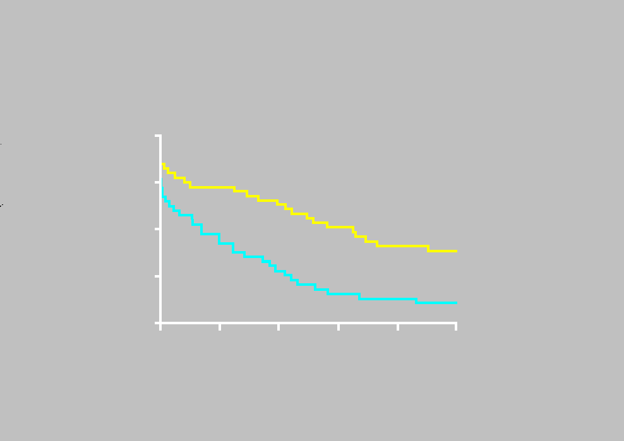
Grampion region early anistreplase trial
Delaying thrombolysis by 1 hour results in 43 additional deaths per 1000 lives over 5 years
100
90
% Survival
Prehospital lysis 75%
80
70
In-hospital lysis 64%
60
0
1
2
3
4
5
Years
Rawles, J Am Coll Cardiol 1997;30:1181

Slide 15
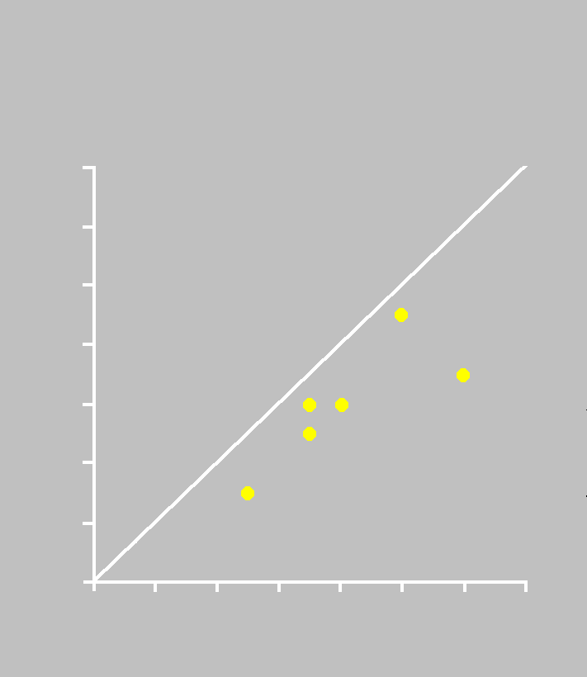
Meta-analysis of 6 trials of pre-hospital thrombolysis (n=6436)
14
Time from symptoms (SE) to
thrombolysis:
104 (7) min for pre-hospital
162 (16) mins for in-hospital
(Urokinase, anistreplase, t-PA)
12
10
8
% mortality pre-hospital
thrombolysis
6
4
For all cause in-hospital mortality
OR 0.83 95% CI 0.70-0.98
2
0
0
2
4
6
8
10
12
14
% mortality in-hospital
thrombolysis
Morrison, JAMA 2000;283:2686

Slide 16
Comparison of primary PCI and prehospital thrombolysis in acute MI (CAPTIM n=840)
Events at 30 days
P=0.61
P=0.29
Planned 1200 patients
Symptoms to lysis 130 min
Symptoms to balloon 190 min
Bonnefoy, Lancet 2002;360:825
Notes:
Differences not significant
26% of pre-hospital lysis group underwent PCI

Slide 17
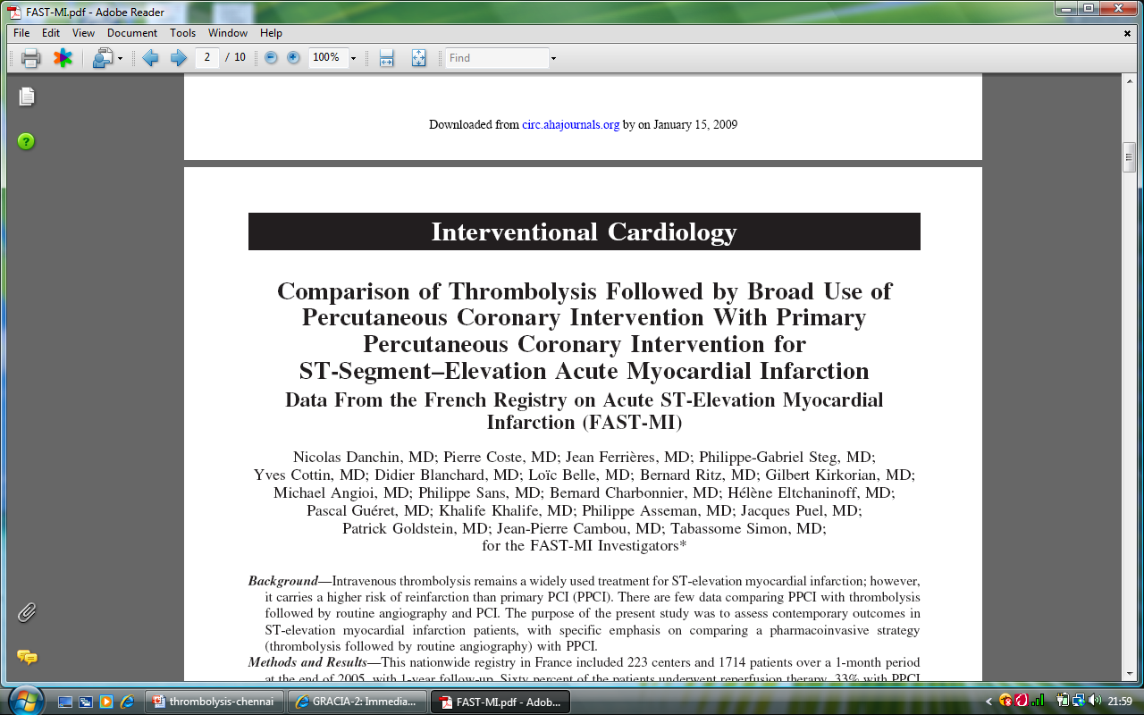
Nationwide registry in France – 233 centres – 1714 patients
Post -thrombolysis – 96% CART / 84% PCI
Median time from lysis to PCI 220 mts
Mortality: Thrombolysis 4.3% . PPCI 5%
1 year survival: Thrombolysis 94%. PPCI 93%
Circulation. 2008;118:268-276.

Slide 18
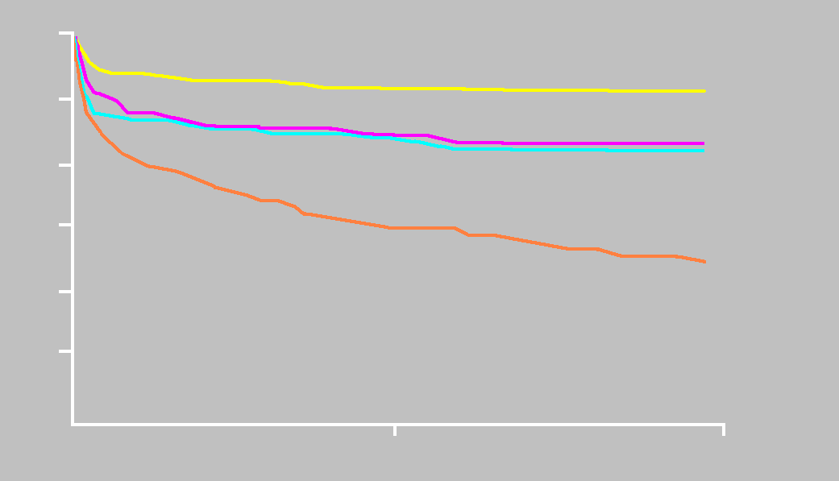
Pre-hospital thrombolysis vs primary PCI
French Nationwide USIC 2000 registry (n=1922)
Age-adjusted survival (%)
100
Pre-hospital lysis 94%
95
In-hospital lysis 89%
90
Primary PCI 89%
%
85
80
No reperfusion 79%
75
P<0.0001
0
180
360 days
Danchin et al, Circulation 2004;110:1909

Slide 19
Prehospital Thrombolysis: Other issues
Lamfers EJP, Hooghoudt THE, Hertzberger DP et al. Heart 89:496-501, 2003. Abortion of acute ST segment elevation myocardial infarction after reperfusion: incidence, patients’ characteristics and prognosis.
Conclusion: Prehospital thrombolysis is associated with a fourfold increase of aborted myocardial infarction compared with in-hospital treatment. A shorter time to treatment, a lower ST elevation and a higher incidence of preinfarction angina were predictors of aborted myocardial infarction.
Lamfers EJP, Schut A, Hertzberger DP et al. Am Heart J 147:509-15, 2004. Prehospital versus hospital fibrinolysis therapy using automated versus cardiologist electrocardiographic diagnosis of myocardial infarction: Abortion of myocardial infarction and unjustified fibrinolytic therapy
Conclusions: Abortion of myocardial infarction is associated with prehospital thrombolysis. Unjustified fibrinolysis occurs in prehospital fibrinolysis as frequently as in the inhospital setting. The use of different electrocardiographic methods for diagnosing acute myocardial infarction does not appear to make any difference.

Slide 20
Total Ischemia Time
Pre-Hospital Lysis – What the studies tell us
TN STEMI Project
TN STEMI Project – Phase II
Challenges for a successful Program

Slide 21
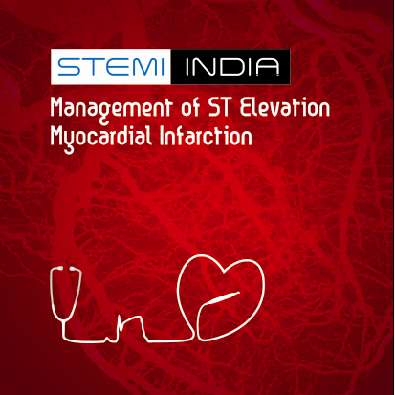
Dr.T.Alexander
Dr.A.Mullasari
Dr.V.Bahuleyan
Dr.B.Bhargav
Dr.P.Kerkar
Dr.A.Mathur
Dr.C.Narasimhan
Dr.R.Nayak
Dr.R.Rajani

Slide 22
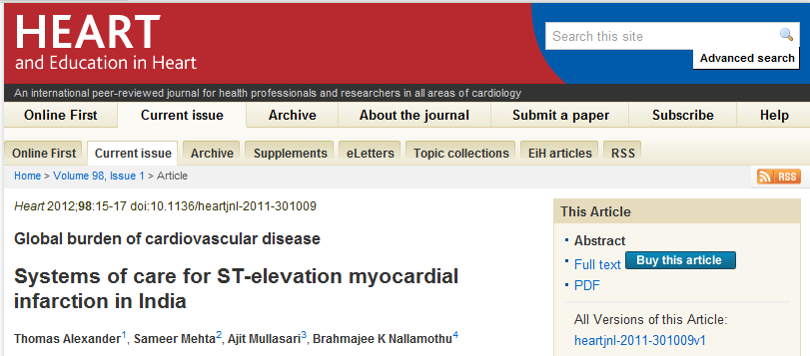
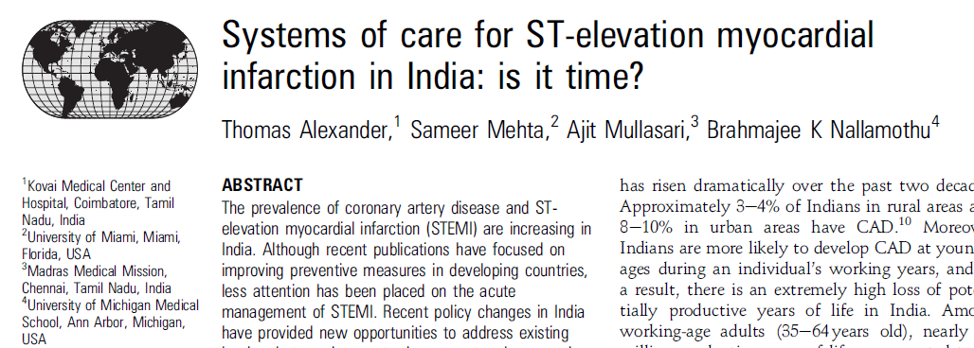

Slide 23
Collaborating agencies:
1. STEMI – INDIA
2. GVK EMRI
3. Hospitals under the government Health Insurance Scheme
4. HCL Technologies
5. Lotus Clinical Research Academy Pvt. Ltd.
6. AOSTA
7. Maestros
Principal Investigators:
Dr. Thomas Alexander
Dr. Ajit Mullasari
Tamilnadu STEMI Project – STEMI INDIA

Slide 24
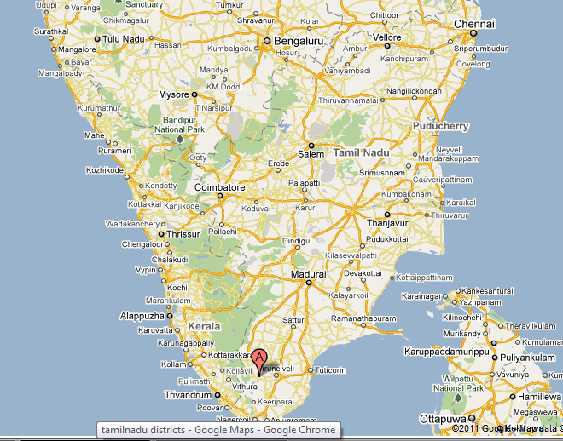
Trichy

Slide 25



STEMI Cluster
Class D
Class C
Class C
Class A/B Hospital
Class D
Class C
Class D
- Location of patient
- Location of closest STEMI hospital
- Patient clinical condition – fibrinolytic contraindications
cardiogenic shock

Slide 26
Total Ischemia Time
Pre-Hospital Lysis – What the studies tell us
TN STEMI Project
TN STEMI Project – Phase II
Challenges for a successful Program

Slide 27
Pre-Hospital Lysis – The wider definition
Mobile Intensive Care Unit - GVK – Emergency Medical Research and Research Institute (EMRI)
Primary Health centre
Designated Private Practitioner
Pharmaco-invasive - 3-24 hours

Slide 28
Total Ischemia Time
Pre-Hospital Lysis – What the studies tell us
TN STEMI Project
TN STEMI Project – Phase II
Challenges for a successful Program
NRHM / IPHS
Generic TPA
Finances
Ambulance Services
Patient care and Management systems
Medico-legal Issues

Slide 29
Total Ischemia Time
Pre-Hospital Lysis – What the studies tell us
TN STEMI Project
TN STEMI Project – Phase II
Challenges for a successful Program
NRHM / IPHS
Generic TPA
Finances
Ambulance Services
Patient care and Management systems
Medico-legal Issues

Slide 30
National Rural Health Mission (2005-2012)
Vision of NRHM
- Effective health care to rural population with special focus on 18 states with weak public health indices
- Increase health spending to 2.3% GDP
- Implement Indian Public Health Standards

Slide 31
Indian Public Health Standards - 2007
Three levels of health care delivery envisaged in India
Sub centre – lowest rung for 3000-5000 population
Multi-purpose worker
Primary level - PHC – 20,000 – 30,000 population.
1 doctor
24 hour emergency service
Secondary level – Community Health Centre (CHC) and constitutes the first referral system
4 PHC’s are included under a CHC
Caters to approximately 80,000 population in hilly/tribal areas and 1,20,000 in the plains
30 bedded hospital with specialists in Medicine, Surgery, Paediatrics and OG
ECG available in CHC

Slide 32
Total Ischemia Time
Pre-Hospital Lysis – What the studies tell us
TN STEMI Project
TN STEMI Project – Phase II
Challenges for a successful Program
NRHM / IPHS
Generic TPA
Finances
Ambulance Services
Patient care and Management systems
Medico-legal Issues

Slide 33
National Guidelines
The Cardiovascular Guideline committee set up by the Union Ministry of Health has started work on developing STEMI guidelines
These would indicate the preference for TPA as the preferred lytic
Primary PCI superior to conventional thrombolysis
Early cath and PCI in the post lysis high risk patients

Slide 34
Total Ischemia Time
Pre-Hospital Lysis – What the studies tell us
TN STEMI Project
TN STEMI Project – Phase II
Challenges for a successful Program
NRHM / IPHS
Generic TPA
Finances
Ambulance Services
Patient care and Management systems
Medico-legal Issues

Slide 35
Source: National Health Account, MoHFW, GOI

Slide 36
Source: National Health Account, MoHFW, GOI

Slide 37
INDIA – Health Care Innovations
Janani Suraksha Yojana is a conditional cash transfer mechanism (introduced in 2005) to encourage women to give birth in a health facility
National Rural Health Mission was introduced in 2006 to expand public spending on health and to decentralise health-care delivery to where it is needed most—in rural areas
Rashtriya Swasthya Bima Yojna is a health benefits programme that covers hospitalisation for those living below the poverty line
Jan Aushadhi—a countrywide chain of medical stores to make generic and other drugs available at reasonable prices
State Social Insurance Schemes

Slide 38
Star Health Insurance
Aarogyasri model (June 07)
One of the most successful insurance schemes
Started in the state of Andhra Pradesh
88% of the states population covered
Covers procedures in various specialties – Cardiac, Renal, Neuro, Polytrauma etc
Annual Premium of Rs.300 (US$6) covering a family of 5
Sum assured – Rs.1,50,000 (US$3000) + contingency fund of Rs.50,000 (US$1000)
Coronary Angioplasty – Rs.60,000 (US$1200)
Pacemaker Implantation – Rs.75,000 (US$1500)
Heart Valve Replacement – Rs.120,000 (US$2400)

Slide 39
Health Insurance – other states
Tamilnadu Government Employees Health Insurance
1.3 million families covered
Rs. 200,000/- in blocks of 4 years
Tamilnadu Insurance for BPL families
Planned to cover 56 million (80% of population)
Rs.400,000/- per family in blocks of 4 years
Primary PCI and thrombolysis will be fully covered
STAR insurance in other states
Talks on for roll out in Karnataka, Orissa and Delhi

Slide 40
Total Ischemia Time
Pre-Hospital Lysis – What the studies tell us
TN STEMI Project
TN STEMI Project – Phase II
Challenges for a successful Program
NRHM / IPHS
Generic TPA
Finances
Ambulance Services
Patient care and Management systems

Slide 41

Innovative Pro-Poor PPP
(Public Private not for Profit Partnership)
Service Delivery Model to provide free Emergency Response Services
Serving 1 Emergency every 8 seconds & Saving 1 Life every 8 minutes!

Slide 42
GVK – Emergency Medical and Research Institute (EMRI)
Jammu & Kashmir
Himachal Pradesh
372 million population in 9 states
54000 calls per day
2148 ambulances making 5 trips per day
Projected to increase to 10000 ambulances in the next few years
Cost per ambulance trip Rs 600/-
($12 vs $800 in the US)
6800+ private hospitals partnership
Punjab
Arunachal Pradesh
Haryana
Uttarakhand
Delhi
Rajasthan
Uttar Pradesh
Sikkim
Assam
Nagaland
Bihar
Meghalaya
Manipur
Jharkhand
Gujarat
Madhya Pradesh
West Bengal
Mizoram
Tripura
Chattisgarh
Orissa
Maharashtra
Goa
Andhra Pradesh
Karnataka
Tamil Nadu
Kerala

Slide 43
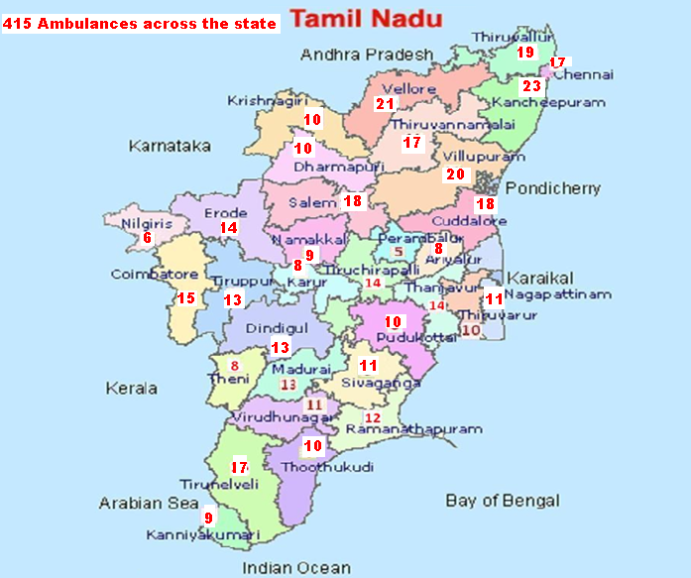
108 Ambulances in TN

Slide 44
Total Ischemia Time
Pre-Hospital Lysis – What the studies tell us
TN STEMI Project
TN STEMI Project – Phase II
Challenges for a successful Program
NRHM / IPHS
Generic TPA
Finances
Ambulance Services
Patient care and Management systems
Medico-legal Issues

Slide 45
Patient care and Management System
Hardware
ECG confirmation of STEMI
Management protocols
STEMI work flow process

Slide 46
Hardware
Handheld device with 3G/GPS and biometric authentication- GVK-EMRI ambulances and STEMI coordinators at each STEMI Hospital and at the pre-hospital lytic sites
These can record and transmit – ECG
- Vital signs
- Management algorithms
Data repository in the STEMI coordinating centre
Web server – dedicated server
Separate domain registration – STEMI-INDIA

Slide 47
Patient care and Management System
Hardware
ECG confirmation of STEMI
Management protocols
STEMI work flow process

Slide 48
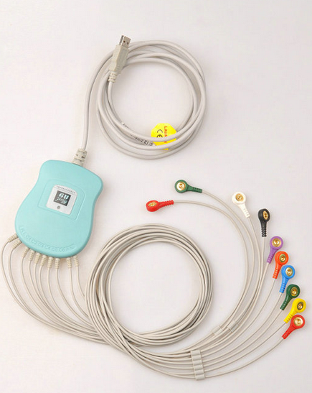
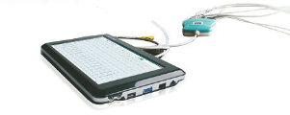
PH-ECG Interpretation Strategies
Pre-Hospital Electrocardiogram interpretation strategies
  Automated Computer Algorithm (on-site)
  Direct Paramedic Interpretation (on-site)
  WiPI ⇒ Wireless transmission & Physician Interpretation (off-site)

Slide 49
Confirmation of Diagnosis
Overall Tele-density - 44.87
As on 30th June 2009 - Urban Teledensity 95.05
  Rural Teledensity 16.61
By 2012, rural tele-density to increase to 40%
ECG recorded on the handheld device and transmitted from EMRI ambulance / spoke hospitals to the Hub hospital and the STEMI co-ordinating centre.
‘On Call’ cardiologist to read ECG before starting thrombolysis– in the pharmacoinvasive strategy

Slide 50
Patient care and Management System
Hardware
ECG confirmation of STEMI
Management protocols
STEMI work flow process

Slide 51
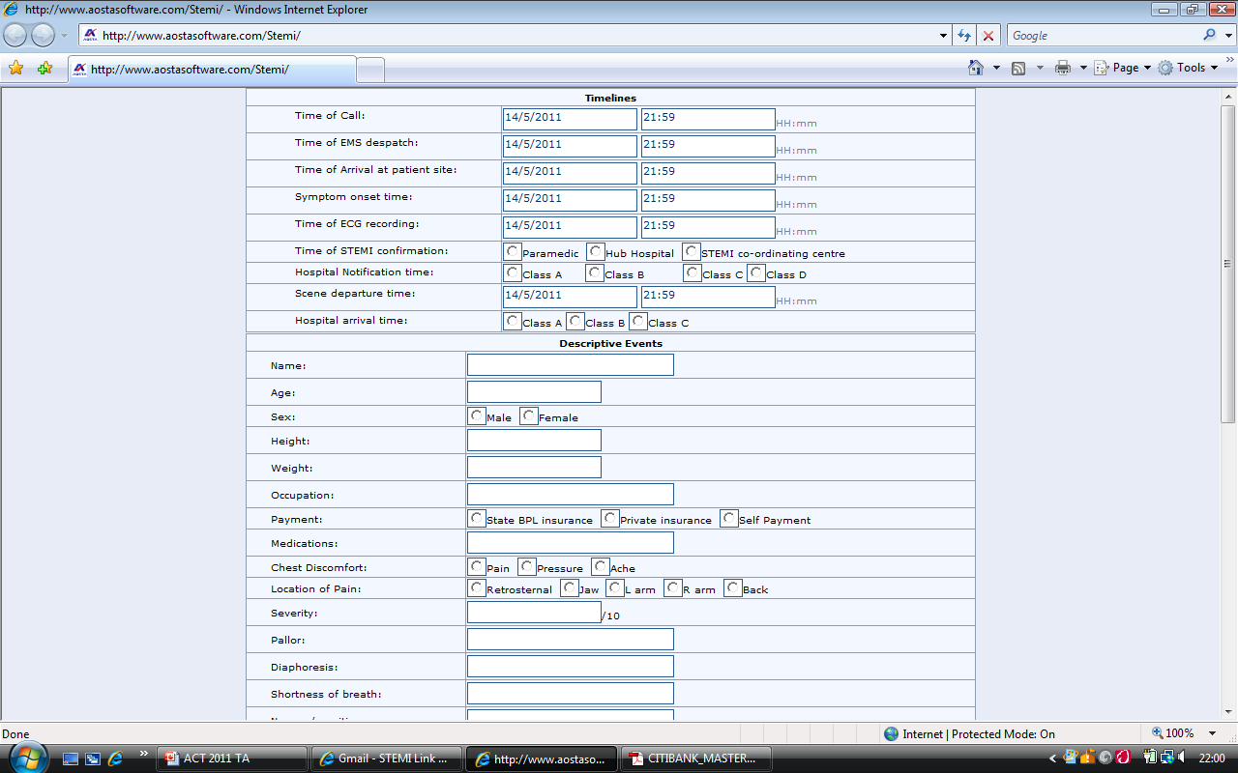
Management Protocols
Protocols loaded on the handheld device
Patient data entry can be at any patient access site ambulance/STEMI hospital. Data record can be seamlessly accessed and continued during the patient care at any of the transfer sites
STEMI work flow process integrated with specific management protocols and depends on
- Location of patient
- Location of closest STEMI hospital
- Patient clinical condition – fibrinolytic contraindications
cardiogenic shock

Slide 52
Patient care and Management System
Hardware
ECG confirmation of STEMI
Management protocols
STEMI work flow process

Slide 53
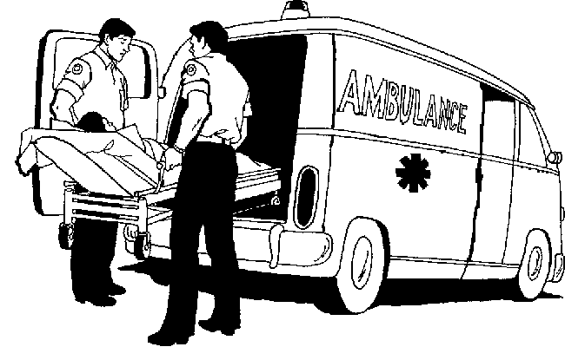
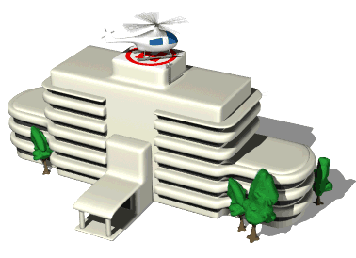

GPS–3G Assisted Data Transfer
GVK-EMRI
Hub Hospital
STEMI India Functional Flow
Spoke Hospital
STEMI Coordination Centre

Slide 54
Total Ischemia Time
Pre-Hospital Lysis – What the studies tell us
TN STEMI Project
TN STEMI Project – Phase II
Challenges for a successful Program
NRHM / IPHS
Generic TPA
Finances
Ambulance Services
Patient care and Management systems
Medico-legal Issues

Slide 55
Conclusions
Regional STEMI Reperfusion Clusters
Clear Guidelines
Empowering experienced decision maker to implement best care for an individual patient
FMC
Funding
Telemedicine
Patient
Paramedic/Physician
Administrators
Cardiologist

Slide 56
Thank You for Your attention

