Slide 1
Consideration for Medical Rx vs Revascularization in Stable CAD: The impact of
COURAGE and BARI-2D Trials
Dr. Nirav Panchani
Assistant professor
Department of Cardiology
SBKS MI & RC
Notes:
1

Slide 2
India: The Coronary Capital of the World” Coronary Heart Disease Mortality in India
No. in Millions
Ghaffar A, et al. BMJ 2004; 328:807-10

Slide 3
Dual Goals for Management of
Stable Ischemic Heart Disease (SIHD)
Prevent MI and Death (Disease Modification)
Improve “Quantity of Life”
Reduce Ischemia & Relieve Anginal Symptoms
Improve “Quantity of Life”
Boden WE. Medical management of chronic coronary disease. Am J Cardiol. 2008;101:69D-74D.
Gibbons RJ et al. Circulation. 2003;107:149-158.
http://acc.org/qualityandscience/clinical/guidelines/stable/stable_clean.pdf.
Notes:
3

Slide 4
Stable Angina
Treatment Options
Angina
Treatment Options
Percutaneous Intervention
Medical Rx
CABG

Slide 5
Optimal Medical Therapy (OMT) Vs Revscularization in the Management of SIHD
Revascuarization has become the preferred therapeutic approach for many patients with stable CAD in the hope that such an approach will prevent MI and Death and prolong survival
However Does it reduce MI and prolong survival????
Notes:
5

Slide 6
FACT
Number of Studies showing efficacy of revascularization with PTCA in reducing risk of MI/death
NONE

Slide 7
FACT
Number of Studies have shown efficacy of Aggressive RF modification in reducing risk of MI/death

Slide 8
HMG-CoA Reductase Inhibitor Evidence:
Secondary Prevention
Relationship between LDL-C Levels and Event Rates in Secondary Prevention Statin Trials of Patients with Stable CHD
30
4S
Statin
Placebo
25
4S
20
Event (%)
LIPID
LIPID
15
CARE
CARE
10
HPS
HPS
TNT (atorvastatin 10 mg/d)
5
TNT (atorvastatin 80 mg/d)
0
0
70
90
110
130
150
170
190
210
LDL-C (mg/dL)
CARE=Cholesterol and Recurrent Events Trial, HPS=Heart Protection Study, LDL-C=Low density lipoprotein cholesterol, LIPID=Long-term Intervention with Pravastatin in Ischaemic Disease; 4S=Scandinavian Simvastatin Survival Study, TNT=Treating to New Targets
LaRosa JC et al. NEJM 2005;352:1425-1435
Courtesy RJ Tedford, ACCF Prevention Series
Notes:
Lowering of LDL-C levels with statin therapy leads to a reduction in cardiovascular morbidity and mortality, at multiple baseline risk levels.

Slide 9
ACE Inhibitor Evidence:
Secondary Prevention
Meta-Analysis of the HOPE, EUROPA, and PEACE Trials*
Clinical Trial
N
Deaths
RR of Mortality
HOPE 9,297 1051
HR=0.84 P=0.005
EUROPA 12,218 795
HR=0.89 P=0.10
PEACE 8,290 633
HR=0.89 P=0.13
All Trials 33,960 >3000
HR=0.86 P<0.001
0.4 0.6 0.8
1.0
1.2 1.4 1.6
ACE-I Better
Placebo Better
*7 RCTs, 33,960 randomized patients, and 4.4 years of mean follow-up.
Other findings include a CVD HR=0.81, MI HR=0.82, and stroke HR=0.77
ACE-I=Angiotensin converting enzyme inhibitors, CVD=Cardiovascular disease, MI=Myocardial infarction
Danchin N et al. Arch Intern Med 2006;166:787-796
Courtesy RJ Tedford, ACCF Prevention Series
Notes:
A meta-analysis of 7 trials demonstrated that ACE inhibitors decrease overall mortality (OR, 0.86; 95% confidence interval, 0.79-0.93), myocardial infarction (OR, 0.82; 95% confidence interval, 0.75-0.89), cardiovascular mortality (OR, 0.81; 95% confidence interval, 0.73-0.90), and stroke (OR, 0.77; 95% confidence interval, 0.66-0.88) in patients with coronary artery disease and preserved left ventricular systolic function as compared to placebo.

Slide 10
Optimal Medical Therapy (OMT) in the Management of Stable Ischemic Heart Disease (SIHD)
Lifestyle interventions
Ischemia treatment & symptom control—improving quality of life
Disease-modifying pharmacologic therapy and secondary prevention—improving quantity of life

Slide 11
Medical Therapies for
Stable Ischemic Heart Disease
Associated with Survival Benefits
Lifestyle change: diet, exercise, rehabilitation programs
Lipid lowering: statins
Antiplatelet therapy: aspirin +/- P2Y₁₂ inhibitors
Beta-blockers post-MI
ACE inhibitors (especially with LV dysfunction) (alt: ARBs)
Aldosterone receptor antagonism (with LV dysfunction, HF)
Optimal treatment of diabetes and associated risk factors
Antihypertensive therapy
Smoking cessation
Influenza vaccination

Slide 12
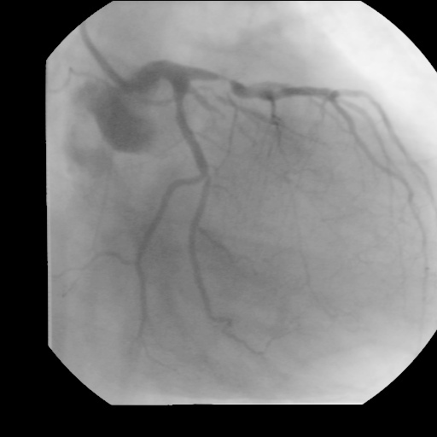
An SIHD Patient with Angina and 1.5 mm ST ↓ at 9.5 min Exercise
Is this a benign lesion
in a benign condition?

Slide 13
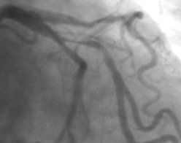
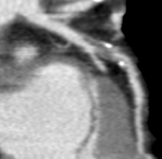
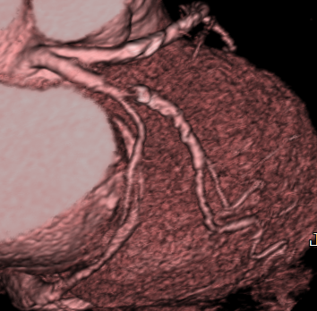
The Issue is Not “What
We SEE” – it is what we “DO NOT SEE”

Slide 14

What Can Invasive Rx Change
Compared to Medical Rx
CAD Risk
Progression
Time to Events
Severity of Events
Death
MI or ACS
Refractory
Ischemia / Re Interventions
NO
Heart Failure
Total Ischemic
Burden
Silent Ischemia
NO
Angina
Yes / Maybe

Slide 15
How Should We Think About CAD
Disease Modification
Vs. Segmental Protection
Vs. Lesion Amelioration
More “Stenosis” is not like more LDL
Treating Biology is More Important
than Treating Morphology
Multi vessel CAD reflects more Atheroma.
Events Are Mostly “Non Culprit” Vessel
Best Method is the wrong question!
Is it Needed At All And Why?

Slide 16
Stable CAD: PCI vs. Medical
Management Pre-COURAGE
Meta-analysis of 11 randomized trials; N = 2950
Favors PCI
Favors Medical Management
Death
Cardiac death or MI
Nonfatal MI
CABG
PCI
P
0.68
0.28
0.12
0.82
0.34
0
1
2
Risk ratio
(95% Cl)
Katritsis DG et al. Circulation. 2005;111:2906-12.

Slide 17
2287 patients
objective evidence of myocardial ischemia
stenosis > 70% in > one proximal coronary artery
“Optimal Medical Therapy“
At 5 yrs: 70% had LDL <100 mg/dl; median LDL = 71 mg/dl at 5 yrs
65% and 94% had SBP and DBP < 130/85 mmHg, respectively
45% of patients with diabetes had Hb A1c <7%
High adherence to diet, exercise, smoking cessation, and meds
Objective myocardial ischemia:
ST-segment depression or T-wave inversion on the resting ECG
or inducible ischemia (exercise or vasodilator stress)
or at least one coronary stenosis > 80% plus classic angina
97% BMS; 3% DES; all patients suitable for PCI; intermediate event rate
Notes:
17

Slide 18
What Can Be Achieved with OMT in SIHD: COURAGE Primary Endpoint
Survival Free of Death or MI
Randomization to PCI + OMT vs OMT
Intensive, Guideline-driven Medical Therapy & Lifestyle Intervention In Both Groups
1.0
Optimal Medical Therapy (OMT)
0.9
0.8
PCI + OMT
0.7
Hazard ratio: 1.05
95% CI (0.87-1.27)
P = 0.62
0.6
0.5
0.0
0
1
2
3
4
5
6
7
Years
Boden WE et al. N Engl J Med. 2007; 356:1503-1516.

Slide 19
Freedom from Angina
CASS (1975-1983) vs. COURAGE (2000-2006)
80
80
72
74
72
70
C
A
B
G
70
66
67
66
63
M
E
D
60
60
58
50
50
% Angina-Free
% Angina-Free
40
38
40
30
30
30
22
22
20
20
13
12
10
10
0
0
Baseline
1 Year
5 Year
Baseline
1 Year
3 Year
5 Year
Coronary Artery Surgery Study (CASS). J Am Coll Cardiol. 1984;3:114-128.
Boden WE et al. N Engl J Med. 2007;356:1503-1516.
PCI + OMT
OMT
Notes:
From 1975 to 1979, CASS randomized 780 patients with stable CAD to CABG or medicine. BOTH groups received medical therapy: modify risk factors, and nitrates and beta blockers were given for angina. At 5 years, average annual mortality for CABG was 1.1% and for medicine was 1.6%.
Assuming that CABG is the benchmark for complete revascularization, note that at 1 year PCI and CABG had the same 66% angina free. At 5 years only 63% of CABG patients were angina-free, compared with 74% in COURAGE. This should silence any who believe that PCI done properly should have produced more freedom from angina than we achieved (although it is fair to acknowledge that DES might have improved our statistics).
Notice how much better the medical group fared in COURAGE compared with CASS. This speaks to the extraordinary advances made in medical therapy and the comprehensiveness of our medical intervention, and suggests why the PCI arm in COURAGE outperformed the CABG arm in CASS.
19

Slide 20
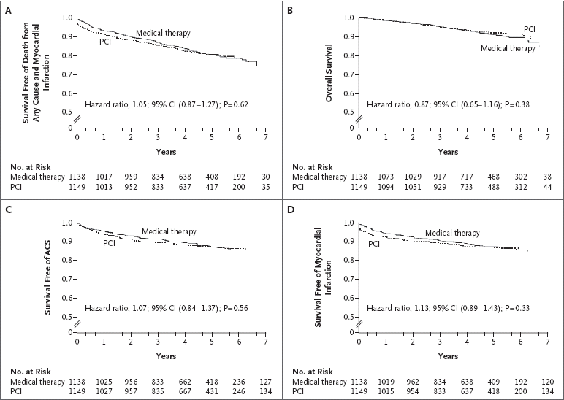
Plausible interpretation of COURAGE: performing PCI for lesions responsible for angina (and inducible ischemia) does reduce angina, but does not change overall outcome because most of the lesions responsible for later coronary events are non-obstructive (<70% cross-sectional stenoses)
Boden WE et al. N Engl J Med. 2007;356:1503-1516.
Notes:
20

Slide 21
COURAGE Trial: Impact of Treatment by Cardiovascular and Diabetes Subgroups
Baseline characteristics
OMT + PCI Better
OMT Better
Myocardial infarction
Yes
No
Extent of CAD
Multivessel disease
Single-vessel disease
Diabetes
Yes
No
Angina
CCS 0-I
CCS II-III
Ejection fraction
≤50%
>50%
Previous CABG
No
Yes
0.25
0.50
1.00
1.50
1.75
2.00
Hazard ratio (95% CI)
Boden WE, et al. N Engl J Med. 2007;356:1503-1516.
21
Notes:
21
Slide: COURAGE Study: Impact of Treatment by Cardiovascular and Diabetes Subgroups
Subgroup analyses showed similar effects for both treatments strategies in patients with multivessel coronary artery disease, previous myocardial infarction, and diabetes.¹
Reference
Boden WE, O'Rourke RA, Teo KK, et al. Optimal medical therapy with or without PCI for stable coronary disease. N Engl J Med. 2007;356:1503-1516.

Slide 22
Ischemia on OMT with / without PCI
Shaw L J et al. Circulation 2008;117:1283-1291
1.0
0.8
0.6
Adjusted P value of 0.09
Cumulative Event Free Survival
0.4
35
% with > 5% Reduction of Ischemia on MPI
30
0 %
25
Interventional Rx
0.2
1 - 4.9 %
20
Medical Rx
5 – 9.9 %
15
> 10 %
0.0
10
2
3
4
5
Time to Follow Up (Years)
Notes:
Figure 4. A, Kaplan–Meier survival for patients by residual ischemia including 0%, 1% to 4.9%, 5% to 9.9%, and ≥10% ischemic myocardium, respectively, after 6 to 18 months of PCI+OMT or OMT. Overall event-free survival was 100%, 84.4%, 77.7%, and 60.7%, respectively, for 0%, 1% to 4.9%, 5% to 9.9%, and ≥10% ischemic myocardium (P=0.001). In a risk-adjusted Cox model (controlling for randomized treatment), this difference was not significant (P=0.09). B, Unadjusted (dark gray bars) and risk-adjusted (light gray bars) hazard ratios for the extent and severity of residual ischemia at 6 to 18 months of follow-up.

Slide 23
Need for Subsequent Revascularization: 7 Years of F/U*
 | PCI + OMT | OMT
Overall Need for Revascularization | 21% | 33%
Subsequent CABG | N=77 | N=81
Median Time to Revascularization† | 10 months; 10.5% | 10.8 months; 16.5%
*Median 4.6 years of follow-up
†Median time to Repeat or 1st Revascularization
After ~ 11 mo, the avg. X-over from OMT to PCI was 2.8%/year over years 1-7

Slide 24
COURAGE Trial:
Summary
PCI added to OMT did not reduce risk of death, MI, or other major CV events as compared with OMT alone
  21.1% of patients in the PCI group required additional revascularization versus 32.6% of patients in the optimal therapy group (HR: 0.60; P<0.001)—but over 7 years!
Findings reinforce existing clinical practice guidelines
  OMT and aggressive management of multiple treatment targets without initial PCI can be implemented safely in the majority of patients with chronic stable angina, even those with objective evidence of ischemia and significant multivessel CAD
Boden WE, et al. N Engl J Med. 2007;356:1503-1516.
Boden WE. Cleve Clin J Med. 2007;74:623-633.
24
Notes:
24
Slide: COURAGE Trial: Summary
Data from the COURAGE trial showed that PCI added to optimal medical therapy did not reduce risk of death, MI, or other major CV events compared with optimal medical therapy alone.^{1,2}
21.1% of patients in the PCI group required additional revascularization versus 32.6% of patients in the optimal therapy group (HR: 0.60; P<0.001) .
These findings reinforce existing clinical practice guidelines that recommend optimal medical therapy and aggressive management of multiple treatment targets without initial PCI can be implemented safely in the majority of patients with chronic stable angina, even those with objective evidence of ischemia and significant multivessel coronary artery disease.^{1,2}
References
Boden WE, O‘Rourke RA, Teo KK, et al. Design and rationale of the Clinical Outcomes Utilizing Revascularization and Aggressive DruG Evaluation (COURAGE) trial Veterans Affairs Cooperative Studies Program no. 424. Am Heart J. 2006;151:1173-1179.
Boden WE, O'Rourke RA, Teo KK, et al. Optimal medical therapy with or without PCI for stable coronary disease. N Engl J Med. 2007;356:1503-1516.

Slide 25
Factors Impacting Worse CAD Progression or Worse PCI Outcomes in Diabetes
Inflammation
Endothelial dysfunction
Renal dysfunction, left ventricular dysfunction, peripheral artery disease
Atherosclerotic burden
Restenosis
Prothrombotic state
  Increase platelet aggregation
Roffi M, et al. Eur Heart J. 2004;25:190-198.
25
Notes:
25
Slide: Factors Impacting Worse CAD Progression or Worse PCI Outcomes in Diabetes
There are a number of factors that may lead to worse coronary artery disease progression or worse PCI outcomes in patients with diabetes. These include inflammation, endothelial dysfunction, renal dysfunction, left ventricular dysfunction, peripheral artery disease, atherosclerotic burden, restenosis, and prothrombotic state (ie, increase platelet aggregation).¹
Reference
Roffi M, Topol EJ. Percutaneous coronary intervention in diabetic patients with non-ST-segment elevation acute coronary syndromes. Eur Heart J. 2004;25:190-198.

Slide 26
BARI 2D Study:
Type 2 Diabetes and CAD
Patients with type 2 diabetes and stable ischemic cardiovascular disease
  Mean follow-up: 5.3 years
Randomized to PCI or CABG stratums (2x2 factorial design)
  Strategy 1
    Prompt coronary revascularization or optimal medical therapy
  Strategy 2
    Insulin-sensitization therapy or insulin-provision therapy
Baseline Characteristics
 | PCI (n=1605) | CABG (n=763)
History of (%) MI CHF PAD | 30.1 7.7 23.9 | 36.0 4.5 23.5
Prior revascularization (%) | 28.6 | 13.0
Triple vessel disease (%) | 20.3 | 52.4
Proximal LAD disease (%) | 10.3 | 19.4
Ejection fraction (%) | 57.1 | 57.3
Symptomatic myocardial ischemia (%) | 82.3 | 81.6
Duration of diabetes (years) | 10.4 | 10.5
HbA_{1c} (%) | 7.6 | 7.7
BARI 2D Study Group. N Engl J Med. 2009;360:2503-2512.
26
Notes:
26
Slide: BARI 2D Study: Type 2 Diabetes and CAD
The BARI 2D study evaluated two cardiac treatment strategies and two glycemic treatment strategies in patients who were receiving uniform glycemic control and intensive therapy for cardiac risk factors^{.1}
Hypothesis 1: prompt revascularization (either surgical or catheter-based) would reduce long-term rates of death and cardiovascular events, as compared with medical therapy alone.
Hypothesis 2: insulin sensitization (with a target level for glycated hemoglobin of less than 7.0%) would reduce long-term rates of death and cardiovascular events, as compared with a strategy of insulin provision.
Patients were randomly assigned to two treatment strategies in a 2-by-2 factorial design.¹
Strategy 1: patients were assigned to undergo either prompt coronary revascularization or medical therapy.
Strategy 2: patients were assigned to undergo either insulin-sensitization therapy or insulin-provision therapy to achieve a target glycated hemoglobin level of less than 7.0%.
Reference
BARI 2D Study Group, Frye RL, August P, et al. A randomized trial of therapies for type 2 diabetes and coronary artery disease. N Engl J Med. 2009;360:2503-2515.

Slide 27
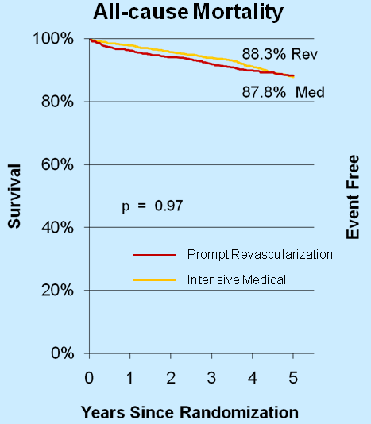
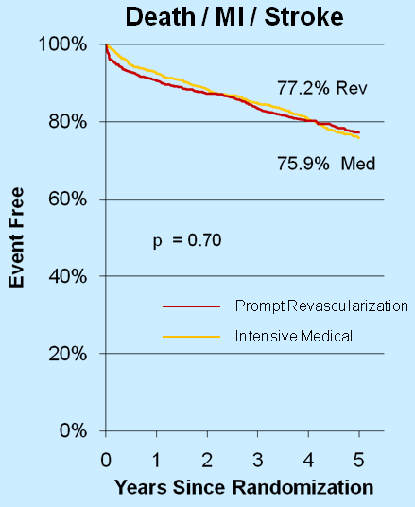
BARI 2D: Prompt Revascularization vs.
Medical Therapy
Primary End Point
Principal Secondary End Point
BARI 2D Study Group. New Engl J Med. 2009;360:2503-15

Slide 28
BARI 2D Study: Medical Therapy Versus Revascularization
Primary Outcome (All-Cause Death)
PCI
CABG
89.9%
86.4%
89.2%
83.6%
P=0.48
P=0.33
Survival (%)
Survival (%)
Medical therapy
Revascularization
Medical therapy
Revascularization
0 1 2 3 4 5
0 1 2 3 4 5
Follow-Up (Years)
Follow-Up (Years)
BARI 2D Study Group. N Engl J Med. 2009;360:2503-2512.
28
Notes:
28
Slide: BARI 2D Study: Medical Therapy Versus Revascularization
The rate of death did not differ significantly between the revascularization group and the medical-therapy group in either the CABG or the PCI stratum.¹
Reference
BARI 2D Study Group, Frye RL, August P, et al. A randomized trial of therapies for type 2 diabetes and coronary artery disease. N Engl J Med. 2009;360:2503-2515.

Slide 29
BARI 2D Study: Medical Therapy Versus Revascularization
Principal Secondary Endpoint (Death, MI, or Stroke)
PCI
CABG
78.9%
77.6%
77.0%
69.5%
Survival (%)
P=0.15
Survival (%)
P=0.01
Medical therapy
Revascularization
Medical therapy
Revascularization
0 1 2 3 4 5
0 1 2 3 4 5
Follow-Up (Years)
Follow-Up (Years)
BARI 2D Study Group. N Engl J Med. 2009;360:2503-2512.
29
Notes:
29
Slide: BARI 2D Study: Medical Therapy Versus Revascularization
The rate of death, MI, or stroke did not differ significantly between the revascularization group and the medical-therapy group in either the PCI stratum, but was significantly better in the revascularization group in the CABG stratum.¹
Reference
BARI 2D Study Group, Frye RL, August P, et al. A randomized trial of therapies for type 2 diabetes and coronary artery disease. N Engl J Med. 2009;360:2503-2515.

Slide 30
BARI 2D Study:
Summary
In patients with type 2 diabetes and stable ischemic cardiovascular disease, there were no significant difference in the rates of death and major cardiovascular events between
  Patients undergoing prompt revascularization and those undergoing medical therapy
  Strategies of insulin sensitization and insulin provision
BARI 2D Study Group. N Engl J Med. 2009;360:2503-2512.
30
Notes:
30
Slide: BARI 2D Study: Summary
In patients with type 2 diabetes and stable ischemic cardiovascular disease, there were no significant difference in the rates of death and major cardiovascular events between patients undergoing prompt revascularization and those undergoing medical therapy and strategies of insulin sensitization and insulin provision.¹
Reference
BARI 2D Study Group, Frye RL, August P, et al. A randomized trial of therapies for type 2 diabetes and coronary artery disease. N Engl J Med. 2009;360:2503-2515.

Slide 31
Percent of Patients With Angina at Baseline vs. 1 Year Post-PCI
Comorbid
Diabetes
% Patients With Angina
N=1755
N=1205
N=2287
N=1800
N=1434
*Total N=2364 patients with CAD and Type 2 DM. This analysis includes only the 1434 patients who had classic angina at baseline.
Holubkov R, et al. Am Heart J. 2002;144:826-833. Serruys PW, et al. N Engl J Med. 2001;344:1117-1124. Boden WE, et al. N Engl J Med. 2007;356:1503-1516. Cohen DJ, et al. N Engl J Med. 2011;364:1016-1026. Dagenais GR, et al. Circulation. 2011;123(14):1492-1500.
Notes:
Serruys PW, Unger F, Sousa E, et al. Comparison of coronary-artery bypass surgery and stenting for the treatment of multivessel disease. N Engl J Med. 2001;344:1117-1124.
Boden WE, O’Rourke RA, Teo KK, et al; COURAGE Trial Research Group. Optimal medical therapy with or without PCI for stable coronary disease. N Engl J Med. 2007;356:1503-1516.
Cohen DJ, Van Hout B, Serruys P, et al. Quality of life after PCI with drug-eluting stents or coronary-artery bypass surgery. N Engl J Med. 2011;364:1016-1026.
Dagenais GR, Lu J, Faxon DP, et al. Effects of optima medical treatment with or without revascularization on angina and subsequent revascularization in patients with type 2 diabetes and stable ischemic heart disease. Circulation. 2001;123:1492-1500.

Slide 32
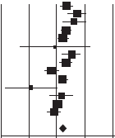
Summary Odds Ratio of Freedom from Angina
Study, Year (Reference) | PCI, n/n | Medical Therapy, n/n | OR (95% CI)
ACME, 1997 (27), 1998 (28) | 78/124 | 55/127 | 2.22 (1.33-3.68)
MASS, 1995 (19), 1999 (20) | 44/68 | 17/66 | 5.28 (2.51-11.11)
TOPS, 1992 (13) | 34/42 | 23/45 | 4.07 (1.55-10.69)
RITA-2, 2003 (4), 1997 (9) | 130/188 | 105/206 | 2.16 (1.43-3.26)
AVERT, 1999 (31) | 95/177 | 67/164 | 1.68 (1.09-2.58)
Dakik et al, 1998 (12) | 18/19 | 21/22 | 0.86 (0.05-14.71)
SWISSI II, 2007 (11) | 85/96 | 73/105 | 3.39 (1.60-7.19)
ALKK, 2003 (14) | 115/149 | 92/151 | 2.17 (1.31-3.59)
Bech et al, 2001 (5); Pijls et al, 2007 (38) | 51/90 | 61/91 | 0.64 (0.35-1.18)
MASS II, 2004 (29), 2007 (30) | 119/205 | 92/103 | 1.67 (1.13-2.47)
Hambrecht et al, 2004 (6) | 43/50 | 50/51 | 0.12 (0.02-1.04)
DECOPI, 2004 (15) | 101/109 | 92/103 | 1.51 (0.58-3.92)
COURAGE, 2007 (8) | 316/423 | 296/406 | 1.10 (0.81-1.49)
OAT, 2006 (7) | 234/263 | 233/257 | 0.83 (0.47-1.47)
Summary | 1463/2003 (73.0%) | 1277/1997 (63.9%) | 1.69 (1.242.30)
OR (95% CI)
P = 0.001
Heterogeneity Q = 47.7 (P < 0.001)
I ² = 72.7
0.01
0.1
1
10
100
Favors
Medical Therapy
Favors PCI
Wijeysundera HC et al. Ann Intern Med. 2010;152:370-379.
Notes:
32

Slide 33
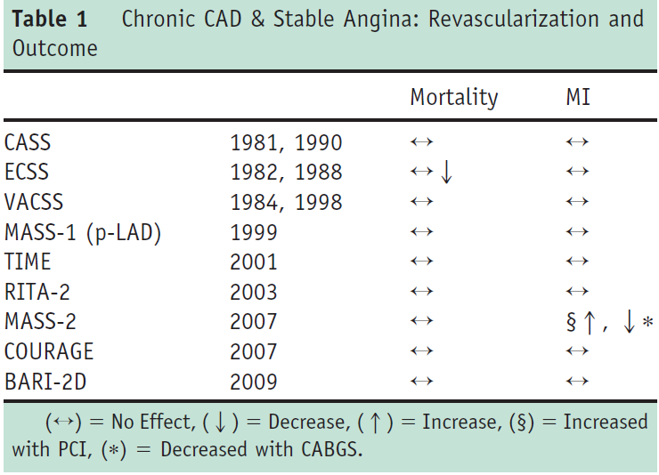
Impact of revascularization on mortality and MI in stable CAD
Deedwania and Carbajal. Am J Med 2011; 124:681

Slide 34
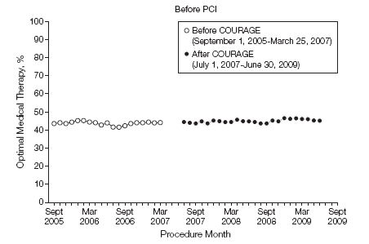
Percentage of Patients Achieving OMT
Before PCI by Procedural Month
NCDR; OMT defined as prescribed or contraindication to antiplatelet therapy, β-blocker, and statin
COURAGE published 3/26/2007
Borden WB et al. JAMA. 2011;305:1882-89

Slide 35
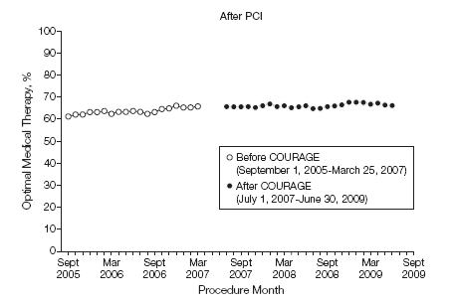
Percentage of Patients Achieving OMT
After PCI by Procedural Month
NCDR; OMT defined as prescribed or contraindication to antiplatelet therapy, β-blocker, and statin
COURAGE published 3/26/2007
Borden WB et al. JAMA. 2011;305:1882-89

Slide 36
2011 ACCF/AHA/SCAI PCI Guideline
“The findings from individual studies and systematic reviews of PCI vs medical therapy can be summarized as follows:
  PCI reduces the incidence of angina
  PCI has not been demonstrated to improve survival in stable patients
  PCI may increase the short-term risk of MI
  PCI does not lower the long-term risk of MI”
Levine GN et al. 2011 ACCF/AHA/SCAI Guideline for PCI. Circulation and
J Am Coll Cardiol. epub ahead of print

Slide 37
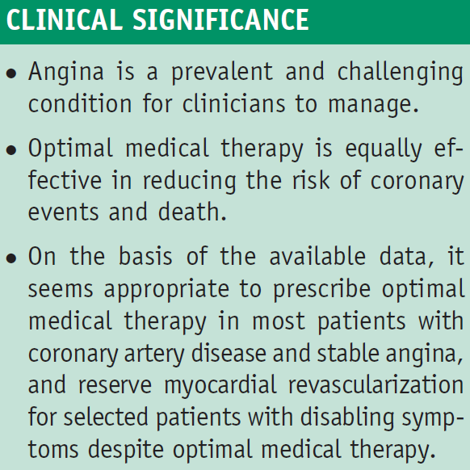
OMT vs. revasc in chronic coronary syndrome:summary
Deedwania and Carbajal. Am J Med 2011; 124:681

