Slide 1
SULFONAMIDES and COTRIMOXAZOLE

Slide 2
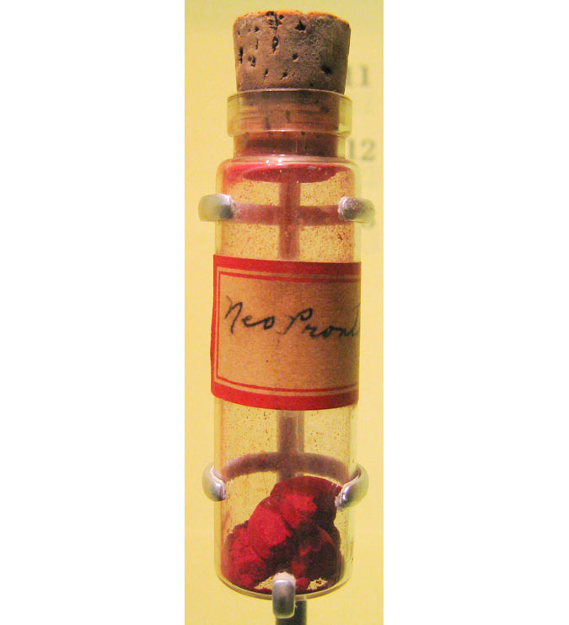
Introduction
first antimicrobial agents-effective against pyogenic bacterial infections
sulfonamido-chrysoidine-Domagk -action against streptococci
Treated his daughter
Sulfanilamide- active AMA

Slide 3
Classification
Short acting (4-8 hr): Sulfadiazine
Intermediate acting ( 8-12 hr ) : Sulfamethoxazole
Long acting(7 days):
    Sulfadoxine
    Sulfamethopyrazine
Special purpose sulfonamides:
  Sulfacetamide sod.
  Mafenide,
  Silver sulfadiazine,
  Sulfasalazine

Slide 4
ANTI BACTERIAL SPECTRUM
Primarily bacteriostatic -many gram-positive and gram-negative bacteria
Strepto.pyogenes
Haemophilus influenza
H. ducreyi
C. granulomatis
V. cholerae

Slide 5
Staph.aureus, gonococci, meningococci, pneumococci,E scherichiac oli, and Shigella respond, but majority are resistant
Chlamydiae
Actinomyces
Nocardia
Toxoplasma

Slide 6
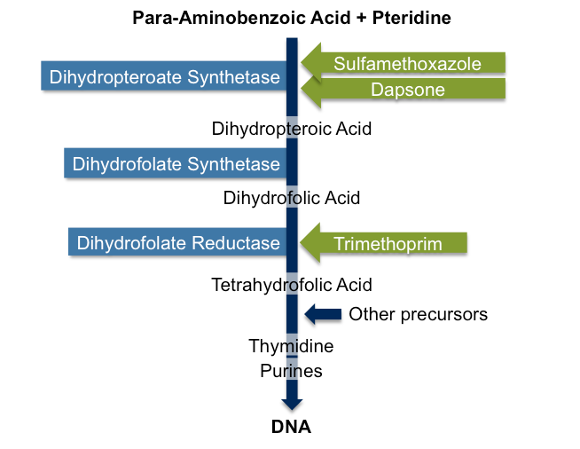

Slide 7
Mechanism of action
Structural analogues of p-aminobenzoic acid (PABA)
Synthesis of folic acid
Altered folate
‘COMPETITIVE INHIBITION’

Slide 8
Resistance to Sulfonamides
gonococci, pneumococci,Staph. aureus,mentngococci, E. coli, Shigella and some Strep. pyogenes, Strep. viridans and anaerobes
  produce increased amounts of PABA
  folate sythetase enzyme has low affinity for sulfonamides
  adopt an alternative pathway in folate metabolism
  efflux pump

Slide 9
PHARMACOKINETICS
rapidly and nearly completely absorbed
PPB differs
highly protein bound those are longer acting
widely distributed in the body—enter serous cavities easily
primary pathway of metabolism –acetylation
crystalluria
excreted mainly by the kidney

Slide 10
THERAPEUTIC USES

Slide 11
Topical Use
Sulfacetamide
Silver Sulfadiazine
Mafenide

Slide 12
Sulfacetamide
highly soluble compound
only mildly iritating to the eye in concentrations up to 30%
‘OCULAR INFECTIONS’
(chlamydia, including ophthalmia neonatorum caused by Ch. Oculogenitalis)
The incidence of sensitivity reactions-LOW

Slide 13
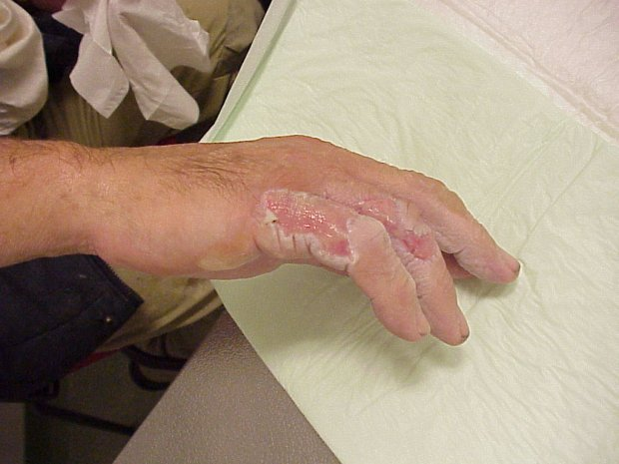
Silver Sulfadiazine
as 1% cream
active against a large number of bacteria and fungi
Slowly releases silver ions
Prevention of burnt surfaces and chronic ulcers
Local side effects are-burning sensation on application , itch

Slide 14
Mafenide
not a typical sulfonamide
inhibits a variety of gram positive and gram-negative bacteria
Pseudomonas, clostridia to prevent
Prevention of burnt surfaces
biggest limitation- burning sensation and severe pain when applied to raw surface

Slide 15
Systemic use
Alone is RARE- combination
Though.....
chronic urinary tract infection
streptococcal pharyngitis
gum infection
Cotrimoxazole
Sulfadoxine + pyrimethamine- malaria,
pneumocystis jiroaeci pneumonia in AIDS patients and in toxoplasmosis.

Slide 16
ADVERSE EFFECTS
Nausea, vomiting and epigastric pain
Crystalluria
Hypersensitivity reactions
Hepatitis
haemolysis in a dose dependent manner in individuals with G-6 PD deficiency
Agranulocytosis
Aplastic Anemia
Kernicterus

Slide 17
COTRIMOXAZOLE
fixed dose combination of Trimethoprim and sulfamethoxazole
Trimethoprim is a diaminopyrimidine-inhibit bacterial dihydrofolate reductase
Both individually- bacteriostatic
But in combination- bacteriocidal
sequential steps
synergistic

Slide 19
trimethoprim is a highly selective inhibitor of dihydrofolate reductase of lower organisms:
~100,000 times more drug is required to inhibit human reductase than the bacterial enzyme

Slide 20
WHY COMBINED?........
Same t1/2-(10hr)
Sequential blockade
Optimal synergism of most organisms is exhibited at a concentration ratio of sulfamethoxazole20: trimethoprim 1
the MIC of each component may be reduced by 3-6 times
Less adverse effects

Slide 21
Why trimethoprim’s conc. Is less?.....
Larger volume of distribution
crosses blood-brain barrier and placenta, while
sulfamethoxazole has a poorer entry
Rapidly absorbed
Trimethoprim is 40% plasma protein bound, while sulfamethoxazole is 65 % bound.
partly metabolized in liver and
excreted in urine.

Slide 22
Antibacterial Spectrum
The antibacterial spectrum of trimethoprim is similar to that of sulfamethoxazole
Most gram-negative and gram-positive microorganisms are sensitive to trimethoprim, but resistance can develop when the drug is used alone

Slide 23
Efficacy of Trimethoprim-Sulfamethoxazole in Combination
Chlamydia diphtheriae and N. meningitidis
S. pneumoniae
Staphylococcus aureus, Staphylococcus epidermidis, S. pyogenes, the viridans group of streptococci, E. coli, Proteus mirabilis, Proteus morganii, Proteus rettgeri, Enterobacter spp., Salmonella, Shigella, Pseudomonas pseudomallei, Serratia, and Alcaligenes spp.
Also sensitive are Klebsiella spp., Brucella abortus, Pasteurella haemolytica, Yersinia pseudotuberculosis, Yersinia enterocolitica, and Nocardia asteroides

Slide 24
Bacterial Resistance
acquisition of a plasmid that codes for an altered dihydrofolate reductase

Slide 25
Therapeutic Uses
Urinary Tract Infections
Enterobacteriaceae
Single-dose therapy (320 mg trimethoprim plus 1600 mg sulfamethoxazole in adults) -acute uncomplicated UTI ( 4 tablets)
chronic and recurrent infections of the urinary tract
(Small doses 200 mg + 40mg per day)
bacterial prostatitis (trimethoprim)

Slide 26
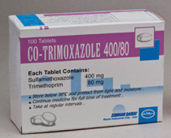
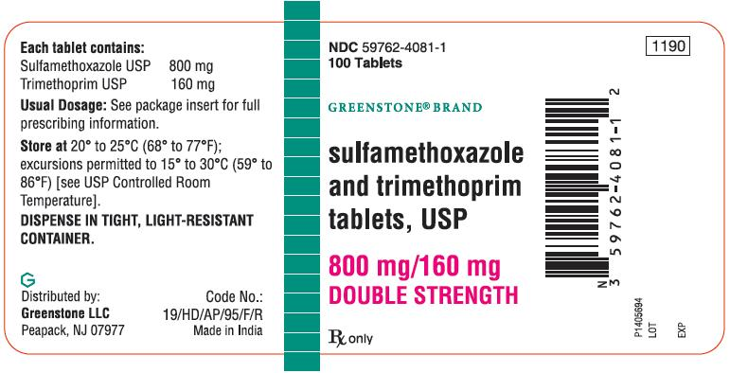

Slide 27
Bacterial Respiratory Tract Infections
acute exacerbations of chronic bronchitis
Otitis media
acute maxillary sinusitis - H. influenzae
  800-1200 mg sulfamethoxazole plus 160-240 mg trimethoprim twice a day

Slide 28
GI Infections
Typhoid- second line drug
Bacterial diarrhoeas and dysentery-Campylobacter, E. coli, Shigella
But quinolones preferred

Slide 29
Infection by Pneumocystis jiroveci in pts with AIDS
High-dose therapy
(trimethoprim 15-20 mg/kg per day plus sulfamethoxazole 75-100 mg/kg per day)
prophylactic as well as therapeutic value

Slide 30
Chancroid
Cotrimoxazole(800+160mg)BD for 7 days-3rd choice
Prophylaxis in Neutropenic Patients
agranulocytosis patients and treating respiratory

Slide 31
Adverse effects
Nausea, vomiting, stomatitis, headache and rashes
folate deficiency -precipitate megaloblastosis
Should not be given during pregnancy-Neonatal haemolysis
Exfoliative dermatitis, Stevens-Johnson syndrome, and toxic epidermal necrolysis

Slide 32
Permanent impairment of renal function-with renal disease
A high incidence of fever, rash and bone marrow hypoplasia -Infection by Pneumocystis jiroveci in pts with AIDS

Slide 33
References
Tripathi KD, Essentials of medical pharmacology, 6th edition, Jaypee publication New Delhi
Lauraence DR, Bennett TN and Brown MJ. Unwanted effects and adverse drug reactions. Clinical Pharmacology 8th edn. Churchill Livingstone 1997
Adri M, Ehrlich R, Wood R, Maartens G.Initiating co-trimoxazole prophylaxis in HIV-infected patients in Africa: an evaluation of the provisional WHO/UNAIDS recommendations.AIDS 2001,1511

Slide 34
Author | Results | Journal
Alvaro T. Figueredo, William M. Hryniuk, Ingrid Strautmanis, George Frank, and Sue Rendel | Co-trimoxazole Prophylaxis During High-Dose Chemotherapy of Small-Cell Lung Cancer | Journal of Clinical Oncology, Vol 3, No 1 (January) 1985

