Slide 1
Haresh A Desai
Assistant Professor
Department of Pharmacology
S. B. K. S. Medical Institute and Research Centre
Sumandeep Vidyapeeth, Piparia.

Slide 2
NON-STEROIDAL ANTI-INFLAMMATORY DRUGS
H A DESAI

Slide 3
Non steroidal antiinflammatory drugs
NSAIDS : aspirin type or non opioid analgesics.
Have analgesic, antipyretic & antiinflamma. actions in different measure.
In contrast to opioid --- do not depress CNS , no dependence , and are weaker analgesics.
1st available from willow bark (salicin )
Sodium salicylate – 1st used in fever & pain in 1875.
Acetyl salicylic acid ( aspirin ) ----- 1899.
Phenylbutazone ----------------1949.
Indomethacin -----------------1963.

Slide 4
CLASSIFICATION
Non- selective COX inhibitors:
Salicylates: Aspirin
Propionic acid derivatives: Ibuprofen, Ketoprofen, Naproxen, Flurbiprofen
Anthranilic acid derivative: Mephenamic acid
Aryl-acetic acid derivatives: Diclofenac, aceclofenac
Oxicam derivatives: piroxicam, tenoxicam
Pyrrolo-pyrrole derivative: Ketorolac
Indole derivative: Indomethacin

Slide 5
CLASSIFICATION
Preferential COX-2 Inhibitors: Nimesulide, Meloxicam
Selective COX-2 inhibitors: Celecoxib, Etoricoxib, Parecoxib
Analgesic-antipyretics with poor anti-inflammatory action:
Paracetamol, nefopam, metamizol

Slide 6
Mechanism of action
Blocks prostaglandin synthesis
Inhibits cyclooxygenase enzyme

Slide 7
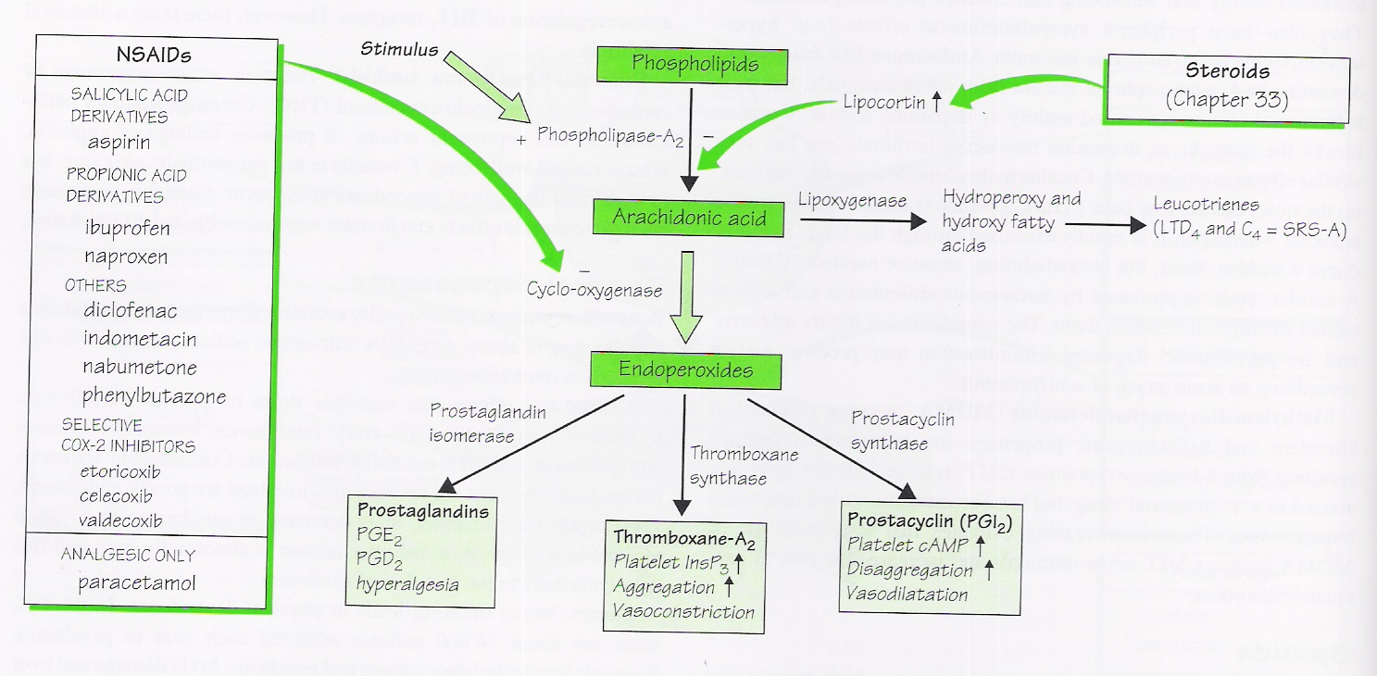

Slide 8
Actions
Analgesia
Antipyresis: Fever during infection is produced through the generation of pyrogens including, ILs, TNF, interferons which induce PGE2 production in hypothalamus-raise its temperature set point.
Anti-inflammatory: The most important mechanism of anti-inflammatory action of NSAIDs is considered to be inhibition of PG synthesis at the site of injury.
  PGs are only one of the mediators of inflammation; inhibition of COX does not depress the production of other mediators like LTs, PAF, cytokines, etc

Slide 9
Actions
Dysmenorrhoea: Involvement of PGs in dysmenorrhoea has been clearly demonstrated: Level of PGs in menstrual flow, endometrial biopsy and that of PGF2 metabolite in circulation are raised in dysmenorrhoeic women.
Antiplatelet aggregatory: NSAIDs inhibit synthesis of both proaggregatory (TXA2) and antiaggregatory (PGI2) prostanoids, but effect on platelet TXA2, (COX-1 generated) predominates.
Ductus arteriosus closure: During foetal circulation ductus arteriosus is kept patent by local elaboration of PGE2 and PGI2.

Slide 10
Actions
Gastric mucosal damage: Deficiency of PGs reduces mucus and HCO3- secretion, tends to enhance acid secretion and may promote mucosal ischemia.
Renal effects: NSAIDs produce renal effects by at least 3 mechanisms:
  COX-1 dependent impairment of renal blood flow and reduction of g.f.r. can worsen renal insufficiency.
  Juxtaglomerular COX-2(probably COX-1 also) dependent sodium and water retention.
  Ability to cause papillary necrosis on habitual intake.

Slide 11
Actions
Anaphylactoid reactions: Aspirin precipitates asthma, angioneurotic swellings, urticaria or rhinitis in certain susceptible individuals.
Respiration : in therapeutic doses (4 to 6 gms / day) salicylate increases consumption of O2 by skeletal muscle. As a result more CO2 production .
Increase CO2 = stimulates resp. Centre.
Rise in salicylate level = resp. Depression , death is due to resp. Failure.

Slide 12
Acid base & electrolyte imbalance –
In antiinfla. Doses – salicylate produce resp. stimulation-co2 washed out = resp. alkalosis, PH becomes alkaline.
Compensated by increase excretion of Hco3 in urine. PH then becomes normal ( known as compensatory res. alkalosis )
Toxic doses - Depresses resp. centre directly. So CO2 accumulates, as more co2 produced then is exhaled.
So plasma co2 rises & PH decreases.
Since plasma Hco3 is low due to enhanced renal excretion = resp. acidosis.
Toxic doses = depress vasomotor centre= accumulation of strong acids like lactic acids & pyruvic acids.

Slide 13
Salicylates- Aspirin
Analgesic, antipyretic, anti-inflammatory actions
Respiration
Acid-base and electrolyte balance
Gastro-intestinal tract
Blood

Slide 14
ADVERSE EFFECTS
Analgesic doses –well tolerated.
Antiinflammatory doses –adv effects if given for long time.
GIT : N/V , epigastric distress, erosive gastritis, PU ,increase blood loss in stools .
NEPHROTOXICITY : on long term use salt & water retension & impaired renal function.
HEPATOTOXICITY : large doses for prolonged period.
ALLERGIC REACTIONS : rashes, urticaria, photosensitivity, rhinorrhoea, angioedema & asthma .

Slide 15
REYE’S PHENOMENON - in children , form of hepatic encephalopathy ( fatal )
Devolops a few days after a viral infection like influenza & varicella . ( when aspirin is given to treat fever )
So aspirin –C/I in children with viral fever ( below 12 yrs, )
PREGNANCY & INFANCY – delays onset of labour due to inhibition of PG synthesis.
Premature closure of ductus arteriosus may occur in foetus.
Increases postpartum haemorrahage due to inhibi. Of platelets.

Slide 16
SALICYLISM : higher doses for longer time = chronic salicylate intoxication - salicylism.
Symptoms : headache, vertigo, dizziness, tinnitus , vomitting , mental confusion , diarrhoea , sweating & dehydration.
Actute salicylate poisoning : common in children. Fatal dose in adult = 15 to 30 gm.
Symptoms – vomiting, dehydration, elec & acid base imbalance, restlessness, delirium , metabolic acidosis, tremors, convulsions coma & death may occur due to res. Failure & cv collapse.
Treatment : gastric lavage, iv fluids, cooling, vit k , forced alkaline diuresis.

Slide 17
Uses
As analgesic: For headache (including migraine), backache, myalgia, joint pain, pulled muscle, toothache, neuralgias and dysmennorhea; it is effective in low doses (0.3-0 6 g , 6-8 hourly).
As antipyretic
Acute rheumatic fever
Rheumatoid arthritis
Osteoarthritis
Postmyocardial infarction and poststroke patients
Closure of patent ductus arteriosus

Slide 18
Acute rheumatic fever : Aspirin 1st drug to be given, other drugs are added only when aspirin fails (steroids acts faster )
Dose – 4 to 6 gm/day. In 4 -6 divided doses.
Aspirin brings dramatic change in signs & symptoms in 24 to 48 hours. Dose –reduced after 4-7 days & maintenance dose is 50mg/kg for 2 to 3 weeks.

Slide 19
Blood (post MI & post stroke patients ) :
Aspirin even in small doses irreversibly inhibits TXA2 synthesis by platelets .
It interferes with platelet aggregation & bleeding time is prolonged. ( normally twice to normal value ) .
This effect last for a week (turn over time of platelets )
Aspirin acetylates & inhibits the enz cox & TX –synthetase .
As platelets are exposed to aspirin in the portal circu. Before it is deacetylated during 1st pass in the liver & because platelet can not synthesize fresh enz. ( have no nuclei ) TXA2 formation suppressed. ( at very low doses & till new platelets are formed. )

Slide 20
Minimum dose 40mg.
Maximum inhibition 160 mg/ day.
It is possible that low doses TXA2 formation is selectively suppressed , where higher doses ( > 900 mg/day ) may decreases both PGI2 & TXA2.
Aspirin in low doses reduces incidence of MI.
Also lowers the incidence of reinfarction.

Slide 21
Propionic acid derivatives
Ibuprofen and all its congeners are better tolerated than aspirin. Side effects are milder and their incidence is lower.
lbuprofen is used as a simple analgesic and antipyretic in the same way as low dose of aspirin. It is particularly effective in dysmenorrhoea.
Ibuprofen and its congeners are widely used in rheumatoid arthritis, osteoarthritis and other musculoskeletal disorders, especially where pain is more prominent than inflammation
Used in soft tissue injuries, fractures, vasectomy tooth extraction, postpartum and postoperatively: suppress swelling and inflammation.

Slide 22
ARYL-ACETIC ACID DERIVATIVES
Diclofenac sodium: it has good tissue penetrability and concentration in synovial fluid is maintained for 3 times longer period than in plasma, exerting extended therapeutic action in joints.
Diclofenac is among the most extensively used NSAID; employed in rheumatoid and osteoarthritis, bursitis, ankylosing spondylitis,toothache, dysmenorrhoea, post-traumatic and postoperative inflammatory conditions-affords quick relief of pain and wound edema.

Slide 23
OXICAM DERIVATIVES
Piroxicam: It is a long-acting potent NSAID with good antiinflammatory potency and good analgesic-antipyretic action
Piroxicam is suitable for use as short term analgesic as well as long-term anti-inflammatory drug-rheumatoid and osteoarthritis, ankylosing spondylitis, acute gout, musculoskeletal injuries, dentistry, episiotomy, dysmenorrhea etc.

Slide 24
PYRROLO-PYRROLE DERIVATIVE
Ketorolac: A novel NSAID with potent analgesic and modest antiinflammatory activity. In post-operative pain it has equalled the efficacy of morphine.
Ketorolac is frequently used in postoperative, dental and acute musculoskeletal pain.

Slide 25
Indole derivative
Indomethacin: It is a potent anti-inflammatory drug with prompt antipyretic action. Indomethacin relieves only inflammatory or tissue injury related pain.
Conditions requiring potent anti-inflammatory action like ankylosing spondylitis, acute exacerbations of destructive arthropathies, psoriatic arthritis and acute gout that are not responding to better tolerated NSAIDs.
It has been the most common drug used for medical closure of patent ductus arteriosus

Slide 26
PREFERENTIAL COX-2 INHIBITORS
Nimesulide: This newer NSAID is a relatively weak inhibitor of PG synthesis and there is some evidence to indicate relative COX-2 selectivity.
Antiinflammatory action may be exerted by other mechanisms as well, e.g. reduced generation of superoxide by neutrophils, inhibition of PAF synthesis and TNFa release, free radical scavanging/ inhibition of metalloproteinase activity in cartilage.
It has been used primarily for short-lasting painful inflammatory conditions like sports injuries, sinusitis and other ear-nose-throat disorders, dental surgery, bursitis, low backache, dysmenorrhoea,postoperative pain, osteoarthritis and for fever.
Safety

Slide 27
Selective COX-2 Inhibitors
Selective COX-2 inhibitors available in India are: Celecoxib, Etoricoxib and Parecoxib.
They do not depress TXA2 production by platelets (COX-I dependent); do not inhibit platelet aggregation or prolong bleeding time but reduce PGI2 production by vascular endothelium.
Only in patients at high risk of peptic ulcer, perforation or bleeds.

Slide 28
Cox 2 inhibitors do not have any effect on platelet aggregation & so devoid of any cardioprotective effect like aspirin. ( cox 1 dependent )
Cox 2 inhibitors can reduce whole body PGI2 production without affecting TXA2 content of platelets , thus disturb cardioprotective PGI2 : TXA2 ratio.
Increase in TXA2 =increase in cardiovascular risk .
So rofecoxib - discontinued.

Slide 29
PARA-AMINO PHENOL DERIVATIVE
Paracetamol: The central analgesic action of paracetamol is like aspirin, i.e. it raises pain threshold, but has weak peripheral antiinflammatory component.
Paracetamol has negligible anti-inflammatory action. It is a poor inhibitor of PG synthesis in peripheral tissues, but more active on COX in the brain.
Adverse effects :
Safe in antipyretic doses.
High dose = acute paracetamol poisoning.
10 to 15 gms = serious toxicity.

Slide 30
Symptoms : N /V , anorexia & abdominal pain (in 1st 24 hrs.)
Hepatotoxic .
Manifestations are = increase transaminases, jaundice, liver tenderness & prolonged prothrombin time, may progress to liver failure.
Mechanism : N –acetyl P benzoquinone- imine (NABQI ) ,detoxified by congugation with glutathione.
High doses= glutathion is depleted & toxic metabolite binds to sulphhydryl group in hepatic proteins = hepatic necrosis.
Antidote = N –ACETYL CYSTEINE.

Slide 31
Compare & contrast
Salicylate derivative
Anal, antipyre, & potent anti infla.
Gi irritation (N/V ,PU )
Large doses-A/B & electrolyte imbalance
Affects blood clotting
Antiplatelet activity
NO SPECIFIC ANTIDOTE
Para amino phenol deri.
Potent anal, antipyre, but poor anti infla.
No gastric irritation.
NO imbalance
Does not
NO
N ACETYL CYSTEINE
ASPIRIN
PARACETAMOL

Slide 32
Source of Information | Chapter | Author | Information | Level of evidence
The england journal of medicine 2005; March 17: 352 | CV events associated with rofecoxib in a colorectal adenoma chemoprevention trial. | Robert S. Bresalier et al. | 1092-1102 | Among patients with a history of colorectal adenomas, the use of rofecoxib increases cardiovascular risk. Level- 1

Slide 33
THANK YOU

