Slide 1
Quinolones
Drugs: norfloxacin, ciprofloxacin, ofloxacin, levofloxacin, moxifloxacin
Mechanism of action:
  Inhibit bacterial DNA synthesis by inhibiting DNA gyrase and topoisomerase IV → rapid cell death
  Post antibiotic effect: lasts 1 to 2 hours, increases with increasing concentration
Mechanism of resistance:
  Chromosomal:
    Alter target enzymes: DNA gyrase and topoisomerase IV
    Decreased drug penetration: Pseudomonas, E. coli
  Plasmid: seen in some K. pneumoniae and E. coli
  Mutations in both target enzymes are needed to produce significant resistance
Notes:
Mechanism of Action: inhibit enzymatic activity of topoisomerase: DNA gyrase and topoisomerase IV → cleavage of DNA
Plasmid: plasmid – encoded gene qnr to protect DNA gyrase and topoisomerase IV
Different alterations in genes are needed to produce resistance to staph aureus

Slide 2
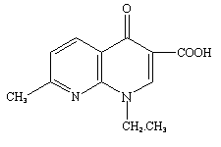
Quinolones
Parent drug: nalidixic acid
Notes:
All the antibiotics in the quinolone class are derived from the parent drug nalidixic acid

Slide 3
Classification
Quinolones (1st generation)
  Highly protein bound
  Mostly used in UTIs
Fluoroquinolones (2nd, 3rd and 4th generation)
  Modified 1st generation quinolones
  Not highly protein bound
  Wide distribution to urine and other tissues; limited CSF penetration.
Notes:
Quinolones highly protein bound so best activity is in protein-free compartment (i.e. urinary tract); fluoro group attached to central ring

Slide 4
Generation | Drug Names | Spectrum
1st | nalidixic acid cinoxacin | Gram- but not Pseudomonas species
2nd | norfloxacin ciprofloxacin enoxacin ofloxacin | Gram- (including Pseudomonas species), some Gram+ (S. aureus) and some atypicals
3rd | levofloxacin sparfloxacin moxifloxacin gemifloxacin | Same as 2nd generation with extended Gram+ and atypical coverage
4th | *trovafloxacin | Same as 3rd generation with broad anaerobic coverage
Notes:
Trovafloxacin first designed as a novel therapeutic approach to MRSA infections but was withdrawn in 1999 due to liver toxicity and death

Slide 5
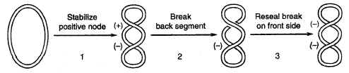
Mechanism of Action
Dual MOA:
  Inhibition of bacterial DNA Gyrase (Topoisomerase II)
    Formation of quinolone-DNA-Gyrase complex
    Induced cleavage of DNA
  Inhibition of bacterial Topoisomerase IV
    Mechanism poorly understood
Mechanism of DNA Gyrase
Notes:
Topo IV mechanism not well understood; mostly Topo II inhibition in G-; Topo IV inhibition more in G+; Quinolones bind to the DNA-gyrase complex resulting in a new quinolone-DNA-gyrase complex. This conformational change results in the prevention of DNA supercoiling which ultimately results in DNA cleavage

Slide 6
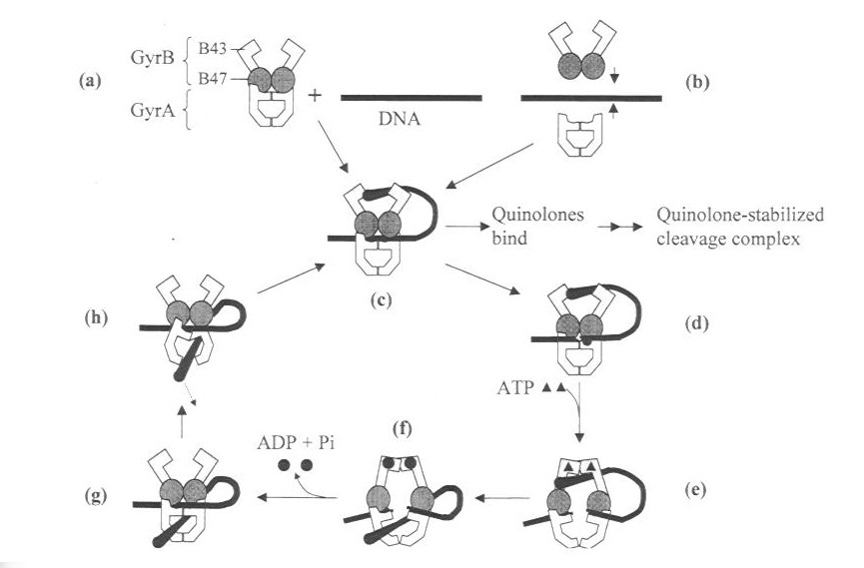
Mechanism of Action

Slide 7
Quinolones
[Conc] > serum:
  Prostate tissue
  Stool
  Bile
  Lung
  Neutrophils
  Macrophages
  Kidneys
[Conc] < serum:
  Prostatic tissue fluid
  Bone
  CSF

Slide 8
Quinolones
Drug interactions:
  ↓ absorption: Al3+, Mg2+, and Ca2+ antacids
  CYP450 inhibition potential drug interactions for ciprofloxacin
    (Ex) can increase warfarin exposure (real changes in INR are rare, but monitor)
Adverse effects:
  GI: Nausea, vomiting
  CNS: HA, dizziness, confusion, insomnia, delerium, hallucinations, seizure (rare)
  Cardiovascular: Torsades de pointes (rare)
  Musculoskeletal: Rupture of tendon (rare)
  Neurologic: Polyneuropathy (rare)

Slide 9
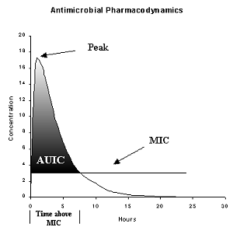
Quinolones PK/PD
Bactericidal antibiotics
Show both time-dependent and a combination of time-dependent and concentration dependent killing
Time-Dependent vs. Concentration-Dependent Killing
Notes:
Time-dependent - PD parameter dependent on the time the serum concentrations remain above the MIC during the dosing interval; Concentration-dependent – PD parameter dependent on what the peak/MIC ratio is (divide AUC by MIC to get the PD variable)

Slide 10
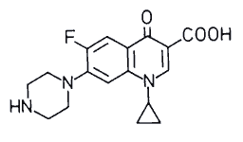
Ciprofloxacin
Administration [Usual Dosage]: IV, PO [500 – 750 mg q 8-12h]
Spectrum: Gram- aerobic rods, and Legionella pneumophila, and other atypicals. Poor activity against Strep. pneumoniae.
Indications:
  -- Nosocomial pneumonia
  -- Intra-abdominal infections
  Uncomplicated/complicated UTI
  Anthrax exposure and prophylaxis
Unique Qualities:
  Binds divalent cations (i.e. Ca & Mg) which decreases absorption
  -- Increased effects of warfarin
ADRs
  QTC prolongation, torsades de pointes, arrhythmias
  Nausea, GI upset
  Interstitial nephritis
Notes:
Not inclusive list of indications; patients at risk for tendon effects (>60 yo, renal failure, dialysis, concomitant corticosteroid therapy, dyslipidemia); weakest quinolone against MSSA

Slide 11
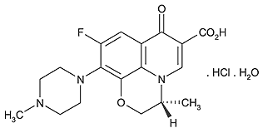
Levofloxacin
Brand Name: Levaquin®, Quixin®
Administration [Usual Dosage]: IV, PO and ophthalmic [500-750 mg q24h]
Spectrum: Gram-, Gram+ (S. aureus including MRSA & S. pneumoniae) and Legionella pneumophila, atypical resp. pathogens,
Mycobacterium tuberculosis
Indications:
  Chronic bronchitis and CAP
  -- Nosocomial pneumonia
  SSTIs
  Intra-abdominal infections
Unique Qualities:
  Binds divalent cations (i.e. Ca & Mg) which decreases absorption
  ADRs
  Blood glucose disturbances in DM patients
  QTC prolongation, torsades de pointes, arrhythmias
  Nausea, GI upset
  Interstitial nephritis
Notes:
Not inclusive list of indications; patients at risk for tendon effects (>60 yo, renal failure, dialysis, concomitant corticosteroid therapy, dyslipidemia)

Slide 12
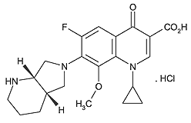
Moxifloxacin
Brand Name: Avelox®, Vigamox®
Administration [Usual Dosage]: IV, PO and ophthalmic [400mg q24h]
Spectrum: Gram-, Gram+ (S. aureus including MRSA & S. pneumoniae) & atypicals (L. pneumophila, C pneumonia & M. pneumoniae), Mycobacterium tuberculosis, gram-negative anaerobes
Indications:
  Chronic bronchitis
  CAP
  Bacterial conjuctivitis
  Sinusitis
Unique Qualities:
  Binds divalent cations (i.e. Ca & Mg) which decreases absorption
  Safety and efficacy not established in patients <18 y.o.
ADRs
  Blood glucose disturbances in DM patients
  QTC prolongation, torsades de pointes, arrhythmias
  Nausea, GI upset
  Interstitial nephritis
Notes:
Not inclusive list of indications; Chlamydia pneumonia and Mycoplasma pneumonia

Slide 13
Resistance Mechanisms
Mutations that enhance antibiotic efflux capability
Bacterial chromosomal mutations for genes that encode for bacterial DNA gyrase and Topo IV
Mutations in outer membrane porins (Gram-)
Notes:
Resistance developing in various species (S. aureus, Pseudomonas aerg and Strep. Pyogenes) so could be a problem in the future

Slide 14
ESSENTIALS OF MEDICAL PHARMACOLOGY | .QUINOLONES | K D TRIPATHI | 7TH EDITION MAY-2014 | TENDINITIS & TENDIN RUPTURE HAVE ODDURED.

