Slide 1
Ervilla Dass
Assistant Professor
Department of Pharmacology
S. B. K. S. Medical Institute and Research Centre
Sumandeep Vidyapeeth, Piparia.

Slide 2
PARASYMPATHETIC
NERVOUS SYSTEM
Ervilla Dass

Slide 3
FUNCTIONS OF THE PARASYMPATHETIC NERVOUS SYSTEM
Protects the retina from excess light
Decreases heart rate
Promotes glandular secretions
Promotes the emptying of hollow organs
Promotes the conservation of energy
Promotes rest and repair
Physiologically antagonizes the sympathetic nervous system

Slide 4
DUAL INNERVATION AT MOST SITES

Slide 5
PARASYMPATHETIC INNERVATION FROM BRAIN

Slide 6
PARASYMPATHETIC INNERVATION FROM THE SACRAL CORD

Slide 7
SYNTHESIS OF ACETYLCHOLINE
+
Acetyl CoA
Choline
Choline acetylase
Acetylcholine

Slide 8
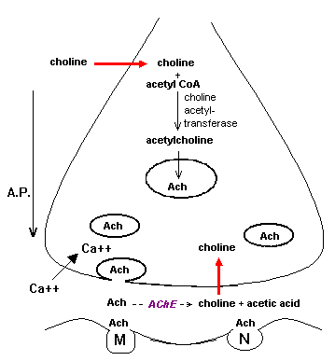
CHOLINERGIC FIBER

Slide 9
ACETYLCHOLINE AND ITS METABOLITES
hydrolysis
AChE
Acetylcholine
+
Choline
Acetate

Slide 10
AGENTS AFFECTING CHOLINERGIC TRANSMISSION
Hemicholinium
Latrotoxin
Vesamicol
Calcium
Physostigmine
Atropine
d-Tubocurarine
Botulinus Toxin

Slide 11
EVIDENCE

Slide 12
K. D. Tripathi M.D., Essentials of Medical Pharmacology , 7th dition , 2013, pg. 90 to 98
Source of Information | Chapter | Author | Information | Level of evidence
K. D. Tripathi Essentials of Medical Pharmacology, Jaypee Brothers Medical Publishers (P) LTD, NEW DELHI 7th edition, 2013 | Section II DRUGS ACTING ON AUTONOMIC NERVOUS SYSTEM Chapter 7 Cholinergic system and drugs | Dr. K. D. Tripathi M.D. Ex-Director Professor and head of Pharmacology Maulana Azad Medical College and Associated LN B Pant Hospitals, New Delhi | Cholinergic innervation, transmission | Level of evidence - Grade one

Slide 13
Satoskar & Bhandarkar, Pharmacology and Pharmacotherapeutics , Revised 23rd Edition , 2013, pg . 285 to 290
Source of Information | Chapter | Author | Information | Level of evidence
Pharmacology and Pharmacotherapeutics – R. S. Satoskar, S. D. Bhandarkar, Nirmala N. Rege POPULAR PRAKASHAN, Mumbai. Revised 23rd Edition, 2013 | Section IV AUTONOMIC NERVOUS SYSTEM Chapter 18 Cholinergic drugs | Satoskar & Bhandarkar | Cholinergic innervation, transmission | Level of evidence - Grade one

Slide 14
Cholinergic-nitrergic transmitter mechanisms in the cerebral circulation.
Lee TJ¹, Liu J, Evans MS.
Microsc Res Tech. 2001 Apr 15;53(2):119-28.
Source of Information | Chapter TITLE | Author | Information | Level of evidence
Microsc Res Tech. 2001 Apr 15;53(2):119-28. | Cholinergic-nitrergic transmitter mechanisms in the cerebral circulation. | Lee TJ¹, Liu J, Evans MS. | Acetylcholine Acetylcholine (ACh) released from parasympathetic cholinergic nerves was first suggested to be the transmitter for vasodilation.

