Slide 1

Diseases of Bone & Joints -II

Slide 2
Focal Osteoporotic Marrow Defect
Non-pathologic area of hematopoietic marrow sufficient in size to appear radiographically as a radiolucency.
Asymptomatic ill-defined circumscribed lucency from a few to several cm in size.
More than 75% of cases in adult females in an edentulous area posterior mandible; biopsy.

Slide 3
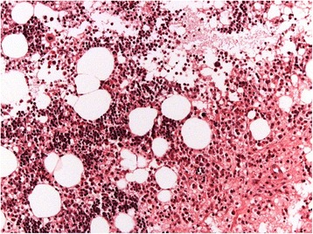
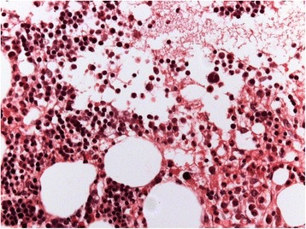

Slide 4
Idiopathic Osteosclerosis
Focal area of increased radiodensity of unknown cause.
Also known as dense bone island, bone eburnation, focal (periapical) osteopetrosis.
Peak age 20’s.
Well defined rounded or elliptic radiodense mass 3-20 mm.

Slide 5
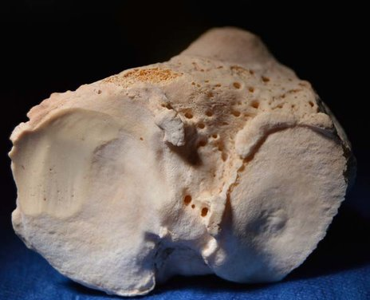

Slide 6
Idiopathic Osteosclerosis
Need to rule-out condensing osteitis (pulp disease).
Diagnosis based on history clinical and radiographic features;
Biopsy if expansion is present.
Because lesion becomes stable and indolent, no treatment necessary.

Slide 7
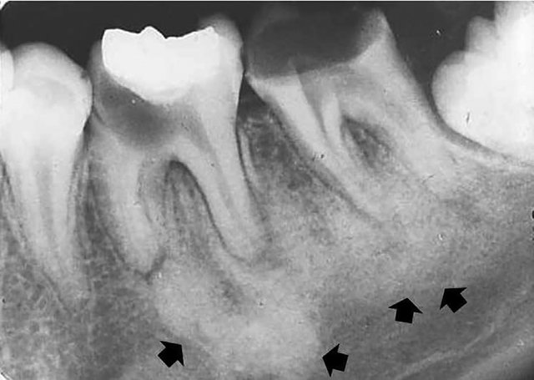

Slide 8
Massive Osteolysis
Also known as Gorham disease, Gorham-Stout syndrome, vanishing bone disease and phantom bone disease.
Most often in children & young adults;
50% report antecedent trauma.
Pelvis, humeral head or shaft & axial skeleton most common sites.

Slide 9
Massive Osteolysis
30% maxillofacial involvement,
usually the mandible.
Signs include mobile teeth, pain, malocclusion,
Intramedullary lucency, loss of lamina dura, thinning of cortex.
Spontaneous arrest; radiation/surgery.

Slide 10
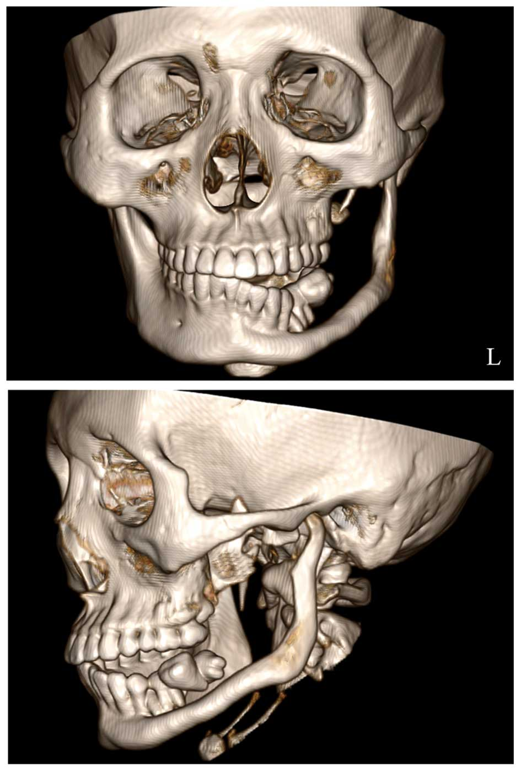
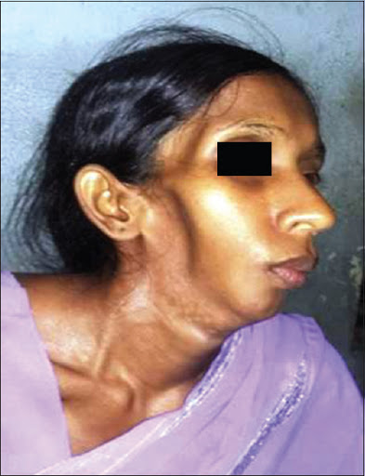
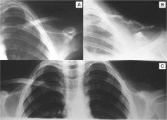

Slide 11
Paget’s Disease of Bone
Also known as osteitis deformans.
Preferred term is osteodystrophia deformans
Relatively common after age 40;
1/100-150 (increasing to 1/10 by age 90);
M>F; white > blacks or Asians.
Usually polyostotic (multiple bone affected),
Rarely monostotic (single bone)

Slide 12
Pathogenesis:
Increased osteoclastic bone resorption,
Increased but somewhat disorganized bone formation, and increased vascularity of bone.
The resultant bone is a mosaic of woven and lamellar bone that is mechanically insufficient and at increased risk for fracture or deformity.

Slide 13
Increased sensitivity to factors known to stimulate bone resorption
1,25 dihydroxy vitamin D and receptor activator of NF-kB ligand (RANKL)
Environmental factors:
Rural life and animal contacts
Viral infection

Slide 14
Genetic factors:
Rank ligand (RANKL),
binds RANK on osteoclast precursors promoting osteoclast proliferation and differentiation.
Osteoprotegerin (OPG)
Receptor which binds RANKL, thus preventing RANKL from binding RANK.

Slide 15
Paget’s Disease of Bone
Bowing of legs, leontiasis ossea, fracture, bone and joint pain, pressure neuropathy.
May cause progressive alveolar ridge expansion, spacing of teeth and “dental appliances that no longer fit the mouth”.
Altered trabecular pattern initially from decreased bone density evolves to patchy sclerotic areas having a “cotton wool” appearance.

Slide 16
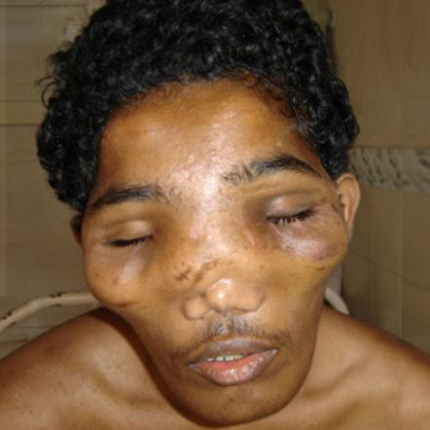
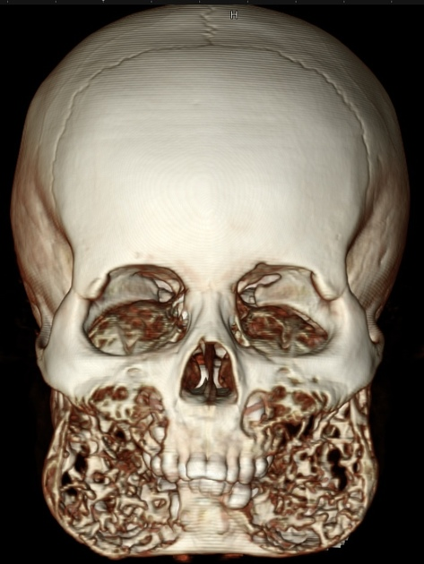
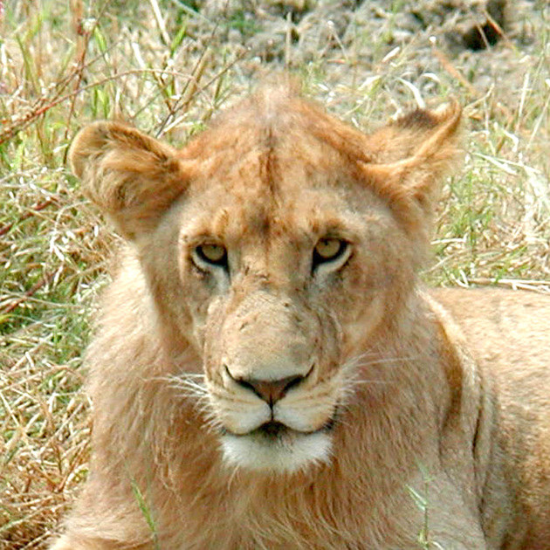
Notes:
Paget disease
gigantism
craniosynostosis
tumors of the paranasal sinuses
syphilitic osteoperiostitis
uremia with secondary hyperparathyroidism ²

Slide 17
Paget’s Disease of Bone
Alternating resorption and formation of bone produces a characteristic “mosaic” pattern and marrow replaced by highly vascular fibrous connective tissue.
Increased risk of osteosarcoma (1%) and giant cell tumors of bone.
Treatment with calcitonin & biophosphonate.

Slide 18
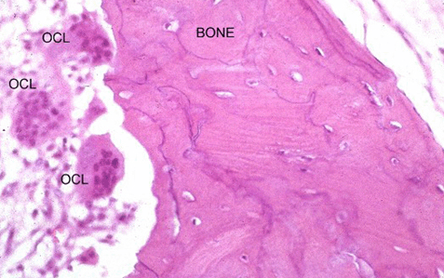

Slide 19
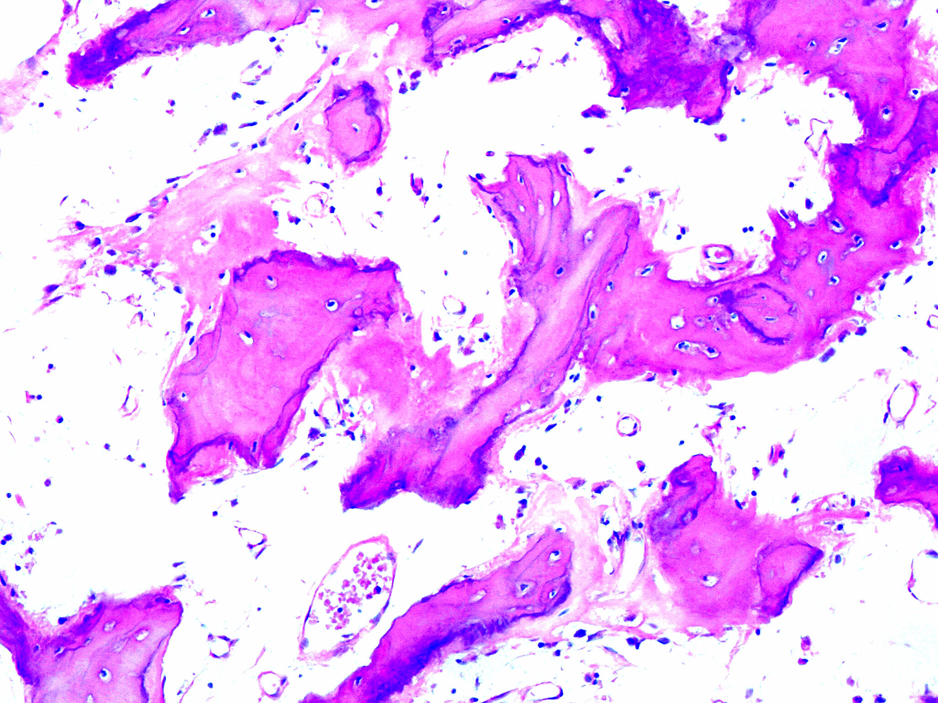

Slide 20
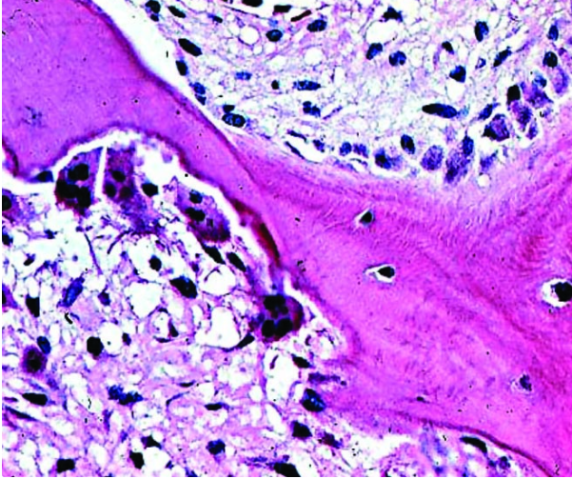

Slide 21
Complications of Paget's disease of bone:
Musculoskeletal: Bone pain, Bone deformity, Fractures
Neurologic : Hearing loss, Headache, Cranial nerve deficits
Cardiovascular: Congestive heart failure, Calcification of the aortic valve
Neoplastic
Giant cell tumors
Miscellaneous:

Slide 22
Laboratory findings:
Serum total and bone specific alkaline phosphatase (BSAP) levels are usually elevated.
Hypercalcemia usually reflects a coexisting condition such as primary hyperparathyroidism
Prudent to measure the serum 25-hydroxy vitamin D level to exclude vitamin D deficiency as a contributing factor to an elevated SAP.

Slide 23
thank you

