Slide 1

Mid face fractures – I introduction to mid face and lefort fractures

Slide 2
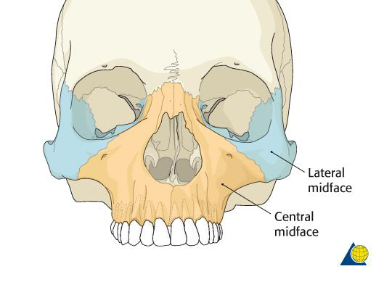
What is mid face??
Area between a superior plane drawn
through the zygomaticofrontal sutures
tangential to the base of the skull and
an inferior plane at the level of the
maxillary dental occlusal surfaces
These planes do not parallel each other
but converge posteriorly at a level
approximating that of the foramen
magnum
Triangular region with its widest
dimension facing anteriorly

Slide 3
Two maxillae
Two zygomatic bones.
Two palatine bones.
Two zygomatic process of temporal bone.
Two nasal bones.
Two lacrimal bones.
Vomer
Ethmoid and its attached conchae.
Two inferior conchae.
Pterygoid plates of sphenoid

Slide 4
Bony architecure
Composed of maxilla , orbits , NOE complex & paired zygomatic complexes
Developmental sutures between these structures represent areas of weakness
FZ,ZM sutures
Other areas such as bone surrounding some structures

Slide 5
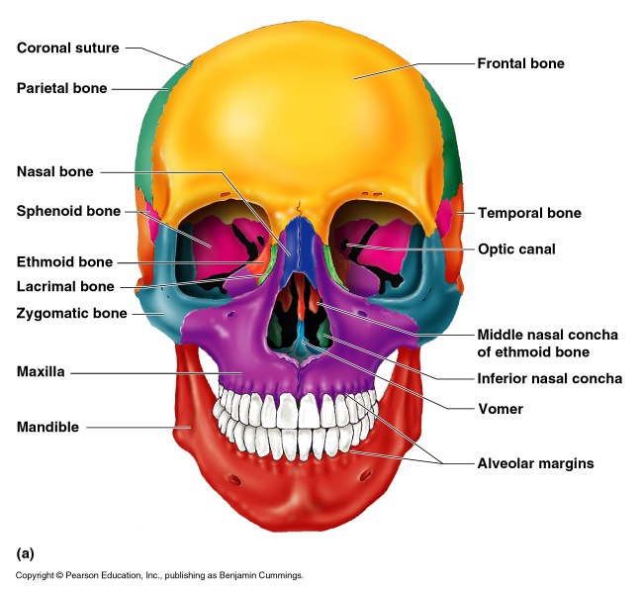
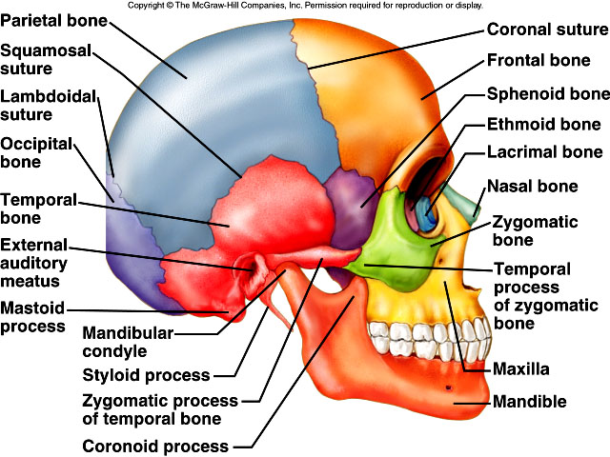

Slide 6
Biomechanics
Sustain masticatory forces and provide normo-occlusion
Provide support for soft tissue envelope with complex facial expressions
Basis for aesthetics in facial height and width
Protect vital organ systems and their function

Slide 7
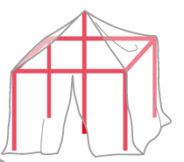
Basically, the midface equates to a tent, where the tent poles represent the bony midface and the tarpaulin represents the overlying soft tissues. However, the vectors of the midface address all three dimensions i.e, vertical, sagittal, and transverse, which makes it much more demanding than the construction plan of a tent
The reconstruction sequence to reestablish midfacial pillars and dimensions begins with establishing the most reliable reference structures. This can be occlusion, an outside-to-inside (“Joe’s outer frame”, Gruss 1986) or an up-to-down procedure as a first step.

Slide 8
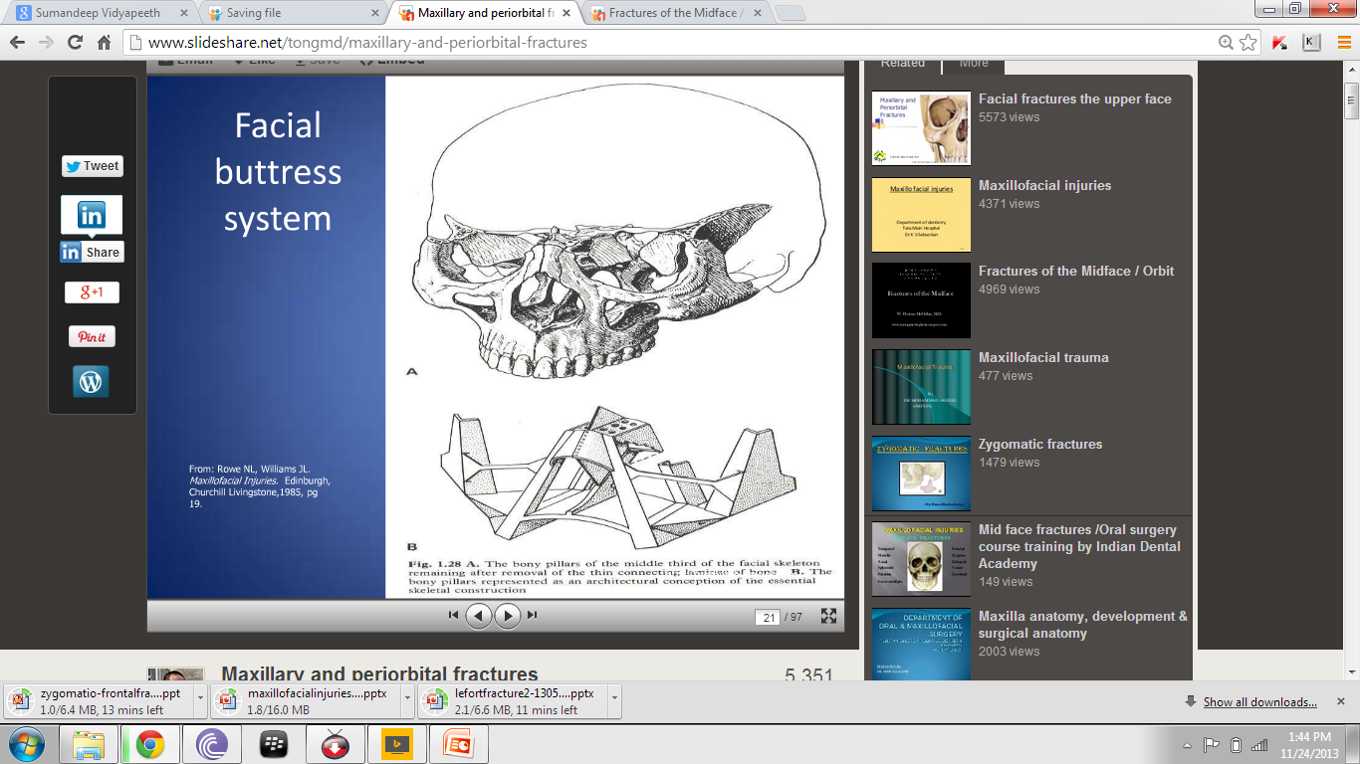

Slide 9
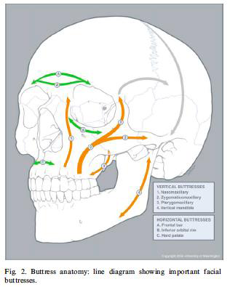
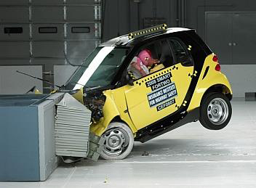
PILLARS OF FACE BETWEEN THE BUTTRESSES - CRUMPLE ZONES

Slide 10
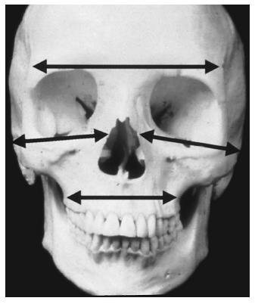
Horizontal – supraorbital rims
- infraorbital rims
- alveolar process of maxilla

Slide 11
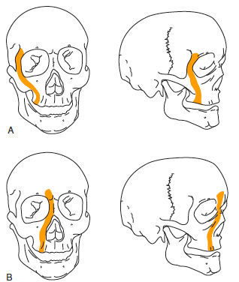
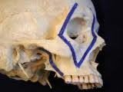
Vertical - pyriform
- zygomatic
- pterygomaxillary

Slide 12
Rowe & william’s classification
A – FRACTURES NOT INVOLVING DENTOALVEOLAR COMPONENTS
1. central region
a- fracture of nasal bone &/or nasal septum
- lateral nasal injuries
- anterior nasal injuries
b- fractures of frontal process of maxilla
c- fractures of type a & b which extend into ethmoid
bone
d- fractures of type a ,b ,c which etends into frontal
bone
2.lateral region- fractures involving zygomatic bone,arch & maxilla excluding dentialveolar component

Slide 13
B –FRACTURES INVOLVING DENTOALVEOLAR COMPONENT
1.central region
a-dentoalveolar fractures
b-subzygomatic fractures
2.combined central & lateral region
a-high level
b-LeFort III with midline split
c-LeFort III with midline split + fracture
of roof of orbit or frontal bone

Slide 14
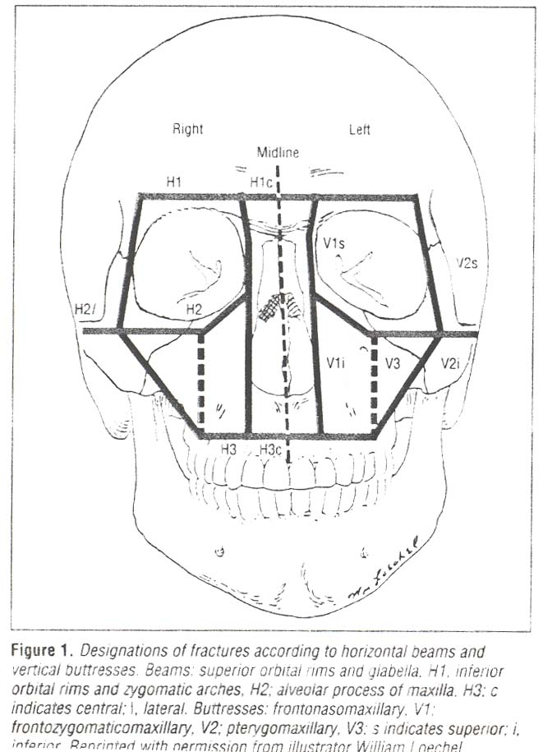
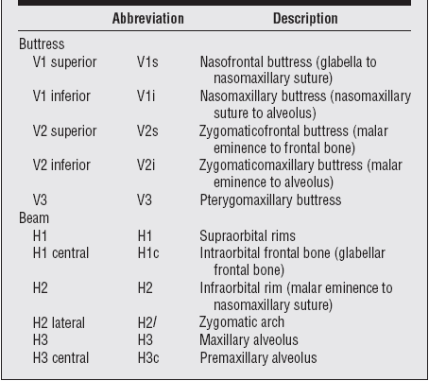
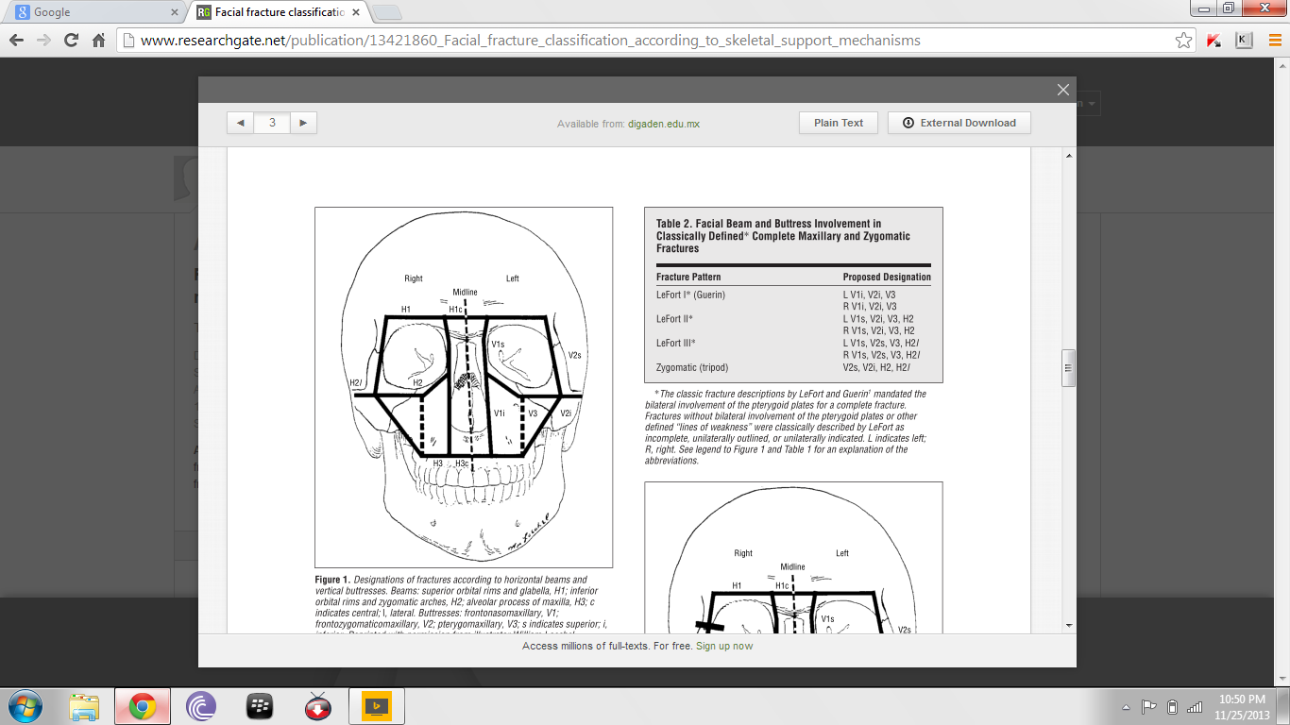
Donag,Endress,Mathog classification (1998)

Slide 15
Rowe & killey 1968
Type I-no significant displacement
Type II-fractures of zygomatic arch
Type III-rotation around vertical axis
A-inward displacement of orbital rim
B-outward displacement of orbital rim
Type IV-rotation aruond longitudinal axis
A-medial displacement of frontal process
B-lateral displacement of frontal process
Type V-displacement of complex en bloc
A-medial
B-inferior
C-lateral
Type VI-displacement of orbitoantral partition
A-inferiorly
B-superiorly
Type VII-displacement of orbital rim segments
Type VIII-complex comminuted fractures

Slide 16
Larsen & Thomsen 1968
Group A – stable fracture – showing minimal or no displacement & requires no intervention
Group B -unstable fracture – with great displacement & disruption at FZ suture & comminuated fractures- requires reduction as well as fixation
Group C –stable fracture- other types of zygomatic fractures, which require reduction, but no fixation

Slide 17
Sub units
Lefort fractures
Nasal fractures
NOE fractures
Palatal fractures
Zygomatic fractures

Slide 18
The Midface fractures generally were used to be treated by closed reduction. As a result, the preoperative imaging needs were only those that can identify the presence of the fracture
Imaging of the middle third can include the following
1- Occipitomental (standard ,10°, 15° and 30°)
2- True lateral
3- Soft tissue lateral
4- Occlusal
5- Intra orals
6- Submento-vertex
7- C.T Scan
8- 3D C.T Scan
9- MRI (to detect CSF leaks and fistula)

Slide 19
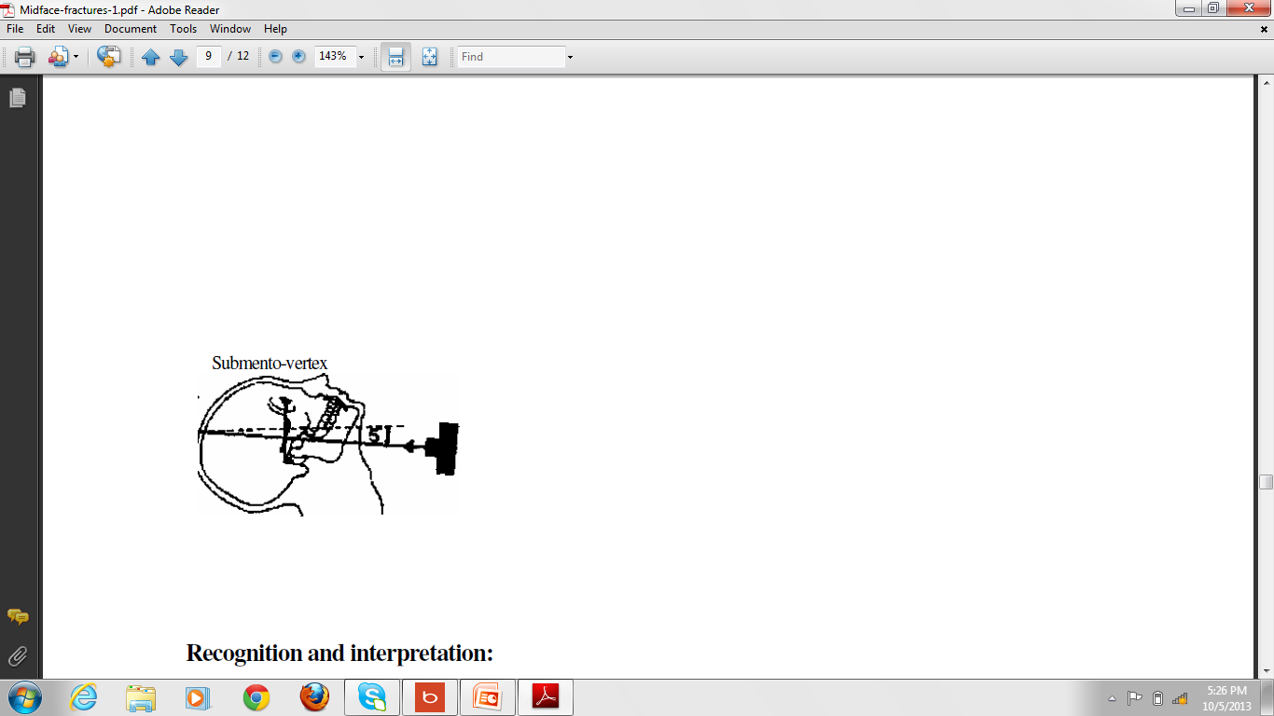
When taking the radiographs there is a radiographic baseline to orient the patient in relation to the film and the x-ray source, this baseline is extending from the outer canthus of the eye to the external auditory meatus.
Submento-vertex: patient is not facing the film, the baseline is parallel to the film, the x-ray tube at 5° to the horizontal plane.

Slide 20
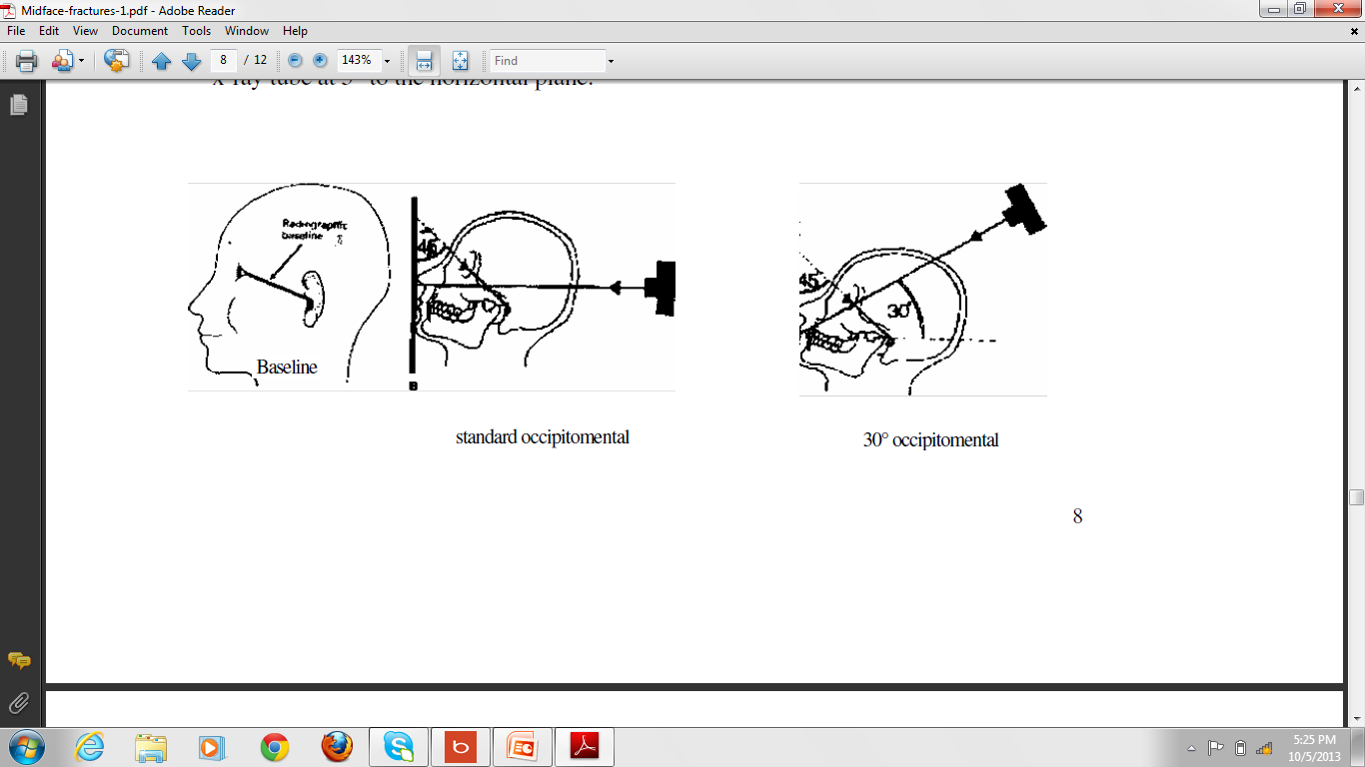
Standard occipitomental: patient facing the film, baseline at 45° to the film, the tube is perpendicular to the film.
30° occipitomental: patient facing the film, baseline at 45°, the tube at 30° to the horizontal plane.

Slide 21
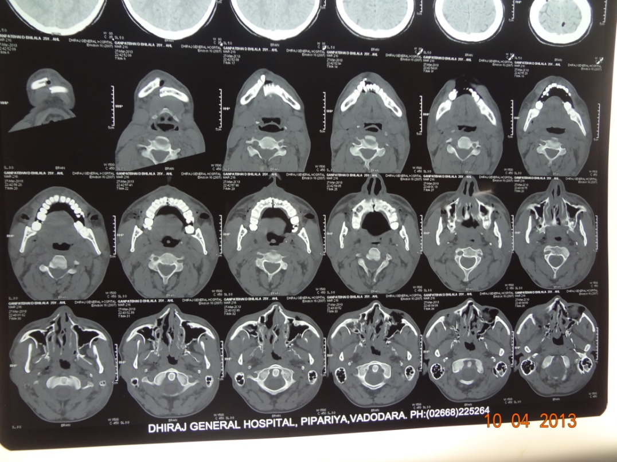
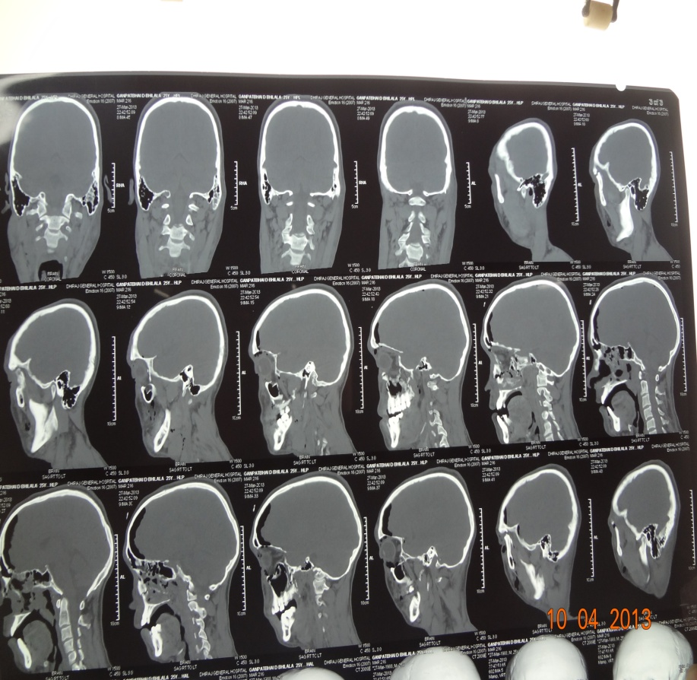
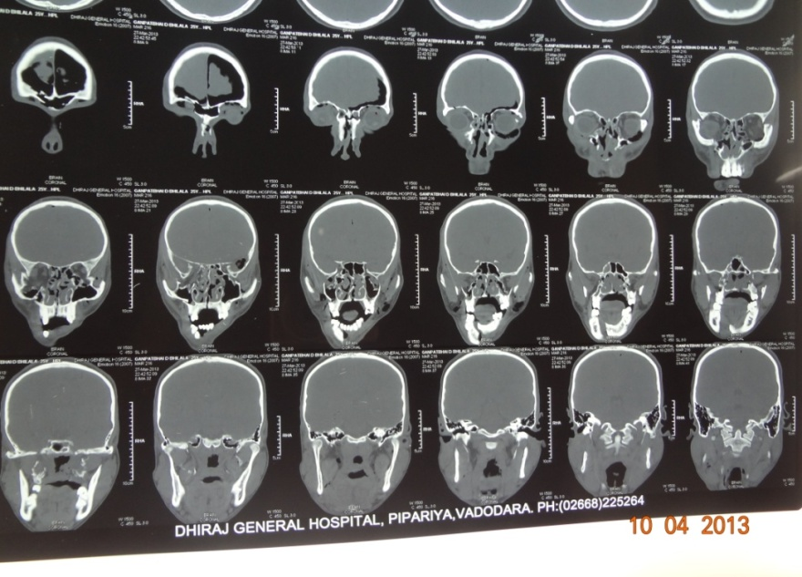
2D CT

Slide 22
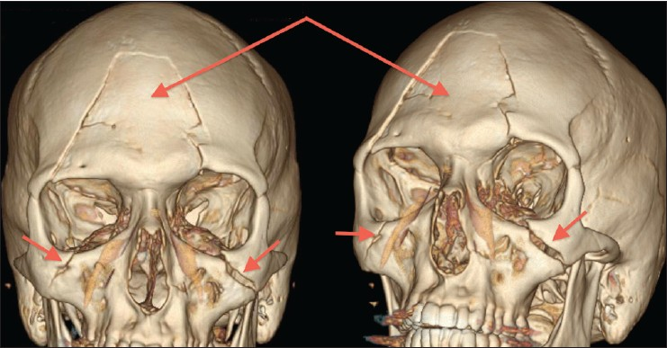
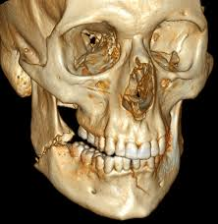
3D CT

Slide 23
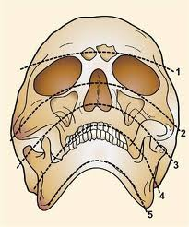
Campbell's and trapnell's lines
1- First line across the zygomaticofrontal, the superior margin of the orbit and the frontal sinus
2- Second line across the zygomatic arch, zygomatic body, inferior orbital margin and nasal bone
3- Third line across the condyles, coronoid process and the maxillary sinus
4- Fourth line across the mandibular ramus, occlusal plane
5- Fifth line (trapnell's line) across the inferior border of the mandible from angle to angle

Slide 24
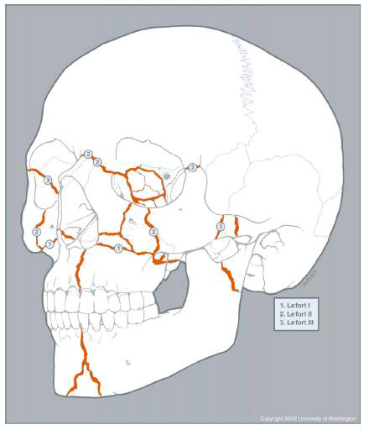
Le fort fractures
Lefort I
Lefort II
Lefort III

Slide 25
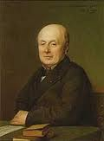
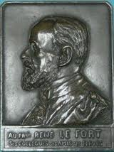
Alphonse Guerin in 1886 described fracture of the tooth-bearing portion of the maxilla without displacement, then in 1901 Rene Le Fort investigated the facial skeleton of 35 cadavers that had subjected to a variety of traumas then dissected and he found the typical three classes of weak lines of the midface fractures.
The mid face fractures is more complex than those produced by Le fort, there is a modified Le fort fracture classification which includes subdivisions to nearly cover the complex pattern of mid face fractures

Slide 26
Modified Le Fort classification
By marciani 1993 (NOE, ZMC)
Le Fort I – low maxilary fracture
Ia-low maxillary fracture/multiple segment
LeFort II-pyramidal fractures
IIa-pyramidal & nasal fracture
Iib-pyramidal & NOE fracture
LeFort III-craniofacial dysjunction
IIIa- +nasal fracture
IIIb- +NOE fracture
LeFort IV-LeFort II or III fracture & cranial base fracture
IVa- +supraorbital rim fracture
IVb- +anterior cranial fossa & supraorbital rim fracture
IVc - +anterior cranial fossa & orbital wall fracture

Slide 27
Le Fort’s classification (1901)
  Le Fort I, II, III
Erich’s classification (1942)
  Horizontal, pyramidal, transverse
Classification based on relationship of fracture line to zygomatic bone
  Subzygomatic, suprazygomatic
Classification based on level of fracture line
  Low, mid, high level fractures

Slide 28
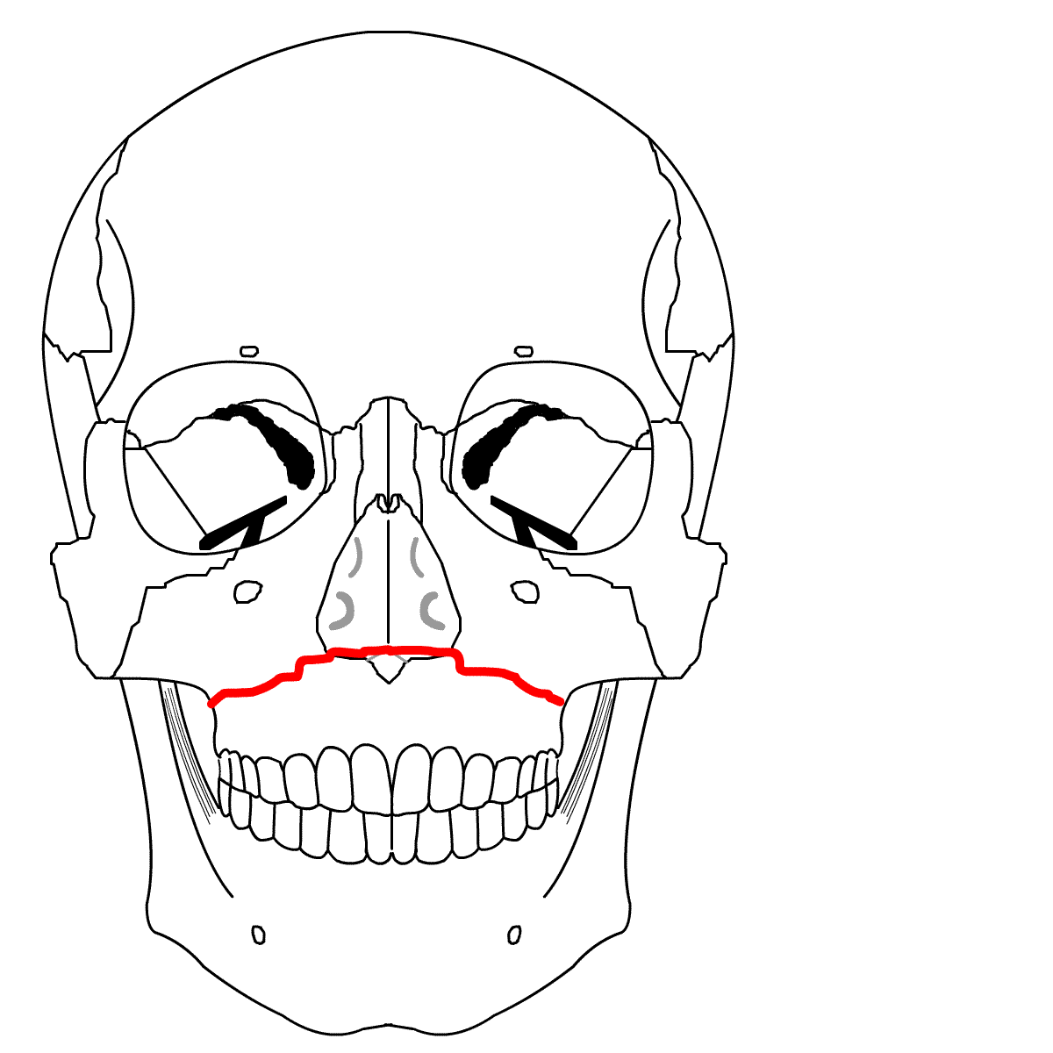
LEFORT I
Also called Horizontal fracture, Guerin’s fracture , floating fracture, low level, subzygomatic fracture
Separation of complete dentoalveolar part of the maxilla
and the fracture is held only by means of soft tissue
This is a horizontal fracture above the level of nasal floor.
The fracture line extends backwards from the lateral
margin of the anterior nasal aperture below the
zygomatic buttress to cross the lower third of the
ptetygoid laminae. The 2nd line passes along the lateral
wall of the nose and the 3rd line through lower third of
the nasal septum to join the lateral fracture behind the
tuberosity

Slide 29
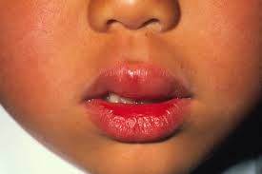
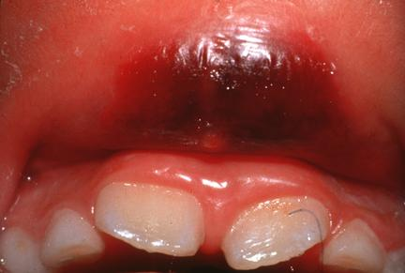
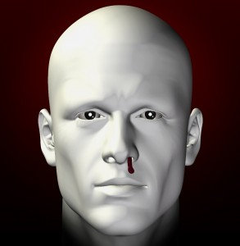
Signs and symptoms
Slight swelling and edema of the lower part of the face along with the upper lip swelling
Ecchymosis in the labial and buccal vestibule, as well as contusion of the skin of the upper lip may be seen
Bilateral nasal epistaxis may be observed
Mobility of the upper dentoalveolar portion of jaw, which is mobile to digital pressure

Slide 30
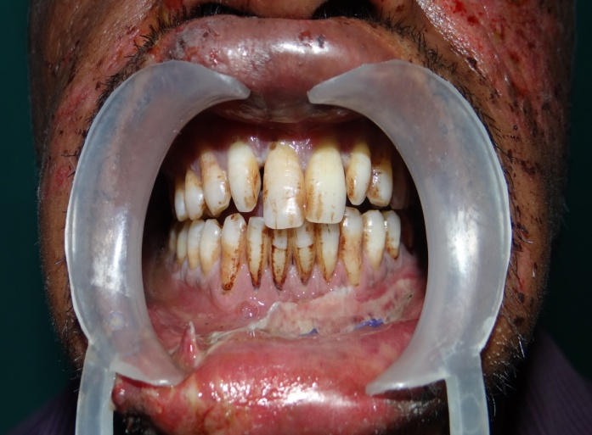
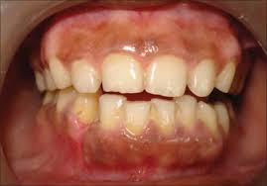
Occlusion may be disturbed, difficult mastication
Pain while speaking and moving the jaw
Sometimes there will be upward displacement of the entire fragment, locking it against the superior intact structures, such a fracture is called as impacted or telescopic fracture. Anterior open bite may be seen in this case
Percussion of maxillary teeth produces dull “ cracked cup “ sound

Slide 31
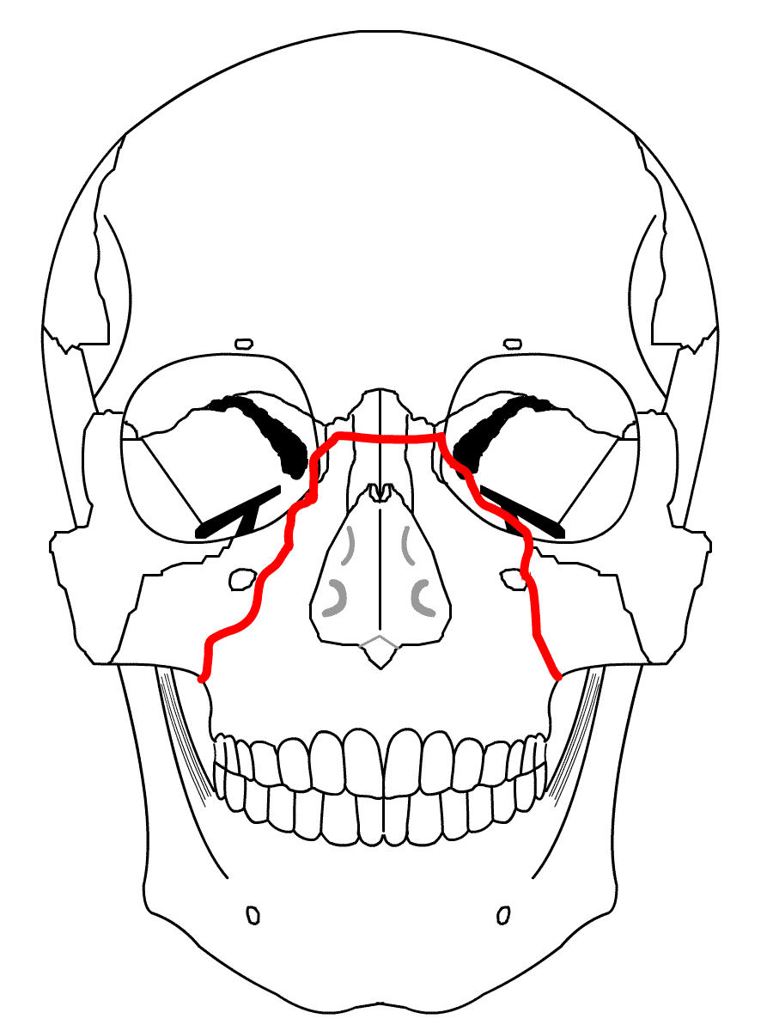
LEFORT II
Also called pyramidal , subzygomatic fracture
Force may be delivered at the level of nasal bones
This fracture runs from the thin middle area of the
nasal bones down either side , crossing the frontal
process of maxillae into the medial wall of each orbit.
Within each orbit, the fracture line crosses the lacrimal
Bone behind the lacrimal sac, before turning forward
to cross the infra-orbital margin slightly medial to or
Through the infra-orbital foramen. The fracture now
Extends downwards and backwards across the lateral
Wall of antrum below zygomaticomaxillary suture and
Divides the pterygoid laminae about halfway up.
Separation of the block from the base of the skull is
Completed via the nasal septum and may involve the
Floor of the anterior cranial fossa

Slide 32
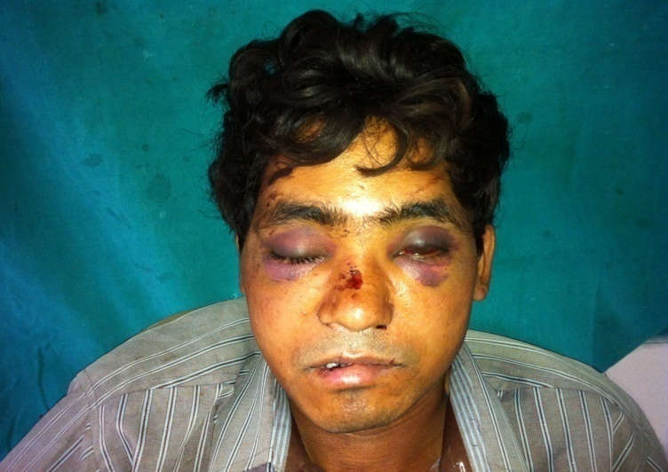
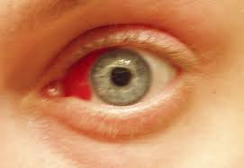
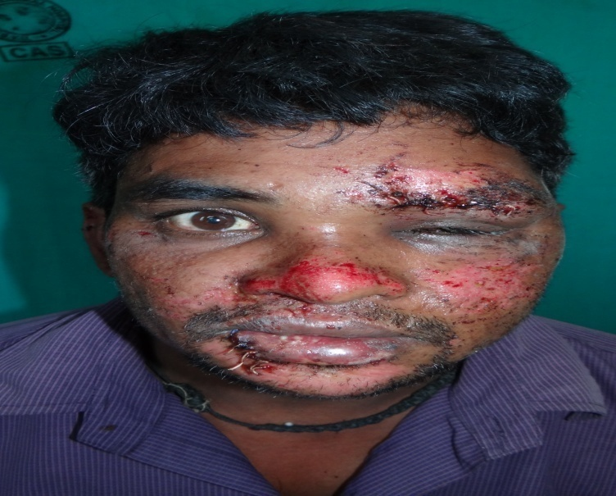
Signs and symptoms
There is a gross edema of the middle third of the face known as ballooning or moon face. Edema sets in within a short time of injury
Presence of bilateral circumorbital edema and ecchymosis. Rapid swelling of the eyelids makes examination of the eyes difficult
Bilateral subconjunctival hemorrhage confined to medial half of the eye
The bridge of the nose will be depressed (flat face). Nasal disfigurement

Slide 33
If there is impaction of the fragment against the cranial base then shortening of the face with anterior open bite will be seen
If there is gross downward and backward displacement of the fragement then elongation or lengthening of the face will be seen with posterior gagging of the occlusion with anterior open bite(Dish shaped face)
Bilateral epistaxis may be present
Difficulty in mastication and speech, due to derranged occlusion may be seen
Airway obstruction may be seen due to posterior and downward displacement of the fragement impinging on the dorsum of the tongue

Slide 34
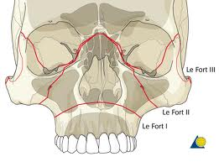
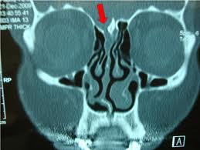
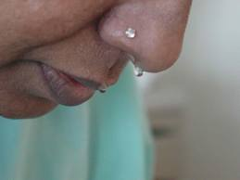
Surgical emphysema-crackling sensation transmitted to the fingers doe to escape of air from the paranasal sinuses is seen
Step deformity at the infraorbital margins may be seen
CSF leak may be present “Rhinorrhea”
Anaesthesia and/or paraesthesia of the cheek is noted

Slide 35
Citations | Type of article | Aims & objectives | Materials & method | Conclusion
Dent. J. (Maj. Ked. Gigi), Vol. 41. No. 2 April-June 2008: 77-83 | A case report:a case control study | A case of delayed bilateral fracture of zygoma and maxilla is presented here to give illustration on how the principle of diagnosis and surgical treatment of complex zygomatico-maxillary fracture are applied. | The submentovertex view more clearly detects fractures of the zygomatic arch. CT scan and its three-dimensional applications is indicated for visualization of the orbit if the orbital portion of the zygomatic fracture is suspected | The midface fractures has tendency to quick and spontaneous healing especially in non-displaced fractures where the maxilla is immobile or only slightly mobile.

Slide 36
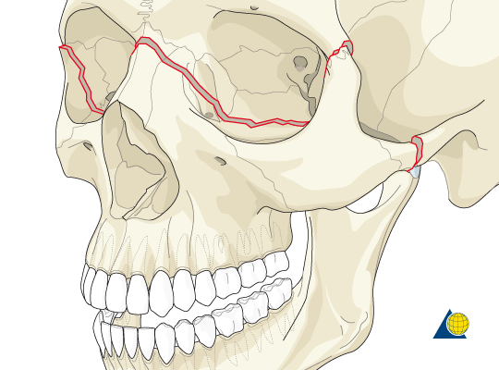
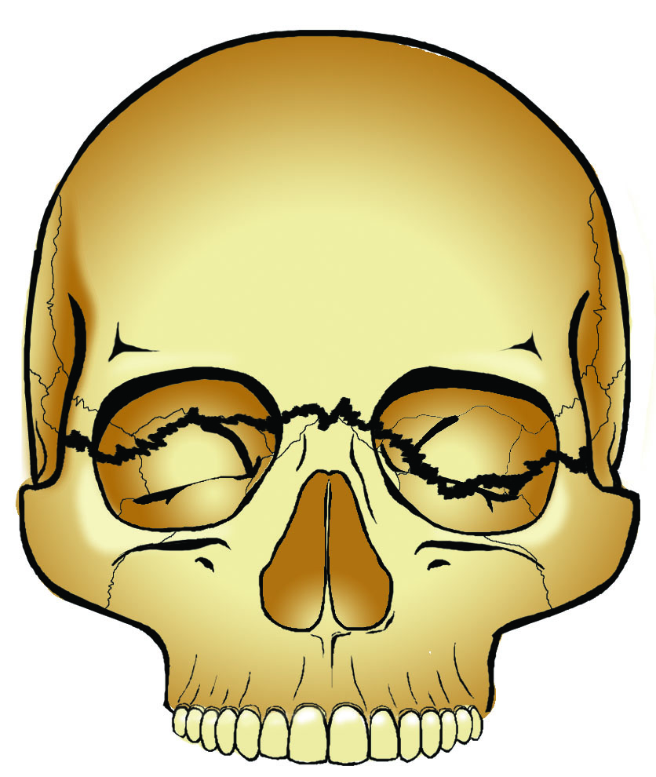
LEFORT III
Also called High level, transverse , supra-zygomatic
Fracture, craniofacial dysjunction
The fracture runs from near the frontonasal sutures
Transversely backwards,parallel with the base of the
Skull and involves the full depth of the ethmoid bone,
including the cribriform plate. within the orbit,the
fracture passes below the optic foramen into the
posterior limit of the inferior orbital fissure. from the
base of the inferior orbital fissure the fracture line
extends in two directions; backwards across the
pterygomaxillary fissure to fracture the roots of the
pterygoid laminae and laterally across the lateral wall
of the orbit separating the zygomatic bone from the
frontal bone. In this way the entire middle third of the
facial skeleton becomes detached from the cranial
base.

Slide 37
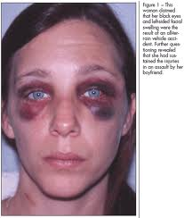
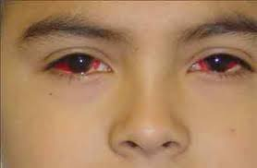
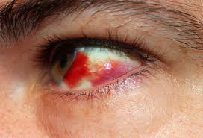
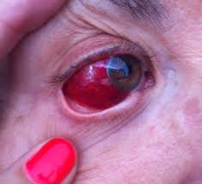
Signs and symptoms
Gross edema of the face,ballooning.’panda facies’ Within 24 to 48 hours
Bilateral circumorbital edema/periorbital ecchymosis and gross edema ‘racoon eyes’.gross circumorbital edema will prevent eyes from opening
Bilateral subconjunctival haemorrhage ,where posterior limit will not seen,when patient is asked to look medially

Slide 38
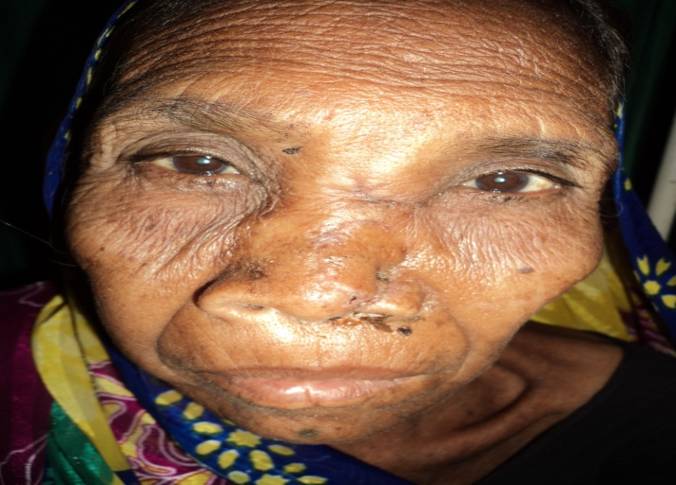
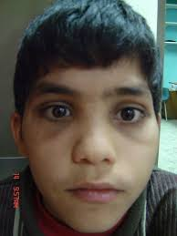
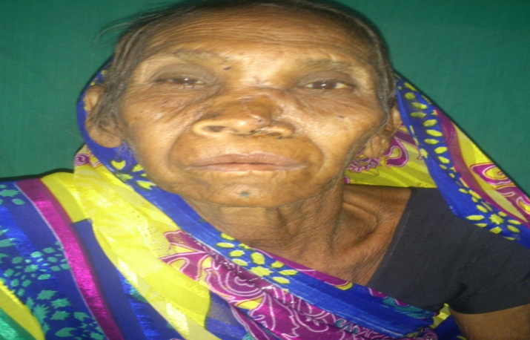
There may be tenderness and separation at the frantozygomatic sutures.this will lengthening of the face and lowering of the ocular level.unilateral or bilateral hooding of the eyes seen.
Characteristic ‘dish face’ deformity.
May be enophthalmos,diplopia or impairment of vision,temporary blindness etc.
Flatenning and widening,deviation of the nasal
bridge.
Epistaxis, CSF rhinorrhea.

Slide 39
principles
Accurate diagnosis
Determination of priority of treatment
Early reconstruction
Wide exposure of vertical and horizontal pillar of face
Use of bone graft to restore skeletal form
Use of rigid fixation to stabilize # segment
Restoration of bony support to over lying soft tissue envelop

Slide 40
Maxillary # fixation
Internal fixation
Direct osterosynthesis
1. Miniplates/Microplates
2. Intraosseous Wires
- high(FZ,FN)
- Mid(buttress,orbital rim)
- Low(alveolar/midpalatal)
Suspension wires
1. Frontal
2. Circumzygomatic
3. Zygomatic
4. Circumpalatal
5. Infraorbital
6. Piriform aperture
7. Peralveolar
External fixation
Craniomandibular
Craniomaxillary
1. Supraorbital pins
2. Zygomatic pins
3. POP head frame
4. Halo frame
5 Levant frame
6. Box frame

Slide 41
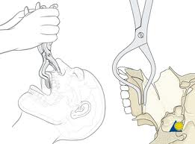
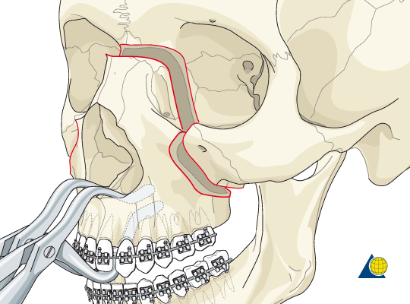
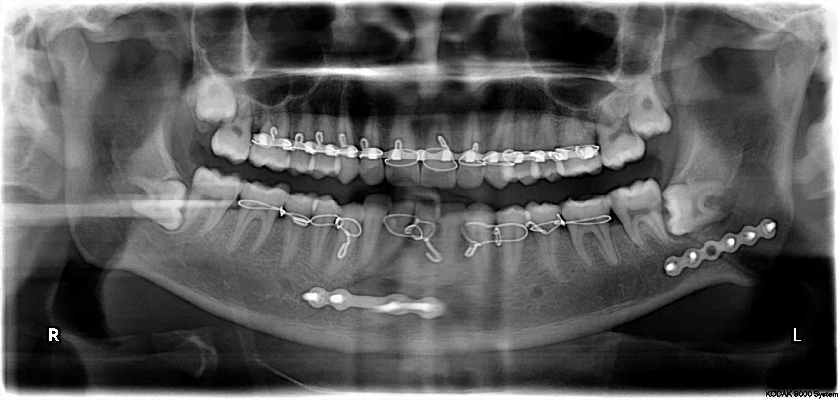
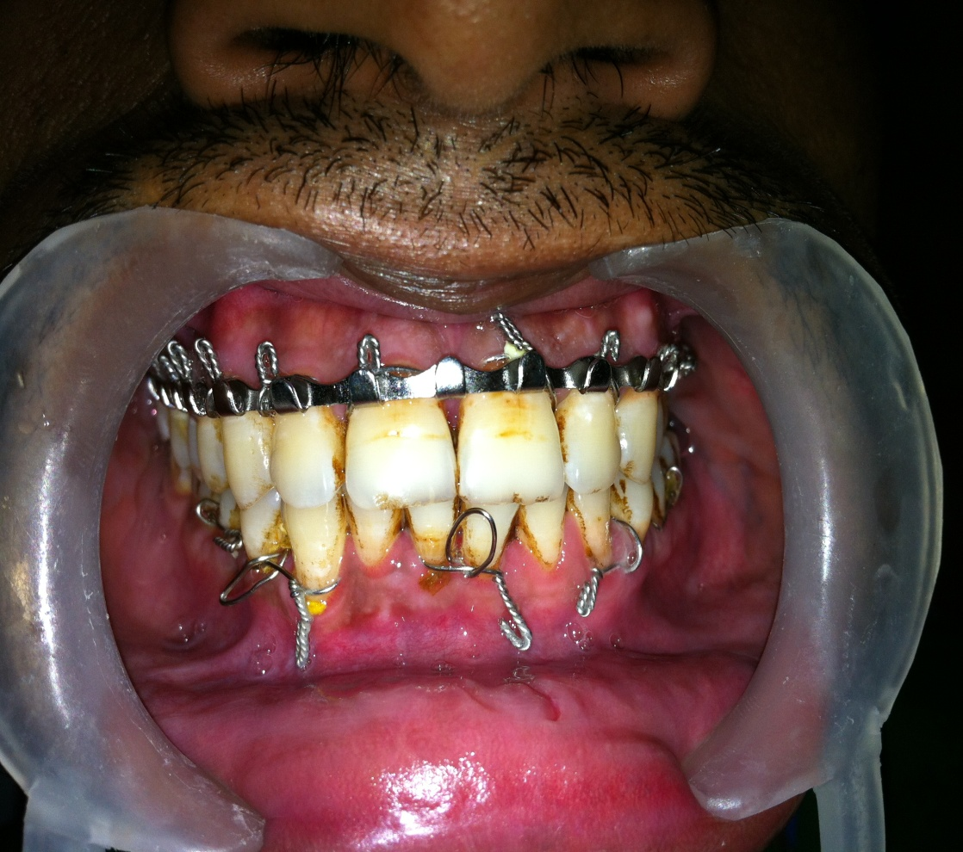



Management
- reduction
Rowe’s disimpaction forceps
Hayton- william forceps
Arch Wiring – closed method

Slide 42
support
Support is achieved by packing the maxillary sinus with:
  Antral Pack
  Antral Balloon

Slide 43
Extra cranial fixation forms
Principle: External appliances relies on sandwiching the midface between base of skull and mandible to provide cantilever support to midface in 3D following disimpaction and closed reduction.

Slide 44


POP head cap with metal frame
Heavy
Uncomfortable
Unstable

Slide 45

CRANIAL ARCH BAR SUSPENSION

Slide 46



Halo frame
Described by Crawford
modified by Mackenzie & Ray,1970
Secure the frame work to the skull directly
by screw pins
Advantage:
Light weight
Adjustable
Titanium Screw pin

Slide 47

Box frame
More stable and rigid
Other unstable fracture fragment
can also be attached to vertical rod

Slide 48


Levant frame
Developed at Royal Melbourne Hospital
Provided simple rigid craniomaxillary fixation between supraorbital rims and maxilla connected by central rod attached at lower end by means of cast metal splint or acrylic splint

Slide 49

Internal Fixation
Intra-osseous wiring
Miniplates and screws
Suspension wiring
Splint or denture

Slide 50
Citations | Type of article | Aims & objectives | Materials & method | Conclusion
World Journal of Emergency Surgery 2010, 5:17 | A case report:a retrospective study | To evaluate the accuracy of criteria used to recommend angiotomography in the diagnosis of cervical BCVI in 100 patients with blunt cervical trauma in the trauma services section of a Brazilian quaternary care hospital. | Although there is no consensus regarding the criteria that should be used to indicate angiotomography for BCVI diagnosis, we conclude that the criteria used in the current study led to a diagnosis of BCVI in 0.93% of 2,467 trauma patients, BCVI injuries were associated with more severe traumas and did not affect mortality | During a 30-month (2006-2008), all patients admitted to the emergency room of Hospital das Clínicas da Faculdade de Medicina da Universidade de São Paulo with blunt cervical trauma and potential risk of cervical vessel injury, were subjected to cervical angiotomography to diagnose BCVI. The data analyzed are presented as mean ± standard deviation, and statistical analyses included Chi-square and Fisher's exact tests, and the Mann-Whitney test.

Slide 51


Intra-osseous wiring
By Merville & Derome(1976)

Slide 52


Miniplates and screws
These are monocortical, semi-rigid fixation device which provide 3D stability.
Designs: X, H, L, T, Y
Thickness:1 .5mm

Slide 53
Plating system depends on:
Rigidity of plate
Width and shape
Diameter and number of screws
Increase in width provides more stability towards rotational forces.
Type of metal:
Stainless steel
Titanium
Vitallium
Advantages:
Easily adaptable
Monocortical
Functional stability
Reduced surgical access

Slide 54
Factor affecting screw stability
Minimum 2 screws required in each bone segment to prevent rotation in X and Y axis
Farther the point of stabilization the more effective the device is in preventing rotation
Large diameter screws are not used because of constraint imposed by particular anatomic location
All screw require adequate intervening bone between adjacent holes to preserve integrity of screw bone interface

Slide 55

Location of fixation
Le fort I: L plates at zygomatic buttress
Curved plate at pyriform aperture
3D plate sometimes to fix buttress #
Le fort II: Linear/Y plate/curved plate along intra orbital rim
L plate at buttress
Le fort III: Linear/Y plate at FN and ZF junction

Slide 56
Micro plates
Harle & duker(1975;Luhr(1979)
0.5 to 1 mm
Used for :
FN region
Frontal bone
Frontal process of maxilla
Sites of application:
Linear/T/Y plate at FN region
Long curve plate for frontal process of maxilla or frontal bone

Slide 57

Mesh fixation
Used for retention and alignment of small fragments or bone grafts.
Sites of application:
Anterior and lateral wall of maxilla
Anterior table of frontal bone

Slide 58
Transfixation with Kirschner wire or Steinmann pin
1. Transfacial (one zygoma to the other)
2. Zygomatic – Septal (two wires from each zygomatic bone into the nasal septum)

Slide 59

Suspension wiring

Slide 60




Frontal

Slide 61

Incision in lateral 3rd/nasal process of frontal bone
Exposure of zygomatic proces/outer cortex of frontal bone
Drilling of bur hole and placement of screw
Passage of SS wire attached to awl; through incision into maxillary vestibule
Release of wire and attachment to the arch bar

Slide 62


Circumzygomatic wiring

Slide 63



Slide 64


Zygomatic buttress

Slide 65

Incision in maxillary vestibule below buttress
Exposure of ZM junction
Drill hole and passage of wire
Release of wire and attachment to the arch bar

Slide 66


Infraorbital

Slide 67

Incision in maxillary vestibule above canine
Subperiosteal dissection and exposure of infra orbital rim
Drill hole and passage of wire above IO rim and back to oral cavity
Release of wire and attachment to the arch bar

Slide 68


Piriform aperture

Slide 69

Incision in maxillary vestibule in canine fossa
Subperiosteal dissection and exposure of pyriform aperture
Elevation of nasal mucosa and drill hole from lateral to medial
Passage of wire and attachment to the arch bar

Slide 70
Nasal spine wire
Introduced by Bowerman and Conroy, 1981
Simple technique for fixing gunning splint to maxilla
Superior retention, stability and decreased discomfort
Incision in maxillary vestibule over nasal spine
Exposure of ANS
Drill hole and passage of wire
Release of wire and attachment to the arch bar

Slide 71

Bone grafts
Provide dimensional stability
Indications:
    Grossly communited #
    Extensive soft tissue loss
    Bone gap>5mm
Sites:
    Calvarium
    Iliac
    Rib

Slide 72






Recent Advancements
Resorbable plates
Endoscopic management(Harold Hopkins)
Distraction osteogenesis(Ilizarov)

Slide 73
REFFERENCES
R J Fonseca – Trauma 2
Peter Ward Booth - 1
Rowe And William - 2
Killey’s Fractures Of The Middle Third Of The Facial Skeleton
Donat T L et al . Facial Fracture Classi fication According to Skeletal Support Mechanisms. Arch Otolaryngol Head Neck Surg 1998;12(4):1306-1314.
Humaidi GA. Amethod of Craniofacial suspension of the fracturedmiddle third of facial skeleton through a cranial arch bar. TQMJ 2010;4(3):86-99

Slide 75
THANK YOU

