Slide 1
URETER
Dr. Manoj Kulkarni
Associate Professor
Department of Anatomy
S.B.K.S.M.I. & R.C.

Slide 2
URETER
Definition
The ureters are a pair of narrow, thick-walled muscular tubes which convey urine from the kidneys to the urinary bladder
They lie deep to the peritoneum, closely applied to the posterior abdominal wall in the upper part, and to the lateral pelvic wall in the lower part.
Dimensions
Each ureter is about 25 cm (10 in.) long, of which the upper half (5 in.) lies in the abdomen,
and the lower half (5 in.) in the pelvis. It measures about 3 mm in diameter, but it is slightly constricted at three places.

Slide 3
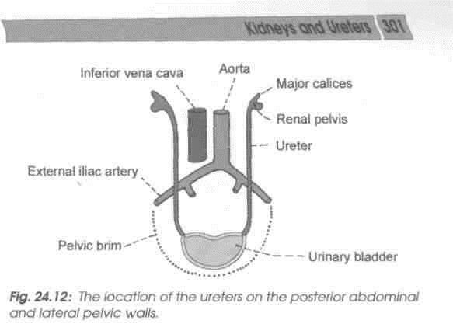

Slide 4
Course
The ureter begins within the renal sinus as a funnel-shaped dilatation, called the renal pelvis.
The pelvis issues from the hilus of the kidney, descends along its medial margin, or partly behind it. Gradually it narrows till at the lower end of the kidney it becomes the ureter proper.
The ureter passes downwards and slightly medially on the psoas major muscle, and enters the pelvis by crossing in front of the termination of the common iliac artery

Slide 5
In the lesser or true pelvis the ureter at first runs downwards, and slightly backwards and laterally, following the anterior margin of the greater sciatic notch.
Opposite the ischial spine it turns forwards and medially to reach the base of the urinary bladder.
The ureter enters the bladder wall obliquely to open into it at the lateral angle of its trigone.
The ureter is slightly constricted at three places:
(1) At the pelviureteric junction;
(2) at the brim of the lesser pelvis; and
(3) at its passage through the bladder wall.

Slide 6
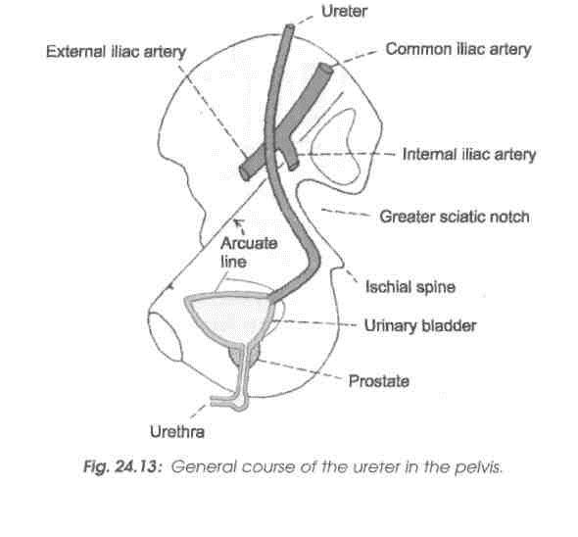

Slide 7
Relations
Renal Pelvis
In the renal sinus, branches of renal vessels lie both in front and behind it.
Outside the Kidney
Anteriorly: On the right side, there are the renal vessels and the second part of the duodenum. On the left side, there are the renal vessels, the pancreas, the peritoneum and the jejunum
Posteriorly: Psoas major muscle

Slide 8
Abdominal Part of Ureter
Anteriorly
On of the right side the ureter is related to (1) the third part of the duodenum (2) the peritoneum, (3) the right colic vessels, (4) the ileocolic vessels, (5) the gonadal vessels; (6) the root of the mesentery, and (7) the terminal part of the ileum.
On left side the ureter is related to (1) the peritoneum, (2) the gonadal artery, (3) the left colic vessels, (4) the sigmoid colon; and (5) the sigmoid mesocolon.
Posteriorly
The ureter lies on (1) the psoas major, (2) the tips of transverse processes, and (3) the genitofemoral nerve.
Medially
On the right side there is the inferior vena cava; on the left side, there is the left gonadal vein, and still further medially, the inferior mesenteric vein.

Slide 9
Pelvic Part of Ureter
In its Downward Course
Posteriorly
(1) Internal iliac artery;
(2) commencement of the anterior trunk of the internal iliac artery;
(3) internal iliac vein,
(4) lumbosacral trunk; and
(5) sacroiliac joint

Slide 10
Laterally
(1) Fascia covering the obturator internus,
(2) superior vesical artery,
(3) obturator nerve,
(4) obturator artery,
(5) obturator vein,
(6) inferior vesical vein,
(7) middle rectal artery,
(8) in the female, it forms the posterior boundary of the ovarian fossa.

Slide 11
Intravesical Part
The intravesical oblique course of the ureter has a valvular action, and prevents regurgitation of urine from the bladder to the ureter.
The ureteric openings lie about 5 cm apart in a distended bladder, and only 2.5 cm apart in an empty bladder.

Slide 12
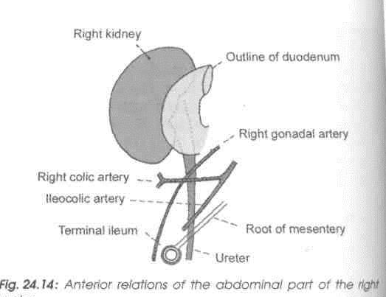

Slide 13
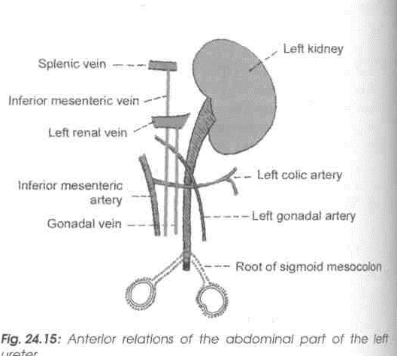

Slide 14
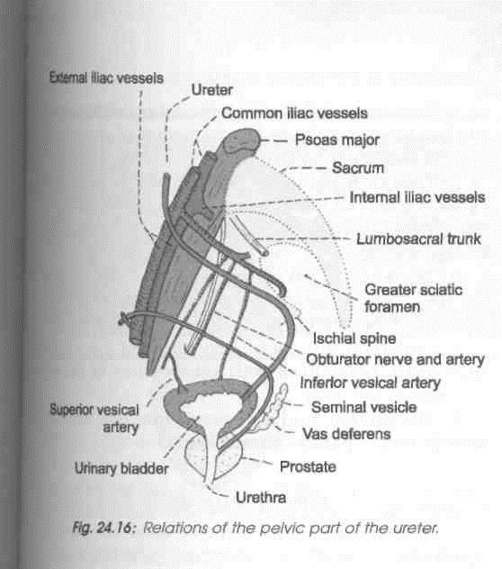

Slide 15
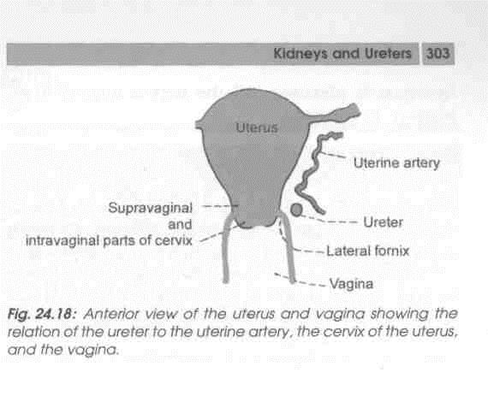

Slide 16
Blood Supply
The ureter is supplied by three sets of long arteries:
(1) The upper part receives branches from the renal artery. It may also receive branches from the gonadal, or colic vessels.
(2) The middle part receives branches from the aorta. It may also receive branches from the gonadal, or iliac vessels.
(3) The pelvic part is supplied by branches from the vesical, middle rectal, or uterine vessels! The arteries to die ureter lie closely attached TO peritoneum. They divide into ascending and descending branches which first form a plexus on the surface of the ureter, and then supply it.

Slide 17
In about 10% of cases the middle part of the ureter is supplied only by minute twigs from the peritoneal vessels.
In another 2% of cases although there are several long arteries to the middle part, the upper and lower parts are supplied by short vessels.
Nerve Supply
The ureter is supplied by sympathetic from T10-L1 segments and parasympathetic from S2-S4 nerves.
They reach the ureter through the renal, aortic and hypogastric plexuses. All the nerves appear to be sensory in function.

Slide 18
CLINICAL ANATOMY
1. Renal colic: This term is used for sever pain due to a ureteric stone or calculus which causes spasm of the ureter.
The pain starts in the loin and radiates down the groin, the scrotum or the labium majus and the inner side of the thigh. Note that the pain is referred to the cutaneous areas innervated by segments, mainly T 1 to L2, I which also supply the ureter.
2. Ureteric stone: A ureteric stone is liable to become impacted at one of the sites of normal constriction of the ureter, e.g. pelviureteric junction, brim of the pelvis and intravesical course.

Slide 19
Title | Author / Journal | Material | Result | Summary
Ureteral Anomalies | Ronald Rabinowitz, Merck Manual | Ureteral anomalies frequently occur with renal anomalies but may occur independently. Complications include Obstruction, vesicoureteral reflux, infection, and calculus formation Urinary incontinence | Diagnosis of ureteral anomalies may be suggested by abnormalities on routine prenatal ultrasonography (eg, hydronephrosis) and occasionally by physical examination (eg, finding an external ectopic ureteral orifice or a palpable mass). | Ureteral anomaly treatments are surgical

