Slide 1
Uterus
Dr. Kinjal Jethva
Assistant Professor
Department of Anatomy
S.B.K.S.M.I. & R.C.

Slide 2
THE UTERUS
Synonym
In layman's language the uterus is called the womb. It is also called hystera, on which word hysterectomy is based.
Definition
Uterus is a child-bearing organ in females, situated in the pelvis between bladder and rectum. Though hollow, it is thick walled and firm, and can be palpated bimanually during a PV (per vaginum) examination. It is the organ which protects and provides nutrition to a fertilized ovum, enabling it to grow into a fully formed foetus. At the time of child-birth or parturition contractions of muscle in the wall of the organ result in expulsion of the foetus from the uterus.

Slide 3
Size and Shape
The uterus is pyriform in shape. It is about 7.5 cm long, 5 cm broad, and 2.5 cm thick.
It weighs 30 to 40 grams. It is divisible into an upper expanded part called the body and a lower cylindrical part called the cervix.
The body forms the upper two-thirds of the organ, and the cervix forms the lower one-third.

Slide 4
Normal Position and Angulation
Normally, the long axis of the uterus forms an angle of about 90 degrees with the long axis of the vagina.
The angle is open forwards. The forward bending of the uterus relative to the vagina is called anteversion.
The uterus is also slightly flexed on itself : this is referred to as antefiexion. The angle of anteflexion is 125 degree
Roughly, the long axis of the uterus corresponds to the axis of the pelvic inlet, and the axis of the vagina to the axis of the pelvic cavity and of the pelvic outlet.

Slide 5
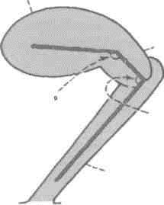

Slide 6
Communications
Superiorly, the uterus communicates on each side with the uterine tube,
and inferiorly, with the vagina.
Body of Uterus
The body has (a) a fundus; (b) two surfaces, anterior or vesical and posterior or intestinal; and (c) two lateral borders.

Slide 7
The fundus is formed by the free upper end of the uterus. Fundus lies above the openings of the uterine tubes. It is convex like a dome. It is covered with peritoneum and is directed forward when the bladder is empty. The fertilized oocyte is usually implanted in the posterior wall of the fundus
The anterior or vesical surface is flat and related to the urinary bladder. It is covered with peritoneum

Slide 8
and forms the posterior or superior wall of the uterovesical pouch.
The posterior or intestinal surface is convex and is related to coils of the terminal ileum and to the sigmoid colon. It is covered with peritoneum and forms the anterior wall of the rectouterine
Each lateral border is rounded and convex. It provides attachment to the broad ligament of the uterus which connects it to the lateral pelvic wall. The uterine tube opens into the uterus at the upper end of this border. This end of the border gives attachment to the round ligament of the uterus, anteroinferior to the tube; and to the ligament of the ovary posteroinferior to the tube. The uterine artery ascends along the lateral border of the uterus between the two layers of the broad ligament .

Slide 9
In sagittal section, the cavity of the body of the uterus is seen as a mere slit because the uterus is compressed anteroposteriorly. In coronal section, the cavity is seen to be triangular in shape, the apex being directed downwards. At the apex, the cavity becomes continuous with the canal of the cervix. The junction is called the internal os. The superolateral angles of the cavity receive the openings of the right and left uterine tubes

Slide 10
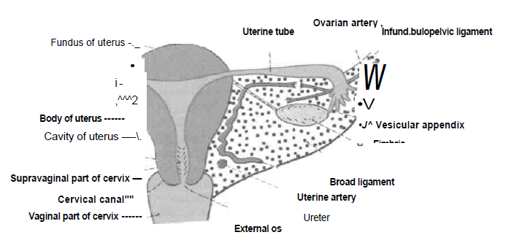

Slide 11
Cervix of Uterus
The cervix is the lower, cylindrical part of the uterus.
It is less mobile than the body. It is about 2.5 cm long, and is slightly wider in the middle than at either end. The lower part of the cervix projects into the anterior wall of the vagina which divides it into supravaginal and vaginal parts.
The supravaginal part of the cervix is related: (a) Anteriorly to the bladder; (b) posteriorly to the rectouterine pouch, containing coils of intestine and to the rectum and (c) on each side, to the ureter and to the uterine artery, embedded in parametrium.

Slide 12
The fibrofatty tissue between the two layers of the broad ligament and below it is called the parametrium. It is most abundant near the cervix and vagina.
The vaginal part of the cervix projects into the anterior wall of the vagina. The spaces between it and the vaginal wall are called the vaginal fomices. The cervical canal opens into the vagina by an opening called the external os. In a nulliparous woman, i.e. a woman who has not borne children, the external os is small and circular. However, in multiparous women, the external os is bounded by anterior and posterior lips, both of which are in contact with the posterior wall of the vagina

Slide 13
The cervical canal, i.e. the cavity of the cervix is fusiform in shape. It communicates above with the cavity of the body of the uterus, through the internal os, and below with the vaginal cavity through the external os. The canal is flattened from before backwards so that it comes to have anterior and posterior walls. These walls show mucosal folds which resemble the branches of a tree called the arbor vitae uteri. The folds in the anterior and posterior walls interlock with each other and close the canal.

Slide 14
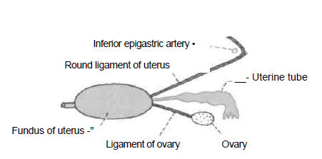

Slide 15
Ligaments of Uterus Peritoneal Ligaments
These are mere peritoneal folds which do not provide any support to the uterus.
1. The anterior ligamentconsists of the uterovesical fold of peritoneum.
2. The posterior ligament consists of the rec-tovaginal fold of peritoneum.
3. The right and left broad ligaments are folds of peritoneum which attach the uterus to the lateral pelvic wall. When the bladder is full, the ligament has anterior and posterior surfaces, and upper, lower, medial and lateral borders.

Slide 16
The upper border is free. The anterior and posterior layers of peritoneum forming the ligament become continuous here. The lateral and inferior borders of the ligament are attached to the corresponding parts of the pelvic wall. The medial border is attached to the lateral margin of the uterus
Some names given to subdivisions of the broad ligament may now be noted.The ovary is attached to the posterior layers of the ligament through the mesovarium.

Slide 17
The ligament of the ovary passes from the lower pole of the ovary to the lateral angle of the uterus. The part of the broad ligament lying between the uterine tube and the ovarian ligament of ovary is called the mesosalpinx, while the part below the ligament of ovary is called the mesometrium. The part of the broad ligament that stretches from the upper pole of the ovary and the infundibulum of the uterine tube to the lateral pelvic wall is called the suspensory ligament of the ovary or the infundibulopelvic ligament

Slide 18
The broad ligament contains the following structures.
1. The uterine tube
2. The round ligament of the uterus.
3. The ligament of the ovary.
4. Uterine vessels near its attachment to the uterus.
5. Ovarian vessels in the infundibulopelvic ligament.
6. The uterovaginal and ovarian nerve plexuses.
7. Epoophoron.
8. Paroophoron.
9. Some lymph nodes and lymph vessels.
10. Dense connective tissue or parametrium present on the sides of the uterus.

Slide 19
Fibromuscular Ligaments
The fibromuscular ligaments are:
(1) Round ligaments of the uterus;
(2) transverse cervical ligaments; and
(3) uterosacral ligaments.

Slide 20
Arterial Supply
The uterus is supplied : (1) Chiefly by the two uterine arteries which are markedly enlarged during pregnancy; and (2) partly by the ovarian arteries.
The uterine artery is a branch of the anterior division of the internal iliac artery. It first runs medially towards the cervix, crossing the ureter above the lateral fornix of the vagina and 2 cm lateral to the cervix. Then the artery ascends along the side of the uterus, with a tortuous course. Finally, it runs laterally towards the hilus of the ovary, and ends by anastomosing with the ovarian artery. The tortuosity of the artery permits expansion of the uterus during pregnancy. Apart from the uterus, the artery also gives branches to: (1) The vagina; (2) the medial two-thirds of the uterine tube; (3) the ovary; (4) the ureter; and (5) to structures present in the broad ligament

Slide 21
Venous Drainage
The veins form a plexus along the lateral border of the uterus. The plexus drains through the uterine, ovarian and vaginal veins into the internal iliac veins.
Lymphatic Drainage
Lymphatics of the uterus begin at three inter-communicating networks, endometrial, myometrial and subperitoneal. These plexuses drain into lymphatics on the side of the uterus. Of these, the upper lymphatics from the fundus and upper part of the body drain mainly into the aortic nodes, and only partly to the superficial inguinal nodes along the round ligament of the uterus. The lower lymphatics from the cervix drain into the external iliac, internal iliac and sacral nodes. The middle lymphatics from the lower part of body drain into the external iliac nodes.

Slide 22
Nerve Supply
The uterus is richly supplied by both sympathetic and parasympathetic nerves, through the inferior hypogastric and ovarian plexuses. Sympathetic nerves from T12, LI segment of spinal cord produce uterine contraction and vasoconstriction. The parasympathetic nerves (S2, S3, S4) produce uterine inhibition and vasodilatation.
However these effects are complicated by the pronounced effects of hormones on the genital tract.

Slide 23
SUPPORTS OF THE UTERUS
The uterus is a mobile organ which undergoes extensive changes in size and shape during the reprodxictive period of life. It is supported and prevented from sagging down by a number of factors which are chiefly muscular and fibromuscular.

Slide 24
Primary Supports
A. Muscular or active supports
1. Pelvic diaphragm
2. Perinea! body
3. Urogenital diaphragm
B. Fibromuscular or mechanical supports
1. Uterine axis
2. Pubocervical ligaments
3. Transverse cervical ligaments of Mackenrodt
4. Uterosacral ligaments
5. Round ligaments of uterus.

Slide 25
Secondary Supports
1. Broad ligaments
2. Uterovesical fold of peritoneum
3. Rectovaginal fold of peritoneum

Slide 26
Role of Individual Supports
Pelvic Diaphragm
The pelvic diaphragm supports the pelvic viscera and resists any rise in the intra-abdominal pressure. The pubococcygeus part of the levator ani is partly inserted into the perinea! body between the vagina and the rectum. Some of these fibres also form a supporting sling and a sphincter for the vagina, and so indirectly for the uterus and the urinary bladder. If the pubococcygeus is torn during parturition, the support to the vagina is lost, and the latter tends to sink into the vestibiile along with the uterus, thus causing prolapse of the uterus. The efficacy of the levator ani as a support is also lost when the perineal muscles are torn. They normally fix the perineal body, and make it an anchor for the levator ani

Slide 27
Perineal Body
It is a fibromuscular node to which ten muscles are attached. It acts as an anchor for the pelvic diaphragm, and thus maintains the integrity of the pelvic floor. The muscles are two superficial transversus, two deep transversus perinei, two pubococcygeus part of levator ani, two bulbospongiosus and single sphincter ani externus and unstriped fibres of longitudinal muscle coat of the anal canal

Slide 28
Urogenital Diaphragm
It is constituted by a pair of deep transversus perinei and single sphincter urethrae muscles. The sphincter urethrae muscle chiefly forms the external sphincter of the urethra. However, many inferior fibres of the muscle support the vagina by getting attached to its walls

Slide 29
Urogenital Diaphragm
It is constituted by a pair of deep transversus perinei and single sphincter urethrae muscles. The sphincter urethrae muscle chiefly forms the external sphincter of the urethra. However, many inferior fibres of the muscle support the vagina by getting attached to its walls

Slide 30
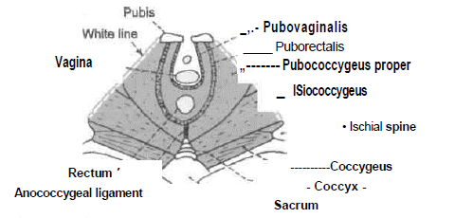

Slide 31
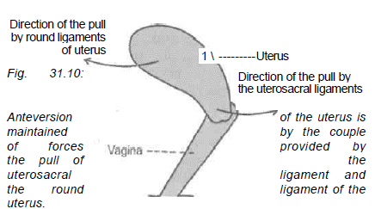

Slide 32
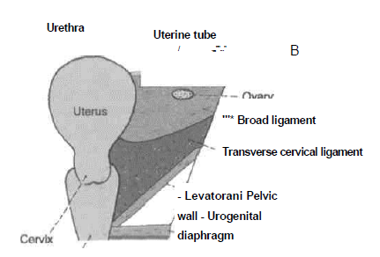

Slide 33
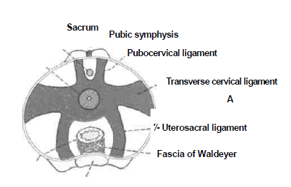

Slide 34
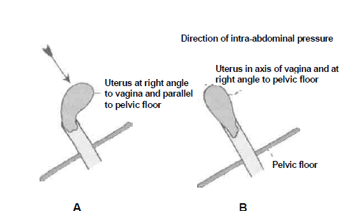

Slide 35
Pubocervicol Ligaments
These ligaments connect the cervix to the posterior surface of the pubis. They are derived from the pelvic fascia, and correspond to the medial and lateral puboprostatic ligaments in the male
Transverse Cervical Ligaments of Mackenrodt
These are also known by various other names like lateral cervical ligaments; cardinal ligaments; paracervical ligaments; retinacula uterior sustent-aculum of Bonny
These are fan-shaped condensations of the pelvic fascia on each side of the cervix above the levator ani and around the uterine vessels. They connect the lateral aspects of the cervix and of the upper vaginal wall to the lateral pelvic wall, about 2.5 cm ventraJ to the ischial spine. They form a 'hammock' that supports the uterus.

Slide 36
Uterosacral Ligaments
These are also condensations of the pelvic fascia. They connect the cervix to the periosteum of the sacrum (S2, S3) and are enclosed within the rectouterine folds of peritoneum (which form the lateral boundaries of the rectouterine pouch). The uterosacral ligaments keep the cervix braced backwards against the forward pull of the round ligaments. The two ligaments form a couple that maintains the uterine axis

Slide 37
Round Ligaments of Uterus
The round ligaments are two fibromuscular flat bands, 10 to 12 cm long, which lie between the two layers of the broad ligament, anteroinferior to the uterine tube. Each ligament begins at the lateral angle of the uterus, runs forwards and laterally, passes through the deep inguinal ring, traverses the inguinal canal and merges with the areolar tissue of the labium majus after breaking up into thin filaments. In the inguinal canal, it is accompanied by a process of peritoneum during foetal life. If it persists after birth, it is known in females as the canal ofNuck. The round ligament keeps the fundus pulled forwards and maintains the angle of anteversion against the backward pull of the uterosacral ligaments

Slide 38
CLINICAL ANATOMY
1. In some cases the uterus comes to lie in straight line with the vagina. This is called a retroverted uterus. It may give rise to various symptoms.
2. Sometimes the uterus passes downwards into the vagina invaginating it. The condition is called prolapse of the uterus. It is caused by weakening of the various supports of the uterus.
3. Insertion of a foreign body into the uterus can prevent implantation of a fertilized oocyte. This is the basic principle underlying the use of various intrauterine contraceptive devices for preventing pregnancy.
4. Caesarean section: In some cases normal child-birth through the vagina is not possible, and the child is delivered by cutting open the abdomen, and the uterus. The operation is called Caesarean section because the Roman emperor Julius Caesor is supposed to have been born in this way.

Slide 39
5. Hysterectomy is the operation for removal of the uterus. Opening up of the uterus is called -hysterotomy, while fixing of an abnormally mobile uterus is called hysteropexy.
6. Radiological visualisation of the uterus and uterine tubes can be done after filling them with a radiopaque dye. The procedure is called hysterosalpingography.
7. Malignant growth is more common in cervix than in the body. Carcinoma of cervix spreads more rapidly than that of body
8. Benign growth are more common in the body of uterus (fibromyoma) than in cervix.

Slide 40
Age and Reproductive Changes
1. In foetal life the cervix is larger than the body which projects a little above the pelvic brim.
2. At puberty the uterus enlarges and descends to the adult position. The arbor vitae uteri also appear.
3. During menstruation the uterus is slightly enlarged and becomes more vascular. The lips of the external os are swollen.
4. During pregnancy the uterus is enormously enlarged, mainly due to hypertrophy of the muscle fibres and partly to hyperplasia. As pregnancy advances the uterine wall becomes progressively thinner. After parturition the uterus gradually involutes and returns to the nonpregnant size.
5. In old age the uterus becomes atrophic and smaller in size and more dense in texture. The internal os is frequently obliterated. The lips of the external os disappear, and the os itself may be obliterated.

Slide 41
Title | Author/ Journal | Material | Results | Conclusion
Total uterine prolapse causing hydroureteronephrosis | Hadar H , Meiraz | Six women with advanced uterine prolapse underwent examination by drip infusion urography. | Drip infusion urography should include an exposure area of about 15 centimeters below the pubis, and at least one exposure should be taken with the patient in the standing position. | Thus, the hourglass appearance of the prolapsed bladder will not be overlooked and would be helpful in explaining the cause of the hydroureteronephrosis.

