Slide 1
3rd week of Development
Gastrula
primitive streak & notochord
Formation of 3 germ layers
Dr. A. Gandotra
HOD and Professor
Department of Anatomy
S.B.K.S.M.I. & R.C.

Slide 2
PRECHORDAL PLATE
Embryonic disc is flat and bilaminar during 2nd week
At one point on the circumference the cells of hypoblast become columnar in a localized area
These columnar cells form a thickened area called prechordal plate

Slide 3
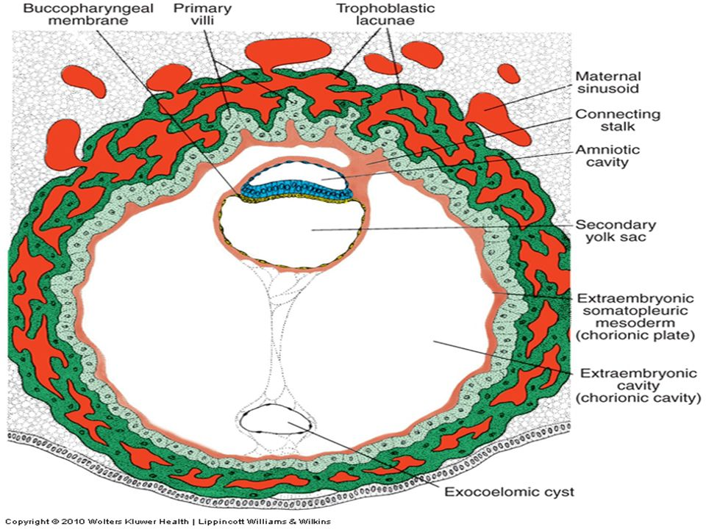
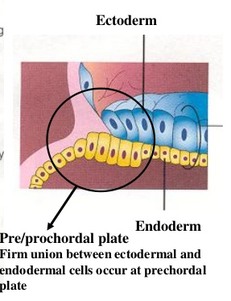

Slide 4
SIGNIFICANCE OF PRECHORDAL PLATE
Determination of cranio-caudal axis of the embryo
It forms oropharyngeal membrane and is the future site of mouth
It is an important organizer of head region

Slide 5
3RD WEEK OF DEVELOPMENT
(GASTRULATION)
It is a process by which three germ layers and axial orientation of embryo are established
The embryo during this period is referred to as GASTRULA
Four important processes occur during this period:
1) Formation of primitive streak
2) Formation of three germ layers
3) Formation of notochord
4) Formation of allantois

Slide 6
FORMATION OF PRIMITIVE STREAK
The prechordal plate determines the cranial end of the embryonic disc
At the caudal end of the embryonic disc a linear thickened band of cells is formed by the proliferation of the epiblast in the median plane
This linear band is called primitive streak and is formed in the beginning of 3rd week

Slide 7
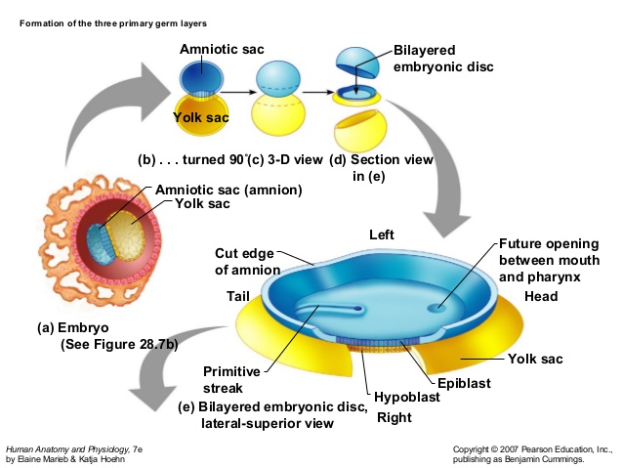

Slide 8
RESULT OF PRIMITIVE STREAK FORMATION
Identification of cranio caudal axis
Identification of cranial and caudal ends
Identification of dorsal and ventral surfaces
Identification of right and left sides

Slide 9
FORMATION OF PRIMITIVE STREAK
The primitive streak elongates in cranial direction due to the addition of cells at its caudal end from epiblast
The cells at the cranial end of primitive streak proliferate to form a thickening called primitive node
A narrow groove appears in the primitive streak and ends in a small depression in the primitive node called primitive groove and primitive pit
The primitive groove and pit are formed due to invagination of epiblastic cells

Slide 10
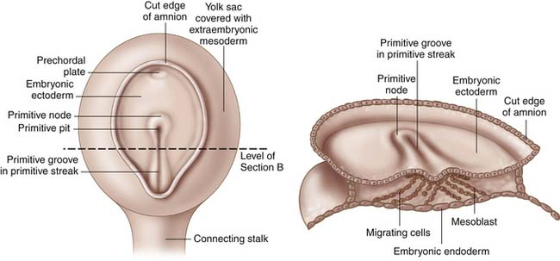

Slide 11
PRIMITIVE STREAK FORMATION
Two groups of mesodermal cells form, based on their paths of migration.
The epiblast cells that migrate cranially after dropping through the primitive node form the notochord, a tightly condensed mass of intraembryonic mesoderm that extends cranially from the primitive node.
The epiblast cells that migrate more laterally after dropping through the primitive groove form mesenchyme that fills the space between the epiblast and hypoblast.

Slide 12
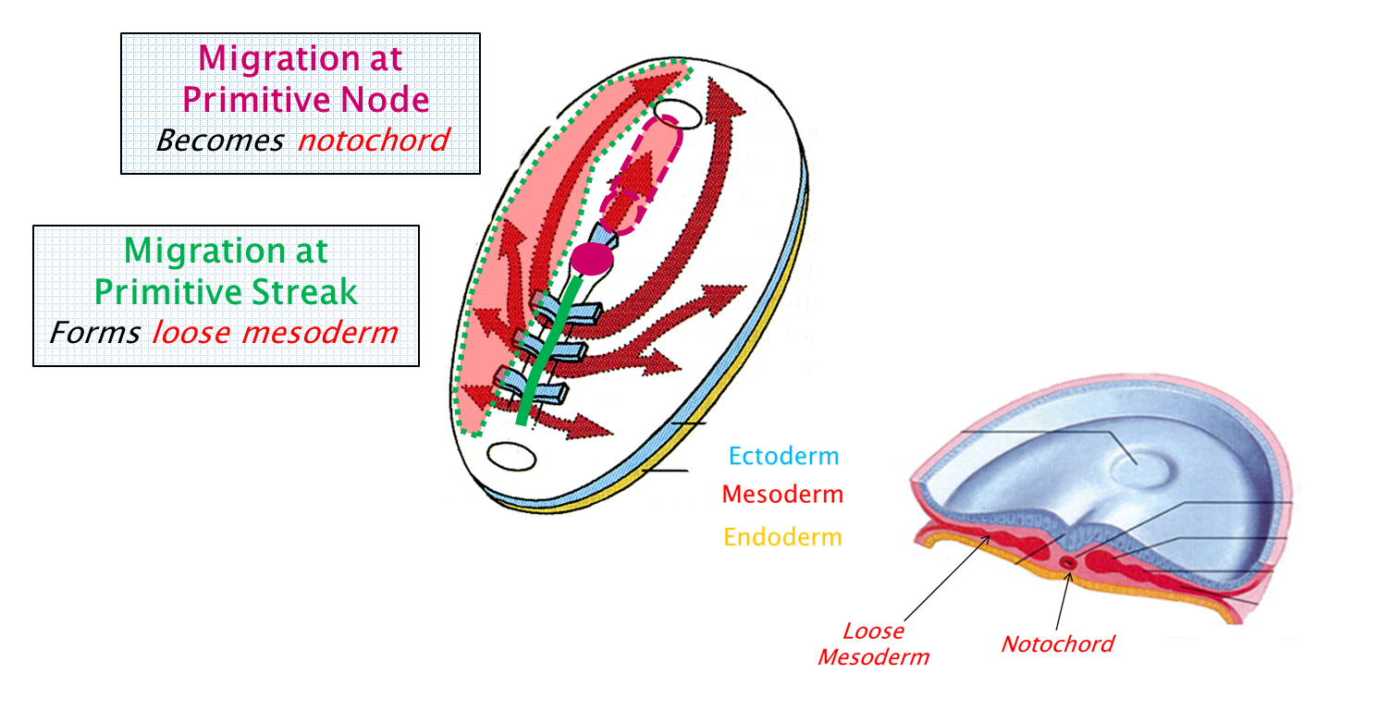

Slide 13
FORMATION OF THREE GERM LAYERS
The epiblast cells that migrate laterally after dropping through the primitive groove of primitive streak proliferate to form mesenchyme which lies between epiblast and hypoblast
The mesenchymal cells are:
- Loosely arranged
- Amoeboid
- Suspended in gelatinous material
- Pleuripotent cells
- They migrate widely

Slide 14
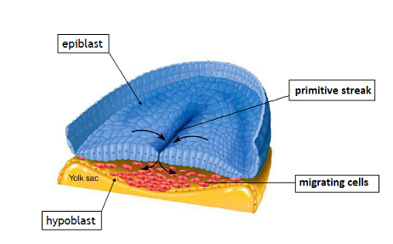
PRIMITIVE STREAK

Slide 15
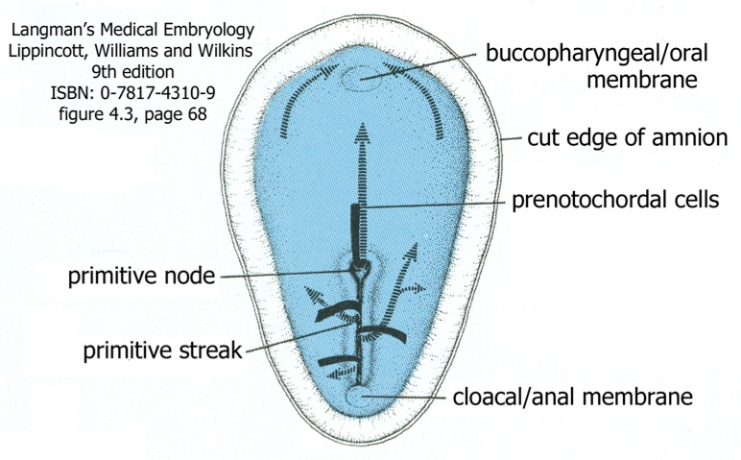

Slide 16
Intra embryonic mesoderm
Some mesenchymal cells differentiate to form mesoblast which in turn form embryonic mesoderm (intraembryonic mesoderm)

Slide 17
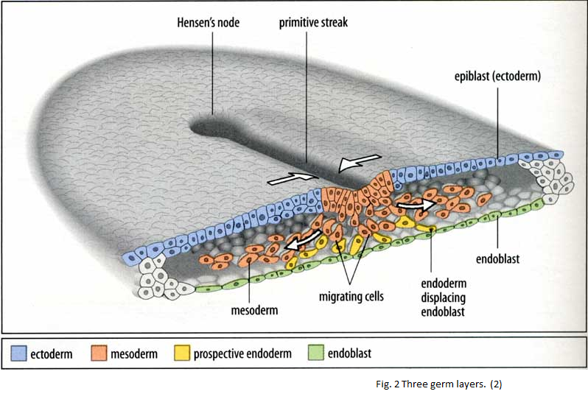

Slide 18
FORMATION OF THREE GERM LAYERS
The epiblastic cells from primitive streak keep on proliferating and migrating
These migrating epiblastic cells displace hypoblastic cells and form embryonic endoderm which now forms the roof of secondary yolk sac
The remaining epiblastic cells after the formation of intra embryonic mesoderm and endoderm form embryonic ectoderm

Slide 19
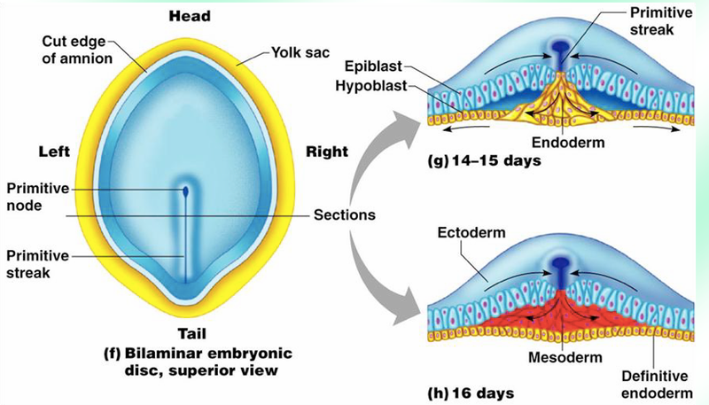
PRIMITIVE STREAK

Slide 20
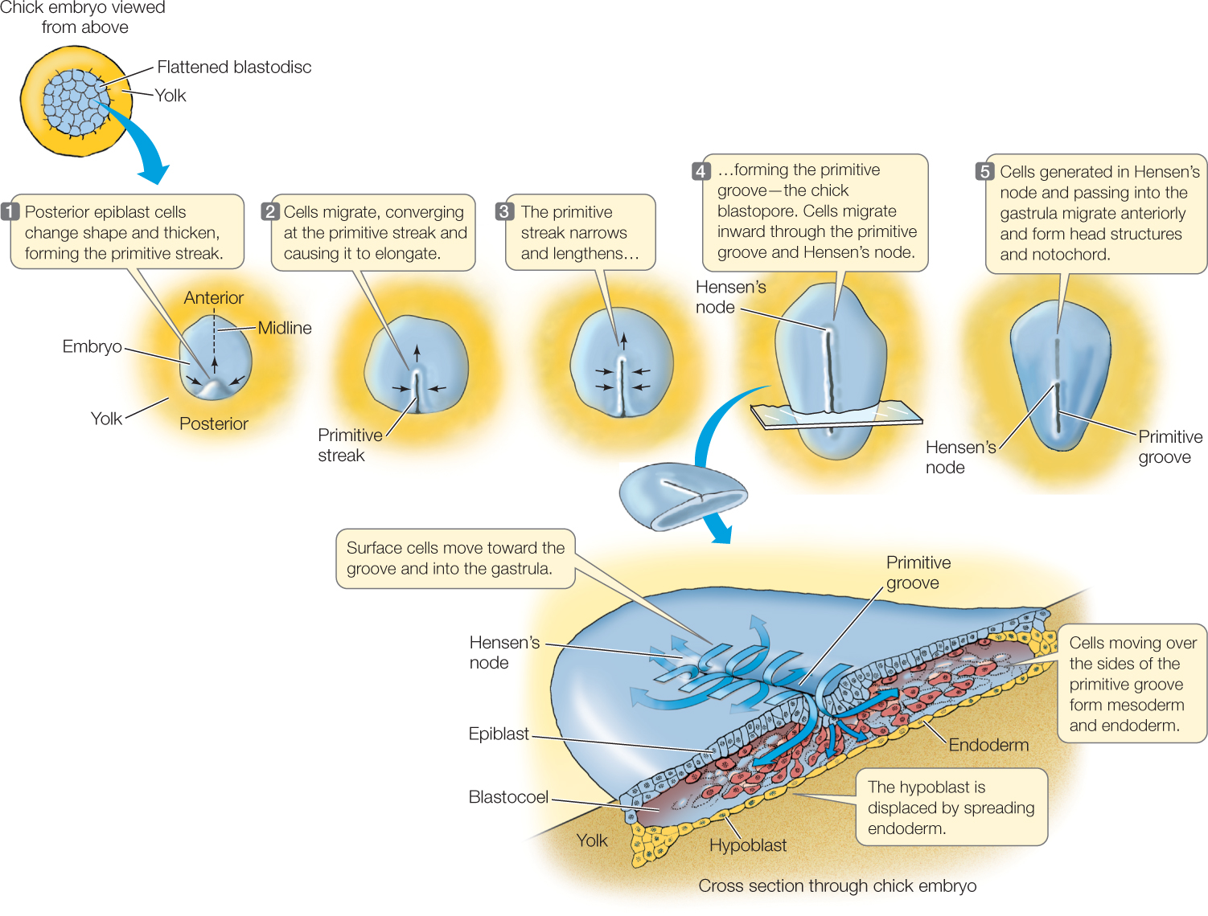

Slide 21
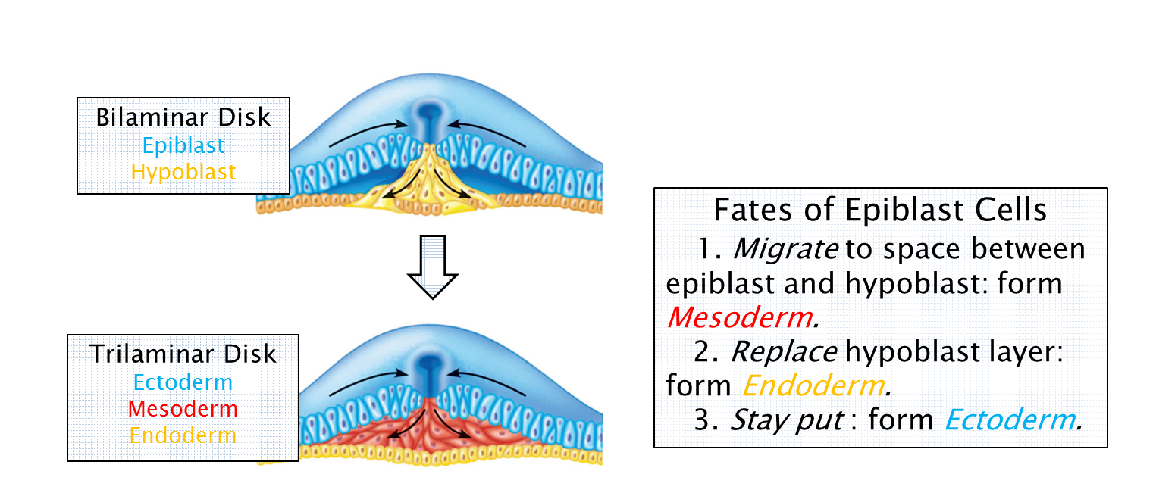
Formation of trilaminar disc

Slide 22
FORMATION OF PRIMITIVE STREAK
At the caudal end of primitive streak there is a circular area where ectoderm and endoderm are in contact with each other
This circular area is called cloacal membrane which indicates the future site of anus
Thus two area do not have mesoderm between Ectoderm & Endoderm: Prechordal plate & Cloacal membrane

Slide 23
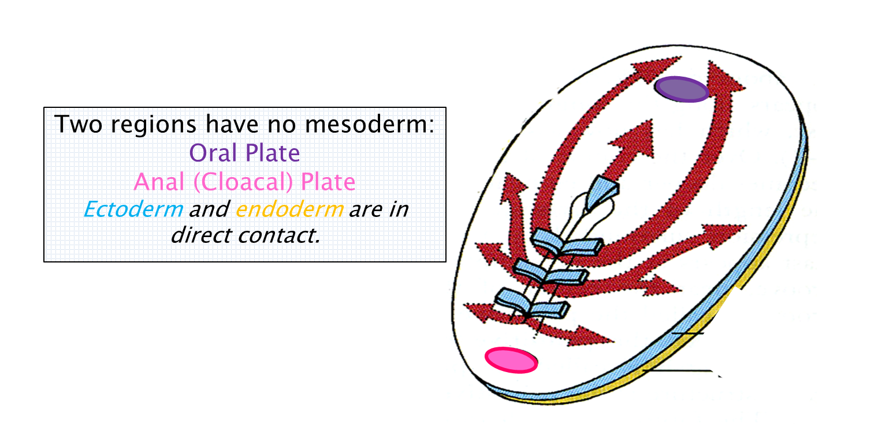

Slide 24
FATE OF PRIMITIVE STREAK
It actively forms mesoderm in the early part of 4th week
By the end of 4th week the primitive streak degenerates and disappears

Slide 25
CONGENITAL ANOMALIES
Sacro coccygeal teratoma
Remnant of primitive streak, Common tumor in new born
Incidence – 1: 3500, 80% females
Since the cells of primitive streak are pleuripotent, therefore these tumors contain elements of all three germ layers in incomplete stages of development
Most tumors are benign
Prognosis good if surgically removed

Slide 26
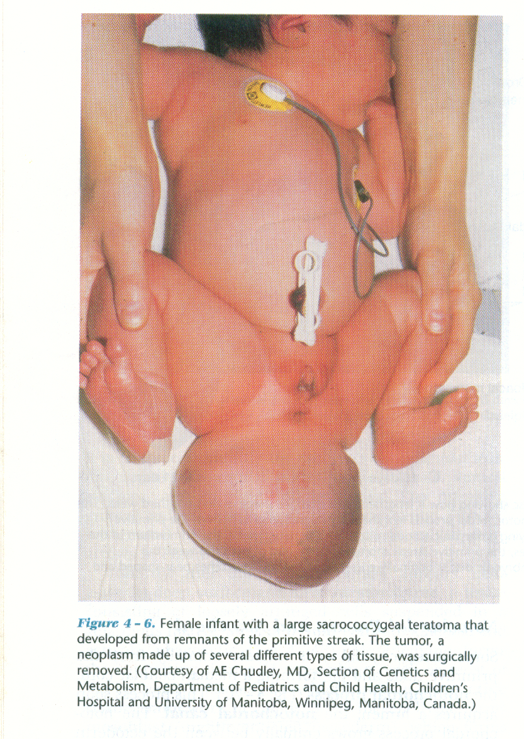

Slide 27
FORMATION OF NOTOCHORD
Some mesenchymal cells migrate cranially from primitive node and pit
These cells form a median cellular cord called notochordal process
The notochordal process extends cranially until it reaches prechordal plate and does not extend beyond it
This process acquires a lumen called notochordal canal which communicates with amniotic cavity through primitive pit

Slide 28
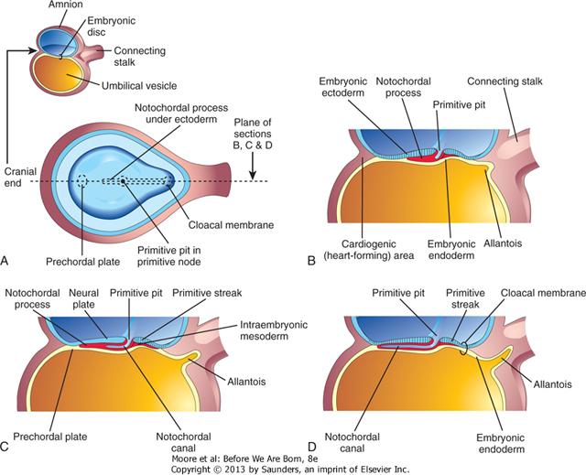

Slide 29
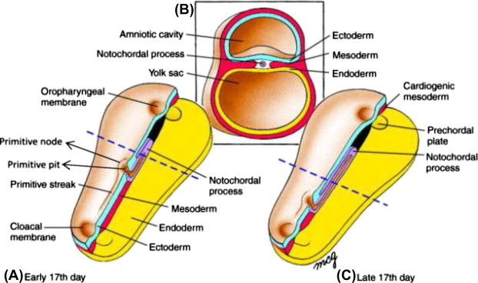

Slide 30
NOTOCHORD
The floor of the notochordal process fuses with underlying endoderm
Fused layers undergo degeneration and small openings appear
These openings fuse and the floor of notochordal canal disappears
Thus the notochordal canal communicates with yolk sac
The notochordal process becomes flattened grooved notochordal plate

Slide 31
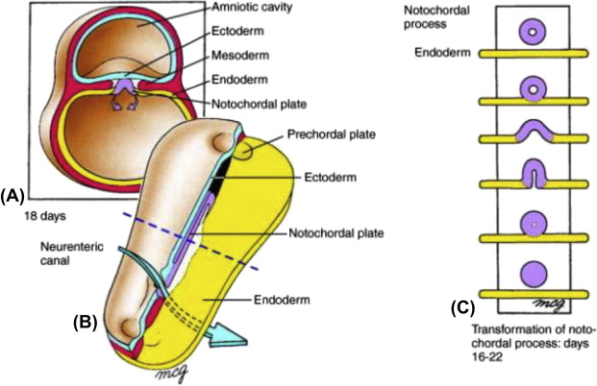

Slide 32
NOTOCHORD
Beginning at the cranial end, the notochordal cells proliferate
The notochordal plate infolds to form a solid cord of cells called notochord
Proximal part of the notochordal canal persists temporarily as neurenteric canal which forms a communication between yolk sac and amniotic cavity
Once the formation of notochord is complete the neurenteric canal disappears
Now the notochord detaches itself from endoderm which again becomes a continuous layer

Slide 33
FUNCTION OF NOTOCHORD
a) Defines primordial axis of embryo
b) Gives rigidity to embryo
c) Serves as a basis of axial skeleton
d) Indicates future site of vertebral bodies
e) It induces the formation of neural plate (future central nervous system)
f) primary organizer or inducer during organogenesis

Slide 34
FATE OF NOTOCHORD
After the formation of vertebral bodies it persists as nucleus pulposus of inter vertebral disc and apical ligament of dens

Slide 35
Chordoma
They are both benign and malignant tumours which arise from Notochordal tissue
1/3rd chordomas arise at the base of skull and extend to nasopharynx
Benign forms grow slowly but malignant forms infiltrate bone

Slide 36
MCQ
Q. 1 Primitive streak results in all except
a) Formation of secondary yolk sac
b) Identification of cranial and caudal ends
c) Formation of three germ layers
d) Identification of dorsal & Ventral surface of embryo

Slide 37
MCQ
Q. 2 Primitive streak disappears at the end of ____ week
4
3
2
1

Slide 38
MCQ
Q. 3 Remnant of notochord is
Urachus
Nucleus pulposus
Endoderm
Ectoderm

Slide 39
Q 4 During development, the notochordal process:
A. arises from involuting endodermal cells
B. extends from the prochordal plate to the primitive node
C. Gets converted into ectoderm
D. becomes the appendicular skeleton

Slide 40
Q 5 Which of the following structures is believed to be a primary organizer or inducer during organogenesis?
A. Ectoderm
B. notochord
C. Intra embryonic mesoderm
D. Cloacal membrane

Slide 41
Title | Author / Journal | Material | Summary | Conclusion
Chordoma: incidence and survival patterns in the United States, 1973–1995 | Mary L. McMaster Alisa M. Goldstein Christina M. Bromley Naoko Ishibe Dilys M. Parry An International Journal of Studies of Cancer in Human Populations January 2001, Volume 12, Issue 1, pp 1–11 | We used data from the Surveillance, Epidemiology, and End Results (SEER) program of the National Cancer Institute, 1973–1995, to calculate age-adjusted incidence and survival rates for 400 cases of microscopically confirmed chordoma and to derive information regarding case distribution and risk of second cancer. | The age-adjusted chordoma incidence rate (IR) of 0.08 per 100,000 was age-dependent, more common in males (IR 0.10) than females (IR 0.06) and rare among patients aged <40 years and blacks. Within the axial skeleton 32% of cases were cranial, 32.8% spinal and 29.2% sacral. Young age (<26 years; p = 0.0001) and female sex (p = 0.037) were associated with greater likelihood of cranial presentation | This study provides new data regarding incidence and survival patterns of chordoma in the US. Additional epidemiologic studies are required to elucidate the genetic and environmental determinants underlying this rare, distinctive neoplasm.

Slide 42
MCQ
Q. 4 Intra embryonic mesoderm migrates between
Amnion and cytotrophoblast
Epiblast and hypoblast
Heusers membrane and cytotrophoblast
Cytotrophoblast and syncytiotrophoblast

