Slide 1
Nose and nasal cavity
Mr. K.M.Parmar
Assistant Professor
Department of Anatomy
S.B.K.S.M.I. & R.C.
.

Slide 2
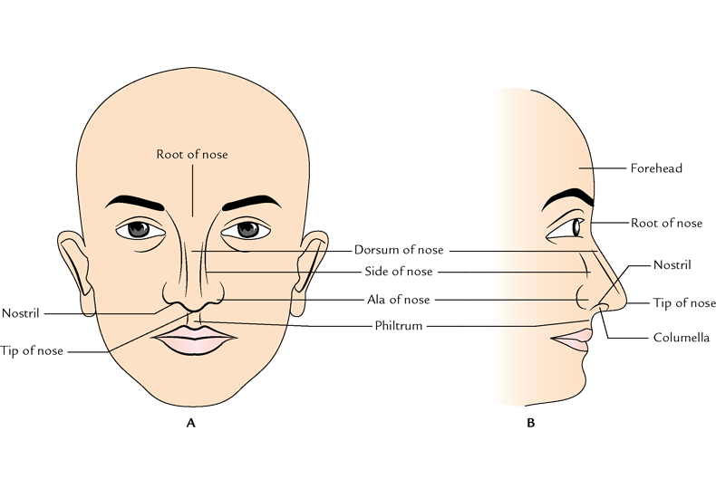

Slide 3
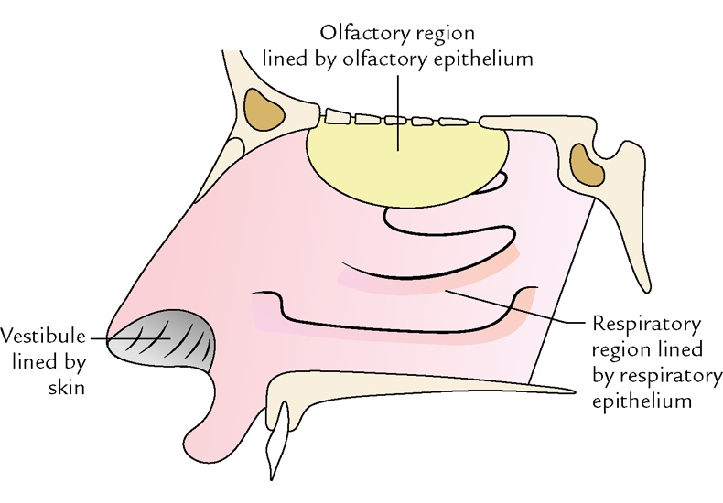
Upper 1/3
Lower 2/3

Slide 4
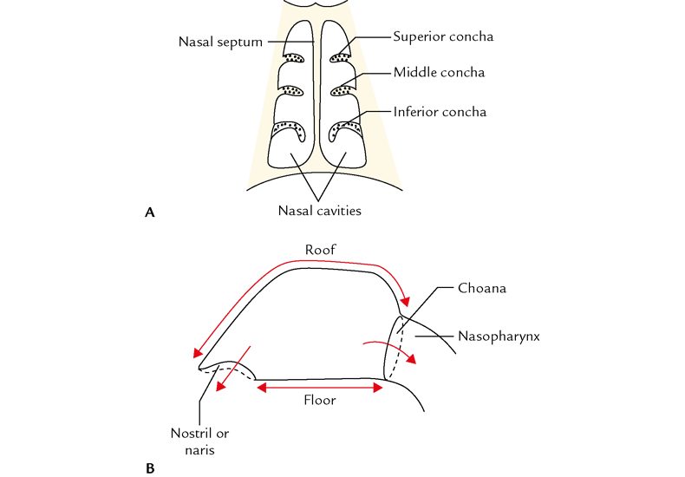

Slide 5
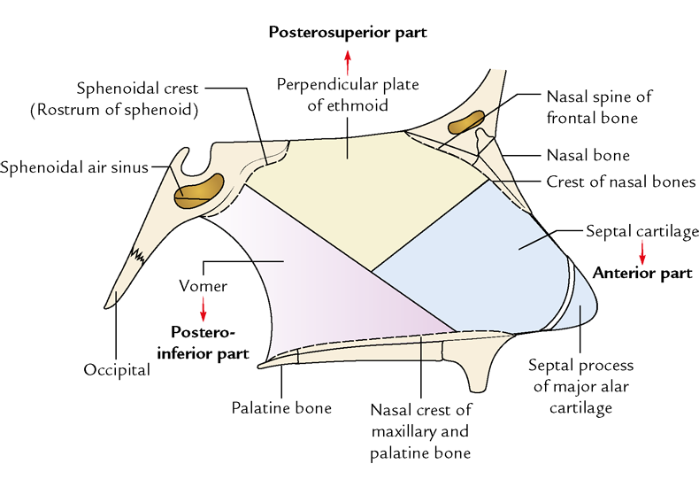
NASAL SEPTUM

Slide 6
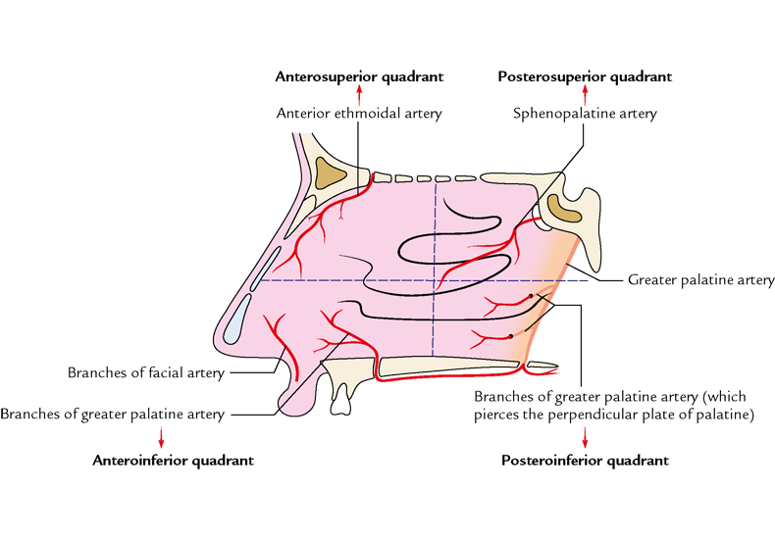
ARTERIAL SUPPLY

Slide 7
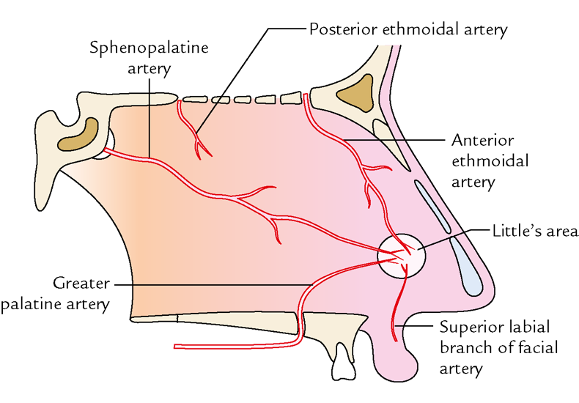
Little’s area

Slide 8
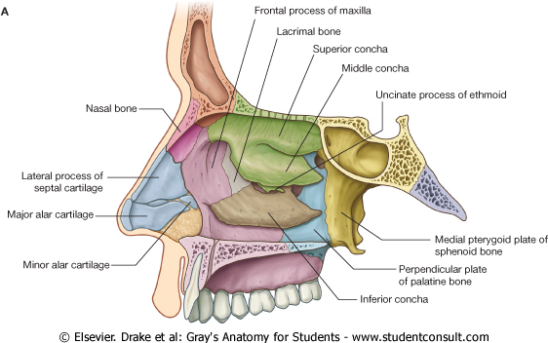

Slide 9
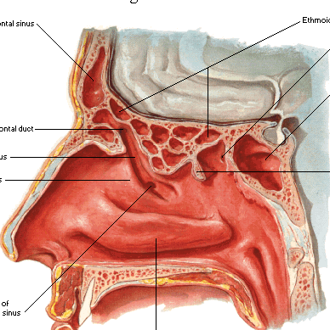
Frontal
Ethmoidal
Sphenoidal

Slide 10
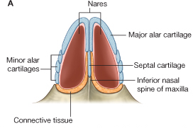

Slide 11
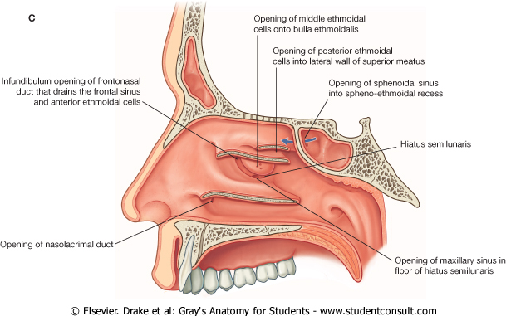

Slide 12
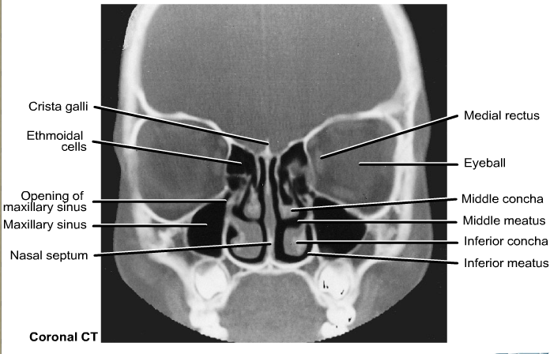

Slide 13
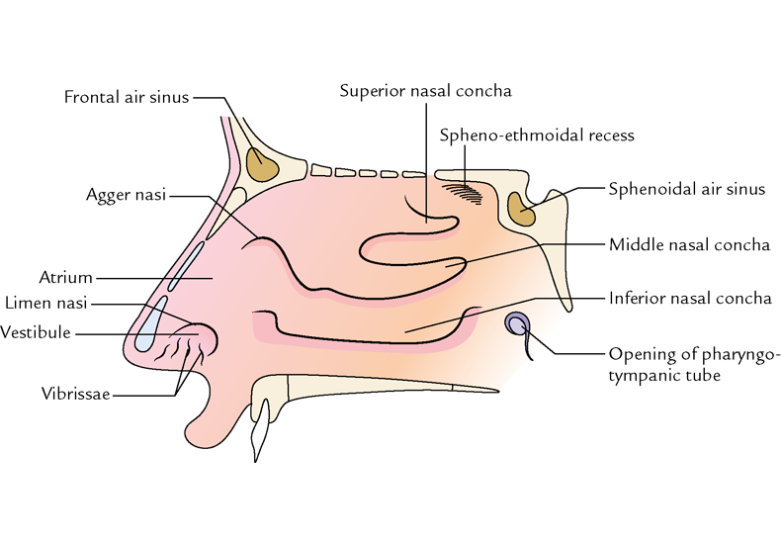
Formation of lateral wall

Slide 14
APPLIED
LITTLE’s area is site of epistaxis
Pathological deviation of nasal septum is responsible of repeated common cold ,allergic rhinitis, sinusitis etc. it requires surgical correction
Common cold or rhinitis is the commonest infection of nose
Hypertrophy of mucosa over inferior conchae is common feature of allergic rhinitis characterised by nasal blockage excessive watery discharge.

Slide 15
Title | Author / Journal | Material | Result | Summary
Deviated nasal septum | American Academy of Otolaryngology — Head and Neck Surgery Patient Health Information | Patients with chronic sinusitis often have nasal congestion, and many have nasal septal deviations. | Estimates are that 80 percent of all nasal septums are off-center, a condition that is generally not noticed. A "deviated septum" occurs when the septum is severely shifted away from the midline | Septoplasty is a surgical procedure performed entirely through the nostrils, accordingly, no bruising or external signs occur.

Slide 16
MCQ
1)Nasolacrimal duct open in which meatus
Inferior meatus
Middle meatus
Superior meatus
Sphenoidal meatus
2)All structure form nasal septum except.
Vomer
Perpendicular plate of ethmoid
Perpendicular plate of palatine bone
Septal cartilage

Slide 17
3)All structures are open in middle meatus except
Frontal sinus
Ethmoidal sinus
Sphenoidal sinus
Maxillary sinus
4)Posterior ethmoidal sinus open in
Superior meatus
Middle meatus
Inferior meatus
Supreme meatus

Slide 18
5)All structures form lateral wall of nose except
Superior conchae
Middle conchae
Nasal spine of frontal bone
Labyrinth of ethmoid

