Slide 1
Lateral compartment of leg
Mrs.Priyanka Sharma
Tutor
Department of Anatomy
S.B.K.S.M.I. & R.C.

Slide 2
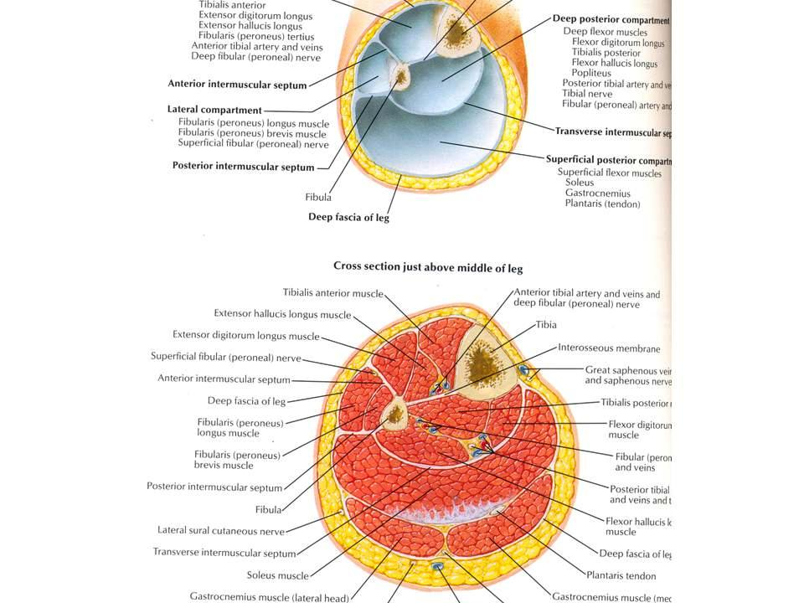
Peroneal compartment
Bounded medially by peroneal surface of fibula.
Bounded laterally by deep fascia
Front anterior intermuscular septa
Behind by posterior intermuscular septum.

Slide 3
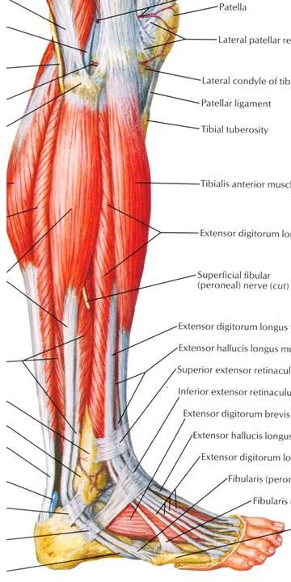
Contents
2 muscles:
Peroneus longus and Peroneus brevis.
Artery: Peroneal branch of posterior tibial artery.
Vein: Drain into short saphenous vein
Superficial peroneal nerve.

Slide 4
Peroneal retinacula
Superior peroneal retinacula
Situated behind the lateral malleolus to hold the tendons
Ant.- to the posterior margin of the lat.malleolus
Post.- to the lateral surface of the calcaneum
Both tendons lies in common compartment surrounded by a synovial sheath
Inferor peroneal retinacula-
Situated anteroinferior to the lat. Malleolus
Sup.- to the anterior part of the sup. Surface of the calcaneum
Inf. – to the lat.surface of the calcaneum
Both tendons lies in separate compartment covered by synovial sheath

Slide 5
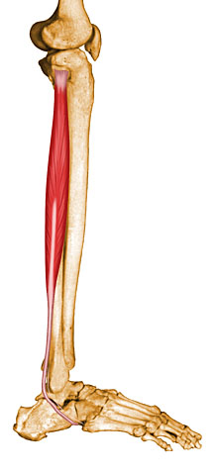
Peroneus longus
Origin: Bipennate- upper part, unipennate-lowerpart.
  Upper 2/3rd of the peroneal surface of fibula
  Adjacent surface of the lateral condyle of tibia
  Intermascular septa.

Slide 6
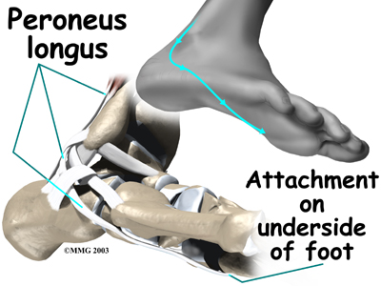
Peroneus longus
Insertion:
  Inserted into infero-lateral surface of the base of 1st metatarsal bone + adjacent medial cuneiform bones.
  Sesamoid fibro-cartilage

Slide 7
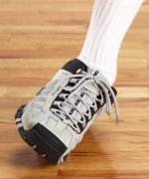
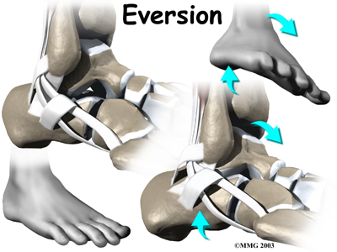
Peroneus longus
Nerve Supply: superficial peroneal nerve nerve
Action:
  Evertor of the foot at the ankle joint.
  Prolonged action –plantar flexion of the foot.
  Maintains the lateral longitudinal arch of the foot
  Transverse arch.

Slide 8
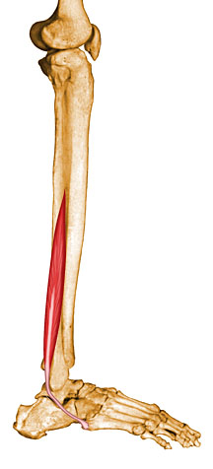
Peroneus brevis
Origin: Bipennate-
  Lower 2/3rd of the peroneal surface of fibula
  Adjoining intermascular septa.

Slide 9
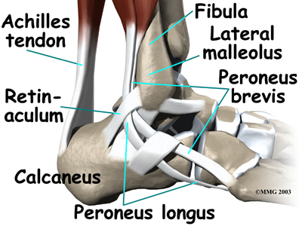
Peroneus brevis
Insertion:
  Tendon lodges in a groove behind lateral malleoleus
  Lodges in a groove above the peroneal trochlea of calcaneus
  Inserted into a tubercle at the base of 5th metatarsal bone

Slide 10
Peroneus brevis
Nerve Supply: superficial peroneal nerve
Action:
  Evertor of the foot at the ankle joint.
  Maintains the lateral longitudinal arch of the foot

Slide 11
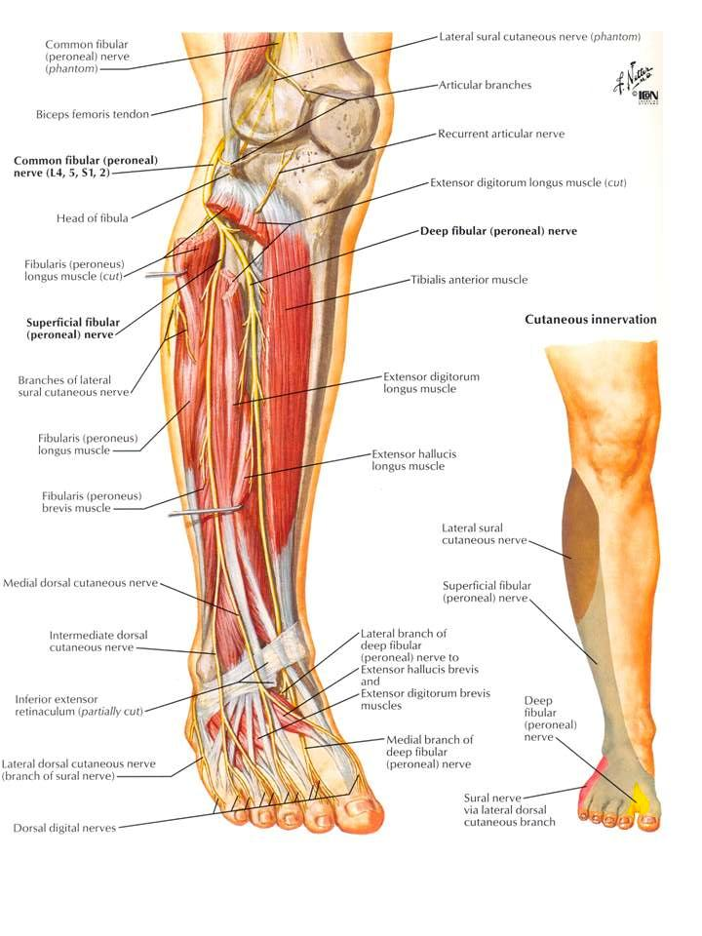
Common peroneal nerve

Slide 12
Common peroneal nerve
Branches
Muscular branches
Cutaneous nerve- lower 1/3rd of the lat. side of the leg and dorsum of the foot
Medial branches- 2 dorsal digital nerves for great toe,2 and 3 toes
Lateral branches- 2 dorsal digital nerves for adjoining side of the 3,4 and 5 toes.
Communicating branches- medial branch with the saphenous and deep peroneal nerve and lateral with the sural nerve.

Slide 13
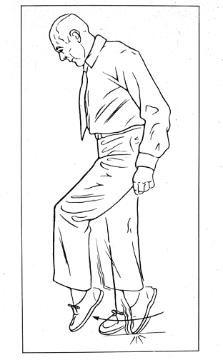
Applied anatomy
  Fracture of the neck of fibula
  Foot drop
  Toes do not clear the ground during swing phase of walking.

Slide 14
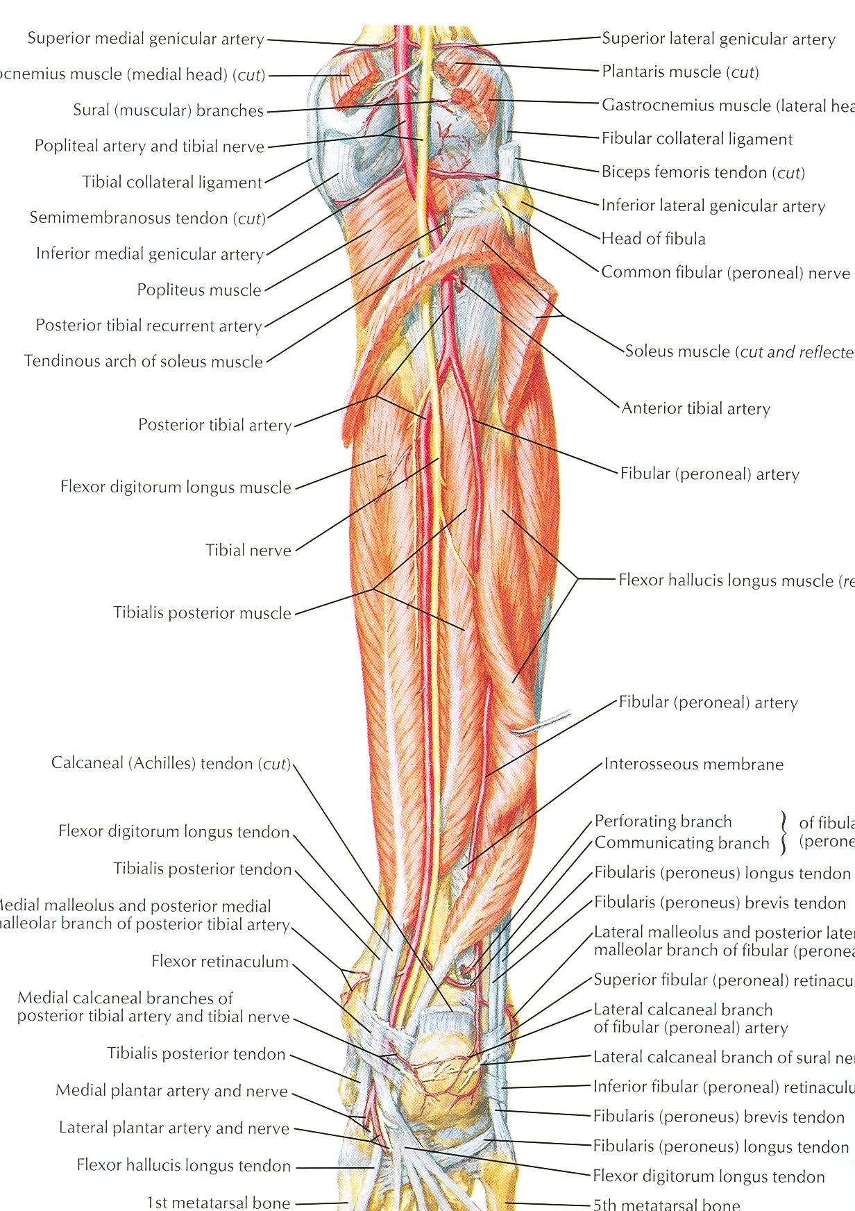
Peroneal artery
Largest branch of the post. Tibial art.
Begings 2.5 cm below the lower border of the popliteus mus.
Branches:
Muscular branches
Nutrient artery- to fibula
Anastomotic branch
Lateral calcaneal branches

Slide 15
TITLE | AUTHOR/ JOURNAL | MATERIAL | RESULT | CONCLUSION
Split Peroneus Brevis Tendon: An Unusual Cause of Ankle Pain and Instability | Journal of American Board of Family Medicine Bindiya Chauhan Pina Panchal Edward Szabo, DPM and Thad Wilkins, | A 64-year-old white woman presented to our family medicine clinic with complaints of right lateral ankle pain with dorsiflexion and inability to bear weight for the past 4 weeks. Her inability to bear weight was related to the sensation of instability. | Magnetic resonance imaging (MRI) of the right ankle showed that the peroneal brevis tendon was flattened to the borders of both the medial and lateral aspects of the peroneal longus, consistent with a split tendon | PBT tears often are associated with a forced dorsiflexion injury and are most commonly longitudinal rather than transverse

Slide 16
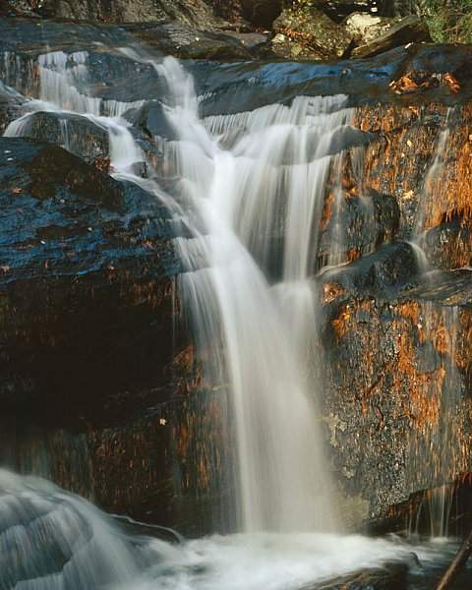
TAHNK YOU
THANK YOU

