Slide 1
THIRD VENTRICLE
Mr. I. N. Wani
Assistant Professor
Department of Anatomy
S.B.K.S.M.I. & R.C.

Slide 2
Median cleft between two thalami and hypothalami
ROOF: Ependyma between upper edges of lateral walls
FLOOR: Antero-posteriorly –
1. Optic chiasma
2. Infundibulum
3. Tuber cinerium
4. Mamillary bodies
5. Posterior perforated substance
6. Tegmentum of cerebellar peduncles

Slide 3
ANTERIOR WALL:
1. Inferiorly – Lamina terminalis from rostrum to
optic chiasma
2. Superiorly – Columns of fornix, anterior commissure
Junction of floor and anterior wall has optic recess
Junction of roof and anterior wall has inter ventricular
foramen.

Slide 4
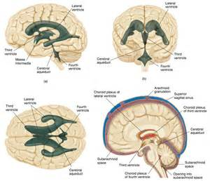

Slide 5
POSTERIOR WALL:
- Pineal, Posterior commissure, Pineal and Supra pineal recesses
LATERAL WALL:
- Upper part: anterior 2/3rd medial surface thalamus
- Lower part: hypothalamus and hypothalamic sulcus
Limited superiorly by stria medullaris thalami
Lateral walls joined by inter thalamic adhesion

Slide 6
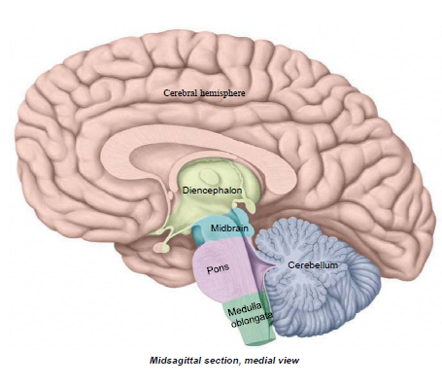

Slide 7
INTER PEDUNCULAR FOSSA
Located at the base of brain
Boundaries:
Anterior – Optic chiasma
Anterolaterally – Optic tracts
Posterolaterally – Crus cerebri
Posterior – Pons
Roof – from anterior to posterior
: Infundibulum : Tuber cinerium : Mamillary bodies
: Posterior perforated substance

Slide 8
The structures of the roof separate the 3rd ventricle
from inter peduncular cistern and form the
floor of 3rd ventricle
Floor – Arachnoid mater
Encloses inter peduncular cistern
Contains –
: Posterior cerebral arteries
: Posteromedial group of central branches
: Posterior communicating artery
: Oculomotor nerve

Slide 9
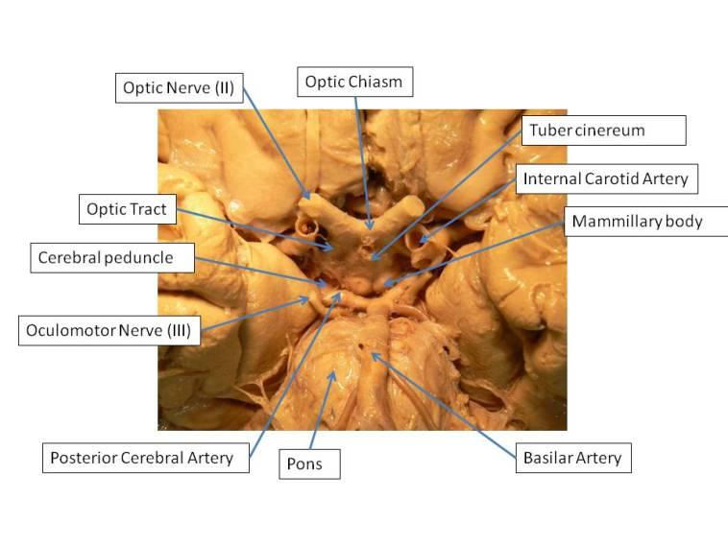

Slide 10
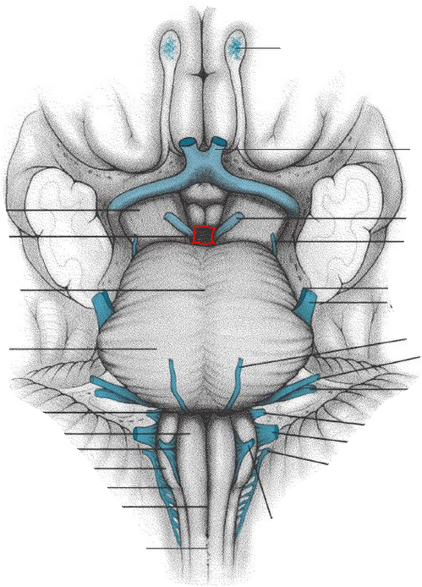

Slide 11
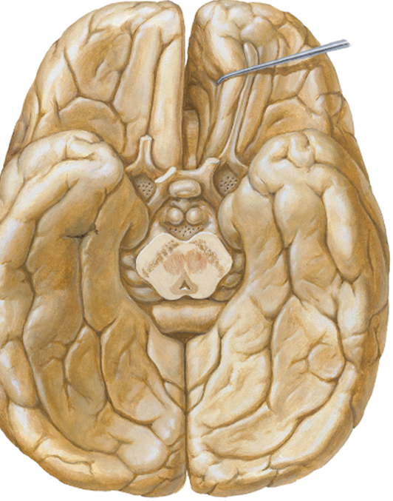

Slide 12
Title | Author / Journal | Material | Result | Conclusion
Transcallosal Removal of Lesions Affecting the Third Ventricle: An Anatomic and Clinical Study Anatomical Report: 117 | Neurosurgery: January 1995 - Volume 36 - Issue 1 - p 117–123 | A SERIES OF 54 patients with lesions affecting the third ventricle with a wide range of pathology were operated on by the transcallosal approach | No physiological consequences were ever observed after the partial commissurotomy. The postoperative callosal defect was verified by magnetic resonance imaging. Furthermore, 40 formalin‐fixed brains were sectioned to study the variations of the anterior cerebral arteries. | The results and the clinical as well as anatomical material indicate that the anterior transcallosal route is a safe and feasible alternative in the management of a wide spectrum of pathological lesions within the third ventricle and deserves preference over the transcortical technique.

Slide 13
MCQ
Q. 1 Hypothalamic sulcus lies in the_____ wall of 3rd
ventricle.
Anterior
Posterior
Floor
Lateral

Slide 14
MCQ
Q. 2 Posterolateral boundary of inter peduncular fossa
is formed by.
Optic chiasma
Optic tract
Crus cerebri
Pons

Slide 15
MCQ
Q. 3 Which structure does not form the lateral wall
of 3rd ventricle?
Lamina terminalis
Hypothalamic sulcus
Hypothalamus
Thalamus

Slide 16
MCQ
Q. 4 Posterior perforated substance
Lies close to optic chiasma
Lies close to pons
Lies in anterior wall of 3rd ventricle
Lies anterior to mamillary bodies

Slide 17
MCQ
Q. 5 Which of the following structure is not shared by
3rd ventricle and inter peduncular fossa
Infundibulum
Lamina terminalis
Tuber cinerium
Mamillary bodies

Slide 18
MCQ Answers
Q. 1 d
Q. 2 c
Q. 3 a
Q. 4 b
Q. 5 b

