Slide 1
Trachea
Mr. K.M.Parmar
Assistant Professor
Department of Anatomy
S.B.K.S.M.I. & R.C.

Slide 2
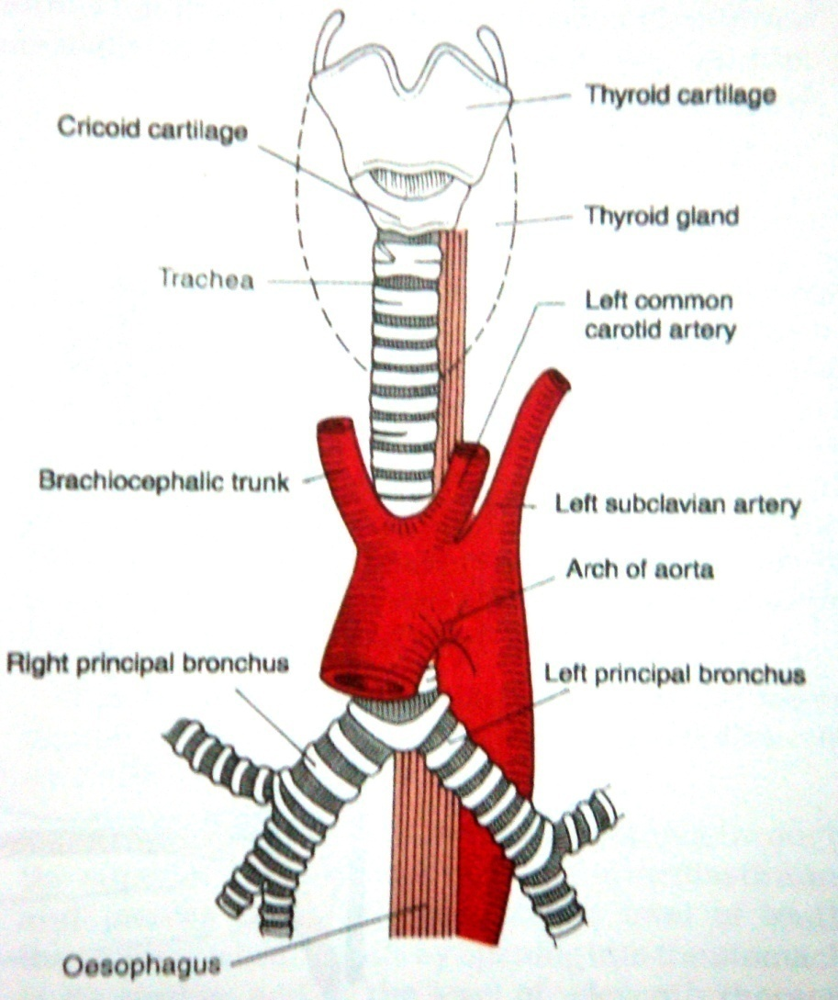
TRACHEA

Slide 3
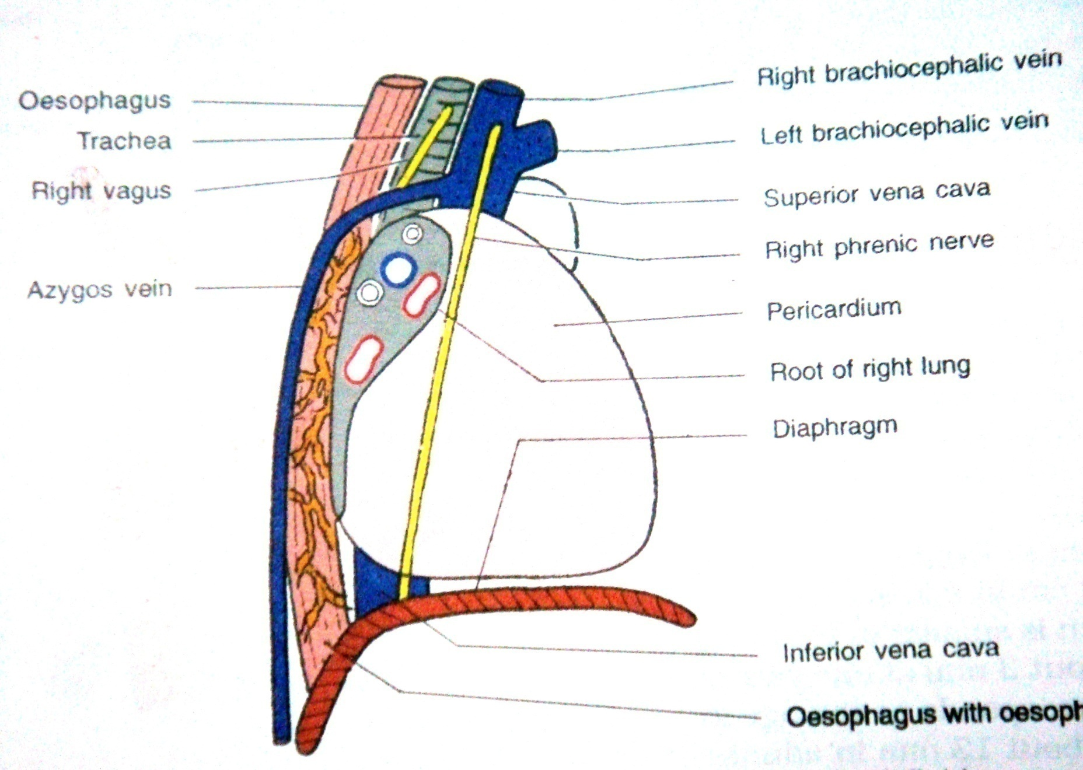
RIGHT LATERAL RELATIONS

Slide 4
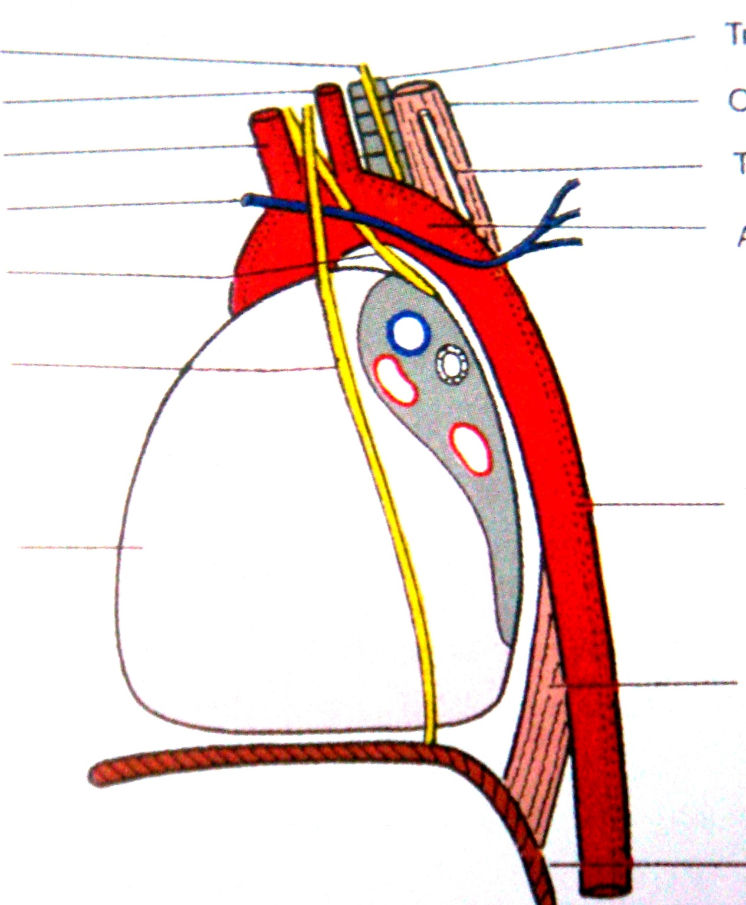
LEFT LATERAL RELATIONS
Lt recurrent laryngeal N
LCCA
Lt subclavian A
Arch of aorta
HEART

Slide 5
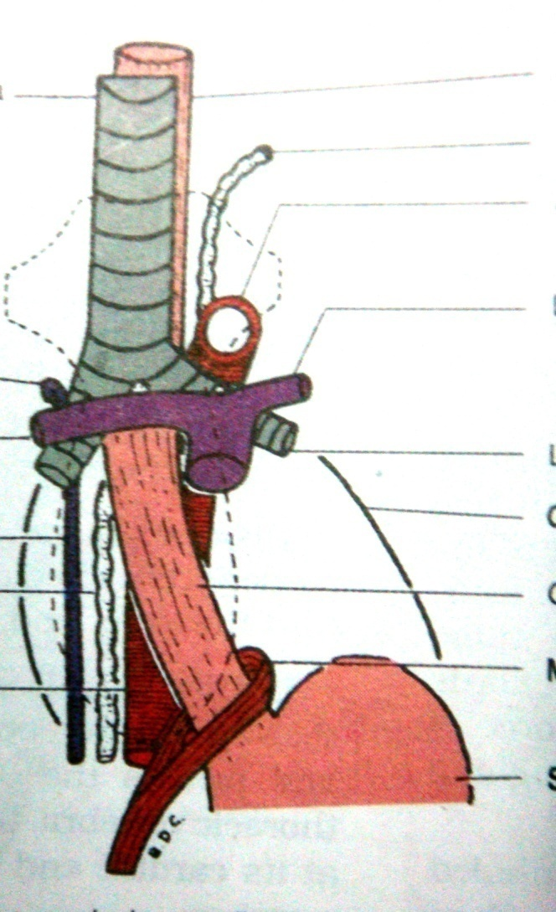
TRACHEA
THORACIC DUCT
PULMONARY TRUNK
OESOPHAGUS
AORTA

Slide 6
RIGHT LATERAL RELATIONS

Slide 7
LEFT LATERAL RELATIONS
Lt recurrent laryngeal N
LCCA
Lt subclavian A
Arch of aorta
HEART

Slide 8
Clinical anatomy
Palpation of trachea
Tracheal tug
Tracheostomy
Dyspnoea /Irritative cough/Husky voice
Oesophageal varices
Barium swallow
Achalasia cardia
Tracheo-osophageal fistula
Thoacic duct obstruction

Slide 9
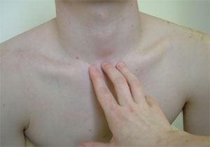

Slide 10
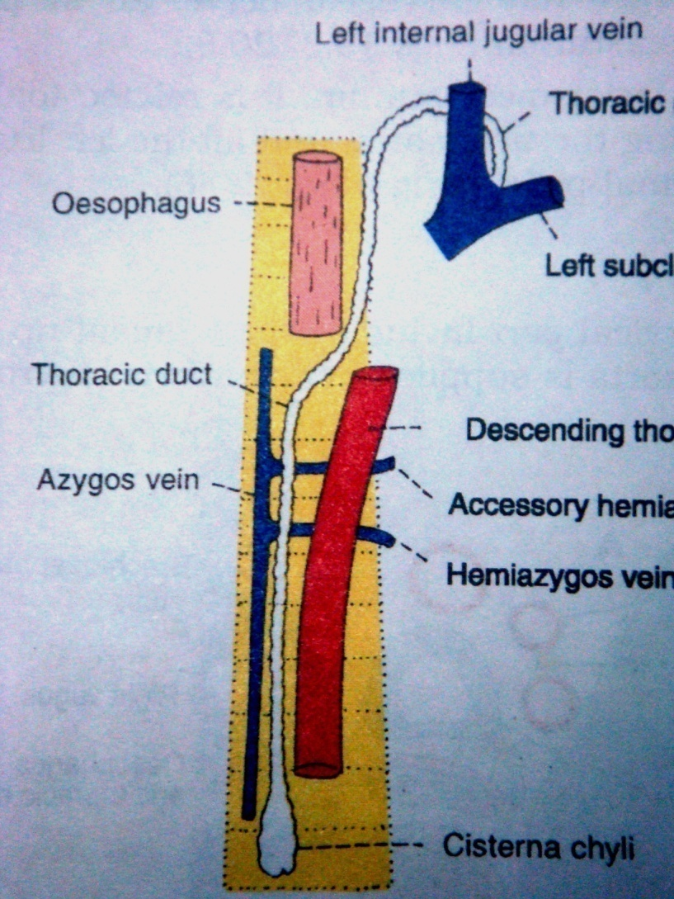
Thoracic duct

Slide 11
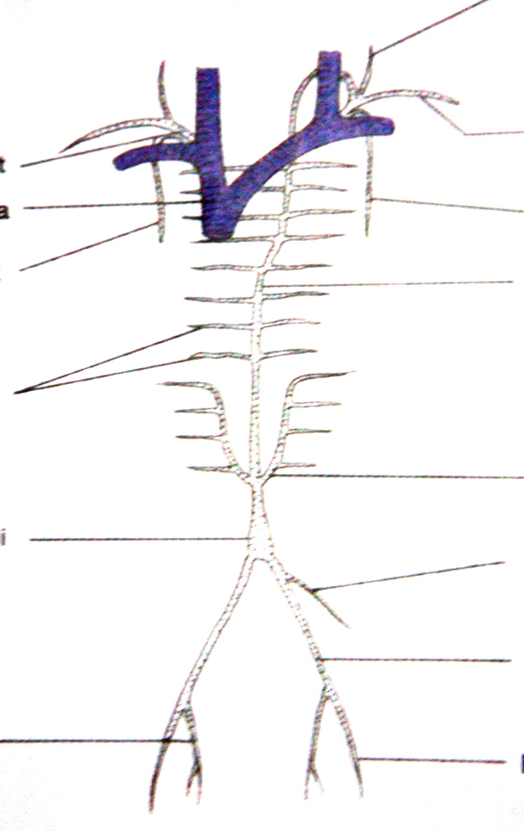
THORACIC DUCT
LEFT BRACHEO-
CEPHALIC VEIN
CISTERNA CHYLI

Slide 12
Clinical anatomy
Palpation of trachea
Tracheal tug
Tracheostomy
Dyspnoea /Irritative cough/Husky voice
Oesophageal varices
Barium swallow
Achalasia cardia
Tracheo-osophageal fistula
Thoacic duct obstruction

Slide 13
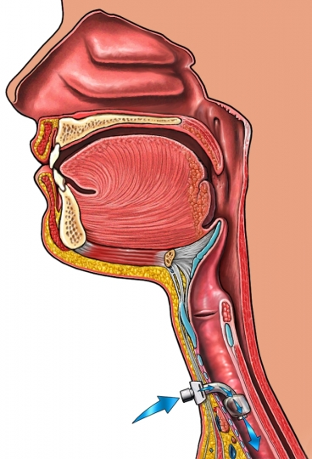
TRACHEOSTOMY
TRACHEOSTOMY TUBE

Slide 14
Clinical anatomy
Palpation of trachea
Tracheal tug
Tracheostomy
Dyspnoea /Irritative cough/Husky voice
Oesophageal varices
Barium swallow
Achalasia cardia
Tracheo-osophageal fistula
Thoacic duct obstruction

Slide 15
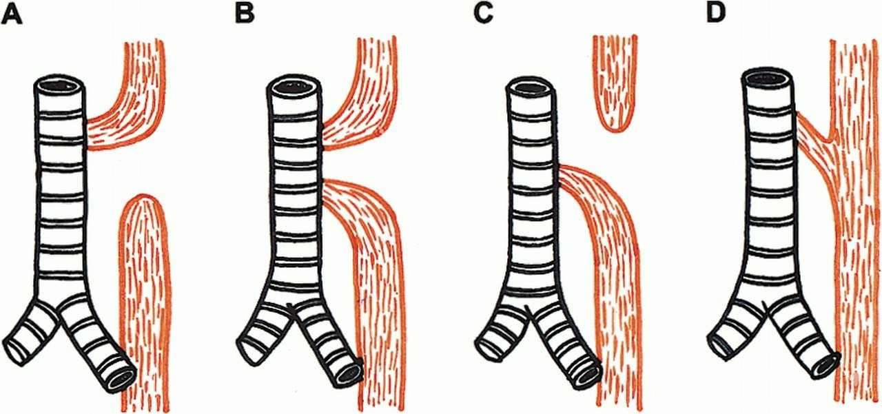
TRACHEO-OESOPHAGEAL FISTULA
TRACHEA
OESOPHAGUS

Slide 16
1981 Sep;142(3):350-4.
Alfonso A, Christoudias G, Amaruddin Q, Herbsman H, Gardner B.
Author | Title | Material and methods | Result | conclusion
Alfonso A, Christoudias G, Amaruddin Q, Herbsman H, Gardner B. | Tracheal or esophageal compression due to benign thyroid disease. | Tracheal or esophageal compression was present in 91 (33 percent) of 273 consecutive patients with benign goiter during a 7 year experience.they are examine for type of thyroid enlargement. | A clinical spectrum ranging from a presymptomatic tracheal compression stage to one wherein progressive worsening of symptoms occurs is suggested. | Early operation whenever roentgenographic evidence of tracheal deviation becomes manifest is recommended.

