Slide 1
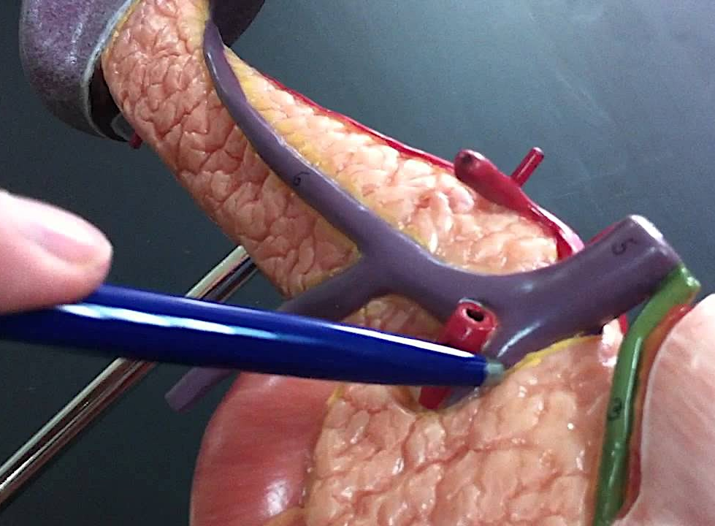
Portal vein and
Portocaval Anastomosis
Dr. Manoj Kulkarni
Associate Professor
Department of Anatomy
S.B.K.S.M.I. & R.C.
www.slideshare.net

Slide 2
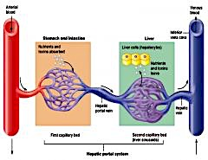
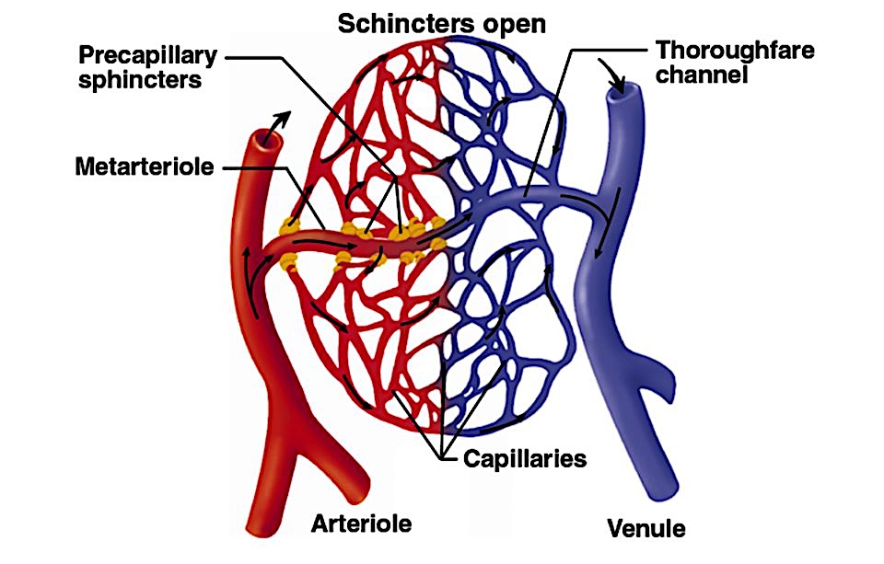
Portal system
Usual circulation
Portal circulation

Slide 3
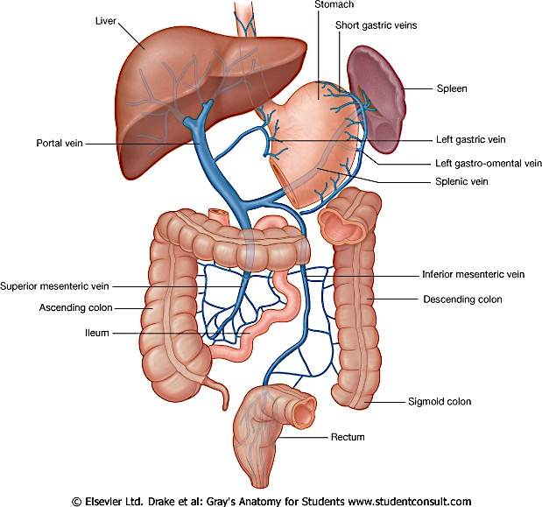
Hepatic Portal Vein
Origin & end in capillaries / venous sinusoids
Size: 8cm X 1 cm
Drains
  Abdominal part of alimentary tract (except lower part of anal canal)
  Spleen & Pancreas
Conveys absorbed products of digested food to liver
Devoid of valves
Reservoir of blood : 1200 ml / min

Slide 4
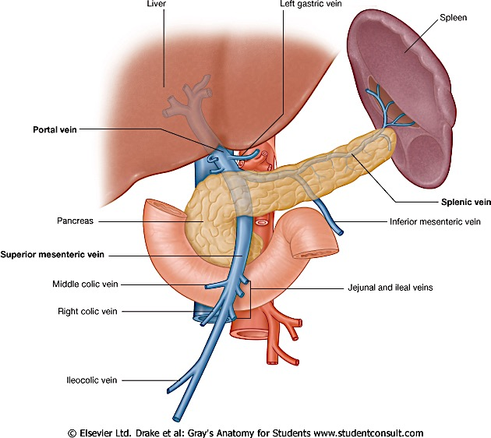
Formation
  Union of Sup mesenteric & Splenic vein
  Between neck of Pancreas & IVC at level L2

Slide 5
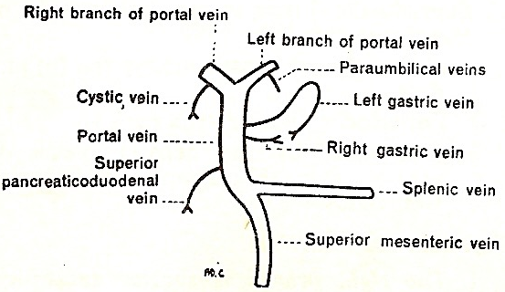
Tributaries

Slide 6
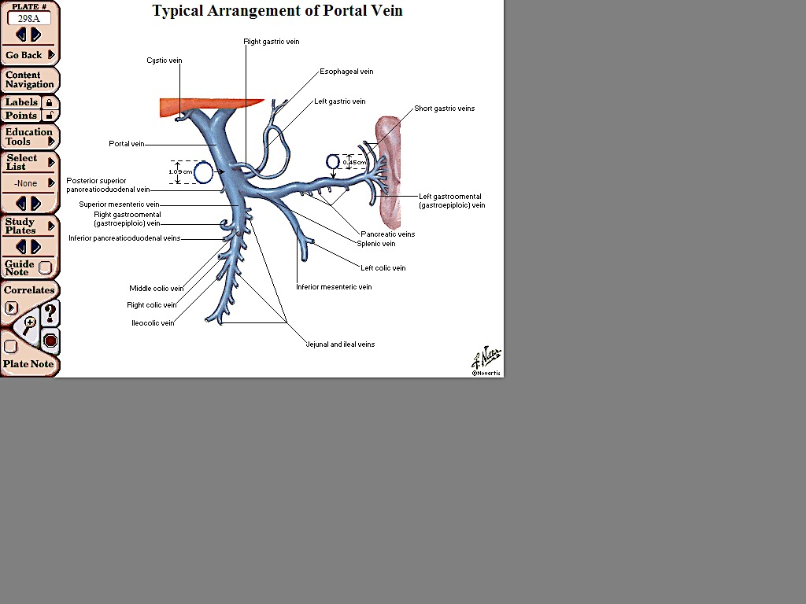
Tributaries
Formative
  Sup Mesenteric vein
  Splenic vein
Received by Trunk
  Rt & lt Gastric veins
  Superior PD vein
Received by branches
  Cystic vein
  Paraumbilical veins
Occasional
  Inf mesenteric
  Rt gastro-epiploic
  Pre-pyloric vein.

Slide 7
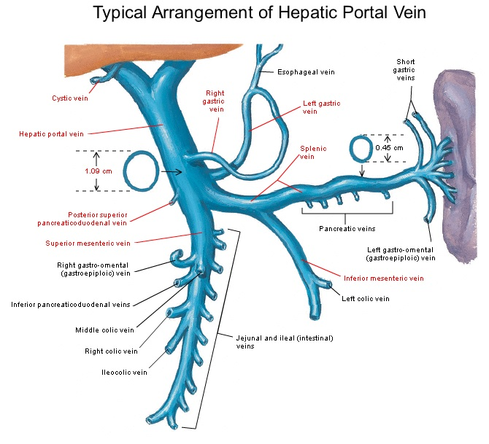
Portal Vein
Formed by union of (behind the neck of pancreas)
Superior Mesenteric Vein
Splenic vein
Tributaries:
Left gastric vein
Right gastric vein
Cystic veins
Posterior superior pancreaticoduodenal vein

Slide 8
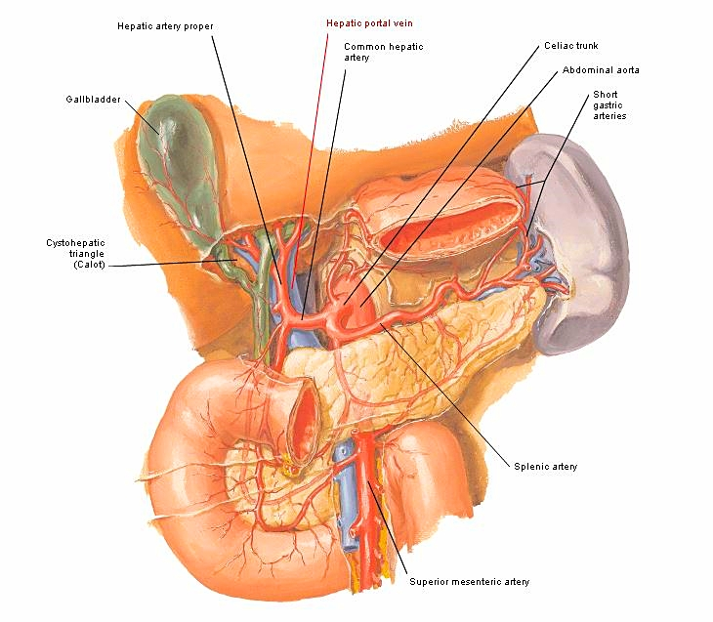
Location
Runs almost vertically upwards in the free margin on lesser omentum.
Anteriorly : Pancreas and first part of duodenum.
Posteriorly : Inferior vena cava (but loses contact by entering between two layers of lesser omentum.

Slide 9
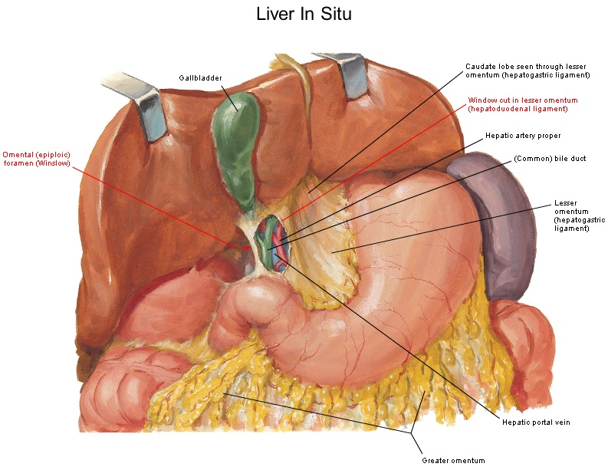
Hepatic Artery and the common bile duct lie in the same plane and in front of the Portal vein.

Slide 10
Relations

Slide 11
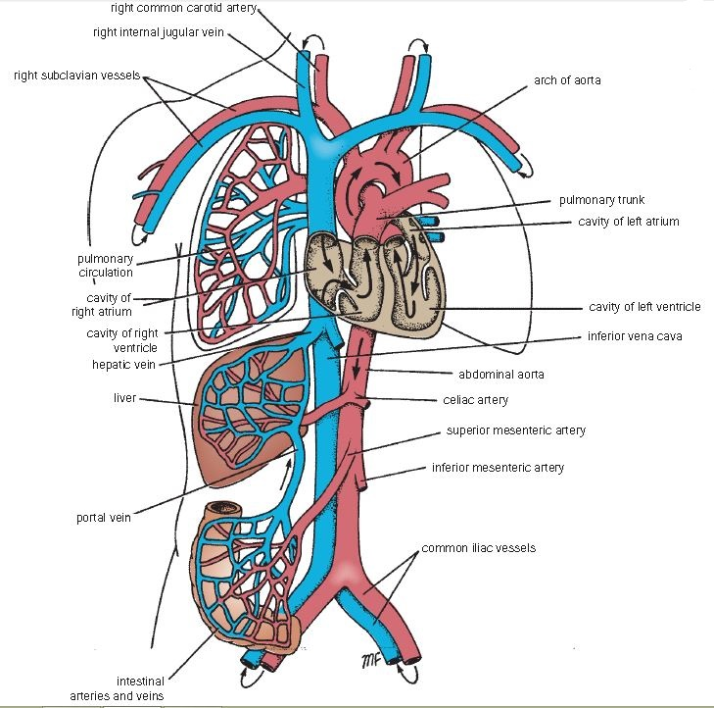
General Plan of Blood Circulation
PORTAL CIRCULATION
Blood is collected from one set of capillaries and is passed to a larger vessel which then again divides into capillaries before the blood is returned to systemic circulation.

Slide 12
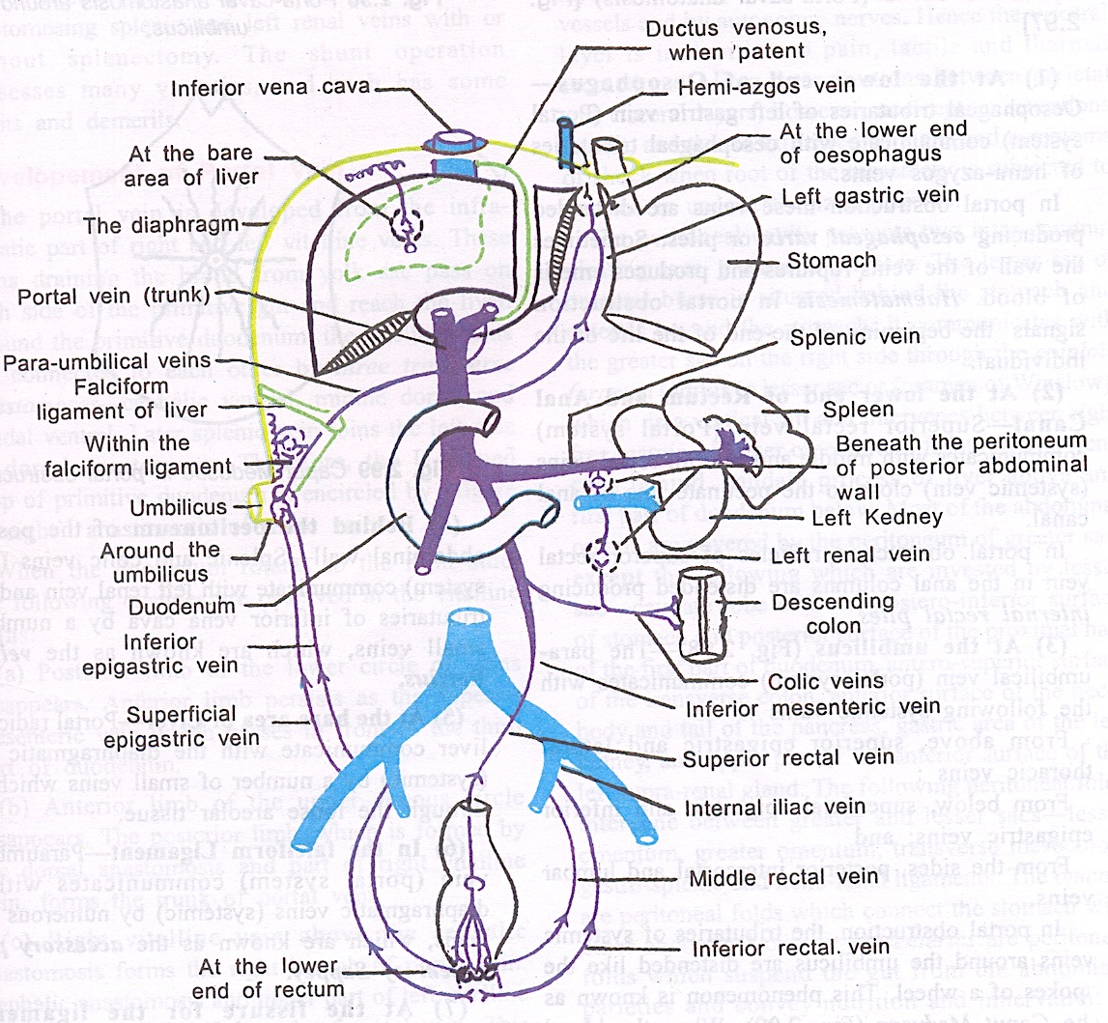
Portocaval anastomosis

Slide 13
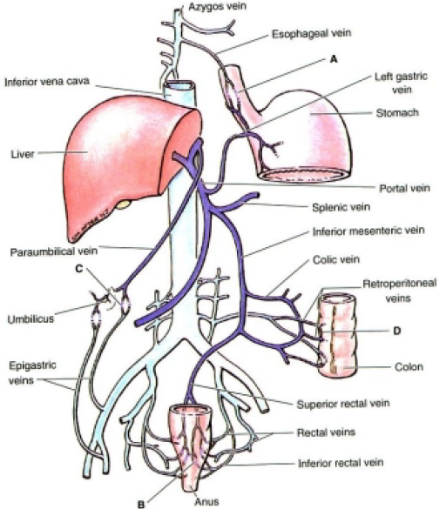
SITES OF PORTACAVAL ANASTOMOSIS
Five sites of portal/systemic circulation :
Lower third of the Esophagus
Paraumbilical Area
Upper end of Anal canal
Retroperitonial
Bare area of liver

Slide 14
Site | Caval | Portal | Effect in PHT
Lower end of esophagus | Esophageal tributaries of hemiazygos V | Oesophageal tributaries of Lt gastric V | Oesophageal varices
Umbilicus | Veins of AAW | Paraumbilical veins (tributaries of Lt br of Portal V) | Caput medusae
Lower end of rectum & Anal canal | Middle & inf rectal Vs | Sup rectal V | Anorectal varices, Internal hemorrhoids

Slide 15
Site | Caval | Portal
Post abd wall | Lt renal V Veins of Post Abd wall | Splenic V Veins of retroperitoneal organs like duodenum, Asc & Desc colon
Bare area of liver | Diaphragmatic veins | Hepatic brs of Portal V
Liver | Patent Ductus venosus (rare) | Lt br of portal v
Post wall of vagina | Vaginal venous plx | Sup rectal v
Falciform lig | Diaphragmatic v | Paraumblical v

Slide 16
Portal hypertension
> 12 mm of Hg
Causes :
  Pre hepatic : Thrombosis of portal vein
  Hepatic: Cirrhosis
  Post hepatic: Budd-Chiari Syndrome
Effects: Splenomegaly, Ascites, Collateral circulation through sites of Portasystemic anastomosis

Slide 17
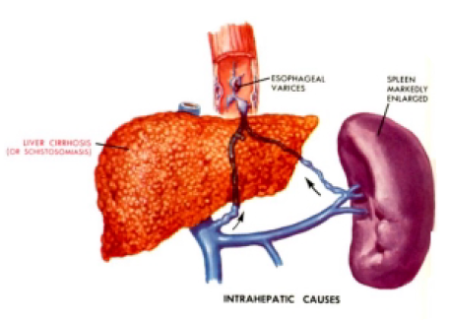
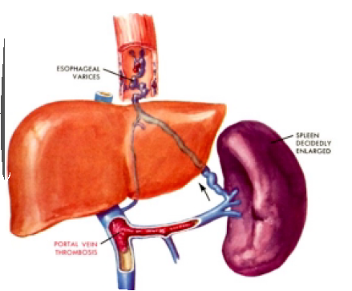
Portal Hypertension
It is defined as increase in blood pressure in the veins of the portal system caused by obstruction in the liver (due to cirrhosis, thrombophlebitis), causing enlargement of collateral veins and splenomegaly.
It is caused by :
Liver Cirrhosis (Interahepatic)
Thrombosis of Portal vein. (Extrahepatic)

Slide 18
Consequences of Portal Hypertension
Esophageal varices
Caput Medusae
Hemorrhoids
Ascites
Splenomegaly

Slide 19
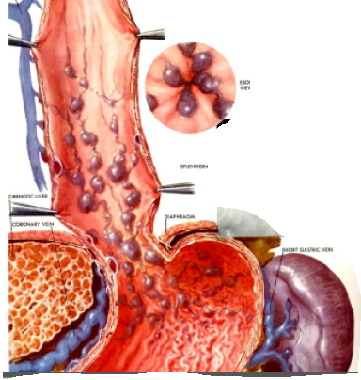
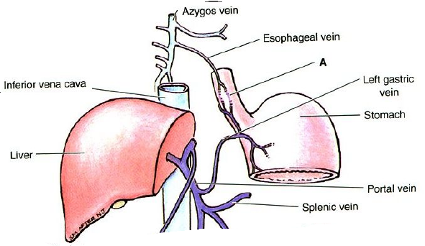
Esophageal varices
Patient typically presents with Haematemesis & Black tarry stools.
It can be visualized using Esophagogastroduodenoscopy (endoscopy).

Slide 20
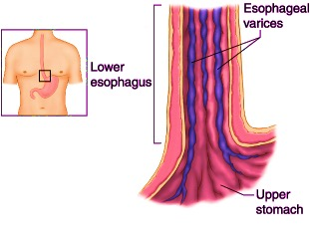
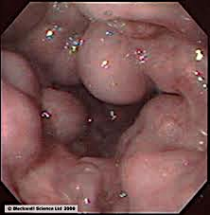
Esophageal varices

Slide 21
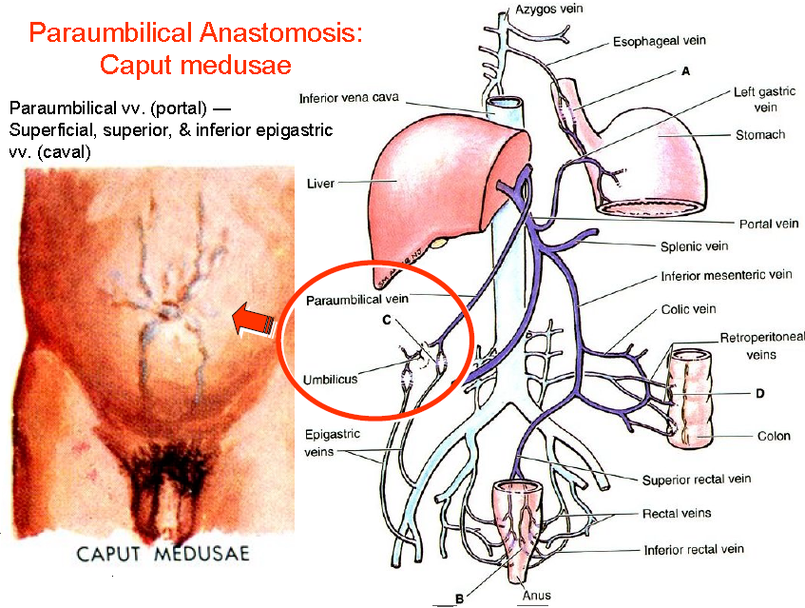
Caput Medusae

Slide 22
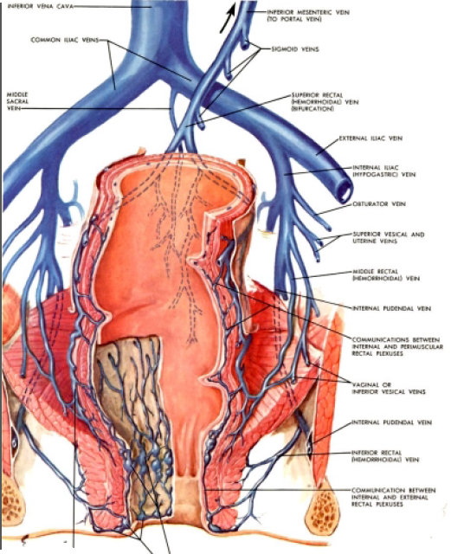
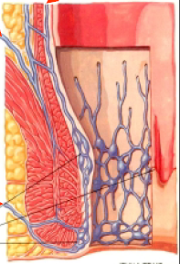
Hemorrhoids
Hemorrhoids are painful, swollen veins in the lower portion of the rectum or anus.
Hematochezia / fresh blood.

Slide 23
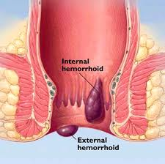
Internal piles (Hemorrhoids)

Slide 24
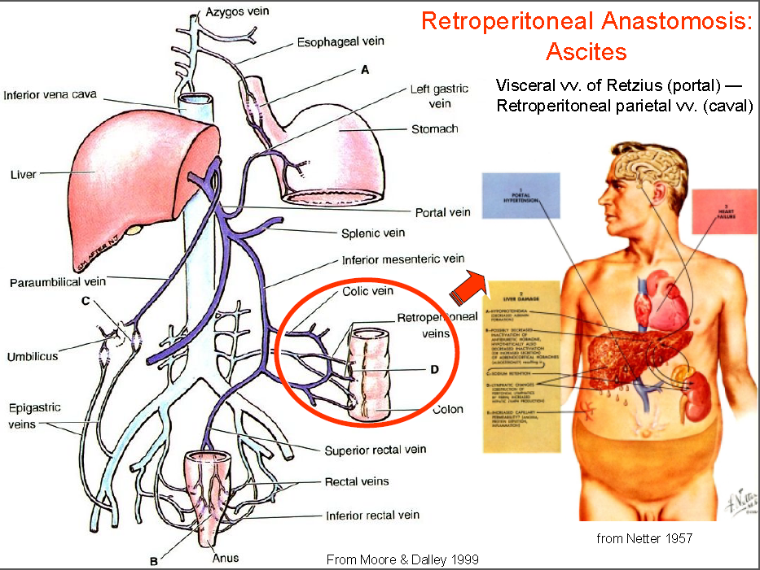
Ascites accumulation of fluid in the peritoneal cavity

Slide 25
1) What is length of portal vein ??
8 cm
10 cm
18 cm
15 cm

Slide 26
2) Portal vein is for by union of
Superior & inferior mesenteric veins
Splenic & superior mesenteric veins
Splenic & inferior mesenteric veins
None of the above

Slide 27
3) All Tributaries of portal vein except
Splenic vein
Superior mesenteric
Inferior mesenteric
Left gastric

Slide 28
4) Caput medusae form by obstruction of which vein ??
a. Right gastric vein
b. Splenic vein
c. Cystic vein
d. Paraumbilical vein

Slide 29
5) Portal vein terminates into liver
Right & left branches
Superior & inferior branches
Splenic branch
None of the above

Slide 30
Francesco Vizzutti , Umberto Arena , Roberto G. Romanelli, Luigi Rega, Marco Foschi Stefano Colagrande Antonio Petrarca Stefania Moscarella Giacomo Belli Anna Linda Zignego Fabio Marra Giacomo Laffi Massimo Pinzani
Hepatology, Volume45, Issue5, May 2007,Pages 1290-1297
Francesco Vizzutti Umberto Arena Roberto G. Romanelli Luigi Rega Marco Foschi Stefano Colagrande Antonio Petrarca Stefania Moscarella Giacomo Belli Anna Linda Zignego Fabio Marra Giacomo Laffi Massimo Pinzani | Liver stiffness measurement predicts severe portal hypertension in patients with HCV‐related cirrhosis | Measurement of hepatic venous pressure gradient (HVPG) is a standard method for the assessment of portal pressure and correlates with the occurrence of its complications. Liver stiffness measurement (LSM) has been proposed as a noninvasive technique for the prediction of the complications of cirrhosis. They evaluated the ability of LSM to predict severe portal hypertension compared with that of HVPG in 61 consecutive patients with HCV‐related chronic liver disease | A strong relationship between LSM and HVPG measurements was found in the overall population (r = 0.81, P < 0.0001). the correlation was excellent for HVPG values less than 10 or 12 mm Hg (r = 0.81, P = 0.0003 and r = 0.91, P < 0.0001, respectively), linear regression analysis was not optimal for HVPG values ≥10 mm Hg (r² = 0.35, P < 0.0001) or ≥12 mm Hg (r² = 0.17, P = 0.02). The AUROC for the prediction of HVPG ≥10 and ≥12 mm Hg were 0.99 and 0.92, respectively | LSM represents a non‐invasive tool for the identification of chronic liver disease patients with clinically significant or severe portal hypertension and could be employed for screening patients to be subjected to standard investigations including upper GI endoscopy and hemodynamic studies

