Slide 1

Introduction to
Orthodontics & Dentofacial Orthopaedics
Dr. Romil Shah
Professor & PG Guide,
Dept. of Orthodontics and Dentofacial Orthopaedics,
KMSDC&H, SVDU

Slide 2
Orthodontics is the oldest specialty (1000 B.C.)
Awareness about ‘crooked teeth’ has been mentioned in the writings of Hippocrates(460-377) B.C. and Aristotle(384-322)B.C.
The word orthodontia was first coined by Le foulan- a French man in 1839.
The first recorded orthodontic treatment was of Celsus by using finger pressure.
Edward H. Angle, known as ‘Father of modern orthodontics’, he classified malocclusion in 1899.
Noyes first defined Orthodontics in 1911.
Bunon introduced the term “Orthopaedics” with orthodontics.

Slide 3
The word Orthodontia is derived from two Greek words ;
“Orthos” meaning straight, right or correct
“Odontos” meaning teeth.
(White & Gardiner-Orthodontics for dental students. W.B. Saunders: 3rd ed; 1997. pg-1 )

Slide 4
Definition: 1
Orthodontics is that branch of dentistry concerned with the study of the growth of the craniofacial complex, development of occlusion and treatment of dentofacial abnormalities.
(Robert Moyers: Handbook of orthodontics. Mosby: 4th edition; 1992 Pg-3)

Slide 5
Definition: 2
ACCORDING TO BRITISH SOCIETY OF ORTHODONTICS (1922):
ORTHODONTICS INCLUDES, THE STUDY OF GROWTH AND DEVELOPMENT OF THE JAWS AND FACE PERTICULARLY AND THE BODY GENERALLY AS INFLUENCING THE POSITION OF TEETH; THE STUDY OF ACTION AND REACTION OF INTERNAL AND EXTERNAL INFLUENCES ON THE DEVELOPMENT AND THE PREVENTION AND CORRECTION OF ARRESTED AND PERVERTED DEVELOPMENT.

Slide 6
JACKSON’S TRIAD
(AIMS OF ORTHODONTIC TREATMENT)
STRUCTURAL BALANCE
FUNCTIONAL EFFICIENCY
ESTHETIC HARMONY
White & Gardiner-Orthodontics for dental students. W.B. Saunders: 3rd ed; 1997. pg-3.

Slide 7
SCOPE OF ORTHODONTIC TREATMENT
ALTERATION IN TOOTH POSITION
ALTERATION IN SKELETAL PATTERN
ALTERATION IN SOFT TISSUE PATTERN

Slide 8
BRANCHES OF ORTHODONTICS
Preventive Orthodontics
Interceptive Orthodontics
Corrective Orthodontics
Surgical Orthodontics

Slide 9
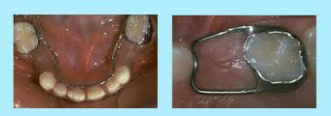
Preventive Orthodontics
Procedures undertaken prior to onset of a malocclusion e.g., space maintainers

Slide 10
Interceptive Orthodontics
Procedures undertaken at an early stage of malocclusion to eliminate or reduce the severity of the same.
So it is possible to prevent establishment of full fledged malocclusion
e.g., Habit breaking appliances

Slide 11
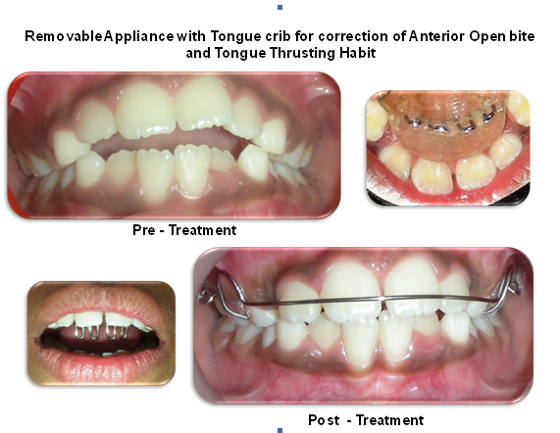
HABIT BREAKING APPLIANCES

Slide 12
c. Corrective Orthodontics
‘Orthodontic procedures undertaken to correct a fully established malocclusion.’
APPLIANCES:
1. REMOVABLE
2. MYO-FUNCTIONAL
3. FIXED

Slide 13
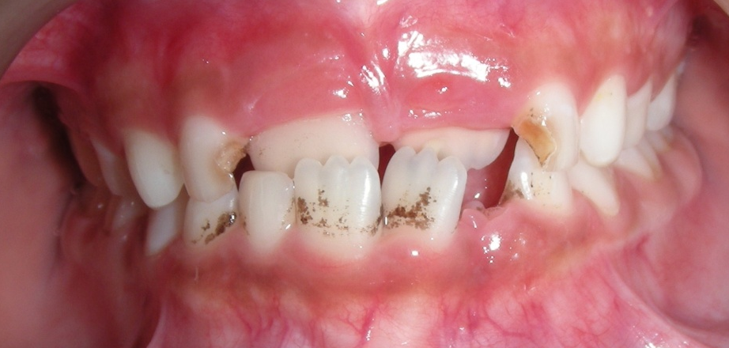
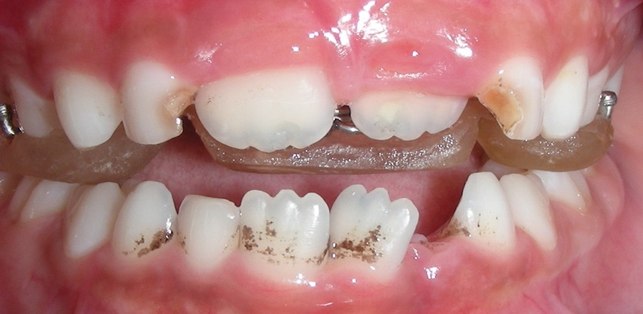
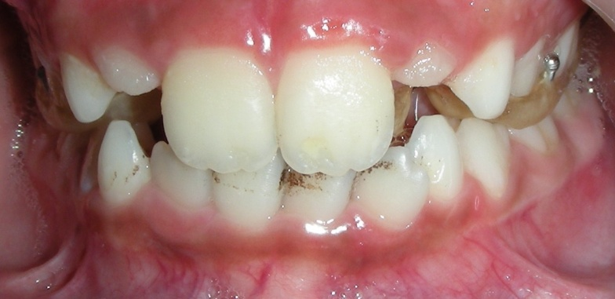
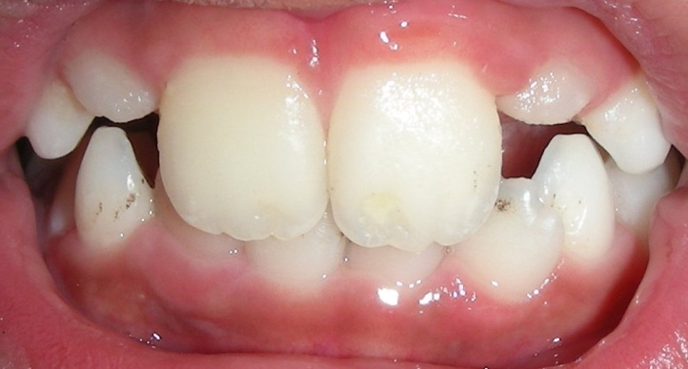
REMOVABLE APPLIANCE
PRE-TREATMENT
WITH APPLIANCE
POST TREATMENT

Slide 14
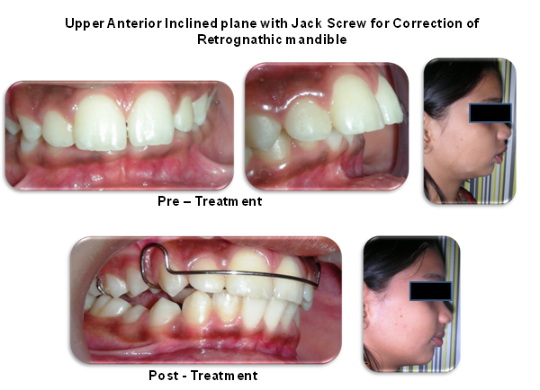
MYO-FUNCTIONAL APPLIANCES

Slide 15
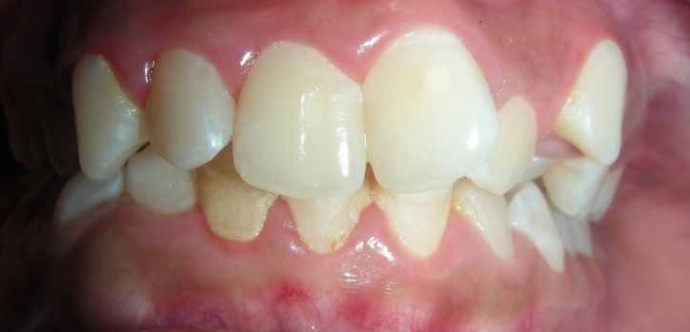
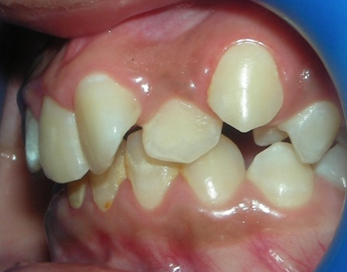
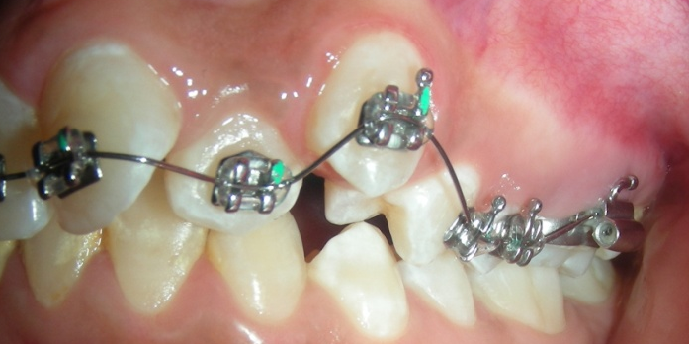
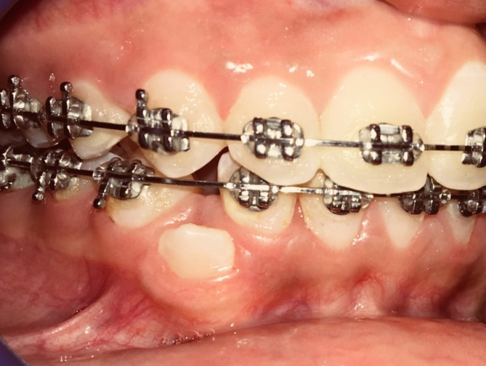
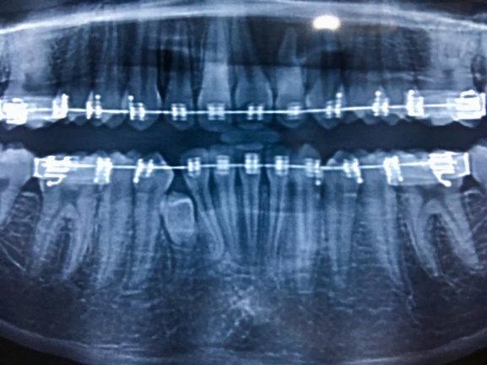
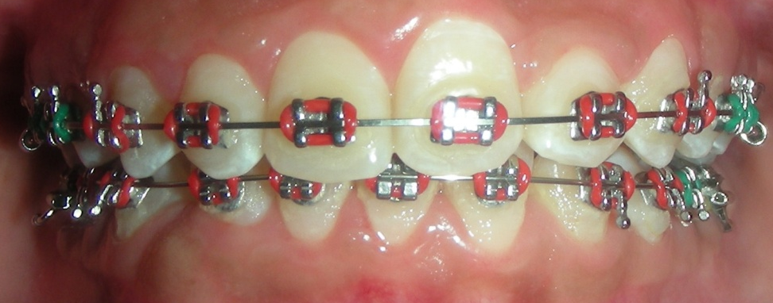
Metal Braces

Slide 16
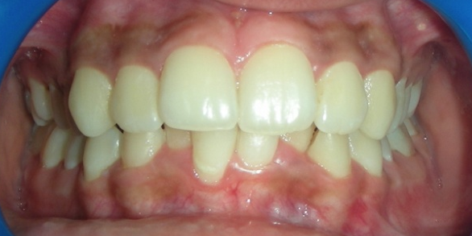
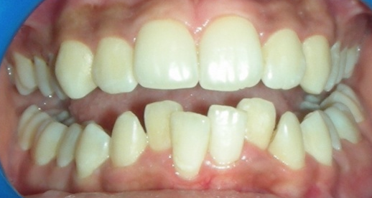
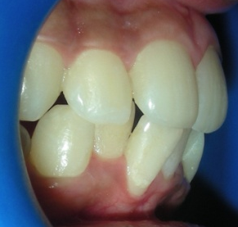
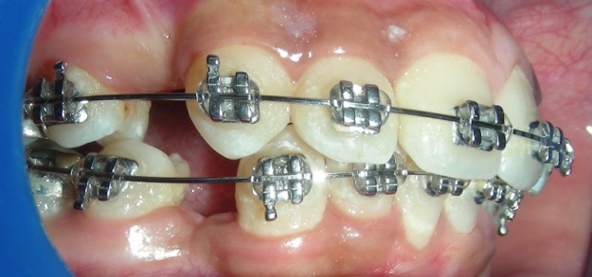
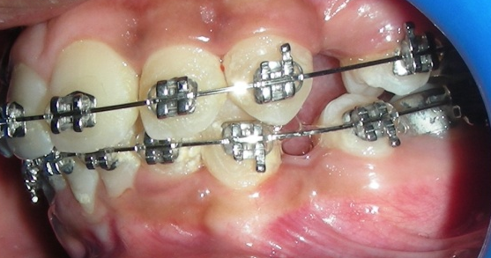
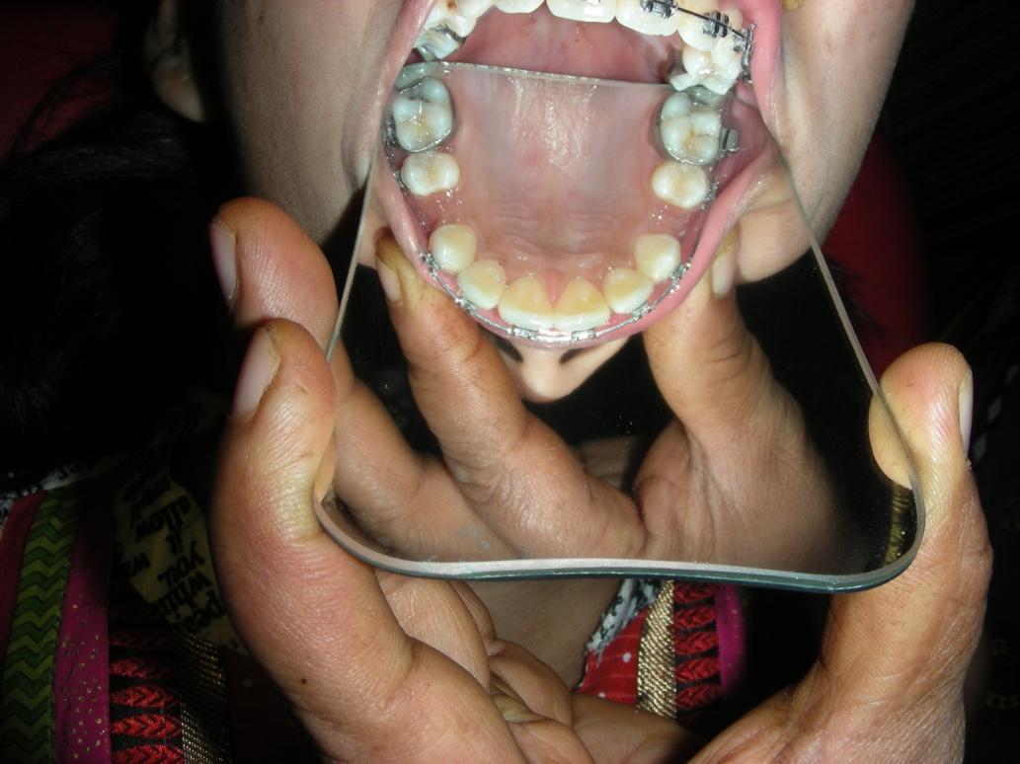
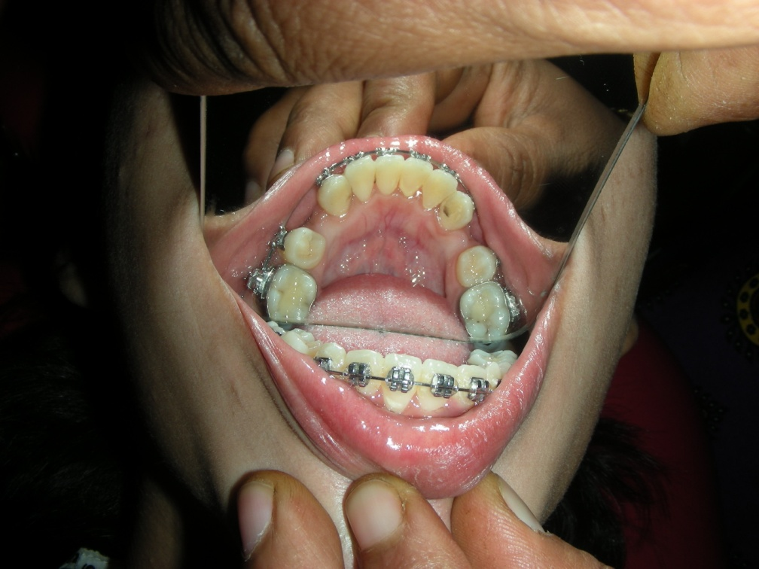
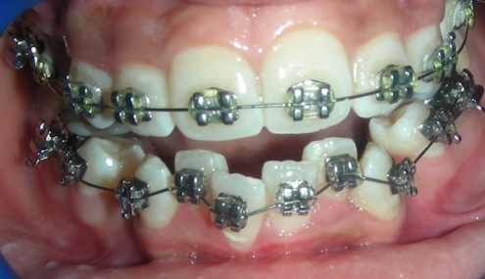
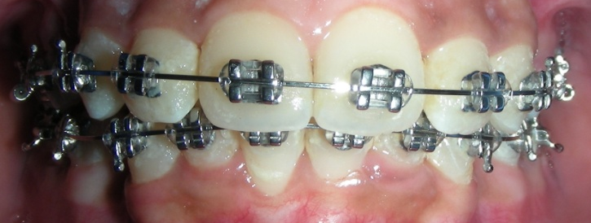
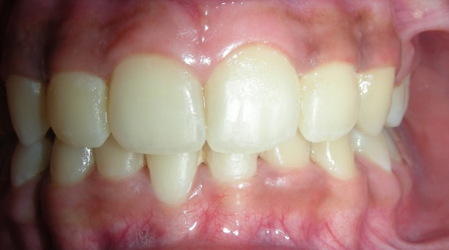
Metal Braces: Extraction case

Slide 17
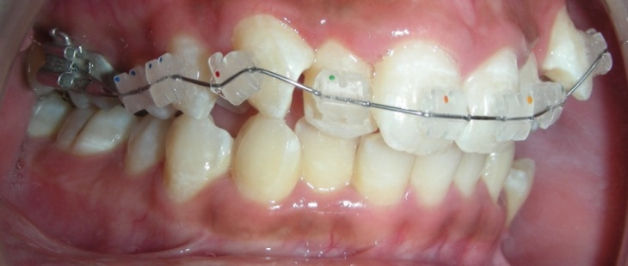
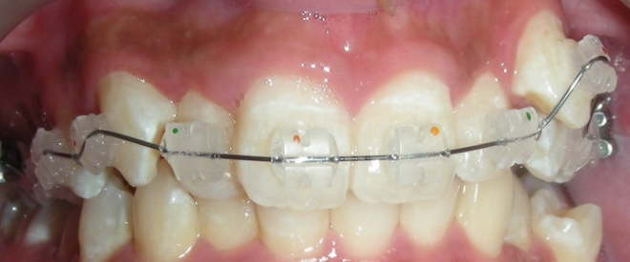
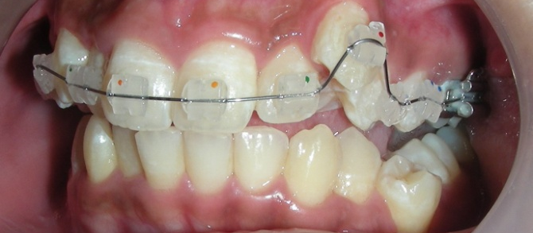
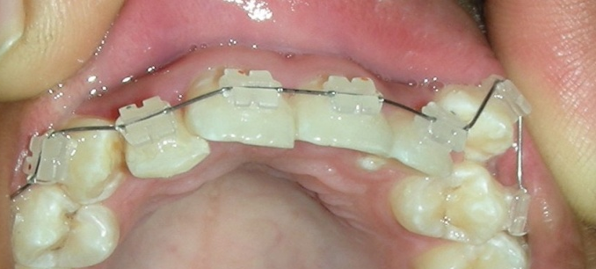
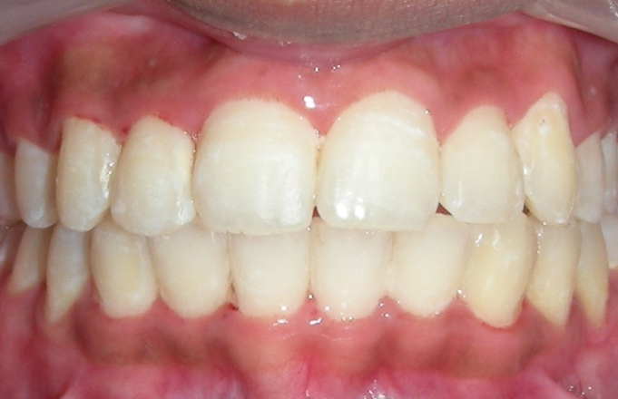
Ceramic Braces

Slide 18
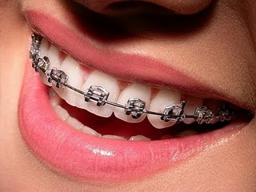
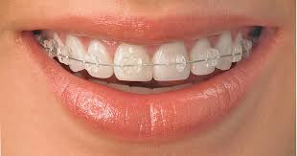
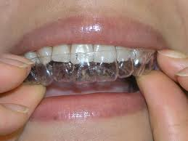
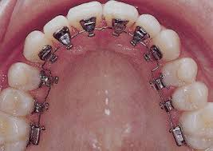
CERAMIC BRACES
METAL BRACES
LINGUAL BRACES
INVISALINE TECHNOLOGY

Slide 19
Surgical Orthodontics
surgical procedures that are undertaken in combination with or as an addition to orthodontic treatment.
The surgical orthodontic procedures are usually carried out to treat very severe dento-facial deformities that can not be treated by Orthodontic treatment alone.

Slide 20
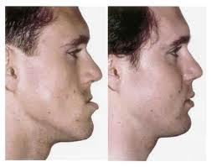
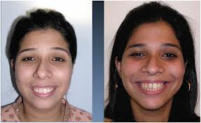
BILATERAL SAGITTAL SPLIT OSTEOTOMY
FOR MANDIBULAR SETBACK
LEFORT OSTEOTOMY FOR MAXILLARY SETBACK
ORTHOGNATHIC SURGERIES

Slide 21
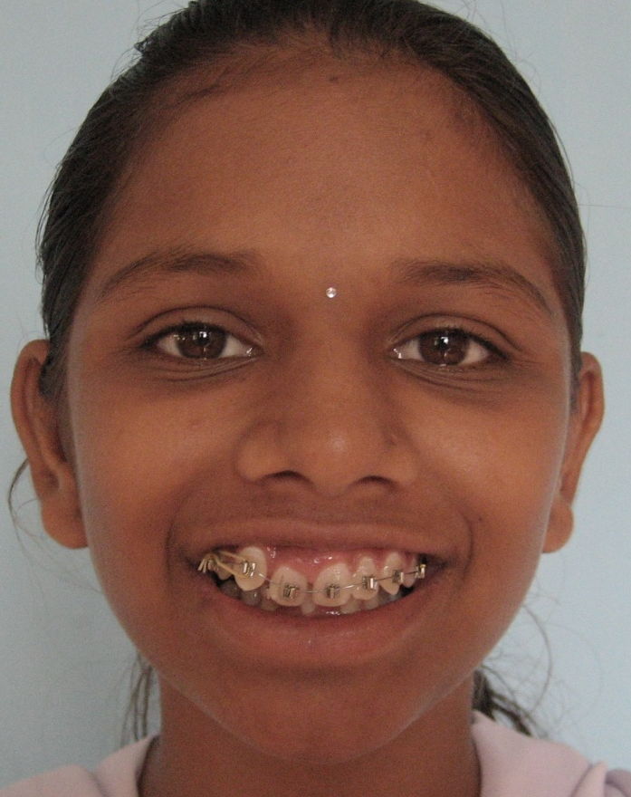
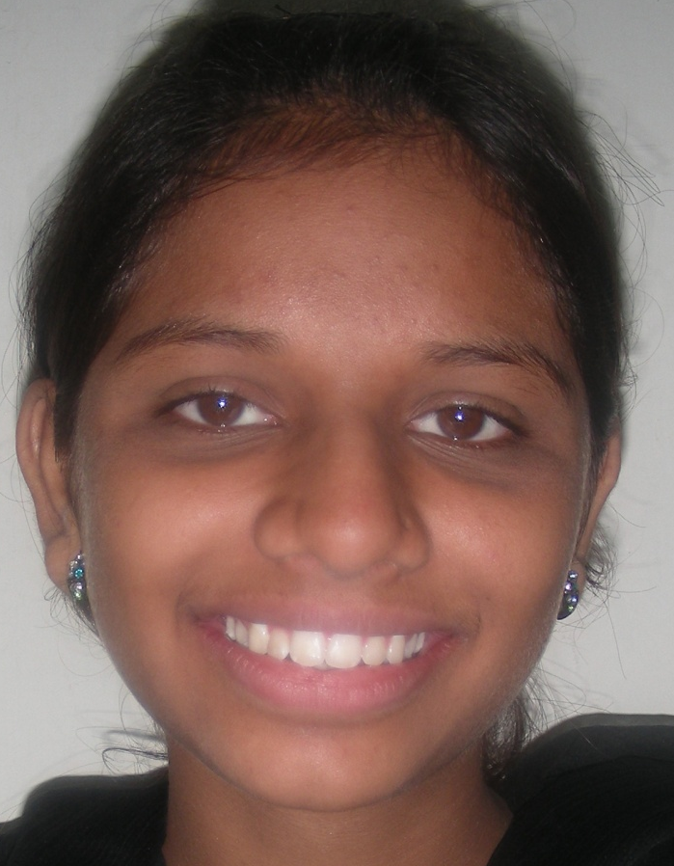
SMILE DESIGNING
BEFORE
AFTER

Slide 22
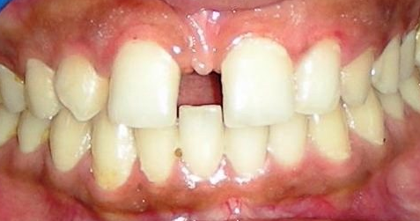
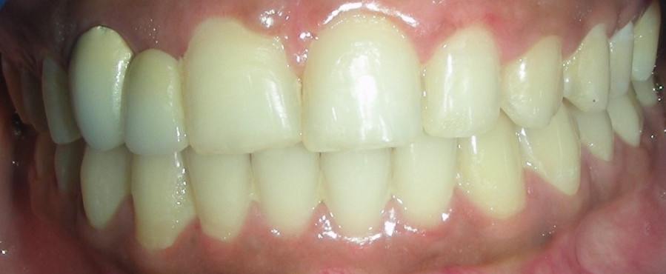
Interdisciplinary Approach

Slide 23
Need for orthodontic care
Aesthetic reasons.
Periodontal considerations.
To prevent injury.
To intercept and correct abnormal Oral habits.
To guide normal growth of the jaws.
To manage TMJ problems.
To facilitate prosthetic rehabilitation.
To correct speech defects.
To guide impacted teeth into occlusion.
To prepare patient for surgical correction of jaw deformities.

Slide 24
LIMITATIONS IN ORTHODONTICS
CLEDOCRANIAL DYSPLASIA
CRANIOFACIAL DYSOSTOSIS
PATHOLOGIES LIKE CYSTS AND TUMORS
EXECSSIVE BONE LOSS DUE TO PERIODONTAL DISEASES
DEVELOPMENTAL DENTAL ANOMALIES
NEUROLOGICAL DISORDERS

Slide 25
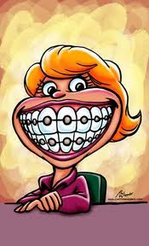
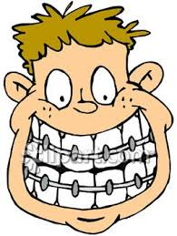
Thank you………………………….

Slide 26
MCQs
Q-1) In which year has the British Society for the study of orthodontics put forward the definition of orthodontics?
A. 1922
B. 1923
C. 1935
D. 1924

Slide 27
Q-2) Who coined the word orthodontics?
A. Martin Dewey
B. Norman Kingsley
C. Le Foulan
D. Pierre Robin

Slide 28
Q-3) Who is known as the Father of Modern Orthodontics?
A. Calvin Case
B. Celsus
C. Dr. E.H. Angle
D. Noyes

Slide 29
Q-4)The aims of orthodontics have been summarised by:
A. Le Felon
B. Jackson
C. Emerson C Angell
D. Edward H Angle

Slide 30
Q-5) Who was the first to use the term orthopaedics in connection with the correction of malocclusions?
A. Angle
B. Bunon
C. Le Felon
D. John Hunter

