Slide 1
Pawan toshniwal
Chemistry Of Nucleic Acids : DNA, RNA

Slide 2
NUCLEIC ACIDS
Two types of nucleic acids :-
1. Deoxyribonucleic acid(DNA)
2. Ribonucleic acid (RNA)
Primary function is to store and transmit genetic information.

Slide 3
FUNCTIONS OF NUCLEIC ACIDS:-
The three classes of biomolecules viz., DNA, RNA and Proteins are interrelated. This constitutes the central dogma of life.
DNA is the chemical basis of heredity. It stores genetic information.
It is organised into genes, which are the fundamental units of genetic information.

Slide 4
Functions of nucleic acids (contd.)
TRANSCRIPTION
TRANSLATION
DNA RNA PROTEIN
DNA is organised into genes;
Genes control protein synthesis through the mediation of RNA

Slide 5
COMPONENTS OF NUCLEIC ACIDS:-
Nucleic acids are polymers of nucleotides(polynucleotides).

Slide 6
NUCLEOTIDE STRUCTURE
PHOSPATE
SUGAR
Ribose or Deoxyribose
BASE
PURINES | PYRIMIDINES
Adenine (A) Guanine(G) | Cytocine (C) Thymine (T) Uracil (U)
NUCLEOTIDE

Slide 7
Ribose is a pentose
C5
O
C4
C1
C3
C2

Slide 8
Spot the difference
RIBOSE
DEOXYRIBOSE
CH₂OH
CH₂OH
O
OH
O
OH
C4
C1
C4
C1
H
H
H
H
H
H
H
H
C3
C2
C3
C2
OH
OH
OH
H

Slide 9
NUCLEOTIDES:-
Composed of
1. a nitrogenous base
2. a pentose sugar
3. a phosphate
NUCLEOSIDE

Slide 10
STRUCTURE OF NUCLEOTIDES:-
Base + Sugar = Nucleoside.
Nucleoside + Phosphate = Nucleotide.
THE NITROGENOUS BASE:-
They are aromatic heterocyclic compounds.
Of 2 types:- purines & pyrimidines.

Slide 11
MAJOR BASES IN NUCLEIC ACIDS:-
DNA & RNA contain the same purines viz., Adenine (A)& Guanine(G).
Pyrimidine: Cytosine(C) is found in both DNA & RNA.
DNA & RNA differ in the second pyrimidine base. DNA contains Thymine(T) & RNA contains Uracil(U).

Slide 12
Major purine bases in DNA are Adenine& Guanine.
Major pyrimidine bases in DNA are Thymine & Cytosine.
Major purine bases in RNA are
Adenine& Guanine.
Major pyrimidine bases in RNA are Cytosine & Uracil.

Slide 13
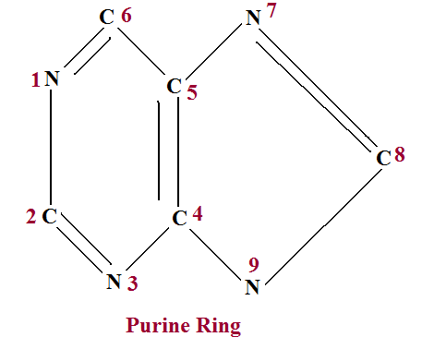
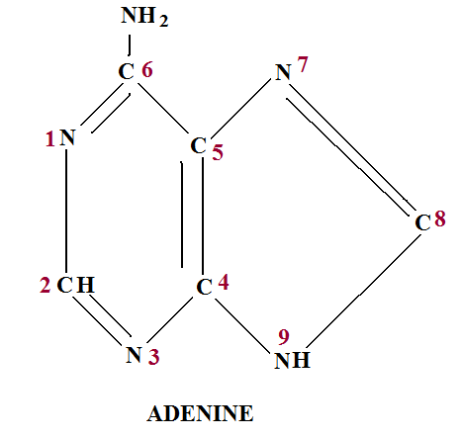
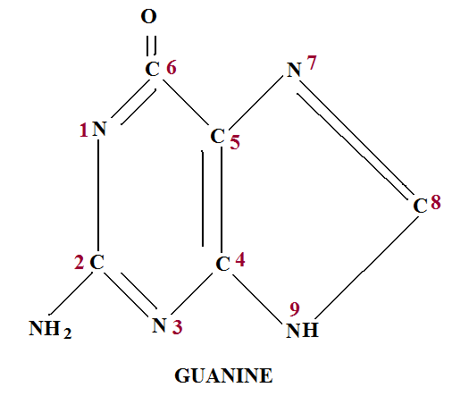

Slide 14
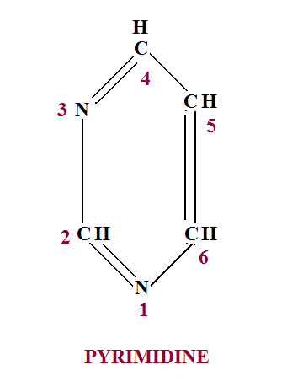

Slide 15
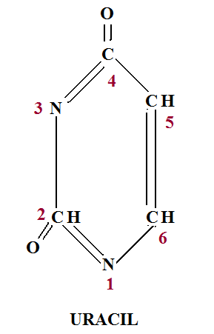
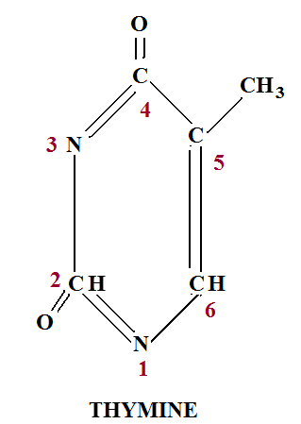
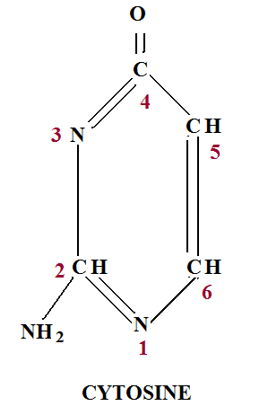

Slide 16
THE SUGAR-PHOSPHATE BACKBONE
P
5
3’,5’-phosphodiester bridge
5 C
3
P
The nucleotides are all orientated in the same direction
The phosphate group joins the 3rd Carbon of one sugar to the 5th Carbon of the next in line.
H
3
P
P
P
P
© 2007 Paul Billiet ODWS

Slide 17
ADDING IN THE BASES
P
G
P
C
The bases are attached to the 1st Carbon
Their order is important
It determines the genetic information of the molecule
P
C
P
A
P
T
P
T
© 2007 Paul Billiet ODWS

Slide 18
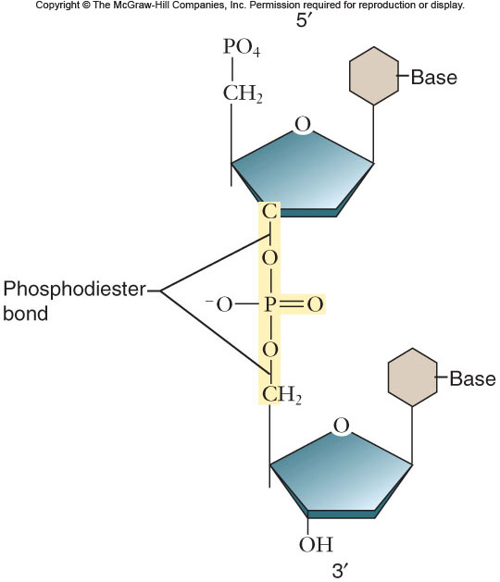
Phosphodiester bond

Slide 19
Author/year | Study design | Level | Conceptualization | Conclusion
THE STRUCTURE OF DNA J. D. Watson1 and F. H. C. Crick Cavendish Laboratory, Cambridge, England | Experimental Study | NA | We first discuss the chemical and physical-chemical data which show that DNA is a long fibrous molecule. Next we explain why crystallographic evidence suggests that the structural unit of DNA consists not of one but of two polynucleotide. | DNA consist of two polypeptide chains which has such a composition of the nucleotides that it follows Chargaffe’s rule.

Slide 20
DNA IS MADE OF TWO STRANDS OF POLYNUCLEOTIDE
Hydrogen bonds
P
G
C
P
P
C
G
P
P
C
G
P
P
A
T
P
P
T
A
P
P
T
A
© 2007 Paul Billiet ODWS
P

Slide 21
NOMENCLATURE OF NUCLEOTIDES:-
When a single phosphate is added to a nucleoside, a mononucleotide is formed.
Eg.,
Adenine + Ribose + Phosphate = Adenosine Monophosphate (AMP)

Slide 22
MINOR BASES FOUND IN NUCLEIC ACIDS:-
5-methylcytosine
N⁴-acetylcytosine
N⁶-methyladenine
N⁶,N⁶-dimethyladenine
Pseudouridine

Slide 23
EXAMPLE OF AN UNUSUAL BASE:-
“Pseudouridine”(ψ) , present in RNA in which C-5 of pyrimidine is linked to the C-1’ of sugar.

Slide 24
Other biologically important bases:-
Hypoxanthine
Xanthine
Uric acid
Intermediates in purine synthesis
End product of purine degradation

Slide 25
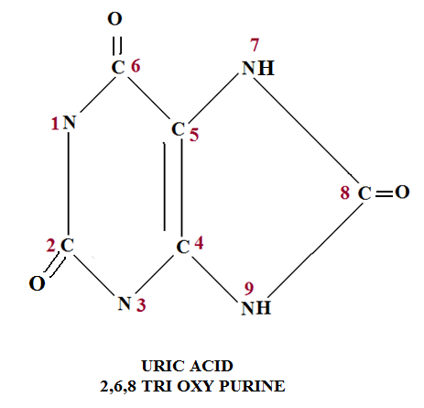

Slide 26
Pharmacologically important bases:-
Theophylline (present in tea): 1,3- dimethyl xanthine.
2. Theobromine (present in cocoa): 3,7-dimethyl xanthine.
3. Caffeine (present in coffee):1,3,7- trimethyl xanthine.

Slide 27
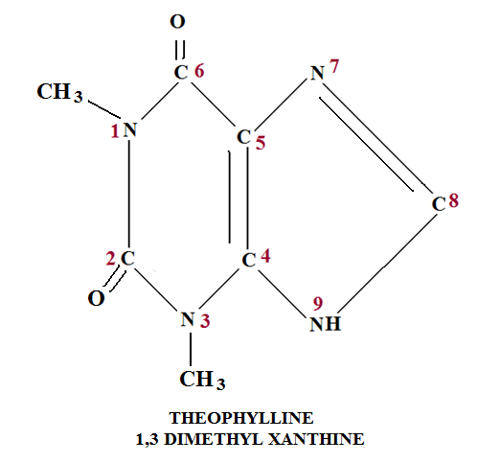
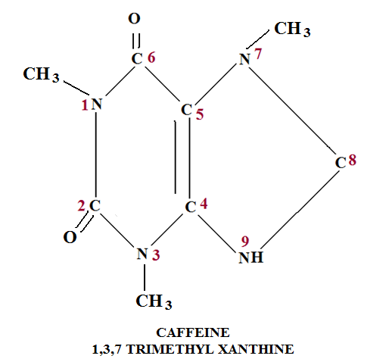
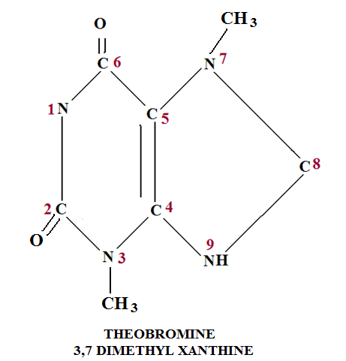

Slide 28
NOMENCLATURE OF NUCLEOTIDES:-
When a single phosphate is added to a nucleoside, a mononucleotide is formed.
Eg.,
Adenine + Ribose + Phosphate = Adenosine Monophosphate (AMP)

Slide 29
Base | Ribonucleoside | Ribonucleotide 5’monophosphate | Abbreviation
Adenine(A) | Adenosine | Adenosine 5’monophosphate or Adenylate | AMP
Guanine(G) | Guanosine | Guanosine 5’ monophosphate or Guanylate | GMP
Cytosine(C) | Cytidine | Cytidine 5’ monophosphate or Cytidylate | CMP
Uracil(U) | Uridine | Uridine 5’ monophosphate or Uridylate | UMP

Slide 30
Base | Deoxyibonucleoside | Deoxyibonucleotide 5’monophosphate | Abbreviation
Adenine(A) | Deoxyadenosine | Deoxyadenosine 5’monophosphate or Deoxyadenylate | dAMP
Guanine(G) | Deoxyguanosine | Deoxyguanosine 5’ monophosphate or Deoxyguanylate | dGMP
Cytosine(C) | Deoxycytidine | Deoxycytidine 5’ monophosphate or Deoxycytidylate | dCMP
Thymine(T) | Deoxythymidine | Deoxythymidine 5’ monophosphate or Deoxythymidylate | dTMP

Slide 31
Nucleoside di- and triphosphates:-
Eg., ADP, ATP.
Formed by addition of second and third phosphates to nucleoside monophosphates ( Eg., AMP, TMP).

Slide 32
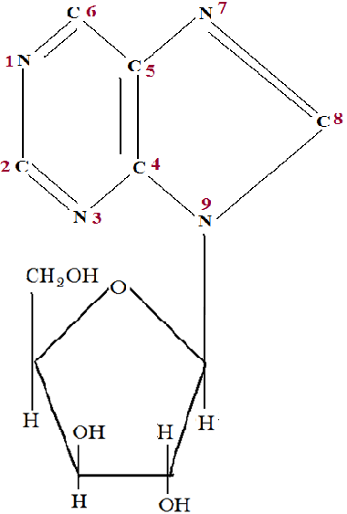
N-GLYCOSIDIC LINKAGE BETWEEN C9 OF PURINE AND C1 OF RIBOSE

Slide 33
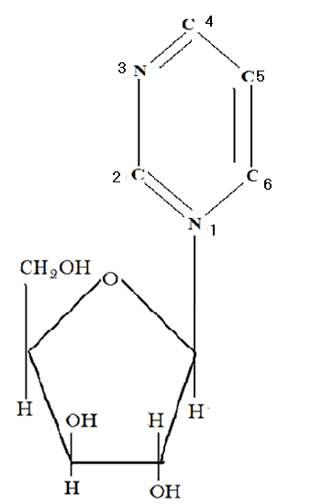
11
N-GLYCOSIDIC LINKAGE BETWEEN N1 OF PYRIMIDINE AND C1 OF GLUCOSE

Slide 34
NUMBERING OF CARBON ATOMS:-
C-atoms of the purine ring are numbered 1 to 9.
C-atoms of the pyrimidine ring are numbered 1 to 6.
C-atoms of the sugar are represented
1’ to 5’ to differentiate from those of the base.

Slide 35
CLINICALLY IMPORTANT SYNTHETIC ANALOGUES OF PURINE-PYRIMIDINE NUCLEOTIDES:-
Allopurinol: used in the treatment of hyperuricemia & gout.
5-Fluorouracil: used in the treatment of cancer. Binds to DNA & blocks cell proliferation.
Azathioprine: used to supress immunological rejection during transplantation.
Arabinosyladenine: used for treatment of neurological diseases.

Slide 36
DNA(DEOXYRIBONUCLEIC ACID)
Polymer of deoxynucleotides (deoxyribonucleotides).
Found in chromosomes, mitochondria.
Monomeric units are deoxyadenylate(dAMP), deoxyguanylate(dGMP), deoxycytidylate(dCMP) and
deoxythymidylate(dTMP/ TMP)

Slide 37
DNA IS PRESENT IN EVERY NUCLEATED CELL BOUND TO BASIC PROTEINS FORMING A COMPLEX KNOWN AS CHROMATIN AND CARRIES THE GENETIC INFORMATION.

Slide 38
< 0.1% of the total DNA is present in the mitochondria.
DNA is also present in the chloroplasts of plants.
Many viruses contain DNA as the genetic material.

Slide 39
Functions of DNA :-
Stores genetic information.
The genetic Information--
is the source of information for synthesis of all proteins molecules of the cell.
Provides information inherited by daughter cells or offspring.
DNA serves as a template in both (transcription/replication)

Slide 40
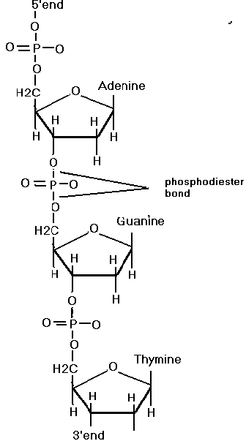
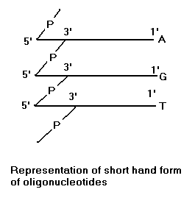
Type of linkage in DNA polynucleotide:-

Slide 41
Primary structure of DNA:-
Very long thread-like molecule. (mol.wt.1.6X10⁶ to 2X10⁶)
Each DNA is a polymer of about 10¹⁰ nucleotides.
Nucleotides are bound to each other by covalent 3’-5’ phosphodiester linkage.
The two ends of the linear polydeoxyribonucleotide strand are free.

Slide 42
The end of the strand with free 5’-phosphate group without phosphodiester linkage is called the 5’-end.
The end with free 3’-OH group is called the 3’-end.

Slide 43
The primary structure is the number & sequence of different deoxyribo -nucleotides in its strand joined together by phosphodiester linkages.
The backbone of the primary structure is the linear strand of interconnected sugar & phosphate residues while thebase(purine/pyrimidine)connected with the sugar residue projects laterally from the backbone.

Slide 44
Secondary structure of DNA:-
First proposed by Watson & Crick in 1953. Awarded Nobel prize in 1962.
According to this model,
Two polynucleotide chains coil around a central axis.
Usually forms a right-handed helix.
The strands run in opposite directions(antiparallel).

Slide 45
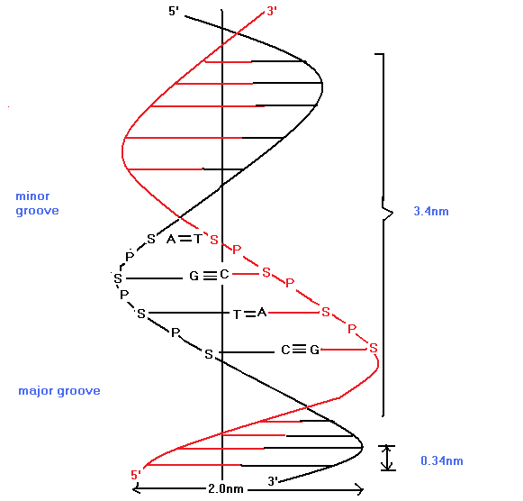
WATSON CRICK MODEL OF DNA HELIX

Slide 46
the diameter of the helix is 20Å.
One complete turn(pitch) of the helix measures 34Å. Every turn contains 10 nucleotide residues. So, distance between adjacent bases/nucleotides is 3.4Å.
Two chains are held together by Hydrogen bonds between complementary base pairs.
Adenine is always paired with Thymine by two hydrogen bonds. Guanine always pairs with Cytosine by three hydrogen bonds.

Slide 47
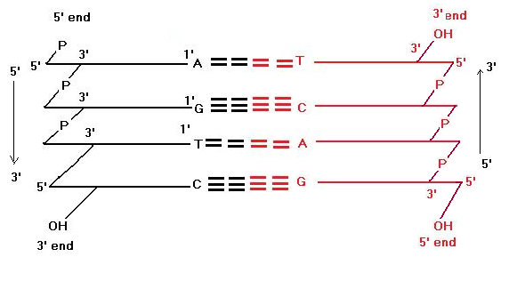
Complementary Base Pairing in DNA helix

Slide 48
The ratio of purine & pyrimidine bases in a DNA molecule is always 1. (Chargaff’s rule).
The glycosidic bonds between sugar & bases are not exactly opposite each other. So, grooves of unequal widths form around the double helix.(major groove & minor groove).

Slide 49
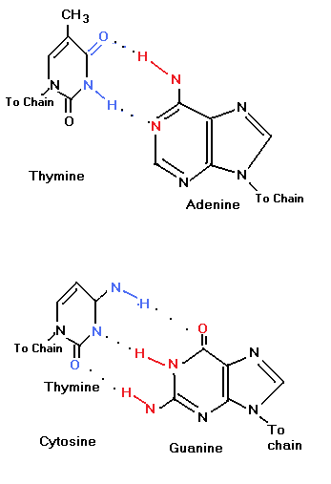
T pairs with A by 2 H-bonds
C pairs with G by 3 H-bonds
COMPLEMENTARY BASE PAIRING IN DNA

Slide 50
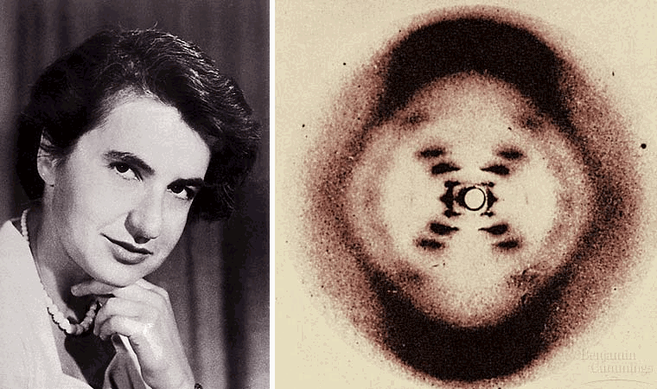
Wilkins & Franklin (1952): X-ray crystallography

Slide 51
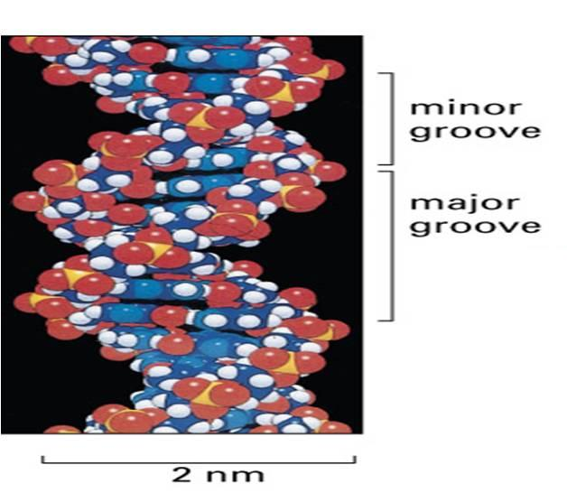

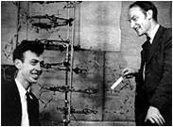
SPACE FILLING 3-D REPRESENTATION OF WATSON & CRICK MODEL OF DNA

Slide 52
DNA structural polymorphism:-
DEPENDING ON DIFFERENT PHYSICAL CONDITIONS AND BASE COMPOSITION(X-Ray crystallography)
DNA can exist in three structural forms:-
A-DNA.
B-DNA(Watson Crick model)
Z-DNA
A and B are right handed helices. Z-DNA is a left handed double helix.
Under physiologic conditions, DNA is entirely of B-form.

Slide 53
HIGHER ORDER OR TERTIARY STRUCTURE OF DNA
DNA molecules are either linear (in humans) or circular (in prokaryotes).
Length of a linear DNA molecule ~ 1.74 metres.
Supercoiling (positive or right handed, negative or left handed) occurs to make it compact.

Slide 54
Organisation of DNA in the cell :-
In prokaryotes, DNA is organised as a single chromosome in a double stranded circular form.
In eukaryotes, DNA is associated with proteins to form chromatin. Chromatin organised into chromosomes.
Double helical DNA and core protein together constitute a nucleosome, the basic unit of chromatin.

Slide 55
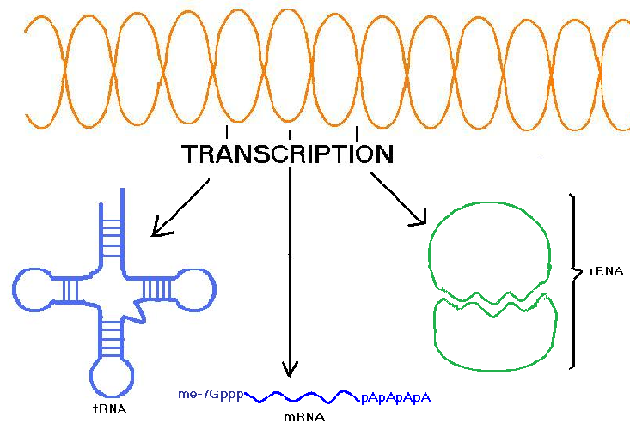
DNA
EXPRESSION OF GENETIC INFORMATION

