Slide 1
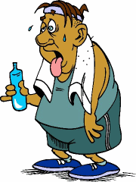
Diabetes
Trushna Shah

Slide 2
def--- it is a metabolic disease due to absolute or relative insulin deficiency.
it is a major cause of morbidity and mortality.
about 10% of total population suffer from this disease.

Slide 3
Diabetes
Prevalence of Diabetes: 25.8 million adults in the US – 8.3%. UK rates are around 3.5-5.0%
Metabolic Syndrome: Risk factors related to obesity.
Type I: Beta cells produce little or no insulin.
Type II: Fat, Liver, and muscle cells do not respond to insulin (insulin resistance)
Gestational Diabetes: High sugars in Preg.

Slide 4

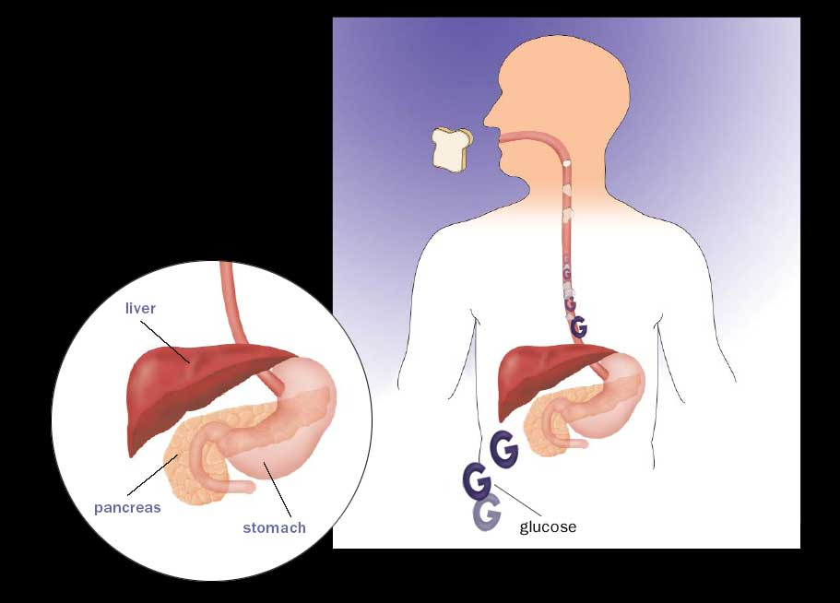

Pathophysiology of Diabetes
When you eat, your body breaks food down into glucose. Glucose is a
type of sugar that is
your body’s
main source
of energy.
6

Slide 5
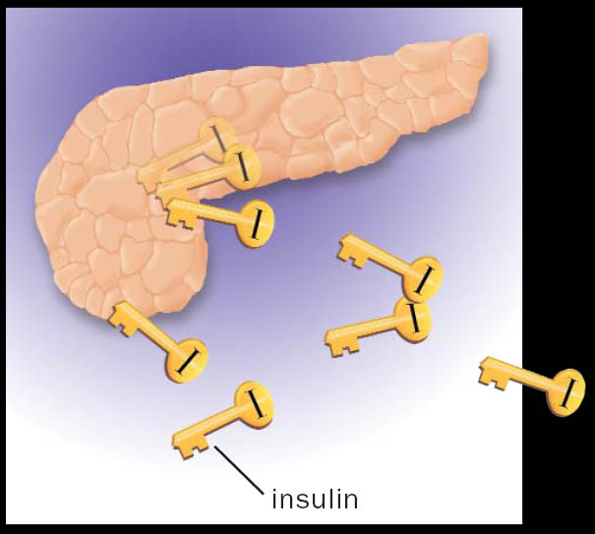

Pathophysiology of Diabetes
As blood glucose rises, the body sends a signal to
the pancreas, which releases insulin.
7

Slide 6
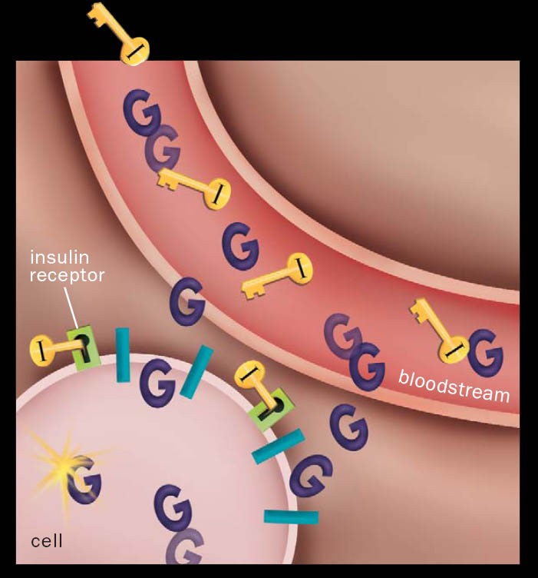

Pathophysiology of Diabetes
Acting as a key, insulin binds to a place on the cell wall (an insulin receptor), unlocking the cell so glucose can pass into it. There, most of the glucose is used for energy right away.
7

Slide 7
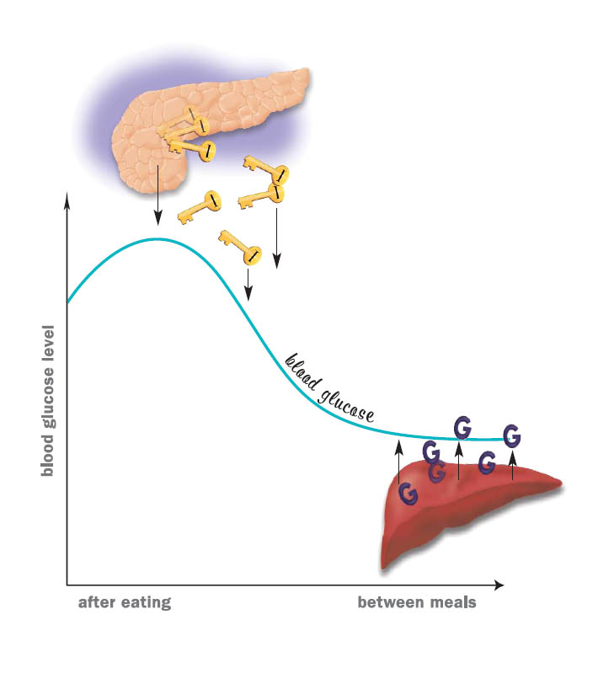
Blood glucose regulation
Blood glucose goes up and down throughout the day:
As your blood glucose rises
(after a meal), the
pancreas releases insulin.
8

Slide 8
TYPES
A. Diabetes incipidus -- ADH
B. Diabetes mellitus --
Type -1 – Insulin dependent diabetes melliris
Type -2 non Insulin dependent.
c. gestational diabetes.-- during pregnancy.

Slide 9
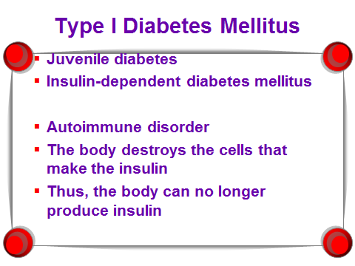

Slide 10
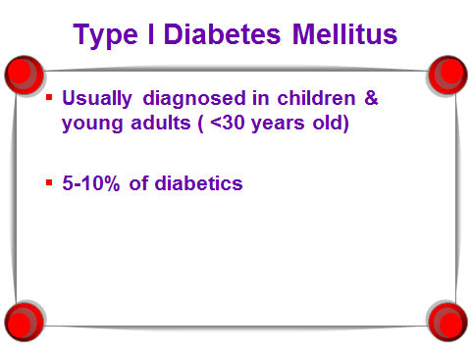

Slide 11
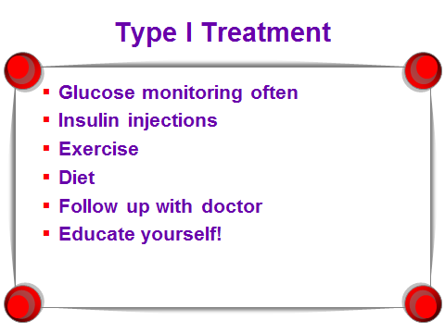

Slide 12
Type II (adult) (non-insulin dependent, NIDDM) – 90%
  decreased insulin production or ineffective use of insulin produced due to insulin resistance. Due to genetics somewhat but mostly lifestyle; obesity, inactivity.

Slide 13
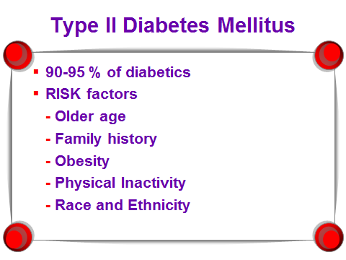

Slide 14
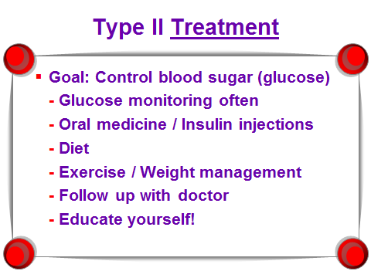

Slide 15
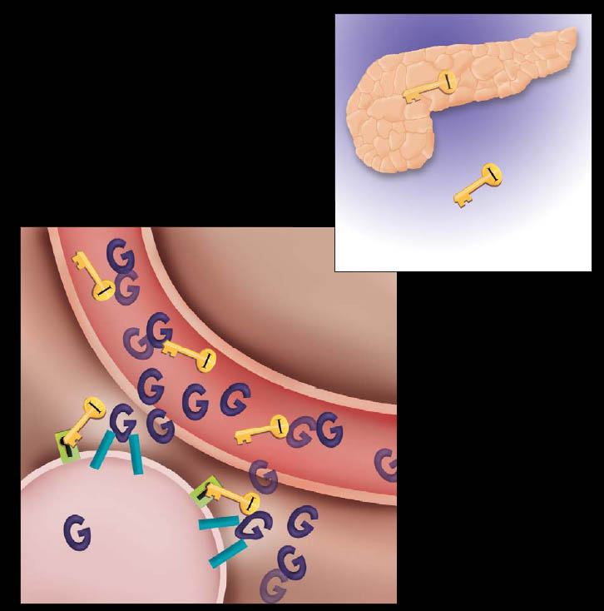
Type 2 diabetes
Your pancreas may not produce enough insulin (insulin deficiency).
Your cells don’t use insulin properly. The insulin can’t fully “unlock” the cells to allow glucose to enter (insulin resistance).
13

Slide 16
Natural History of Diabetes

Slide 17
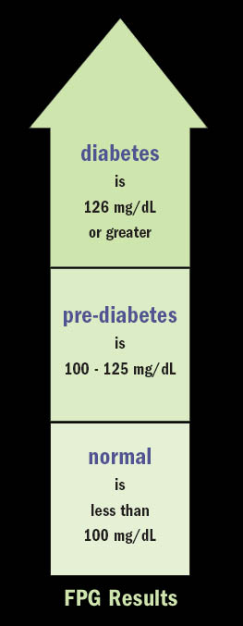
Diagnosing diabetes
Fasting plasma glucose test (FPG) results
diabetes
126 mg/dL or greater
pre-diabetes
125 mg/dL to 100 mg/dL
normal
less than 100 mg/dL
28

Slide 18
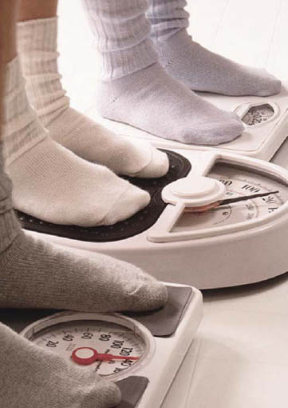
Risk factors for type 2 diabetes
Type 2 is more common in people who:
Are overweight.
Are 45 or older.
Are physically inactive.
Have a parent or sibling with type 2 diabetes.
Are African American, Native American, Hispanic American, or Pacific Islander.
Have abnormal cholesterol levels.
Have had gestational diabetes, or given birth to a baby greater than 9 lbs.
Have high blood pressure.
14

Slide 19
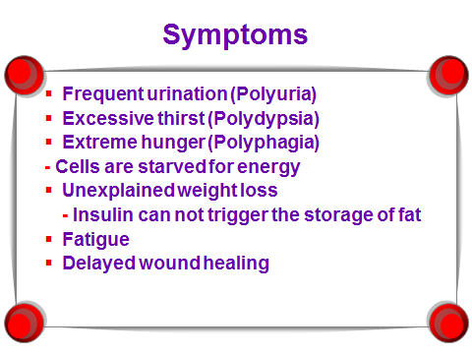

Slide 20
Author/year | Study design | Level | Results | Outcome
Diabetic control and coronary artery bypass: effect on short-term outcomes. Asian Cardiovasc Thorac Ann. 2013 Jun;21(3):281-7. doi: 10.1177/0218492312451983. Strahan S¹, Harvey RM, Campbell-Lloyd A, Beller E, Mundy J, Shah P. Author information | Cohort study | 3 | Data of 3857 patients undergoing primary coronary artery bypass grafting was prospectively collected and retrospectively analyzed. The preoperative risk factors of hypertension (p < 0.001), hyperlipidemia (p < 0.001), renal failure (p < 0.04), peripheral vascular disease (p < 0.001), and chronic obstructive pulmonary disease (p < 0.04) were significantly more prevalent in diabetic patients. Major complications were not significantly different between the diabetic and control groups (p = 0.33), but minor complications were less frequent in diabetic patients (p = 0.03). | Short-term outcomes were not affected by the degree of preoperative glycemic control or type of treatment used in diabetic patients undergoing primary coronary artery bypass grafting. A plausible explanation is strict protocol-driven glycemic control in the perioperative period.

Slide 21
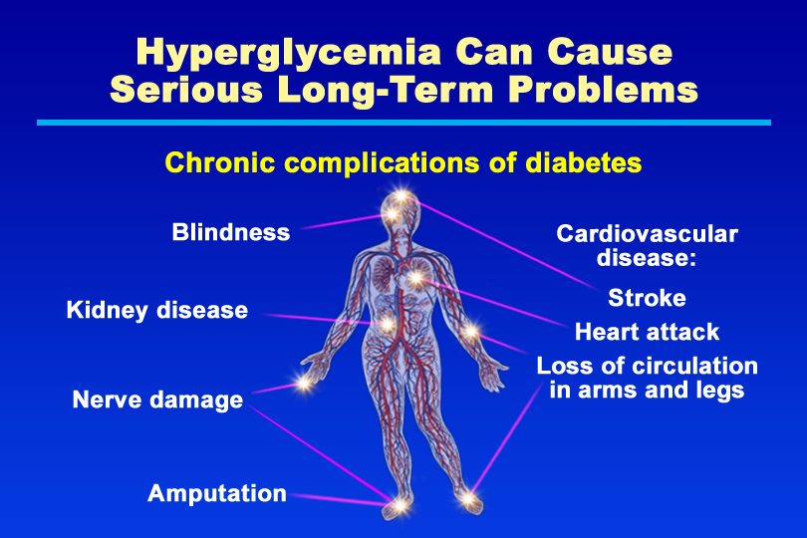
Hyperglycemia Can Cause Serious Long-Term Problems

Slide 22
Blood Glucose Targets for Adults
Pre-meal or fasting: 80-120
2 hours post-meal:
80-140
Bedtime: 80-140 or 100-140

Slide 23
When & How Often
Should I Be Testing?
On insulin: 4 times per day.
Not on insulin: 2 times per day.

Slide 24
Test at Alternating Times of the Day
Before or 2 Hours After Eating
Day of the week
Breakfast
Lunch
Dinner
Bedtime
Mon.
X
X
Tues.
X
X
Wed.
X
X

Slide 25
Meal plan works like this
Maximum
CHO
Breakfast
Lunch
Dinner

Slide 26
Meal plan works like this
CHO
CHO
CHO
Breakfast
Lunch
Dinner

Slide 27
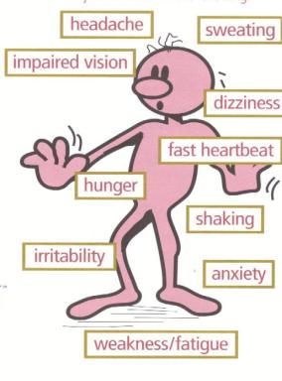
Hypoglycemic Symptoms

Slide 28
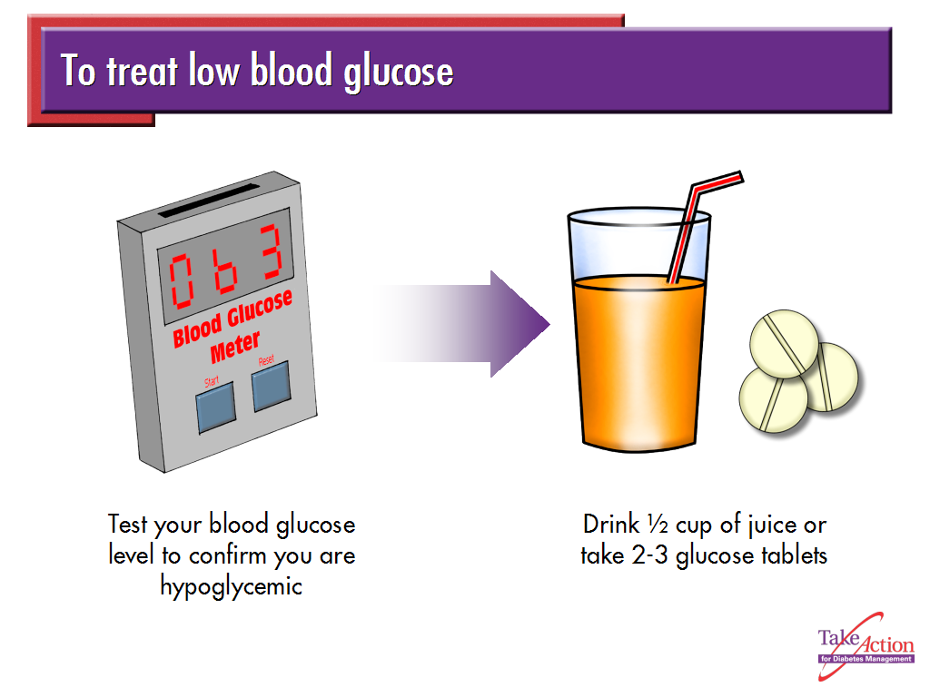

Slide 29
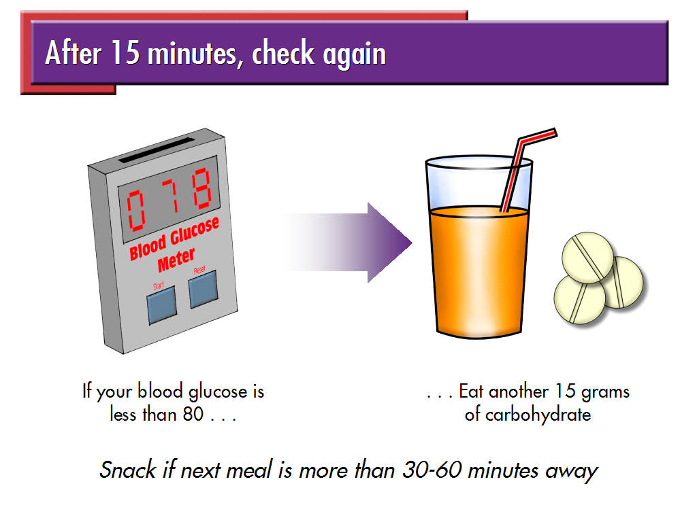

Slide 30

How to care for yourself when you’re hypoglycemic
Eat or drink 15 grams of fast-acting,
low-fat carbohydrate right away.
Quick energy sources
The following items are quick energy sources that contain about 15 grams of carbohydrate:
½ cup fruit of orange, apple, or grapefruit juice
1/3 cup grape, prune, or cranberry juice
2 tbsp raisins
6 crackers
3-5 pieces hard candy
1 cup skim milk
1 piece bread
3-4 glucose tablets, or 1 tube glucose gel
½ cup regular soft drink (not diet)
11 jellybeans
96

Slide 31
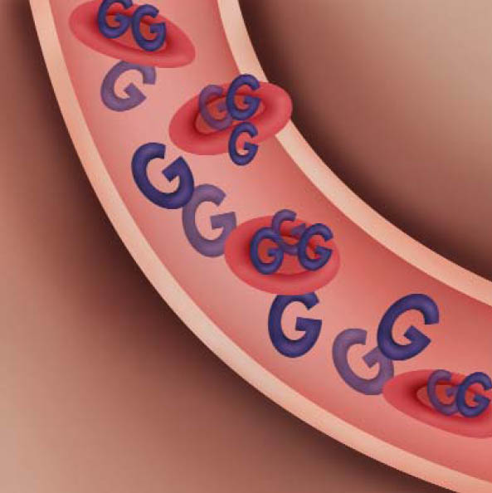
HbA1c: the blood test with a memory
What is HbA1c?
Hemoglobin is a protein that makes your red blood cells red-colored.
When hemoglobin picks up glucose from your bloodstream, the hemoglobin becomes glycosylated.
Glycosylated hemoglobin is HbA1c. The HbA1c test measures the percentage of HbA1c in your blood—
a number that corresponds to your average blood glucose for the previous 3 months.
HbA1c in your bloodstream.
45

Slide 32
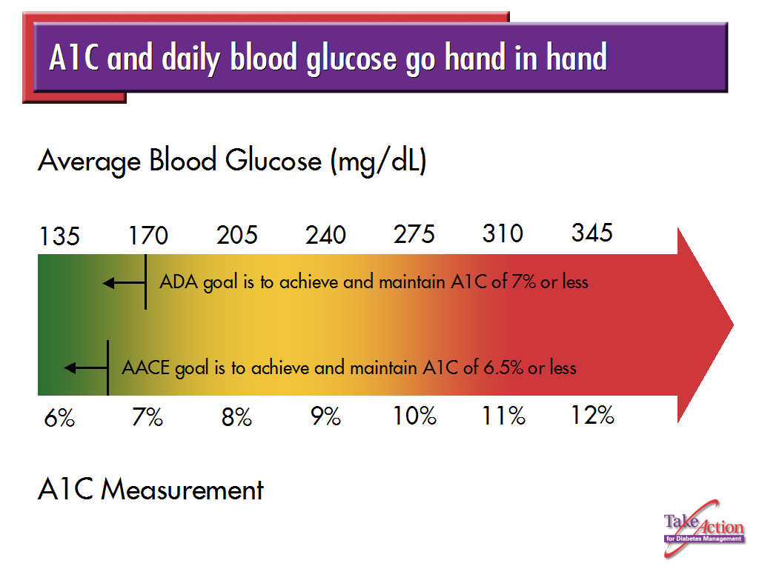

Slide 33
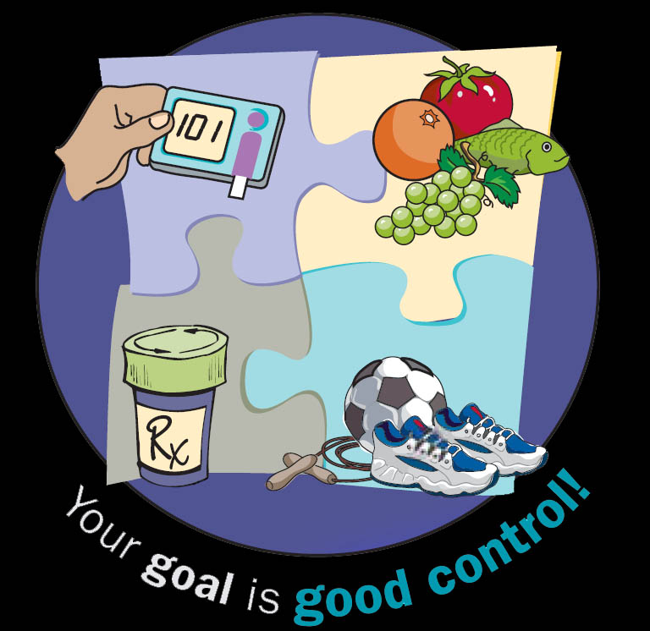
Introduction to self-management
Key pieces of diabetes self-management:
Following a meal plan
Monitoring blood glucose
Getting regular exercise
Taking medication
34

Slide 34
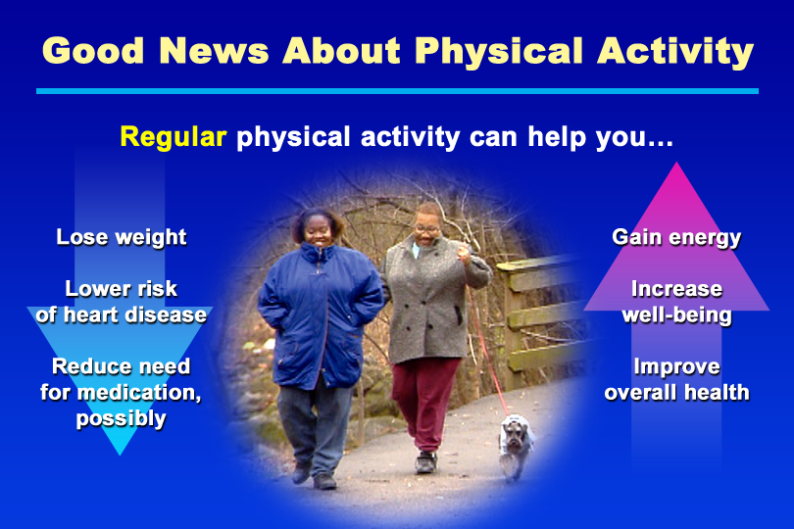
Good News About Physical Activity

Slide 35
Can’t exercise?
Pools
Exercise balls or exercise bands
Walking tape
Stationary bikes
Exercise videos
Yoga
Local Recreation Centers or school facilities
TV Programs like: “Sit and Be Fit” M,W, F at 8:30AM on channel 9

Slide 36
Exercise is boring.
Vary your routine and don’t be afraid to try something new.
Participate in things you like to do.
Exercise with a friend
Use music or books on tape to make the time pass more quickly.

Slide 37
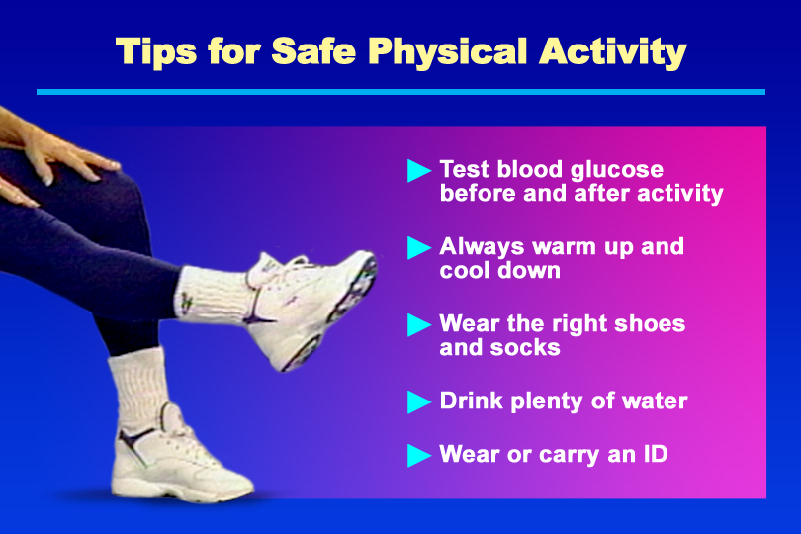
Tips for Safe Physical Activity

Slide 38
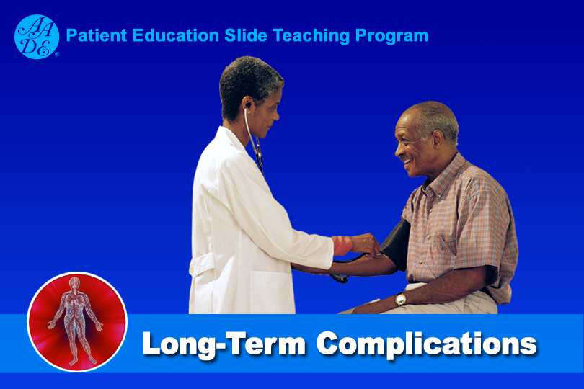
Long-Term Complications

Slide 39
Hyperglycemia Can Cause Serious Long-Term Problems

Slide 40
Diabetes-CVD Facts
Nearly all adults with diabetes have one or more cholesterol problems, such as:
  high triglycerides
  low HDL (“good”) cholesterol
  high LDL (“bad”) cholesterol
4

Slide 41
ABC’s
A – A1c, or hemoglobin A1c test.
      ADA goal is 7% or less.
      AACE goal is 6.5% or less.
B – Blood pressure
      < 130/80 mmHg for non-pregnant adults.
C – Cholesterol
      HDL (good) cholesterol – <40 mg/dl (men); <50 mg/dl (women)
      LDL (bad) cholesterol – <100 mg/dl
      Triglycerides – <150 mg/dl

Slide 42
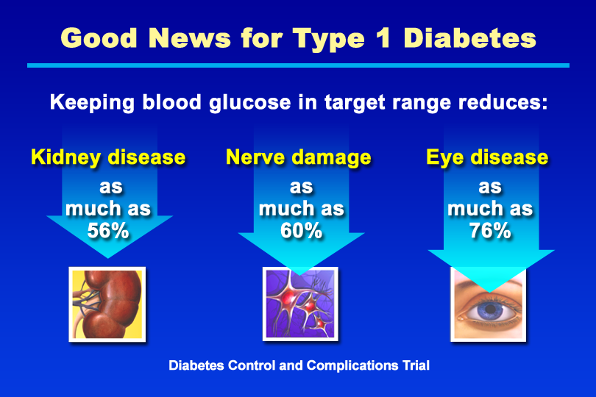
Good News for Type 1 Diabetes

Slide 43
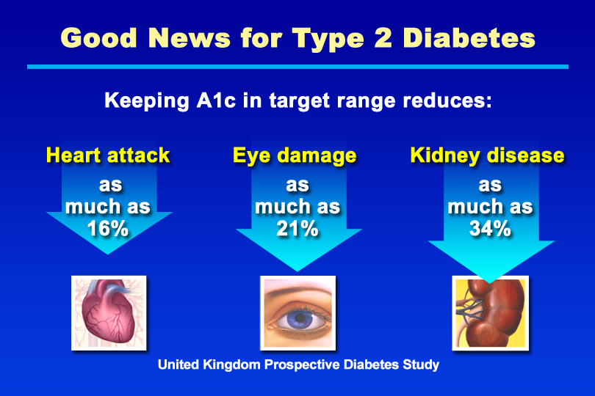
Good News for Type 2 Diabetes

Slide 44
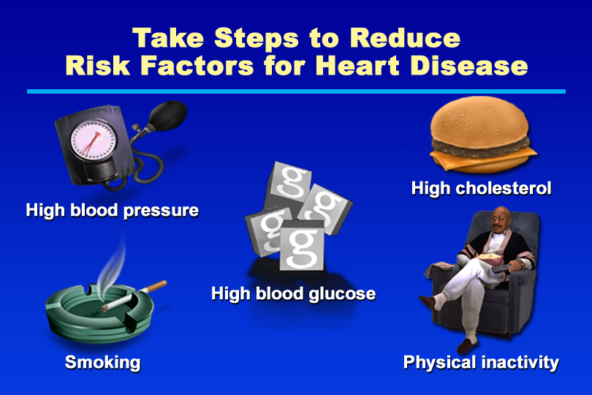
Take Steps to Reduce Risk Factors for Heart Disease

Slide 45
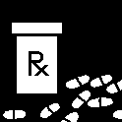
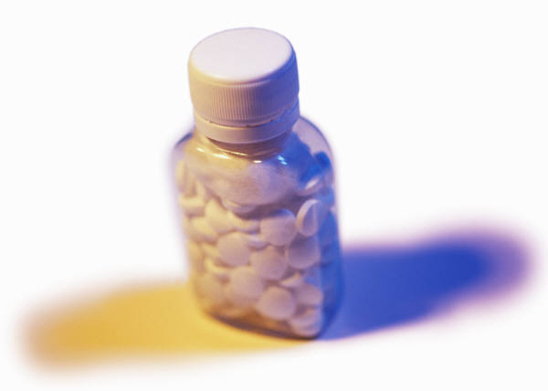
Aspirin Therapy
Recommended dose: 81-325 mg /day
Should not be used in people with: Aspirin allergies, a history of gastric bleeding, clotting disorders, or people already taking a blood-thinning agent.

Slide 46
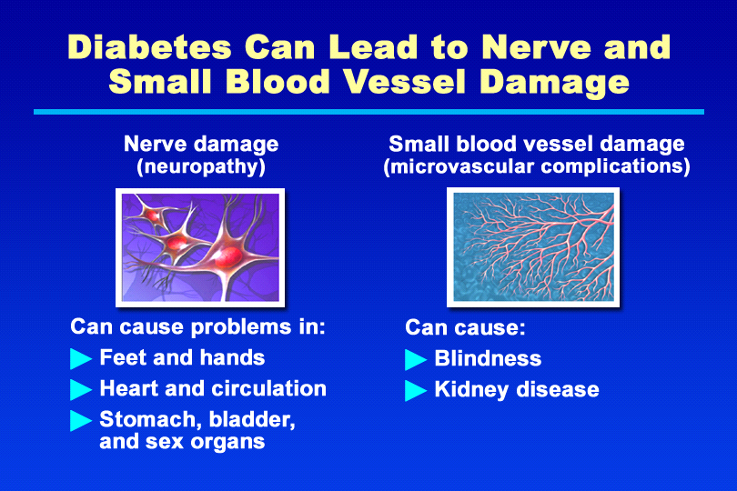
Diabetes Can Lead to Nerve and Small Blood Vessel Damage

Slide 47

THANK YOU

