Slide 1
COMMON POISONINGS IN CHILDREN
By
Dr Hemal Dave
SBKS MIRC

Slide 2
Approach to poisoned child
Kerosene poisoning
Acetaminophen poisoning
Organophosphorus poisoning
Lead poisoning
Case presentation

Slide 3
Introduction
Poisoning represents one of the most common medical emergencies encountered by young children and adolescents.
Young children aged 1 to 5 years who innocently ingest a small amount of a single substance constitute the first group .Those at higher risk include male gender, hyperactivity and increased finger mouth activity or pica
The second group of children , which is more prone to poisoning, includes adolescents who purposefully ingest larger amounts of one or more substances because of emotional or psychiatric distress.

Slide 4
Approach to poisoned child
Primary management – aims at supporting vital functions
Secondary management – evaluation, decontamination, neutralization with supportive care

Slide 5
Basic elements of medical management involve
Support vital functions
Identify agent (when possible)
Remove, neutralise or reverse the effects of poisons
Hastening elimination of toxin
Treat damaged/ poisoned organs/systems & prevent further damage whenever possible

Slide 6
1. Support Vital Functions
Airway
Breathing
Circulation
Glassgow coma scale GCS
Aim is to treat the patient, not the poison.

Slide 7
2. Identify the agent
From history :
* Type of toxic exposure
* Form of toxin (solid, liquid, gas)
* Route (oral, inhalation)
* When did it occur ?
* How long the exposure ?
* Were other people exposed ?
* Any underlying medical condition/ medications used ?

Slide 8
TOXIDROMES
The constellation of signs/ symptoms due to poisoning is known as Toxidrome.
Rely on readily observable findings:
      Eyes
      Skin
      Secretions
      Vital signs

Slide 9
Traditional toxidrome
CHOLINERGIC
ANTICHOLINERGIC
OPIODS
SYMPATHOMIMETIC

Slide 10
Sympathomimetic toxidrome
Clinical indicator | findings
Heart rate | fast
Blood pressure | high
Cardiac rhythm | Sinus tachyarrythmia
Respiratory rate | Normal to high
Temperature | Normal to high
Eyes | Mydriatic
skin | Normal to diaphoretic
secretions | normal

Slide 11
Anticholinergic toxidrome
Clinical indicator | findings
Heart rate | fast
Blood presssure | high
Cardiac rhythm | fast
Respiratory rate | Normal to high
temperature | high
eyes | mydriatic
skin | dry
secretions | dry

Slide 12
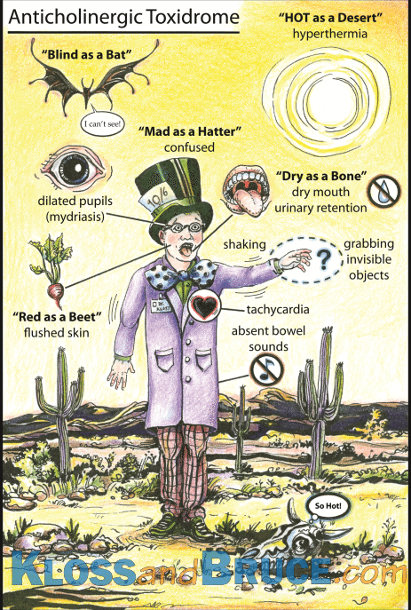

Slide 13
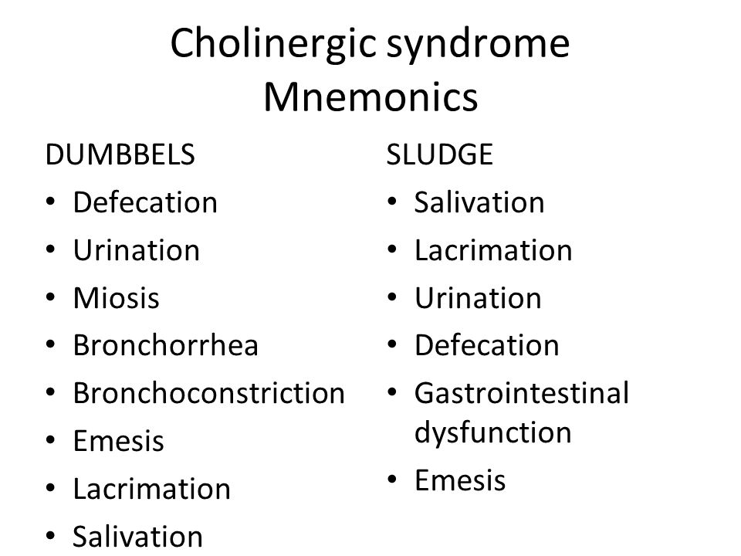

Slide 14
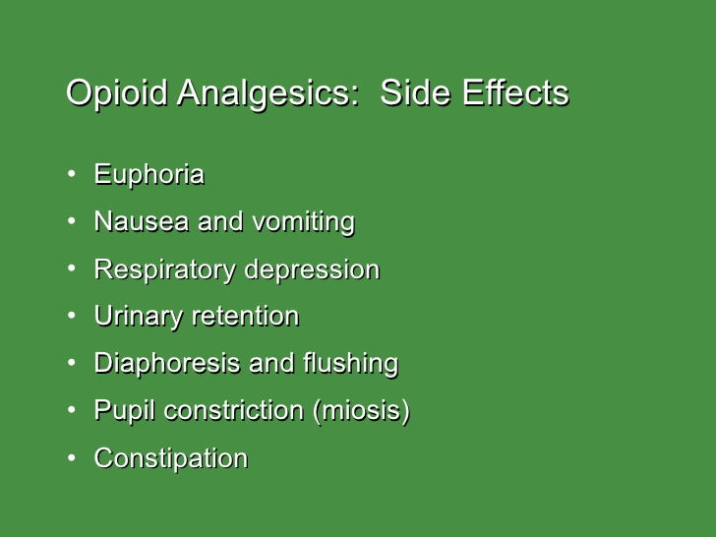

Slide 15
Toxidromes-review
Tosin | HR/BP | Resp | Temp | Eyes | Skin/Secreation | Mental status
Sympathomimetic |  |  |  |  | Diphoretic | Agiteted
Anticholinergics |  |  |  |  | Dry | Agiteted
Cholinergics |  |  |  |  | Copiously wet | Somnolent
Sedative-hypnotic |  | --or | -- | -- | Normal | Somnolent coma
Opiods |  |  | -- |  | -- | Somnolent coma

Slide 16
3. Remove, Neutralize/ Reverse Effects
Gastrointestinal Decontamination (GID)
Hastening the excretion of toxin
Use of appropriate antidote
GID includes :
1. Syrup of Ipecac (Not commonly used)
2. Gastric lavage
3. Activated Charcoal
4. Whole bowel irrigation

Slide 17
Gastric Lavage
It is an alternate technique for stomach emptying that theoretically allows direct irrigation and removal of unabsorbed toxin from the stomach.
Before gasrtic lavage the gag reflex of the child should be evaluated. If it is absent, endotracheal tube should be done before passing the lavage tube to protect the airway.
Patient should be placed in left lateral position.
Gastric lavage maybe done with 0.9% saline or tap water in 15ml/kg cycles until the lavage fluid is clear.

Slide 18
Indication : patients who ingest highly toxic substances and
are brought to the emergency department soon after ingestion.
Contraindications : it includes corrosive poisoning (acid as well as alkali) and hydrocarbon ingestion.

Slide 19
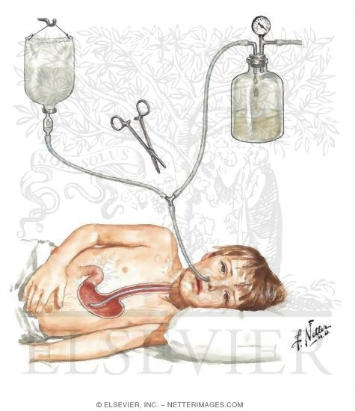

Slide 20
Activated Charcoal
Charcoal is produced from wood, coconut, petroleum or other organic material, which is heated to approx. 900 degree C with steam and carbon dioxide in the activation process. This increases the surface area of charcoal, removes previously absorbed materials and reduces the partical size.
Net result is the marked increase in total adsorbtive surface area as high as 1600-1800m2/g.
Recommended dose is 1-2 g/kg.
Activated carbon should be given as premixed slurry with or without a laxative.

Slide 21
Drugs for which multiple dose charcoal has been shown to be effective are carbamazepine, barbiturates, phenytoin, digitoxin, dapsone, methotrexate, nadolol, quinine, theophylline, salicylates, amitriptyline and many others.

Slide 22
Whole Bowel Irrigation
It is an electrolyte balanced, non-absorbable solution to cleanse the bowel in preparation for elective surgery or colonoscopy.
Solution most commonly used is, polyethylene glycol.
This therapy has been found to be effective in the overdose of iron and sustained release theophylline. Also effective in cocaine and heroin body stuffers.
Dose is 25-40ml/kg/h.
Clear contraindication to the use of WBI includes bowel obstruction, perforation, ileus.

Slide 23
Hastening elimination of toxin
Diuresis and alkanization
Forced diuresis is usually ineffective treatment for most poisonings.
Maintaining an adequate output of alkaline urine is useful to enhance the excretion of salicylates and phenobarbitone. The urinary pH should be maintained between 7 and 8.
Hemodialysis : For dialysis to be effective, toxin must be of low molecular weight<500 relative molecular mass and highly water soluble.

Slide 24
Kerosene poisoning
Introduction
Kerosene is an aliphatic hydrocarbon
Most commonly ingested in Indian children especially below 5yrs of age.
Easy accessibility and improper storage.

Slide 25
Pathophysiology
Viscosity or resistance to flow determines the aspiration potential of a hydrocarbon. Aspiration is inversely related to viscosity.
Kerosene has low viscosity(60 saybolt universal seconds) and high volatilty-high aspiration potential.
Because of its high volatility, it displaces the alveolar gas and interfere with ventilation and CNS depression
Due to decrease in surface tension , it enhances spreading of liquid on lung tissue and areas of atelectasis may develop.

Slide 26
Pulmonary toxicity
Due to hydrocarbon aspiration
Fatal chemical pneumonitis
Loss of surfactant causes decrease in surface tension ,poor oxygen exchange and atelectasis.
May lead to air trapping phenomenon like emphysematous changes, pnuematoceles , pneumothorax and pneumomediastinum.

Slide 27
CNS Toxicity
Kerosene being highly lipid soluble and neurons have high lipid content so causes direct CNS toxicity in form of CNS depression,weakness, ataxia, cognitive impairement and ventilatory drive.

Slide 28
Fatal dose
Ingestion of 10-15ml of kerosene may be fatal, although recovery has been seen following ingestion of 200-250ml.

Slide 29
Clinical features
Earliest signs involve choking, gaging, coughing and gasping respiration.
Local effects- burning sensation, abdominal pain, loose stools.
Vomiting may occur as kerosene is highly irritant and may cause aspiration.
Cyanosis and tachypnea may develop which may progress to severe respiratory distress in the form of nasal flaring, grunting and retractions.
Headache, ataxia, weakness, blurred vision and lethargy may occur.

Slide 30
Vitals
Fever (38-39 degree Celsius)
Persistence beyond 48hrs suggestive of bacterial superinfection
Decreased spO2.

Slide 31
Laboratory investigations
Chest X ray- usually significant within 6-8hours. Earliest changes may be seen within 30 minutes.
X ray findings :
bilateral, fine mottled densities usually perihilar and in mid lung region.
Hyperinflation, emphysematous changes
2) ABG- hypoxemia and normal Co2 initially and if CNS depression is marked, hypercarbia may develop rapidly.
3) CBC- leukocytosis may occur within 1 hr of ingestion and may be misleading for infections.

Slide 32
Management
PRIMARY MANAGEMENT
Maintaining airway, breathing and circulation.
Children are at increased risk of aspiration because of low viscosity and high volatility of kerosene.RT should never be inserted in kerosene poisoning patients.
If child has mild respiratory symptoms,only oxygen to correct hypoxemia may be given.
Endotracheal intubation is indicated if child develops severe respiratory distress or neurologicaly depressed.

Slide 33
Secondary management
Evaluation phase:
Brief evaluation of patient done to determine potential severity of toxin exposure.
Detailed examination of respiratory ,CNS ,changes in skin and mucous membrane and odors.
2) Detoxification phase
Involves removal of kerosene from the body by cutaneous and gastrointestinal decontamination.
Any part of the skin exposed to kerosene must be thoroughly washed with soap and water as it is highly irritant to the skin.
Gastric lavage is contraindicated in kerosene poisoning as it increases the risk of aspiration.

Slide 34
3) Supportive care
Care for respiratory signs and symptoms, level of consciousness, urine output and fluid and electrolyte status.
Antibiotics are usually not indicated and should not be given prophylactically.
Prognosis:
If the child improves from the immediate hospitalisation of aspiration, the prognosis is good.

Slide 35
ACETAMINOPHIN POISONING
Acetaminophin is widely used antipyretic and analgesic.

Slide 36
PATHOPHYSIOLOGY
Acetaminophen
Mainly metabolised through
Glucornidation
Sulfation
5% metabolise by cytochrome p-450
NAPQI (N acetyl P benzoquinone imine
Glutathione(detoxifies NAPQI)

Slide 37
NAPQI is a toxic metabolite .
When hepatic stores of glutathione are depleted, the toxic metabolite binds with hepatic macromolecules and cause hepatic necrosis.
Fatal dose
Level of 150microgm/ml at 4hrs after ingestion is considered hepatotoxic.
Single acute ingestion of 250mg/kg may develop hepatotoxicity.
Normal recommended therapeutic levels-15mg/kg every 4 hrs(max 6omg/kg/day)

Slide 38
Clinical features
Presents with features of hepatic cell damage ,renal tubular necrosis, and hypoglycemic coma.
There are 4 stages of toxicity.
Stage I- lasts for first 24hrs after ingestion
Child presents with anorexia, nausea ,vomiting, malaise, pallor.
Laboratory investigations such as ALT, AST, serum bilirubin and prothrombin time are normal in this stage.
Stage II- lasts for next 24hrs after stage I.
Resolution of symptoms of stage I with upper quadrant abdominal pain and tenderness.
Mild hepatomegaly and jaundice present
Elevated ALT,AST and prothrombin time.

Slide 39
Stage III-seen 48hrs to 96hrs of ingestion.
Maximum liver function abnormalities seen.
Elevated transaminases( 1000iu/l), serum bilirubin>4mg/dl and prolonged prothrombin time indicators of severe toxicity.
Less than 1 percent develop fulminant hepatotoxicity and dies of hepatic failure .
Stage IV- stage of resolution and extends from 4 days to 2 weeks.
Resolution of hepatic dysfunction although AST may remain elevated

Slide 40
Diagnosis
History of ingestion
Clinical features
Laboratory investigations
      Plasma AST levels greater than 1000IU/l.
      Serum bilirubin > 4mg/dl
      Prolonged prothrombin time

Slide 41
Management
Assessment
Acetaminophen alone does not produce any alteration in the sensorium in first 24hrs and usually does not produce encephalopathy. Thus if any patient comes with significant change in sensorium some other agent should be considered in addition to acetaminophen.
General measures
Gastric lavage must be done with normal saline
Activated charcoal is effective in adsorbing acetaminophen( maximal effects within 30 minutes of ingestion)

Slide 42
Specific measures
Antidote- N acetyl cysteine
Mechanism of action- improvement of renal blood flow and glutathione replenishment
Oral dosage 140mg/kg body wt as loading dose followed by 70 mg/kg at 4 hourly intervals for an additional 17doses.
If the patient vomits within an hr of administration, the dose should be repeated.
Maximum effective within 10hrs of ingestion and less effective thereafter.

Slide 43
N acetyl cysteine is given with citrus fruit juices or carbonated beverages because of its unpleasant odor and frequent vomiting.
Anaphylactoid reactions such as angioodema , flushing, hypotension, hypokalemia , tachycardia, rashes, bronchospasm may occur 15-60 minutes after n acetyl infusion in 10% patients.
NAC contraindicated in patients who have developed hepatic failure. Such patients should be managed with lactulose, vit k, 20 % mannitol and appropriate iv fluids.

Slide 44
Prognosis
Poor prognostic factors in PCM induced hepatic failure are:
pH below 7.3
serum creatinine >3.4mg/L
prothrombin time >100sec in grade III to IV encephalopathy

Slide 45
ORGANOPHOSPHORUS(OP) POISONING

Slide 46
INTRODUCTION
OP compounds account for 80% exposure to insecticides.
They are the most widely used pesticides today (agriculture, industry, the home, gardens and veterinary practice).
The most toxic compound include parathion, mevinphos and disulfoton.

Slide 47
PATHOPHYSIOLOGY
OP INHIBITES ACETYLECHOLINESTERASE
ACCUMULATION OF ACETYLECHOLINE
CENTRAL NERVOUS SYSTEM
PERIPHERAL NERVOUS SYSTEM
NEUROMUSCULAR JUNCTION
NEUROTOXICITY
CLINICAL MENIFESTATION
INITIAL CHOLINERGIC CRISIS
INTERMEDIATE SYNDROME
DELAYED POLYNEUROPATHY

Slide 48
CLINICAL FEATURES
OP compounds are efficiently absorbed from the skin, lungs and GI tracts.
Clinical features depends on nature, type of OP compounds, degree and route of exposure, lipid solubility and metabolic degradation.
Most patients becomes symptomatic after 12 hours of exposure.
The quickest symptoms occur with inhalation followed by GI absorption and dermal exposure, with respiratory symptoms being the most critical.

Slide 49
ACUTE EFECTS OF INITIAL CHOLINERGIC CRISIS
MUSCARINIC EFFECTS | NICOTINIC EFFECTS | CNS EFFECTS
SLUDGE-salivation, lacrimation, urination, diarrhoea,gi upset, emesis | Skeletal muscle fasciculation, fatigue, paralysis, respiratory muscle weakness, diminished respiratory efforts | Anxiety, restlessness, delirium, psychosis, headache, dizziness, ataxia, seizures, insomnia, dysarthria, tremors, central respiratory paralysis, hypotonia, cardiovascular depression and coma
BBB-bronchorrhea, bronchospasm, bradycardia | Sympathetic ganglia tachycardia, hypertension, pallor and hyperglycemia
DUMBELS-diaphoresis and diarrhoea, urination, miosis, bradycardia, bronchospasm, bronchorrhea, emesis, lacrimation, salivation

Slide 50
DELAYED EFFECTS
INTERMEDIATE SYNDROME
It occurs after resolution of acute severe cholinergic crisis.
It generally occurs 24-96 hrs after exposure.
This syndrome lacks muscarinic type symptoms.
It primarily involves acute respiratory and muscular paresis, especially proximal limb muscles and those of the face and neck flexors, and also include cranial nerve palsies and decrease deep tendon reflexes.
It tends to occur in patient with prolonged exposure prior to the treatment.

Slide 51
It may persist for 4 to 18 days, can require intubation, and can be complicated by infection or cardiac arrhythmias.

Slide 52
OP compound induced delayed polyneuropathy (OPIDP)
It occurs 2-3 weeks after exposure of large doses of certain OP.
Patient may have persistent CNS effect like weakness, lethargy, fatigue and memory loss.
Distal muscle weakness with relative sparing of the neck muscles, cranial nerves and proximal groups characterised OPIDP.

Slide 53
DIAGNOSIS
Depression of plasma pseudocholinesterase and/or RBC acetyle cholinesterase enzyme activities are the generally available biochemical indicators of excessive OP absorption.
Other supportive laboratory test includes chest xray, s.electrolytes, BUN, s.creatinine, CBC, ABG and ECG.
Many retrospective studies have shown that prolonged QTc interval is the most common ECG abnormality.

Slide 54
Management
Maintaining airway, breathing and circulation.
Decontamination – washing whole body with soap and water and replacing clothes worn by patient with fresh ones. Special care should be given washing skin creases around the ears and external auditory canal around umbilicus and genitalia and nails.
Gut decontamination achieved by gastric lavage. If done within an hour, maximum effect attained.

Slide 55
Antidotes
Atropine
it antagonises the central and muscaranic cholinergic effects and acts by blocking the muscaranic receptors.
Dose of atropine is 0.05 mg/kg iv every 5 minutes till signs of atropinisation appear ie dryness of mouth, no bronchial secretion and no bradycardia.
after proper atropinisation is established, maintenance doses are given to keep tracheobronchial tree dry for 24hrs.

Slide 56
Pralidoxime
It neutralises the nicotinic effects of OPC .
Within 24-48hrs of organophospahte binding to AChE, some phosphorylated AChE can be dephosphorylated by the oxime antidote 2-PAM.
WHO recomends 25 to 50mg/kg in normal saline over 30 minutes followed by 10 to 20mg/kg/hr.
Dosage:
<12yr old child- 20-50mg/kg iv over 30 minutes
>12yr old child- 1-2gm by infusion over 30minutes.
Dosage may be repeated in 1-2hours, then at 6-12hour interval.
Continuous infusion may be needed until recovery is observed in dose of 8mg/kg/h for atleast 24hrs.

Slide 57
Common side effects of 2 PAM are hypertension, blurred vision and dizziness.
Glycopyrrolate
It is quaternary ammonium compound used as an alternative to atropine since adverse effects are less.

Slide 58
Lead poisoning(Plumbism)
It is a heavy metal.
Main source of lead poisoning involve paints from walls of old houses, ingesting paint chips(pica), food and water stored in lead containers and storage batteries.
Who is at high risk?
All children under the age of 6years old.
People living in old houses.

Slide 59
Pathophysiology
Lead is highly reactive divalent cation with marked affinity for the sulfydrl group.
It exerts its toxic action on mitochondrial function where it interferes with oxidative phosphorylation.
Lead interferes with DNA transcription, enzymes that help in the synthesis of vitamin D, and enzymes that maintain the integrity of the cell membrane.
It also interferes with metabolism of bones and teeth.
It may also be harmful to the developing immune system.
The target tissues involved are bone marrow, renal tubular cells and cells of central and peripheral nervous system.

Slide 60
FATAL DOSE
Lead acetate 20gm
Lead carbonate 30gm

Slide 61
Clinical features
Acute toxicity: abdominal colic, constipation,fatigue, anemia, peripheral neuropathy .
Severe cases may present as acute encephalopathy with coma, convulsions, papillodema.
Subclinical toxicity: it denotes that relatively low dose exposure to lead can cause harmful effects.
Impaired biosynthesis of heme, slowed nerve conduction and altered excretion of uric acid are the subclinical findings seen.

Slide 62
Chronic toxicity.
Paedetric ABCDE Drops For Me
Pallor
Anemia, anorexia
Basophillic stippling, burtonian line( thin black blue line present along margin of gum)
Constiptaion, colic
Dyspepsia
Encephalopathy (dreadful manifestation)
Drop: foot/wrist
Foul breath
Metallic taste in mouth

Slide 63
Renal toxicity:
reversible renal tubular disorder( seen with acute lead exposure)
Irreversible interstitial nephropathy( usually seen in adults after chronic lead exposure)
Hematologic toxicity: anaemia is either normochromic or hypochromic with increased reticulocyte count and basophilic stippling of erythrocytes.
erythrocyte osmotic fragility is decreased and bone marrow shows erythroid hyperplasia.

Slide 64
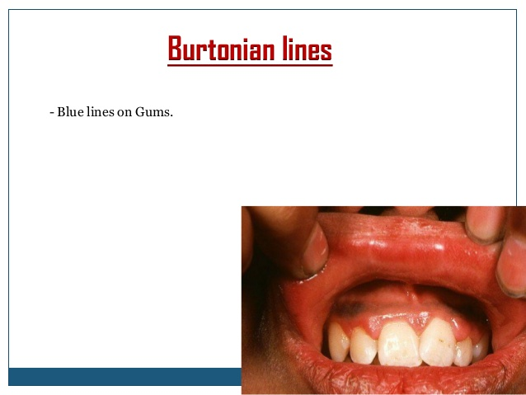

Slide 65
classification on basis of blood lead concentration
Class | Blood lead concentration | Comments
1 | <9 | A child in class 1 is considered to be lead poisoned
2A | 10-14 | Many children with blood lead levels in this range should trigger community wide childhood lead poisoning prevention activities.children in this range may need to be rescreened more frequently
2B | 15-19 | A child in class 2B should receive nutritional and educational intervention and more frequent screening. If the blood lead level persists in this range ,environmental investigation and intervention should be done

Slide 66
3 | 20-44 | A child in class 3 should receive environmental evaluation and remediation. Such a child may need pharmacological treatment of lead poisoning
4 | 45-69 | A child in class 4 will need both medical and environmental intervention, including chelation therapy
5 | >70 | A child with class 5 lead poisoning is a medical emergency. Medical and environmental investigation and intervention must begin immediately.

Slide 67
Laboratory tests
CBC with peripheral smear
Serum iron level to rule out iron deficiency anaemia. Iron deficiency can enhance lead absorption so all children with blood lead levels.20microgm/dl should be tested for iron.
Serum lead level is best indicator of lead absorption.
It can be measured by atomic absorption spectrophotometry or anodic strpping voltametry.
Harmful effects of lead -10microgm/dl
Free erythrocyte protoporpyhrin or Zinc protoporphyrin(ZPP) in blood reflect the effect of lead on the heme synthetic pathway and indicate lead exposure over three months prior to testing.

Slide 68
X ray abdomen- may show radioopaque foreign material if done within 24-36hrs.
X ray of the long bones shows metaphyseal band . It is area of increased mineralization or calcification .
Nerve conduction velocity(NCV) – to see peripheral neuropathy. It should be considered when lead levels exceed 80microgm/dl.
X ray fluroscene scan

Slide 69
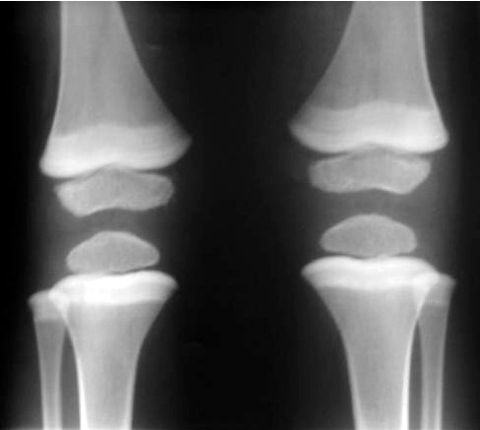

Slide 70
Diagnosis of lead poisoning
Lead poisoning must be considered in all cases of:
Altered sensorium with features of raised intracranial tension.
Wrist and foot drop
Abnormal behaviour of recent onset
Regression of milestones after 12-18months of age.
Bluish black lines on gum
Recurrent, poorly controlled seizures
Recurrent abdominal pain
Hypochromic microcytic anemia
Pica

Slide 71
Management
Removing the source of Lead exposure
Chelation therapy- based on current blood ,adverse clinical effect and duration of excessive exposure and symptoms

Slide 72
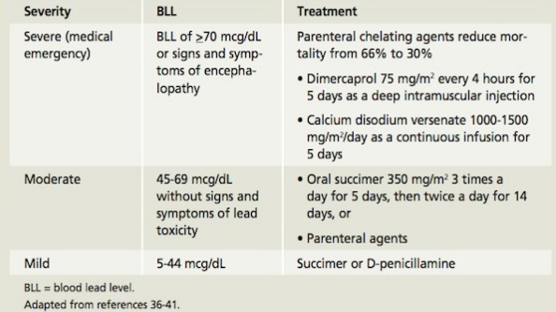

Slide 73
Case Presentation
A 16-year-old man was brought to ED, because he was found on the ground in shed at work. He was white powder on his face and clothing.
What can you do to save his life ?

Slide 74
His vital signs are:
temperature-35.9
pr – 55/min
RR- 24/min
bp -108/55 mmhg
Spo2 85% on room air
Gurgling respirations with pooled secretions in oropharynx
Pupils constricted and pinpoint pupils.
Skin cool diaphoretic

Slide 75
Management:
High-flow O2 and positive pressure to maintain adequate oxygenation
Antidote:
Atropin-restores cholinergic tone
Pralidoxime (2PAM) –reactivates acetylcholinestersase

