Slide 1

Lip repositioning for correction of gummy smile
Presented by : Dr..Monali Shah

Slide 2
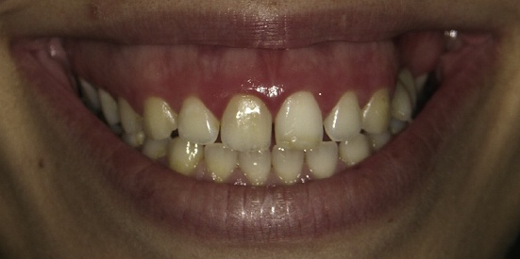
INTRODUCTION
Excessive gingival display, also known as a “gummy smile” is a common esthetic concern among dental patients.
A non-pathological condition causing esthetic disharmony, in which more than 3 to 4 mm of gingival tissue is exposed when smiling.
When diagnosing and treating patients with a gummy smile, the clinician must accurately understand and identify the etiology.
Notes:
Excessive gingival display, also known as a “gummy smile” is a common esthetic concern among dental patients.

Slide 3
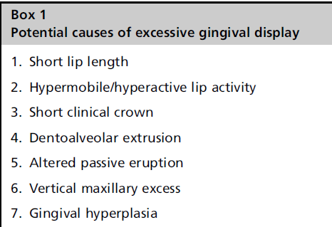
ETIOLOGY

Slide 4
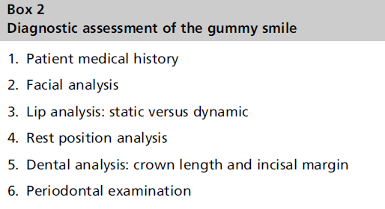
DIAGNOSIS

Slide 5
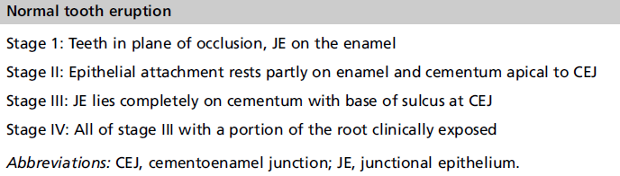
ALTERED PASSIVE ERUPTION
Condition in which the relationship between teeth, alveolar bone, and the soft tissues create an excessive gingival display
Normal tooth eruption occurs in an active and passive phase.

Slide 6
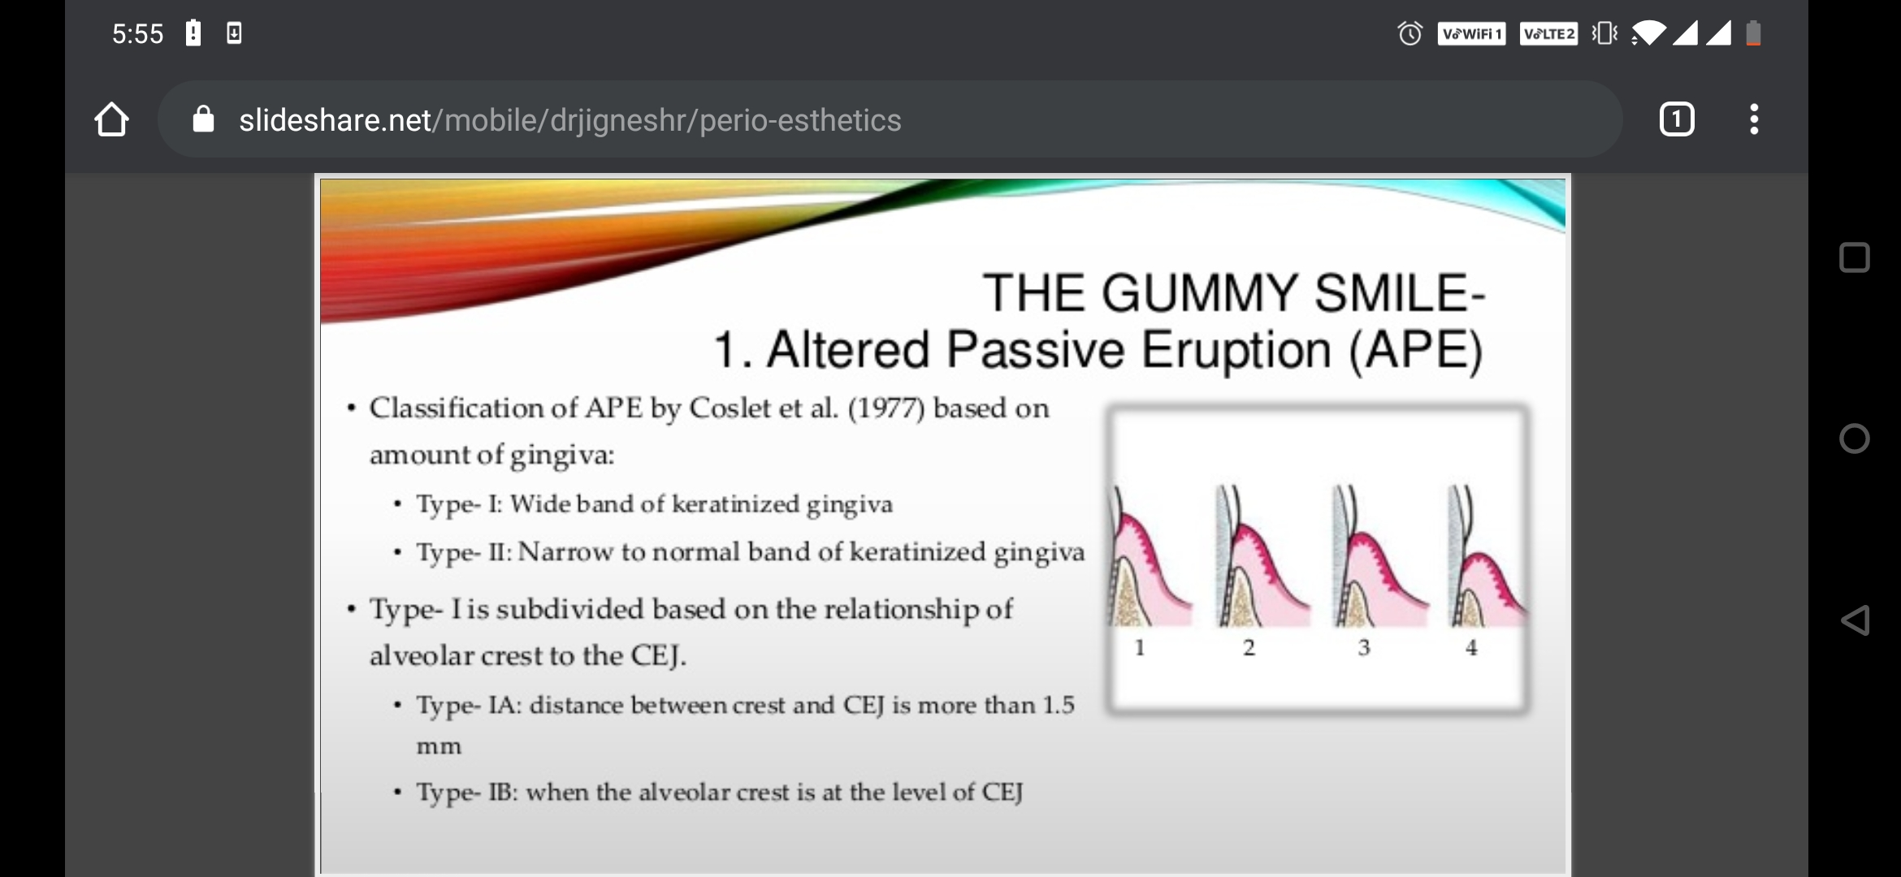

Slide 7
Altered passive eruption is the failure of the gingival/dental complex to migrate apically past stage 2, with the most obvious sign being a short looking tooth.
When making the diagnosis of altered passive eruption, the lips need to be assessed in repose and while smiling.
Ruling out a hypermobile lip is necessary before making the diagnosis of altered eruption. A normal translational movement of the lip from rest is about 6 to 8 mm and up to 10 mm in a hypermobile lip situation.

Slide 8
CEMENTOENAMEL JUNCTION (CEJ)
A key element to arriving at a diagnosis is noting the location of the cementoenamel junction (CEJ) in the gingival sulcus.
The CEJ normally resides just apical to the free gingival margin of the crown.
Conversely, the CEJ can reside up to 10 mm apical to the free gingival margin in altered passive eruption.
If the CEJ can be detected in the gingival sulcus, and all other etiologies have been ruled out, a diagnosis of altered passive eruption can be made.

Slide 9
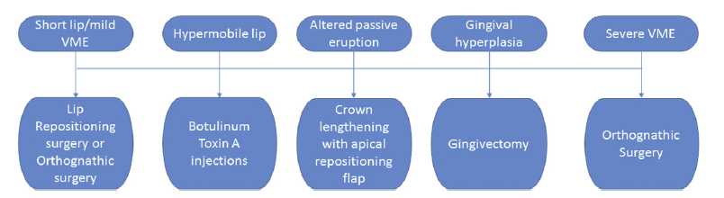
Treatment
A proper diagnosis should be made first and then the corresponding surgical approach can be used based on the patient’s specific needs.

Slide 10
LIP REPOSITIONING
“Ideal smile” - length of the maxillary teeth with approximately 1 to 3 mm of gingival exposure.
The intended goal is to remove a strip of mucosa and shortening the vestibule, thereby restricting the muscle pull of the elevator muscles during smiling.
The amount of mucosa to remove is based on the “twice the amount of gingival display rule.”
1st surgical lip repositioning- Rubinstein and Kostianovsky (1973)

Slide 11
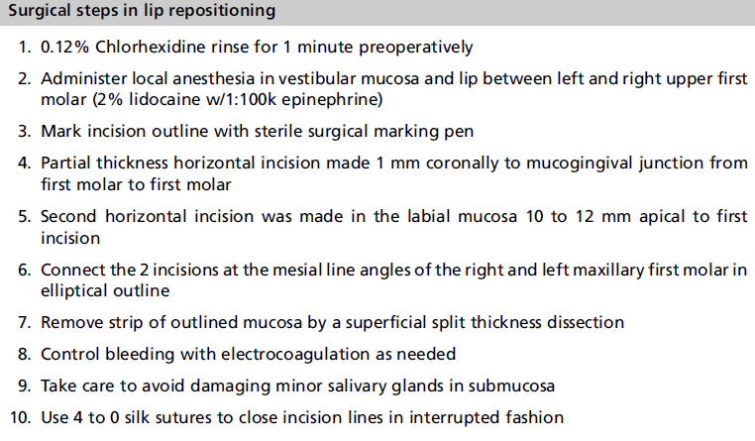

Slide 12
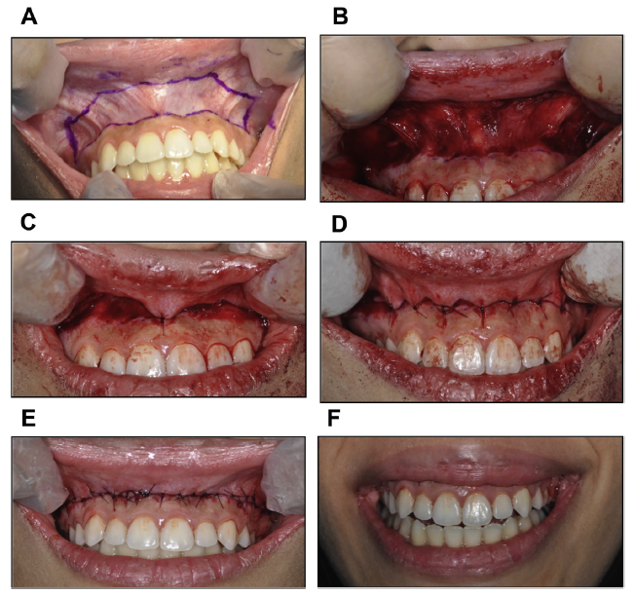

Slide 13
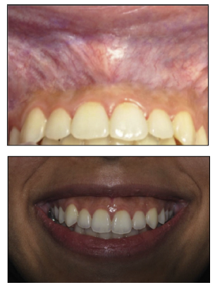
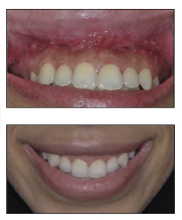
Pre-op
Post-op

Slide 14
Modification
Litton and fournier (1979) modified it by separating the muscles from the basal bony structures to coronally place the upper lip.
Miskinyar (1983) using a more aggressive approach which included myectomy and a partial resection of the muscle- levator labii superioris along with nerve repositioning before muscle resection.
Riberio et al maxillary labial frenum was preserved to maintain the midline and reduce post-op morbidity

Slide 15
Contraindications
Minimal zones of attachment
Severe VME
Postoperative complications
Pain
Bruising
Swelling
Mucocele formation
Possible relapse.

Slide 16
CAUSES OF RELAPSE
Not following the “twice the gingival display” rule during the incision
Cutting in the keratinized attached gingiva
Performing the procedure with limited amount of keratinized attached gingiva
Incising deep into the connective tissue and muscle fibers
Cases with high muscle pull

Slide 17
SUMMARY
Excessive gingival display is a true esthetic concern that concerns many patients.
The gummy smile can be caused by a variety of etiologies as discussed and it is up to the clinician to ultimately arrive at an accurate diagnosis.
Once a final diagnosis is made, the appropriate treatment plan can be presented to the patient tailoring it specifically to the patients’ needs and concerns.
As more research continues, we will likely see new treatment ideas and modifications to existing surgical approaches to the gummy smile.

Slide 18
REFERENCES
Chan DK. Predictable treatment for “Gummy Smiles” due to altered passive eruption. Inside Dent 2015;11(7).
Bynum J. Treatment of a “Gummy Smile”: understanding etiology is key to success. Compend Contin Educ Dent 2016;37(2):114–22.
Mahn D. Lip repositioning to eliminate the gummy smile. Inside Dent. 2017.13 (3).
Foudah M. Lip repositioning: an alternative to invasive surgery a 4 year follow up case report. Saudi Dent J 2019;31:S78–84.
Deepthi K, Yadalam U, Ranjan R, et al. Lip repositioning, an alternative treatment of gummy smile––a case report. J Oral Biol Craniofac Res 2018;8:231–3.

Slide 19


Thank you
Periodontology Kmsdch
#periokmsdch
Follow us on
Acknowledgement : To Dr. Yesha Raval for the contribution

