Slide 1
FATTY ACID OXIDATION
DR MIHIR MEHTA

Slide 2
Author/year | Study design | Level | Results | Outcome
Retrospective biochemical screening of fatty acid oxidation disorders in postmortem livers of 418 cases of sudden death in the first year of life Richard G. Boles, MD, Elizabeth A. Buck, BS, Miriam G. Blitzer, PhD, Marvin S. Platt, MD, And et al. The Journal of Pediatrics Volume 132, Issue 6, June 1998, Pages 924–933 | Retrospective cohort study | L-3 | Fatty acid oxidation (FAO) disorders are frequently reported as the cause of sudden and unexpected death, but their postmortem recognition remains difficult. We have devised a biochemical protocol in which informative findings in liver tissue are microvesicular steatosis, elevated concentrations of C₈-C₁₆ fatty acids, glucose depletion, and low carnitine concentration. Study design: We analyzed 27 cases representing five FAO disorders and compared the results with those obtained in a retrospective blinded analysis of 418 cases of sudden infant death (313 SIDS, 45 infections, and 34 accidents and abuse).Results: All cases of accidents and abuse correctly tested negative. Among the others, 25 (6%) showed at least two abnormal findings. Of these, 14 closely matched the biochemical profiles seen in specific FAO disorders. These included 2 cases with medium-chain acyl-CoA dehydrogenase deficiency, 4 cases consistent with glutaric acidemia type 2, 4 cases with either very long-chain acyl-coenzyme A dehydrogenase deficiency or long-chain 3-hydroxy-acyl-coenzyme A dehydrogenase deficiency, and 4 cases predicted to be affected with carnitine uptake defect. | The results of this study support the view that approximately 5% of all cases of sudden infant death are likely caused by an FAO disorder.

Slide 3
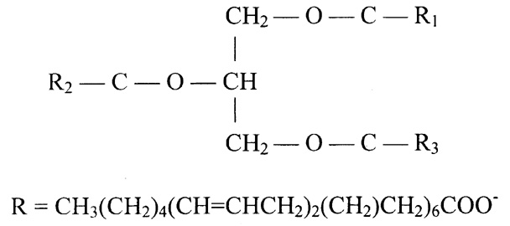
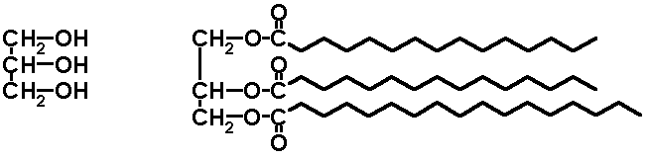
Molecule of TG/TAG/Triacylglycerol

Slide 4
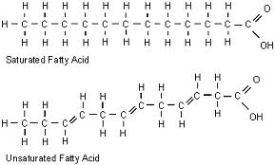
FATTY ACIDS
A fatty acid contains a long hydrocarbon chain and a terminal carboxylate group. The hydrocarbon chain may be saturated (with no double bond) or may be unsaturated (containing double bond).

Slide 5
FUNCTIONS OF FATTY ACIDS
Fatty acids have four major physiological roles.
1) Fatty acids are building blocks of phospholipids and glycolipids.
2) Fatty acids are fuel molecules. They are stored as triacylglycerols. Fatty acids mobilized from triacylglycerols are oxidized to meet the energy needs of a cell or organism.

Slide 6
TRIGLYCERIDES
Triglycerides are a highly concentrated stores of energy because they are reduced and anhydrous and stored in adipose tissue.
The yield from the complete oxidation of fatty acids is about 9 kcal g-1 (38 kJ g-1)
Triacylglycerols are non-polar, (Water insoluble) and are stored in a anhydrous form.

Slide 7
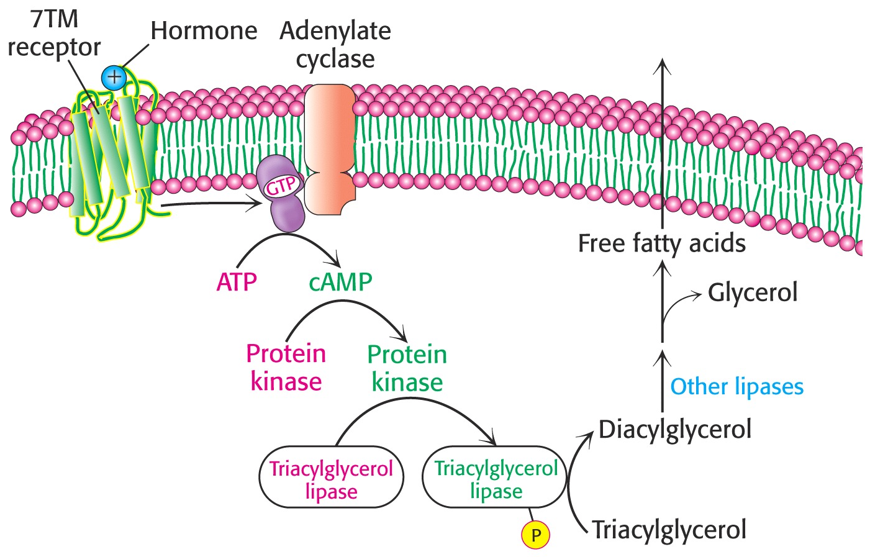
PROVISION OF FATTY ACIDS FROM ADIPOSE TISSUE
The triacylglycerols are degraded to fatty acids and glycerol by hormone sensitive lipase.The released fatty are transported to the energy-requiring tissues.

Slide 8
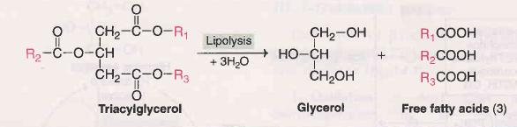
Lipolysis and Lipogenesis
TG are stored in adipose tissue.
Lipolysis yields three FFA and three molecules of glycerol
Lipogenesis is reverse of this.
FFA undergo oxidation in mitochondrion to yield energy

Slide 9
TRANSPORTATION OF FREE FATTY ACIDS
Free fatty acids—also called unesterified (UFA) or nonesterified (NEFA) fatty acids—are fatty acids that are in the unesterified state.
In plasma, longer-chain FFA are combined with albumin, and in the cell they are attached to a fatty acid-binding protein.

Slide 10
TYPES OF FATTY ACID OXIDATION
Fatty acids can be oxidized by-
1) Beta oxidation- Major mechanism, occurs in the mitochondria matrix. 2-C units are released as acetyl CoA per cycle.
2) Alpha oxidation- Predominantly takes place in brain and liver, one carbon is lost in the form of CO2 per cycle.
3) Omega oxidation- Minor mechanism, but becomes important in conditions of impaired beta oxidation
4) Peroxisomal oxidation- Mainly for the trimming of very long chain fatty acids.

Slide 11
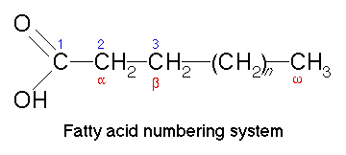
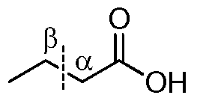
Beta oxidation

Slide 12
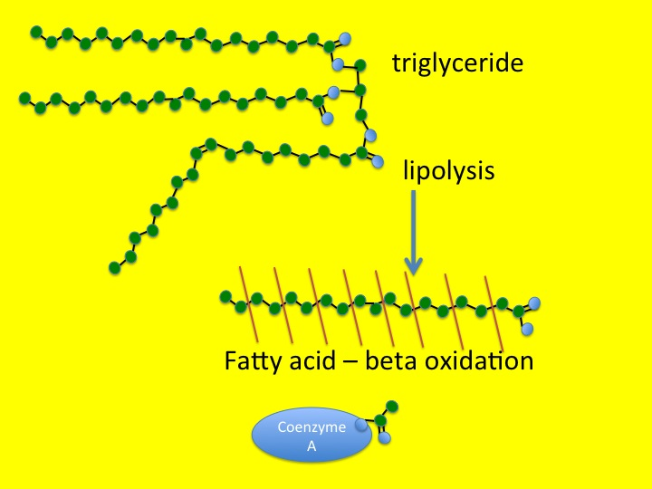

Slide 13
BETA OXIDATION
Overview of beta oxidation
A saturated acyl Co A is degraded by a recurring sequence of four reactions:
1) Oxidation by flavin adenine dinucleotide (FAD)
2) Hydration,
3) Oxidation by NAD⁺, and
4) Thiolysis by Co ASH

Slide 14
BETA OXIDATION
The fatty acyl chain is shortened by two carbon atoms as a result of these reactions,
FADH2, NADH, and acetyl Co A are generated.
Because oxidation is on the β carbon and the chain is broken between the α (2)- and β (3)-carbon atoms—hence the name – β oxidation .

Slide 15
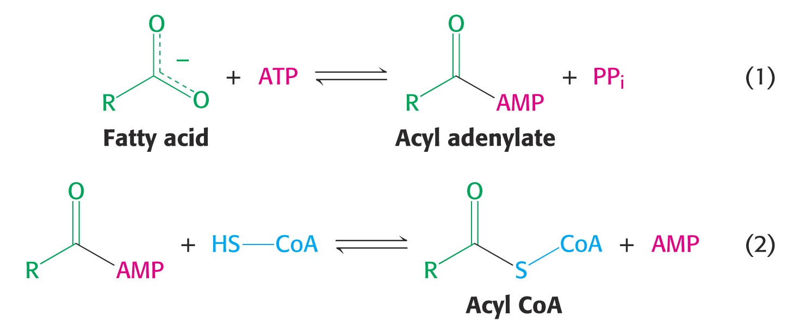
ACTIVATION OF FATTY ACIDS
Fatty acids must first be converted to an active intermediate before they can be catabolized. This is the only step in the complete degradation of a fatty acid that requires energy from ATP. The activation of a fatty acid is accomplished in two steps-

Slide 16
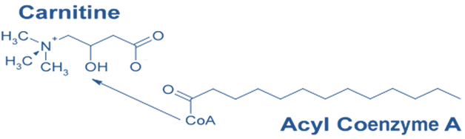
TRANSPORT OF FATTY ACID IN TO MITOCHONDRIAL MATRIX
Fatty acids are activated on the outer mitochondrial membrane, whereas they are oxidized in the mitochondrial matrix.
Activated long-chain fatty acids are transported across the membrane by conjugating them to carnitine, a zwitterionic alcohol.
Carnitine (ß-hydroxy-Υ-trimethyl ammonium butyrate), (CH₃)₃N⁺—CH₂—CH(OH)—CH₂—COO–, is widely distributed and is particularly abundant in muscle. Carnitine is obtained from foods, particularly animal-based foods, and via endogenous synthesis.

Slide 17
ROLE OF CARNITINE
1) The acyl group is to the hydroxyl group of carnitine to form acyl carnitine. This reaction is catalyzed by carnitine acyl transferase I
2) Acyl carnitine is then shuttled across the inner mitochondrial membrane by a translocase.
3) The acyl group is transferred back to CoA on the matrix side of the membrane. This reaction, which is catalyzed by carnitine acyl transferase II.
Finally, the translocase returns carnitine to the cytosolic side in exchange for an incoming acyl carnitine

Slide 18
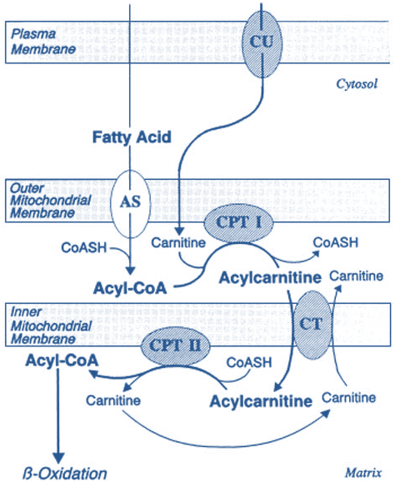
ROLE OF CARNITINE

Slide 19
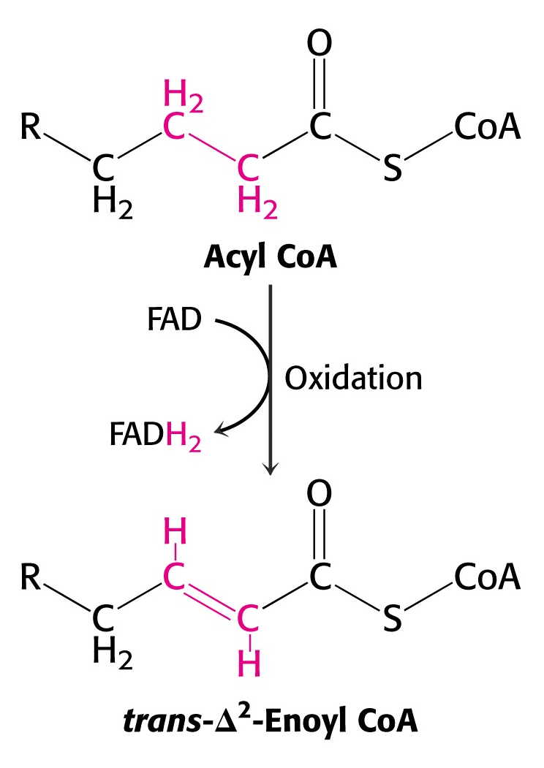
STEPS OF BETA OXIDATION
Step-1 Dehydrogenation-The first step is the removal of two hydrogen atoms from the 2(α)- and 3(β)-carbon atoms, catalyzed by acyl-CoA dehydrogenase and requiring FAD. This results in the formation of Δ²-trans-enoyl-CoA and FADH₂.

Slide 20
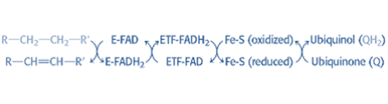
STEPS OF BETA OXIDATION
Electrons from the FADH2 prosthetic group of the reduced acyl CoA dehydrogenase are transferred to electron-transferring flavoprotein (ETF).
ETF donates electrons to ETF: ubiquinone reductase, an iron-sulfur protein.
Ubiquinone is thereby reduced to ubiquinol, which delivers its high-potential electrons to the second proton-pumping site of the respiratory chain.

Slide 21
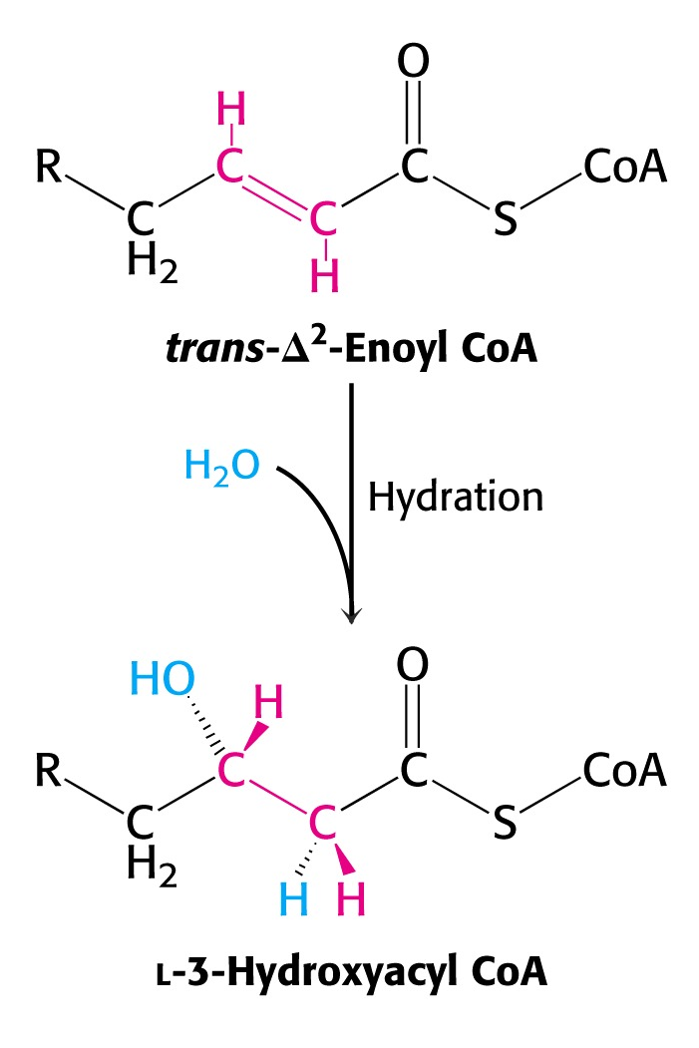
STEPS OF BETA OXIDATION
Step-2- Hydration
Water is added to saturate the double bond and form 3-hydroxyacyl-CoA, catalyzed by Δ ²-enoyl-CoA hydratase.

Slide 22
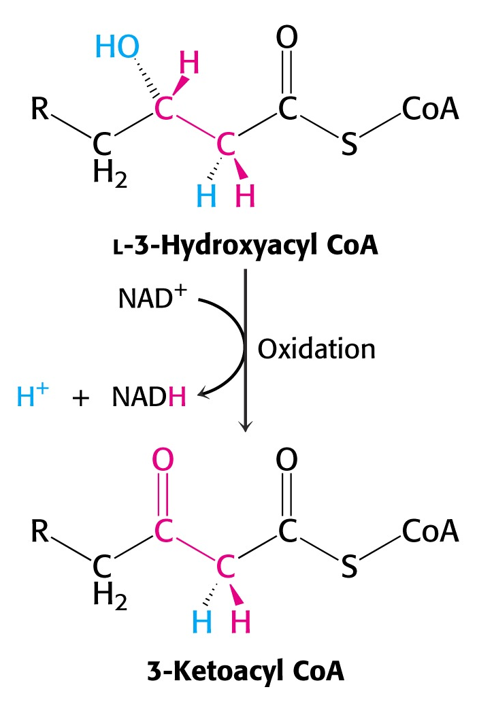
STEPS OF BETA OXIDATION
Step-3- dehydrogenation-
The 3-hydroxy derivative undergoes further dehydrogenation on the 3-carbon catalyzed by L(+)-3-hydroxyacyl-CoA dehydrogenase to form the corresponding 3-ketoacyl-CoA compound. In this case, NAD⁺ is the coenzyme involved.

Slide 23
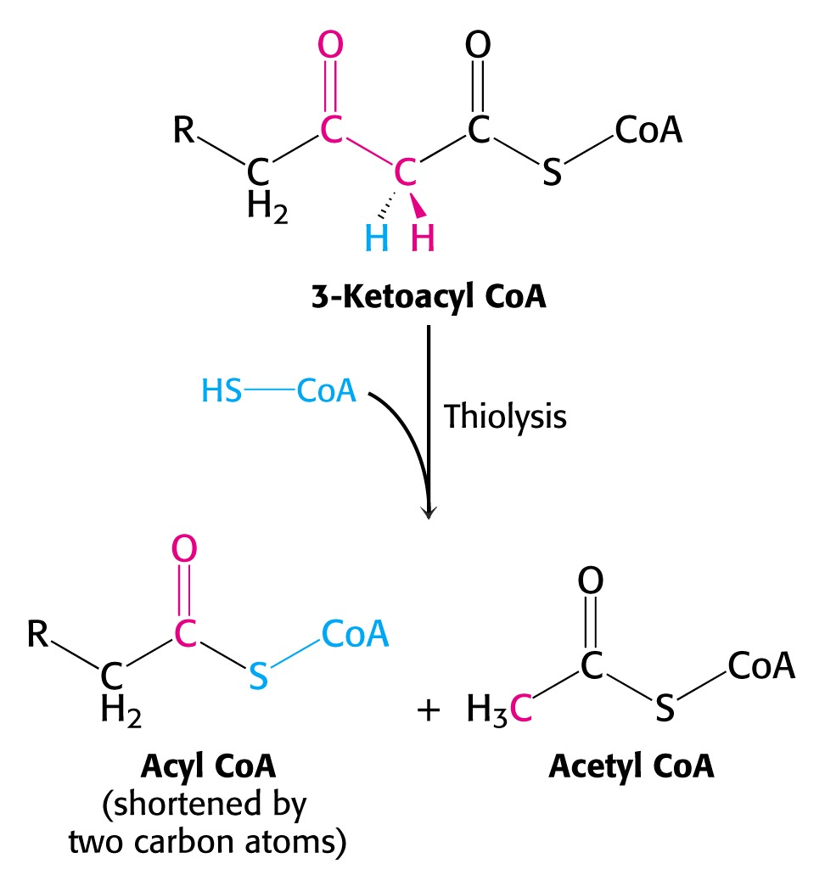
STEPS OF BETA OXIDATION
Step-4- Thiolysis-
3-ketoacyl-CoA is split at the 2,3- position by thiolase (3-ketoacyl-CoA-thiolase), forming acetyl-CoA and a new acyl-CoA two carbons shorter than the original acyl-CoA molecule.

Slide 24
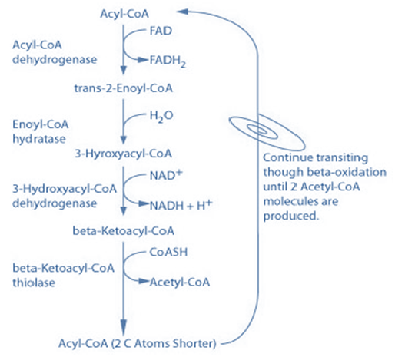
STEPS OF BETA OXIDATION
The acyl-CoA formed in the cleavage reaction reenters the oxidative pathway at reaction 2.
Since acetyl-CoA can be oxidized to CO₂ and water via the citric acid cycle the complete oxidation of fatty acids is achieved

Slide 25
Summary steps of beta oxidation
1. Activation of acyl to acyl CoA
2. Carnitine shuttle into Mitochondrial matrix
3. Dehydrogenation
4. Hydration
5. Dehydrogenation
6. Splitting by thiolase to yield acetyl-CoA
7. repetition of cycle

Slide 26

BETA OXIDATION
The overall reaction can be represented as follows-

Slide 27

BETA OXIDATION- ENERGY YIELD
Energy yield by the complete oxidation of one mol of Palmitic acid-
The degradation of palmitoyl CoA (C16-acyl Co A) requires seven reaction cycles. In the seventh cycle, the C4-ketoacyl CoA is thiolyzed to two molecules of acetyl CoA.
106 (129 As per old concept) ATP are produced by the complete oxidation of one mol of Palmitic acid.

Slide 28
BETA OXIDATION- ENERGY YIELD
2.5 ATPs per NADH = 17.5
1.5 ATPs per FADH2 = 10.5
10 ATPs per acetyl-CoA = 80
Total = 108 ATPs
2 ATP equivalents (ATP AMP + PPi
PPi 2 Pi)
consumed during activation of palmitate to Palmitoyl CoA
Net Energy output- 108-2 = 106 ATP

Slide 29
DISORDERS ASSOCIATED WITH IMPAIRED BETA OXIDATION
1) Deficiencies of carnitine or carnitine
transferase or translocase
Symptoms include muscle cramps during
exercise, severe weakness and death.
Muscle weakness related to importance of
fatty acids as long term energy source
Hypoglycemia and hypo ketosis are common findings
Diet containing medium chain fatty acids is recommended since they do not require carnitine shuttle to enter mitochondria.

Slide 30
DISORDERS ASSOCIATED WITH IMPAIRED BETA OXIDATION
2) Jamaican Sickness- Jamaican vomiting sickness is caused by eating the unripe fruit of akee tree, which contains the toxin hypoglycin, that inactivates medium and short-chain acyl-CoA dehydrogenases, inhibiting β oxidation and thereby causing hypoglycemia.
3) Dicarboxylic aciduria is characterized by-
i) Excretion of C₆–C₁₀ -dicarboxylic acids and
ii) Nonketotic hypoglycemia which is caused by lack of mitochondrial medium chain acyl-CoA dehydrogenases.

Slide 31
DISORDERS ASSOCIATED WITH IMPAIRED BETA OXIDATION
4) Acute fatty liver of pregnancy
Manifests in the second half of pregnancy, usually close to term, but may also develop in the postpartum period.
The patient developed symptoms of hepatic dysfunction at 36 weeks of gestation.
Short history of illness, hypoglycemia, liver failure, renal failure, and coagulopathy are observed.
Diagnosis is made based on an incidental finding of abnormal liver enzyme levels.
Affected patients may become jaundiced or develop encephalopathy from liver failure, usually reflected by an elevated ammonia level.
Profound hypoglycemia is common.

Slide 32
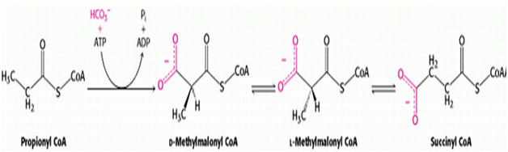
BETA OXIDATION OF ODD CHAIN FATTY ACIDS
Fatty acids with an odd number of carbon atoms are oxidized by the pathway of β-oxidation, producing acetyl-CoA, until a three-carbon (propionyl-CoA) residue remains. This compound is converted to Succinyl-CoA, a constituent of the citric acid cycle
The propionyl residue from an odd-chain fatty acid is the only part of a fatty acid that is glucogenic. Acetyl CoA cannot be converted into pyruvate or Oxaloacetate in animals.

Slide 33
BETA OXIDATION OF UNSATURATED FATTY ACIDS
In the oxidation of unsaturated fatty acids, most of the reactions are the same as those for saturated fatty acids, only two additional enzymes an isomerase and a reductase are needed to degrade a wide range of unsaturated fatty acids.
Energy yield is less by the oxidation of unsaturated fatty acids since they are less reduced.
Per double bonds 2 ATP are less formed, since the first step of dehydrogenation to introduce double bond is not required, as the double already exists.

Slide 34
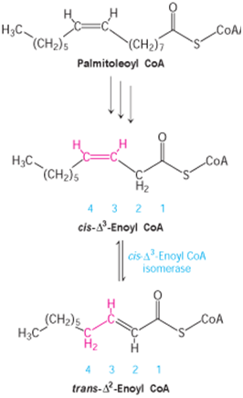
BETA OXIDATION OF UNSATURATED FATTY ACIDS
Palmitoleoyl Co A undergoes three cycles of degradation, which are carried out by the same enzymes as in the oxidation of saturated fatty acids.
The cis- Δ 3-enoyl CoA formed in the third round is not a substrate for acyl CoA dehydrogenase.
An isomerase converts this double bond into a trans- Δ 2 double bond.
The subsequent reactions are those of the saturated fatty acid oxidation pathway, in which the trans- Δ 2-enoyl CoA is a regular substrate .

Slide 35
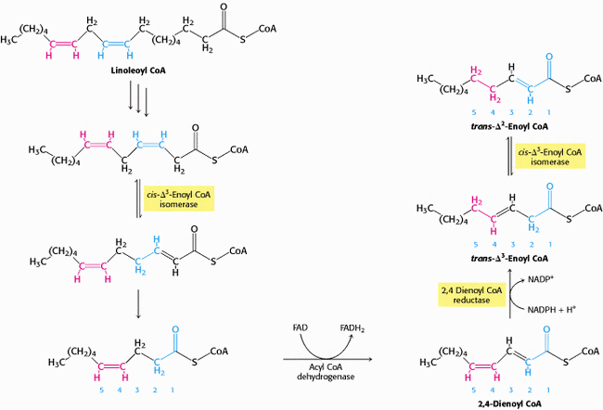
BETA OXIDATION OF POLY UNSATURATED FATTY ACIDS

Slide 36
BETA OXIDATION OF POLY UNSATURATED FATTY ACIDS
A different set of enzymes is required for the oxidation of Linoleic acid, a C18 polyunsaturated fatty acid with cis-Δ 9 and cis-Δ12 double bonds .
The cis- Δ 3 double bond formed after three rounds of β oxidation is converted into a trans- Δ 2 double bond by isomerase.
The acyl CoA produced by another round of β oxidation contains a cis- Δ 4 double bond. Dehydrogenation of this species by acyl CoA dehydrogenase yields a 2,4-dienoyl intermediate, which is not a substrate for the next enzyme in the β -oxidation pathway.
This impasse is circumvented by 2,4-dienoyl CoA reductase, an enzyme that uses NADPH to reduce the 2,4-dienoyl intermediate to trans-D 3-enoyl CoA.
cis-Δ 3-Enoyl CoA isomerase then converts trans- Δ 3-enoyl CoA into the trans- Δ 2 form, a customary intermediate in the beta-oxidation pathway.

Slide 37
MINOR PATHWAYS OF FATTY ACID OXIDATION
1) α- Oxidation- Oxidation occurs at C-2 instead of C-3 , as in β oxidation
2) ω- Oxidation – Oxidation occurs at the methyl end of the fatty acid molecule.
3) Peroxisomal fatty acid oxidation- Occurs for the chain shortening of very long chain fatty acids.

Slide 38
α- OXIDATION OF FATTY ACIDS
Takes place in the microsomes of brain and liver,
Involves decarboxylation process for the removal of single carbon atom at one time with the resultant production of an odd chain fatty acid that can be subsequently oxidized by beta oxidation for energy production.
It is strictly an aerobic process.
No prior activation of the fatty acid is required.
The process involves hydroxylation of the alpha carbon with a specific α-hydroxylase that requires Fe⁺⁺ and vitamin C/FH4 as cofactors.

Slide 39
BIOLOGICAL SIGNIFICANCE OF ALPHA OXIDATION
α- Oxidation is most suited for the oxidation of phytanic acid, produced from dietary phytol, a constituent of chlorophyll of plants.
Phytanic acid is a significant constituent of milk lipids and animal fats.
Normally it is metabolized by an initial α- hydroxylation followed by dehydrogenation and decarboxylation.
Beta oxidation can not occur initially because of the presence of 3- methyl groups, but it can proceed after decarboxylation.
The whole reaction produces three molecules of propionyl co A, three molecules of Acetyl co A, and one molecule of iso butyryl co A .

Slide 40
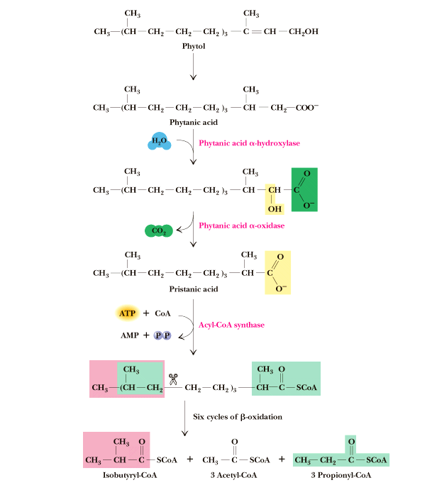
Phytanic acid is oxidized by Phytanic acid α oxidase (α- hydroxylase enzyme) to yield CO2 and odd chain fatty acid Pristanic acid that can be subsequently oxidized by beta oxidation.

Slide 41
BIOLOGICAL SIGNIFICANCE OF ALPHA OXIDATION
2)The hydroxy fatty acids produced as intermediates of this pathway like Cerebronic acid can be used for the synthesis of cerebrosides and sulfatides
3) Odd chain fatty acids produced upon decarboxylation in this pathway, can be used for the synthesis of sphingolipids and can also undergo beta oxidation to form propionyl co A and Acetyl co A. The number of acetyl co A depend upon the chain length. Propionyl co A is converted to Succinyl co A to gain entry in to TCA cycle for further oxidation.

Slide 42
CLINICAL SIGNIFICANCE OF ALPHA OXIDATION
Refsum's disease (RD)-is a neurocutaneous syndrome that is characterized biochemically by the accumulation of phytanic acid in plasma and tissues. Patients with Refsum disease are unable to degrade phytanic acid because of a deficient activity of Phytanic acid oxidase enzyme catalyzing the first step of phytanic acid alpha-oxidation.
Peripheral polyneuropathy, cerebellar ataxia, retinitis pigmentosa, and Ichthyosis (rough, dry and scaly skin) are the major clinical components. The symptoms evolve slowly and insidiously from childhood through adolescence and early adulthood.

Slide 43
OMEGA OXIDATION OF FATTY ACIDS
Involves hydroxylation and occurs in the endoplasmic reticulum of many tissues.
Hydroxylation takes place on the methyl carbon at the other end of the molecule from the carboxyl group or on the carbon next to the methyl end.
It uses the “mixed function oxidase” type of reaction requiring Cytochrome P450, O2 and NADPH, as well as the necessary enzymes.
Hydroxy fatty acids can be further oxidized to a dicarboxylic acid via sequential reactions of Alcohol dehydrogenase and aldehyde dehydrogenases.
The process occurs primarily with medium chain fatty acids.

Slide 44
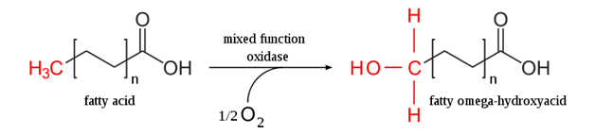
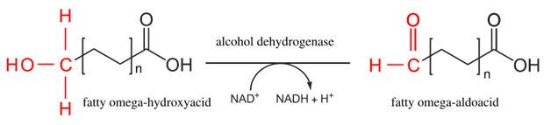
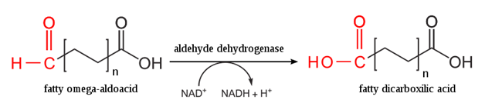
OMEGA OXIDATION OF FATTY ACIDS
Dicarboxylic acids so formed can undergo beta oxidation to produce shorter chain dicarboxylic acids such as Adipic acids(C6) and succinic acid (C4).

Slide 45
SIGNIFICANCE OF OMEGA OXIDATION
The microsomal (endoplasmic reticulum, ER) pathway of fatty acid ω-oxidation represents a minor pathway of overall fatty acid oxidation.
However, in certain pathophysiological states, such as diabetes, chronic alcohol consumption, and starvation, the ω-oxidation pathway may provide an effective means for the elimination of toxic levels of free fatty acids.

Slide 46
PEROXISOMAL OXIDATION OF VERY LONG CHAIN FATTY ACIDS
In peroxisomes, a flavoprotein dehydrogenase transfers electrons to O₂ to yield H₂O₂ instead of capturing the high-energy electrons as FADH₂, as occurs in mitochondrial beta oxidation.
Catalase is needed to convert the hydrogen peroxide produced in the initial reaction into water and oxygen.
Subsequent steps are identical with their mitochondrial counterparts,
They are carried out by different isoform of the enzymes.

Slide 47
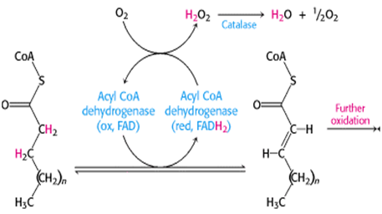
PEROXISOMAL OXIDATION OF VERY LONG CHAIN FATTY ACIDS
The specificity of the peroxisomal enzymes is for longer chain fatty acids. Thus peroxisomal enzymes function to shorten the chain length of relatively long chain fatty acids to a point at which beta oxidation can be completed in mitochondria.

Slide 48
SIGNIFICANCE OF PEROXISOMAL OXIDATION
Peroxisomal reactions include chain shortening of very long chain fatty acids, dicarboxylic acids, conversion of cholesterol to bile acids and formation of ether lipids.
The congenital absence of functional peroxisomes, an inherited defect , causes Zellweger syndrome.

Slide 49
ZELLWEGER SYNDROME
Zellweger syndrome, also called cerebrohepatorenal syndrome is a rare, congenital disorder (present at birth), characterized by the reduction or absence of Peroxisomes in the cells of the liver, kidneys, and brain.
The most common features of Zellweger syndrome include vision disturbances, prenatal growth failure, lack of muscle tone, unusual facial characteristics, mental retardation, seizures, and an inability to suck and/or swallow.

Slide 50
ZELLWEGER SYNDROME
The abnormally high levels of VLCFA( Very long chain fatty acids ), are most diagnostic.
There is no cure for Zellweger syndrome, nor is there a standard course of treatment.
Most treatments are symptomatic and supportive.
Most infants do not survive past the first 6 months, and usually succumb to respiratory distress, gastrointestinal bleeding, or liver failure.

