Slide 1

Local Drug Delivery
By Jasuma J. Rai
01-04-2020

Slide 2

Synonyms:
Sustained release,
Controlled release delivery (CRD), Prolonged release,
timed release,
slow release,
sustained action,
prolonged action or
extended action.
The concept of controlled release local delivery of therapeutic agents in the periodontal pocket was pioneered by Dr. Max Goodson (1979).

Slide 3
INDICATIONS
Periodontal patients with successful phase I therapy
Periodontal patients who are medically compromised where surgical therapy is contra indicative.
In combination with mechanical debridement or alone.
In-patients who are suffering from recurrent or refractory periodontitis.
During periodontal regenerative procedures.

Slide 4
Classification
Based on the application [Rams and Slots] 1996
1. Personally applied (in patient home self-care )
A. Nonsustained subgingival drug delivery
Home oral irrigation
Home oral irrigation jet tips
Traditional jet tips
Oral irrigation (water pick)
B. Sustained subgingival drug delivery
2. Professionally applied (in
dental office)
A. Nonsustained subgingival drug delivery
Professional pocket irrigation
B. Sustained subgingival drug delivery
Controlled release devices
Hollow fibres
Dialysis tubing
Strips
Films

Slide 5
CLASSIFICATION cont…..
II Based on the duration of medicament release (Greenstein and Tonetti 2000)
A. Sustained release devices – Designed to provide drug delivery for less than 24 hours
B. Controlled release devices – Designed to provide drug release that at least exceeds 1 day or for at least 3 days following application (Kornman1993)
III. Depending on degradability
1. Nondegradable devices (first generation)
2. Degradable devices (second generation)

Slide 6
CONTRAINDICATIONS
Periodontal patients with known hypersensitivity reaction to any of the antimicrobials used for periodontal therapy.
With local delivery of Metronidazole preparations, contraindicated in alcoholics.
Patients susceptible to infective endocarditis are contra indicated for irrigation devices to avoid the risk of bacteremia.
Delivery of antimicrobial agents using ultrasonic scalers is contraindicated in asthmatics, infective conditions (AIDS, TB) and those with cardiac pacemakers.

Slide 7
ADVANTAGES
Local drug delivery can attain 100 folds higher concentrations of the agent in subgingival sites compared with a systemic drug regimen.
Local delivery may employ antimicrobial agents not suitable for systemic administration.
Professionally applied antimicrobial regimens reduce potential problems with patient compliance that plague the use of systemic drug regimens.
Local antimicrobial delivery reduces the dangers associated with systemic administration such as toxicity, adverse reactions, resistant strains and superimposed infections.

Slide 8
DISADVANTAGES
Difficulty in placing antimicrobial agents into deeper parts of pockets and furcation lesions.
Locally applied antimicrobial agents do not markedly affect pathogens residing on extra-pocket oral surfaces.

Slide 9

SYSTEMIC VERSUS LOCAL DRUG DELIVERY
Sr. No. Route of administration Pain/Discomfort Drug dosage Peak levels Pharmacokinetics Frequency | Systemic Orally or Parental Not painful Higher drug dosage (in mg) Few hours in plasma Distribution in various compartments where antimicrobial effect may not be required. Once in 6-12 hours | Local Site Specific Nil Lower dosage (in micrograms) Within few minutes in GCF Minimal body distribution to different compartments with max concentration at delivered sites. Usually once a week

Slide 10
SYSTEMIC VERSUS LOCAL DRUG DELIVERY
Sr. No | Systemic | Local
Super infection Microbial resistance Patients compliance Time required Side effects Effects of connective tissue associated plaque | Present Present Required for better efficacy Less time More Effective | Limited Limited Patient delivered compliance required, Professional Delivered not required Longer time if many sites are required Limited Limited

Slide 11
REQUIREMENTS FOR LOCAL ANTIMICROBIAL AGENTS:
Locally applied antimicrobial agents should have the following criteria.
Safety
Stability
Substantivity
Efficacy
Adequate subgingival delivery
Achievement of effective concentrations.
Cost-effectiveness and patient compliance.

Slide 12
TETRACYCLINE FIBRE (ACTISITE )
The first delivery devices involved hollow fibers of cellulose acetate filled with tetracycline fibers
Actisite (Tetracycline hydrochloride) fiber for periodontal pocket placement consists of a 23 cm (9 inch) monofilament of ethylene vinyl acetate copolymer, 0.5mm in diameter, containing 12.7 mg of evenly dispersed tetracycline hydrochloride. Actisite fiber provides continuous release of tetracycline for 10 days.

Slide 13
Tetracycline gel (ATRIDOX)
10% doxycycline in a gel system using a syringe is administered by filling the periodontal pocket with with a blunt needle. Upon contact with the gingival crevicular fluid in the pocket, the liquid drug delivery system converts into a solid within the pocket and releases doxycycline over a period of several days (9 days). As the polymer biodegrades, it fragments and the pieces are flushed out of the pocket.

Slide 14

CHLORHEXIDINE CHIP (PERIO-CHIP)
The perio-chip is a unique patented “targeted controlled release” bio degradable polymer containing chlorhexidine. It is a small, bullet-shaped, thin film, weighing 7.4mg. It measures 5*4 mm in size and 0.35 mm thickness. The chip contains 2.5 mg chlorhexidine gluconate incorporated in a biodegradable matrix of cross-linked hydrolyzed gelatin.
Initially releasing approximately 40% of Chlorhexidine within the first 24 hours and then releasing the remaining chlorhexidine in a linear fashion for 7-10 days.

Slide 15
CHLORHEXIDINE GEL (CHLOSITE)
Is an agent containing 1.5 % chlorhexidine in xanthan gel. Sustained release of the drug is due to controlled process from the pocket within 10-30 days.
It consist of blend of two preparations: Chlorhexidine dihydrochloride - 1% which is slow releasing and Chlorhexidine digluconate - 0.5% with faster release

Slide 16
METRONIDAZOLE GEL (ELYSOL)
ELYZOL is an oil based gel form contains 25% metronidazole.
Metronidazole concentrations of above 100µ/ml were measurable in periodontal pocket for at least 8 hours and concentrations above 1µ/ml after 36 hours.

Slide 17
MINOCYCLINE MICROSPHERES (Arestin)
When delivered locally into periodontal pockets Minocycline hydrochloride has a maximum serum concentration of 0.10 ug/ml. It is more lipid soluble than other tetracyclines and is widely distributed in body tissues and fluids including gingival crevicular fluid (GCF).
Arestin contain 3 mg polyglycolide-co-dl lactide (PGLA) copolymer and 1 mg of minocycline per unit (pocket) dose. As the polymer microspheres resorb, minocycline is released locally within the periodontal pocket at effective concentrations for at least 14 days.

Slide 18
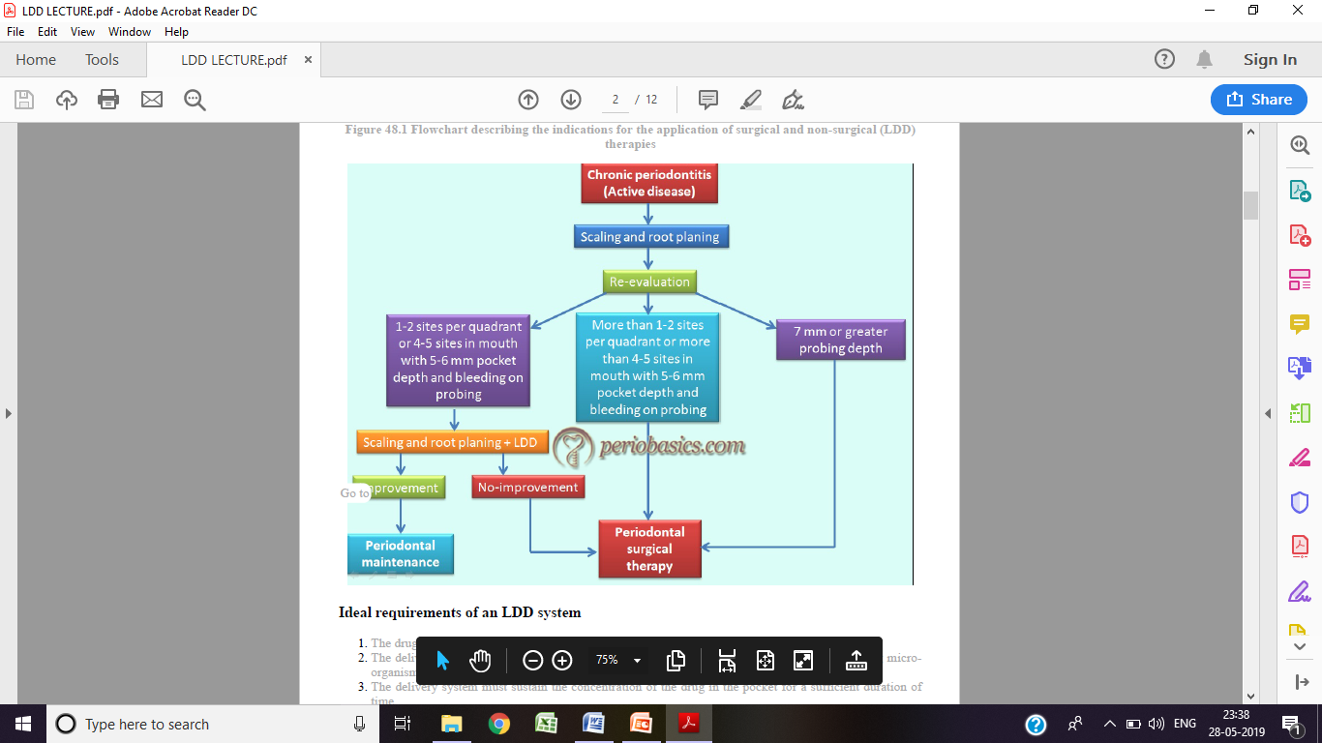

Slide 19

THANK YOU

