Slide 1

FURCATION INVOLVEMENT AND ITS MANAGEMENT

Slide 2
High rate of periodontal destruction
???

Slide 3
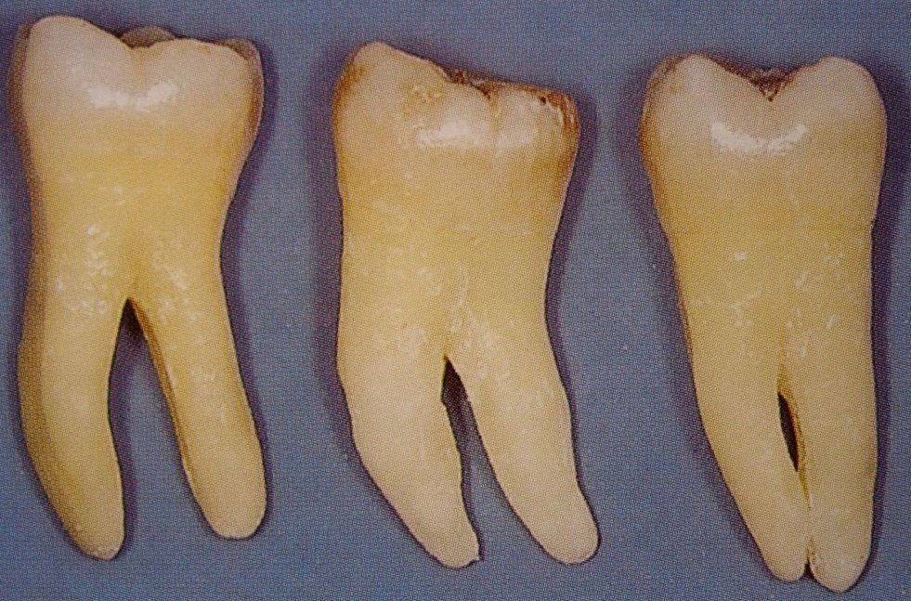
Molars are the tooth type demonstrating the highest rate of periodontal destruction in untreated disease and suffer the highest frequency of loss for periodontal reasons.

Slide 4
Definition
The term Furcation involvement refers to the invasion of the bifurcation and trifurcation of multi-rooted teeth by periodontal disease

Slide 5
Glossary of periodontal terms defines Furcation as “the area of a multi-rooted tooth where the roots diverge”. It defines a furcation invasion as the “pathologic resorption of bone within a furcation”
Such a condition is reported to considerably increase the risk for tooth loss.

Slide 6
Therefore, furcation defects represent a formidable problem in the treatment of periodontal disease, principally related to the complex and irregular anatomy of furcation.

Slide 7
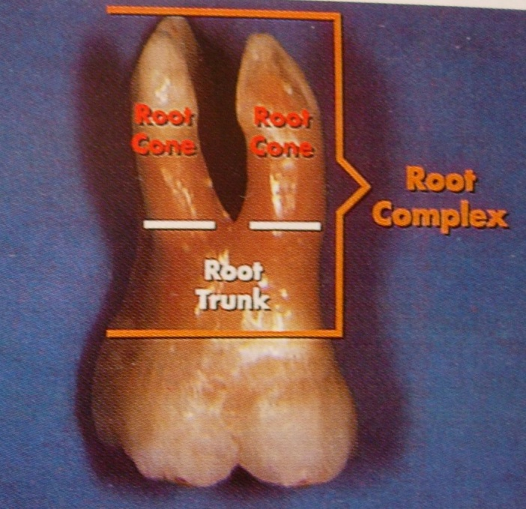
Terminology
Root complex is the portion of a tooth that is located apical of the cementoenamel junction (CEJ) i.e., the portion that normally is covered with a root cementum
- Root trunk
- Root cone

Slide 8
The root trunk represents the undivided region of the root. The height of the root trunk is defined as the distance between the CEJ and the separation line (furcation) between two root cones (roots).

Slide 9
The root cone is included in the divided region of the root complex

Slide 10
Furcation is the area located between individual root cones and it refers to the anatomic area of a multirooted tooth where the roots divide or diverge from the common root trunk

Slide 11
Roof which is the base of the root trunk and contains bifurcation ridge
Flute Usually concave or grooving of the root trunk, extending from the cervical line and blending into the actual furca

Slide 12
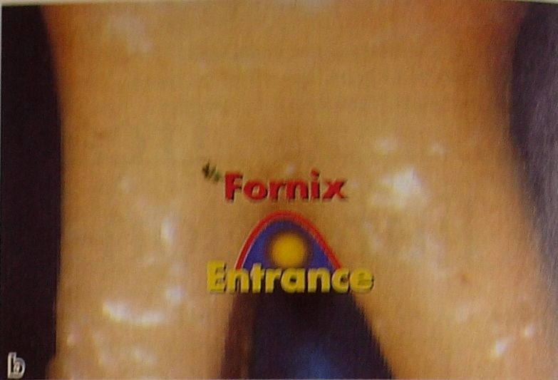
Furcation entrance the transitional area between the undivided and the divided part of the root
Furcation fornix is the roof of the furcation

Slide 13
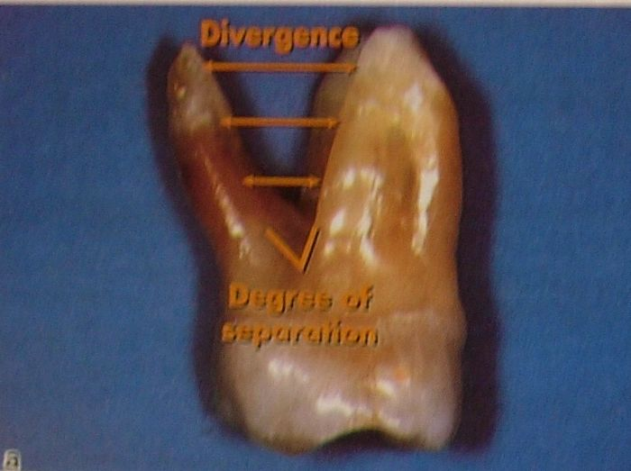
Degree of separation: The angle of separation between two roots (cones)
Divergence: Is the distance between two roots

Slide 14
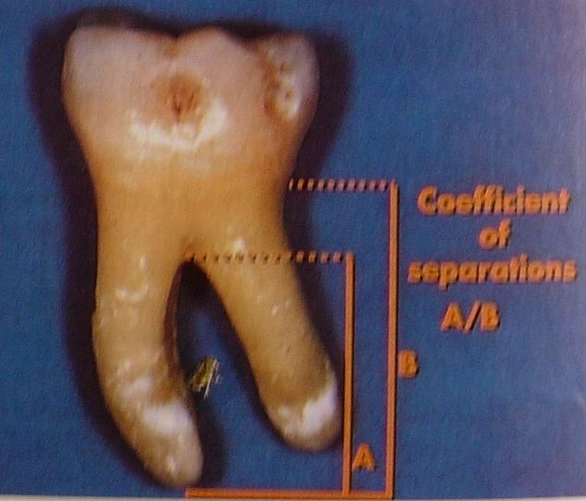
Coefficient of separation: The length of the root cones in relation to the length of the root complex

Slide 15
Contents
ETIOLOGIC FACTORS OF FURCATION
PROBLEM
DIAGNOSIS AND CLASSIFICATION OF
FURCATION DEFECT
CLASSIFICATION OF FURCATION
INVOLVEMENT
LOCAL ANATOMIC FACTORS IN TREATMENT OF
FURCATIONS
- THE TOOTH

Slide 16
Etiology of Furcation Invasions
Primary factor - Bacterial plaque
Predisposing factors - Anatomical considerations
-Root concavities
-Enamel pearls and projections
-Accessory pulp canals
-Bifurcation ridges
-Location of furcation relative to CEJ
-Location and diameter of furcation entrance

Slide 17
Isolated molar furcation invasions
Trauma from occlusion
Pulpal periodontal disease
Iatrogenic cofactors
Root fractures involving furcations

Slide 18
Primary factor – Bacterial plaque
Bacterial plaque – Most common cause of furcation in marginal periodontitis, which progressively invades one or more furcation areas to varying degrees, resulting in irreversible bone loss in the inter radicular area.
Glickman 1950 reported that they present no histologic features to make them unique entities .

Slide 19
The furcation are phase in the rootward extension of the periodontal pockets in the region of furcation
Although plaque is the main etiological factors ,many cofactors predisposes to it.

Slide 20
Pulpal periodontal disease:
The high percentage of molar teeth with patent accessory canal opening into the furcation suggests that pulpal disease could be an initiating cofactor in the development of furcation involvement
Furcation involvement - combined endodontic periodontic defect

Slide 21
% of Accessory canals connecting the pulp chamber floor to the furcation
36% -- Maxillary first molars
12% Maxillary second molars
32% -- Mandibular first molars
24% -- Mandibular second molars
(Vertucci & Antony 1986)

Slide 22
Trauma from occlusion:
TFO as a Predisposing cofactor for rapid formation of furcation involvement is controversial
Glickman (1961) assign a key role to trauma , since furcation areas are most sensitive to injury from excessive occlusal forces

Slide 23
DIAGNOSIS AND CLASSIFICATION OF FURCATION DEFECTS
THOROUGH CLINICAL EXAMINATION
CAREFUL PROBING
TO DETERMINE PRESENCE AND EXTENT OF INVOLMENT
TRANSGINGIVAL SOUNDING
TO FURTHER DEFINE THE ANATOMY OF FURCATON DEFECT

Slide 24
GOAL OF CLINICAL EXAMINATION
-TO IDENTIFY AND CLASSIFY THE EXTENT OF FURCATION INVOLVEMENT AND
-TO IDENTIFY FACTORS THAT MAY HAVE CONTRIBUTED TO THE DEVELOPMENT OF FURCATION DEFECT OR
-THE FACTORS THAT COULD AFFECT TREATMENT OUTCOME

Slide 25
MORPHOLOGY OF AFFECTED TOOTH
LOCAL ANATOMY OF THE ALVEOLAR BONE
CONFIGURATION OF ANY BONY DEFECTS
PRESENCE OF CARIES AND PULPAL NECROSIS

Slide 26
Classification Of Furcation Involvement
Glickman (1958)
Staffileno (1969)
Goldman and Cohen's (1980)
Heins & Canter (1968)
Easley & Drennan’s classification (1969)
Hamp et al (1975)
Lindhe & Nyman (1975)
Ramjford & Ash (1979)

Slide 27
Riccheti (1982)
Lindhe (1983)
Eskow and Kapin (1984)
Tarnow & Fletcher (1984)
Fedi (1985)
Basaraba (1990)
Hou et al (1998)

Slide 28
Glickman (1958)
Grade-I: There is soft-tissue lesion or pocket extending into the flute of the furcation, but the inter-radicular bone is intact.
There is no radiographic evidence of bone loss

Slide 29
Grade-II: Loss of inter-radicular bone & pocket formation of varying depths into the furcation but not completely through the opposite side of the tooth

Slide 30
Grade-III: Complete loss of inter-radicular bone with radiographic evidence presenting a small triangular radiolucency at the furcation area.
There is a pocket formation that is completely probable to the opposite side of the tooth.
The furcation is not visible clinically

Slide 31
Grade-IV: Same features as those of Grade III except that loss of periodontal attachment & gingival recession has makes the furcation clearly visible to a clinical examination.

Slide 32
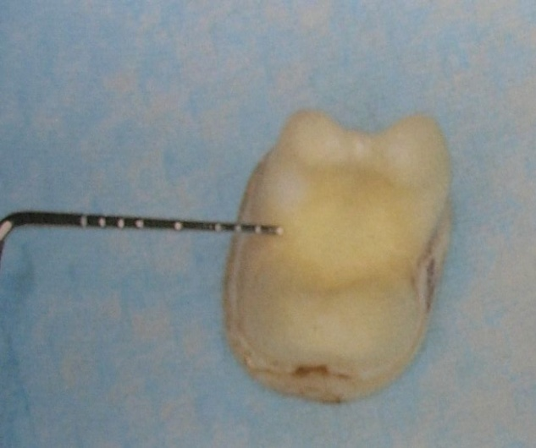
Hamp et al (1975)
Degree I / class 1: Represents horizontal attachment loss of less than 3 mm within the furcation involvement

Slide 33
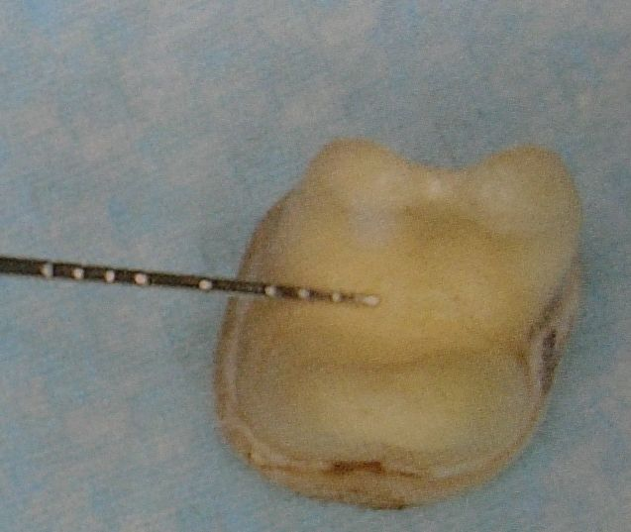
Class-II: Represents horizontal loss greater than 3 mm but not encompassing the total width of the furcation

Slide 34
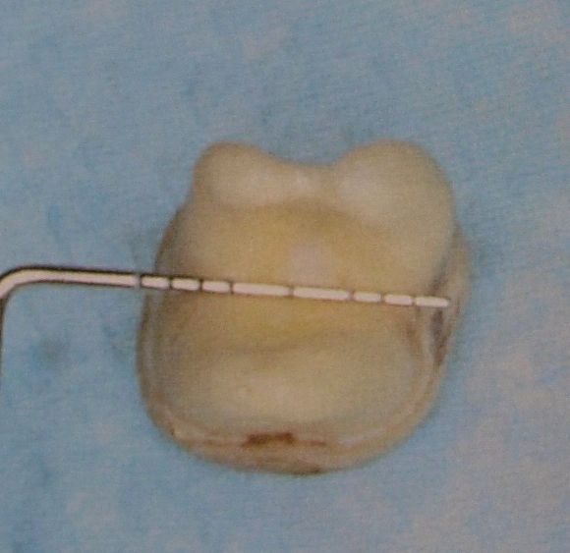
Class-III: Denotes horizontal through and through destruction.
This classification is similar to that described by Lindhe & Nyman (1975)

Slide 35
LOCAL ANATOMIC FACTORS IN TREATMENT OF FURCATIONS
THE TOOTH
Root trunk length
Root length
Root form
Interradicular dimension
Anatomy of furcation
Cervical enamel projections

Slide 36
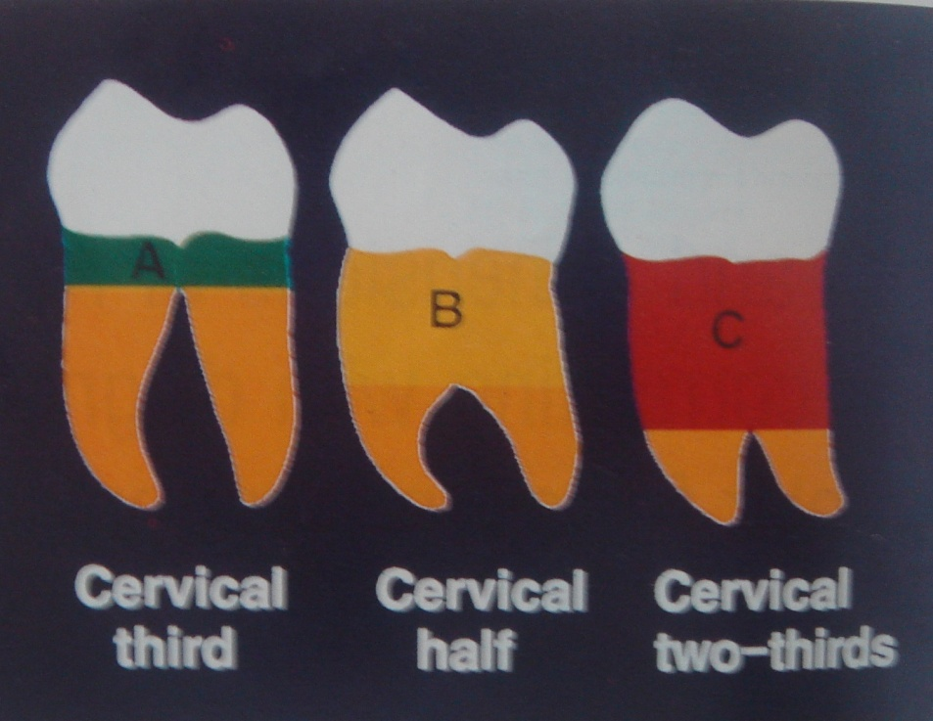
Root trunk length
Short root trunk – Furcation become involved early in the disease process
Long root trunk – Furcation -invaded later - more difficult to reach and instrument
First molars generally have shorter root trunks than 2nd molars

Slide 37

Root length
Directly related to the quantity of attachment supporting tissue
Long root trunk and short root –
easy or difficult to treat ???
Teeth with long roots and short /moderate root trunk
easy or difficult to treat ???

Slide 38
INTERRADICULAR DIMENSION
Degree of seperation – important factor in treatment planning
Closely approximated or fused roots –preclude instrumentation during scaling, root planing and surgery
Widely seperated roots- readily treated

Slide 39
ENAMEL PROJECTION
is “an extension of the cervical enamel margin either toward or into the root furcation area
According Moskow & Canut 1990, incidence rate --- 1.1 – 9.7%

Slide 40
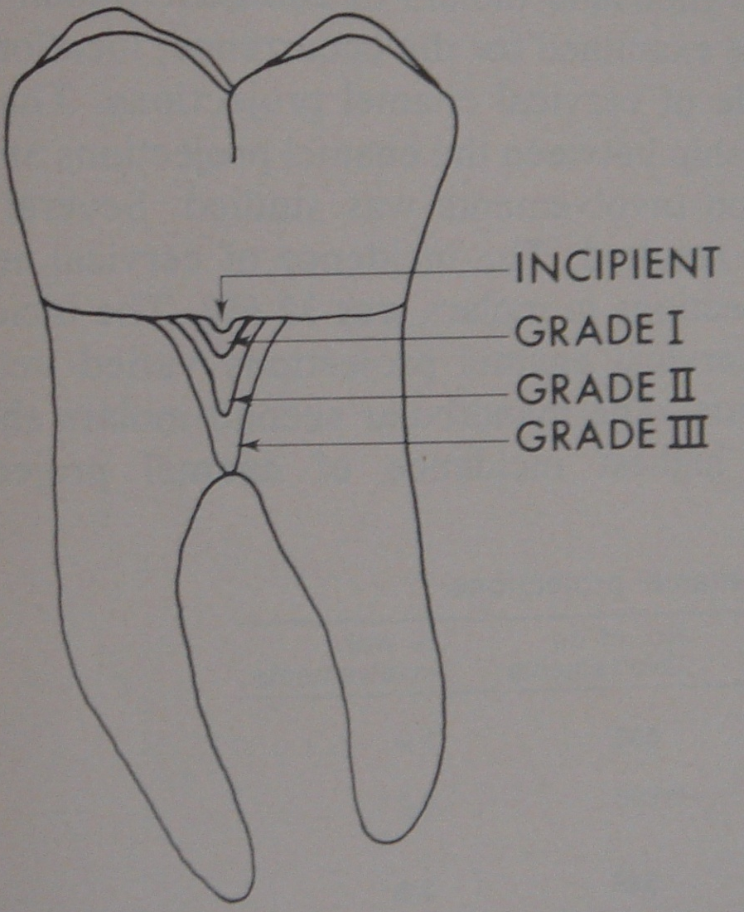
Master & Hoskins (1964)
Grade I: Short CEP from CEJ
Grade II: Longer CEP and approaches the furcation area
Grade III: CEP that extends directly into the furcation

Slide 41
They favor plaque accumulation and must be removed to facilitate scaling and root planing
Buccal surface more common
Max 1st > Mand 1st > Max 2nd > Mand 2nd molar

