Slide 1


Prognosis
Dr. Ekta Shah
Dept. of Periodontology

Slide 2
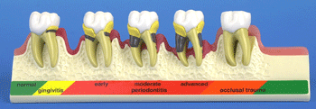
Prognosis
The prognosis is a prediction of the probable course, duration, and outcome of a disease based on a general knowledge of the pathogenesis of the disease and the presence of risk factors for the disease.
Its established after diagnosis and before the treatment plan.

Slide 3
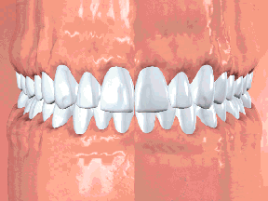
Risk factor
Risk factors are those characteristics of an individual that put the person at increased risk for developing disease.

Slide 4
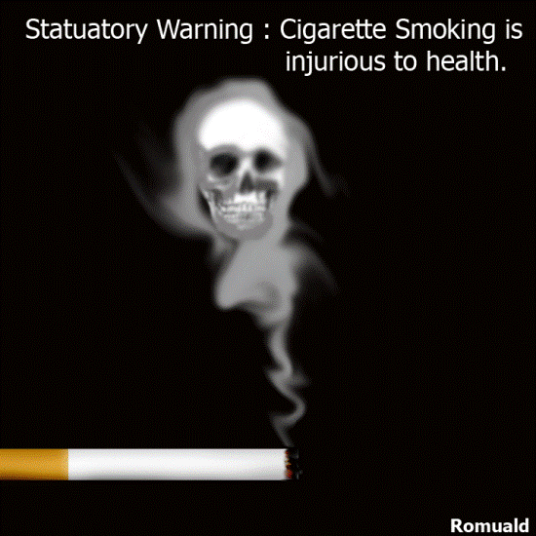
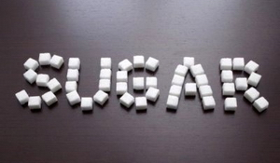
Prognostic Vs Risk Factors
Prognostic factors are characteristics that predict the outcome of disease once the disease is present.
In some cases
  Prognostic factors = Risk factors
  Eg. Patients with diabetes or patients who smoke are more at risk for acquiring periodontal disease, and once they have it, they generally have a worse prognosis.

Slide 5

Types of Prognosis
Excellent
Good
Fair
Poor
Questionable
Hopeless

Slide 6

Excellent Prognosis
No bone loss
Excellent gingival condition
Good patient cooperation
No systemic or environmental factors

Slide 7
Good Prognosis
Adequate remaining bone support
Adequate possibilities to control etiologic factors
Establish a maintainable dentition
Adequate patient cooperation
No systemic or environmental factors
Or well controlled systemic factors

Slide 8
Fair Prognosis
Less-than adequate remaining bone support
Some tooth mobility
Grade I furcation involvement
Adequate maintenance possible
Acceptable patient cooperation
Presence of limited systemic or environmental factors

Slide 9
Poor Prognosis
Moderate to advanced bone loss
Tooth mobility
Grade I and II furcation involvement
Difficult-to-maintain areas
Doubtful patient cooperation
Presence of systemic or environmental factors

Slide 10

Questionable Prognosis
Advanced bone loss
Grade II and III furcation involvements
Tooth mobility
Inaccessible areas
Presence of systemic or environmental factors

Slide 11

Hopeless Prognosis
Advanced bone loss
Nonmaintainable areas
Extraction(s) indicated
Presence of uncontrolled systemic or environmental factors

Slide 12

Provisional Prognosis
The provisional prognosis allows the clinician to initiate treatment of teeth that have a doubtful outlook in the hope that a favorable response may tip the balance and allow teeth to be retained.
Until Phase I therapy
Reevaluation phase
Patient’s compliance

Slide 13
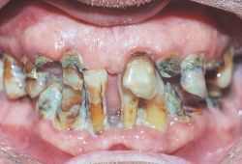
Overall Prognosis
It is concerned with dentition as whole.
  Factors:
    patient age,
    current severity of disease,
    systemic factors,
    smoking,
    the presence of plaque,
    calculus and other local factors,
    patient compliance, and
    prosthetic possibilities.

Slide 14
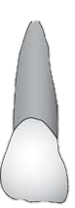
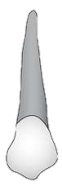

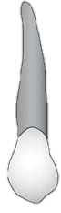
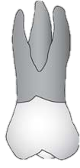
Individual Tooth Prognosis
Determined after the overall prognosis and is affected by it.
Ex: Patient with a poor overall prognosis, attempt should not be made to retain a tooth that has a questionable prognosis.

Slide 15
Factors to Consider
Overall Clinical Factors
  Patient age
  Disease severity
  Plaque control
  Patient compliance
Systemic and Environmental Factors
  Smoking
  Systemic disease or condition
  Genetic factors
  Stress
Local factors
  Plaque and calculus
  Subgingival restorations
  Anatomic factors
    Short tapered roots
    CEP
    Enamel pearls
    Bifurcation ridges
    Root concavities
    Developmental grooves
    Root proximity
    Furcation involvement
  Tooth mobility
Prosthetic and Restorative Factors
  Abutment selection
  Caries
  Nonvital teeth
  Root resorption

Slide 16
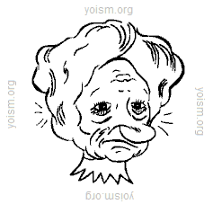
Patient Age
If same amount of attachment loss
  Older patient is considered to have
  good prognosis as destruction has
  happen over long period of time
  Younger patient with same amount of
  destruction, the prognosis is Not good as more aggressive destruction has occurred in short duration of time.
Repair
  Younger would be expected to have a greater reparative capacity
  But destruction in a relatively short period would exceed any naturally occurring periodontal repair.

Slide 17
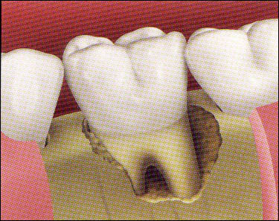
Disease Severity
More Level of clinical attachment loss, poor prognosis
Base of the pocket – close to root apex, poor prognosis
Less height of remaining bone, poor prognosis
Type of defect- 1 wall defect has poor prognosis compared to 3 wall defect.

Slide 18
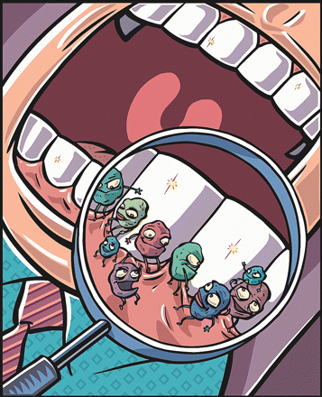
Plaque Control
Etiology of periodontal disease
Therefore effective removal on daily basis is critical
Poor plaque control- poor prognosis

Slide 19

Patient Compliance and Cooperation
Patient’s attitude, desire to retain the natural teeth, and willingness and ability to maintain good oral hygiene.
Patient unwilling or unable to maintain adequate plaque control or regular checkups: the dentist can:
  Refuse to accept the patient for treatment
  Extract the teeth that have a hopeless or poor prognosis

Slide 20
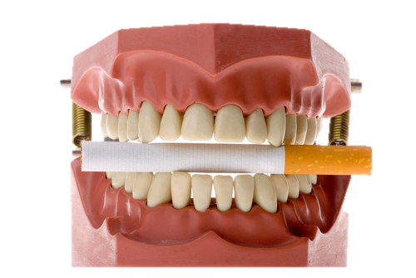
Smoking
Direct relationship exists between smoking and the prevalence and incidence of periodontitis.
Prognosis in patients who smoke:
  Slight to moderate periodontitis -> fair to poor.
  Severe periodontitis -> poor to hopeless.
Prognosis in patient who cease smoking
  Slight to moderate periodontitis -> good prognosis
  Severe periodontitis -> fair prognosis

Slide 21

Systemic Disease or Condition
Affects overall prognosis
Prognosis can be upgraded if its well controlled
  Ex. Well controlled diabetic patients
  slight to moderate periodontitis -> good prognosis
  Surgical periodontal treatment is required but cannot be provided because of patient’s health -> Questionable prognosis

Slide 22
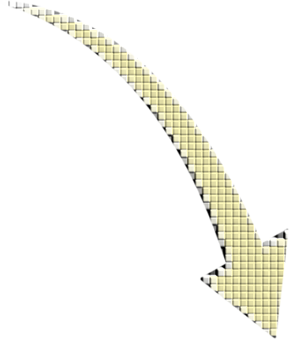

Genetic Factors
Periodontal disease = microbial challenge x host’s response
Chronic periodontitis:
  Genetic polymorphisms in Interleukin-1 (IL-1) genes
Aggressive periodontitis:
  Serum IgG2 antibody
  Expression of FcγRII receptors on the neutrophil
  Leucocyte adhesion deficiency type 1
  Familial aggregation
In such cases early diagnosis, intervention and alterations in the treatment regimen -> improved prognosis

Slide 23

Stress
Physical and emotional stress – alter patient’s ability to respond to periodontal treatment performed.
Incresed stress – poor prognosis.

Slide 24
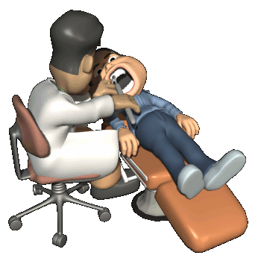
Local Factors:
Plaque and Calculus
Good prognosis depends on the ability of the patient and the clinician to remove thesis etiologic factors.

Slide 25
Local Factors:
Subgingival Restorations
Increased plaque accumulation
Increased inflammation
Increased bone loss
Size of discrepancies,
Duration of presence
Poor prognosis

Slide 26
Local Factors:
Anatomic Factors
C:R ratio:
  Poor prognosis - short, tapered roots and relatively large crowns
  Susceptible to injury by occlusal forces
CEP:
  Flat, ectopic extensions of enamel that exceeds beyond normal CEJ.
  Interfere with the attachment apparatus and may prevent regenerative procedures.
  Negative effect on the prognosis of individual tooth.
Enamel pearls:
  Larger, round deposits of enamel in furcations
  1.1 – 5.7% of permanent molars; 75% maxillary molars.

Slide 27
Local Factors:
Anatomic Factors
Accessibility problems:
  Root concavities – especially on maxillary premolars, molars (MB root), mandibular molars, mandibular incisors
  Developmental grooves - maxillary lateral/central incisors (palatogingival groove), lower incisors.
  Root proximity
  Access to the furcation – opening narrower than instruments
    Maxillary premolar – most difficult, unfavorable prognosis
    Maxillary molars – root resection improves prognosis
    Mandiublar / maxillary buccal furcation – good access – better prognosis
Tooth mobility: - inflammation, TFO, loss of bone
  Pockets on clinically mobile teeth does not respond well
  Splinting may have beneficial impact on the overall and individual tooth prognosis.

Slide 28
Prosthetic & Restorative Factors
Overall prognosis and individual prognosis overlap
Ex: saving or losing a key tooth may determine whether other teeth are save or extracted or whether the prosthesis used is fixed or removable.
Abutments with more functional demands needs good periodontal support.

Slide 29
Caries, Nonvital, Root Resorption
Severely mutilated teeth due to caries – feasibility of adequate restoration should be considered first before periodontal treatment
Root resorption – less stability for periodontal treatment – poor prognosis
Nonvital teeth does not differ from vital teeth in periodontal prognosis until and unless they can be restored adequately.

Slide 30
Prognosis for Gingival Disease
Dental Plaque-Induced Gingival Diseases:
  Gingivitis associated with Dental-plaque:
    No attachment loss
    Good prognosis, provided all local factors are eliminated
    Patient cooperates by maintenance good oral hygiene
  Modified by systemic factors:
    Prognosis depends on how well the systemic factors are controlled
  Modified by medications:
    Prognosis depends on the continued use of the drugs
      Ex. Phenytoin, oral contraceptive, cyclosporine, nifedipine
  Modified by malnutrition:
    Vitamin C deficiency

Slide 31
Prognosis for Gingival Disease
Non-Plaque-Induced Gingival Diseases:
  Bacterial, fungal, and viral infections
  Dermatologic disorders
    Lichen planus
    Pemphigoid
    Pemphigus vulgaris
    Erythema multiforme
    Lupus erythematosus
  Allergic, toxic and foreign body reactions
  Mechanical and thermal trauma.
  Prognosis improves on elimination of etiologic factor

Slide 32
Prognosis for Periodontitis
Chronic Periodontitis:
  Slowly progressive, localized or generalized
  Slight to moderate -> good prognosis
  Severe disease, furcation involvement -> fair to poor
  increasing clinical mobility
  patient noncompliance

Slide 33
Prognosis for Periodontitis
Aggressive periodontitis:
  Localized or generalized
  Less microbial deposit
  Severe attachment and bone loss
  Localized:
    Around puberty
    Localized to molars and incisors
    Robust serum antibody
    Systemic antibiotics, oral hygiene
    Excellent prognosis
  Generalized:
    Poor antibody
    Severe interproximal attachment loss, smoking
    Fair, poor or questionable prognosis

Slide 34
Prognosis for Periodontitis
Manifestation of Systemic Disease:
  1) Hematologic disorders
    Leukemia and acquired neutropenia
  2) Genetic disorders
    Familial and cyclic neutropenia
    Down syndrome
    Papillon-Lefèvre syndrome
    Hypophosphastasia
  Fair to poor prognosis

Slide 35
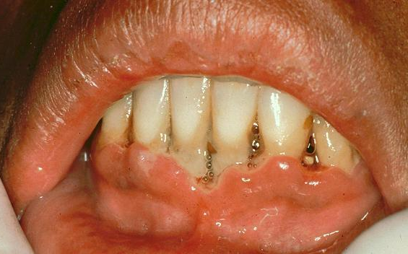
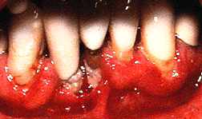
Prognosis for Periodontitis
Necrotizing Periodontal Disease:
  NUG:
    Only gingiva
    Primary factor: Bacterial plaque
    Secondary factors: smoking, stress, malnutrition -> immunosuppression.
    Control of factors -> Good prognosis
    Repeated episodes -> Fair prognosis
  NUP:
    Generally immunocompromised
    Or repeat episodes of NUG
    Prognosis depends on how well the local and secondary factors are controlled

Slide 36
Shift of Prognosis
After Phase 1 therapy
Frank reduction in pocket depth and inflammation -> better prognosis then previously assumed.

Slide 37
Thank you…

