Slide 1
Goniometry
By: Dr. Purvi Patel

Slide 2
Objectives
At the end of the lecture the student will be able to
Define Goniometry
Explain types of Goniometer
Principles of Goniometry

Slide 3
DEFINITION
GONIOMETRY: Comes from two Greek words:
  Gonia meaning angle
  metron meaning measure
Thus goniometry refers to measurement of angles, particularly measurement of angles created at human joints by bones of body
Instrument to measure is called a GONIOMETER

Slide 4
TYPES OF GONIOMETERS
Universal goniometer
Gravity-dependent Goniometer (inclinometers)
Fluid/bubble Goniometers
Electro Goniometers

Slide 5
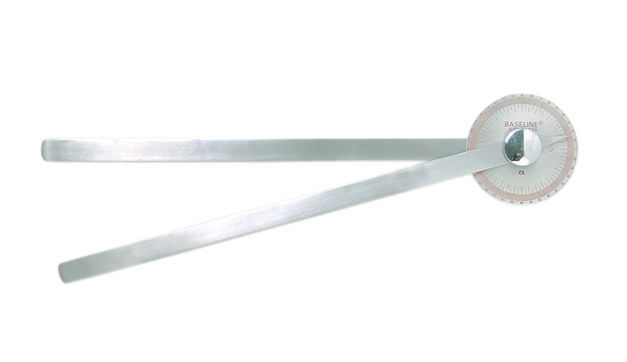
UNIVERSAL GONIOMETER

Slide 6
UNIVERSAL GONIOMETER
Most commonly used. Can measure joint position and ROM at almost all joints of body
May be of plastic or metal and is available in many shapes and sizes
Design consists of body and two arms- a stationary and a moving arm
Body resembles a protractor and may form a half circle or full circle. Scales on a half- circle goniometer read from 0 to 180 degrees and from 180 to 0 degrees and on a full-circle instrument read from 0 to 180 degrees or 0 to 360 degrees

Slide 7
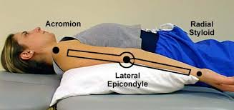
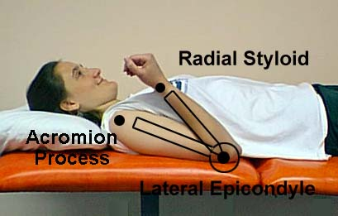

Slide 8
Correct selection of which goniometer device to use depends on joint angle to be measured
Length of arms varies among instruments and can range from 3-18 inches
Longer armed goniometers, or bubble inclinometer are recommended when landmarks are further apart, such as when measuring hip, knee, elbow, and shoulder movements
In smaller joints such as wrist and hand and foot and ankle, a traditional goniometer with a shorter arm is used

Slide 9
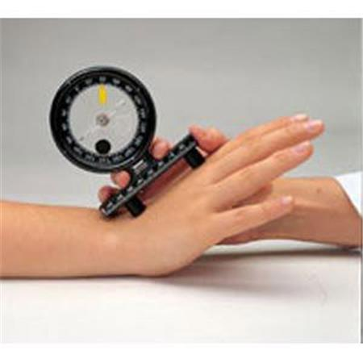
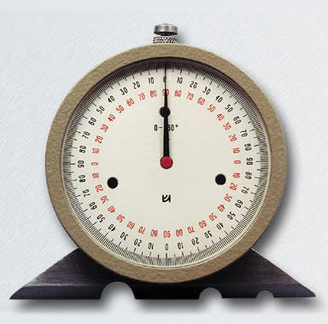
INCLINOMETER

Slide 10
GRAVITY-DEPENDENT GONIOMETER (INCLINOMETERS)
Use gravity’s effect on pointers or fluid levels to measure joint position and motion
They are held on distal segment of joint being measured. The angle between long axis of distal segment and line of gravity is noted
Advantages: Easier to use, as they do not have to be aligned with bony landmarks or centered over the axis of motion
Disadvantages: Difficult to use over small joints and where there is soft tissue deformity or edema

Slide 11
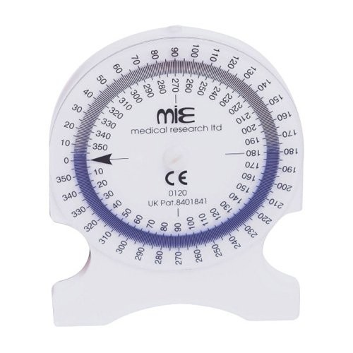
FLUID/BUBBLE GONIOMETER

Slide 12
FLUID/ BUBBLE GONIOMETERS
Has a fluid filled circular chamber containing an air bubble
Bubble goniometer, which has a 360°rotating dial and scale with fluid indicator can be used for flexion and extension; abduction and adduction; and rotation in the neck, shoulder, elbow, wrist, hip, knee, ankle, and the spine

Slide 13
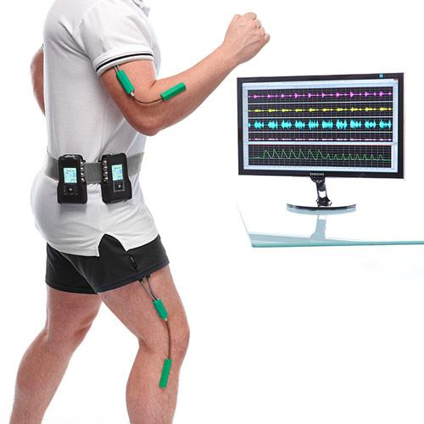
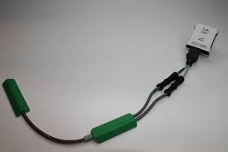
ELECTROGONIOMETER

Slide 14
ELECTRO GONIOMETERS
Used primarily in research to obtain dynamic joint measurements
In addition to 2 arms of universal goniometer, there’s a potentiometer which is connected to 2 arms
Changes in joint position cause resistance in potentiometer to vary
Resultant change in voltage indicates amount of joint motion
Disadvantages: Expensive and take time to calibrate accurately and attach to subject

Slide 15
PRINCIPLES OF GONIOMETRY
Positioning
Stabilization
Alignment
Recording
Procedure

Slide 16
POSITIONING
It is used to place joints in a zero starting position and to help stabilize proximal joint segment. It affects amount of tension in soft tissues (capsule, ligament, muscles) surrounding a joint
A testing position in which one or more of these soft tissue structures become taut results in a more limited ROM than a position in which same structures become lax
  Eg: Testing hip flexion with knee flexion and testing hip flexion with knee extension
When knee is extended, hip flexion is prematurely limited by tension in the hamstring muscles

Slide 17
Testing positions are positions of body recommended for obtaining goniometric measurements
Testing positions are designed to:
  Place joint in a starting position of 0 degrees
  Permit a complete ROM
  Provide stabilization for proximal joint segment
Examiners must use same testing position during successive measurements of a joint ROM
Testing positions include supine, sitting, prone and standing

Slide 18
STABILIZATION
Testing position helps to stabilize subject’s body and proximal joint segment so that motion can be isolated to joint being examined Isolating motion to one joint helps to see that a true measurement of motion is obtained and not combined motions. Positional stabilization may be supplemented by manual stabilization by examiner
Eg: Measuring MR of hip joint in sitting. Pelvis is partially stabilized by body weight but subject can still move his/her pelvis and trunk during hip rotation. Additional stabilization should be provided by subject and therapist

Slide 19
Examiner provides manual stabilization for pelvis by exerting a downward pressure on iliac crest of side being tested. Subject is instructed to shift his/her body weight over hip being tested to help keep body stabilized
Amount of manual stabilization must be sufficient to keep proximal joint segment fixed during movement of the distal component

Slide 20
ALIGNMENT
Goniometer alignment refers to alignment of arms of goniometer with proximal and distal segments of joint being evaluated.
Bony anatomical landmarks are used to accurately visualize the joint segments
These landmarks should be exposed
Stationary arm is often aligned parallel to longitudinal axis of proximal segment of joint and moving arm to distal segment of joint

Slide 21
In some situations it may be necessary to reverse alignment of two arms. Thus, proximal arm refers to arm of goniometer that is aligned with proximal segment of joint and distal arm refers to arm of goniometer that is aligned with distal segment of joint
Fulcrum is placed approximately at axis of motion of joint
When aligning arms and reading scale of goniometer, examiner must be at eye level with goniometer to avoid parallax

Slide 22
RECORDING
Subject’s name, age and gender
Examiner’s name
Date and Time of measurement
Make and Type of Goniometer used
Side of the body, Joint and Motion being measured

Slide 23
ROM, including number of degrees at beginning and at end of motion
Type of motion: passive or active. ROM should always be checked passively.
Any subjective information such as discomfort or pain reported by subject during testing
A complete description of any deviation from recommended testing positions

Slide 24
PROCEDURES
Prior to beginning with evaluation, examiner must gather all necessary equipment like goniometers and towel rolls
Explanation procedure
Introduction and Explanation of Purpose
My name is_____. I am a 1st yr student. I am going to measure amount of motion that you have at your ____ joint
Explanation and demonstration of Goniometer

Slide 25
Instrument that I will be using to obtain the measurements is called a goniometer
Explanation and demonstration of Anatomical landmarks
To obtain accurate measurements I may have to ask you to remove certain articles of clothing like your shirt
Explanation and demonstration of recommended testing positions
Explanation and demonstration of examiner’s and subject’s roles during Active motion
Explanation and demonstration of examiner’s and subject’s roles during Passive motion

Slide 26
Testing Procedure
Place the subject in testing position
Stabilize proximal joint segment
Move distal joint segment to zero starting position
Palpate bony landmarks
Align goniometer
Stabilize proximal joint segment
Read and record ROM

Slide 27
MULTIPLE CHOICE QUESTIONS

Slide 28
1.Placing joint in a starting position of 0 degrees refers to principle of
a. Positioning
b. Stabilization
c. Alignment
d. None of the above
2.Isolating the motion to one joint helps to see that a true measurement of the motion is obtained and not combined motions refers to the principle of
a. Positioning
b. Stabilization
c. Alignment
d. None of the above

Slide 29
3.Alignment of arms of goniometer with proximal and distal segments of joint being evaluated refers to principle of
a. Positioning
b. Stabilization
c. Alignment
d. None of the above
4.When aligning arms and reading scale of the goniometer, examiner must be at eye level with goniometer
a. True
b. False

Slide 30
5. _____ is not a principle of goniometry
a. Positioning
b. Stabilization
c. Alignment
d. Traction

Slide 31
MULTIPLE CHOICE QUESTIONS

Slide 32
1. Goniometry refers to measurement of
a. Muscles
b. Joint angles
c. Bones
d. None of the above
2. Which Goniometer uses principle of gravity for measurement
a. Bubble goniometers
b. Fluid-filled goniometers
c. Universal goniometers
d. Gravity-dependent goniometer

Slide 33
3. __________ is most commonly used in the Research Process
a. Bubble goniometers
b. Electro Goniometer
c. Universal goniometers
d. Gravity-dependent goniometer

Slide 34
4. ­­­­­­­­­­­­_________ can measure joint position and ROM at almost all joints of the body
a. Bubble goniometers
b. Fluid-filled goniometers
c. Universal goniometers
d. Gravity-dependent goniometer
5. The design of _________ goniometer consists of a body and two arms- a stationary and a moving arm with Potentiometer
a. Bubble goniometers
b. Electro goniometers
c. Universal goniometers
d. Gravity-dependent goniometer

