Slide 1
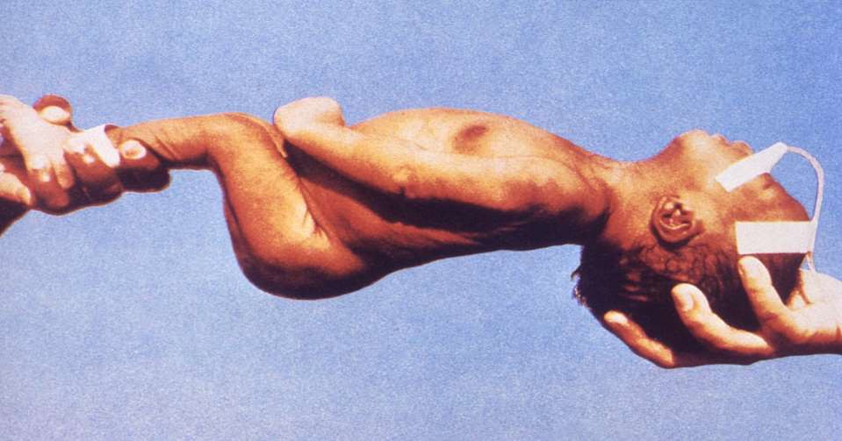


NEONATAL SEIZURES
NEONATAL SEIZURES
Dr. Hemal Dave
Assistant Professor
Department of Paediatrics
SBKS MIRC

Slide 2
Definition
A stereotypic, paroxysmal spell of altered neurologic function
(behavior, motor, and/or autonomic function)
Neonatal period limited to :
  first 28 days for term infants
  44 weeks gestational age for pre-term
First sign of neurological dysfunction
Powerful predictors of long-term cognitive and developmental impairment

Slide 3
Frequency
Incidence of seizures higher in the neonatal period than in any other age group

Slide 4
Why do neonatal seizures have such unusual presentations?
Immature CNS cannot sustain a synchronized, well orchestrated generalized seizure

Slide 5
Epidemiology
Race: No racial preponderance.
Sex: No Sex-based differences
Age:
first 4 weeks of life in a full-term infant -44 weeks from conception for premature infants.
most frequent during the first 10 days of life.

Slide 6
Classification
I. Clinical Seizure
Subtle
Tonic
Clonic
Myoclonic

Slide 7
Classification
II. Electroencephalographic seizure
Epileptic
Non-epileptic

Slide 8
Clinical Classification
1. Subtle
Most common subtype
More in preterm than in term
Eye deviation (term)
Blinking, fixed stare (preterm)
Repetitive mouth and tongue movements
Apnea
Pedaling and tonic posturing of limbs

Slide 9
Clinical Classification
2. Tonic
Primarily in Preterm
May be focal or generalized
Sustained periods of muscle contraction
Sustained extension of the upper and lower limbs (mimics decerebrate posturing)
Sustained flexion of upper with extension of lower limbs (mimics decorticate posturing)
Signals severe ICH in preterm infants
Generally poor prognosis

Slide 10
Clinical Classification
3. Clonic
Primarily in term
Focal or multifocal
Biphasic –Fast contraction, Slow relaxation
Clonic limb movements(synchronous or
asynchronous, localized or often with no anatomic order of progression)
Consciousness may be preserved
Signals focal cerebral injury

Slide 11
Clinical Classification
4. Myoclonic
Rare
Focal, multifocal or generalized
Lightning fast contractions-like jerks of extremities
(upper > lower)
Signify diffuse –serious brain injury

Slide 12
Electroencephalographic seizure
I. Epileptic
Consistently associated with electro-cortical seizure activity on the EEG
Cannot be provoked by tactile stimulation
Cannot be suppressed by restraint of involved limb or repositioning of the infant
Related to hyper synchronous discharges of a critical mass of neuron

Slide 13
Electroencephalographic seizures
II. Non-epileptic
No electro-cortical signature
Provoked by stimulation
Suppressed by restraint or repositioning
Brainstem release phenomena (reflex)

Slide 14
SEIZURE MIMICS
Jitteriness
Apnoea
Benign neonatal sleep myoclonus

Slide 15
APNOEA
Epileptic
Lasts <10-20 sec
Tachycardia
monorrhythmic
Nonepileptic
>10-20 sec
Bradycardia
No EEG signs

Slide 16
Benign neonatal sleep myoclonus
Nonepileptic form of myoclonus
1 wk of life
Resolves spont. Over weeks or months
A/E- Transient dysmaturity of brainstem reticular activating system
Movement abolished by arousal
Never occur in awake state
No EEG findings

Slide 17
Etiology
It is critical to recognize neonatal seizures, to determine their etiology, and to treat them for three major reasons:
  Seizures are usually related to significant illness, sometimes requiring specific therapy

Slide 18
Etiology
Neonatal seizures may interfere with important supportive measures, such as alimentation and assisted respirations for associated disorders.
Experimental data give some reason for concern that under certain circumstances the seizure per se may be a cause of brain injury.

Slide 19
Etiology
Clinical history provides important clue
Family history may suggest genetic syndrome
Many of these syndromes are benign
In the absence of other etiologies, family history of seizures may suggest good prognosis

Slide 20
Etiology
Pregnancy history is important
Search for history that supports TORCH infections
History of fetal distress, preeclampsia or maternal infections

Slide 21
Etiology
Delivery history
Type of delivery and antecedent events
Apgar scores offer some guidance
Low Apgar score without the need for resuscitation and subsequent neonatal intensive care is unlikely to be associated with neonatal seizures

Slide 22
Etiology
Postnatal history
Neonatal seizures in infants without uneventful antenatal history and delivery may result from postnatal cause
Tremulousness may be secondary to drug withdrawal or hypocalcemia
Temperature and blood pressure instability may suggest infection

Slide 23
First 24 hours
Hypoxic-ischemic encephalopathy
CNS & Intrauterine Infections + sepsis
Drug withdrawal
Vascular
Birth trauma
Pyridoxine dependency
Inadvertent local anesthetic toxicity

Slide 24
Hours: 24 to 72
Cerebral dysgenesis
Vascular
Metabolic
Urea cycle disorders
Drug withdrawal
Pyridoxine dependency
Incontinentia pigmenti
Tuberous sclerosis

Slide 25
72 hours to 1 week
Familial neonatal seizures
Cerebral malformations
Cerebral infarction
Hypoparathyroidism (hypocalcemia)
Vascular events (venous thrombosis, hemorrhage)
Kernicterus (bilirubin encephalopathy)
Acidurias (methylmalonic acidemia, propionic acidemia)
Urea cycle disorders
Tuberous sclerosis

Slide 26
Benign familial neonatal seizures
Autosomal dominant
No obivious risk factors
2nd or 3rd day of life, recur for days or weeks
Ictal EEG : sudden brief period of generalized voltage attenuation
C/F: apnoea, tachycardia and tonic posturing
No antiepileptic treatment required

Slide 27
Benign idiopathic neonatal seizures
Normal neonatal course
Birth after 39 weeks
Seizure on day 4 to 6
Normal neurological state
clonic posturing
Normal EEG

Slide 28
Laboratory Studies to Evaluate Neonatal Seizures
Indicated
Complete blood count, differential, platelet count; urinalysis
Blood glucose (Dextrostix), BUN, Ca, P, Mg, electrolytes Blood oxygen and acid-base analysis
Blood, CSF and other bacterial cultures CSF analysis
EEG

Slide 29
EEG
EEG seizure-repetitive series of electrical discharges that evolves in frequency, amplitude
Normal rhythmic EEG pattern --Age specific
EEG seizure is less common before 34 weeks
Frequency increases with increasing maturity
Unlike older children neonatal interictal
EEG can’t predict risk of future seizures

Slide 30
Laboratory Studies to Evaluate Neonatal Seizures
Clinical Suspicion of Specific Disease
Serum immunoglobulins, TORCH antibody titers, and viral cultures
Blood and urine metabolic studies (bilirubin,ammonia, lactate, FECl³, reducing substance.)
Blood and urine toxic screen
Blood and urine amino and organic acid screen
CT or ultrasound scan

Slide 31
Treatment
Identify the underlying cause: hypoglycemia - D10 solution hypocalcemia - Calcium gluconate hypomagnesemia- Magnesium sulfate pyridoxine deficiency- Pyridoxine meningitis- initiation of antibiotics

Slide 32
Treatment
To minimize brain damage
Some controversy when to start anticonvulsants
If seizure is prolonged (longer than 3 minutes), frequent or associated with cardiorespiratory disturbance

Slide 33
Drugs
Dose
Adverse Effects
Comments
Phenobarbitone
20 mg/kg max 40mg/kg
3-5mg/kg/d Q12 hr
Hypotension, resp. depression
arrythmias
Therapeutic level 15-30
microgram
Phenytoin
15-20 mg/kg (<1mg/kg/min) Mainte 4-8 mg/kg/day
cardiovascular collapse, arrhythmias,
10-20micrgms/ml
Admin as infusion, Don’t mix with
 | q12hr | hypotension | dextrose
Benzodiazepines
1] diazepam | 0.1-0.3 mg/kg then 0.3 mg/kg/hr | Cardiac arrest, hypotension, cardiovascular collapse | Short duration, narrow index, sodium benzoate is used at preservative
2]midazolam | 0.15 mg/kg then 0.1- 0.4 mg/kg/hr | Apnoea, cardiac and respiratory arrest | Faster acting
Lorazepam | 0.05 mg/kg stat over 2-5 min | Respiratory arrest, myclonus in LBW | Longer duration, wider index

Slide 34
Acute therapy of neonatal seizures
If with hypoglycemia- Glucose 10%: 2ml/k IV
If no hypoglycemia- Phenobarbital:20mg/k IV loading dose
If necessary : additional phenobarbital: 5 mg/kg IV to a max of 20 mg/kg (consider omission of this additional Phenobarbital
if with baby is asphyxiated)
Phenytoin: 20 mg/kg, IV (1 mg/kg/min)
Lorazepam:0.05-0.10 mg/kg, IV

Slide 35

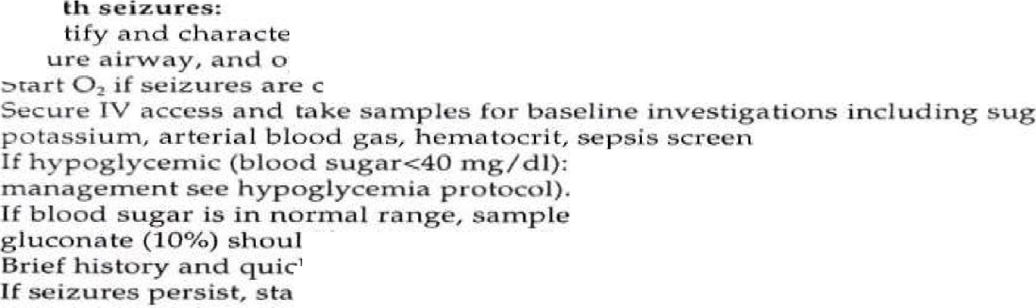




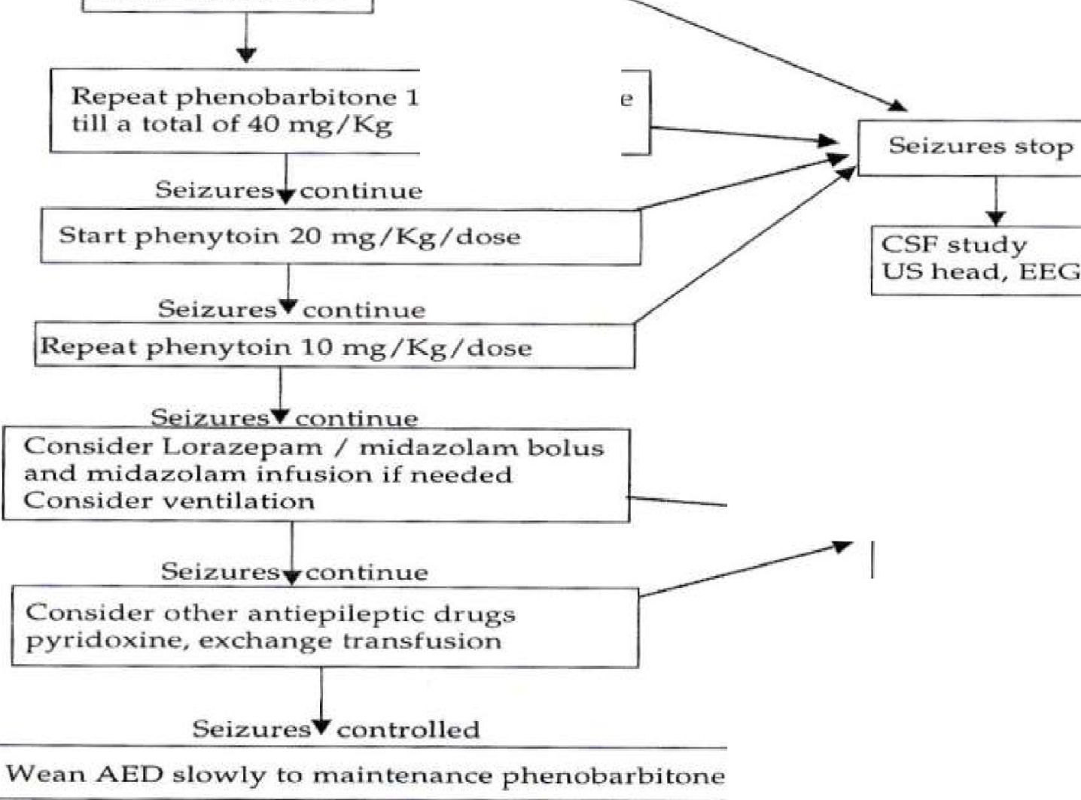
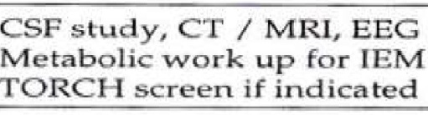
Neon te wi
I n
5 C
tar
d i.a .gr
am on man
ement of ,ne o n a t a l s e i zu
e 5
r i­
p ti
i r uJ -tio
•
on tin uo us
k
r , c a l ci u m ,, m .agn s '.um ,
d i u m ,
•
;'
% d e x t r o
h o ul d
b w i th dr wn :n
Jy. (Fo fu h r
g ·
.
g i v ,en · m m d i _
f ,. i
i -z d
sh
2. ml / K g
f c-a lc i u n,
•
•
d
.
- c ar d i a c m o
.
- - -
rt h
X
. .
m /Kg st t ov
20 rni u
en
o.,...a.-r-
.--
1
Seizur
0 s/ g/ d s.

Slide 36
Determinants of Duration of anticonvulsant therapy for neonatal seizures
Neonatal neurological examination
Cause of neonatal seizure
Electroencephalogram

Slide 37
WHEN TO DO EEG?
As soon as a seizure occurs
Within 24 hours
Continuous EEG monitoring
Interictal EEG normal –nonepileptic process
EEG abnormal-video EEG monitoring
Repeat EEG at 1 wk duration

Slide 38
Neonatal period
Duration of anticonvulsant therapy-Guidelines
If neonatal neurological examination becomes normal discontinue therapy
If neonatal neurological examination is persistently abnormal,consider etiology and obtain EEG
In most such cases- Continue phenobarbital
  Discontinue phenytoin
  Reevaluate in 1 month

Slide 39
Duration of anticonvulsant therapy-Guidelines
One month after discharge
If neurological examination has become normal, discontinue phenobarbital
If neurological examination is persistently abnormal,obtain EEG
If no seizure activity on EEG, discontinue phenobarbital

Slide 40
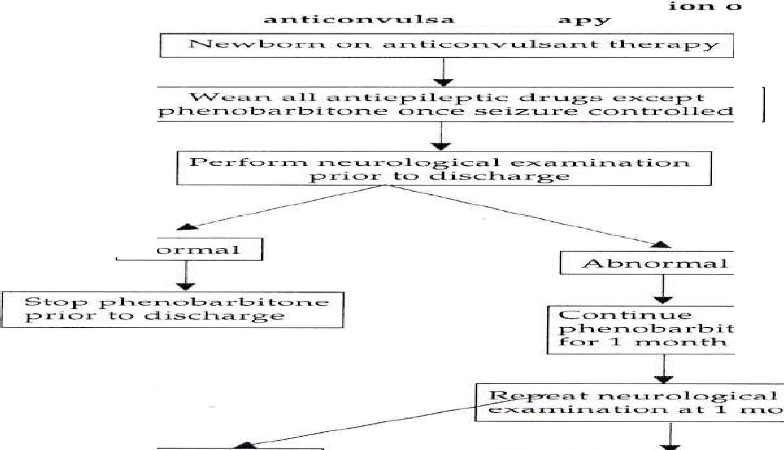
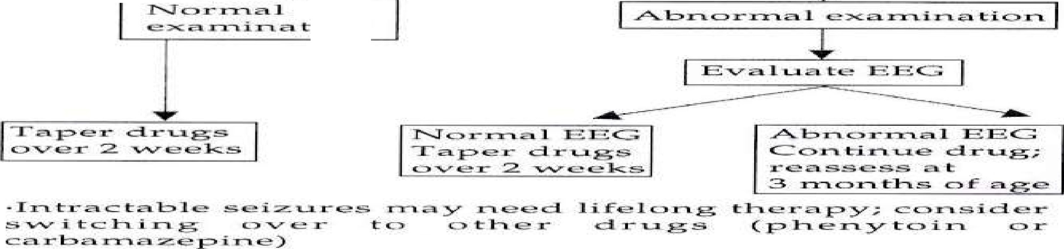
FI
.d. .i.. .-si.
,r ,.a.. m
C> :;rm. w
i.11:"'a..g ....._ tl rl.
I;; t:l:iei::r
'IL'.l....r .
:r-,..J" c::, r- m
C:::,
. . .
- . ,C,,T"'l.
,n.th.
i.C:,, :r"'L

Slide 41
Prognosis
Two most useful approaches in utilizing outcome
EEG
Recognition of the underlying neurological disease

Slide 42
Prognosis of Neonatal seizures in relation to EEG
EEG NEURO.SEQUELE BACKGROUND
Normal
Severe abnormalities† Moderate abnormalities‡
£10
³90
~50

Slide 43
Causes of Neonatal Seizures and Outcomes
Percent of Patients Who Have Normal Development
Cause
Hypoxic-ischemic encephalopathy Intraventricular hemorrhage Subarachnoid hemorrhage Hypocalcemia
Early-onset Later-onset Hypoglycemia
Bacterial meningitis
Developmental malformations Benign familial neonatal convulsions Fifth-day fits
50
10
90
50
100
50
50
0
~100
~100

Slide 44
Complications
Cerebral palsy
Hydrocephalus
Epilepsy
Spasticity
Feeding difficulties

Slide 45
Consultations
Neurology consult needed for
  evaluation of seizures
  evaluation of EEG and video EEG monitoring
  management of anticonvulsant medications

Slide 46
Further Outpatient Care
Developmental evaluation for early identification of physical or cognitive deficits
Orthopedic evaluations if with joint deformities
Consider physical medicine/physical therapy referral if indicated

Slide 47

THANK YOU !

