Slide 1

Investing procedure

Slide 2
Lesson plan
Target : 2nd yr BDS
Time period : 20 min
End of the lesson you will be able to answer what is sprue, sprue length, sprue diameter, investing procedure

Slide 3
Content
Introduction.
Steps in casting procedure.
Preparation of the master die.
Sprue design and casting ring liners.
Investing procedure.
Casting procedure.
- Wax elimination and heating
- Casting Machines
Cleaning of casting.
Conclusion
References

Slide 4
Introduction
Casting is the process by which a wax pattern of a restoration is converted to a replicate in dental alloy.
The casting process is used to make dental restoration such as
- Inlays,
- Onlays,
- crown and Brides
- Removable partial denture
In Dentistry, virtually all casting is done using Lost-Wax Technique, Introduced by TAGGART in 1907

Slide 5
What is investing & Casting ?
Is defined as something that has been cast in a mold, an object formed by the solidification of a fluid that has been poured or injected into a mold.(GPT-8)

Slide 6
Steps in Casting Procedure
Tooth preparation.
Impression.
Die preparation.
Preparing the Wax Pattern.
Spruing the Wax Pattern.
Attaching the sprue to Crucible Former.
Investing procedure.
Wax elimination and heating.
Casting
Cleaning of the casting.
Finishing and Polishing.

Slide 7
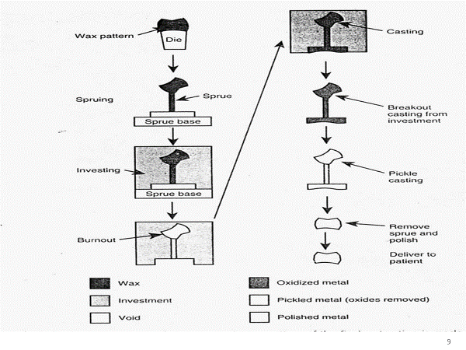

Slide 8
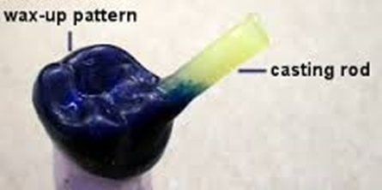
Prior to Casting….
Margins of the wax pattern should be readapted.
Patterns checked for smoothness, finish and contour.
Sprue should be attached to the thickest portion of the wax pattern.
Wax pattern can be removed from the die using sprue.
Surfactant should be applied on the wax.
Invested immediately to prevent distortion.

Slide 9
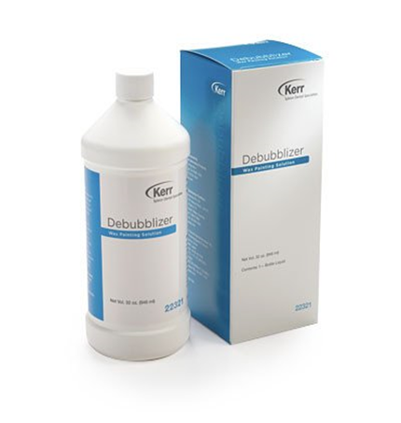
Surfactant
A surface tension reducing agent that allows investment to flow uniformly to all portions of the wax pattern. For use when hand mixing.

Slide 10
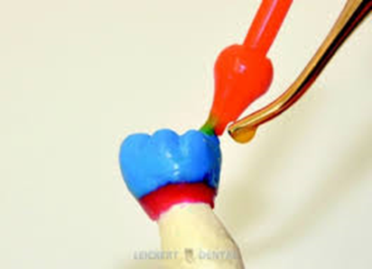
Spruing the Wax Pattern
Sprue is defined as “ the Channel or hole through which metal is poured into the mold.”
Sprue design is depending on the :
- Type of the restoration being cast.
- The alloy used
- The casting machine.

Slide 11
Material used for the sprue
Wax
Preferred for most casting because they melt at the same rate as the pattern and allow for easy escape for molten wax
Plastic
Resist Distortion.
Metal
Noncoroding metal should be used.
Removed before casting.
May Block the escape of wax which casting Roughness.

Slide 12
Sprue Diameter
Should be larger than the thickest portion of the wax pattern.
If too small – suck back porosity.
If too large – Distoration.
2.5 mm for Molar and Metal-ceramic pattern.
2.0 mm for Premolar and Partial coverage Restoration.
Narrow sprue are sufficient for casting to be done on centrifugal machine.

Slide 13
Sprue length
The length of the sprue former depends on the length of casting ring but - it keeps the wax pattern 6mm from the end of the ring.
Too short sprue – gas venting dose not occur properly.
Too long sprue – chances of alloy getting hardened prematurely.

Slide 14
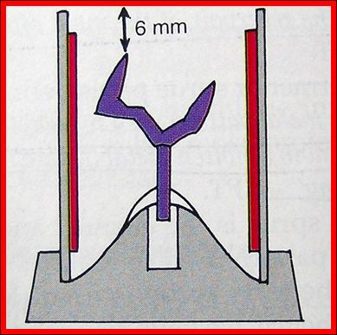
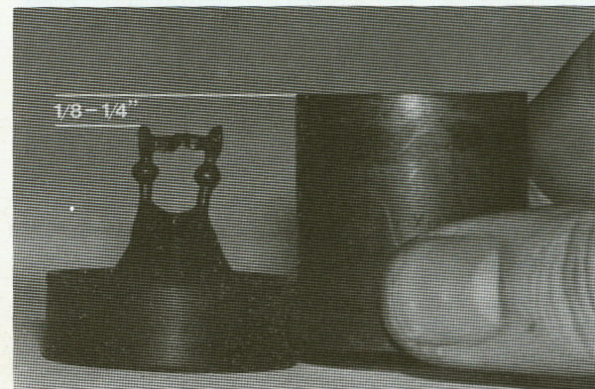

Slide 15
Location
Should attached to the bulkiest noncritical part of the pattern, away from margins and occlusal contacts.
Normally, largest Non-functional cusp is used.
45 angulation near the bulk of the pattern.
Attachment should be flared to prevent turbulence during metal flow.

Slide 16
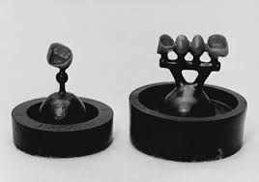
Reservoir
Reservoir is a small amount of additional wax which is added to the sprue former near the junction of wax pattern.
It should be 1 mm from wax pattern.

Slide 17
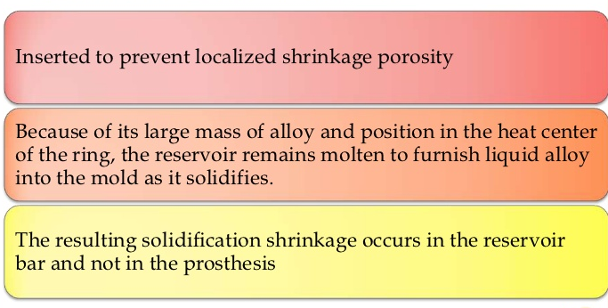
RESERVOIR & ITS IMPORTANCE

Slide 18
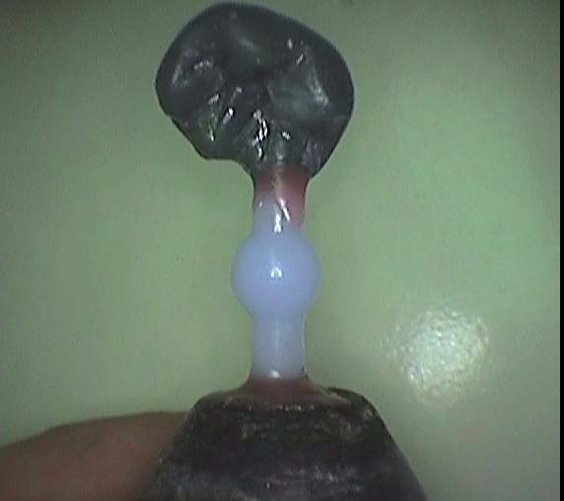
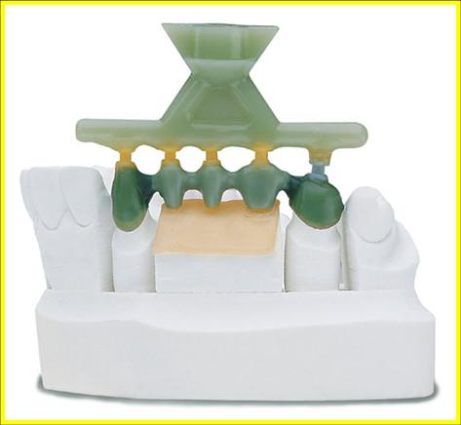
TYPES OF ATTACHMENT
Direct
Indirect

Slide 19
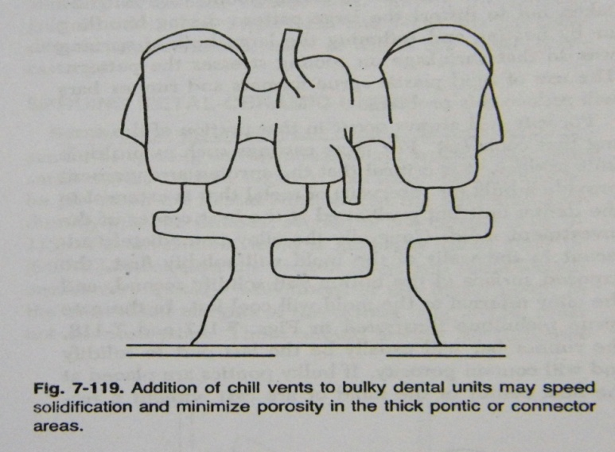
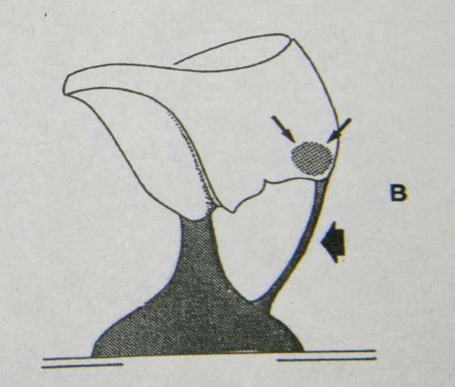
Ventting
Small Auxiliary sprues or vent should be placed to improve the casting.
By allowing the gases to escape.
Auxiliary sprue

Slide 20
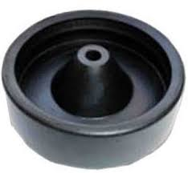
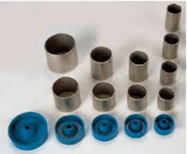
Crucible former
The sprue is attached to crucible former which constitutes the base of casting relation with casting ring during investing.
It also helps by holding sprue in desired ring.

Slide 21
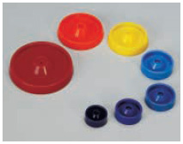
They are available as----
Rubber crucible former
Metallic Crucible former
Plastic crucible former

Slide 22
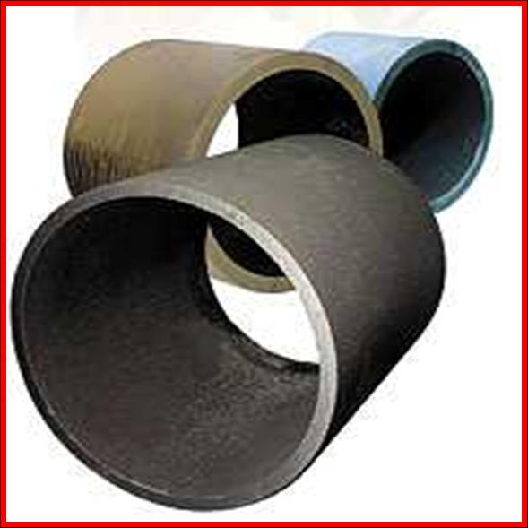
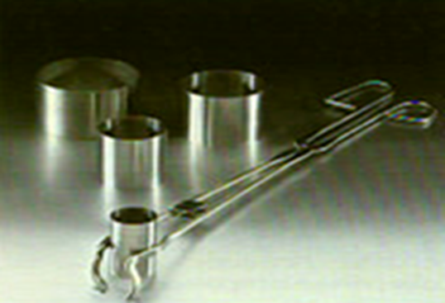
Casting ring
Casting rings are used to confine the fluid investment around the wax pattern while the investment sets.
It also allow the hardened investment to be safely handled during burnout and casting

Slide 23
Considerations in selection of casting rings
The internal diameter of casting ring should be 5-10mm greater than the widest measurement of the pattern and about 6 mm higher.
For single crown/inlay - small rings as used. Diameter - 32 mm
For large fixed partial denture – 63mm; round/oval shaped casting ring are used

Slide 24
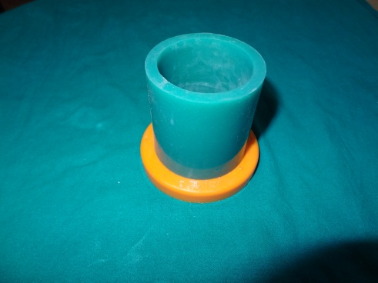
Ringless casting system
Plastic ring with rubber crucible formers are used.
The ring is conical in shape with tapering walls.
As the investment sets the investment is tapped
out of ring.
Then burnout is done with out casting ring, this
causes greater expansion

Slide 25
Casting ring liner
commonly used Materials as ring liners…
1. Asbestos liner
2. Cellulose (blotting paper) liner
3. Ceramic ring liner
4. Combination of ceramic and cellulose ring liner

Slide 26
Function of casting ring liner
Allow uniform expansion.
In case of wet liner technique- hygroscopic expansion.
Thickness of the liner should be less than 1mm.
Place the liner somewhat short of the ends of the ring around 3 mm.

Slide 27
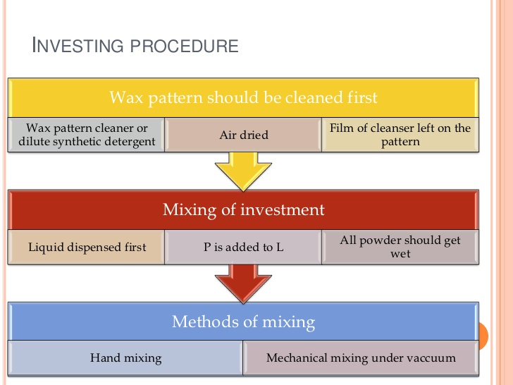
INVESTING PROCEDURE

Slide 28
Next step is Investing
Hand investing.
Vacuum investing.
Hand investing
Thin layer of investment
painted over pattern.
Casting ring positioned on
crucible former.
Pouring and vibrating.
Vacuum investing
Air bubbles can be entrapped
even with Vacuum mixing
Excessive vibration should be
avoided
Advantage of vacuum mixing :
Removes air bubbles
Evacuates harmful gases.

Slide 29
If the Hygroscopic technique is employed, the filled casting ring is immediately placed in a 37 C water both with the crucible former side-down.
For the Thermal expansion or high-heat technique, the invested ring is allowed to bench set undisturbed for the time recommended by the manufacture.

Slide 30
Wax Elimination (Burnout)
It consist of heating the investment in a thermostatically controlled furnace until all traces of the wax are vaporized in order to obtain an empty mold ready to receive the molten alloy during procedure.
Ring is place in the furnace with the sprue hole facing down to allow for the escape molten wax .
Temperature slowly in order to eliminate the wax.

Slide 31
For gypsum bonded investment, the mold is heated to 650-700 C in 60 min and held for 15 to 30 min.
For phosphate-bonded investment, the mold is heated to 750-1030 C and held for 20-30 min.
Ring should be maintained long enough at the maximum temperature(“Heat soak”) to minimize a sudden drop in temp. upon removal from the oven. Such a drop could result in incomplete casting

Slide 32
During burnout, some of the melted wax is absorbed by the investment , and residual carbon produced by ignition of the liquid wax becomes trapped in the porous investment.
It is also advisable to begin the burnout procedure while the mold is still wet.

Slide 33
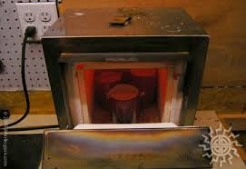

Slide 34
Thank you

