Slide 1
Malaria
Dr Sucheta Lakhani
Professor
Department of Microbiology

Slide 2
History
The name “Malaria” (“Mal” means bad and “aria” means air) -“disease is spread by air pollution through stagnant water and marshy lands”
Alphonse Laveran (1880) discovered the causative agent Plasmodium, in the RBC of a patient in Algeria.
Sir Ronald Ross, in 1897 had described the sexual cycle of the parasite in female Anopheles mosquito in Secunderabad, India.
Alphonse Laveran and Sir Ronald Ross won the Nobel Prize for their contributions in malaria.
Ms Tu Youyou, a chemist was awarded Nobel prize in Medicine (2015), for the discovery of artemisinin, which is used for treatment of falciparum malaria.

Slide 3
Classification
Kingdom: Protozoa
Subkingdom: Neozoa
Phylum: Apicomplexa
Class: Coccidea
Order: Haemosporida
Genus: Plasmodium

Slide 4
Causative agent of Malaria
Human infection is mainly caused by five species such as:
1. P. vivax causes benign tertian malaria (periodicity of fever is once in 48 hours)
2. P. falciparum causes malignant tertian malaria (severe malaria, periodicity of fever is once in 48 hours)
3. P. malariae causes benign quartan malaria (periodicity of fever is once in 72 hours)
4. P. ovale causes ovale tertian malaria (periodicity of fever is once in 48 hours)
5. P. knowlesi causes quotidian or simian malaria (fever periodicity is once in 24 hours, i.e. recurs every day).
  It is a parasite of monkey but can also infect humans and many cases affecting man were recently reported from Asia.

Slide 5
Life Cycle of Malaria Parasite
Host: Plasmodium completes its life cycle in two hosts:
1. Definitive host: Female Anopheles mosquito; Here sexual cycle (sporogony) takes place.
2. Intermediate host: Man; the asexual cycle (schizogony) takes place.
Human Cycle has 3 es
Pre­-erythrocytic schizogony
Erythrocytic schizogony
Gametogony.

Slide 6
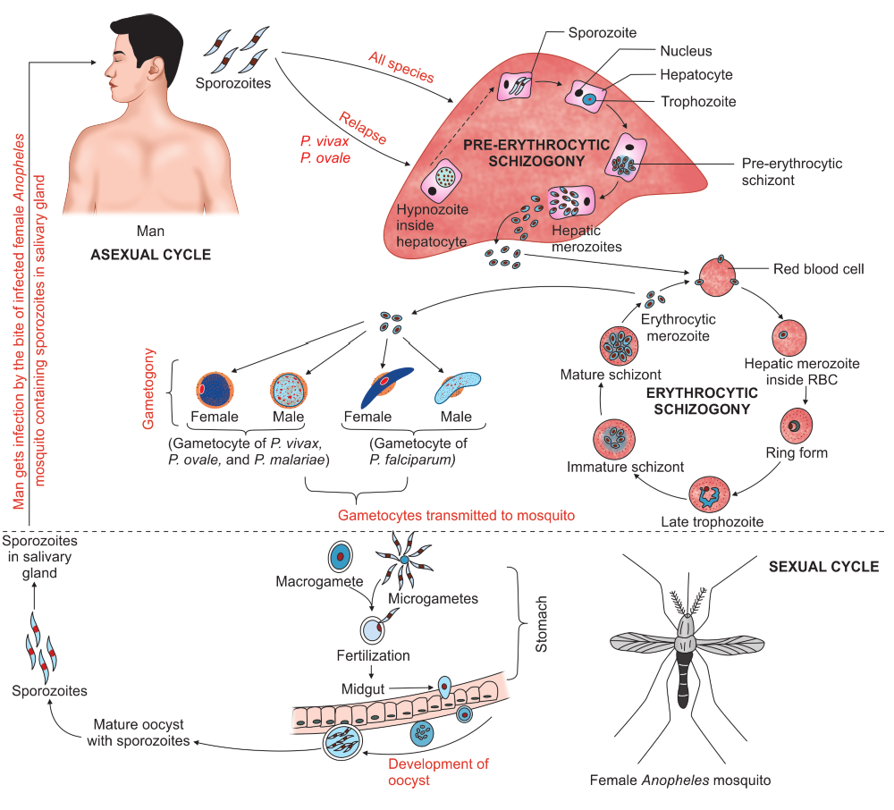
Life cycle of
Malaria
Parasite

Slide 7
Characteristic features of pre-erythrocytic schizogony
Characteristic feature | P.falciparum | P.vivax | P.ovale | P. malariae
Duration of pre-erythrocytic schizogony | 5.5 days | 8 days | 9 days | 15 days
Number of merozoites per infected pre-erythrocytic schizont | 30,000 | 10,000 | 15,000 | 15,000
Pre-erythrocytic schizont size | 60 µm | 45 µm | 60 µm | 55 µm

Slide 8
Relapse Vs Recrudescence
Recrudescence
Although seen in all species, more common in P. falciparum followed by P. malariae
Falciparum malaria—recrudescence is due to persistence of drug resistant parasites, even after completion of treatment
In P. malariae infection, long-term recrudescences for up to 60 years can be seen, due to long-term survival of erythrocytic stages at a low undetectable level in blood
Relapse
Seen in Plasmodium vivax and P. ovale infections
Few sporozoites do not develop into pre-ery throcytic schizont, but remain dormant (known as hypnozoites) for 3 weeks to 1 Year
Reactivation of hypnozoites leads to initiation of erythrocytic cycle and relapse of malaria.

Slide 9
Pathogenesis and Clinical feature
Benign Malaria
It is milder in nature, can be caused by all four species, characterized by a triad of febrile paroxysm, anemia and splenomegaly.
1. Febrile paroxysm
Fever comes intermittently depending on the species. Paroxysm corresponds to the release of the successive broods of merozoites into the bloodstream, at the end of RBC cycle
Each paroxysm of fever is comprised of three stages—
(1) cold stage (2) hot stage and (3) sweating stage

Slide 10
2. Anemia
After a few paroxysms of fever, patient develops normocytic normochromic anemia due to-
  Parasite induced RBC destruction
  Splenic removal of both infected RBC and uninfected RBC coated with immune complexes
  Bone marrow suppression leading to de crease RBC production
  Increased fragility of RBCs.
  Autoimmune lysis of coated RBCs.
3. Splenomegaly
After a few weeks of febrile paroxysms, spleen gets enlarged and becomes palpable. It is due to massive proliferation of macrophages that engulf parasitized and nonparasitized coated RBCs.

Slide 11
Falciparum Malaria (Malignant Tertian Malaria)
Sequestration of the parasites: P. falciparum has ability to sequester the parasites in the blood vessels of deep visceral organs. This leads to blockade of vessels, congestion and hypoxia of internal organs. It is mediated by:
  Cytoadherence: Binding of infected erythrocytes to endothelial cells, via P. falciparum erythrocyte membrane protein-1 (PfEMP-1).
Rosetting: Binding of infected erythrocytes to uninfected erythrocytes.
Deformability: Parasitized RBCs become more spherical and rigid.
PfEMP undergoes frequent antigenic variation and helps the parasite in evading the host immune response.
High level of parasitemia- up to 30–40% of total RBC can be infected.

Slide 12
Complications
Complications of Falciparum Malaria
1. Cerebral malaria:
Occurs due to plugging of brain capillaries by the rosettes of sequestered parasitized RBCs leading to vascular occlusion and cerebral anoxia.
It manifests as diffuse symmetric encephalopathy characterized by generalized convulsion in 10% of adults and up to 50% of children.
Muscle tone and tendon reflexes are reduced, retinal hemorrhages, neurologic sequelae, repeated seizures, and rarely deep coma.
Signs of focal neurologic and meningeal irritations are absent
High mortality rate—20% among adults and > 15% among children.

Slide 13
Complications of falciparum malaria continued..
2. Pernicious malaria: It is characterized by black water fever, algid malaria and septicemic malaria
Black water fever: Sudden intravascular hemolysis followed by fever, hemoglobinuria and dark urine
  It occurs following quinine treatment to subjects previously infected with P. falciparum
  Antibodies develop against parasitized and quininized RBCs. With subsequent infection and
  quinine treatment, there is immunocomplex formation followed by complement mediated
  massive destruction of both parasitized and nonparasitized RBCs.
Algid malaria: Cold clammy skin, hypotension, peripheral circulatory failure and profound shock
Septicemic malaria: High degree of prostration, high grade fever with dissemination of the parasite to various organs leading to multi-organ failure.

Slide 14
Complications of falciparum malaria continued..
3. Pulmonary edema and adult respiratory distress syndrome: Mortality rate is > 80%
4. Hypoglycemia: It is associated with a poor prognosis; specially in children and pregnant women and following quinine therapy
5. Renal failure: It occurs due to erythrocyte sequestration in renal microvasculature leading to acute tubular necrosis.
6. Bleeding/disseminated intravascular coagulation: Patient presents with significant bleeding and hemorrhages from the gums, nose and GIT with or without evidence of DIC.
7. Severe jaundice: It results from hemolysis, hepatocyte injury and cholestasis
8. Severe normochromic, normocytic anemia: Characterized by hematocrit of less than 15% or hemoglobin level of less than 5 g/dL with parasitemia level of more than 100,000/µL (>2%)
9. Acidosis: Results from accumulation of organic acids like lactic acid.

Slide 15
Chronic Complications of Malaria
Tropical splenomegaly -It occurs in people of malaria ­endemic areas in tropical Africa and Asia (including India).
  It results from an abnormal immunologic response characterized by: Elevated IgM, Massive splenomegaly, Hepatic sinusoidal lymphocytosis, Peripheral B cell lymphocytosis (in Africa).
Quartan malarial nephropathy-It is a chronic complication seen with P. malariae.
  It occurs due to injury to the renal glomeruli by the immune complexes, resulting in nephrotic syndrome.
Promotes Burkitt’s lymphoma- Malaria induced severe immunosuppression in African children provoke Epstein­-Barr virus infection to develop Burkitt’s lymphoma.

Slide 16
Immunity against Malaria
Innate Immunity-It is the inherent host resistance against malaria parasite, due to
Age of RBCs: P. falciparum attacks RBCs of any age, P. vivax and P. ovale attack the young RBCs and reticulocytes; whereas P. malariae attacks older RBCs.
Nature of hemoglobin: Sickle cell disease, haemoglobin C and E, fetal hemoglobin and thalassemia haemoglobin are resistant to falciparum malaria.
Hereditary ovalocytosis: Here the rigid RBCs are resistant to falciparum malaria.
RBCs with G6PD deficiency- are resistant to falciparum malaria
Duffy negative red blood cells
Nutritional status: It has a paradoxical effect. Severe malaria is rare in children suffering from malnutrition.

Slide 17
Acquired Immunity
Humoral immunity: Circulating antibodies (IgA, IgM and IgG) against asexual forms give protection by inhibiting the red cell invasion and sequestration, whereas antibodies against sexual forms help in reducing the transmission of malaria
Cellular immunity: It also plays role in providing protection against malaria. Cytokines released from T cells stimulate the macrophages and also stimulate the B cells to produce antibodies.
Immunity against malaria attack is species specific, stage specific and strain specific.
Immunity lasts till the original infection remains active and prevents further infection. This is called as infection immunity or premunition.

Slide 18
Epidemiology of Malaria
World: In 2016, 216 million cases of malaria with 4.45 lakh deaths occurred worldwide
WHO region: Tropical zone is affected the most.
  According to WHO malaria report 2017, WHO African Region (90%) affected the worst, followed by the South­east Asia Region (7%) and Eastern Mediterranean Region (2%)
  Incidence rate: It is about 63 cases per 1000 population at risk; WHO South ­East Asia Region recorded the largest decline (48%)

Slide 19
Epidemiology of Malaria continued..
In 2016, P. falciparum is the most common species worldwide; 99.7% in sub­Saharan Africa and 66% South east Asia.
P. vivax is the predominant parasite only in American region (64%).
Age: Children are more prone to infection and complications.
Predisposing factors for transmission of malaria is directly proportional to:
  Density of the vector
  Number of human bites per day per mosquito
  Time of mosquito bite (more after the dusk)
  Mosquito longevity (as sporogony lasts for 7–30 days, thus, to transmit malaria, the mosquito must survive for >7 days)
  Optimum temperature (20–30°C)
  Optimum humidity (60%)
  Rainfall (July to November)

Slide 20
Malaria Situation In India (NVBDCP Report 2016)
According to National Vector Borne Disease Control Programme (NVBDCP) malaria report 2016:
In 2016, 1.09 million malaria cases were reported from India with 331 deaths. The mortality rate declined by 70% compared to 2001.
P. falciparum was the predominant species; accounted for 65.53% of total cases followed by P. vivax (34%).
Odisha accounted for the maximum malaria cases (41%); followed by Chhattisgarh (13.5%) and Jharkhand (13%).
P. malariae infections are <1% and reported from Karnataka (Tumkur and Hassan districts), Chhattisgarh (Bastar area), Odisha, West Bengal, Madhya Pradesh etc.
P. ovale is mainly confined to tropical Africa. Only few cases are reported from India such as Odisha (Koraput district, 1st case of India), Chhattisgarh (Bastar area), Delhi, Assam, Gujarat and Kolkata.

Slide 21
Laboratory Diagnosis
1.Microscopic tests:
Peripheral blood smear-Thick and Thin smear
Fluorescence microscopy (Kawamoto’s technique)
Quantitative buffy coat examination
2. Non-microscopic tests:
Antigen detection tests (RDTs)
Culture—RPMI 1640 medium
Molecular diagnosis—PCR using PBRK1 primer.

Slide 22
Peripheral Blood Smear
It is the simple and gold standard confirmatory test
Specimen-Peripheral blood is collected from ear lobe or by finger prick or great toe (in infants).
Time for taking blood: Collected few hours after the height of the paroxysm of fever and before taking antimalarial drugs.
Frequency: Smears should be examined at least twice daily until parasites are detected.
Types of peripheral blood smear-(1) thin and (2) thick smears.

Slide 23
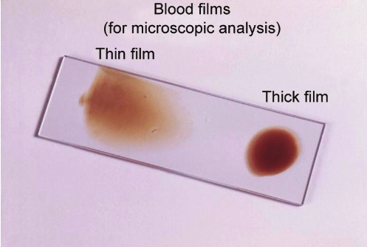
Smears are stained with one of the Romanowsky’s stains such as Leishman’s, Giemsa and Field’s, Wright’s or JSB stain
Thin smear has to be screened first. It is screened near the feathery tail end.
Thick smear has to be examined if no para sites are found in thin smear.
Figure: Glass slide showing thin and thick blood smear

Slide 24
Advantages and disadvantages of peripheral smear
Advantages
Peripheral smear is simple, rapid and cheap
Thick smear is useful in: Detecting the parasites: It is 40 times more sensitive than thin smear, can detect as low as 5–10 parasites per µL of blood.
Quantification of parasitemia
Demonstrating the malaria pigments.
Thin smear is useful in speciation of malaria parasite.
Disadvantages
Labor intensive and requires experienced micro­scopist.
Low sensitivity: The detection limit of thin smear is more than 200 parasites per µL of blood.

Slide 25
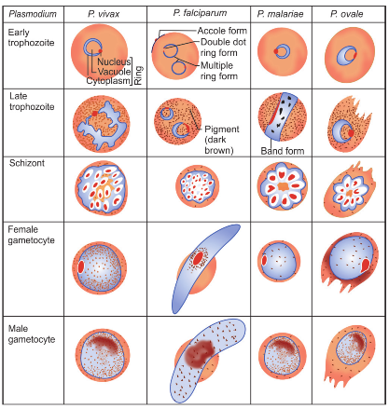
Speciation of malaria parasite

Slide 26
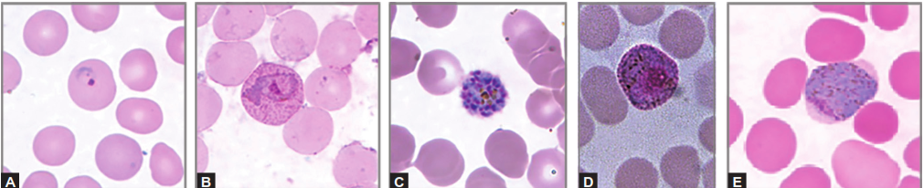
Various morphological forms of Plasmodium vivax
Thin blood smear showing different forms of Plasmodium vivax; (A) Ring form; (B) Amoeboid form; (C) Schizont; (D) Male gametocyte; (E) Female gametocyte

Slide 27
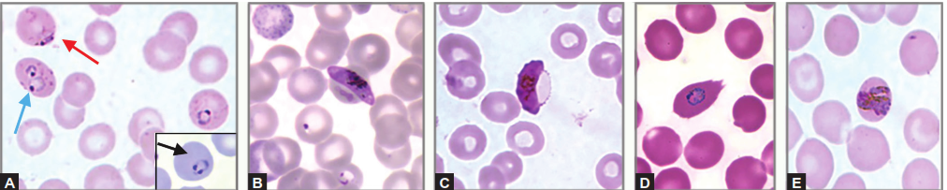
Morphological forms various of Plasmodium species
Thin blood smear showing: (A) P. falciparum ring forms such as multiple rings (blue arrow), accole form (red arrow) and head phone-shaped ring form (black arrow); (B) Female gametocyte of P. falciparum; (C) Male gametocyte of P. falciparum; (D) Ring form of P. ovale; (E) Band form of P. malariae

Slide 28
Quantitative Buffy Coat Examination
QBC malaria test consists of three basic steps—
(1) concentration of blood by centrifugation,
(2) staining with acridine orange stain and
(3) examination under ultraviolet (UV) light source
Interpretation
Acridine orange stains the nuclear DNA fluorescent brilliant green.
Normal RBCs don’t take up the stain (as they are a nucleated).
Parasitized RBCs appear as brilliant green dots. WBCs also take up the stain.
Advantages
QBC examination is faster, more sensitive, quantification is possible.
Disadvantages
It is expensive, less specific and speciation is difficult.

Slide 29
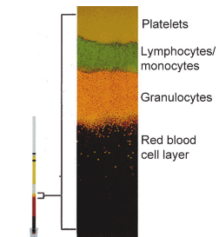
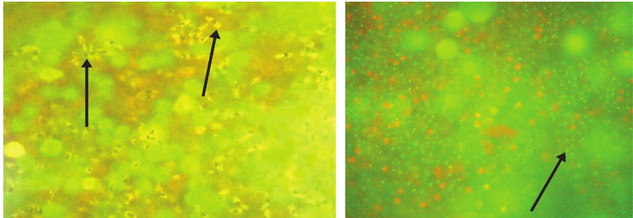
Interpretation of QBC
Crescent shaped gametocytes of
P. falciparum;
QBC capillary tube with
magnified view

Slide 30
Antigen Detection by Rapid Diagnostic Tests
RDTs are based on lateral flow assay or Immunochromatographic test (ICT)
1) Parasite lactate dehydrogenase (pLDH): It is produced by trophozoites and gametocytes of all Plasmodium species. Currently available test kits can differentiate pan malarial pLDH common to all species and pLDH specific to P. falciparum
2) Parasite aldolase: Produced by all Plasmodium species.
3) Plasmodium falciparum specific histidine rich protein-2 (Pf-HRP-II): It is produced by trophozoites and young gametocytes of P. falciparum

Slide 31
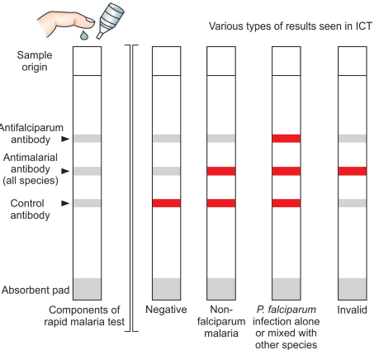
Schematic diagram
of rapid diagnostic test

Slide 32
Advantages and disadvantages of rapid diagnostic tests
Disadvantages
Advantages
Simple to perform, do not need extra equipment or trained microscopist
More than 90% sensitive at >100 parasites/µL.
pLDH is produced by the viable parasites, hence it is used to monitor the response for treatment
HRP2 is a reliable marker to diagnose malaria in pregnancy
Intensity of the band is directly proportional to the parasitemia and severity of the disease.
Expensive
Cannot differentiate between the non­falciparum malaria species
False positive bands appear in rheumatoid arthritis factor positive cases
The lower limit to detect HRP2 is 40 para sites/µL and pLDH is 100 parasites/µL
HRP2/HRP3 gene deletion: resulting in false negative P. falciparum RDT result.

Slide 33
RDT under NVBDCP
RDT based on HRP2 or LDH should be used.
RDT to be selected should have the following sensitivity and specificity
  P. falciparum: Sensitivity and specificity should be minimum 95% at parasite density level of 200 asexual parasites/uL of blood
  For P. vivax: Sensitivity minimum 75% and specificity 90% at density of 200 parasites/uL

Slide 34
Antibody Detection
ELISA, IFA and rapid diagnostic test formats are available using soluble malarial antigens.
Antibodies persist even after the clinical cure.
Serology does not detect current infection, but only measures past exposure.
Therefore, Government of India has banned the use of antibody detection tests for malaria diagnosis.

Slide 35
Culture
Culture techniques for malaria are mainly used for preparation of malaria antigens.
Trager and Jensen (1976) simple method for continuous culture of P. falciparum using RPMI 1640 medium (Roswell Park Memorial Institute and 1640 denotes the number of passages)
  It is a continuous flow system mixed with a thin layer of RBC and an overlay medium consists of human serum maintained with 7% CO2 and 1–5% O2
The other media used are Dulbecco’s Modified Eagle Medium (DMEM), RPMI 1630, and Medium 199.

Slide 36
Molecular Methods
Nested multiplex PCR targeting 18S rDNA has been developed for detection of all five human malaria parasites including P. knowlesi.
  It has a detection limit of 10 to 100 copies/µL.
  PCR can also be used to detect drug resistant genes
Real time PCR is useful for quantification and speciation of parasites.
  Various gene targets include P. falciparum Cox-1 gene, 18S rDNA, and mitochondrial DNA sequence
LAMP assay: Recently loop­mediated amplification (LAMP) kit has been developed.

Slide 37
Treatment of Vivax Malaria
(NVBDCP guideline, India)
Chloroquine- 25 mg/kg, divided over three days, i.e. 10 mg/kg on day 1 and 2 and 5 mg/kg on day 3.
Primaquine 0.25 mg/kg body weight; daily for 14 days; should be given under supervision, aiming to kill hypnozoites of P. vivax (to prevent relapse)

Slide 38
Treatment of Falciparum Malaria
(NVBDCP guideline, India)
NorthEastern States-
  ACT-AL, i.e. co-formulated tablet of artemether and lumefantrine; total dose of 80 mg/480 mg (in adults), given over twice daily for 3 days plus
  Primaquine (0.75 mg/kg) single dose on second day
Other states-
  ACT-SP, i.e. artesunate (4 mg/kg) for 3 days plus sulfadoxine (25 mg/kg)/ pyrimethamine (1.25 mg/kg), 1 tablet given on first day plus
  Primaquine (0.75 mg/kg) single dose on second day

Slide 39
WHO Guideline for Assessing Degree of Resistance
Antimalarial drug resistance is defined as the “ability of a parasite strain to survive and/or to multiply despite administration and absorption of a drug given in doses equal to or higher than those usually recommended but within tolerance of the subject and the drug must be able to gain access to the parasite”

Slide 40
Four categories of degree of resistance :
1. Early treatment failure (ETF): Develop ment of danger sign or severe malaria (fever >37.5°C) on day 0–3 and parasitemia on day 3 is 25% higher than day 0 count.
2. Late clinical failure (LCF): Development of danger sign or severe malaria (fever >37.5°C) in the presence of parasitemia from day 4 to day 28, without previous meeting of any criteria of ETF.
3. Late parasitological failure (LPF): Presence of parasitemia on any day from 7 to 28 days & fever less than 37.5°C; without previous meeting of any criteria of early and late treatment failure.
4. Adequate clinical and parasito logical response (ACR): Absence of parasitemia on day 28 irrespective of fever, with out previous meeting of any criteria of early and late treatment failure.

Slide 41
Prophylaxis against Malaria
Chemoprophylaxis,
Vector control strategies and
Vaccine prophylaxis.

Slide 42
Chemoprophylaxis
For short-term chemoprophylaxis (<6 weeks): Doxycycline is recommended, at a dose of 100 mg daily in adults and 1.5 mg/kg for children.
  The drug should be started 2 days before travel and continued for 4 weeks after leaving the malaria endemic area.
Long-term chemoprophylaxis (>6 weeks): Mefloquine is recommended at a dose of 5 mg/kg weekly and administered two weeks before, during and four weeks after leaving the area.

Slide 43
Vector Control Strategies
Antiadult measures
  Residual insecticide spraying: Dichloro diphenyltrichloroethane (DDT), malathion and fenitrothion is highly effective against adult mosquito
  Space application of pesticide in the form of fog
  Individual protection: by using insecticide treated bed nets, repellents and protective clothing.
Antilarval measures
  Larvicide: Use of mineral oil or Paris green to kill mosquito larvae and pupae
  Source reduction (mosquito breeding sites): Includes environmental sanitation, water management and improvement of the drainage system.
  Biological larvicide: Gambusia affinis (fish) and Bacillus thuringiensis (bacteria) can be used to kill the mosquito larva.

Slide 44
Vaccination for Malaria
RTS, S/AS01
This is the most successful malaria trial; started in 2005 in Africa (Kenya and Ghana) by GlaxoSmithKline (GSK).
Vaccine candidate: It consists of PfCSP (circum sporozoite protein of P. falciparum), hepatitis B surface antigen (HBsAg), combined with a chemical adjuvant (AS01) to boost the immune system response.
Others-ChAd63MVA ME TRAP, MSP3 are phase IIb trial.

