Slide 1

Indirect Retainers
Dr Piyush Javiya
Reader, Dept. of Prosthodontics,
KMSDCH,SVDU

Slide 2
Lesson Plan
Target: III BDS students
Duration: 45 Minutes
Topic: Indirect Retainers in CPD
Content | Duration in Minutes
Introduction | 05
Functions of Indirect retainers | 10
Factors affecting Indirect retainers In Detail | 10
Forms of Indirect retainers | 10
Discussion | 05
CCES | 05

Slide 3
CONTENTS
Introduction
Definition
Auxiliary functions of indirect retainers
Factors determining effectiveness of indirect retainers
Forms of indirect retainers
Conclusion
Bibliography

Slide 4
Introduction
A Removable partial denture that is supported by healthy natural teeth posses adequate stability and retention to resist functional displacement, but a denture base that is supported at one end by a healthy natural abutment and at the other by movable soft tissues will rotate toward or away from the residual ridge when subjected to occlusal forces or the pull of sticky foods.

Slide 5
This rotational movement occurring within a prosthesis supported by natural teeth and soft tissue was first described by F.H.BALKWILL in 1880.
In 1916, J.H.PROTHERO coined the term FULCRUM LINE to identify the primary axis of rotation.

Slide 6
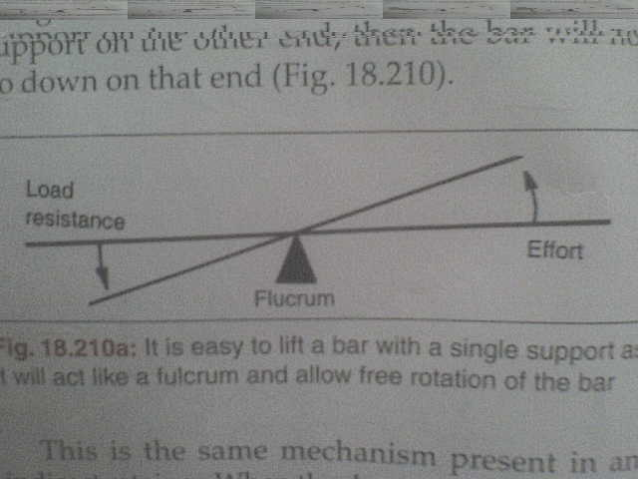
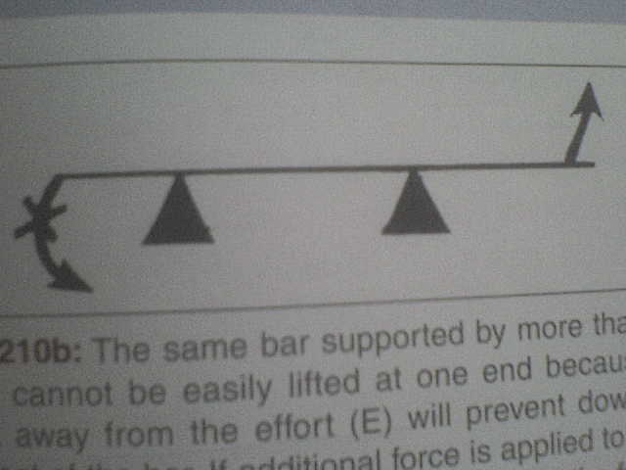
Principle of indirect retainer
Based on lever principle.
When the denture rotate along the retentive fulcrum line, if we provide support away from this line in the form of occlusal rest prevent the rotation and act as indirect retainer.

Slide 7
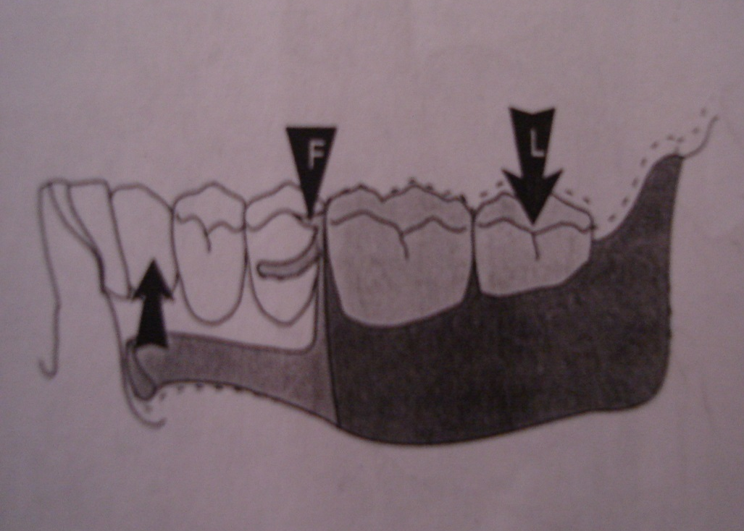
When occlusal load is applied to a distal extension removable partial denture, the prosthesis rotates around a fulcrum line that passes through the most posterior rests, one on each side of the dental arch.
This displacement is resisted by broad and accurate adaptation of the denture base to the supporting tissues.

Slide 8
Forces acting to dislodge the prosthesis in occlusal direction occurs by sticky foods which pull on the artificial teeth and move the extension base away from the underlying ridges.
Active tissues such as the tongue and buccinator muscle also displace the denture base during speech, mastication, or swallowing.

Slide 9
During these forces, the associated fulcrum line passes through the tips of the retentive clasps and the anterior portion of the prosthesis rotates in an apical direction resulting in unwanted prosthesis impingement into the soft tissues of the floor of the mouth.
This impingement of the prosthesis into the floor of the mouth is negated as the fulcrum line is transferred to the anterior rest which acts as an indirect retainer

Slide 10
Indirect retainer
“The component of a partial removable dental prosthesis that assists the direct retainers in preventing displacement of the distal extension denture base by functioning through lever action on the opposite side of the fulcrum line when the denture base moves away from the tissues in pure rotation around the fulcrum line.

Slide 11
Indirect retention
“ The effect achieved by one or more indirect retainers of a partial removable dental prosthesis that reduces the tendency for a denture base to move in an occlusal direction or rotate about the fulcrum line”
The concept of indirect retention was originally described by Dr.W.D.CUMMER

Slide 12
Auxiliary functions of indirect retainers
  When in positive contact with rest seat, an indirect retainer contributes to the overall support and stability of the prosthesis.
  For long span lingual bar, it can provide additional support and rigidity to the major connector.
  It tends to reduce anteroposterior-tilting leverages on the principal abutments, particularly when isolated tooth is being used as an abutment.

Slide 13
  Contact of its minor connector with axial tooth surfaces aids in stabilization and also acts as auxiliary guiding plane when the tooth surface is made parallel to the path of placement.
  Anterior teeth supporting indirect retainers are stabilized against lingual movement.
  It provides the first visual indications for the need to reline an extension base partial denture by the dislodgement of indirect retainers from their prepared rest seats when the denture base is depressed and rotation occurs around the fulcrum.

Slide 14
MECHANICAL DISADVANTAGE
The clasp is always nearer to the indirect retainer (fulcrum) than is the displacing force. The clasp is therefore working at a mechanical disadvantage relative to the displacing force.
The RPD design should strive to reduce the mechanical advantage of the displacing force by placing the clasp axis as close as possible to the saddle and by placing the indirect retainers as far as possible from the saddle.

Slide 15
MECHANICAL DISADVANTAGE
In this RPD design the indirect retainers (the rests on the molar teeth) are inefficient because they are placed too close to the clasp axis.

Slide 16
MECHANICAL DISADVANTAGE
If the clasp axis is moved closer to the saddle the effectiveness of the indirect retention is improved.

Slide 17
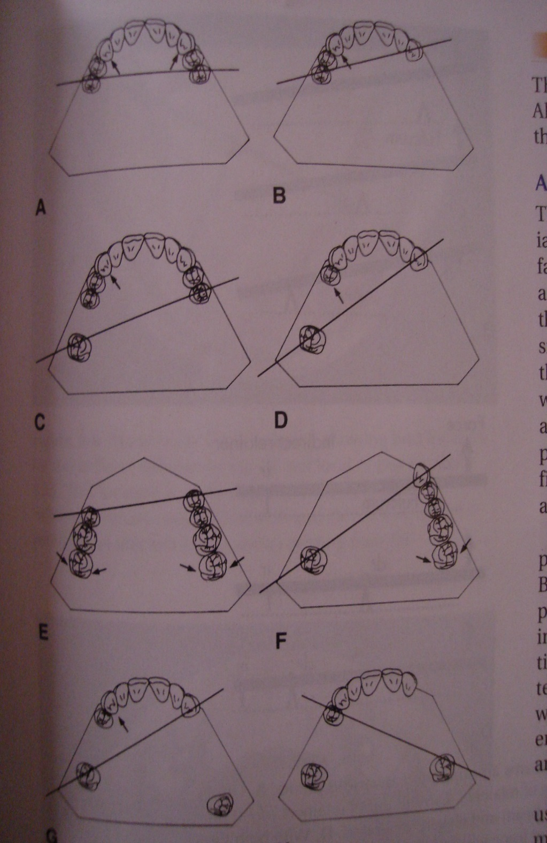
Fulcrum lines in various types of partial edentulous arches and location of indirect retainers.

Slide 18
MCQs

Slide 19
The component of a partial removable dental prosthesis that functioning through lever action on the opposite side of the fulcrum line when the denture base moves away from the tissues in pure rotation around the fulcrum line is known as | Direct retainer | Indirect retainer | Clasp | All of the above
Concept of indirect retention was originally described | Cummers | Prothero | Boucher | Stewart
Indirect retainer works by eliminating class ___ lever | Class I | Class II | Class III | All of the above
Indirect retainer prevent movements | Towards tissue | Away from tissue | Antero posteriorly | All of the above
The mechanical disadvantage of indirect retainer can be reduced by | Placing the clasp axis as close as possible to the saddle | Placing the indirect retainers as far as possible from the saddle | Both of the above | None of the above

Slide 20
Support for Indirect retainers
Tooth support is preferable to mucosal support because the compressibility of mucosa allows movement of the denture to occur.

Slide 21
Support for Indirect retainers
When possible, the indirect retainer should rest on a surface at right angles to its potential path of movement.
If it rests on an inclined tooth surface, movement of the tooth might occur with resulting loss of support for the indirect retainer.

Slide 22
Forms of indirect retianers
Auxiliary occlusal rests.
Cingulum rests.
Incisal rests.

Slide 23
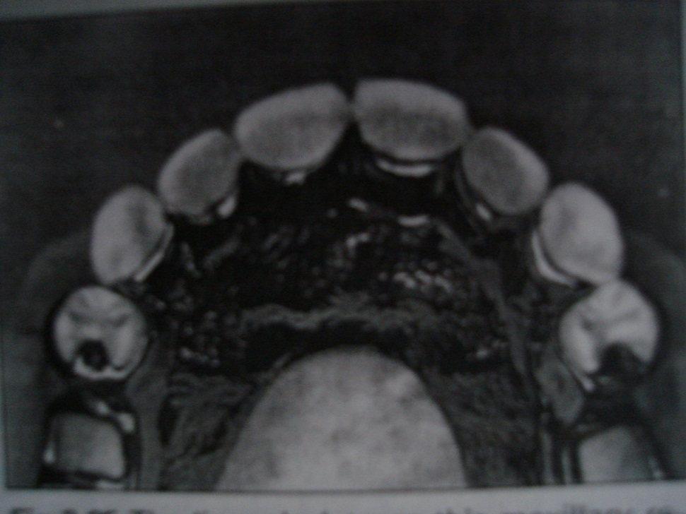
Occlusal rest
Occlusal rest is most preferred because of its location and vertical orientation, permits forces to be directed within the long axis of the abutment.

Slide 24
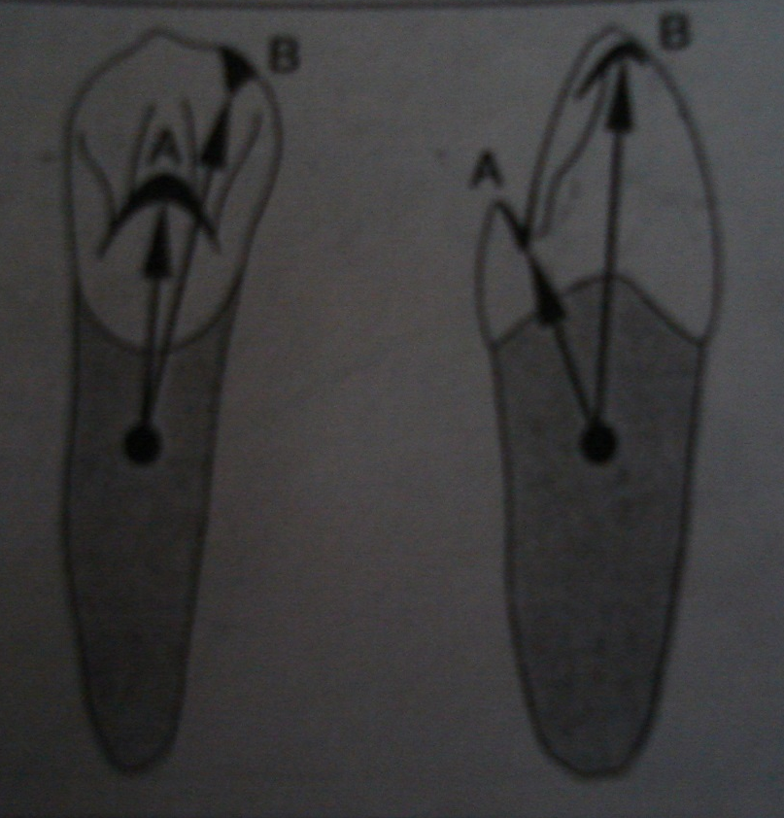
Cingulum rest
A cingulum rest is commonly limited to maxillary canines because of its normal morphology which lends itself to appropriate rest seat preparation with minimal recontouring.

Slide 25
Incisal rest
An incisal rest used as indirect retainer only when all other rests are contraindicated.
It is given in maxillary and mandibular incisors and mandibular canines.
Incisal rests are esthetically objectional and exhibit long approach arms that may transfer harmful tipping forces to abutments

Slide 26
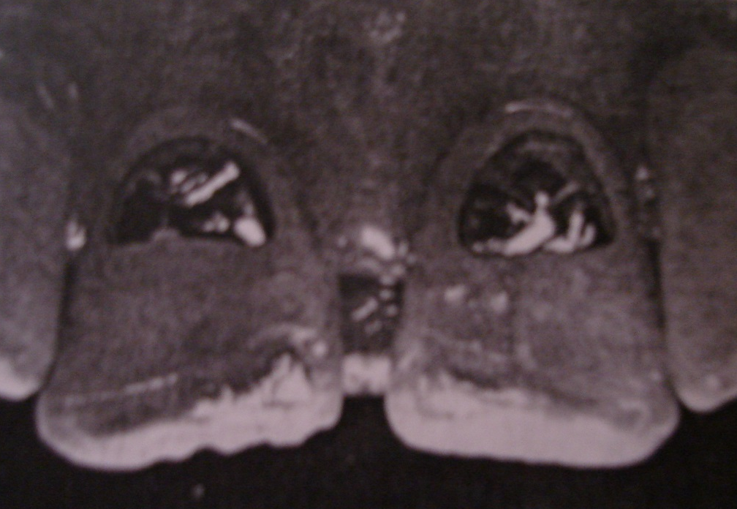
Most effective indirect retention is achieved by preparing the incisor to receive either full coverage restoration or a cast metal rest seat that is bonded to the lingual surface of the tooth.

Slide 27
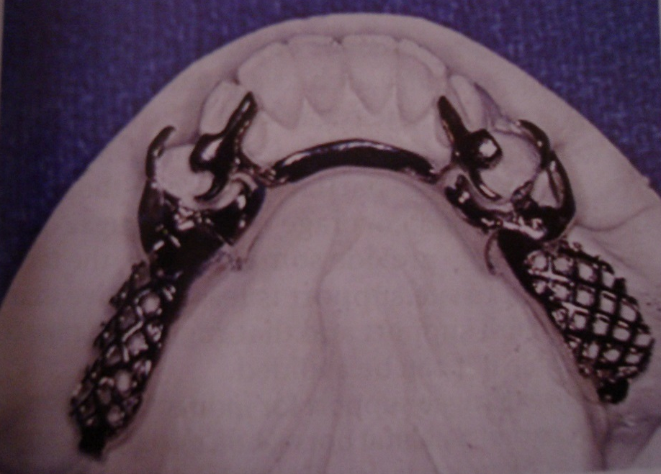
Canine extensions from occlusal rests.
A finger like extensions from a premolar rest is placed on a lingual slope of the adjacent canine tooth.
It is particularly applicable when a first premolar serves as a primary abutment.
No preparation is required on cuspid. Such a design exploits the excellent indirect retention that the cuspid is capable of supplying and combines it with the equally excellent vertical support offered by the bicuspid.

Slide 28
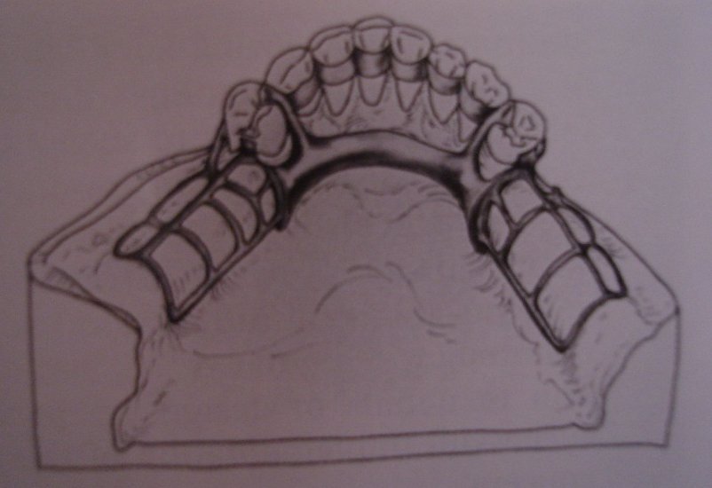
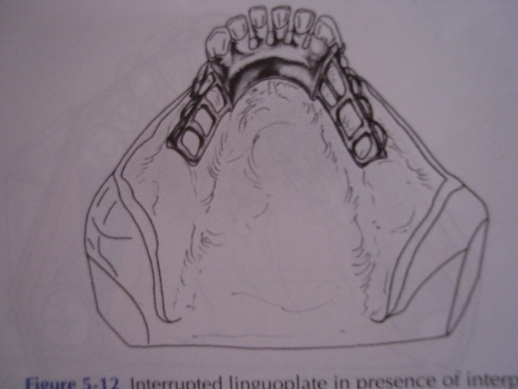
Cingulum bars ( continuous bars ) and linguoplates.
Technically these are not indirect retainers, because they rest on unprepared lingual inclines of anterior teeth, but proves to be effective if it is used with a terminal rest at each end.

Slide 29
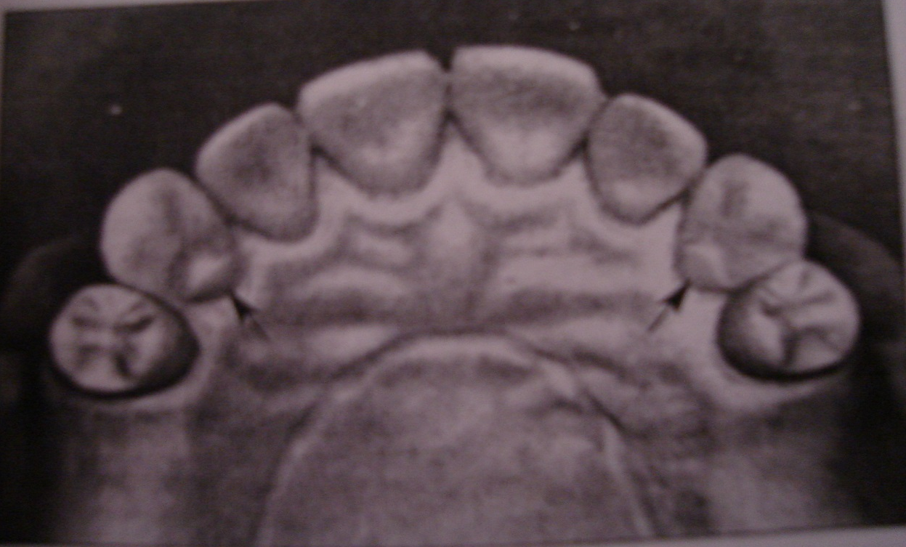
Rugae support

Slide 30
Conclusion
The distal extension partial denture tends to rotate around the fulcrum lines, this movement away from the tissues can be resisted by the activation of the direct retainer, stabilizing components of clasp assembly. Ultimately it is a indirect retainer, a part of the rigid component of the partial denture frame work that are located on the definitive rests on the opposite side of the fulcrum line away from the distal extension base which is responsible to resist the movements away from the tissue .
Hence the choice of the indirect retainer should be based on biologic as well as mechanical principles.
The dentist responsible for the treatment rendered must be able to justify the indirect retention used for each abutment tooth in keeping with these principles.

Slide 31
Bibliography
Mc Cracken’s –Removable partial prosthodontics.
Stewart’s – Clinical Removable partial prosthodontics- third edition
Ernest L. Miller – Removable partial prosthodontics.
Osborne & Lammie’s – Removable prosthodontics

Slide 32
MCQs

Slide 33
Movements of CPD away from the tissue is resisted by following except | Tissues of alveolar ridge | Direct retainers | Stabilizing minor connectors | Indirect retainers
Rotations occuring through most posterior abutments is | Towards the ridge | Away from the ridge | Both of the above | Rotation along longitudinal axis
More preferable support for indirect retainer is | Tooth borne | Tissue borne | Both will do | None
When ever possible rest for indirect retainer should be at __________ to the path of movements. | Acute angle | Right angle | Obtuse angle | All the above
Which of the following can be used as indirect reainers | Occlusal rest | Cingulum rest | Stabilizing minor connectors | All the above

Slide 34


THANK U.......

