Slide 1
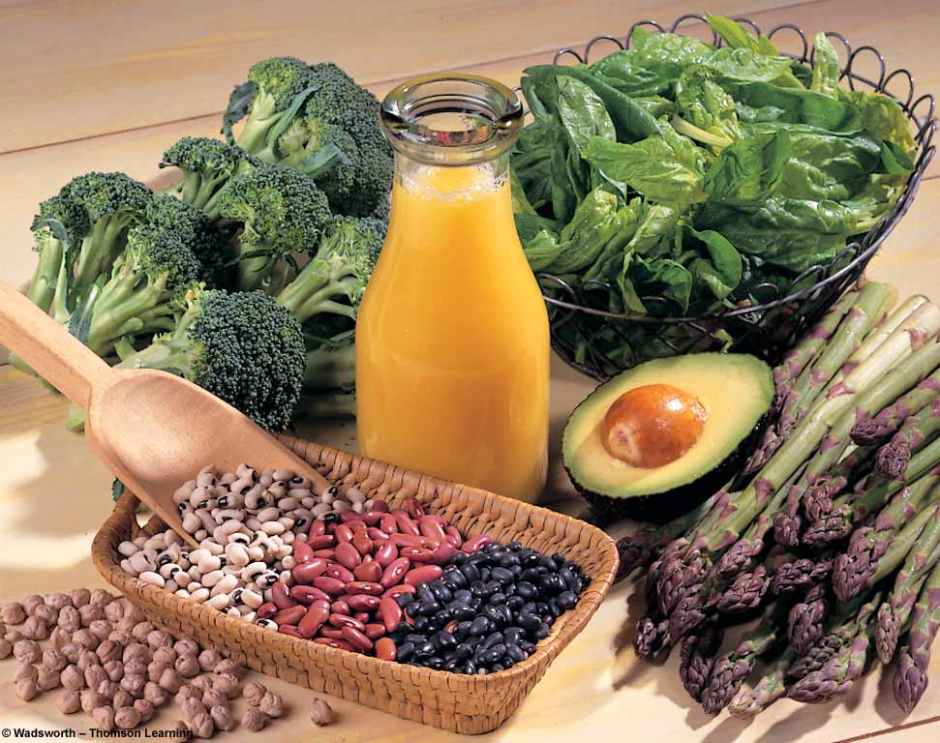

FOLATE or FOLIC ACID
Notes:
1

Slide 2
FOLATE
Other names
  Folic acid
  Folacin
  Pteroylglutamic acid (PGA)
  Vitamin B-9
Contains : pteridine group linked with PABA, (pteroic acid)
Attached to glutamic acid forming pteroyl glutamic acid or folic acid.

Slide 3
SOURCES
Fortified Grains
Leafy Green Vegetables
Legumes, Seeds
Liver

Slide 4
RDA
ADULTS – 200 μg/day
ADDITIONAL – 300 μg/day Pregnancy
        AND – 400 μg/day Lactation

Slide 5
ABSORPTION & TRANSPORT
ABSORPED IN UPPER PART OF JEJUNUM
IN BLOOD IT IS TRANSPORTED BY TWO BETA GLOBULINS
CARRIED TO LIVER BUT NOT STORED ONLY HELPS TO WORK AS COENZYME.
7,8 dihydrofolic acid 5,6,7,8 tetra hydro folic acid (THFA) catalysed by folate reductase and requires NADPH

Slide 6
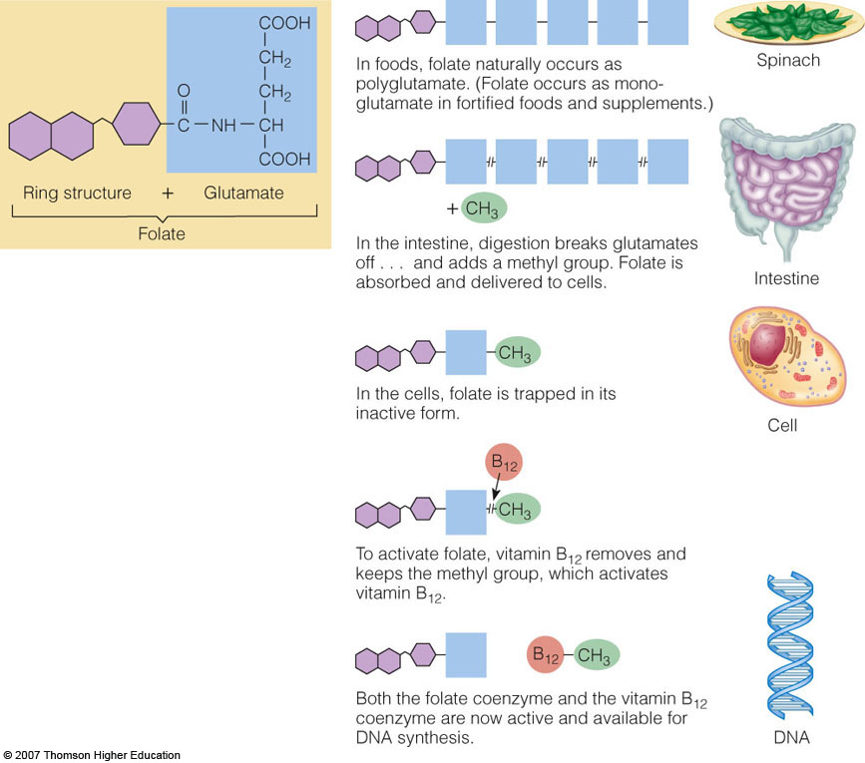

Slide 7
FUNCTIONS
Coenzyme
DNA synthesis
  Anticancer drug methotrexate
Homocysteine metabolism
Neurotransmitter formation
THFA is the carrier of one carbon group

Slide 8
CAUSES
PREGNANCY- much very common
DEFECTIVE ABSORPTION- celiac ds
DRUGS – anticonvulsant drugs
HEMOLYTIC ANEMIAS – requirements are increased
DIETARY DEFICIENCY- absence of green leafy vegetables for prolonged periods.

Slide 9
DEFICIENCY
Similar signs and symptoms of vitamin B-12 deficiency
Anemia
  RBC grow, cannot divide (macrocytic-with FA deficiency)
  Megaloblast: large, immature RBC
Pregnant women
GIT problems

Slide 10
Author/year | Study design | Level | Results | Outcome
Yakoob MY¹, Bhutta ZA. BMC Public Health. 2011 Apr 13;11 Suppl 3:S21. | Sytemic review study | L-I | 31 studies were selected for assessment using CHERG criteria. Daily iron supplementation resulted in 73% reduction in the incidence of anemia at term and 67% reduction in iron deficiency anemia at term compared to no intervention/placebo. For this intervention, both these outcomes were graded as 'moderate' quality evidence. Daily supplementation with iron-folate was associated with 73% reduction in anemia at term with a quality grade of 'moderate'. The effect of the same intervention on iron deficiency anemia was non-significant and was graded as 'low' quality evidence. There was no difference in rates of anemia at term with intermittent iron-folate vs. daily iron-folate supplementation | Applying the CHERG rules, we recommend a 73% reduction in anemia at term with daily iron (alone) supplementation or iron/folate (combined) vs. no intervention or placebo; for inclusion in the LiST model. Given the paucity of studies of intermittent iron or iron-folate supplementation, especially in developing countries, we recommend further evaluation of this intervention in comparison with daily supplementation regimen.

Slide 11

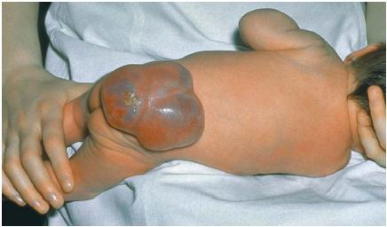
NEURAL TUBE DEFECTS
Spina Bifida Anencephaly

Slide 12
Neural Tube Defects
  Malformation of the central nervous system that forms very early in the pregnancy (often even before woman realizes she is pregnant
Spina bifida- spine develops outside of the body
Anencephaly- entire brain and skull above the ears is missing

Slide 13
Only known way to prevent these congenital malformations is adequate folacin intake prior to pregnancy
Adequate folic acid intake can reduce the risk of NTD by up to 75%

Slide 14
SYMPTOMS
    Macrocytic anemia, also called megaloblastic anemia – large cell type
    Smooth, red tongue
    Mental confusion, weakness, fatigue, irritability and headaches
  Most vulnerable of all the vitamins to interactions with medications
    Anticancer drugs
    Antacids and aspirin

Slide 15
ASSESSMENT
Normal blood level is 20 nanogram/ml, measured by RIA
Histidine load test: histidine converted to FIGLU formimino glutamic acid from which formimino is removed by THFA causing FA deficiency. Hence FIGLU is excreted in urine.
AICAR excretion : In purine ring synthesis the C2 comes with N-10 formyl THFA. When this is blocked AICAR-amino imidazole carboxamide ribosyl-5-PO4 is accumulated and excreted in urine.

Slide 16
TOXICITY
DOSES OVER 1 MG MAY CAUSE AGGRAVATION OF VIT-B12 AND MAY PRECIPITATE NERVE DAMAGE.
FACT AS FA IS LESS SOLUBLE IS H2O LARGE DOSES CAN CAUSE CRYSTALLIZATION IN KIDNEY TUBULES LEADING TO RENAL DAMAGE.

Slide 17
ANTAGONISTS
SULPHONAMIDES (antibacterial): BACTERIA Synthesizes FA from pteridine, PABA and glutamate.
TRIMETHOPRIM : Inhibits folic acid reductase and so formation of THFA is reduced.
PYRIMETHAMINE (antimalarial ): Used against plasmodial infection.
AMINOPTERIN AND AMETHOPTERIN (anticancer):

Slide 18
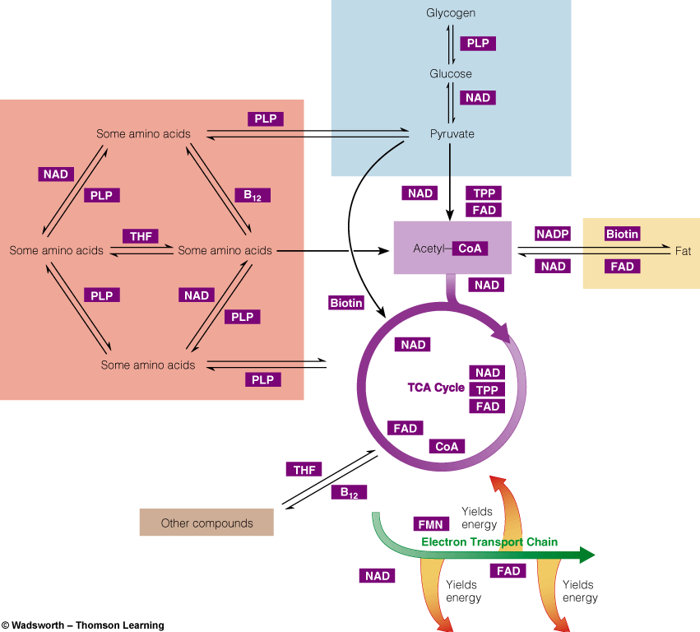
Metabolic Pathways Involving B Vitamins

Slide 19
Vitamin-Like Compounds
Choline
Carnitine
Inositol
Taurine
Lipoic acid
Synthesized in the body at the expense of amino acids and other nutrients

Slide 20
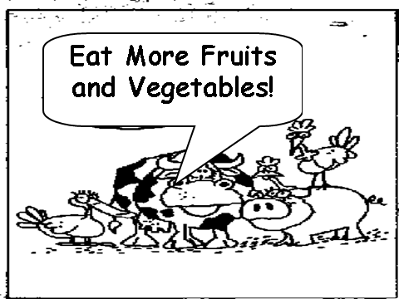

Slide 21
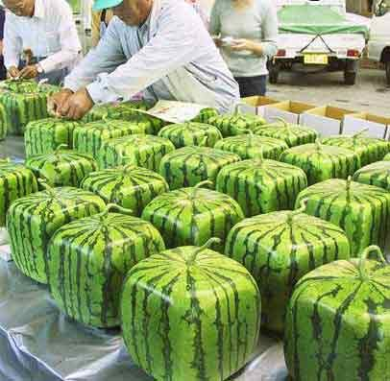

Slide 22


Slide 23


Variety is the Key
Vitamins are derived from a variety of foods.
Notes:
23

Slide 24
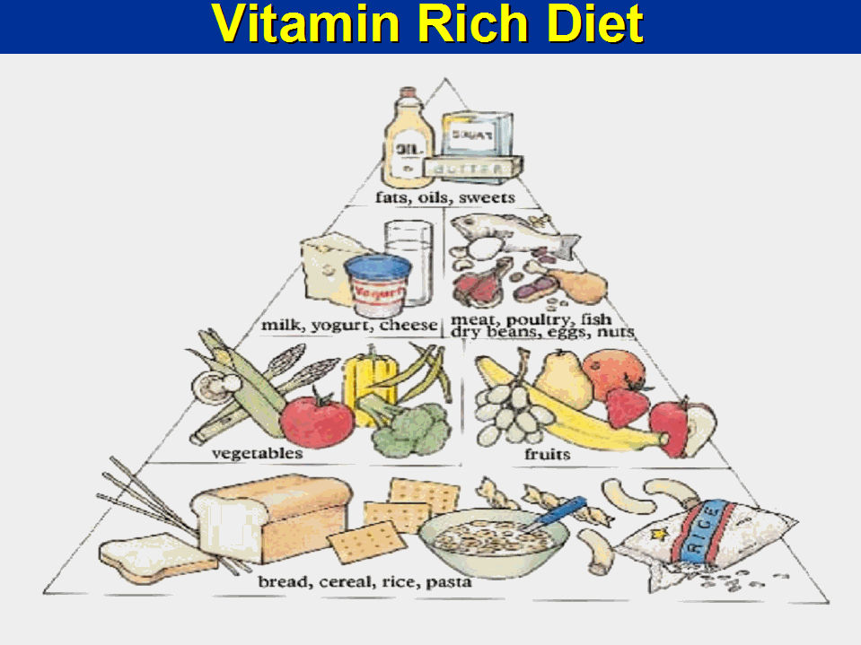
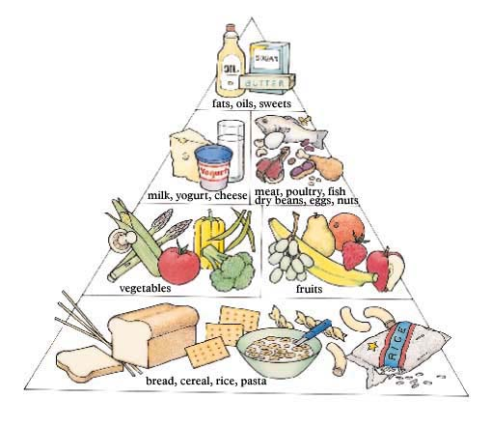
Vitamin Rich Diet

Slide 25
