Slide 1
GLYCOLYSIS:-
Ms. Trushna Shah
Asst.Proff.Biochemistry
S.B.K.S.MI&R.C,Pipariya.Vadodara

Slide 2
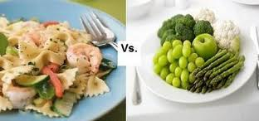
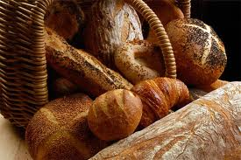
GLYCOLYSIS:-

Slide 3
Points to Remember:
Importance of the pathway.
Reactions of the pathway.
Energetics and clinical aspect
Regulation.
Rapaport-Leubering cycle in RBCs.
Cori’s cycle or Lactic acid cycle.

Slide 4
Glycolysis:-
Definition :-
It is the process that involves the breakdown of glucose into two 3-carbon molecules, Pyruvate or Lactate.

Slide 5
IMPORTANCE
Common to most organisms.
In humans, takes place in all tissues.
Begins with Glucose but other sugars may enter via intermediates.
Glycolysis plays dual role-
i) generates metabolic energy.
ii) provides intermediates for other metabolic pathways.
consists of ten sequential reactions which occur in the cytosol.

Slide 6
End product of glycolysis :-
Fate of pyruvate is different under aerobic / anaerobic conditions.
Under aerobic condition, pyruvate enters mitochondrial matrix oxidised to acetyl CoA, the major metabolic fuel for TCA cycle which generates ATP molecules.
Under anaerobic condition, pyruvate reduces to
Lactate in the cytosol by NADH.

Slide 7
Anaerobic Glycolysis occurs in:-
tissues that lack mitochondria. Eg., RBC, lens & cornea of the eye, renal medulla and leucocytes.
Oxygen deficient tissues like severely exercising muscles.
During hypoxia due vascular obstruction or other causes. Eg., in the myocardium during AMI.

Slide 8
Overall importance of anaerobic glycolysis:-
Provides less energy (2 molecules of
ATP) but carbohydrates are the only
metabolic substrates that can produce ATP under anaerobic conditions

Slide 9
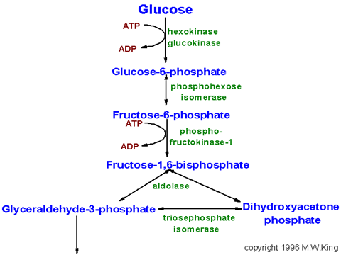

Slide 10
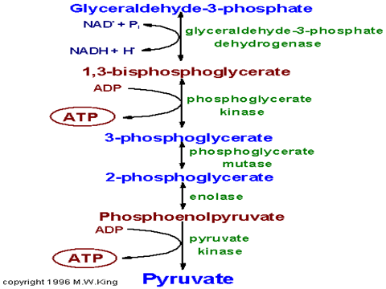

Slide 11
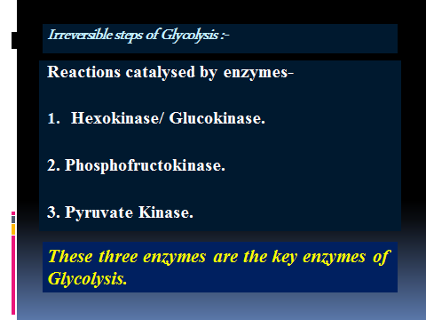

Slide 12
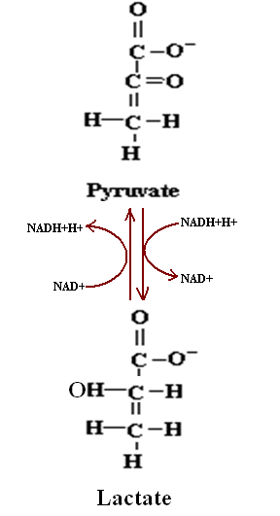
Under anaerobic conditions :-
LDH

Slide 13
Glycolysis in RBCs :- 2,3 BPG Shunt pathway
Reaction catalysed by phosphoglycerate kinase is bypassed by a reaction catalysed by a mutase( bisphosphoglycerate mutase).
2,3 BPG is a negative allosteric effector of the oxygen affinity of hemoglobin.
It decreases the affinity to promote the release of oxygen in the peripheral tissues.
Concentration of 2,3-BPG increases in RBC during adaptation to high altitude & anemia.
HbF is less sensitive to the effects of 2,3-BPG than HbA.

Slide 14
Cori’s cycle or Lactic acid cycle
Glucose
Pyruvate
Lactate
Glucose
Pyruvate
Lactate
blood
Muscle
liver

Slide 15
Energetics of Glycolysis :-
Under anaerobic conditions :-
2 molecules of ATP are produced.
4 ATP molecules from the two reactions involving substrate level phosphorylation (7 & 10).
2 ATP utilised in reactions 1 & 3.
So, net gain – 2 ATP molecules.

Slide 16
Under aerobic conditions :-
TOTAL ATP ARE ------- 8 molecules of ATP are produced.
6 ATP molecules from the reaction catalysed by glyceraldehyde 3-P dehydrogenase (6).
4 ATP molecules from the two reactions involving substrate level phosphorylation (7&10).
2 ATP utilised in reactions 1 & 3.
So, net gain – 8 ATP molecules.

Slide 17
Diseases associated with Glycolysis
Lactic Acidosis – seen in hypoxia, shock, pulmonary failure, alcohol abuse & diabetes mellitus.
Hemolytic anemia due to deficiency of Hexokinase and Pyruvate kinase.

Slide 18
Evidence 1
Hemolytic Anemia with Impaired Hexokinase Activity
ALAN S. KErrr

Slide 19
ALAN S. KErrr | Low level of evidence | J Clin Invest. 1969 November; 48(11): 1997–2007. | Normal red cell hexokinase was demonstrated to be dependent on glucose for maintenance of activity after heating to 45' C. The cells of the proposita are unable to utilize glucose efficiently at glucose concentrations lower than 0.2 mmole/liter whereas normal cells maintain linear glucose consumption to at least 0.05 mm glucose. These qualitative abnormalities could result from the presence of a mutant hexokinase . . | Low red cell glucose 6-phosphate (G6P) was observed not only in the anemic patients but in the presumptive heterozygotes as well and served as a useful marker for the presence of the trait.
Notes:
Antioxidant Supplementation Effects on Low-Density Lipoprotein Oxidation for Individuals with Type 2 Diabetes Mellitus James W. Anderson, MD, Maya S. Gowri, PhD, Jan Turner. Journal of American college of Nurtition.vol 18. Nos.5 451-461, 1999.

Slide 20
Regulation of Glycolysis :-
INDUCTION & REPRESSION
  Insulin / Glucagon / Glucocorticoids
ALLOSTERIC REGULATION
  Phosphofructokinase
  -ve - ATP, Citrate, H⁺
  +ve -AMP, ADP, F-2,6-BP
COVALENT MODIFICATION
  Phosphorylation / Dephosphorylation
FEED BACK INHIBITION
  Hexokinase

Slide 21
Irreversible steps of Glycolysis :-
Reactions catalysed by enzymes-
Hexokinase/ Glucokinase.
2. Phosphofructokinase.
3. Pyruvate Kinase.
These three enzymes are the key enzymes of Glycolysis.

