Slide 1

Shade Selection Procedure
Dr. Sameer Chauhan
Senior Lecturer
Department of Prosthodontics, KMSDCH

Slide 2
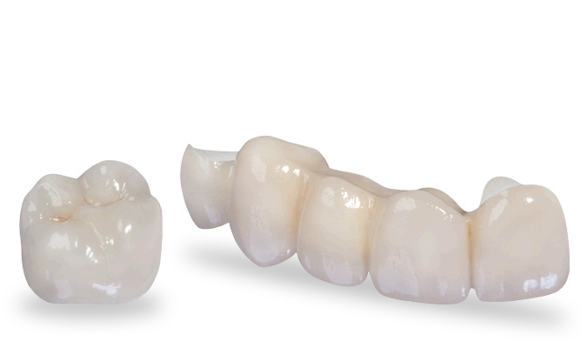
To provide aesthetic restorations to the patients, the dentist must understand the scientific as well as artistic basis of shade selection.
To accomplish this, a through knowledge of the concepts of colour & light is necessary with clear communication to the laboratory.

Slide 3
W
H
A
T
I
S
C
O
L
O
U
R

Slide 4
COLOR MEASUREMENT SYSTEMS
Maxwell’s color triangle (1859)
Munsell system of color notation (1905)
CIE XYZ system (1931)
CIEL*a*b* system (1976)
CIEL*C*h° system (1976)

Slide 5
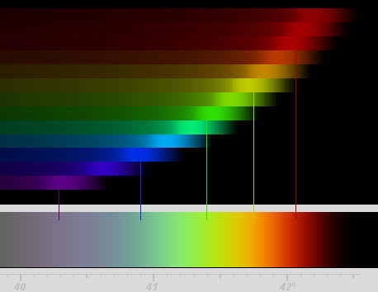
CLARK said that colour like form has three dimensions
According MUNSELL COLOUR ORDER SYSTEM a single colour is described under three parameters
HUE
CHROMA OR SATURATION
VALUE OR BRILLIANCE
These parameters guide in shade selection .

Slide 6
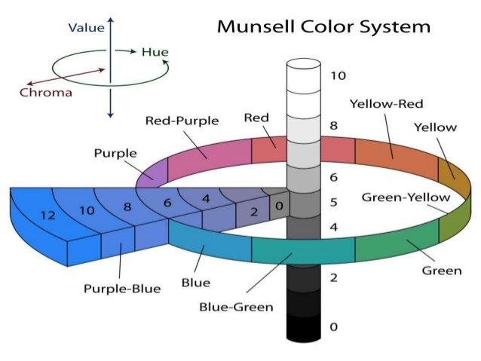
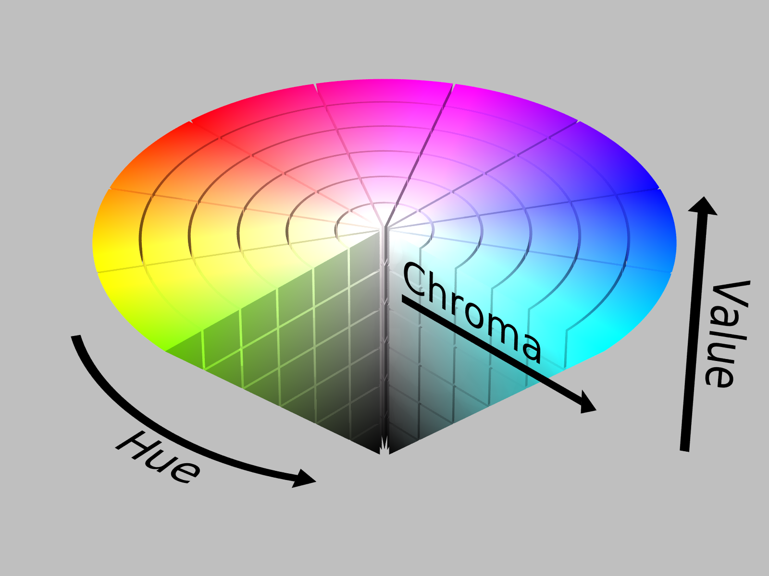
Munsell Colour System
Albert H. Munsell

Slide 7
CIE System
CIE system, other widely used color specification system is developed by the Commission Internationale de’Eclairage (CIE, International commission on illumination) in 1931.
It defines the three essential components for perceiving a color; illuminant, object, and observer.

Slide 8
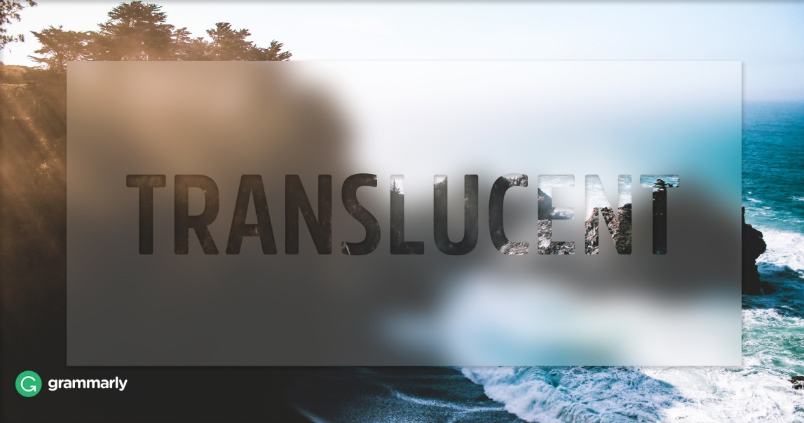
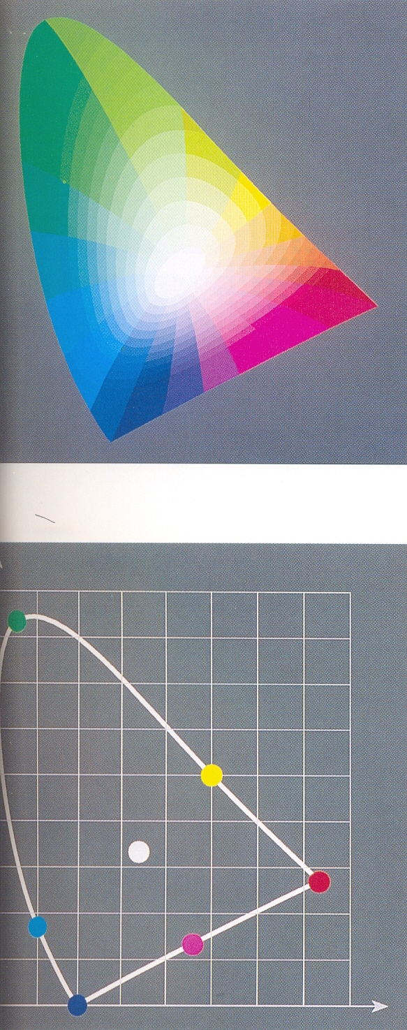
L* -
This is lightness variable proportional to value. It describes the achromatic character of the color.
a* & b* -
These describe the chromatic characteristics of the color. a* coordinate correspond to red- purple/ blue-green axis while b* denotes yellow/purple/ blue axis

Slide 9
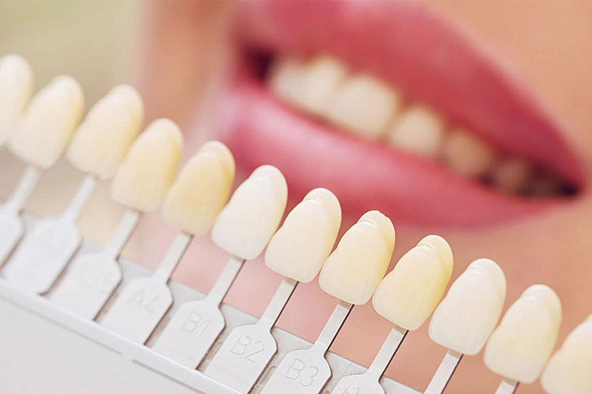
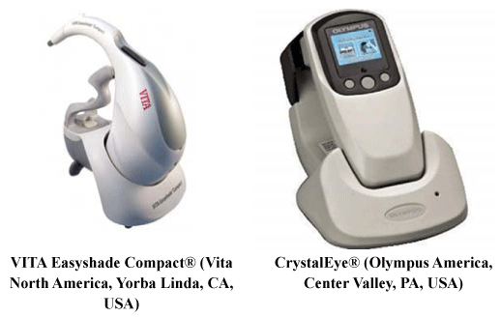
Shade Matching Phase
This phase occurs in the dentist’s office, in which the information on the color and translucency of the adjacent teeth to be matched is recorded through either visual shade matching or instrumental color analysis.

Slide 10

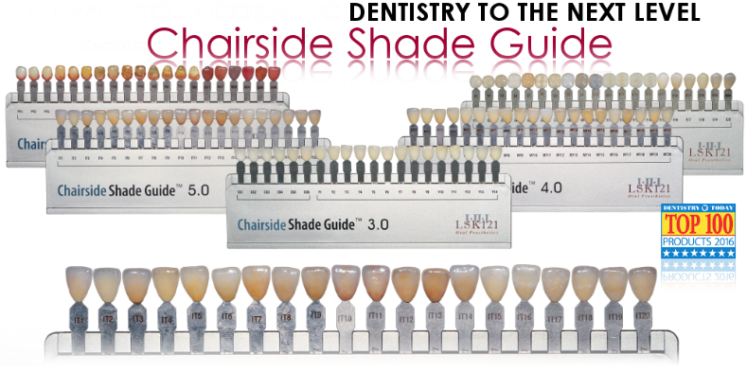
Visual Shade Matching
Most Frequently used method for shade matching.
Requires;
  Light Source
  Reference shade matching guide

Slide 11
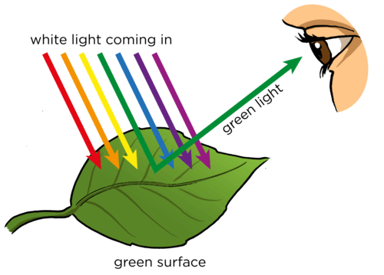
Colour is light and light is color
Light is necessary for color to exist
If an object absorbs certain light waves, you do not see these as colors.
If an object reflects certain light waves, you see these as colors

Slide 12
A light source with a color temperature close to 5500° K (D55) that is spectrally balanced throughout the visible spectrum is ideal for color matching.
Ideal Time: Midday till 3 pm Northern day light.
Confounders: Other day time, Cloud coverage, Humidity, Pollution.

Slide 13
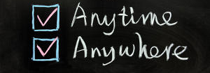
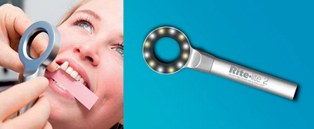
Illuminated Light Source
Artificial light source similar to Northern day light.

Slide 14
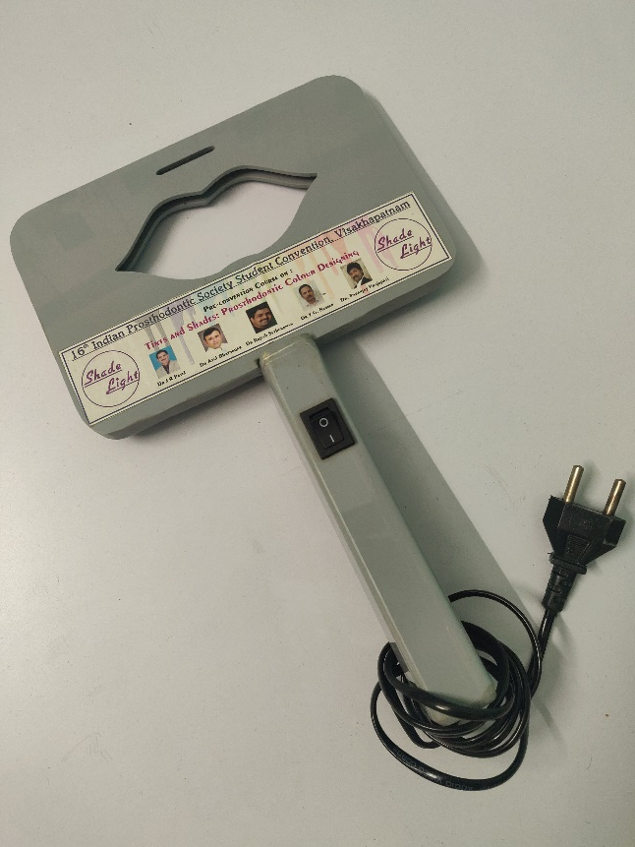
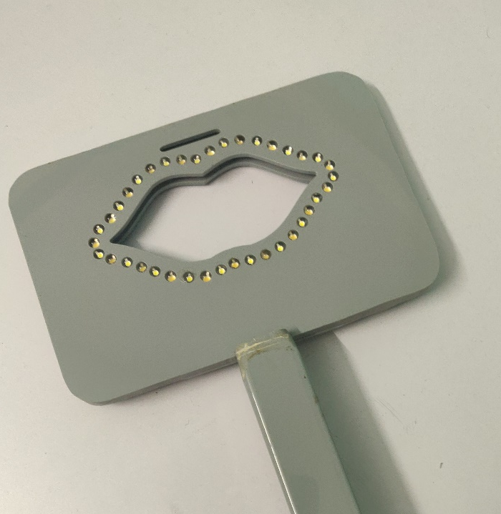
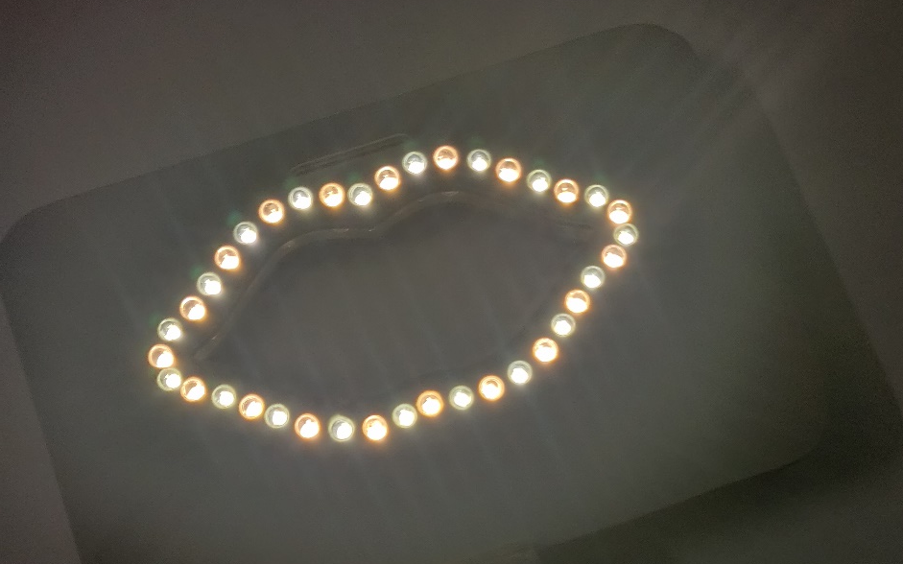
Shade Light

Slide 15
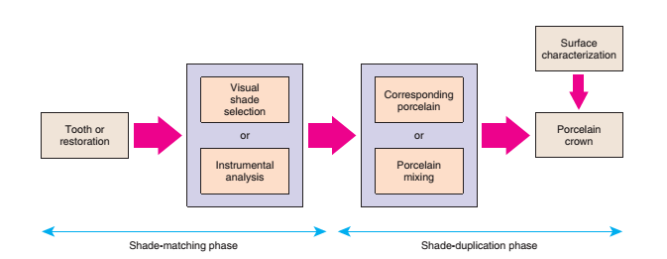
Color replication process

Slide 16
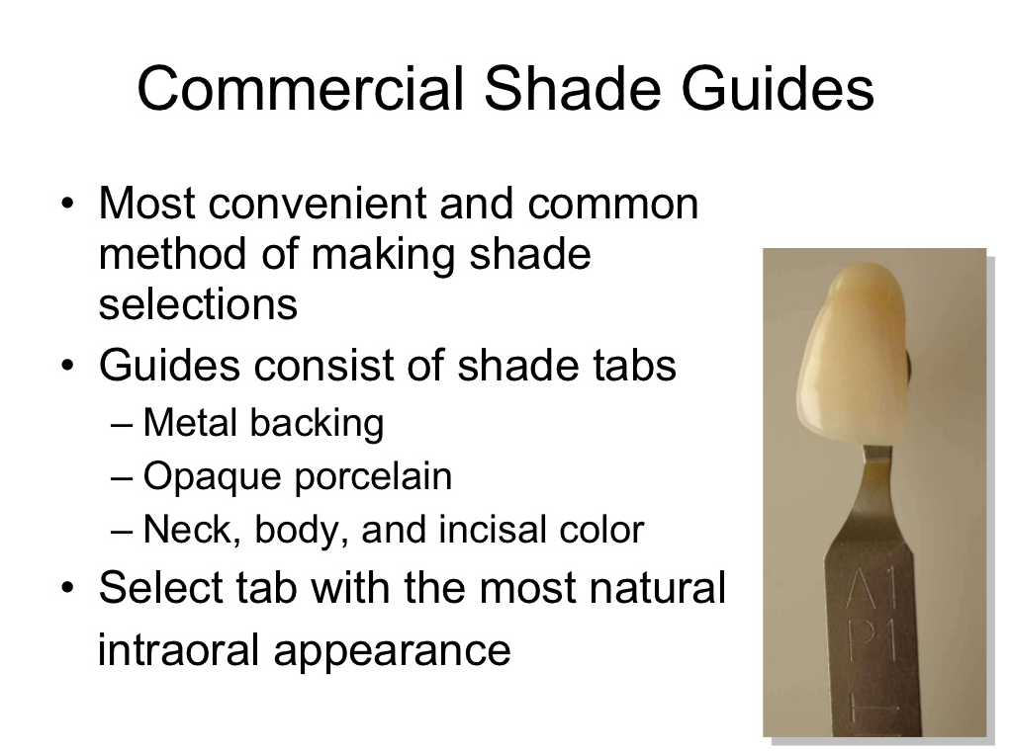

Slide 17
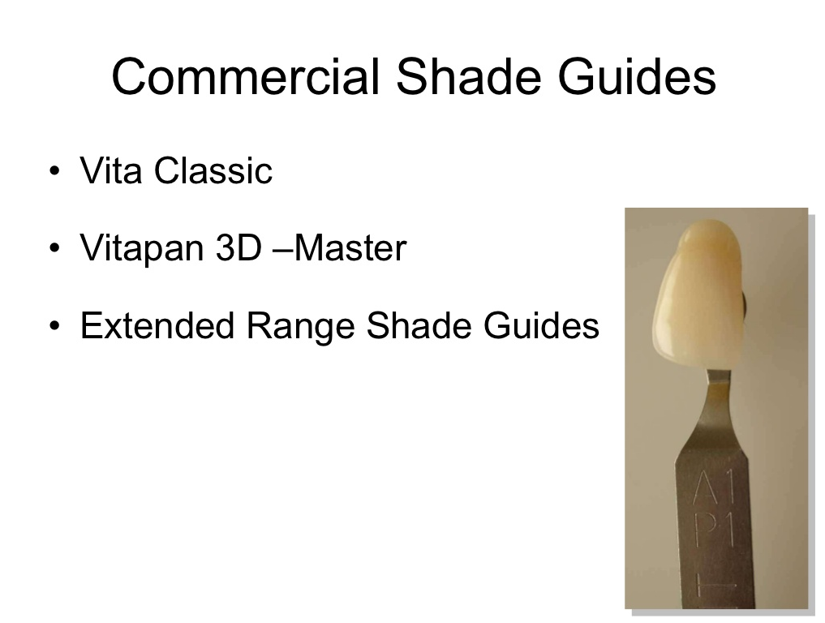

Slide 18
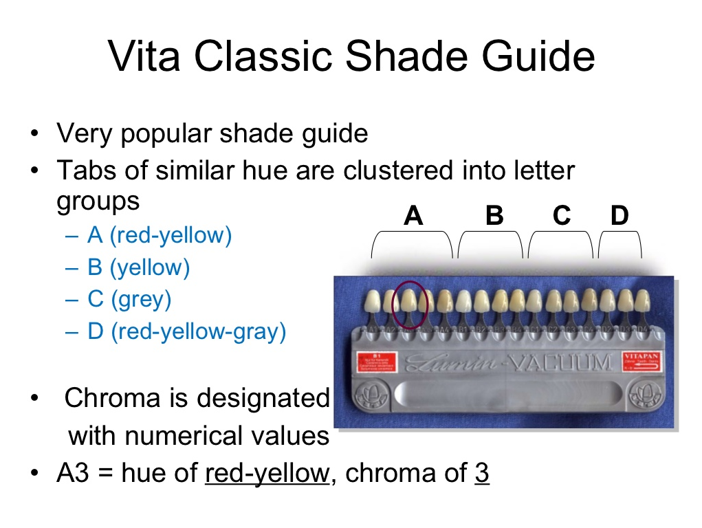

Slide 19
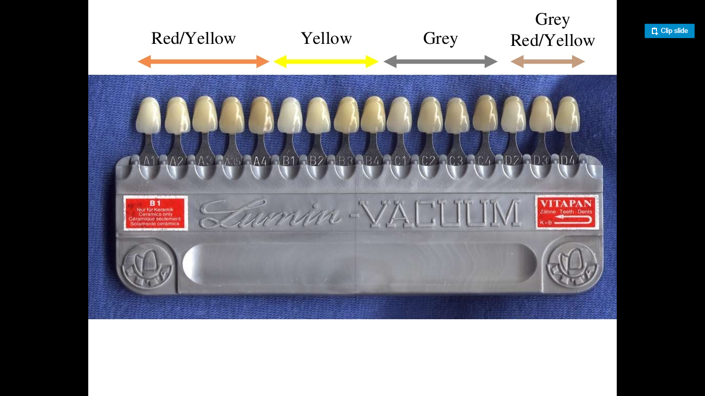

Slide 20
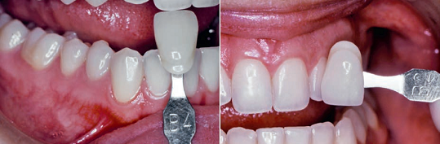
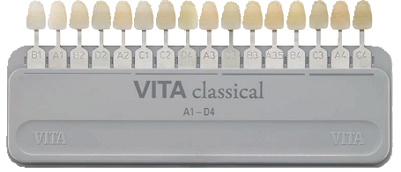
Selecting hue by matching samples with high chroma (e.g., A4, B4, C4, or D3) to a tooth with high chroma (i.e., canine)
Selecting chroma from within the hue group (e.g., B1, B2, B3, or B4)
Value-ordered shade guide is used to check lightness

Slide 21
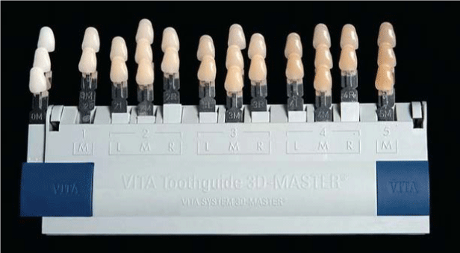
VITA Toothguide 3D-MASTER®
(VITA North America)
They claims that it covers the entire tooth color space.
The shade samples are grouped in five lightness levels, each of which has chroma and hue variations in evenly spaced steps.

Slide 22
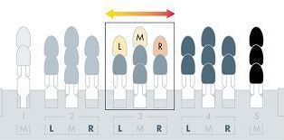
The VITA SYSTEM 3D-MASTER®
Five lightness groups with equal distances (ΔL = 4) within the tooth color space.
The tabs of the individual lightness groups reveal the same lightness (L) but differ in their intensity (chroma) (C) and hue (h)

Slide 23
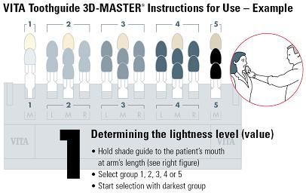
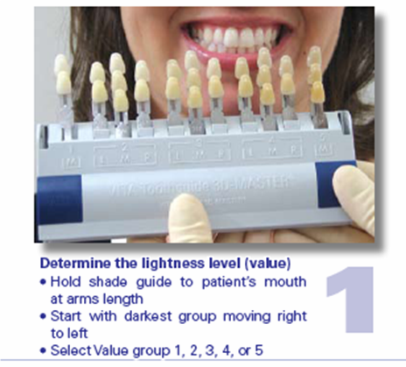
1
Determine the lightness level (Value)
Hold the shade guide to patient’s mouth at arms length
Start with darkest group moving from right to left
Select value group from : 1, 2, 3, 4, 5.

Slide 24
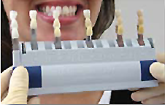
Alternate method of determining lightness level
Remove all the tabs except the middle ‘M’ tab
Select value group

Slide 25
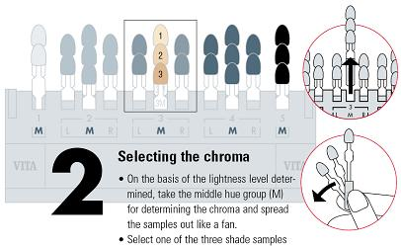
2
Select the Chroma
From selected Value group remove the middle tab (M) & spread out the samples like fan
Select one of the three shade samples to determine Chroma

Slide 26
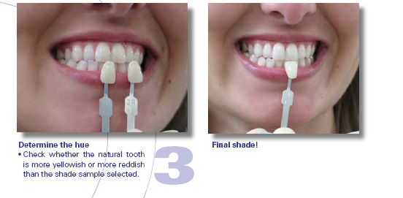
3
Determine the Hue
Check whether the natural tooth is more yellowish or more reddish than the selected shade sample

Slide 27
Advantages of Vitapan 3D master shade guide over Vitapan classical shade guide:
Group division is better.
The lightness range is wider.
More chromatic tabs are included.
The hue range is extended toward reddish spectra part.
The shade tabs are more uniformly spaced.

Slide 28
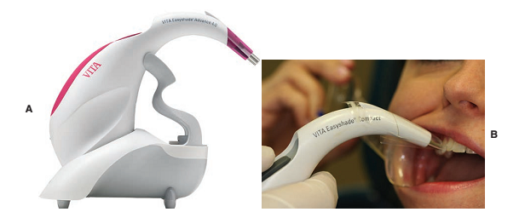
INSTRUMENTAL COLOR ANALYSIS
Color-Measuring Instruments
  Spectrophotometers
  Spectroradiometers and
  Colorimeters

Slide 29
VITA Easyshade Advance 4.0
The probe tip is placed on the tooth, and the tooth shade is recorded

Slide 30
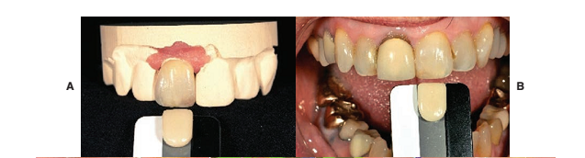
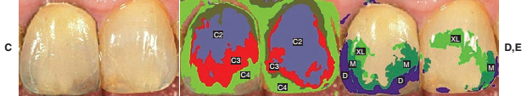
ShadeWave
Photographic method of shade matching
The shade reference (A) is placed beside the adjacent tooth (B), and a digital image is made
The image is uploaded and viewed within the ShadeWave program. The selected shade and translucency are then mapped on to the image

Slide 31
Summary of Guidelines for Visual
Shade Matching
Shade matching should be made under balanced lighting and in an appropriate shade-matching environment with gray or pastel-colored walls and cabinets.
Anything on the patient that influences the shade matching, including brightly colored clothing, should be draped, and lipstick should be removed.
The teeth to be matched should be clean. If necessary, stains should be removed by prophylactic treatment.

Slide 32
The patient should be viewed at eye level so that
the most color-sensitive part of the dentist’s retina
is used. The viewing working distance should be
approximately 25 cm (10 inches).
If the tooth and shade tab have different surface
characteristics, wetting the surface of both helps
remove the differences.
Shade matching should be made quickly (less than
5 seconds), with the shade tab placed directly next
to the tooth being matched.

Slide 33
The dentist should rest his or her eyes between
viewings by focusing on a neutral gray surface
immediately before a matching; this balances all
the color sensors of the retina.
To select the appropriate hue, the canine tooth is
recommended for comparison because it has the
highest chroma of the dominant hue.

Slide 34
The number of shade tabs should be reduced and
separated to approximately three as quickly as
possible. Then one or two of the shade tab that
matches the best should be reselected.
Shade matching should be confirmed at one or
two other visits and, if possible, confirmed with an
auxiliary staff member. It is also recommended
that shade selection be confirmed under several
different lightings.

Slide 35
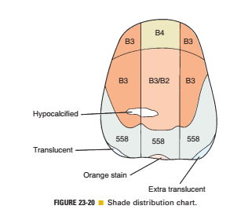
The dentist should map the polychromatic nature
of the tooth being matched—its special characteristics (e.g., cracks, hypocalcifiation, and translucency of the incisal enamel of the tooth)—withone of the following: (1) a shade distribution
chart, (2) a digital image with the closest shade tab
beside the tooth, or (3) staining of the closest
matching shade tab.

