Slide 1
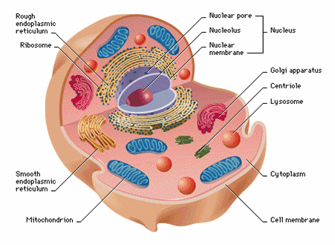
Hexose Monophosphate Shunt / HMP Shunt / Pentose Phosphate shunt Pathway.
Trushna Shah
Asst.Prof.Biochemistry
S.B.K.S.MI&R.C,Pipariya.Vadodara

Slide 2
It is a Minor Oxidative pathway of glucose.
Only 10% of glucose will take entry in HMP shunt pathway and 90% will enters in to glycolysis.
Generates two things
1. Two NADPH and one pentose Phosphate
2. Pentose Phosphate is converted to intermediates of Glycolysis

Slide 3
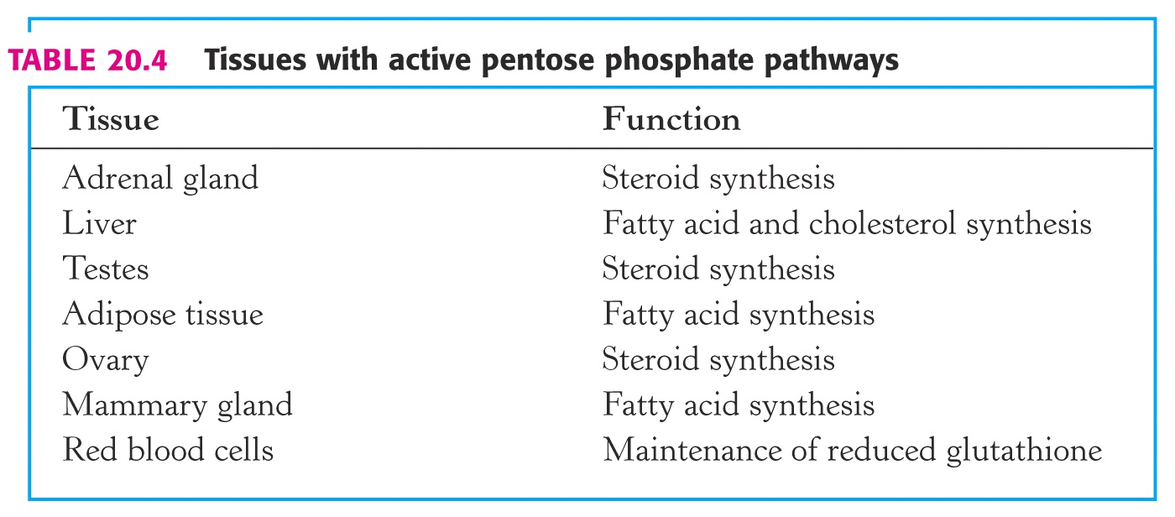

Slide 4
Minor metabolic pathway of glucose.
minimal in muscle/ brain as glycolysis is very active in these tissues.
Highly active in tissues active in the formation of cholesterol & fatty acids which require NADPH (liver, adipose tissue, testes, adrenal cortex & lactating mammary gland).
Active in tissues exposed to high oxygen pressure (RBC, cornea).
cytosolic pathway.
required for provision of NADPH and pentose's.

Slide 5
Where Does This Happen?
Location:
  Cytosol

Slide 6
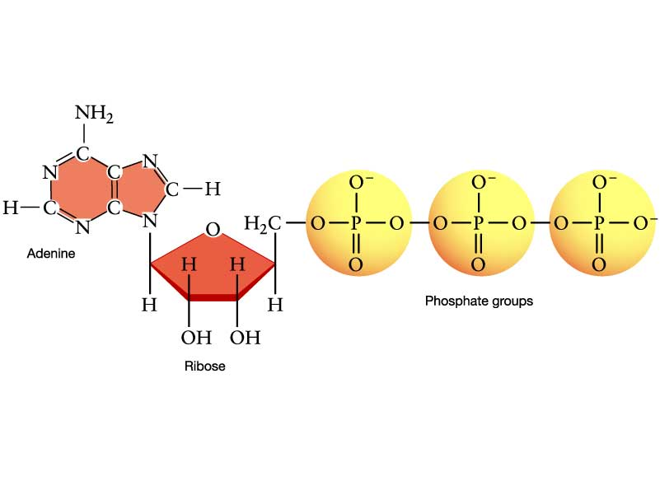
Purpose
Then what is it good for?
Purpose
  NOT ATP!!
  Generate Reducing Power
  Make Five-carbon sugars

Slide 7
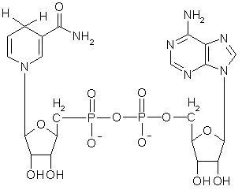
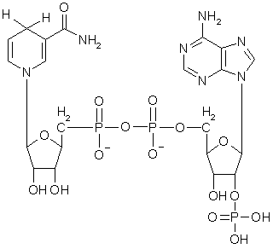
There is a difference
NADH v. NADPH
  NADH: Important for ATP production.
  NADPH: Important for reductive biosynthesis.

Slide 8
Before starting the P/W
1. Ribulose 5 Phosphate
2.Xylulose 5 Phosphate
3.Sedoheptolose 7Phosphate
4.Erythrose 4 Phosphate

Slide 9
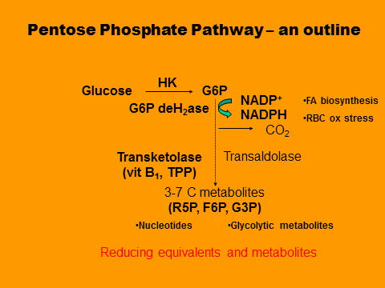

Slide 10
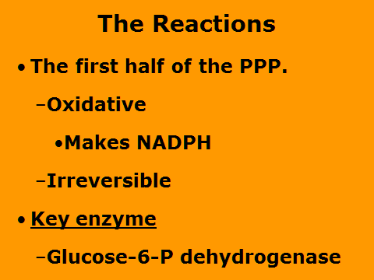

Slide 11
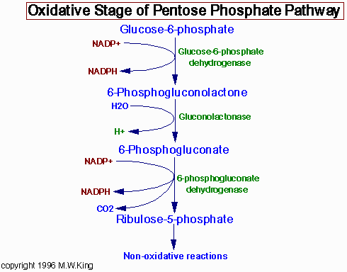
KEY
step

Slide 12
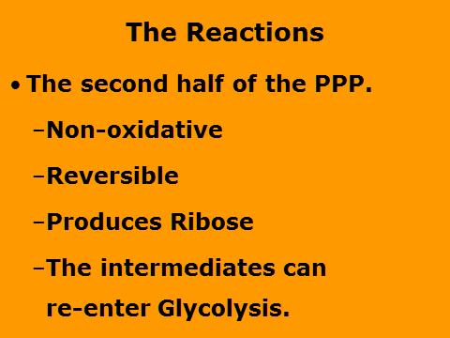

Slide 13
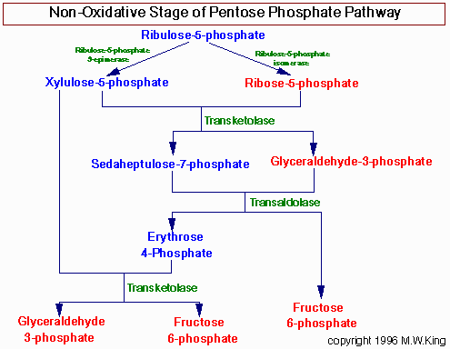

Slide 14
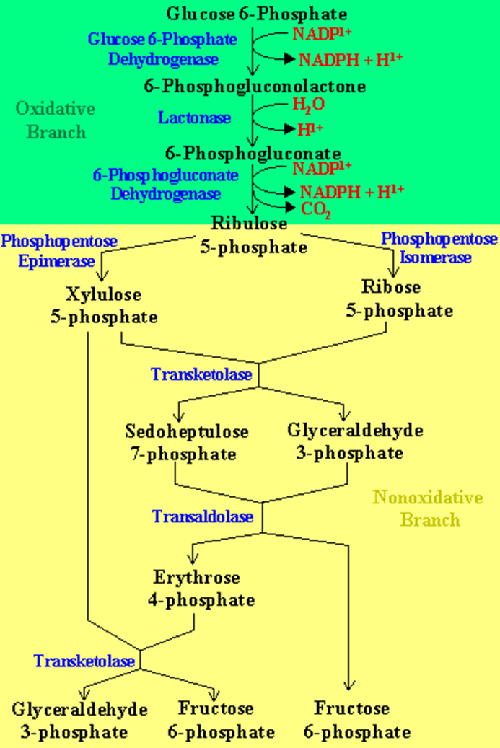

Slide 15
Significance
Generation of reducing equivalents –NADPH
Erythrocytes membrane integrity- by Glutathione
Prevention of met-Hb formation- Less oxygen carrying capacity
Transparency of lens –by NADPH
Bactericidal activity –By NADPH
DNA and RNA synthesis-BY Ribose 5 phosphate

Slide 16
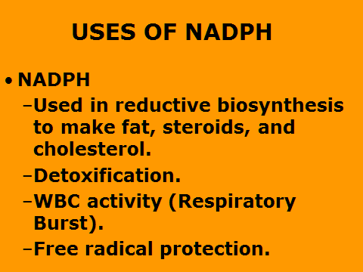

Slide 17
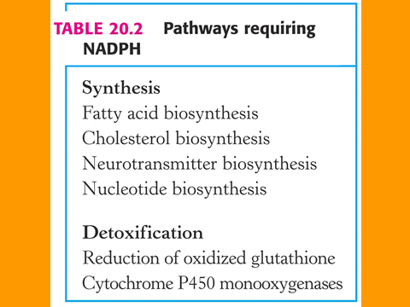
Reductive Biosynthesis
  Cholesterol
  Fatty Acids
  Cellular membranes

Slide 18
Detoxification
  This process uses NADPH to change chemicals from water insoluble to water soluble, so that they may be excreted.
  Cytochrome P-450

Slide 20
Regulation
The Regulation of the PPP is determined by metabolic need.
Are we making stuff or energy?

Slide 21
Regulation
  ATP
  Citrate
  Insulin (based on EC)
  Glucagon

Slide 22
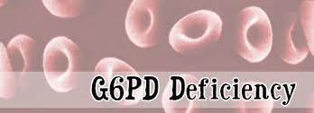
G6PD Deficiency and Hemolytic Anemia
Most common genetic enzymopathy
  400 hundred variants of G6PDH deficiency
  Mediterranean, Asian, African descent
    400 million people affected worldwide
    10-14% of African-American men with G6PD deficiency
Remarkable variation in the clinical spectrum.

Slide 23
People with the disorder are not normally anemic and display no evidence of the disease until the red cells are exposed to an oxidant or stress.
Drugs that can precipitate this reaction:
antimalarial agents
sulfonamides (antibiotic)
nonsteroidal antiinflammatory drugs (NSAIDs) Aspirin
nitrofurantoin
quinidine
quinine
exposure to certain chemicals – mothballs (napthalene)
Fava beans (vicine & isouramil)

Slide 24
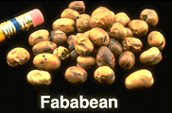
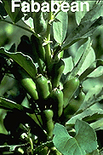
FAVISM
Individuals with G6PD deficiency must not eat Fava beans.
Erythrocytes lyse=dark or black urine.
Interesting
  The growth Plasmodium falciparum (malaria parasite) fails in G6PD deficient individuals.

Slide 25
Evidence 1
Evaluation of liver and kidney function in favism patients.
Dorgalaleh A¹, Shahzad MS, Younesi MR, Moghaddam ES, Mahmoodi M, Varmaghani B, Khatib ZK, Alizadeh S.

Slide 26
Author/year | Study design | Level | Results | Outcome
Evaluation of liver and kidney function in favism patients. Dorgalaleh A¹, Shahzad MS, Younesi MR, Moghaddam ES, Mahmoodi M, Varmaghani B, Khatib ZK, Alizadeh S. | Case control | Low level | This study was performed on favism patients and healthy controls referring to Iranshahr central hospital. Liver and kidney function tests were performed. The results showed a statistically significant difference between these two groups (p <0.05) for liver function tests, (AST, ALT and ALP), but not for renal tests (BUN and creatinine) (p >0.05). | Due to abnormalities were seen in the liver function tests of these patients, we suggest that these tests be regularly performed for favism patients who are constantly exposed to oxidant agents.

Slide 27
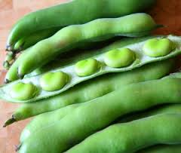
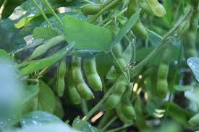
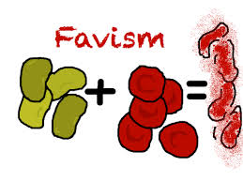

Slide 28
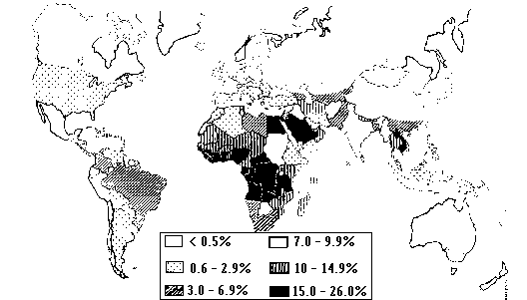
Worldwide distribution of G6PD deficiency: 1995

Slide 29
G6PD Deficiency
Distribution of G6PD deficiency coincides prevalence of malaria
G6PD deficiency may impart some degree of malaria resistance
  Also sickle cell anemia

Slide 30


