Slide 1

CONTENT
OCCLUSAL RESTS AND REST SEATS
  INTERNAL OCCLUSAL RESTS
  LONG/CONTINUOUS RESTS
  INTERPROXIMAL OCCLUSAL RESTS
  EXTENDED OCCLUSAL RESTS
LINGUAL REST AND REST SEATS
INCISAL REST AND REST SEATS
Review
SUMMARY AND CONCLUSION
REFERENCES

Slide 2
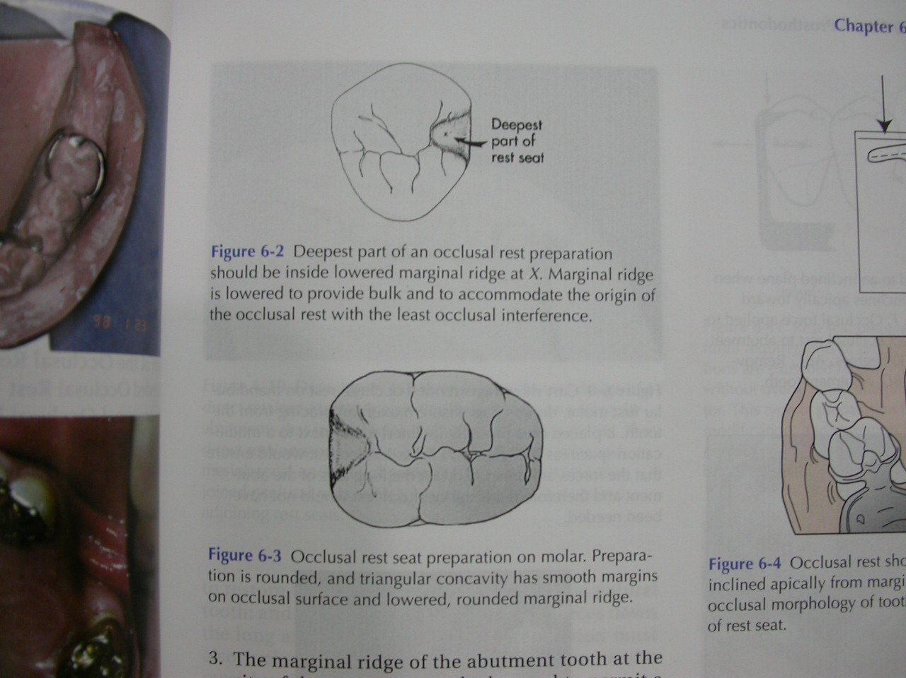
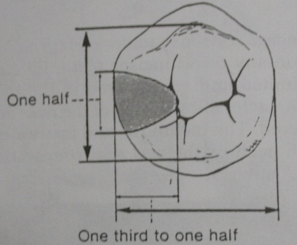
OCCLUSAL REST AND REST SEAT
Outline form
Rounded triangle with the base resting on the marginal ridge and apex toward the center of the occlusal surface.
Should follow outline of mesial or distal fossa.
Dimensions- ½ the buccolingual width from cusp tip to cusp tip and 1/3 to ½ the mesiodistal width. Is as long as it is wide, should be at least 2.5 mm for both molars and premolars.

Slide 3
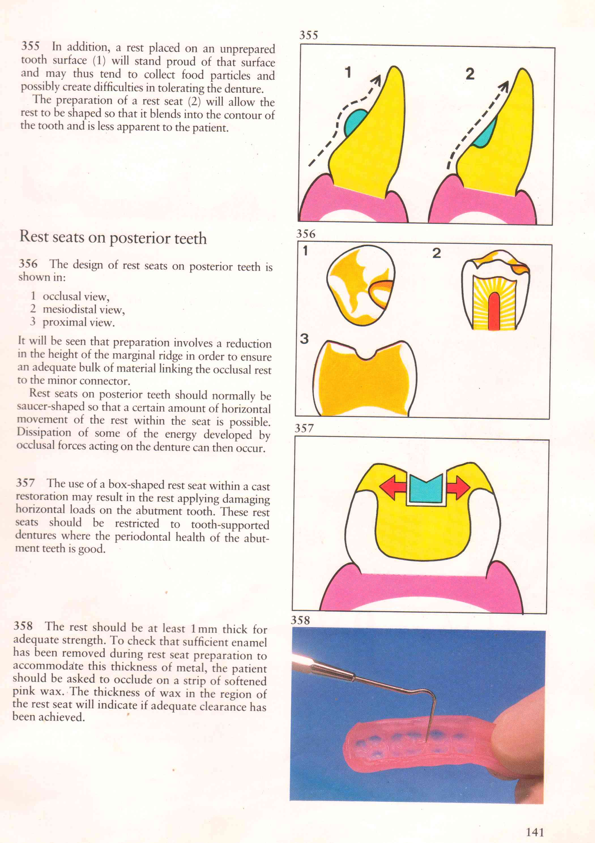
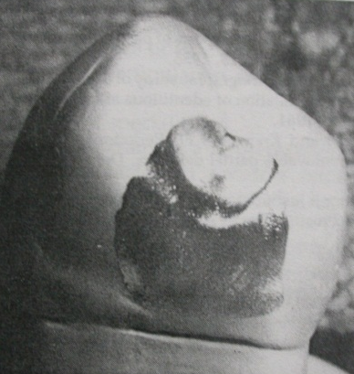
Reduction of the marginal ridge of approximately 1.5 mm is usually necessary.
Junction of occlusal rest to the abutment should be shallow ball and socket joint in distal extension cases.
The floor of the occlusal rest seat should be apical to the marginal ridge and the occlusal surface.
- Can be concave, or spoon shaped- for distal extension.
- Can be box shaped- for tooth supported.

Slide 4
Rest seats not prepared opposing functional cusps.
In tooth borne cases rest must be extended to the center of the tooth.
Minimum metal thickness is 0.5mm at thinnest point and 1-1.5mm at marginal ridge.
proximo-occlusal line angle of the preparation should not be sharp.

Slide 5
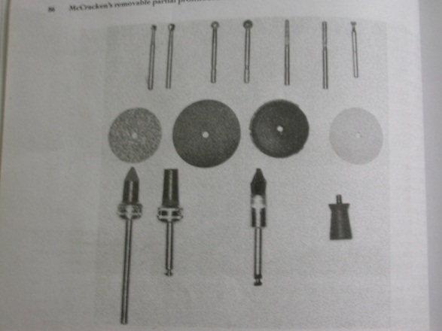
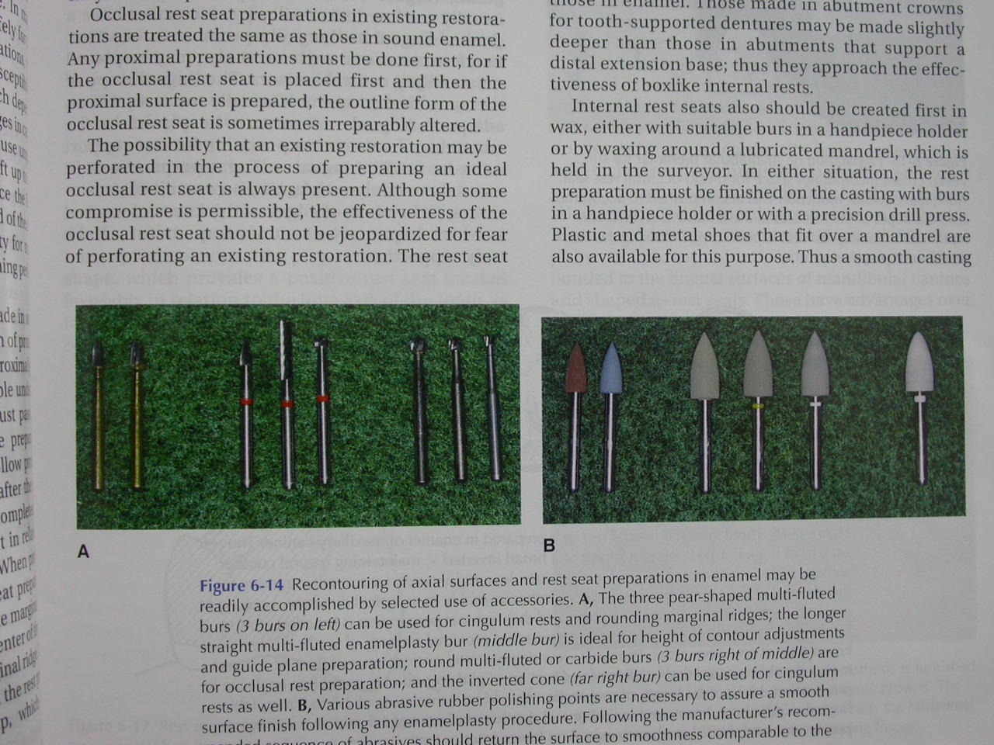
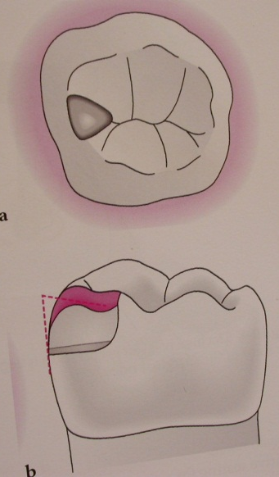
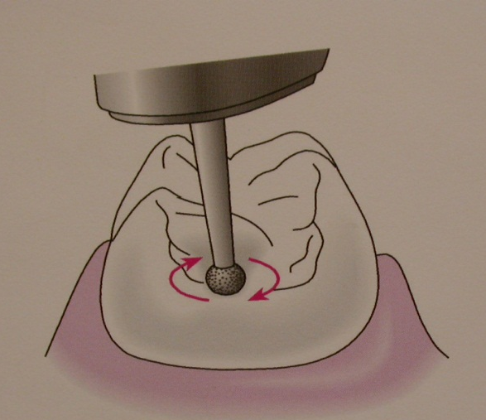
Preparation of occlusal rest.
Armamentarium for rest preparation:
Preparation in enamel:

Slide 6
Method of obtaining positive support
Rest seat preparations in sound enamel.
Preparation of occlusal rest seats always must follow proximal preparation, never precede it.
Occlusal rest seats in sound enamel may be prepared with diamond points of approximately the size of nos. 6 and 8 round burs or with carbide burs.
Occlusal rest seat prep. in existing restoration.
It is same as in enamel. Proximal preparation first and then rest seat should be placed.
Rest seat preparation in amalgam should be avoided because of creep.
Though some compromise is permissible, the basic principles of rest seat preparation should not be violated. When perforation occurs it may be filled with gold foil.

Slide 7
Occlusal rest seats in new restoration.
- They should be placed in the wax pattern.
- The location of the occlusal rest should be shown when the tooth is prepared for a crown or an inlay so that sufficient clearance may be provided in the preparation for the rest.
Occlusal rest seats in crown/inlays/onlays.
- Most ideal way of getting positive support.
- Indicated in - rotated/inclined tooth.
- mandibular bicuspid with rudimentary cusp.
- abraded tooth.
- These are generally made larger and deeper than the enamel.
- Those made in abutment crowns supporting tooth borne dentures maybe slightly deeper than those in abutments supporting a distal extension base.

Slide 8
Horizontal stabilization is from the near-vertical walls of this type of rest seat.
Should be parallel to the path of placement slightly tapered occlusally and dovetailed to prevent dislodgement proximally.
Advantage:
Facilitates the elimination of visible clasp arm buccally
Permits the location of the rest seat in a more favorable position in relation to the “tipping” axis of the abutment. Retention provided by lingual clasp arm lying in a natural or prepared infrabulge area on the abutment tooth.

Slide 9
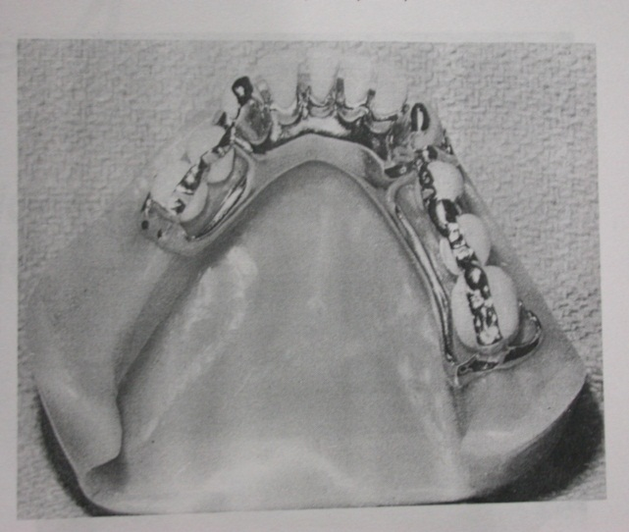
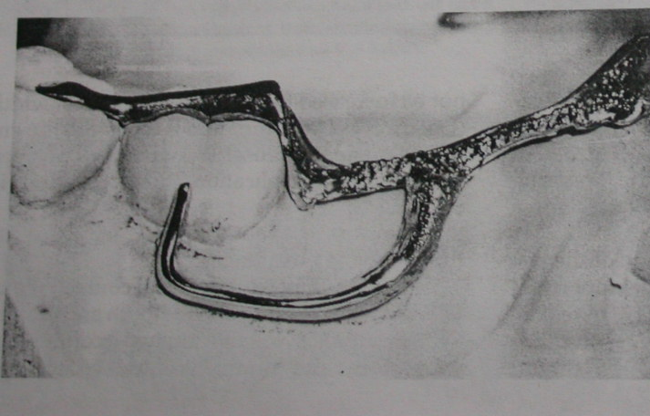
Long Or Continuous Rests
Splinting periodontally weakened teeth
The long or continuous rest can serve as an effective stabilizing or unifying device. The rest can be designed to extend entirely across the occlusal surface of two or more teeth and, in some instances, across the entire arch.
When occlusal force is delivered in one area, all the remaining teeth act in unison to provide support. With planning, this type of rest can restore the occlusal plane, provide support, and splint the arch.

Slide 10
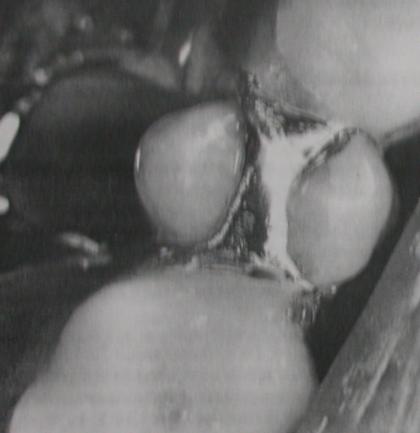
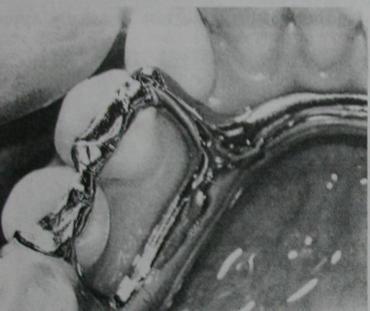
Control position of unopposed teeth
Many times a situation exists in which a tooth has lost its antagonist in the opposing arch but does not need a replacement for masticating functions. Extending the rest in the partial denture planning and design not only gains support from that tooth but also holds it in position, preventing elongation and eliminating the necessity of a second prosthesis in the opposing arch.

Slide 11
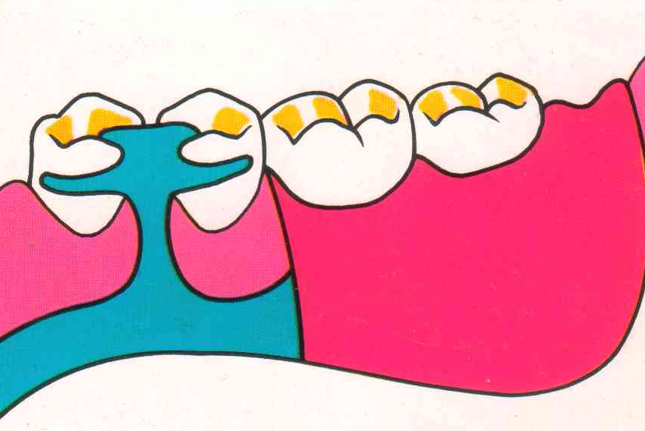
Inter Proximal Occlusal Rests ( embrasure rest)
The design of a direct retainer assembly may require that interproximal occlusal rests be used.
Interproximal occlusal rest seats are prepared as individual adjoining occlusal rest seats.
Preparations must be extended farther lingually.
The lingual interproximal area requires only minor preparation.

Slide 12
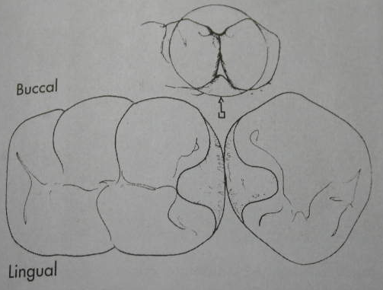
Adjacent rests rather than a single rest are used to
- Avoid inter proximal wedging by the framework.
- Also to shunt the food away from contact points.
Care must be exercised to avoid eliminating contact point of abutment teeth.
Sufficient tooth structure must be removed to allow for adequate bulk of the component to be so shaped that occlusion will not be altered.

Slide 13
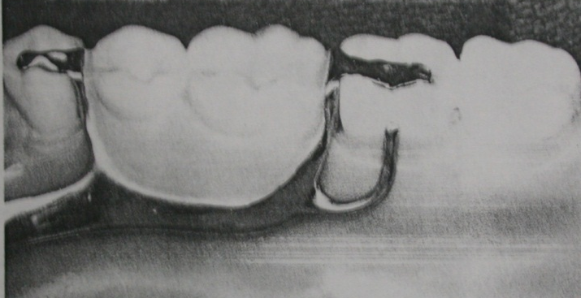
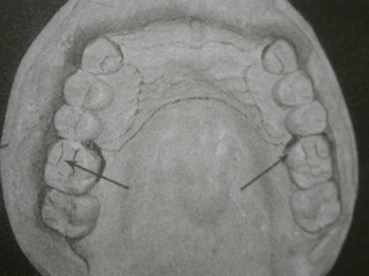
EXTENDED OCCLUSAL REST
Indicated - in Kennedy class II, modification 1 and Kennedy class III situations when the most posterior abutment is a mesially tipped molar
Minimize further tipping of the abutment \ forces are directed down the long axis of the abutment.
This rest should extend more than one-half the mesiodistal width of the tooth, be approximately one-third the buccolingual width of the tooth.
If abutment is severely tilted the extended occlusal rest may be in the form of an onlay.

Slide 14
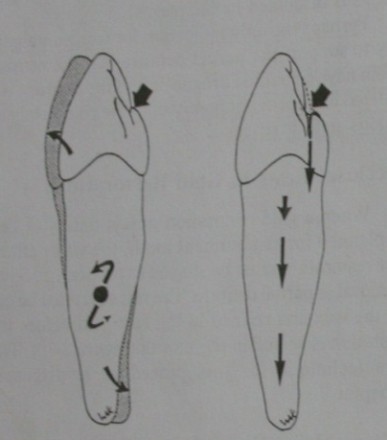
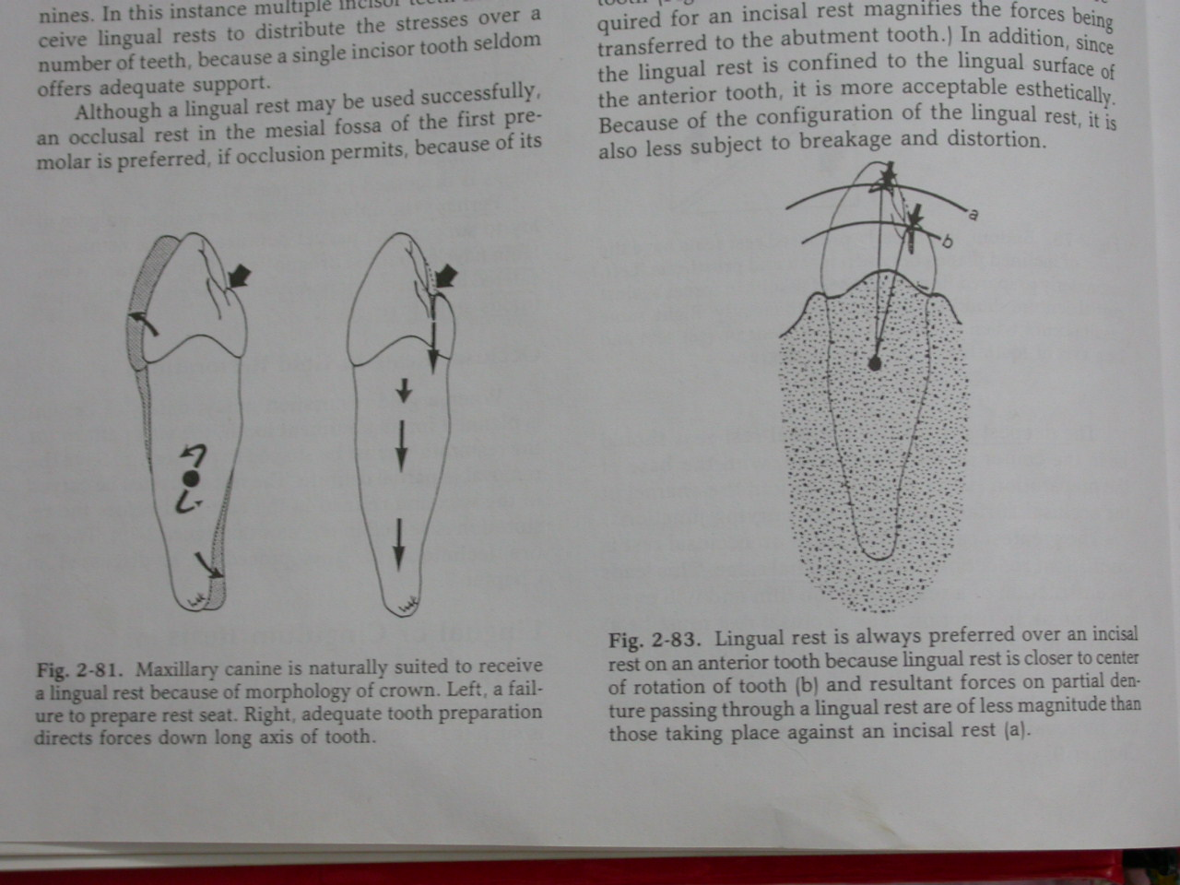
LINGUAL RESTS(Cingulum rests)
Anterior teeth may be used to support an indirect retainer or auxiliary rest.
Canine is preferred over an incisor as an indirect retainer or an auxiliary rest. Normal morphology requires minimal tooth preparation.
When a canine is not present, multiple rests that are spread over several incisor teeth are preferable to the use of a single incisor.
Lingual rest should be kept near the center of rotation.

Slide 15
Preferable to an incisal rest
- It is placed nearer the horizontal axis of rotation (tipping axis) of the abutment , less tendency to tip the tooth.
- More esthetically acceptable.
A lingual rest may sometimes be placed in an enamel seat at the cingulum or just incisally to the cingulum.
Lingual rest seat preparations in enamel are rarely satisfactory on mandibular anterior teeth because of a lack of thickness of enamel in which to prepare a seat of adequate form to be truly supportive.

Slide 16
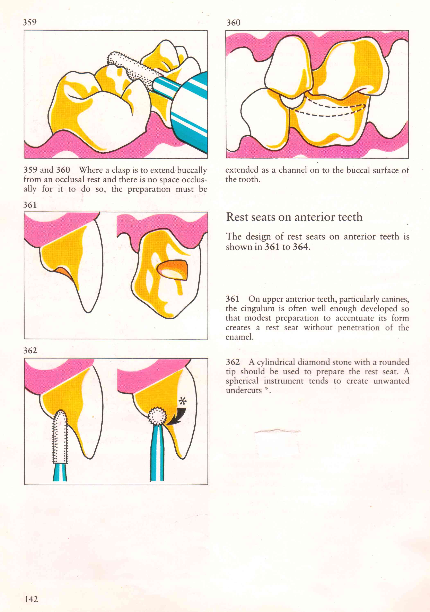
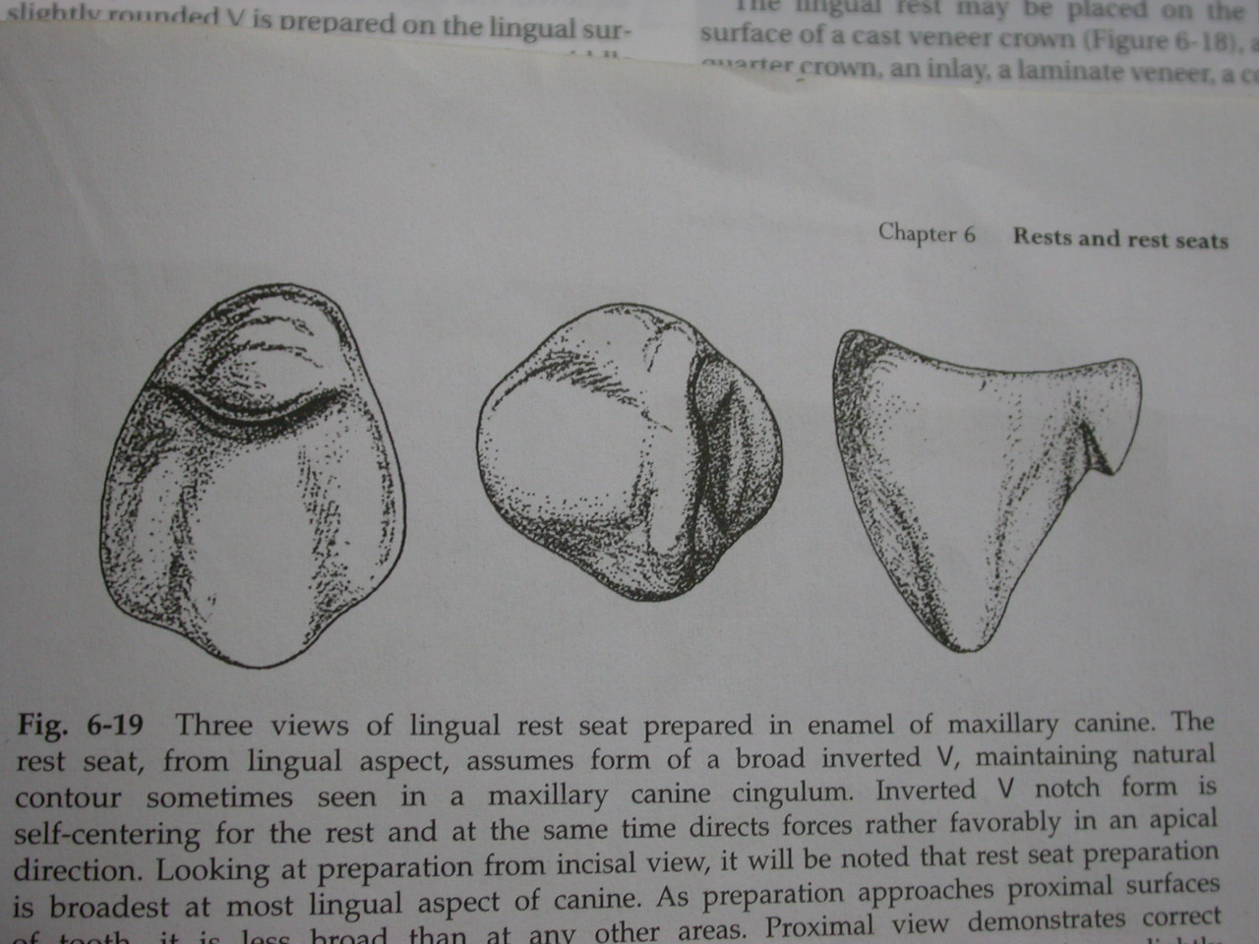
Outline form
A slightly rounded V(half moon shaped) is prepared on the lingual surface at the junction of the gingival and the middle -one third of the tooth. The apex of the V is directed incisally.
The floor of the rest seat should be toward the cingulum rather than the axial wall. Care must be taken not to create an enamel undercut, which interferes with placement of the denture.
preparation is broadest at lingual aspect..
Dimensions – mesiodistal width = 2.5-3mm,
labiolingual width = 2mm,
incisoapical depth = 1.5mm

Slide 17
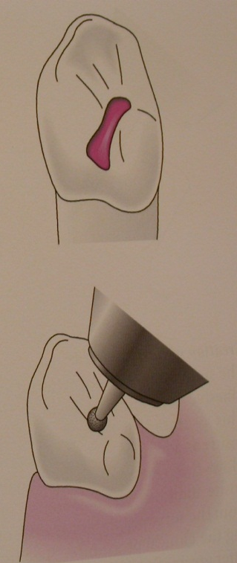
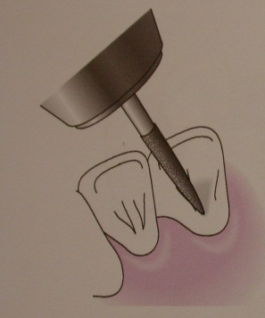
Preparation
Preparation may be started by using an inverted cone-shaped diamond stone and progressing to smaller, tapered stones with round ends to complete the preparation.
All line angles must be eliminated, and the rest seat must be prepared within the enamel and must be highly polished.
A predetermined path of placement for the denture must be kept in mind in preparing the rest seat.

Slide 18
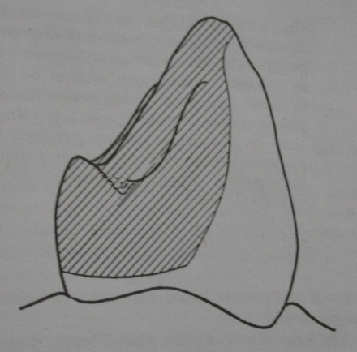
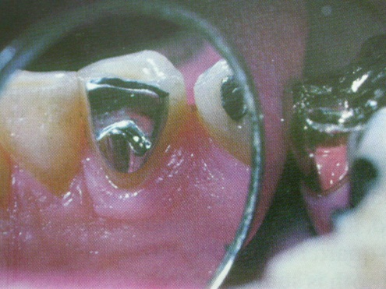
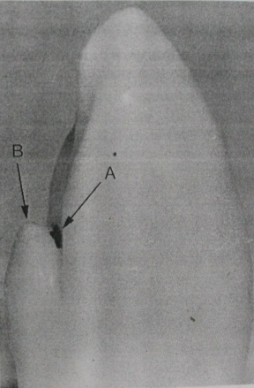
Method of obtaining support
In a cast restoration
Plan and execute a rest seat in the wax pattern
Contour of the framework restores the lingual form of the tooth.
Cast Co-Cr rest seats attached to lingual surface of anterior teeth
Composite may be added to lingual surface

Slide 19
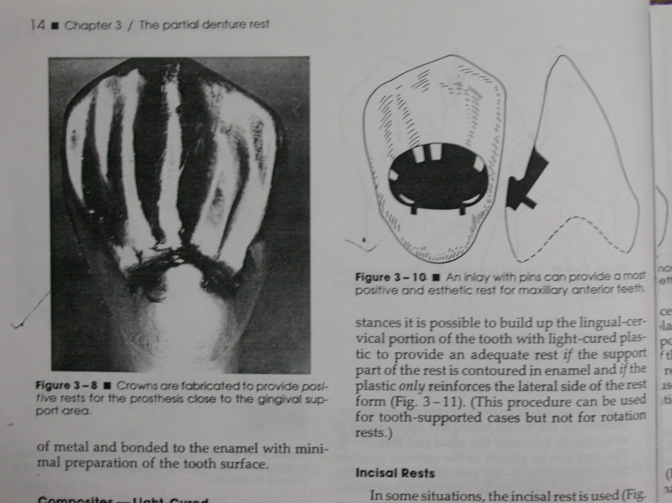
Inlay with pins
Crowns / onlays

Slide 20
INCISAL RESTS AND REST SEATS
Less desirable - more unfavorable leverage than lingual rest - orthodontic movement of the tooth
Incisal rests are placed on prepared rest seats at the incisal angles of anterior teeth
Used predominantly as auxiliary rests or as indirect retainers.
May be used on a canine abutment in either arch, but more commonly on the mandibular canine.
Provides definite support , relatively little loss of tooth structure and little display of metal.

Slide 21
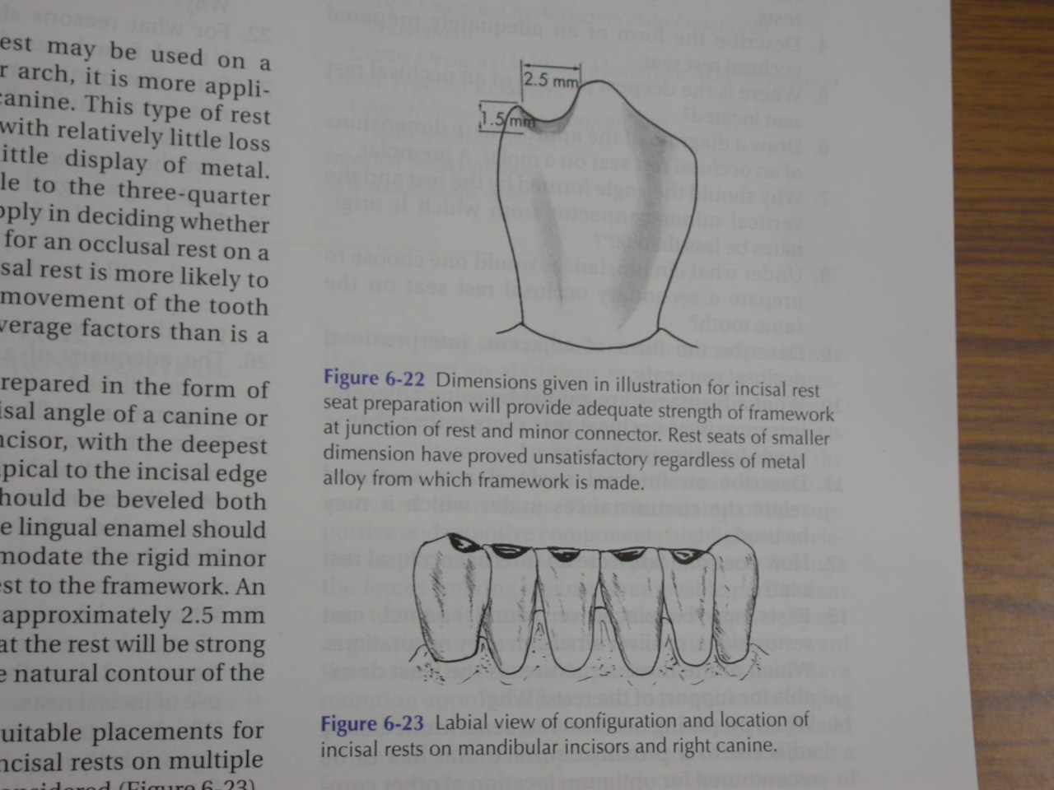
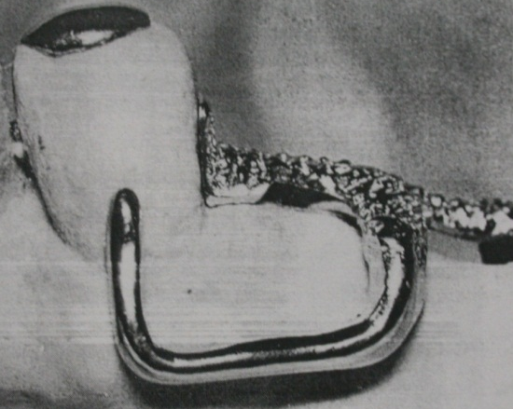
Outline form
Small ‘V’- shaped rounded notch is prepared at the incisal angle of a canine or on the incisal edge of an incisor, with the deepest portion of the preparation apical to the incisal edge.
Dimensions - 2.5 mm wide and 1.5 mm deep.
The notch is beveled both labially and lingually, and the lingual enamel is shaped to accommodate the rigid minor connector connecting the rest to the framework.
The floor of rest seat is extended slightly onto the labial aspect of tooth.

Slide 22
Incisal rest is placed either at mesioincisal or distoincisal angle.
It can be incorporated into a lingual plate – for additional stabilization.
Multiple incisal rests can be placed for additional support.

