Slide 1
AEROBIC EXERCISE
BY:
PARTH DEVMURARI
MPT IN CARDIOPULMONARY SCIENCE,ICU

Slide 2
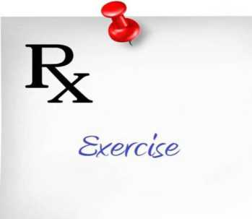
What is EXERCISE??

Slide 3
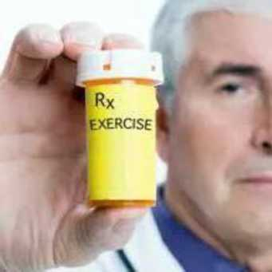
Exercise is a type of PHYSICAL ACTIVITY
consisting of planned, structured, and repetitive
bodily movement done to improve or maintain
one or more components of PHYSICAL FITNESS.
By: Dr. Tejas R. Chokshi

Slide 4
What is PHYSICAL ACTIVITY??
Any bodily movement produced by the contraction of skeletal
muscles that result in a substantial increase over resting energy
expenditure.
What is PHYSICAL FITNESS??
A set of attributes or characteristics that people have or achieve
that relates to the ability to perform physical activity.

Slide 5
What is AEROBIC?

Slide 6
Involving or requiring free OXYGEN
Use of oxygen to adequately meet energy
demands during exercise via aerobic
metabolism

Slide 7
What is
AEROBIC EXERCISE?
By: Dr. Tejas R. Chokshi

Slide 8
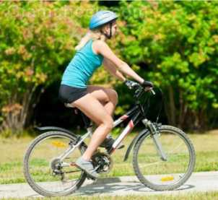

Submaximal, rhythmic, repetitive exercise of
large muscle groups, during which the
needed energy is supplied by inspired
oxygen.

Slide 9
Maximum Oxygen
Consumption
Maximum oxygen consumption (VO2max) is a measure
of the body's capacity to use oxygen.
It is the maximum amount of O2 consumed per minute
when the individual has reached maximum effort (e.g.
Running).
It is usually expressed relative to body weight, as ml of
O2 per kg of body weight per minute (ml/kg per
minute).
Normal value of O2 consumption is 3.5ml/kg/minute

Slide 10
VO2max is dependent on
S The transport of oxygen,
S The oxygen-binding capacity of the blood,
S Cardiac function,
S Oxygen extraction capabilities, and
S Muscular oxidative potential.

Slide 11
ENERGY SYSTEM
Energy systems are metabolic systems involving a series of
biochemical reactions resulting in the formation of ATP, CO2,
and water.
The cell uses the energy produced from the conversion of ATP
to ADP and phosphate (P) to perform metabolic activities.
Muscle cells use this energy for actin-myosin cross-bridge
formation when contracting.

Slide 12
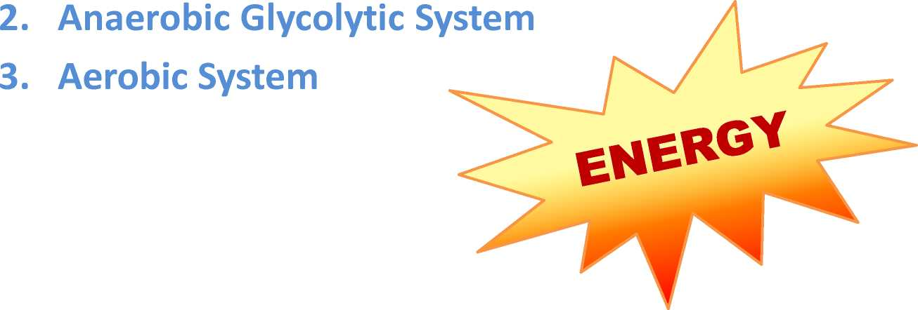
Three major energy systems
1. The ATP-PC system

Slide 13
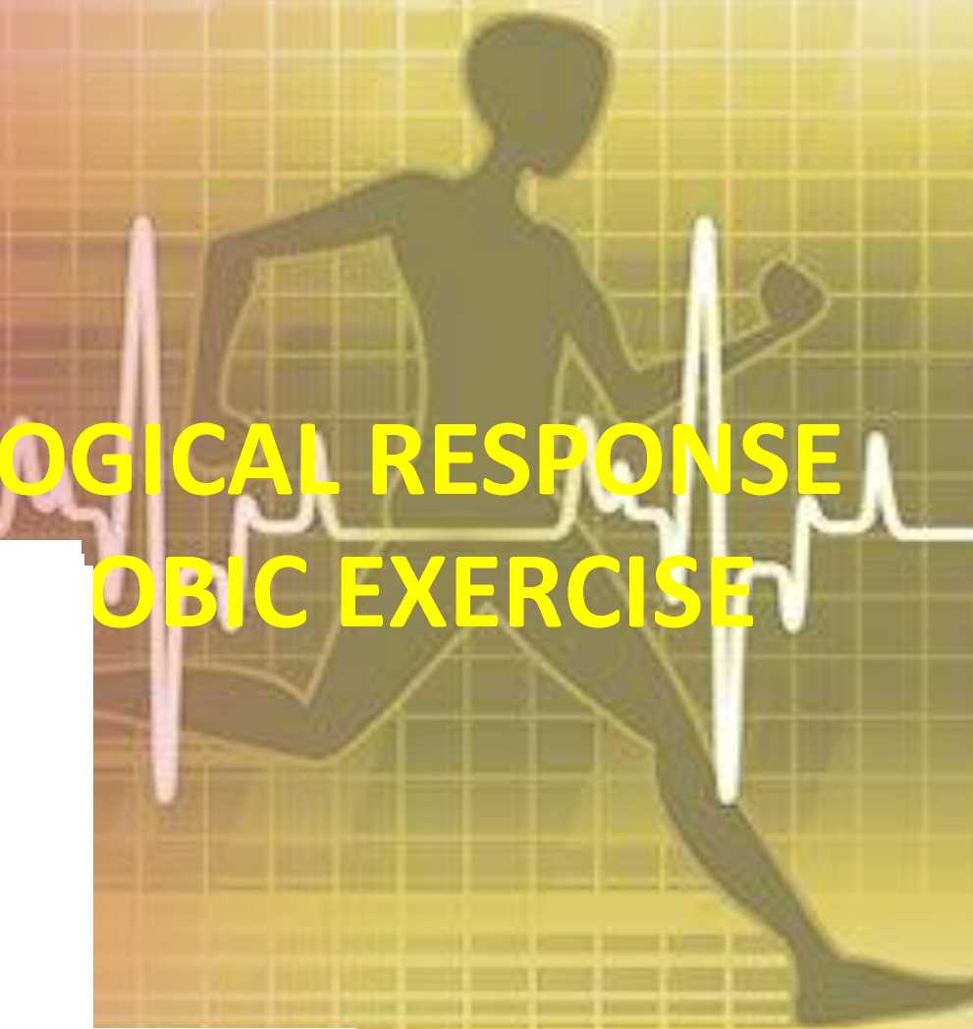
PHYSIOL
TO

Slide 14
PHYSIOLOGICAL EFFECTS OF EXERCISES

Slide 15
The rapid increase in energy requirements during exercise
requires equally rapid circulatory adjustments to meet the
increased need for oxygen and nutrients to remove end-
products of metabolism such as carbon dioxide and lactic acid
and to dissipate excess heat.
The shift in body metabolism occurs through a coordinated
activity of all the systems of the body: neuromuscular,
respiratory, cardiovascular, metabolic, and hormonal.

Slide 16
Cardiovascular
Response to
Exercise

Slide 17
Exercise Pressure Response
■ Stimulation of small myelinated and unmyelinated fibers in
skeletal muscle involves a sympathetic nervous system (SNS)
response.
■ The SNS response includes
■ Generalized peripheral vasoconstriction in non-exercising
muscles,
■ Increased myocardial contractility,
■ An increased heart rate,
■ An increased systolic blood pressure.
■ This results in a marked increase and redistribution of the
cardiac output.

Slide 18
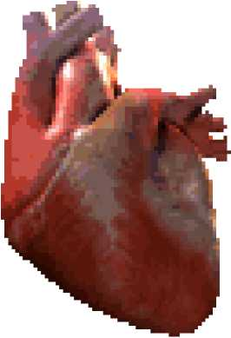
Cardiac Effects:
The frequency of SA node depolarization
increases, as does the heart rate.
There is a decrease in vagal stimuli as well as
an increase in SNS stimulation.
Increase in myocardial contractility.

Slide 19
Peripheral Effects
■ Net Reduction in Total Peripheral Resistance
■ Generalized vasoconstriction occurs that allows blood to
be shunted from the nonworking muscles, kidneys, liver,
spleen, and splanchnic area to the working muscles.
■ A locally mediated reduction in resistance in the working
muscle arterial vascular bed
■ Veins of the working and nonworking muscles remain
constricted

Slide 20
■ Increased Cardiac Output
The cardiac output increases because of the:
■ Increase in myocardial contractility,
■ Increase in stroke volume,
■ Increase in heart rate
■ Increase in the blood flow through the working muscle
■ Increase in the constriction of the capacitance vessels on
the venous side of the circulation in both the working and
nonworking muscles, raising the peripheral venous
pressure
By: Dr. Tejas R. Chokshi

Slide 21
■ Increase in Systolic Blood Pressure
■ The increase in systolic blood pressure is the result of the
augmented cardiac output.

Slide 22
Respiratory
Response to
Exercise

Slide 23
■
Respiratory changes occur rapidly, even before the initiation of exercise.
■ Gas exchange (O2, CO2) increases across the alveolar-capillary membrane
by the first or second breath.
■ Increased muscle metabolism during exercise results in more O2 extracted
from arterial blood resulting in
■ Increase in venous PCO2 and H+ ion
■ Increase in body temperature,
■ Increased epinephrine, and
■ Increased stimulation of receptors of the joints and muscles.
Any of these factors alone or in combination may stimulate the respiratory system.

Slide 24
Minute ventilation increases as respiratory frequency and
tidal volume increase.
Alveolar ventilation, occurring with the diffusion of gases
across the capillary-alveolar membrane

Slide 25
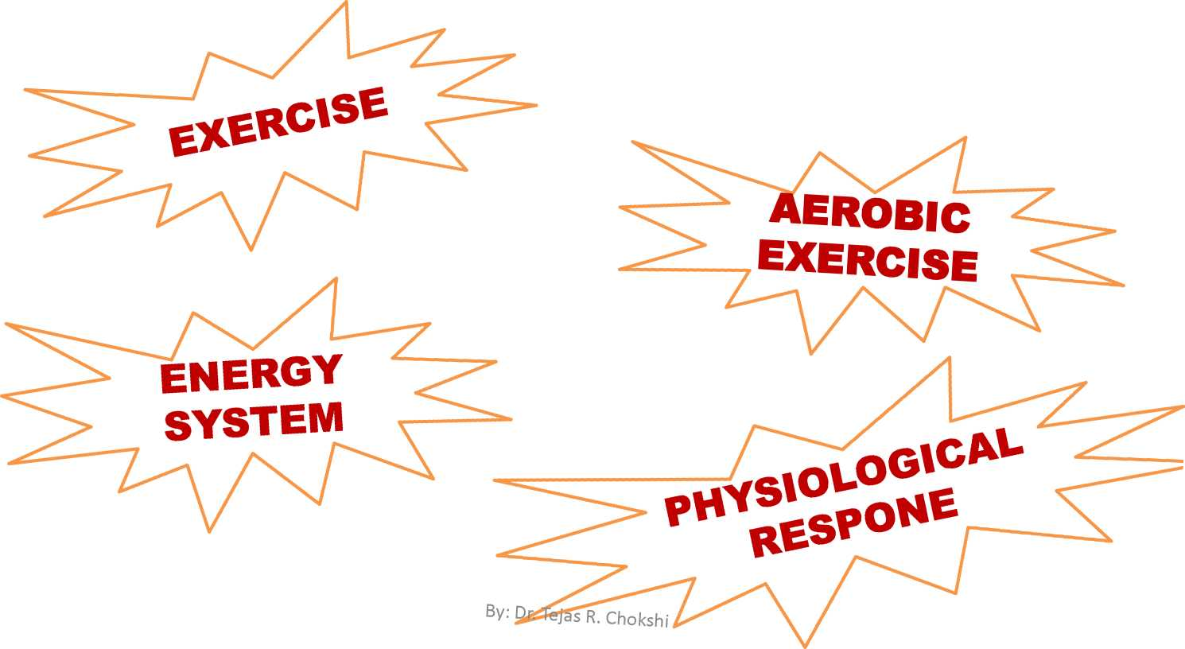
SUMMARY

Slide 26
Therapeutic effects
or uses of aerobic
exercise

Slide 27
Improvement in Cardiovascular and Respiratory
Function
S Increased maximal oxygen uptake resulting from both central
and peripheral adaptations
S Decreased minute ventilation at a given absolute submaximal
intensity (therefore to reduced dypnea)
S Decreased myocardial oxygen cost for a given absolute
submaximal intensity
S Decreased heart rate and blood pressure at a given
submaximal intensity
S Increased exercise threshold for the accumulation of lactate in
the blood or for the onset of disease signs or symptoms (e.g.,
angina pectoris, ischemic ST-segment depression,
claudication)

Slide 28
Reduction in Coronary Artery Disease Risk Factors
S Reduced resting systolic/diastolic pressures
S Increased serum high-density lipoprotein cholesterol and
decreased serum triglycerides
S Reduced total body fat, reduced intra-abdominal fat
S Reduced insulin needs, improved glucose tolerance
S Reduced blood platelet adhesiveness and aggregation

Slide 29
Decreased Morbidity and Mortality
Primary prevention (i.e., interventions to prevent the initial
occurrence)
S Higher activity and/or fitness levels are associated with lower death
rates from coronary artery disease and
S Lower incidence rates for combined cardiovascular diseases,
coronary artery disease, stroke, type 2 diabetes, osteoporotic
fractures, cancer of the colon and breast etc
Secondary prevention (i.e., interventions after a cardiac event [to
prevent another])
S Reduction in postmyocardial infarction patients who participate in
cardiac rehabilitation exercise training, especially as a component of
multifactorial risk factor reduction

Slide 30
Other uses
S Decreased anxiety and depression
S Enhanced physical function and independent living in older
persons
S Enhanced feelings of well-being
S Enhanced performance of work, recreational, and sport
activities
S Reduced risk of falls and injuries from falls in older persons
S Prevention or mitigation of functional limitations in older
adults
S Effective therapy for many chronic diseases in older adults

Slide 31
Purposes of Health-Related Fitness Testing
Educating participants about their present health-related fitness status relative to health-related standards and age- and sex-matched norms
Providing data that are helpful in development of exercise prescriptions to address all fitness components
Collecting baseline and follow-up data that allow evaluation of progress by exercise program participants
Motivating participants by establishing reasonable and attainable fitness goals
Stratifying cardiovascular risk

Slide 32
Components of Physical fitness test
Five Health-Related Components of Fitness
1. Cardio-respiratory endurance
2. Muscular strength
3. Muscular endurance
4. Flexibility
5. Body composition

Slide 33
Modes of Testing
Field tests:
Motor driven treadmills:
Mechanically braked cycle ergometers:
Step testing:

Slide 34
Field tests consist of walking or running a certain distance in a given time (i.e., 12-minute and 1.5-mile [2.4-km] run tests, and the 1- and 6-minute walk test). VO2max can be estimated from the equations
The advantages of field tests are that they are easy to administer to large numbers of individuals at one time and little equipment (e.g., a stopwatch) is needed. The disadvantages are that they all potentially could be maximal tests, and by their nature, are unmonitored for BP and HR. An individual's level of motivation and pacing ability also can have a profound impact on test results.

Slide 35
Motor Driven Treadmills: can be used for submaximal and maximal testing and often are used for diagnostic testing. T hey provide a common form of exercise (i.e., walking) and can accommodate the least fit to the fittest individuals across the continuum of walking to running speeds.
Mechanically braked cycle ergometers are excellent test modalities for submaximal and maximal testing. They are relatively inexpensive, easily transportable, and allow BP and the ECG (if appropriate) to be measured easily. The main disadvantage is that cycling is a less familiar mode of exercise, often resulting in limiting localized muscle fatigue.

Slide 36
Step testing is an inexpensive modality for predicting CR fitness by measuring the HR response to stepping at a fixed rate and/or a fixed step height or by measuring post-exercise recovery HR. Step tests require little or no equipment steps are easily transportable; stepping skill requires little practice; the test usually is of short duration; and stepping is advantageous for mass testing . Post-exercise (recovery) HR decreases with improved CR fitness, and test results are easy to explain to participants

Slide 37
Fitness testing for convalescent individuals
The 6-minute walk test has been used to evaluate CR fitness within some clinical patient populations (e.g., persons with chronic heart failure or pulmonary disease). Even though the test is considered submaximal, it may result in near maximal performance for those with low fitness levels or disease. Patients completing <300 meters during the 6-minute walk demonstrate a limited short-term survival.

Slide 38
Principles of Fitness
S Warm-up and Cool-down
S FITT (Frequency, Intensity, Time /duration, and Type)
Principle
S In Intensity
S Overload principle
S Specificity principle
S Reversibility Principle
S Consistency
S Motivation
S Progression
By: Dr. Tejas R. Chokshi

Slide 39
General Procedures for Submaximal Testing of Cardiorespiratory Fitness
1. Obtain resting heart rate and BP immediately before exercise in the exercise posture.
2. The client should be familiarized with the ergometer. If using a cycle ergometer, properly
position the client on the ergometer (i.e., upright posture, five-degree bend in the knee at maximal leg extension, hands in proper position on handlebars).
3. The exercise test should begin with a two- to three-minute warm-up to acquaint the client with the cycle ergometer and prepare him or her for the exercise intensity in the first stage of the test.
5. Heart rate should be monitored at least two times during each stage, near the end of the second and third minutes of each stage.
6. Blood pressure should be monitored in the last minute of each stage and repeated (verified) in the event of a hypotensive or hypertensive response.

Slide 40
7. Perceived exertion and additional rating scales should be monitored near the end of the last minute of each stage using either the 6–20 or 0–10 scale (Table 4.8).
8. Client appearance and symptoms should be monitored and recorded regularly. The test should be terminated when the subject reaches 70% heart rate reserve (85% of age-predicted maximal heart rate), fails to conform to the exercise test protocol, experiences adverse signs or symptoms, requests to stop, or experiences an emergency situation.
9. An appropriate cool-down/recovery period should be initiated consisting of either: Continued exercise at a work rate equivalent to that of the first stage of the exercise test protocol or lower; or a. A passive cool-down if the subject experiences signs of discomfort or an emergency situation occurs
10. All physiologic observations (e.g., heart rate, BP, signs and symptoms) should be continued for at least 5 minutes of recovery..

Slide 41
Sub maximal exercise tests
Both single-stage and multistage submaximal exercise tests are available to estimate [V with bar above]O2max from simple HR measurements.
e.g., cycle, treadmill, or step test to check Vo2 max
Cycle ergometer test:
  The Astrand-rhymic cycle ergometer test, lsting for 6 minutes, single stage model
YMCA protocol, 2-4 three minutes stages continuous exercise, multi stage modal

Slide 42
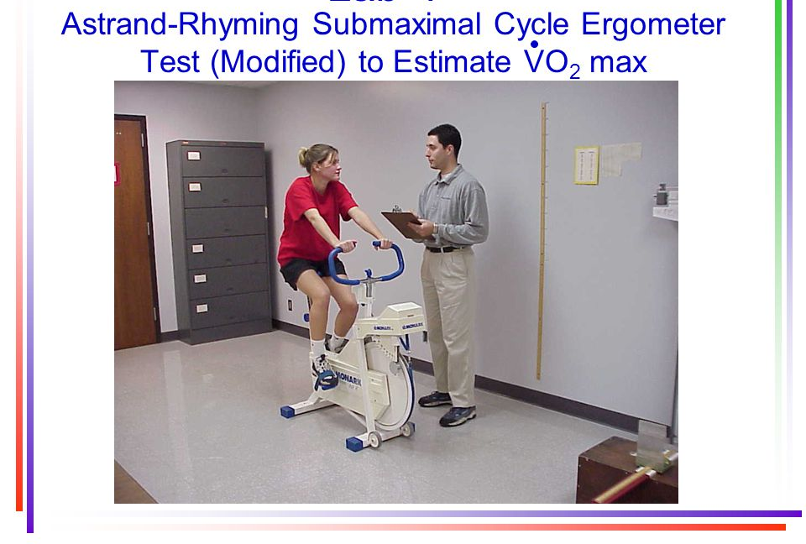

Slide 43
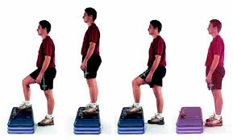

Slide 44
Step test:
Queen’s college step test
YMCA step test, 3 minute , 12 inch step stool, stepping rate 24/minute
  Heart rate values obtained and compared to normative values
To check the heart rate recovery

Slide 45
Treadmill test:
The treadmill and cycle ergometer are the most commonly used modalities for clinical exercise testing. Treadmill testing provides a more common form of physiologic stress
Bruce protocol/ modified Bruce:
it employs relatively large increments (i.e., 2–3 METs per stage) every 3 minutes.
whereas protocols with smaller increments, such as Naughton or Balke-Ware (i.e., 1 MET per stage or lower), are preferable for older or deconditioned individuals and patients with chronic diseases.
Generally used in problem population e.g. post myocardial infarction patients

Slide 46
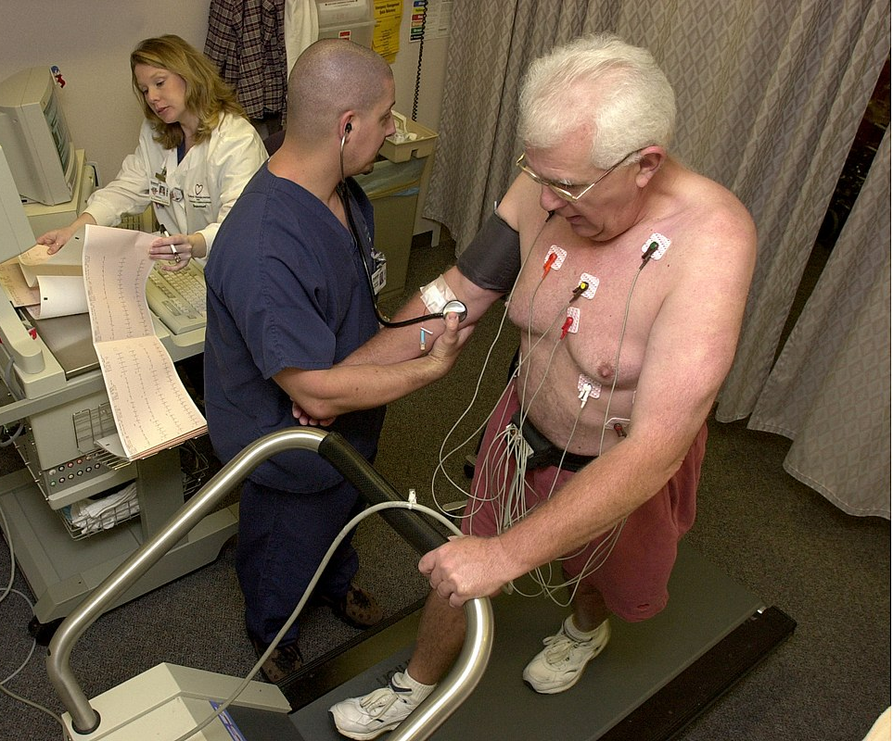

Slide 47
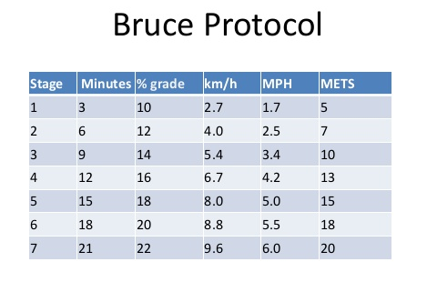

Slide 48
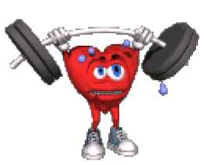
2. Muscle strength
The maximum amount of force a muscle can produce
in a single effort.
or
Muscle strength is the greatest measurable force
that can be exerted by a muscle or muscle group to
overcome resistance during a single maximum effort.

Slide 49
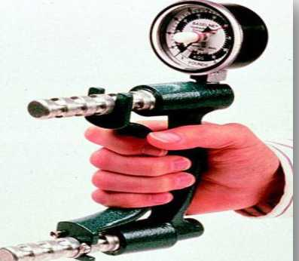
Muscle strength can be assessed by
■ Maximal isotonic contraction
Eg. 1 RM Test
The 1RM is defined as the weight that can be successfully lifted no
more than one time without failure through a specified ROM
■ Single Maximal Voluntary Contraction (MVC)
Hand grip dynamometers
■
Iso-kinetic Peak torque
Isokinetic dynamometers

Slide 50
3. Muscular endurance
Muscle endurance is the ability of a muscle to contract
repeatedly against a load (resistance), generate and
sustain tension, and resist fatigue over an extended period
of time.

Slide 51
Assessment of muscle endurance
Tests of muscular endurance are designed to evaluate the
ability of the muscle groups to produce sub-maximal force for
an extended period of time.
Isotonic Measurement of muscle endurance using free
weights or machines can be achieved by measuring relative or
absolute strength of a person

Slide 52
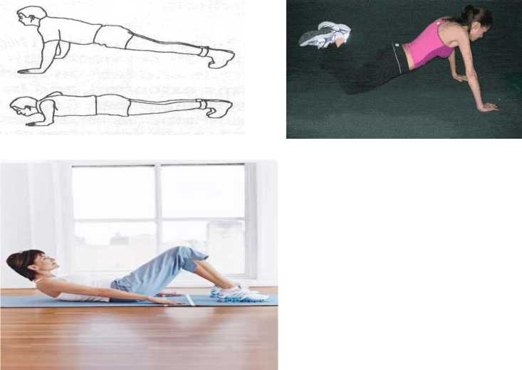
Using an individuals own body mass
1. Pushups test
2. Chin up test
3. Sit ups test

Slide 53
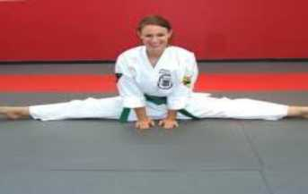
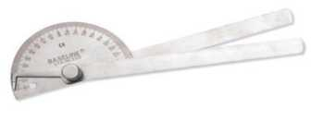
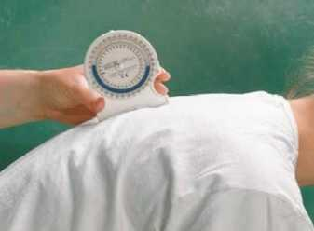
Flexibility:
Flexibility is the ability to move
range of motion.
a
joint
through complete
Assessment of Flexibility
— Goniometers
— Inclinometers
— Sit and Reach Test

Slide 54
BODY COMPOSITION
Body composition is the relative amounts of muscle, fat,
bone, and other vital parts of the body.
Basic body composition can be expressed as the relative
percentage of body mass that is fat and fat free tissue.
Body composition can be estimated with both laboratory and
field techniques that vary in terms of complexity, cost, and
accuracy.

Slide 55
Anthropometric Methods
Measurements of height, weight, circumferences, and
skinfolds are used to estimate body composition.
Body Mass Index
To assess weight relative to height and is calculated by
dividing body weight in kilograms by height in meters squared
(kg-m-2).

Slide 56
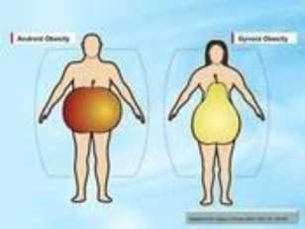
Circumferences
The pattern of body fat distribution is recognized as an
important predictor of the health risks of obesity.
Android obesity, which is characterized by more fat on the
trunk (abdominal fat), common in males
Gynoid or gynecoid obesity (fat distributed in the hip and
thigh), common in females.

Slide 57
Waist hip ratio:
The waist-to-hip ratio is the circumference of the waist divided by
the circumference of the hips and has been used as a simple
method for determining body fat distribution .
Skin-fold Measurements
The principle behind this technique is that the amount of
subcutaneous fat is proportional to the total amount of body fat. It
is assumed that close to one third of the total fat is located
subcutaneously.
common areas for skin fold measurement are chest, midaxillary,
triceps, subscapular, abdomen, suprailiac, thigh.

Slide 58


Slide 59
MCQ 1
Response to aerobic exercise:
A. HEART RATE INCREASE
B. RESPIRATORY RATE DECREASE
C. BLOOD PRESSURE DECREASE
D. None

Slide 60
MCQ 2
FIELD TESTS ARE USED TO MEASURE THE
A. Vo2 Max
B. Respiratory rate
C. Electro cardio gram
D. None

Slide 61
MCQ 3
Following which is Not a component of health
related physical fitness
A. Muscle endurance
B. Muscle strength
C. Muscle power
D. Flexibility

Slide 62
MCQ 4
1 RM test is for
A. Muscle endurance
B. Muscle strength
C. Body composition
D. Flexibility

Slide 63
MCQ 5
Client/ individual should be familiarized before the test performance
A. False
B. True

Slide 64
THANK YOU
WHAT YOU DO
IS UP TO YOU
\/'
$
/J§&>
-vC’HEITIESEILSSY'- *^{w}
liMteaiiw
JUST DO IT.
STAY FIT

