Slide 1
BIOMECHANICS OF GAIT
By – Dr Noel

Slide 2
Objectives of the Lecture
At the end of the Lecture the students will be able to
Define Gait
Enumerate about types of Phases of Gait
Describe about different Phases of Gait.

Slide 3
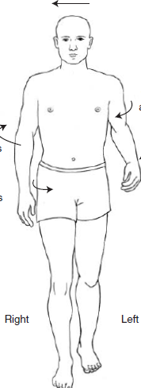
DEFINITION
Gait is described as a translatory progression of the body as a whole, produced by coordinated, rotatory movements of body segments.

Slide 4
The alternating movements of the lower extremities essentially support and carry along the head, arms, and trunk (HAT).
Head, arms, and trunk constitutes about 75% of total body weight, with the head and arms contributing about 25% of total body weight and the trunk contributing the remaining 50%.

Slide 5
KINEMATICS
Phases of the Gait Cycle
During one gait cycle, each extremity passes through two major phases:
A stance phase, when some part of the foot is in contact with the floor, which makes up about 60% of the gait cycle.
A swing phase, when the foot is not in contact with the floor, which makes up the remaining 40%.

Slide 6
The two most common terminologies for the further division of these major phases into sub phases are referred as
Traditional (T),
Rancho Los Amigos (RLA)

Slide 7
COMPARISION OF GAIT TERMINOLOGY
PHASE | TRADITIONAL | RANCHO LOS AMIGOS
Stance | Heel strike | Initial contact
 | Foot flat | Loading response
 | Mid stance | Mid stance
 | Heel off | Terminal stance
 | Toe off | Pre swing phase
Swing | Acceleration | Initial swing
 | Mid swing | Mid swing
 | Deceleration | Terminal swing

Slide 8
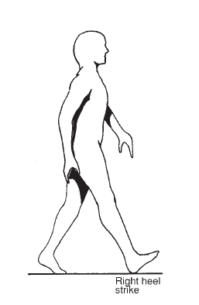
TRADITIONAL STANCE PHASE
Heel strike
Heel contact or heel strike (T) refers to the instant at which the heel of the leading extremity strikes the ground

Slide 9
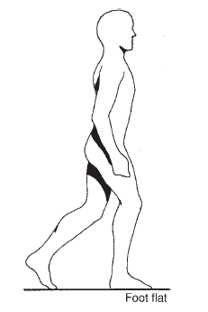
TRADITIONAL STANCE PHASE
2. Foot flat
occurs after initial contact of the gait cycle. It is the first instant during stance when the foot is flat on the ground.

Slide 10
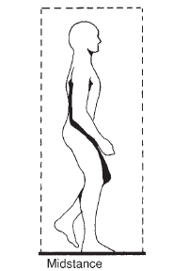
TRADITIONAL STANCE PHASE
3. Midstance
It is the point at which the body weight is directly over the supporting lower extremity.

Slide 11
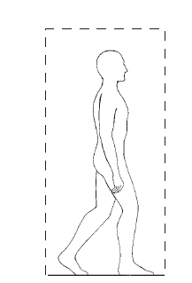
TRADITIONAL STANCE PHASE
4. Heel-off
It is the point at which the heel of the reference extremity leaves the ground

Slide 12
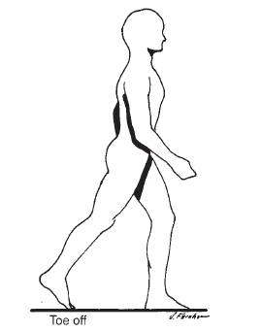
TRADITIONAL STANCE PHASE
5. Toe-off
It is the instant at which the toe of the foot leaves the ground.

Slide 13
RLA STANCE PHASE
Initial contact
refers to the instant the foot of the leading extremity strikes the ground

Slide 14
RLA STANCE PHASE
2. Loading response
begins at initial contact and ends when the contralateral extremity lifts off the ground at the end of the double-support phase.

Slide 15
RLA STANCE PHASE
4. Terminal stance
Begins when the body is directly over the supporting limb and ends a point just before initial contact of the contralateral extremity at about 50% of the gait cycle.

Slide 16
RLA STANCE PHASE
5. Preswing
It is the last 10% of stance phase and begins with initial contact of the contralateral foot (at 50% of the gait cycle) and ends with toe-off

Slide 17
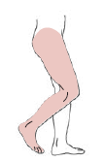
TRADITIONAL SWING PHASE
Acceleration
begins once the toe leaves the ground and continues until midswing, or the point at which the swinging extremity is directly under the body

Slide 18

TRADITIONAL SWING PHASE
2. Midswing
occurs approximately when the extremity passes directly beneath the body, or from the end of acceleration to the beginning of deceleration.

Slide 19
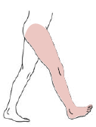
TRADITIONAL SWING PHASE
3. Deceleration
occurs after midswing when limb is decelerating in preparation for heel strike

Slide 20
RLA SWING PHASE
Initial swing
begins when the toe leaves the ground and continues until maximum knee flexion occurs.

Slide 21
RLA SWING PHASE
3. Terminal swing
period from the point at which the tibia is in the vertical position to a point just before initial contact.

Slide 22
KINEMATICS OF GAIT
GAIT TERMINOLOGY
Time and distance are two basic parameters of motion, and measurements of these variables provide a basic description of gait.

Slide 23
Temporal variables
Temporal variables include
Stance time,
Single-limb and double limb support time,
Swing time,
Stride and step time,
Cadence, and
Speed.

Slide 24
Spatial Variables
The Distance/Spatial variables include:
Stride length,
Step length,
Step width, and
Degree of toe-out.

Slide 25
STANCE TIME
Amount of time that elapses during the stance phase of one extremity in a gait cycle

Slide 26
SINGLE-SUPPORT TIME
Amount of time elapses during the period when only one extremity is on the supporting surface in a gait cycle.

Slide 27
DOUBLE-SUPPORT TIME
Amount of time spent with both feet on the ground during one gait cycle.

Slide 28
STRIDE DURATION
Amount of time it takes to accomplish one stride (linear distance between two successive events that are accomplished by the same lower extremity during gait).

Slide 29
STEP DURATION
Amount of time spent during a single step.(linear distance between two successive points of contact of opposite extremities)

Slide 30
CADENCE
Number of steps taken by a person per unit of time. Cadence may be measured as the number of steps per second or per minute, but the latter is more common:
Cadence number of steps/time

Slide 31
WALKING VELOCITY
The rate of linear forward motion of the body, which can be measured in meters or centimeters per second, meters per minute, or miles per hour.
Walking velocity (meters/second) = distance walked (meters)/time (seconds)

Slide 32
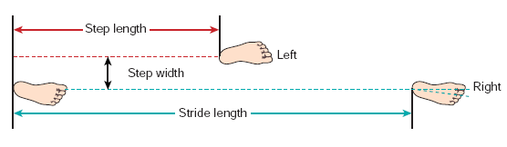
Fig: Spatial Characteristics of Gait: Step Length, Step Width, Stride Length and Angle of Inclination

Slide 33
STRIDE LENGTH
It is the linear distance between two successive events that are accomplished by the same lower extremity during gait.

Slide 34
STEP LENGTH
It is the linear distance between two successive points of contact of opposite extremities. It is usually measured from the heel strike of one extremity to the heel strike of the opposite extremity.

Slide 35

DEGREE OF TOE-OUT
Angle of foot placement (FP) and may be found by measuring the angle formed by each foot’s line of progression and a line intersecting the center of the heel and the second toe. The angle for men normally is about 7 degree from the line of progression of each foot at free speed walking.

Slide 36
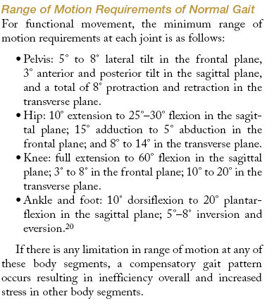

Slide 37
KINETICS
GROUND REACTION FORCE
When a person takes a step, forces are applied to the ground by the foot and by the ground to the foot. These forces are equal in magnitude but opposite in direction. We are usually more interested in the forces being applied to the foot, which are termed ground reaction forces (GRFs).

Slide 38
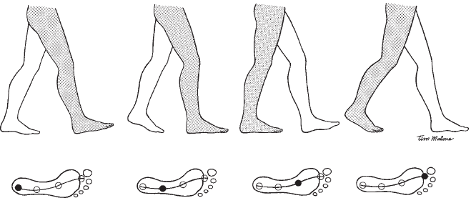
CENTER OF PRESSURE
The CoP of the foot on the supporting surface moves along a path during gait and produces a characteristic pattern

Slide 39
MCQ’s
1. Which Phase of the Gait is not included in the Traditional Classification of Gait?
A. Mid Stance
B. Heel Strike
C. Mid Swing
D. Initial Swing

Slide 40
2. Which Phase of the Gait is not included in the Rancho Los Amigos Classification of Gait?
A. Mid Stance
B. Heel Strike
C. Mid Swing
D. Initial Swing

Slide 41
3. Temporal Components of Gait does not Include
A. Stance time
B. Step Length
C. Single limb support time
D. Swing time

Slide 42
4. Cadence is
A. Time taken between Heel strike between Opposite lower limb
B. Number of Steps taken in unit time
C. Degree between line of Progression and 2nd Toe
D. Measurement of time when both lower limbs are on Floor

Slide 43
5. While Running Double Support time is
A. Doubled
B. Zero
C. Becomes Three time
D. None of the Above

Slide 44
THANK YOU

Slide 45
PATHOMECHANICS OF GAIT

Slide 46
OBJECTIVES OF THE LECTURE
At the end of the Lecture, the students will be able to:
Enumerate different types of Gait Abnormalities
Describe about different Abnormal gaits in brief

Slide 47
In assessing an abnormal gait, it is helpful to classify the cause or causes of deviations into one or more of the following four causal categories:
Structural impairment,
Functional impairment,
Functional pain,
or Compensation/adaptation.

Slide 48
Structural impairment
These are structural malformations that are congenital, caused by injury, or caused by structural changes occurring secondary to these.
A common structural abnormality is leg length discrepancy.
The authors concluded that a limb length discrepancy of 2.0 cm resulted in an asymmetrical gait and had the potential for causing changes in articular cartilage.

Slide 49
Structural problems may be implicated in running injuries.
Increases in the Q-angle, tibial torsion, and pronation of the foot may contribute causes to patellofemoral syndromes.
At the foot, pes cavus and pes planus cause alterations in weight and may cause abnormal stresses at the hip or knee.
In pes cavus, the weight is borne primarily on the hindfoot and metatarsal regions, and the midfoot provides only minimal support.

Slide 50
Disturbances in the normal gait pattern usually cause increases in the energy cost of walking because the normal patterns of transformation from potential to kinetic energy and redistribution between segments are disturbed.

Slide 51
Functional impairment
This group includes all causes in which the timing and/or amplitude of muscle activity is abnormal.
Certain disease conditions produce characteristic gaits that are easily recognized by a trained observer.

Slide 52
The parkinsonian gait is characterized by an increased cadence, shortened stride, lack of heel strike and toe-off, and diminished arm swinging.
The muscle rigidity that characterizes this disease interferes with normal reciprocal patterns of movement.
Paralysis or paresis of the plantarflexors (gastrocnemius, soleus, flexor digitorum longus, tibialis posterior, plantaris, and flexor hallucis longus muscles) results in a calcaneal gait pattern.
This pattern is characterized by greater than normal amounts of ankle dorsiflexion and knee flexion during stance and a shorter-than-normal step length on the affected side.

Slide 53
Sometimes an isolated weakness or paralysis of a single muscle will produce a characteristic gait.
For example, a unilateral paralysis of the gluteus medius results in a typical gait pattern called a gluteus medius gait.
The characteristics of this gait pattern can be deduced by reviewing the function of the gluteus medius during normal gait.
Normally, the gluteus medius stabilizes the hip and pelvis by controlling the drop of the pelvis during single-limb support, especially during the first part of the stance phase.

Slide 54
When the gluteus maximus is paralyzed, the trunk must be thrown posteriorly at heel strike, to prevent the trunk from falling forward when there is an external flexion moment at the hip.
The backward lean is typical of a gluteus maximus gait.
If both the quadriceps and the gluteus maximus are paralyzed, a person may compensate for the loss by pushing the femur posteriorly with his or her hand at initial contact. The arm supports the trunk; it prevents hip flexion and also thrusts the knee into extension.

Slide 55
In patients with bilateral lower extremity paralysis, walking usually involves the use of long leg braces and crutches.
In this form of gait, the trunk and upper extremity muscles must perform all of the work of walking, and the energy cost of walking is much greater than normal.

Slide 56
Functional pain
This group includes all causes of variations that are attributable primarily to pain.
All overuse injuries fall into this category.
Iliotibial band syndrome and popliteal tendonitis experienced by runners are common.
Plantar fasciitis, caused by repetitive stretching of the planter fascia between its origin at the plantar rim of the calcaneous and its insertion into the metatarsal heads, is a common overuse syndrome seen in young athletes.
Many gait variations can be seen in osteoarthritis

Slide 57
Compensation/adaptation
This group includes all causes of variations that occur when one lower extremity has a structural or functional impairment and the other (normal) extremity compensates by adapting its gait pattern.
Most of the compensations that are made are performed unconsciously, and if the disturbance is slight, such as occurs in excessive pronation of the foot, the individual may not be aware that the gait pattern is in any way unusual.
Asymmetries of the lower extremities that result in gait adaptations may have structural or functional primary causes, such as contractures of soft tissues around the joints, bony ankylosis, and muscle weakness or spasticity.

Slide 58
MCQ’S
1. Limb length discrepancy of _______ cm results in an asymmetrical gait
0
1
2
None of the Above

Slide 59
2. The Characteristic of Parkinsonian Gait is
Increased Step Length
Increased Stride Length
Increased Cadence
None of the Above

Slide 60
3. High Steppage gait is characterized by Paralysis of which muscles?
Ankle Plantarflexors
Ankle Dorsiflexors
Knee Extensors
None of the Above

Slide 61
4. Paralysis of Unilateral Hip Abductors lead to?
Hand to Knee gait
Lurching Gait
High Steppage gait
None of the Above

Slide 62
5. Plantar fasciitis caused by repetitive stretching of the planter fascia is an example of gait deviation under which category?
Structural impairment
Functional impairment
Functional pain
Compensation/adaptation

